Slide 1
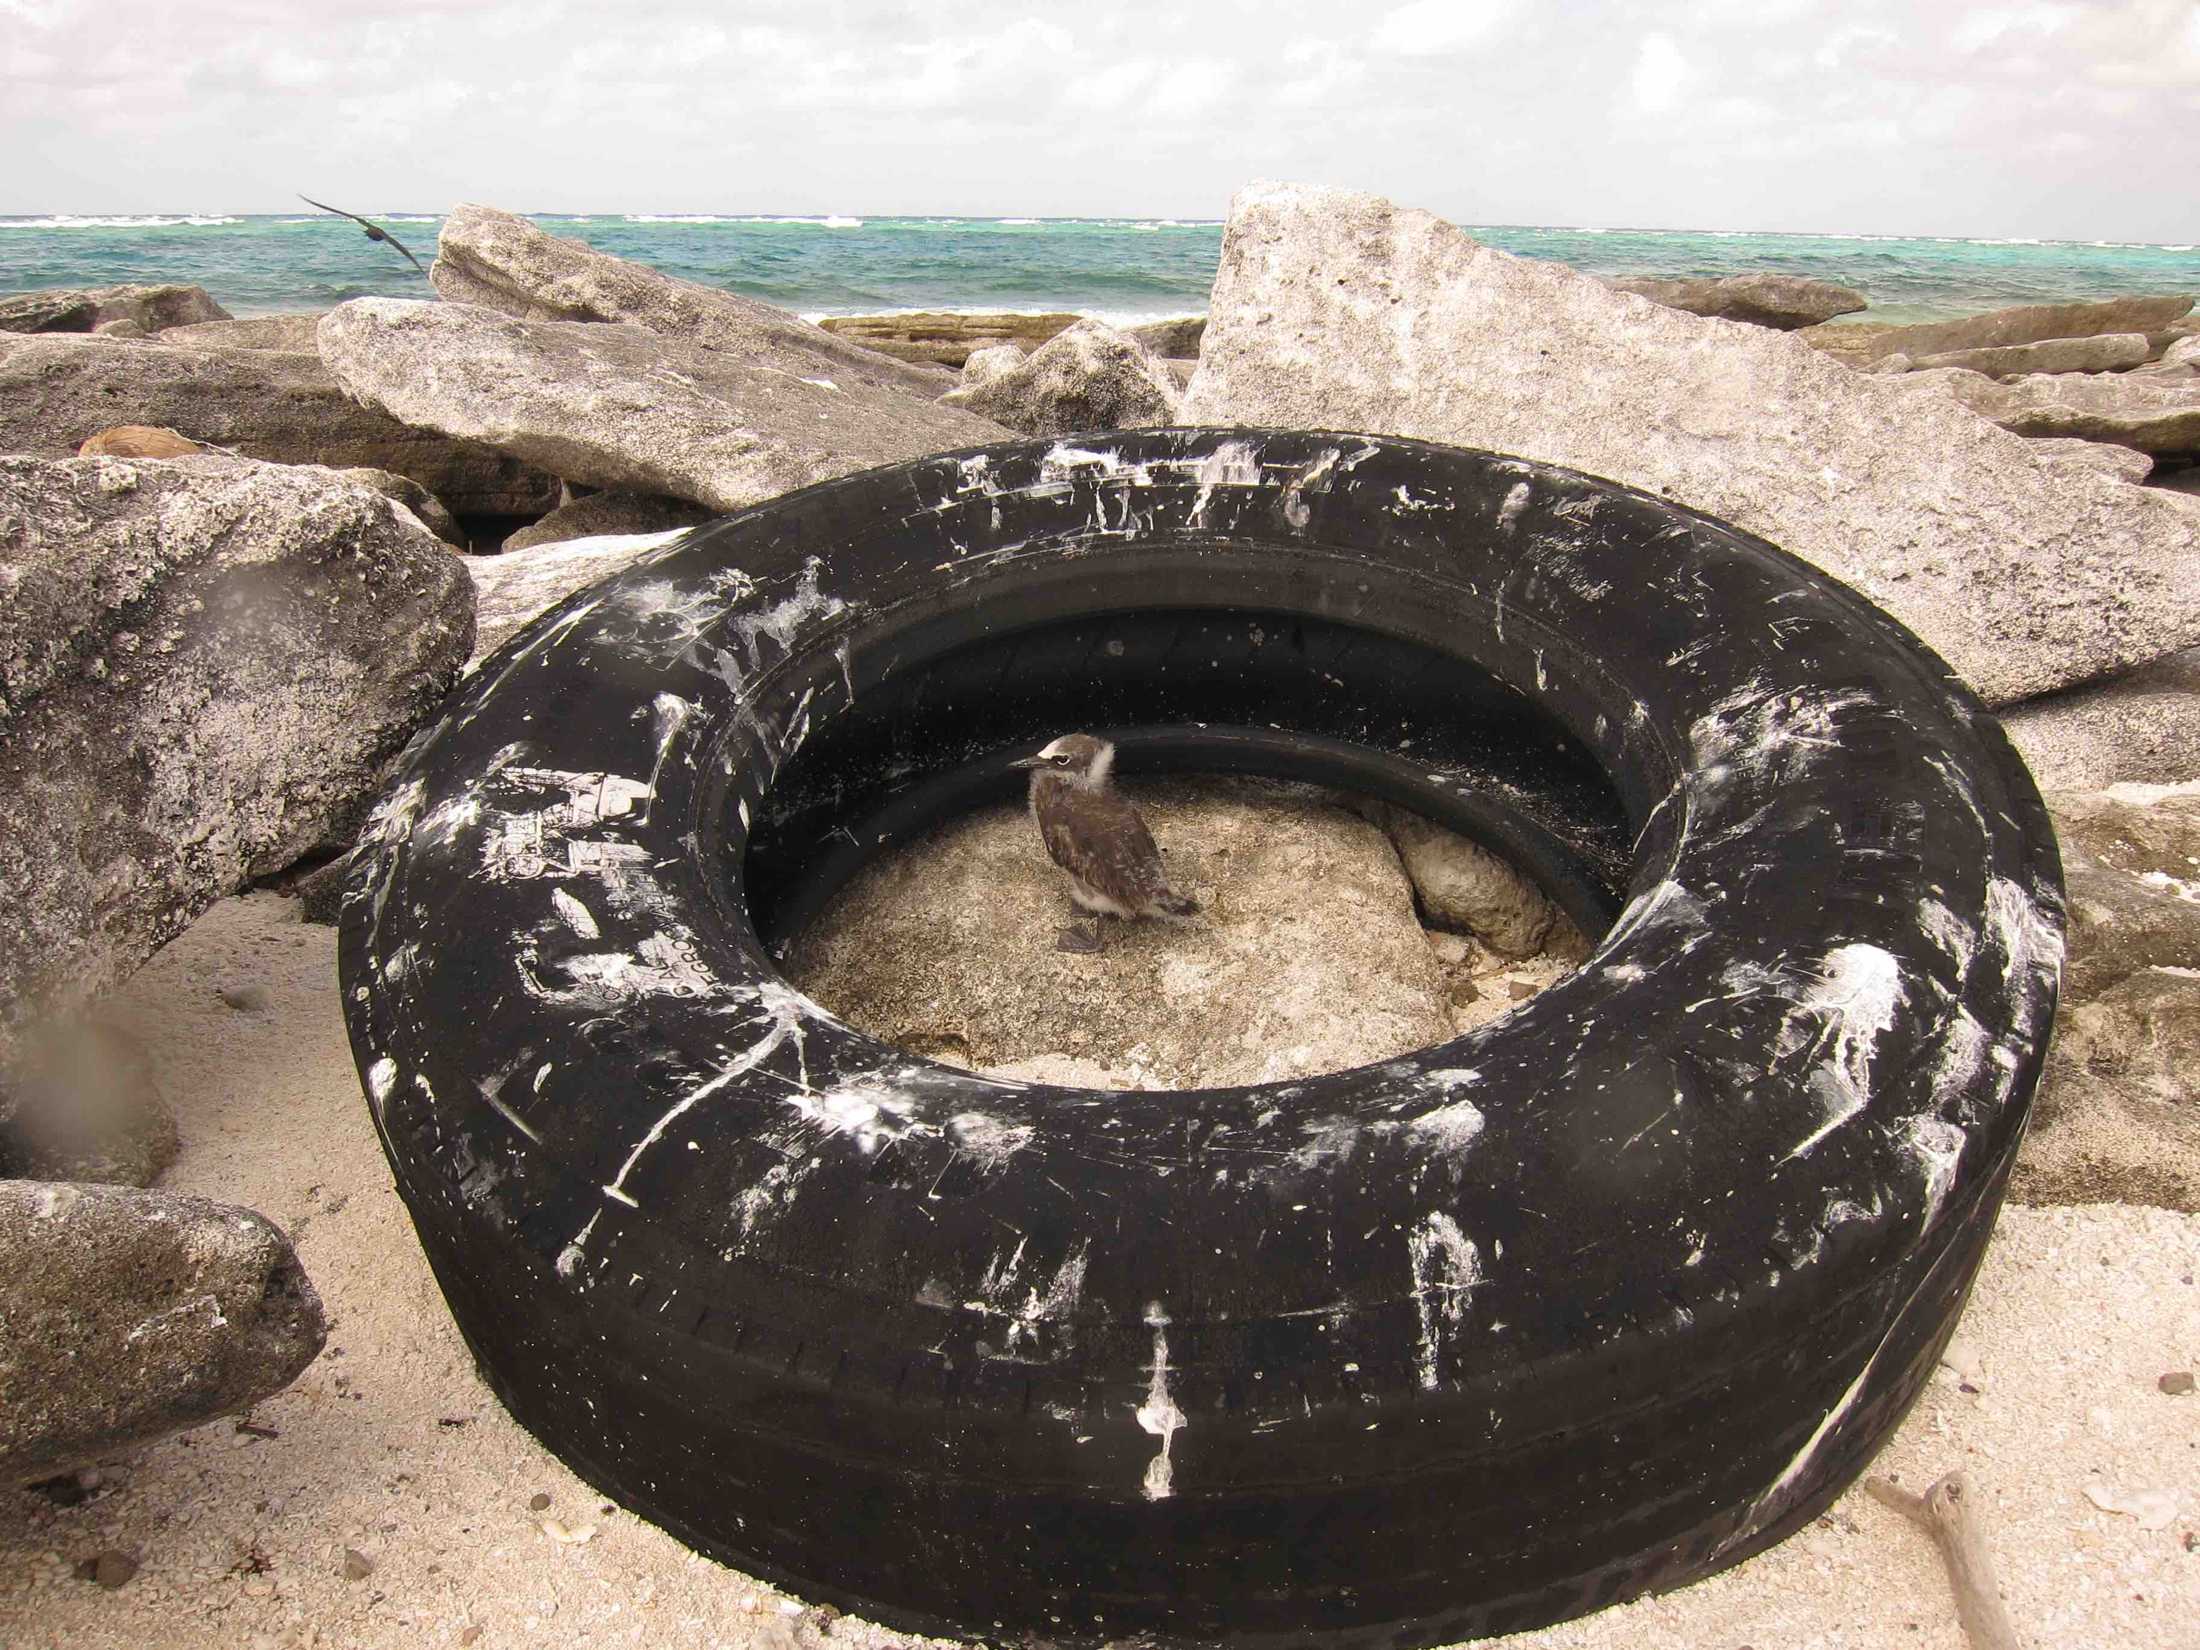
Who am I ? Physical Oceangrapher at LOPS/IRD
FROM ENSO TO REGIONAL CIRCULATION STUDY (SPICE) TO MARINE LITTER (GLOBAL SCALES)

Slide 2
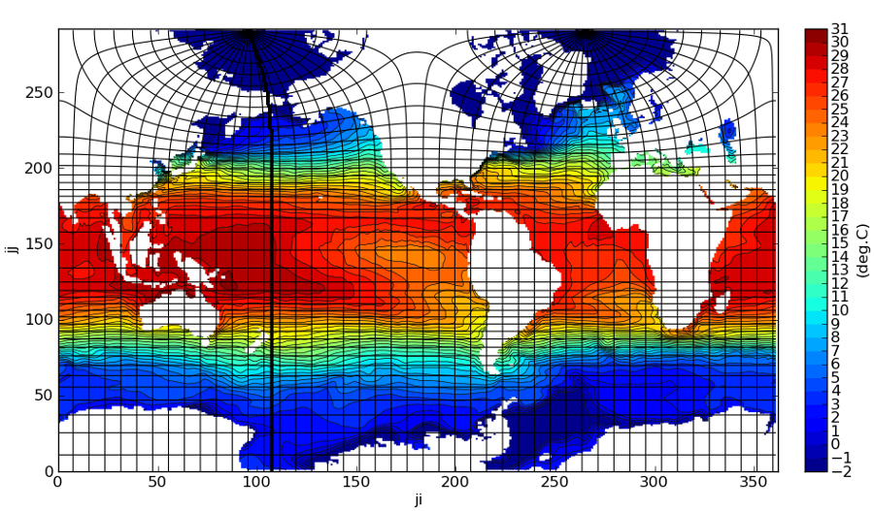
What are my areas of interest ?
ON THE DISPERSION OF MARINE LITTER AND DEBRIS IN THE GLOBAL OCEANS
1/ What are the main scales (Ekman dynamics, meso-to submesoscale) and physical processes (Stokes drift, windage, tides, …) to describe the convergence/divergence dynamics at global scales ?

Slide 3
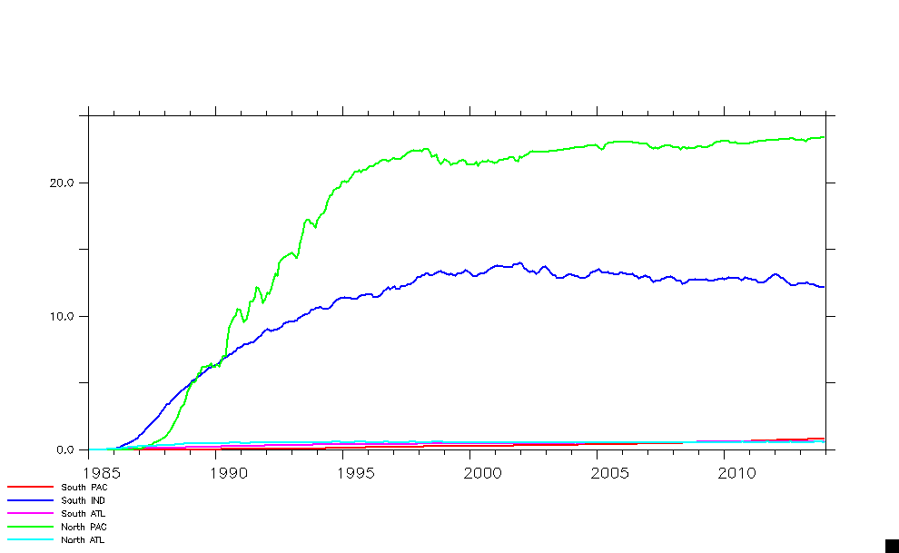
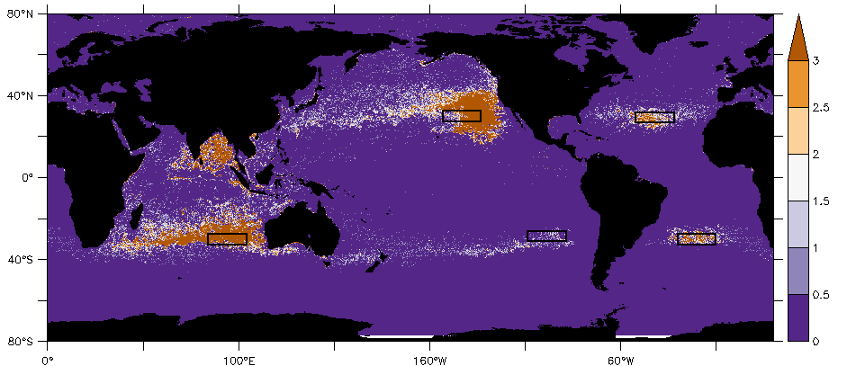
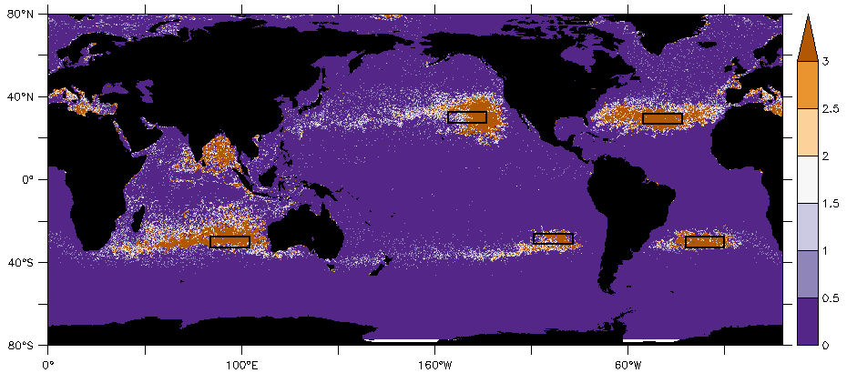
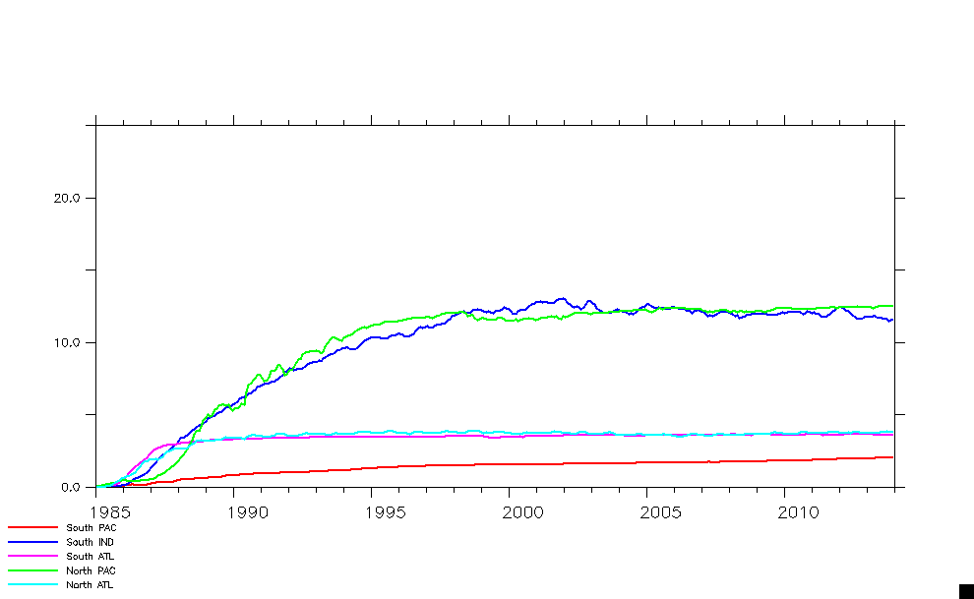
My expectations concerning the workshop and the outcomes
2/ What are the sources/fates of marine debris-plastics to understand observed concentrations?
Lebreton scenario
van Sebille scenario
10-Year
NORTH PAC
SOUTH IND
10-Year
Number of particles per ¼° cell

