Slide 1
Towards a Global Platform for Monitoring Marine Litter and Informing Action
Emily Smail
GEO Blue Planet Initiative

Slide 2
About the White Paper
The purpose of white paper is to outline requirements for the development of a global monitoring platform for marine litter including vision, feasibility and potential structure and funding needed.
This paper will be used to further discussions with the view to develop a long-term project in support of such a platform.
Notes:
The United Nations Environment Assembly (UNEA) has recognized marine litter as one of the top priorities through resolutions from UNEA-1 in 2014 and UNEA-2 in 2016, UNEA-3 in 2017, and UNEA-4 in 2019.
Marine litter has also been recognized in the Sustainable Development Goal 14, and its targets and indicators.

Slide 3
White Paper: A Global Platform for Monitoring Marine Litter and Informing Action
Existing and developing monitoring technologies
Existing marine litter databases and major published datasets
SDG indicators and other types of indicators
Existing and developing platforms of relevance
Proposed features of a global platform
Marine litter in a digital ecosystem for the environment – thought on a pilot project
Future developments
Notes:
UN Environment commissioned white paper

Slide 4
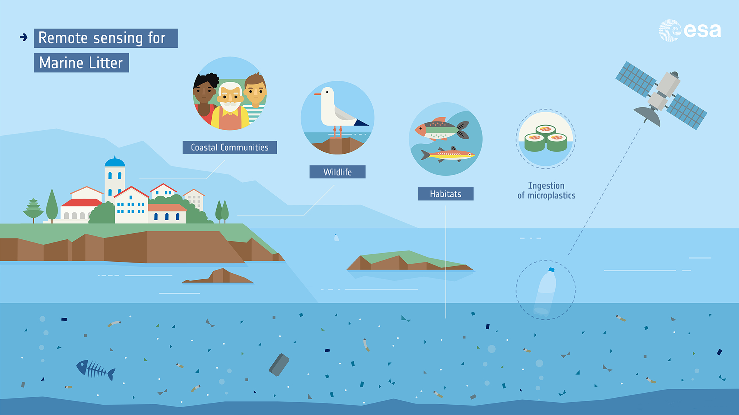
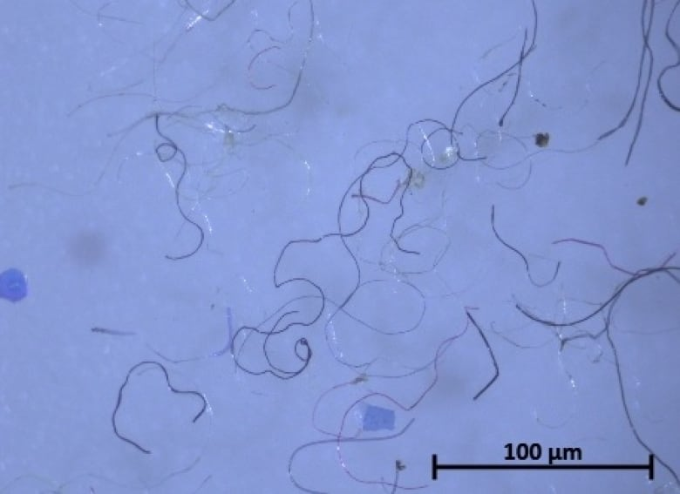
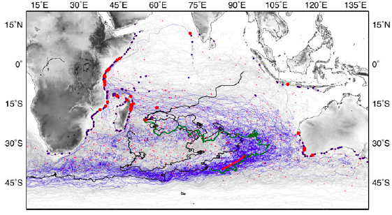
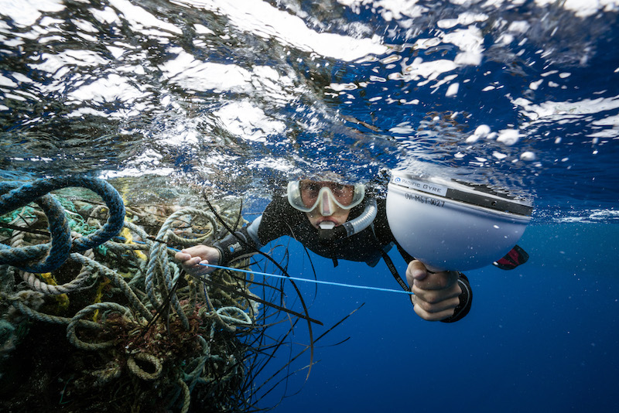
Existing and developing monitoring technologies
Human observers
Microscopy
Weighing
Spectroscopy
Spectronomy
Visual Imagery and Video
Synthetic Aperture Radar
Hyperspectral Imaging
GPS Tags and Transmitters
Modeling
Photo Credit: NOAA
Photo Credit: Joshua Kurek
Photo Credit: ESA
Photo Credit: NOAA
Photo Credit: europa.eu
Photo Credit: Ocean Voyages Institute
Notes:
UN Environment commissioned white paper

Slide 5
Preliminary Marine Litter Database Survey Results
Link to survey: http://form.jotform.com/91395440653157
Notes:
Based on primary survey results obtained from 27 databases and datasets, the vast majority of the databases contained information regarding beach and shoreline, followed by seafloor/seabed, water column, sources of marine plastic, and plastic ingested by biota. A number of the beach or shoreline monitoring databases work in conjunction with citizen science groups to collect litter data. Projects and programs from governmental bodies, NGOs, private enterprises, research institutions and universities from across the world are working to solve the marine litter crisis.

Slide 6
Existing Databases
Notes:
Marine Debris Monitoring and Assessment Project (NOAA)
Marine LitterWatch (European Environmental Agency)
The Deep-Sea Debris Database (JAMSTEC)
The European Marine Observation and Data Network (EMODnet) Marine Litter Database (Istituto Nazionale di Oceanografia e di Geofisica Sperimentale)
The Australian Marine Debris Database (Tangora Blue Foundation)
The Global Ghost Gear Initiative Data Porta (Ocean Conservancy)
….and more!
Challenges: inconsistent methods, formats, quality control, etc.

Slide 7
Indicators and Applications of Technologies
Some primary questions to be addressed by a global platform for monitoring marine litter and information action:
What is the abundance, distribution and composition of marine litter, and are these attributes changing over time?
What are the main sources of marine litter, and are they changing over time?
What are the impacts of marine litter, and are they changing over time?
What are the principal dispersion and accumulation pathways and what are their variability?
Notes:
UN Environment commissioned white paper

Slide 8
Indicators and Applications of Technologies
Approved SDG 14 Indicators
Level 1 (global)
Level 2 (national)
Level 3 (supplemental)
Indicators for abundance, distribution and composition
Beach/shoreline
Floating and water column
Seafloor
Indicators for impacts of marine litter
Biological/ecosystem
Economic
Indicators for sources of marine litter
Rivers and estuaries
Ocean activities
Coastal disasters
Primary Microplastics
Waste management
Plastic Lifecycle
Notes:
UN Environment commissioned white paper

Slide 9
Indicators for SDG 14.1
Level 1: Global Indicator (ABNJ)
Level 2: National Indicators
Level 3: Supplementary Indicators
Monitoring parameters (and methods) | Level 1 | Level 2 | Level 3
Plastic patches greater than 10 meters* | X
Beach litter originating from national land-based sources | X
Beach litter (beach surveys) |  | X
Floating plastics (visual observation, manta trawls) |  | X
Water column plastics (demersal trawls) |  | X
Seafloor litter (benthic trawls (e.g. fish survey trawls), divers, video/camera tows, submersibles, remotely operated vehicles) |  | X
Beach litter microplastics (beach samples) |  |  | X
Floating microplastics (manta trawls, e.g. Continuous Plankton Recorder) |  |  | X
Water column microplastics (demersal plankton trawls) |  |  | X
Seafloor litter microplastics (sediment samples) |  |  | X
Plastic ingestion by biota (e.g. birds, turtles, fish) |  |  | X
Plastic litter in nests |  |  | X
Entanglement (e.g. marine mammals, birds) |  |  | X
Plastic pollution potential (based on the use and landfilling of plastics) |  |  | X
River litter |  |  | X
Other parameters related to plastic consumption and recycling |  |  | X
Health indicators (human health and ecosystem health) |  |  | X
Notes:
Challenges are that the existing data related to these paramaters is not standardized. We may need to label the data that is compliant with the SDG methodology for the formal reporting and have those as a data set that can be extracted and analyzed separately from other data that follows different methodologies but may still be of use for some decision making.

Slide 10
Existing Data Platforms of Relevance
Notes:
Databases, archives, platforms, portals, catalogues…
How:
Understand what is needed (e.g. parameters, temporal & spatial extent);
Know where and how to look for it;
Search appropriate catalogues;
Access and analyse data
Paradigm is changing: bring data to users.
Needs vary at local/national/regional and therefore we have (in many cases) multiplied (and redundant) the number of existing catalogues and portals…

Slide 11
Proposed Features of a Global Platform
To build a useful Global Platform for Marine Litter we must address:
1. Usability — who is it for?
2. Accessibility — who can access it?
3. Capacity — are users equipped?
4. Political buy-in — is there wider support?
5. Governance — frameworks, policies in place?
6. Sustainability — long-term thinking & funding
For the Global Platform to be a useful tool, stakeholders must come together to identify the priorities in terms of the necessary policy drivers and the corresponding information and knowledge products to be made available.

Slide 12
Proposed Features of a Global Platform
Data Ingestion Portal
Standardization and Interoperability
Knowledge Resource repository
Data processing and Analysis
Data visualization
Open Platform: open data, open science and open knowledge
Courtesy of Gilberto Camara (earthobservations.org)

Slide 13
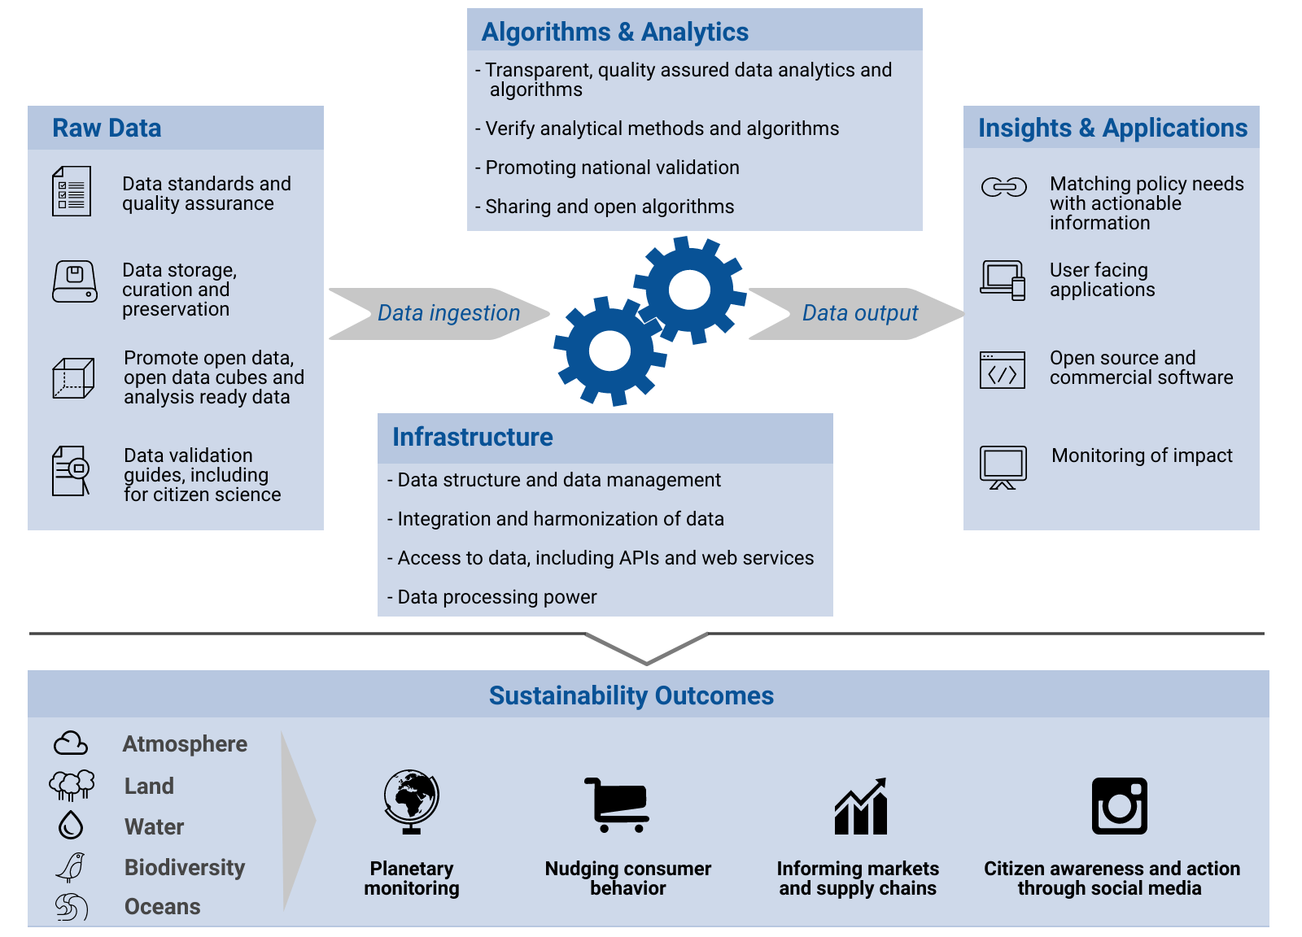
Marine Litter in a Digital Ecosystem for the Planet

Slide 14
Marine Litter in a Digital Ecosystem for the Planet – A Thought Pilot Project
Keystone Species in the Marine Litter Digital Ecosystem
Data collection: digital (software) agents that collect new data and generate a flow to those species that represent data products
Data representation: digital agents that represent data objects and can provide information extracted from these objects, as well as, give access to the data in the objects and receive feedback on data
Tool representation: digital agents that give access to models and data processing tools
Knowledge representatives: digital agents that represent knowledge created by interaction of human and digital agents
Notes:
The species in the Marine Litter Digital Ecosystem (MLDE) fall into at least four main groups:

Slide 15
Future Developments – Artificial Intelligence

Slide 16
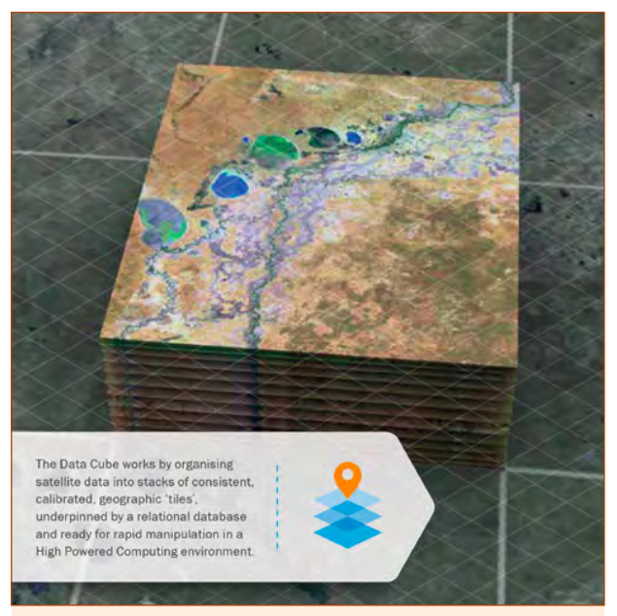
Challenges
Need to reduce EO data size & complexity to allow widespread & application.
Data continuity is crucial for confidence in national investment in human resources & information system to handle EO.
Effective Partnerships: No one can go alone!
Funding: Need committed long-term funding
Data democracy: Open & Free data & access to infrastructure.
EO data complexity and access: Bring data to users (ARD, ODC, DIAS).
Data continuity: NSO need confidence that there will be continuity over years & decades for any new data streams before making investments in new systems.
Leave no one behind: LISTEN TO AND CATER FOR ALL.
Notes:
Need to move beyond pilot projects, ongoing funding to maintain the system once developed will be required

Slide 17
Next Steps
Community input to the white paper will be requested through additional webinars and engagement
Input will be sought from participants from the IEEE workshop in Brest, France from 16-18 December 2019 - Marine Debris Indicators: what’s next?
Final version of the white paper will be released in spring of 2020
Implementation of the proposed platform and a digital ecosystem for the environment will take place at a workshop to be held in Lisbon prior to the Oceans Conference

Slide 18
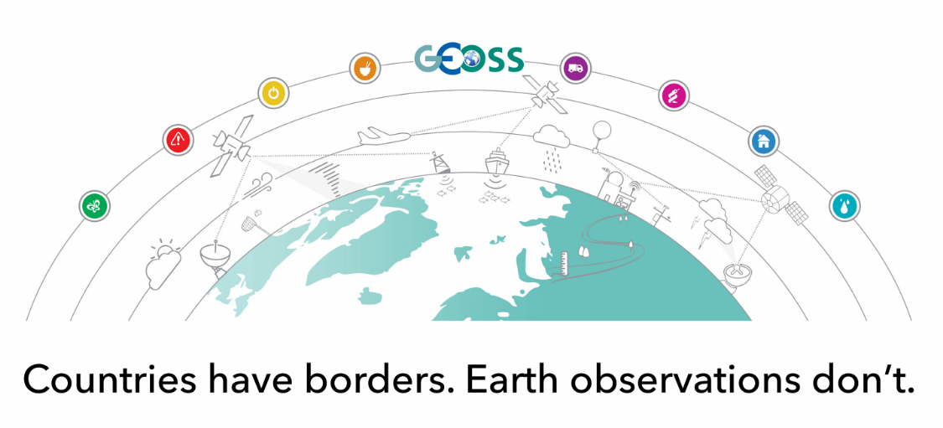
Questions?
Emily.Smail@noaa.gov
@GEOBluePlanet
www.geoblueplanet.org

