Slide 1



Earth Science
Information Partners
Open Biological
and Biomedical Ontologies
A pathway to deeply interoperable semantic technologies across marine debris, Essential Ocean Variables, and the Sustainable Development Agenda
Pier Luigi Buttigieg (on behalf of many)
Notes:
ODIP

Slide 2
The mission
Integrate marine debris knowledge into robust, open, and collaborative digital resources to help distributed systems “understand” core issues, entities, and actors
  Work with domain experts, citizens, and policy-level stakeholders to encode multiple perspectives in the “semantic layer” being linked to a growing list of data and information systems
  Encourage the creation of independent but interoperable resources to enrich the layer

Slide 3

FAIR
Findable
Accessible
Interoperable
Reusable
Wilkinson et al. (2016) Scientific Data 3, DOI:10.1038/sdata.2016.18

Slide 4
FAIR
TO BE INTEROPERABLE:
  I1. (meta)data use a formal, accessible, shared, and broadly applicable language for knowledge representation.
  I2. (meta)data use vocabularies that follow FAIR principles.
  I3. (meta)data include qualified references to other (meta)data.
Technical interoperability based on knowledge is a basis
for community interoperability

Slide 5
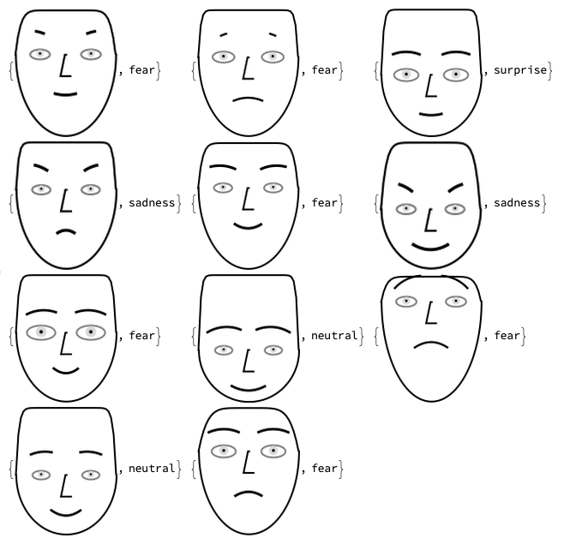




Knowledge representation (KR)
KR
AI
ML
Direct translation of human knowledge to machine-agents
Lots of consistent data signatures → expectation / knowledge

Slide 6
Ontologies
A rough illustration of the semantic gradient
Stronger semantics
Aiming for a high
degree of expressivity,
thus advanced querying
and data mobilisation options
Taxonomies
Controlled
vocabularies
Data models
Thesauri
Glossaries
Weaker semantics
Modified from McCreary D (2006)
Patterns of Semantic Integration. CC 2.5
Notes:
Another note to state that we aim to provide dense semantics, allowing

Slide 7
Ontology
~ def. A machine- and human-readable,
logical representation of (knowledge about)
real-world entities

Slide 8
Global data systems need to understand human
understanding of debris and its links to policy frameworks
…and they need the ontologies to make them interoperable

Slide 9


A semantic interface for the
UN Sustainable Development Goals
github.com/SDG-InterfaceOntology/sdgio
A community-driven ontology for the representation of environments
https://github.com/EnvironmentOntology/envo
Federated, production-grade technologies and BPs for semantic development
www.obofoundry.org

Slide 10
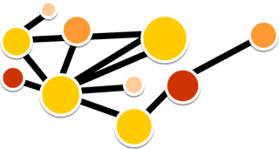
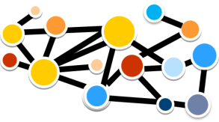

Documents transfer information that is about knowledge
Ontologies encode the knowledge itself in a consistent and computable way
Seite 10

Slide 11
Seite 11

Slide 12

OWL / RDF ontologies
Accessible through linked data servers
Knowledge exchange is mapped in a structured, machine-readable & measurable way
OBO Foundry Ontologies
Seite 12
ENVO, PCO, SDGIO…

Slide 13
Semantics for environmental entities

Slide 14
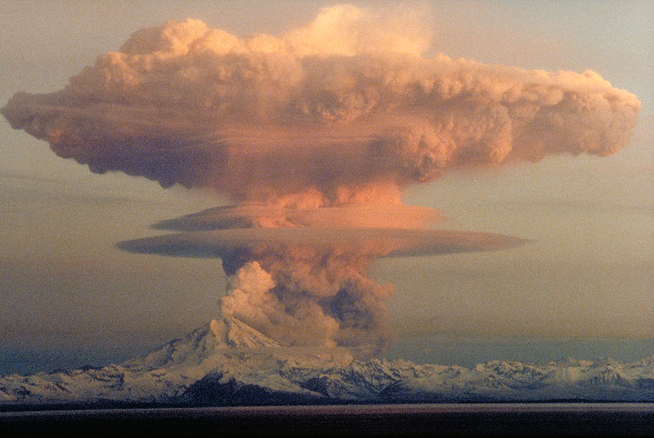
Volcanic
eruption
Public domain: USGS

Slide 15
data_about: volcanic eruption
data_about_uri: http://purl.obolibrary.org/obo/ENVO_01000634

Slide 16
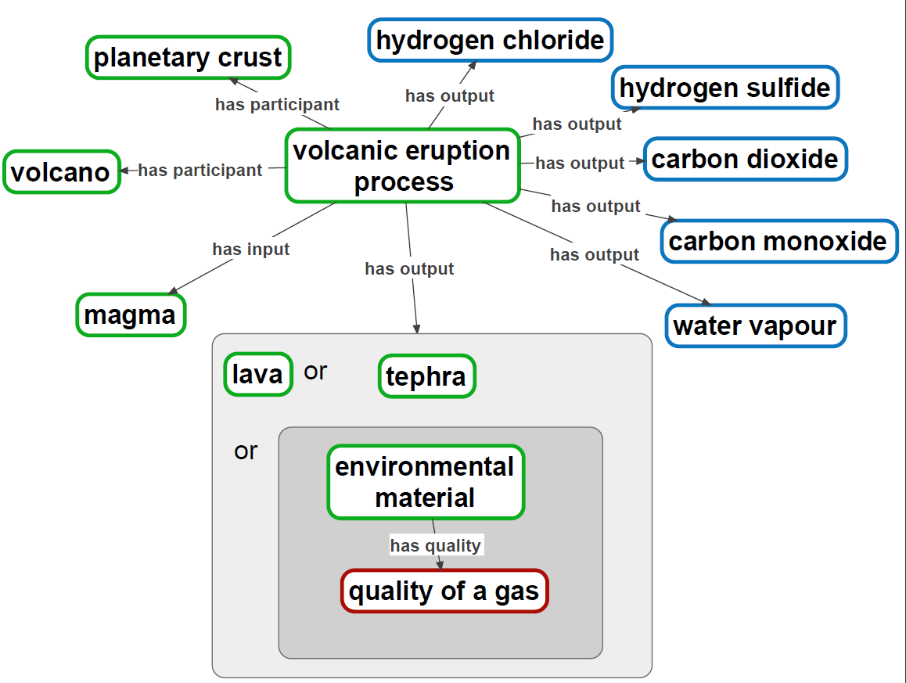
data_about: http://purl.obolibrary.org/obo/ENVO_01000634
CHEBI
ENVO
PATO

Slide 17
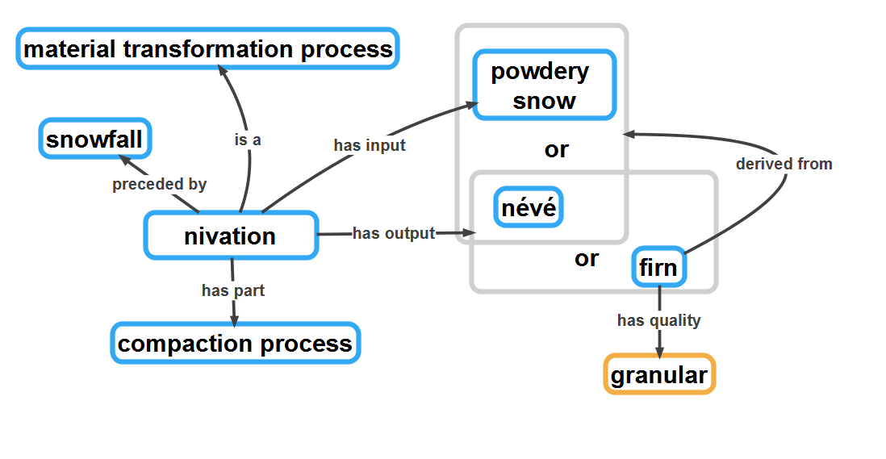
ESIP CryoHackathon series!
PATO
Each node links to many others in ENVO and other interoperating ontologies
Notes:
The goal here is to show a little bit of the carefully and densely woven semantics in envoPolar. For data scientists, this translates into the ability to link and move data using a rich knowledge model. The ontology can help them leverage expert knowledge (which they may not have) to query and mobilise data
Example query: Get me all data about any material transformation process that produces granular snow
Example query: Get me data linked to any material that firn is formed from

Slide 18
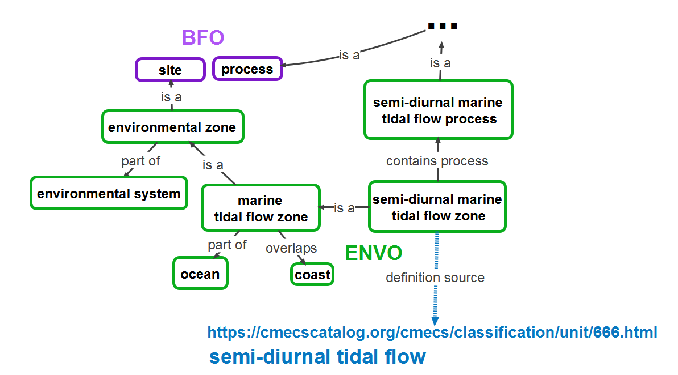
Ontological expression of the CMECS standard
CMECS

Slide 19
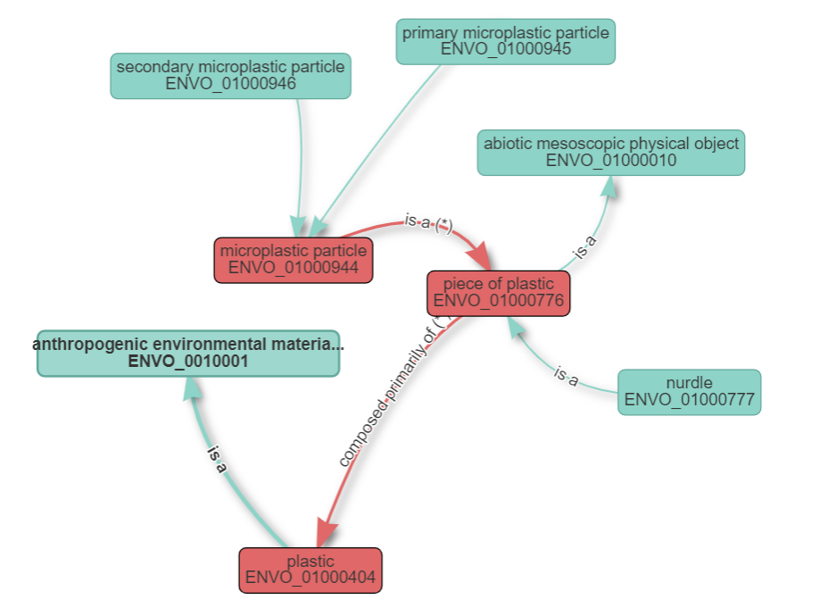
Graph permalink
https://www.ebi.ac.uk/ols/ontologies/envo/terms/graph?iri=http://purl.obolibrary.org/obo/ENVO_01000944&&ed=http://purl.obolibrary.org/obo/ENVO_01000944&&http://purl.obolibrary.org/obo/ENVO_01000776&&http://purl.obolibrary.org/obo/ENVO_01000404&&

Slide 20
Semantics to link to the SDGs

Slide 21
Core ingredients
A common, human- and machine-readable map of SDG-related knowledge available to all
Using standard semantic web technologies and part of a federation of other ontologies
Open editorial policy: all are invited to contribute, co-design, and co-develop SDGIO
UN Environment CoP to extend coverage
https://communities.unep.org/signup.action

Slide 22
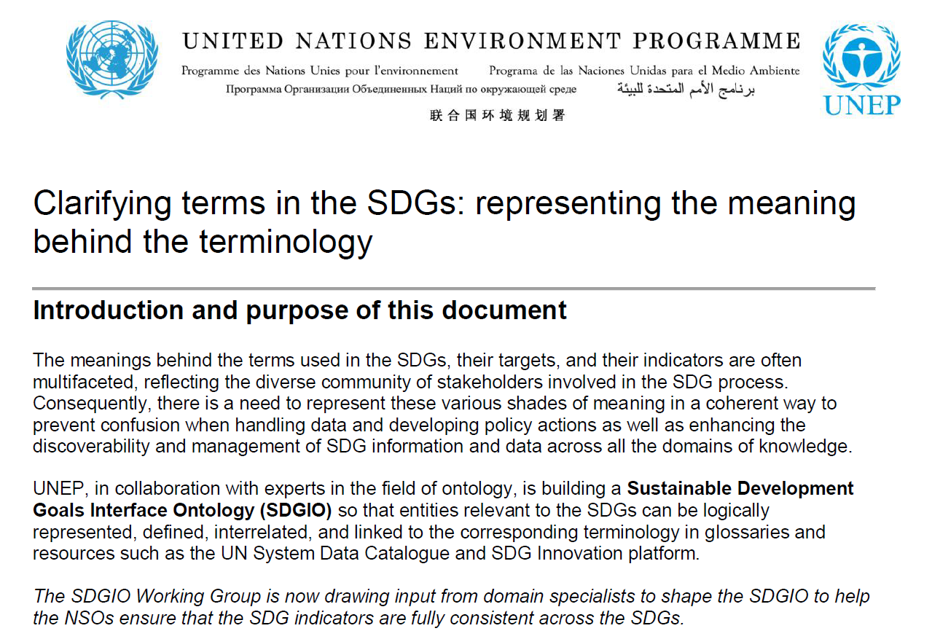
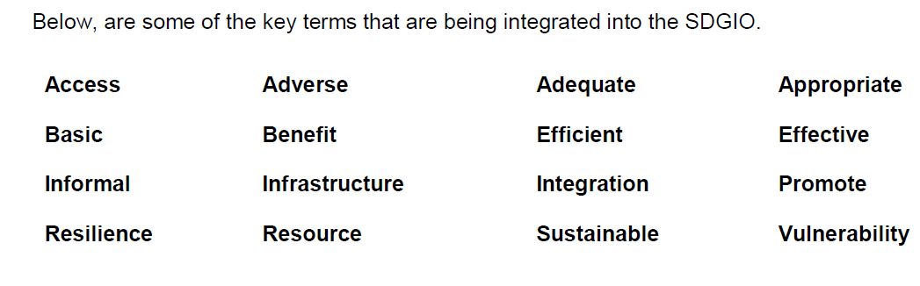

Slide 23
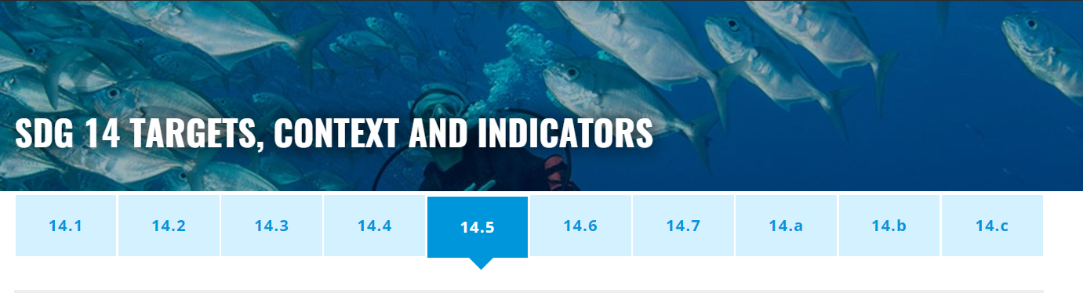
[ SDG 14.5 ] By 2020, conserve at least 10 per cent of coastal and marine areas, consistent with national and international law and based on the best available scientific information.
CONTEXT: Marine Protected Areas (MPAs) help to preserve biodiversity, maintain fish stocks, and sustain coastal economies and livelihoods that depend on healthy marine ecosystems. SDG 14.5 calls for putting at least 10% of the world ocean under MPA by 2020; as of end 2016, this figure stood at about 3.9%.
INDICATOR 14.5.1: Coverage of protected areas in relation to marine areas
http://www.oceanactionhub.org/sdg-14-targets-context-and-indicators

Slide 24

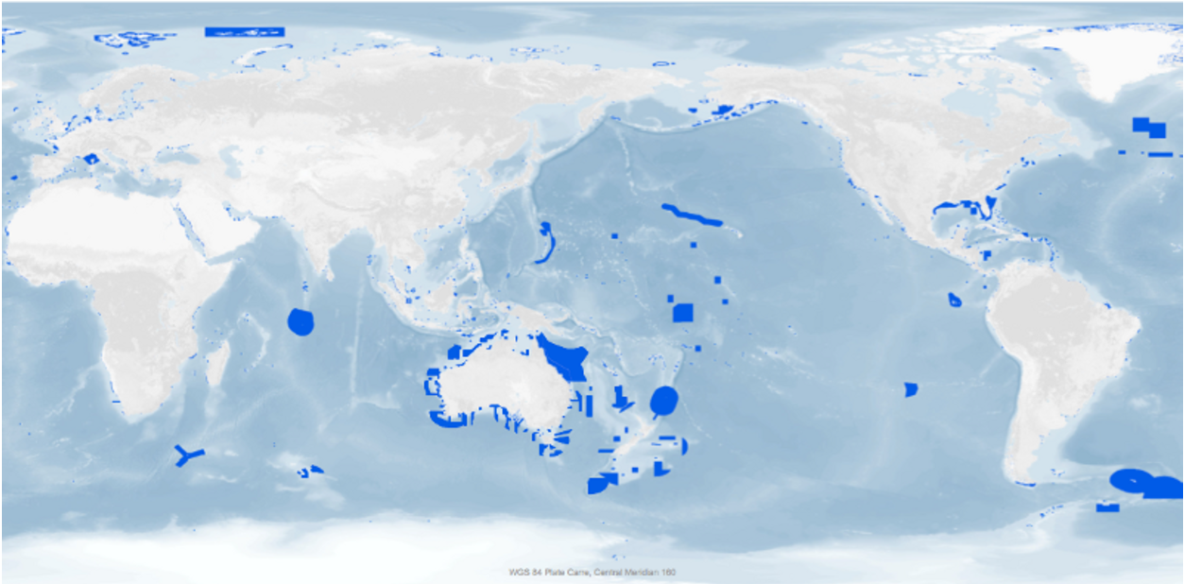
IUCN Protected Areas
Categories System
Ia: strict nature reserve
Ib: wilderness area
II: national park
III: national monument or feature
IV: habitat/species management area
V: protected landscape/seascape
VI: protected area with sustainable use of natural resources
http://www.protectplanetocean.org/official_mpa_map

Slide 25

Designations of protected areas across IUCN categories in the WDPA (UNEP WCMC)
 | conservancy | park | preserve | refuge | reserve | sanctuary | station | zone
Ia | 0 | 53 | 8 | 26 | 296 | 17 | 9 | 0
Ib | 2 | 9 | 0 | 0 | 4 | 15 | 0 | 1
II | 61 | 420 | 0 | 0 | 73 | 7 | 0 | 0
III | 0 | 61 | 1 | 4 | 38 | 9 | 0 | 0
IV | 0 | 72 | 40 | 140 | 226 | 58 | 0 | 19
NA | 0 | 0 | 0 | 0 | 34 | 0 | 0 | 0
NAs | 0 | 1 | 0 | 0 | 0 | 6 | 0 | 0
NR | 0 | 78 | 0 | 19 | 111 | 92 | 0 | 9
V | 0 | 173 | 91 | 18 | 190 | 53 | 0 | 4
VI | 0 | 69 | 1 | 8 | 172 | 132 | 0 | 0
Courtesy of
Miriam Grace
NA = Not applicable, NAs = Not assigned, NR = Not reported

Slide 26
Resilient food system
Access to education
Healthy oceans

Slide 27



















SWEET
AgrO
Data Detektiv
Notes:
Through wide collaboration and an open development policy, ENVO has seeded (and thus interoperates with) new ontologies in ecology (ecoCore), agronomy (AgrO), food science (FOODON), as well as the United Nation’s Sustainable Development Goals Interface Ontology (SDGIO).
To ensure reuse of existing resources and better linked data, ENVO also interoperates with ontologies such as population and community ontology (PCO), the Chemical Entities of Biological Interest (CHEBI) ontology, and the gene ontology (GO) for biological processes.

Slide 28









Links to SDG Agenda
Biological
processes
EOVs
Chemicals
Environmental and
ecological entities
Food and
agriculture
AgrO

Slide 29
Perspectives
A carefully curated and QCed semantic layer will be key to interoperability between Marine Debris DBs and Knowledge Repositories
Where should we look for globally/regionally stable classifications of debris, their impacts, and relation to the EOVs and SDGs?
What are the issues and understandings you care about? Are you willing to add them to the semantic layer (with ontologist support)?
We’re ready to train dedicated marine debris ontologists – any takers?

Slide 30










Acknowledgements
Acknowledgements

