Slide 1
Plastics in the Urban Coast
Kelly Jones
Department of Ocean and Earth Sciences, Old Dominion University

Slide 2
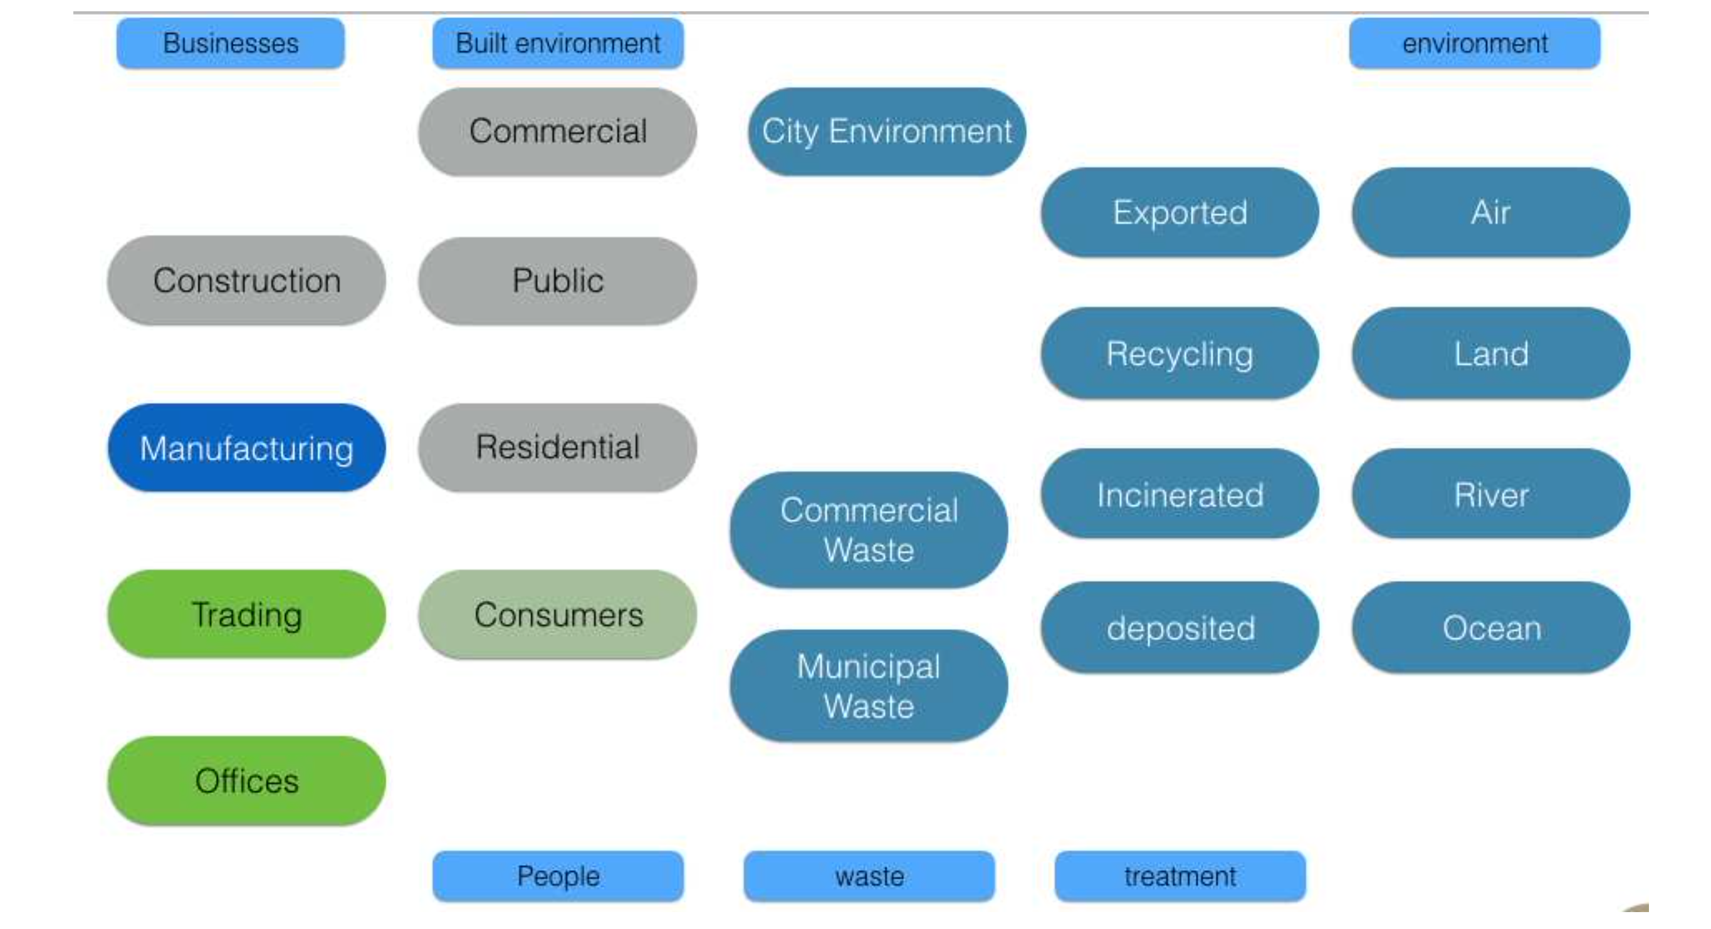
Plastic in the Urban Coast
To determine the amount of plastic in the urban coast, a stock and flow model can be used.
This is a visual representation of the model containing the most relevant stocks. However, not all the stocks are interconnected with flows.
To quantify plastic in the urban coast, the main substocks of plastic in use include:
Construction,
Several types of buildings,
Consumer goods,
Waste streams,
And, in some urban coasts, manufacturing and trading
Notes:
Construction (the plastic used during the process of constructing the built environment),
Several types of buildings (the plastic integrated in the building structure),
Consumer goods (proportional to the population and the amount of consumer goods per person)
Waste (plastic at the end of it’s use),
And, some urban coasts will also include manufacturing and trading with plastic associated with these economic processes.

Slide 3
Estimating Plastic in the Urban Coast
However, for the use of SFMs, the database concerning plastic production and its use needs to be sufficiently detailed to capture the major flows.
Considering the available database, it is will be clear that several of the major flows cannot be quantified.
Databases required to capture the major flows:
The population in the coastal urban built environment
The rate of construction and demolition in the urban area for specific building types
The amount of plastic used in the construction process, the building structure, the demolition process, and within the building itself (consumer goods)
The waste remaining within the urban coast and that exported
The amount of plastic associated with manufacturing and trading in specific cities

Slide 4
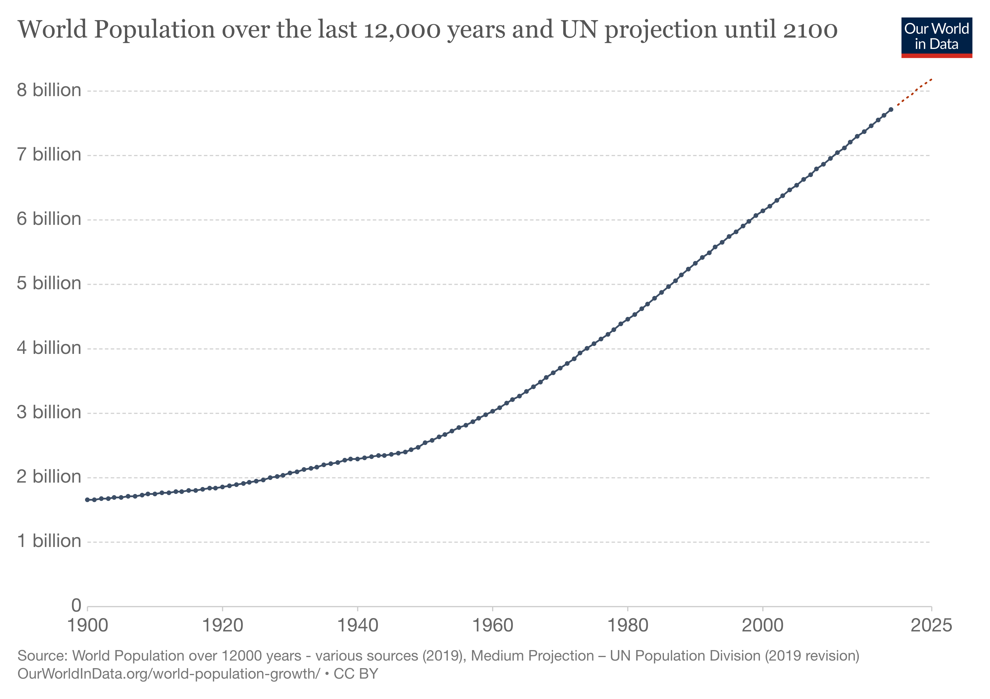
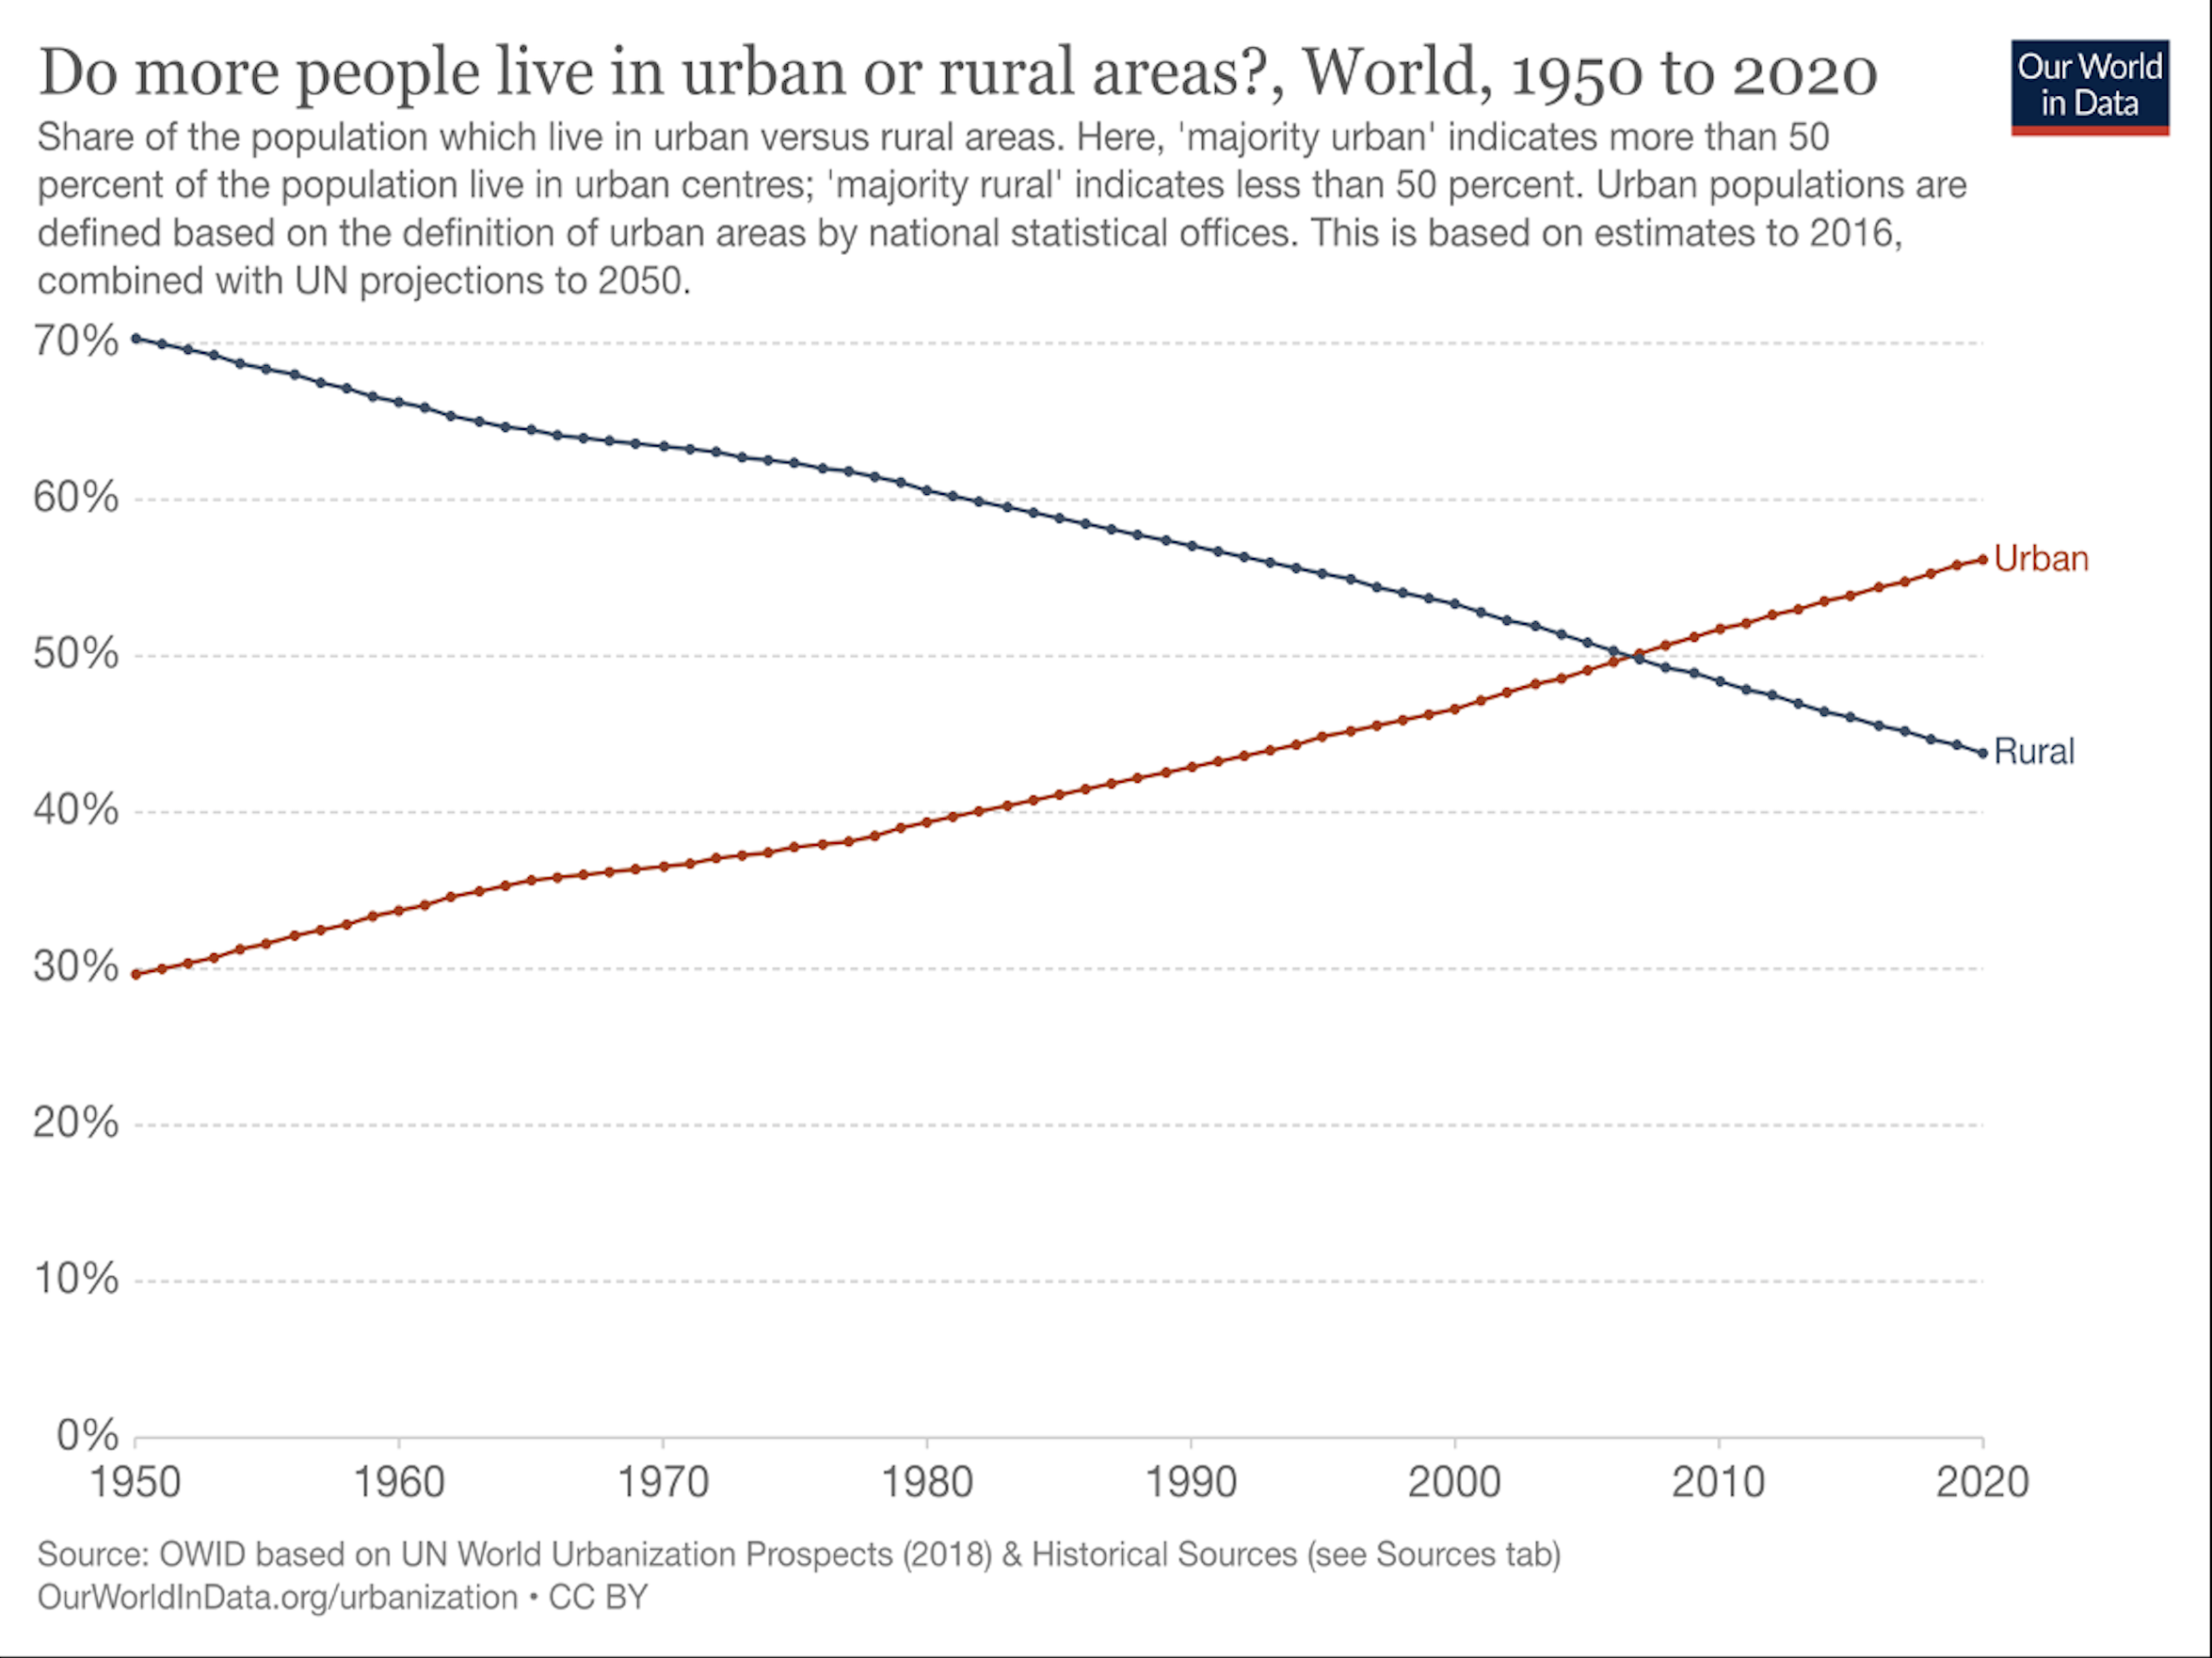
Population in the Coastal Zone
Global population is growing and is expected to continue to grow to 2100
40% of the world’s population inhabits the coastal zone
Historically, much of the population has been classified as rural living, but between 2000 and 2010 this changed to more people residing in urban areas

Slide 5
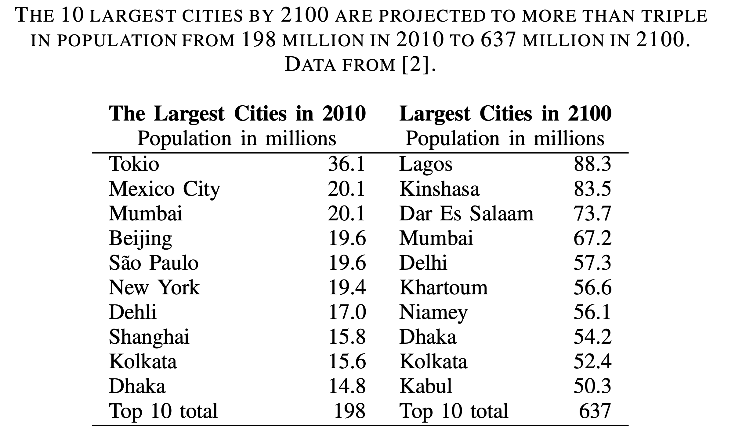
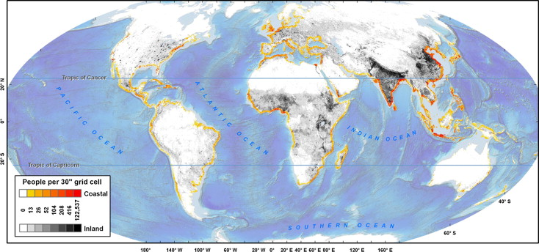
Coastal Urbanization
The 10 cities expected to be the largest by 2100 (table) are likely to more than triple the population from 198 million to 637 million
8 of them are in coastal floodplains or riverine floodplains
The degree of urbanization is higher in the coastal zone than in continental areas (bottom figure)
Using the global fraction of urban population, which was 55% in 2017, at least 22% of the global population is concentrated in the urban coast.

Slide 6
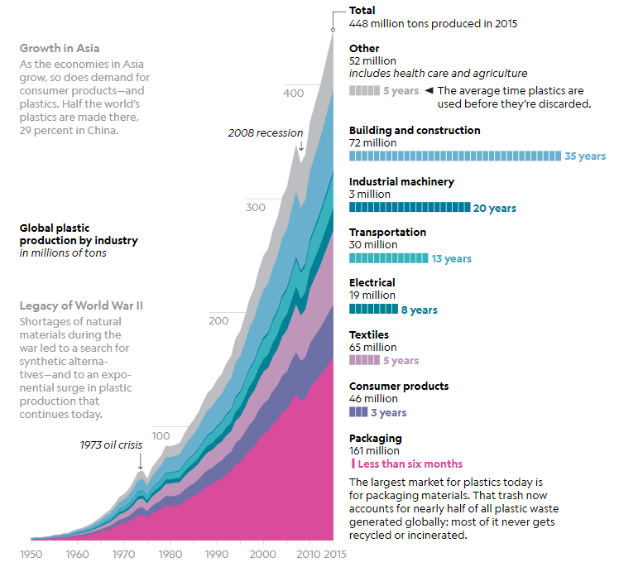
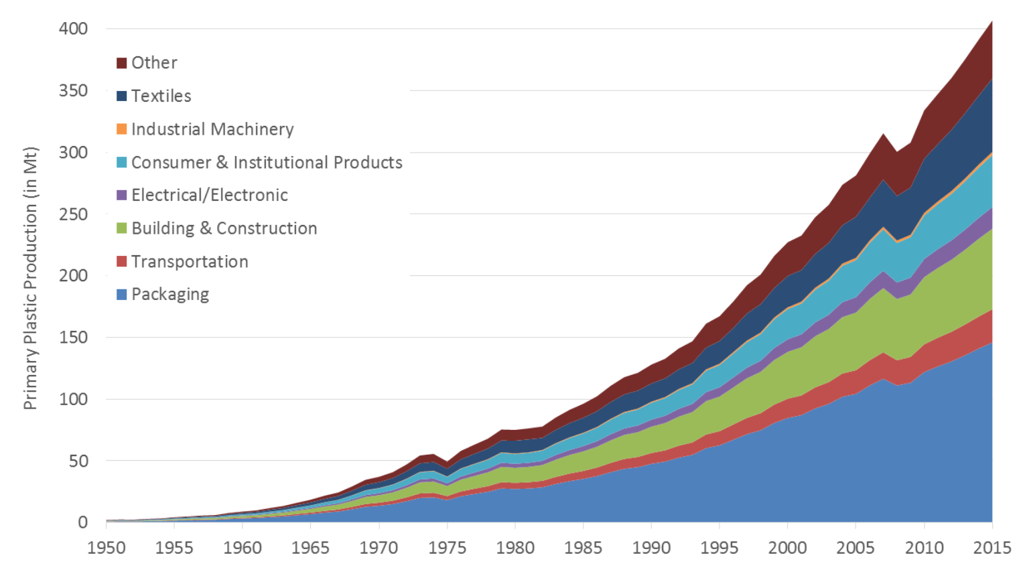
Global Plastic Production and Use
The use of plastics in buildings started to increased after the second World War, and in the 1950s the prospects for using plastic in construction were considered very promising
Little concerns were articulated at that time what plastic could turn into and environmental pollutant

Slide 7
Plastic Production and Use Data
Document Title | Year | Authors | Original Source
Global Plastic Production by Industry | 2018 | Jason Treat and Ryan T. Williams, National Geographic | Source: Roland Geyer, University of California, Santa Barbara
Production, use, and fate of all plastics ever made | 2017 | Roland Geyer, Jenna R. Jambeck, Kara Lavender Law | PlasticsEurope, 2006; PlasticsEurope, 2016
Marine Anthropogenic Litter | 2015 | Bergmann et al. | PlasticsEurope. 2013; PlasticsEurope 2014/ 2015.
Plastics and microplastics in the oceans: From emerging pollutants to emerged threat | 2016 | Carlo Giacomo Avio, Stefania Gorbi, Francesco Regoli* | Plastic Europe, 2014/2015.
Plastic Debris in the Ocean : The Characterization of Marine Plastics and their Environmental Impacts, Situation Analysis Report | 2014 | IUCN: Florian Thevenon, Chris Carroll and João Sousa | PlasticsEurope, 2008; PlasticsEurope, 2009.; PlasticsEurope’s Views on the Marine Litter Challenge, April 2010
River plastic emissions to the world’s oceans | 2017 | Laurent C.M. Lebreton, Joost van der Zwet, Jan-Willem Damsteeg, Boyan Slat, Anthony Andrady & Julia Reisser | Plastics Europe. 2016
Toward the Integrated Marine Debris Observing System | 2019 | Maximenko et al. | Geyer, R., Jambeck, J. R., and Law, K. L. (2017). doi: 10.1126/sciadv.1700782
Mare Plasticum - The Plastic Sea: Combatting Plastic Pollution Through Science and Art | 2020 | Streit-Bianchi et al. | Geyer R, Jambeck J, Lavender Law K (2015); PCI Wood Mackenzie (2017); PlasticsEurope (2018); PlasticsEurope (2019); European Bioplastics (2018)
The geological cycle of plastics and their use as a stratigraphic indicator of the Anthropocene | 2016 | Colin Waters, Anthony Barnosky, Patricia Corcoran, Alejandro Cearreta | PlasticsEurope (2013); PlasticsEurope (2015); Thompson, R.C., Moore, C., vom Saal, F.S., Swan, S.H., 2009.
Sustainable Plastic Strategy | 2020 | Contributing partners: SusChem, Cefic , PlasticsEurope, EuPC, ECP4
PlasticsEurope | 2016 | PlasticsEurope
PlasticsEurope Operation Clean Sweep Report 2019 | 2019 | PlasticsEurope

Slide 8
Estimating Plastic in the Urban Coast
Databases required to capture the major flows:
The population in the coastal urban built environment
The rate of construction and demolition in the urban area for specific building types
The amount of plastic used in the construction process, the building structure, the demolition process, and within the building itself (consumer goods)
The waste remaining within the urban coast and that exported
The amount of plastic associated with manufacturing and trading in specific cities
Without the detailed databases we can make assumptions to give an estimation

Slide 9
Estimating Plastic in the Urban Coast
Coastal Urban Built Environment General Assumptions:
PlasticEurope is publishing accurate data, despite a lack of verification by users
40% of the world’s population inhabitat the coastal zone
At least 22% of the global population is concentrated in the urban coast
Plastic is equally distributed in the population globally
Estimating the Current Plastic (2015)
The plastic produced in 2015 was 448 Mt.
The total amount of plastic produced up to 2015 is on the order of 9 Bt
Assuming that these fraction have remained the same since 1950, resulting in 1.4 Bt of plastic used in construction, and 0.9 Bt of plastic integrated into the built environment
These assumptions represent the low-end probability as it is more likely that the fractions have changed with relatively more plastic being used in other areas of construction, making the 16% a low estimate
Notes:
Assuming approximately 16% goes into construction
About 40% of the plastic used in construction is turned into waste, while the other 60% is integrated into the building structures

Slide 10
Estimating Plastic in the Urban Coast
Extrapolating the Plastic Production to 2050,
The amount of plastic produced in 2050 could reach 900 Mt
With average use times of 5 years, the total stock of plastic in use would reach close to 5 Bt.
The total amount of plastic produced by 2050 will be on the order of 32 Bt.
With the same assumptions as 2015, the plastic that will have been integrated into the built environment by 2050 is on the order of 3 Bt.
Total plastic in the urban coast:
The total estimation for the urban coastal built environment is on the order of 525 Mt in 2017 and 1.25 Bt by 2050
Of this amount, on the order of 375 Mt would be integrated into the built environment
Notes:
With the residence times discussed above, at least half of this amount will still be in the built environment in 2050.

Slide 11
Discussion
Plastic is an ever-present hazard to the marine biosphere, and through the food chain, to human health.
Scientific data requires verification and repetition which has not been done for plastics
Not knowing or fully understanding the amount of plastic in fragile coastal zones does not allow for a full risk assessment
Not assessing the potential risk of plastic in the urban coast is a dangerous mistake
With sea level rise and climate change, the coastal urban areas are more fragile than in the past
Destruction of the urban coast either moves plastic directly to the ocean or allows for it to be available to flow easily into the waterways with another event.

