Slide 1
Marine Debris Indicators:
What’s next?
René GARELLO
Professor IMT Atlantique
Life Fellow IEEE
ExCom member GEO

Slide 2

What is IEEE?
Institute of Electrical and Electronics Engineers
IEEE is the world's largest technical professional organization dedicated to advancing technology for the benefit of humanity.
500 000
MEMBERS
Assembly
Board of Directors
Publications, Services and Products Board
Educational Activities Board
Member & Geo Activities
Technical Activities
Standards Association
Regions & Sections
Societies &
Tech. Councils
& TCs & MSTC & NTCs
IEEE-USA
Chapters
Notes:
Split of the mind with reality

Slide 3
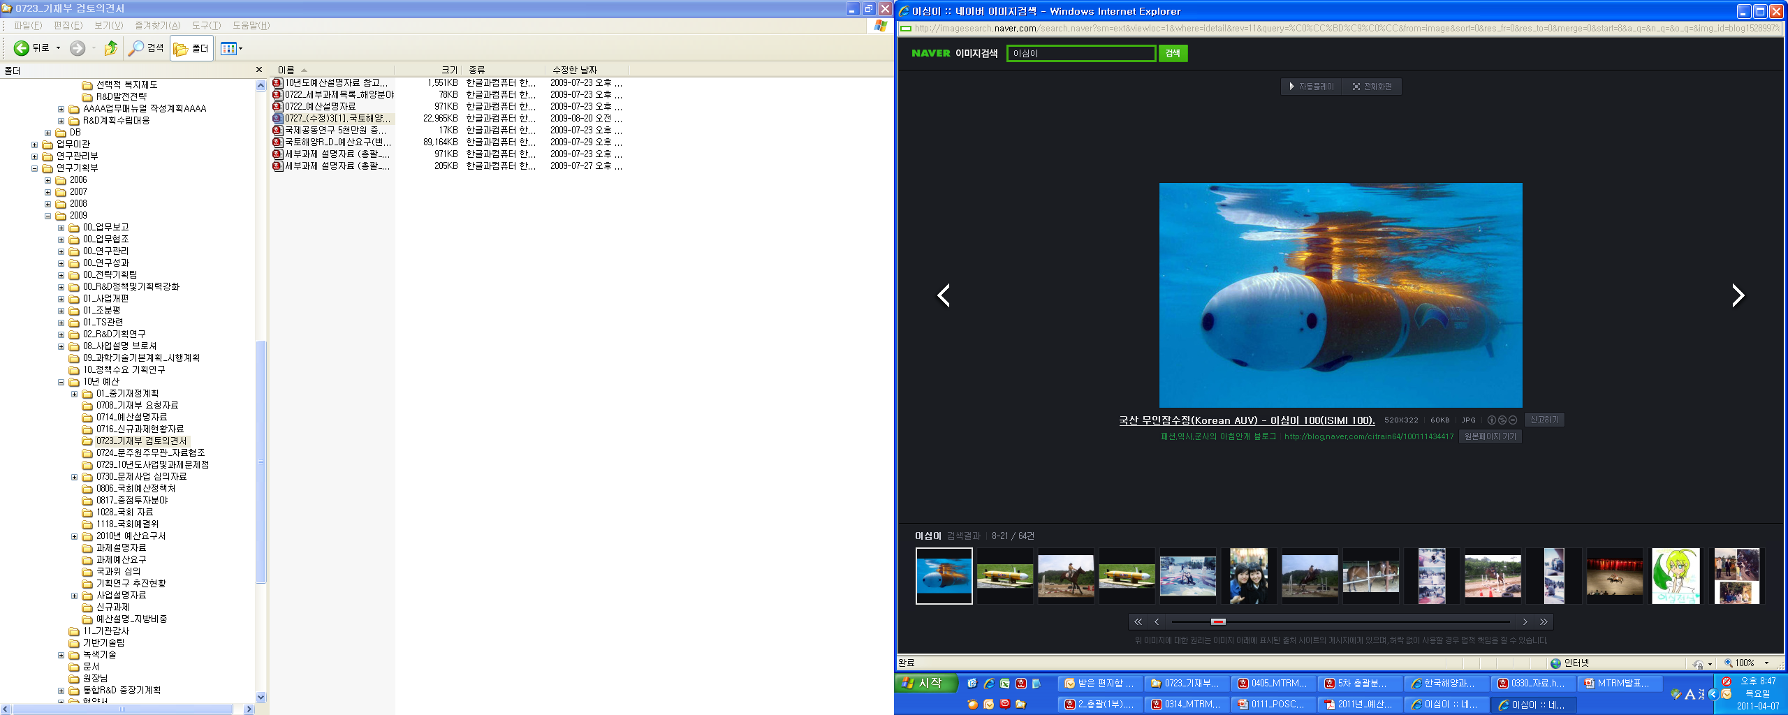
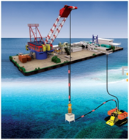
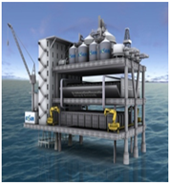
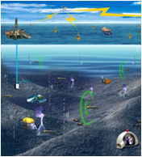
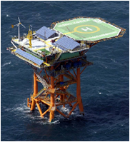
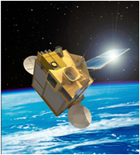
OES in the IEEE
Per ardua ad mare
Signal
Communication
And Processing
Acoustics
Instruments
Sensors
Vehicles
Information
Processing
Modelling
Observing, monitoring, predicting
the marine environment
Physical Observations
Global
Observation
Environment

Slide 4
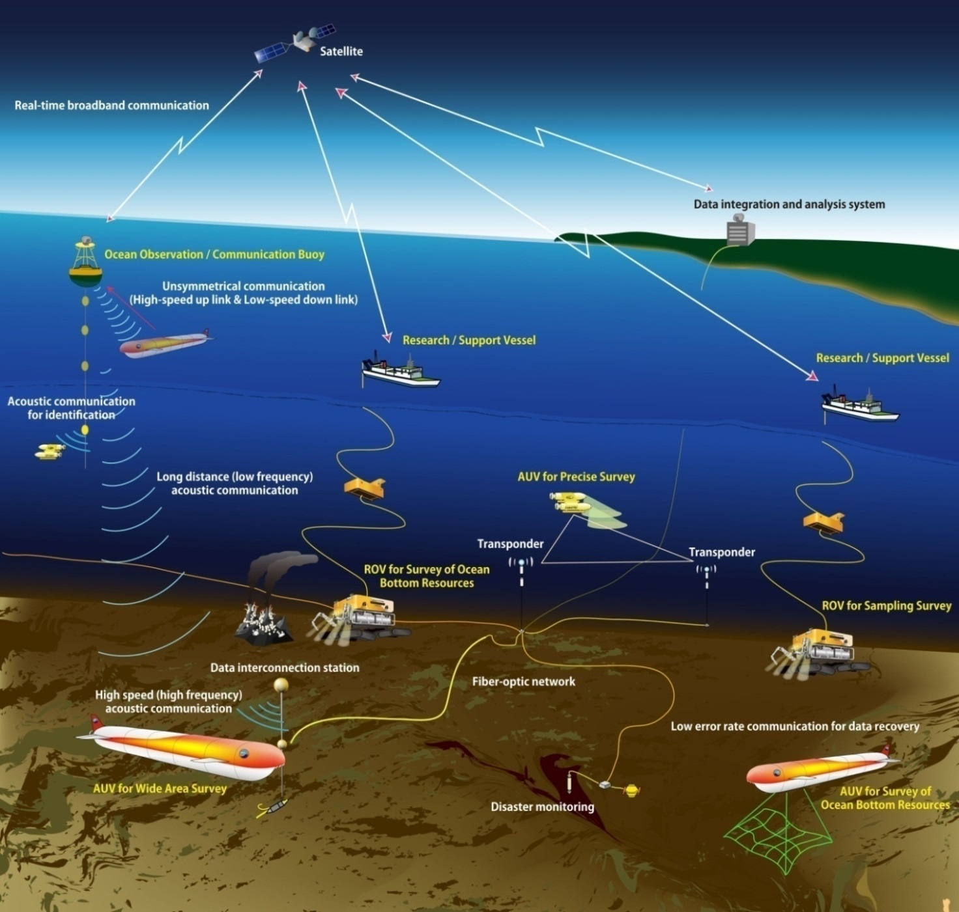
Marine Science & Technology
After “Future Plan for Ocean Research” Hitoshi Hotta, Japan Agency for Marine-Earth Science and Technology, Oceans’12 Yeosu Korea
Sensors, on-board systems, drones
Multisource observations, data processing, communications

Slide 5






Assessment of existing relevant data
Under GEO Blue Planet, an IEEE/OES funded working group on marine litter is investigating the sources, distribution and impact of marine debris, and supporting mitigation measures, policies and regulations to reduce it.
White paper for UN Environment that will cover the available data and technologies available for observing and monitoring marine litter and recommended indicators.

Slide 6
Activities linked to “Marine Debris / Plastics”
Workshop “Technologies for observing and monitoring plastics in the oceans” – Brest - November 2018
The Second Meeting of the Ad Hoc Open-Ended Expert Group on Marine Litter and Microplastics – Geneva – December 2018
RoadMap 6 months – 2 years – 5 years
Dissemination (Conferences, Workshops, Panels) :
Paper/poster, OCEANS 2019 Marseille (June)
“Town Hall”, OCEANS 2019 Seattle (October)
OceanObs 2019, Hawaii (September)
“White Paper” UNEP
Initiative OES “Plastics in the Oceans” – 2020-2021 – $60k USD

Slide 7
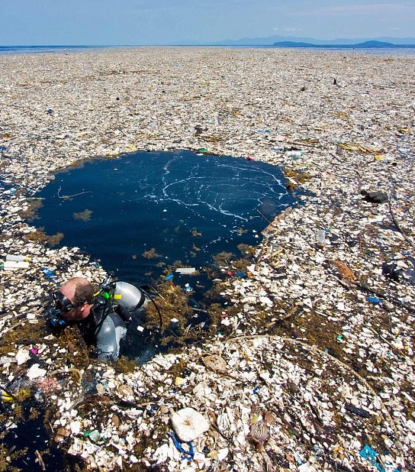
Measuring and monitoring ocean debris
Earth observations support research on time-lagged marine debris impact of built environments, and help researchers predict dispersion
Photo:
AFP / Getty Images
Photo:
AFP / Getty Images

Slide 8
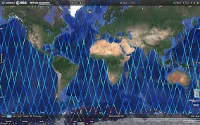
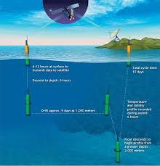
Detecting, tracking, monitoring
Use of litter-like transmitters for Plastic Marine Debris:
Coupling between global circulation/drift model and argos style positioning system

Slide 9
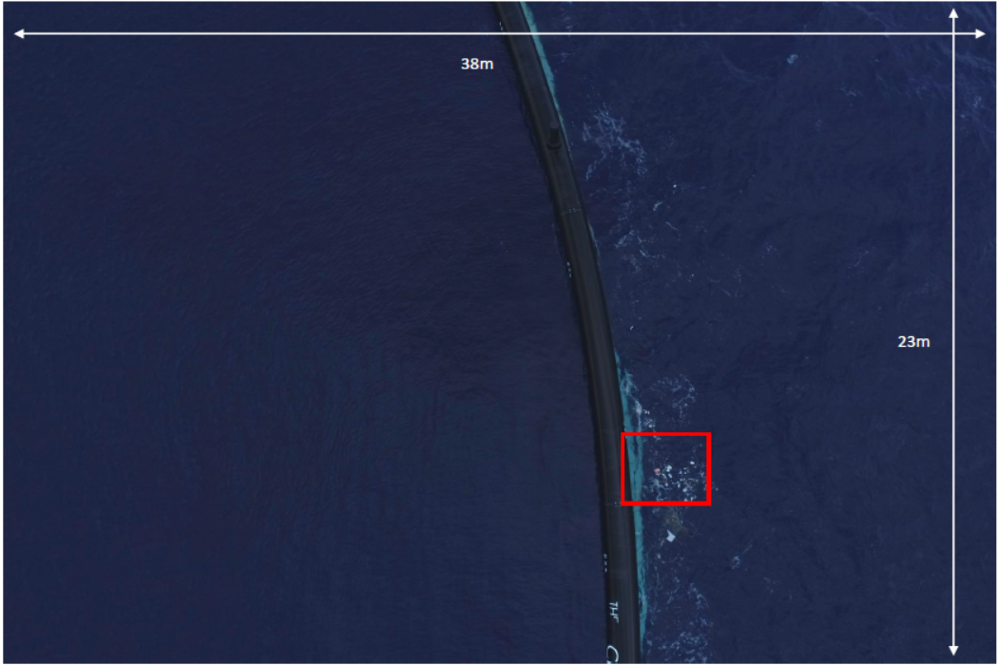
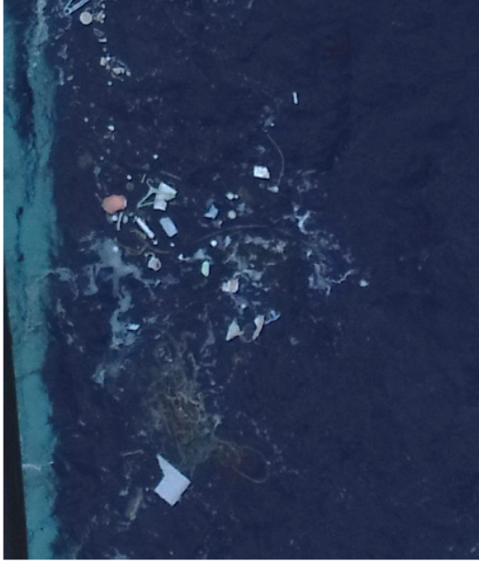

Methods and technologies for plastic measurements
From Garaba, 2018
Drones have shown promising results for measuring the extent of the Great Pacific Garbage Patch.
Imagery from a drone at 25m altitude captured around System001 in November 2018 by Robin de Vries

Slide 10
OCEANS 2019
Marseille

Slide 11
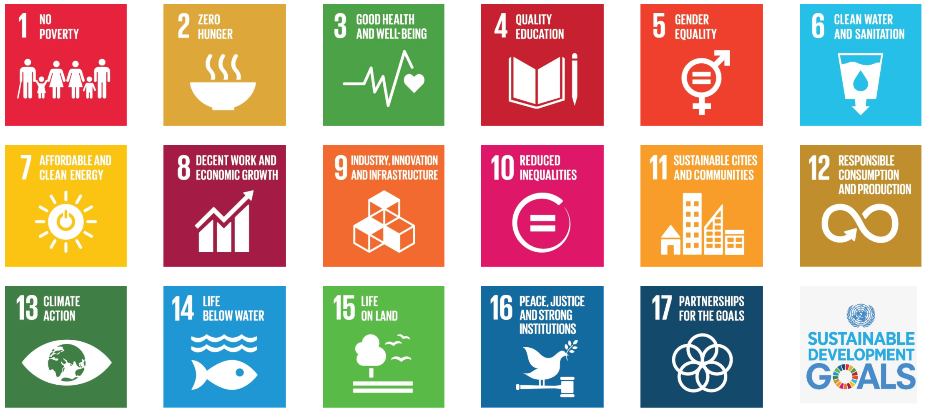
Sustainable Development Goals (SDGs)
(a)
(b)
Goals
Goals
Targets
Targets
169 targets
230 indicators
Indicators
Indicators
Essential Variables
Observations
Observations
Current Opinion in Environmental Sustainability

Slide 12

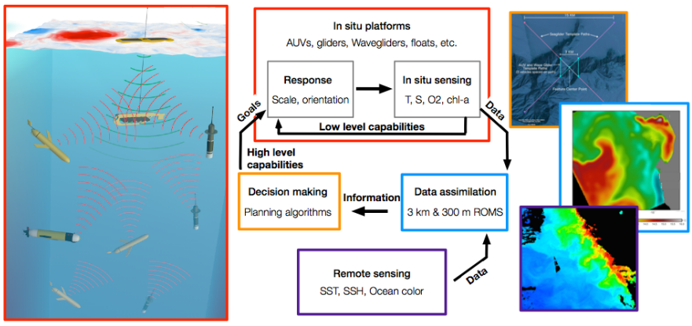
The data model loop: towards AI supervising the loop
Theory driven modeling
Theorie
Collecter des observations
Theorie
Provide hypotheses
Hypotheses
Hypotheses
Observations
Observations
Data driven modeling
Source : KISS , Caltech

Slide 13
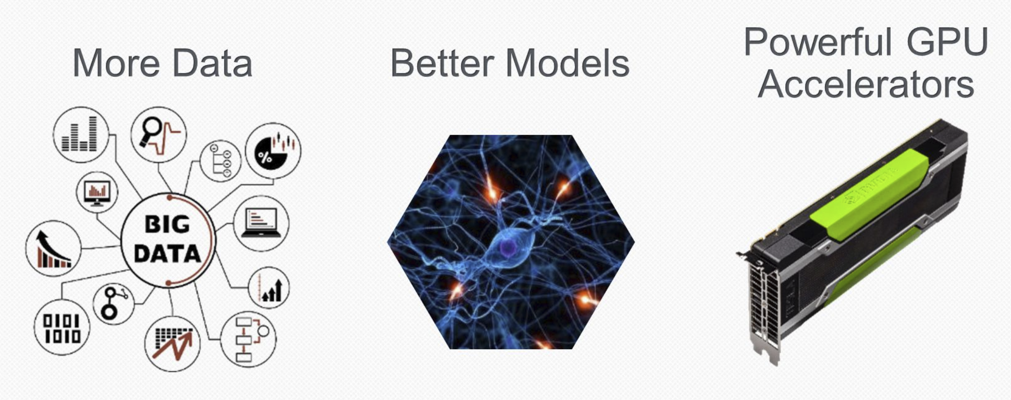

Main Drivers for AI: 3 + 1
YOU

Slide 14

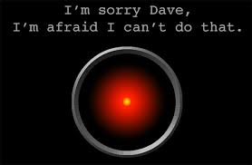
What AI is (?)
The broader concept of machines being able to carry out tasks in a way that we would consider “smart”.
Autonomous machine?
“Intelligent” machine?

Slide 15
Or not

Slide 16


Acknowledgements
Emily Smail, Univ. Maryland
Ronan Fablet, IMT Atlantique
Arnaud Gaillot, Ifremer
Stéphanie Mahevas, Ifremer
Fabio Scotti, University of Milan
Steve Ramage, GEO
Oceandatalab
CLS

