Slide 1
External Presentation

Slide 2
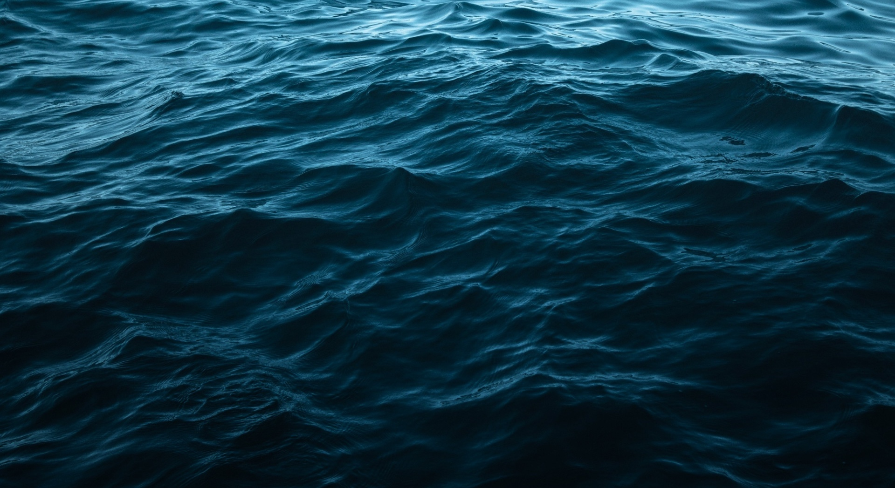
An independent, non-profit, non-compete foundation providing a data platform and associated services for a sustainable ocean
Vision: Liberating data for One Healthy Ocean
Mission: We connect data, people and technology to enable
a sustainable and productive ocean Values: Factual, Independent, Transparent
Product owner of: Ocean Data Platform (ODP)
Notes:
Initial discussion – revisit at end

Slide 3
Liberating data for one healthy ocean
"The clock is ticking on our collective responsibility to achieve the Sustainable Development Goals, and central to SDG 14 for a healthy ocean is the need to increase scientific knowledge and marine research capacity. Opening the bulk of ocean data, and making it available in a user-friendly, standardized and interoperable format, is a must for sustainable use of the ocean.
The Ocean Data Foundation will be a key contributor to making this happen. Friends of Ocean Action has been working with REV Ocean to bring an ocean data platform to fruition and I am excited to see it coming to life. This is excellent timing ahead of the UN Decade of Ocean Science for us to improve knowledge and understanding of the ocean – to give it the best chance of reaching a state of health, abundance and sustainable use. "
Ambassador Peter Thomson UN Secretary General’s Special Envoy for the Ocean and Co-Chair of Friends of Ocean Action

Slide 4
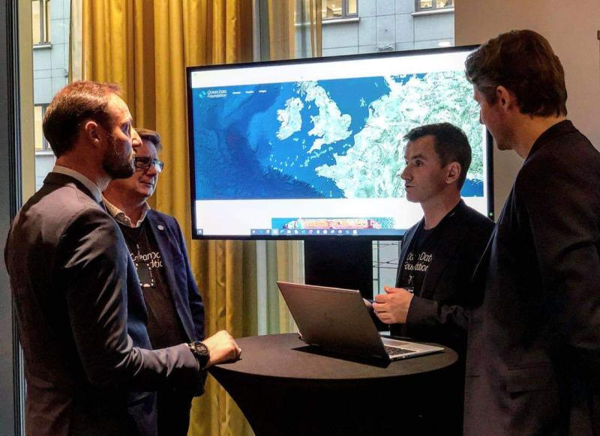
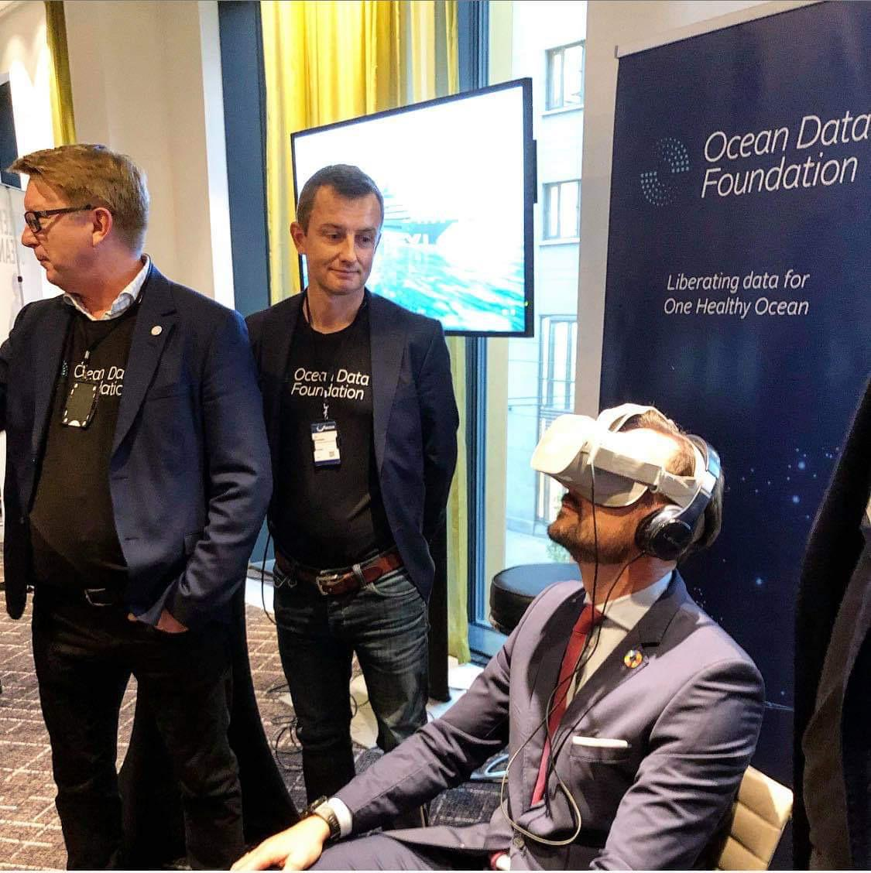
Launch at Our Oceans
HRH Crown Prince Haakon Magnus of Norway
Peter Thomson, UN Special Envoy
Craig McLean, NOAA Chief Scientist
Vladimir Ryabinin, Executive Secretary UNESCO IOC
Julian Barbière, Head Marine Policy UNESCO IOC
Paul Woods, CTO Global Fishing Watch
Kristian Teleki, Director WRI Sustainable
Oceans and Head Friends of Ocean Action
Vidar Helgesen, special representative
High Level Panel for Oceans

Slide 5
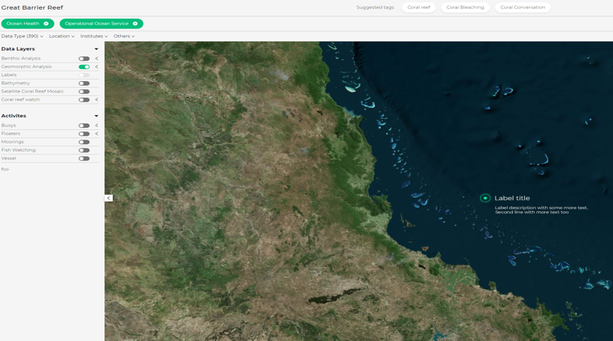
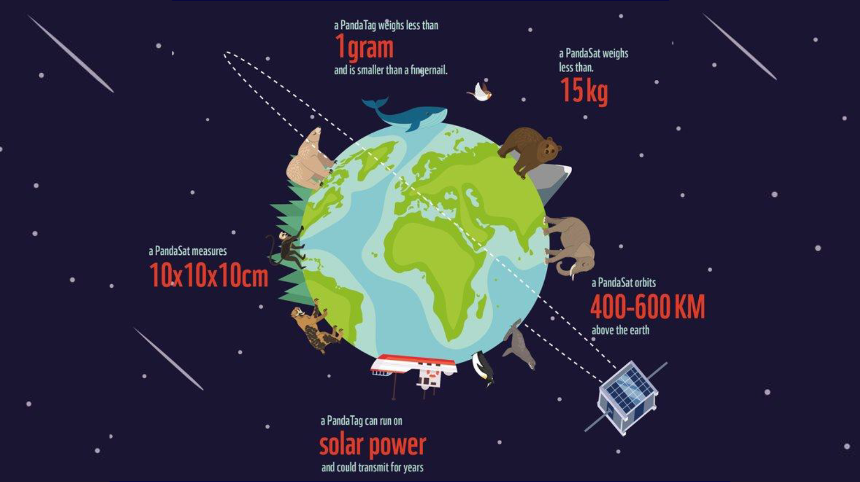
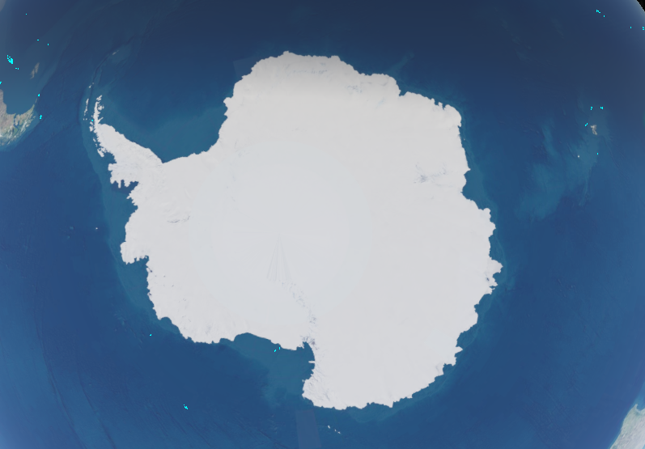
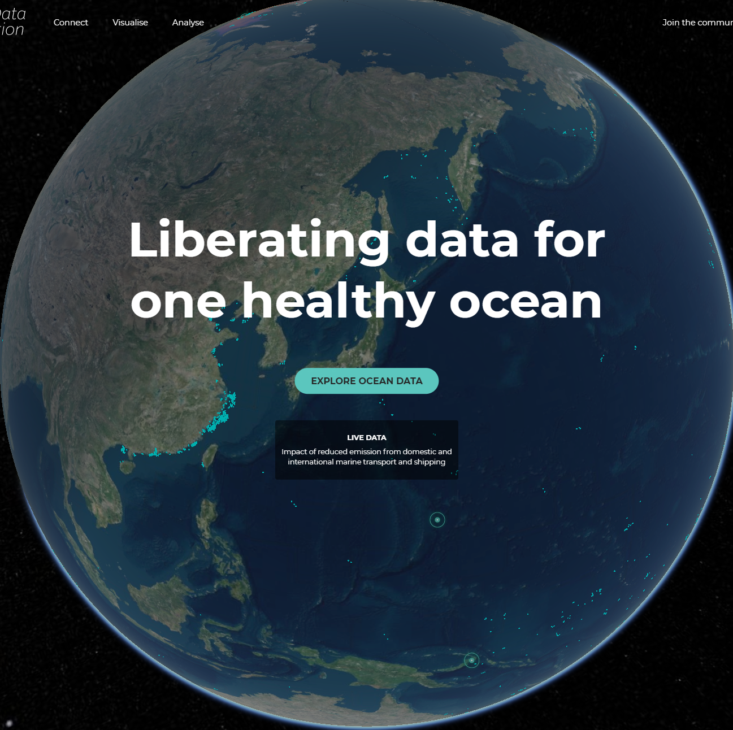
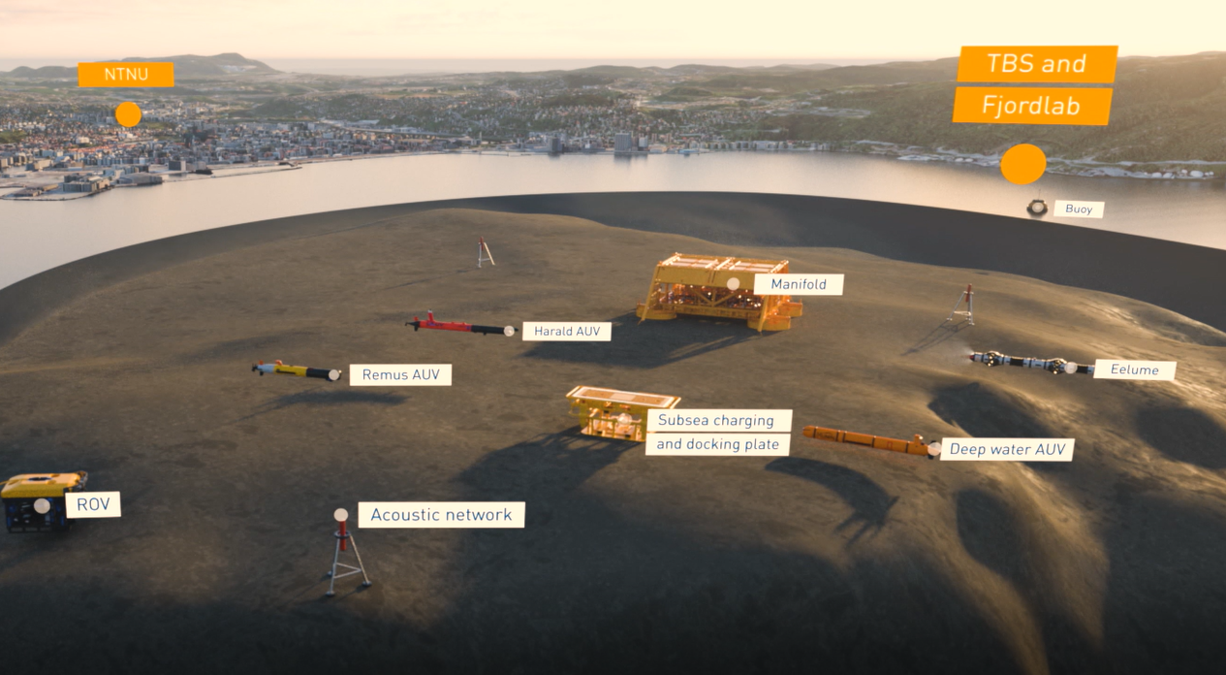
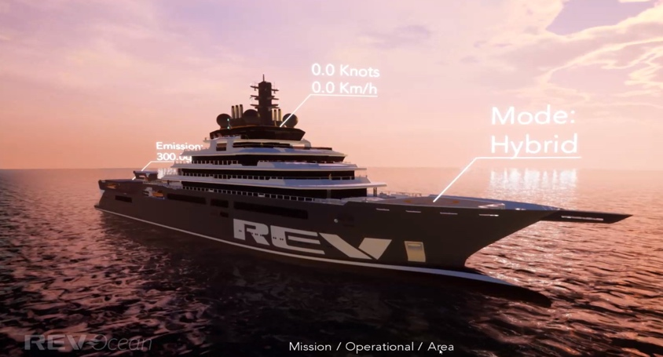
Use-cases - 5 prioritized use-cases currently being progressed
Revolutionize Monitoring to Protect Coral Reefs
Climate change- acidification
Sustainable krill fisheries reduced human impact in sensitive areas
Ghost gear tracking through cheap remote sensing
Pollution - plastic
Overfishing
Revolutionize access to and usefulness of ocean climate data in 4D
Fast actionable insight from autonomous underwater vehicles
Climate change
Visualizing REV capabilities and scoping future REV data solutions
Climate change
Plastic-overfishing-climate change
= REV Ocean focus

Slide 6
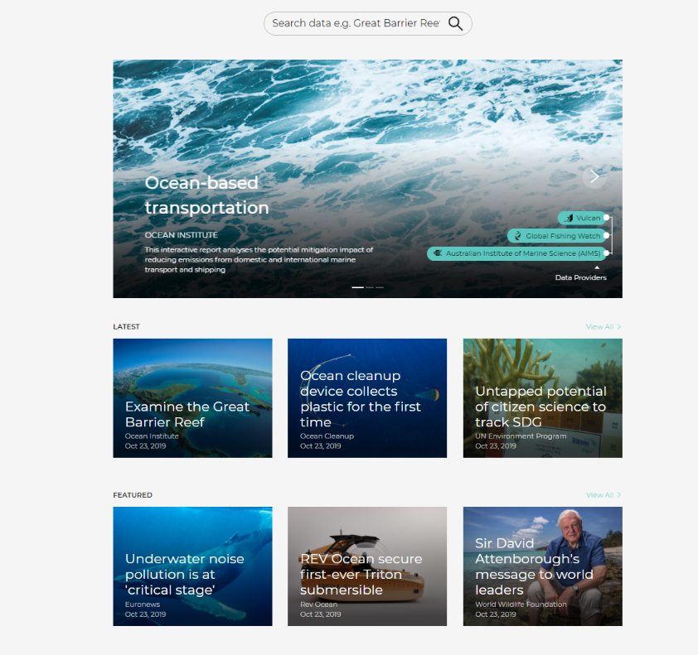
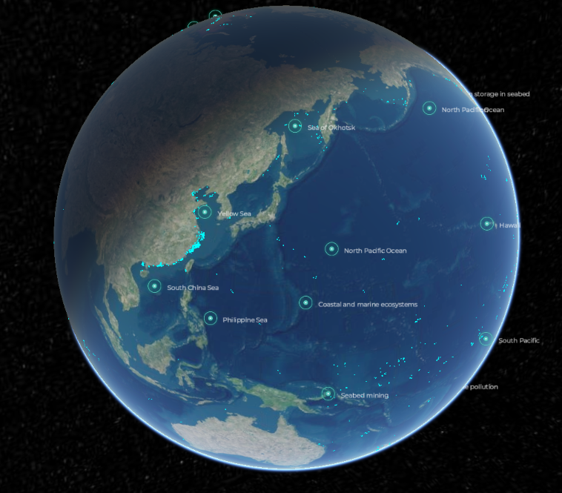
Navigate data from different angles

Slide 7
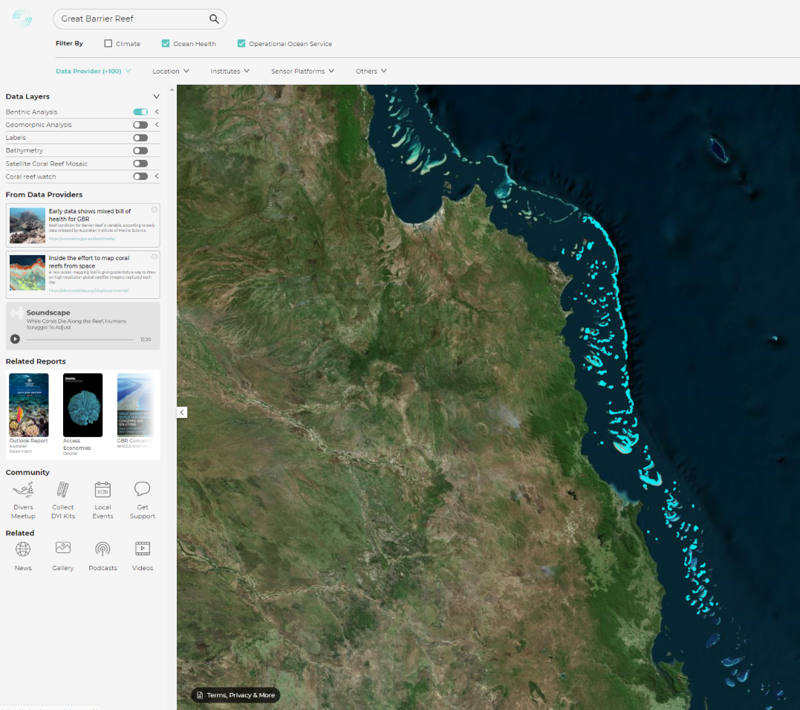
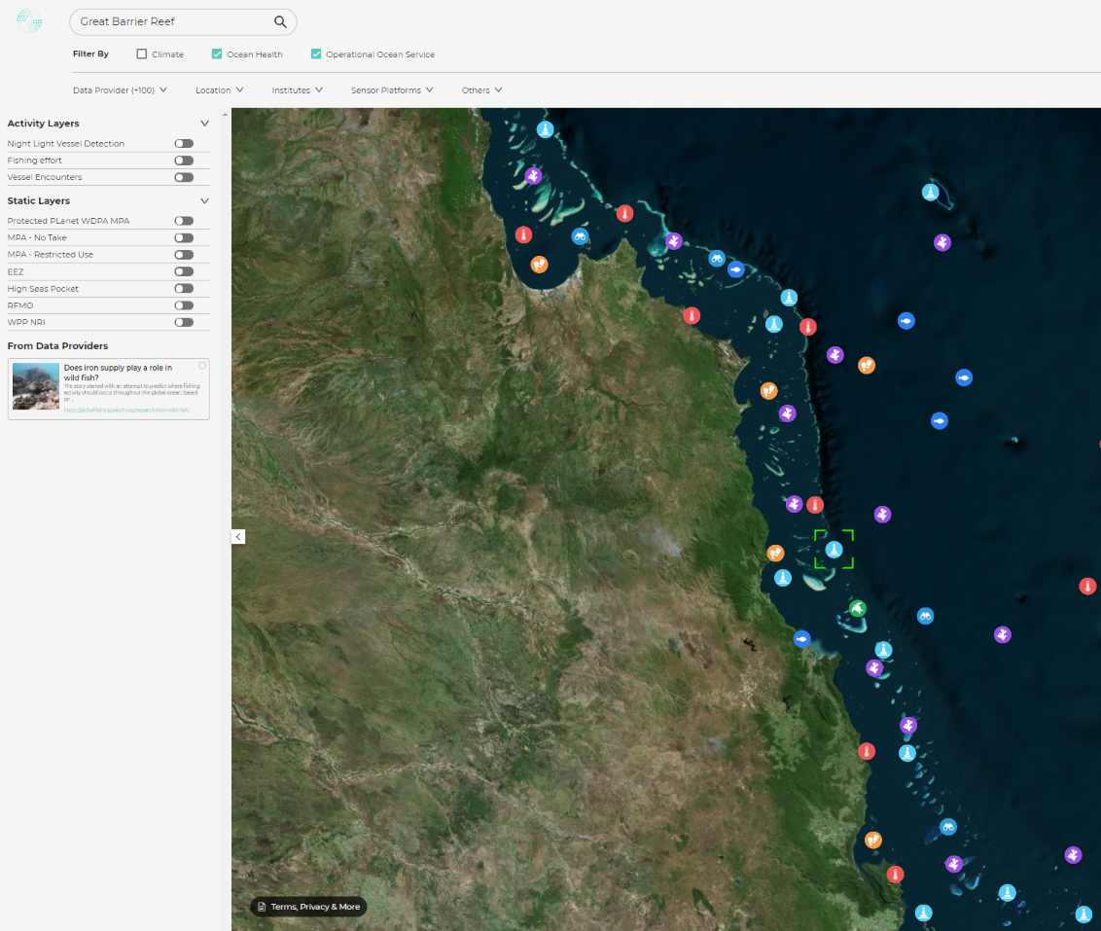
Zoom in to any location – Great Barrier Reef example

Slide 8
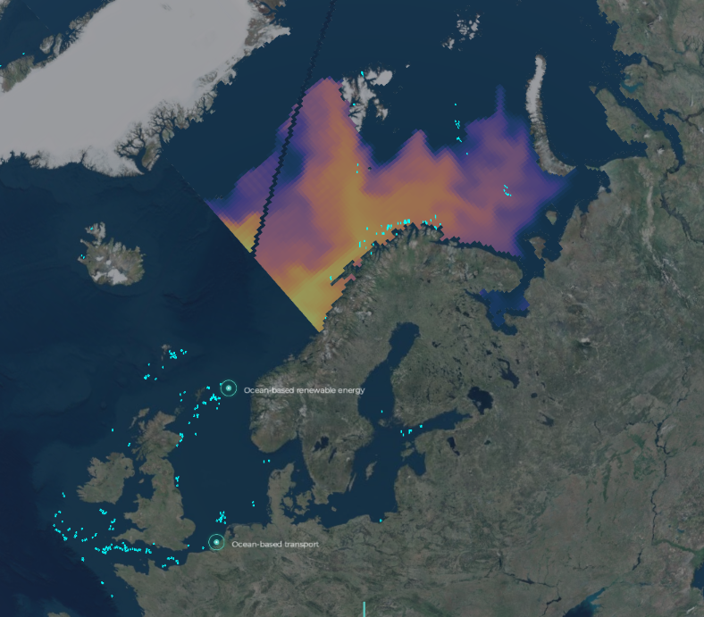
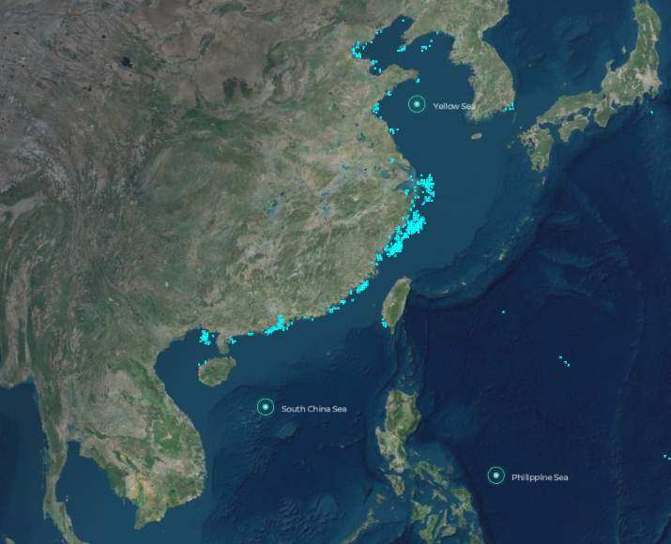
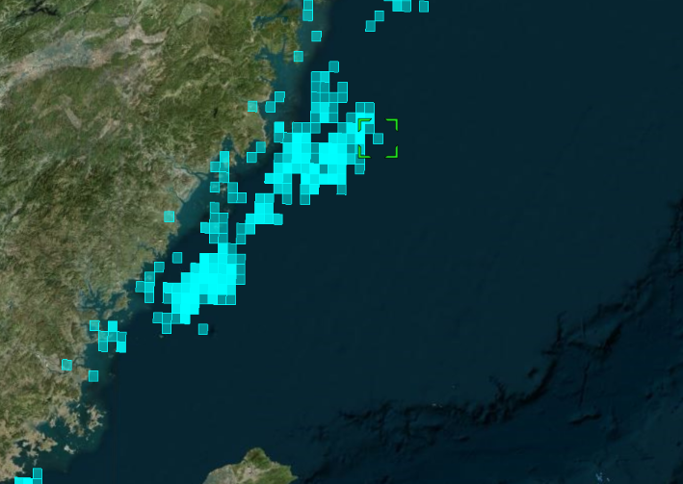
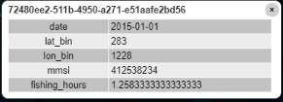
Zoom out to global datasets – Simulation and vessel tracking examples

Slide 9
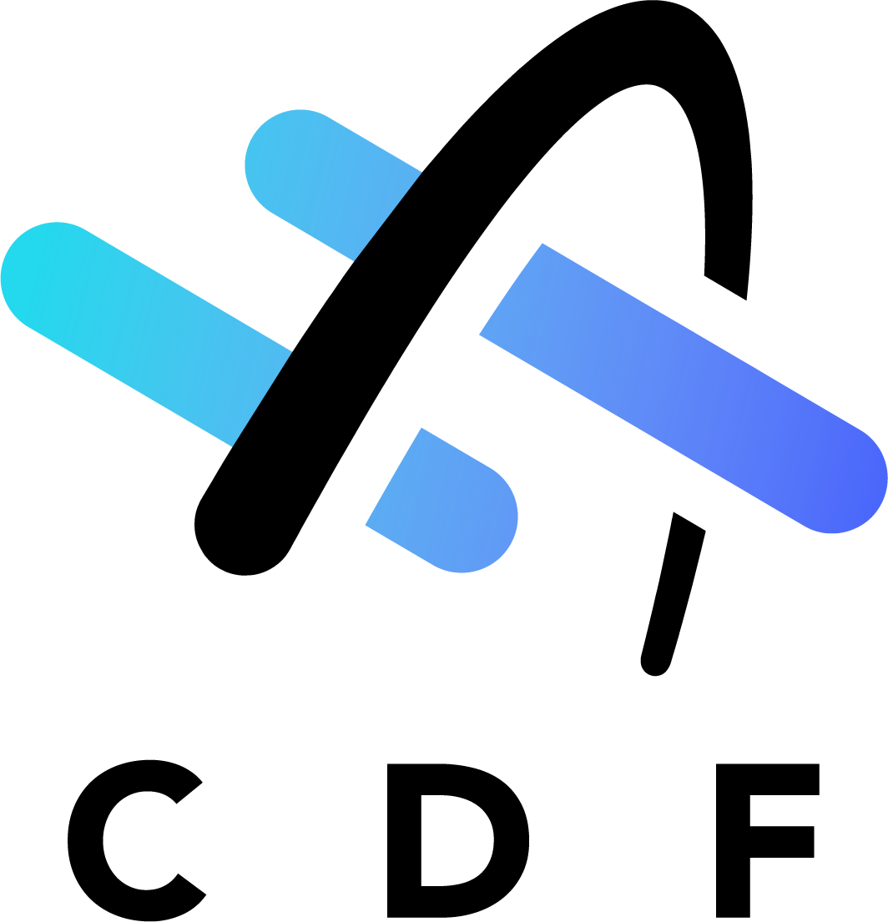
Blueprint architecture and capability roadmap
Ocean Data Platform (Azure)
Cognite Data Fusion (Google Cloud)
Web
Store, process, ingest
Cognite Data Fusion
ODP Applications
Public Data Sources
Data Store
Optimized Storage
ODP front-end
(Login / IAM, Editorial / CMS, Payment, Data Upload, Search)
CDF API
Contextualization
Data Ingestion Pipelines
3rd party applications
Private Data Sources
Connectors
CDF API
3rd party tools
Ocean Data Crawler
Cognite Asset Data Insight
Cognite Console
CDF API

Slide 10
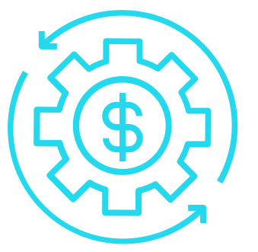
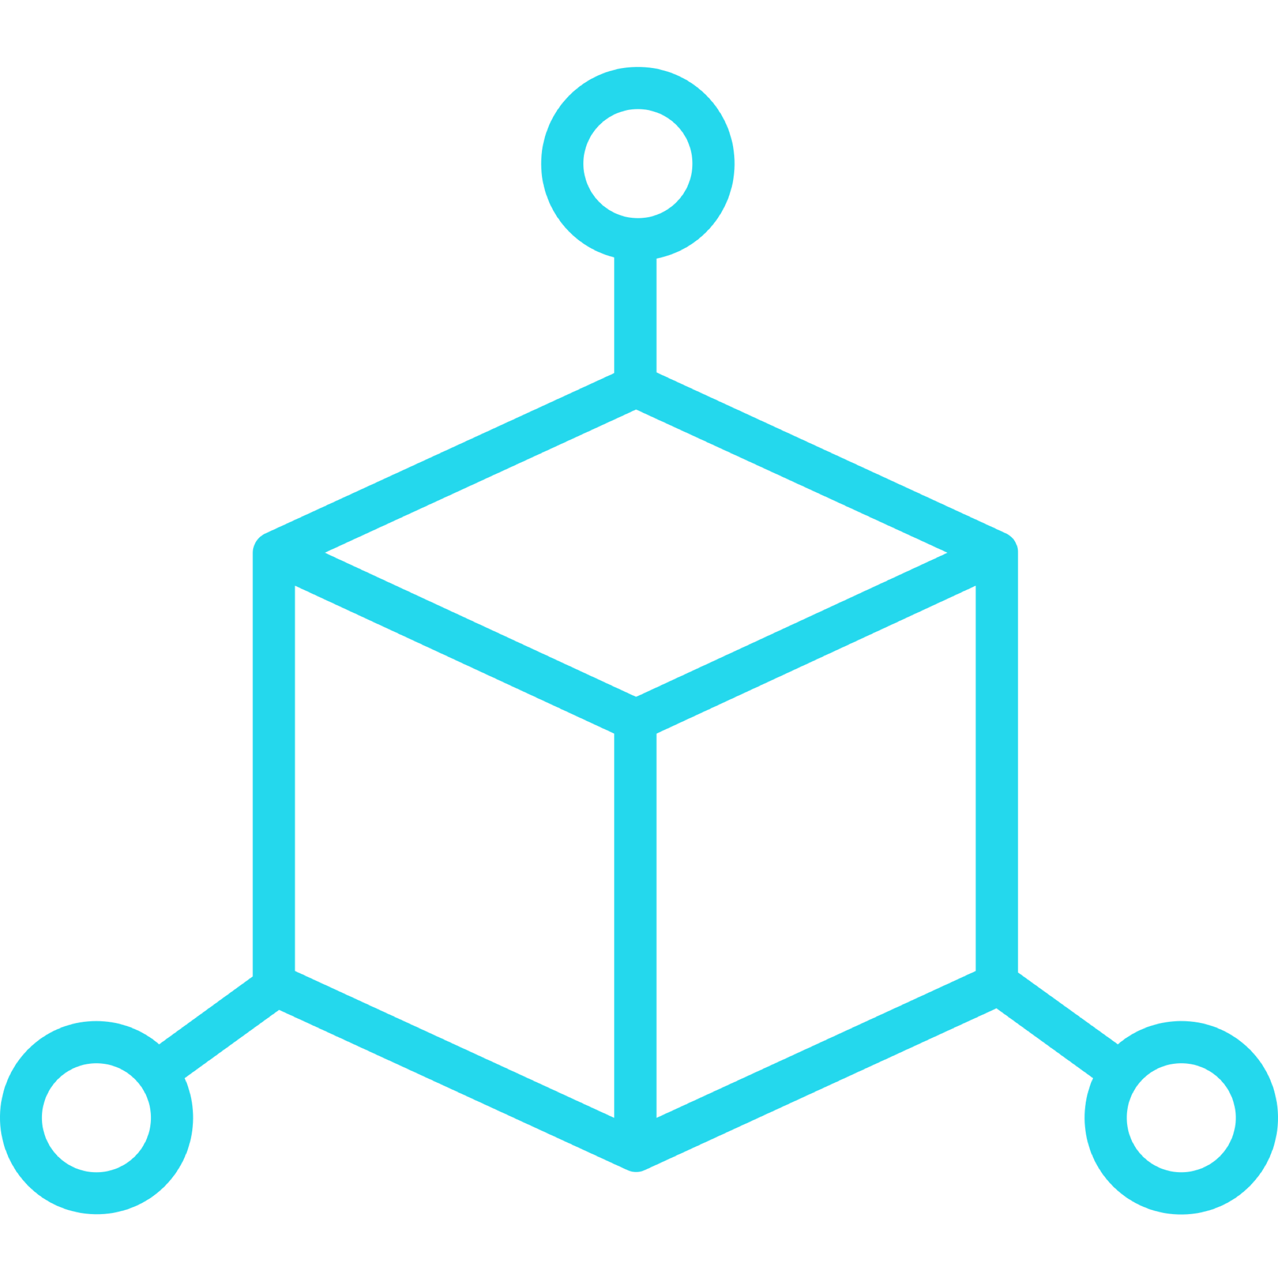
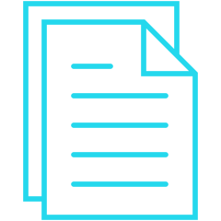
THE COGNITE RESOURCE TYPES
TIME SERIES AND SEQUENCES
EVENT
ASSET
3D
FILE

Slide 11
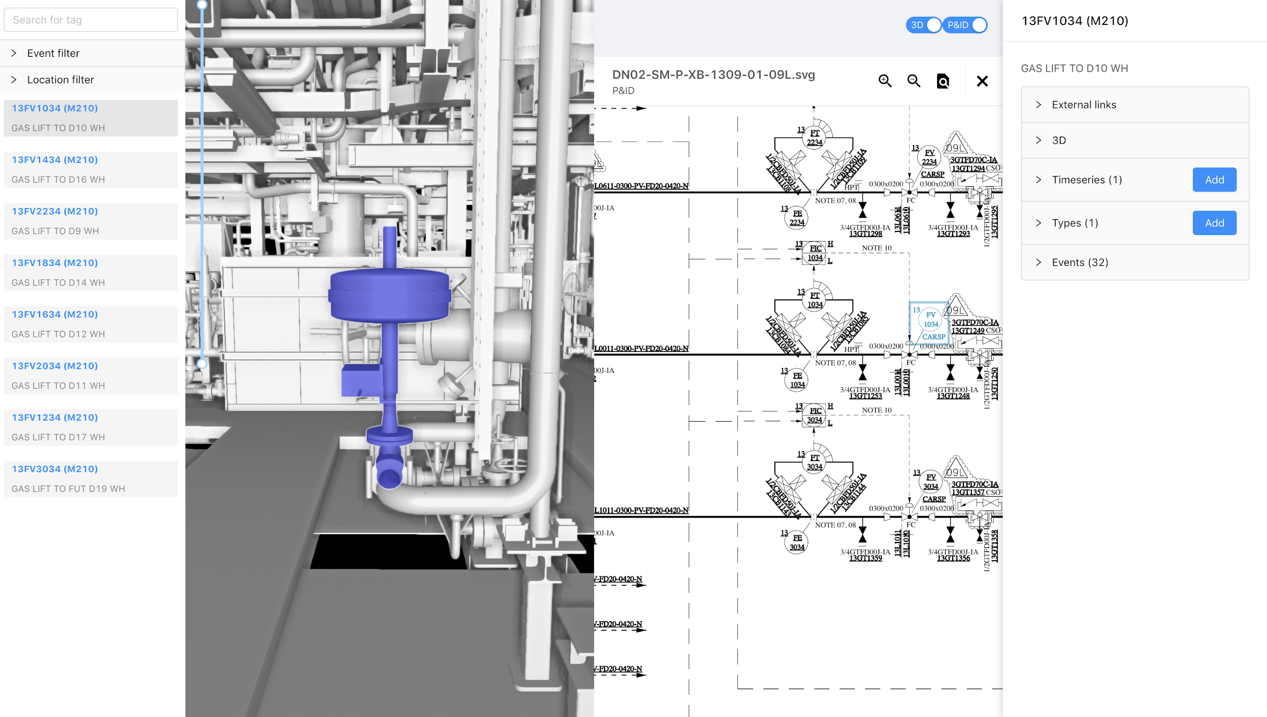
Digital Twin Explorer/ Asset Data Insights

Slide 12
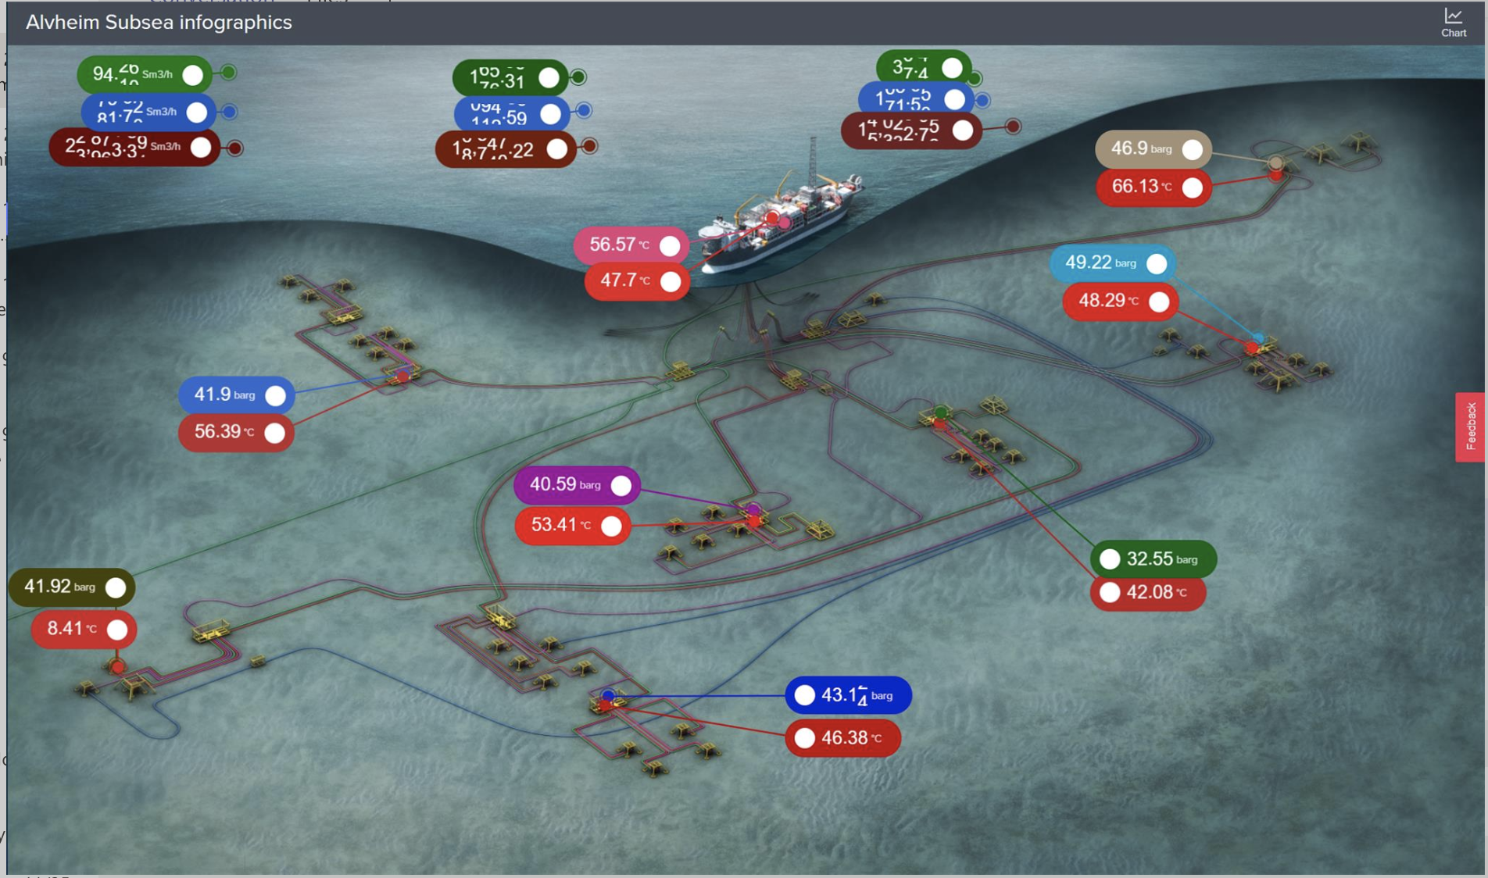

Slide 13
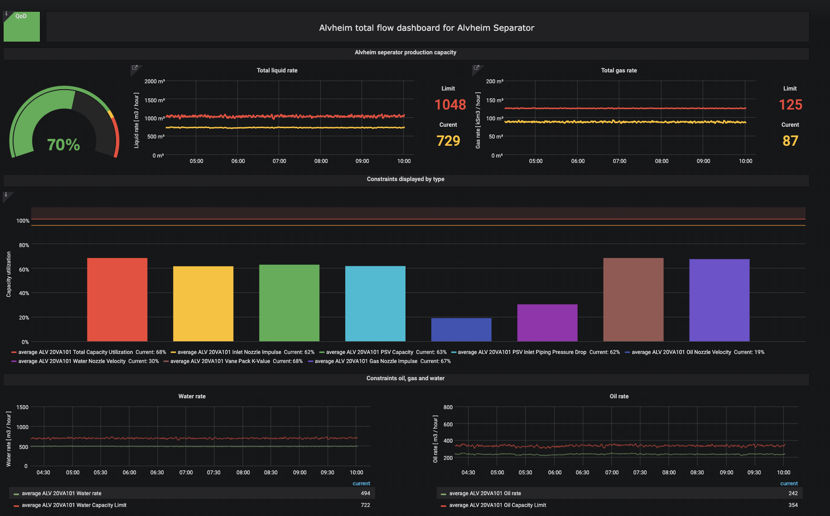

Slide 14
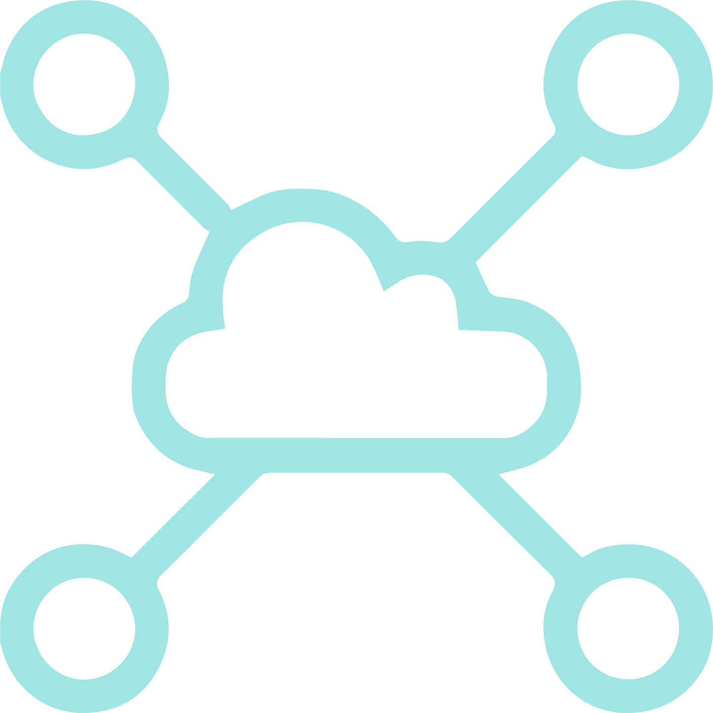
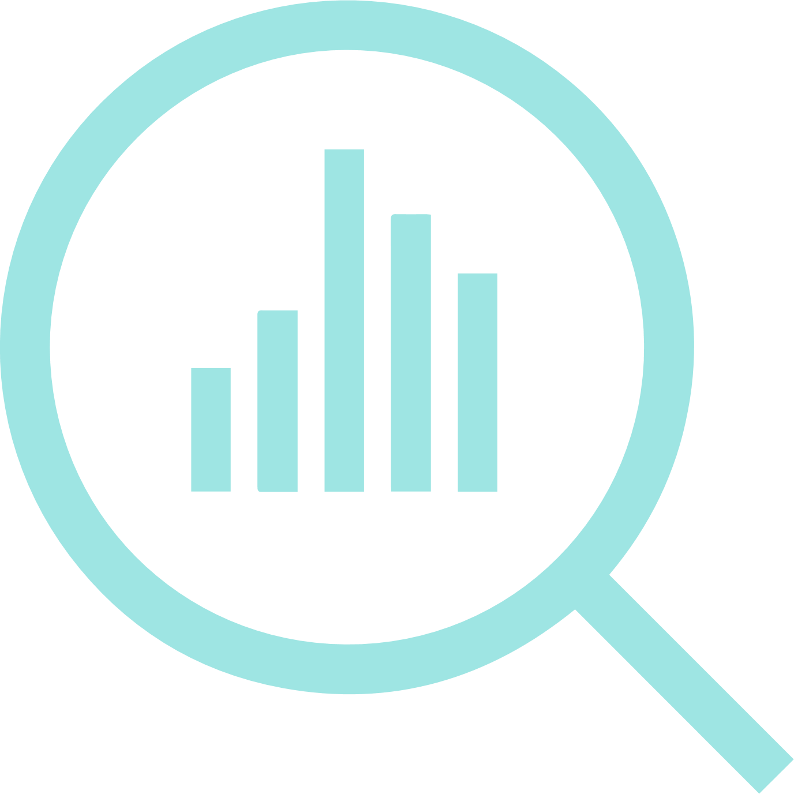
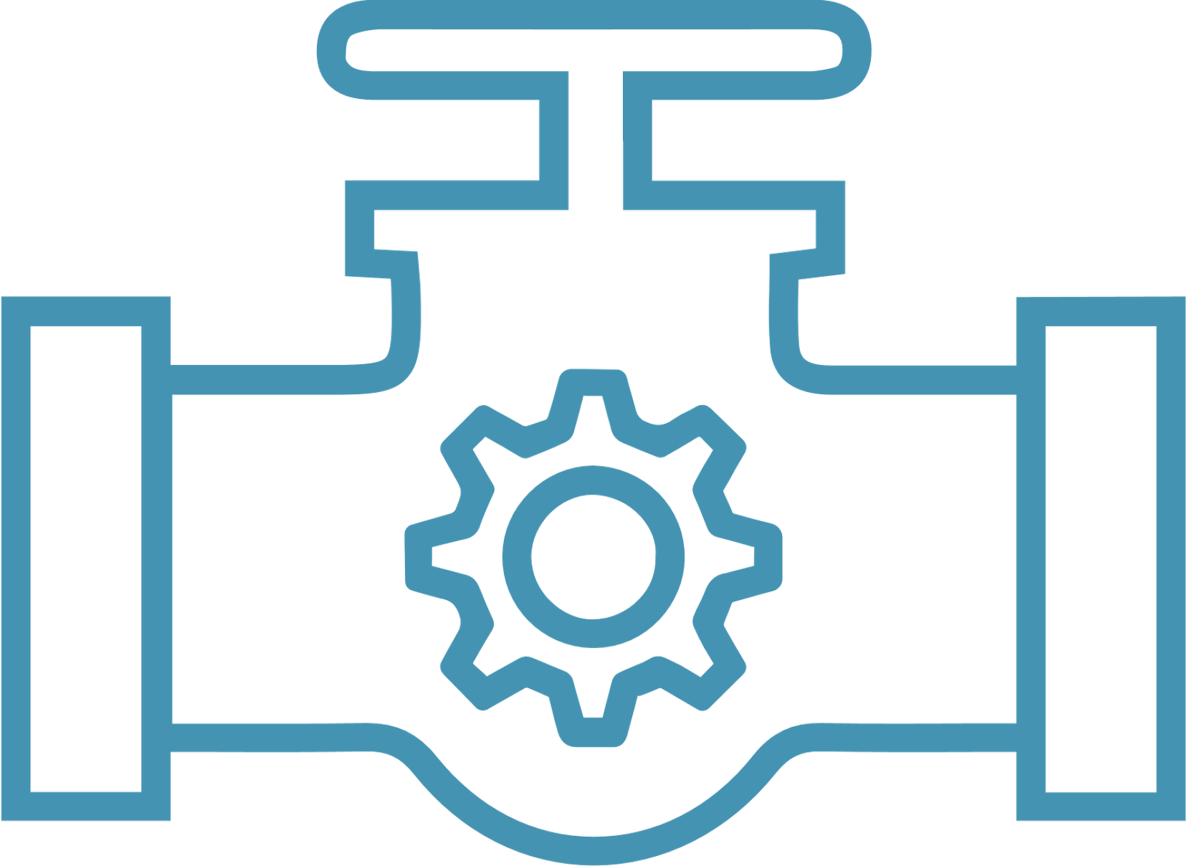
Platform Model & Value Creation
Typical Use Cases
Typical Consumer Types
Policy and Government
Academia and Science
Industry: Shipping, Food, Energy
Civil Society
Delivering value
Ocean conservation
Sustainable industry
Climate change adaptation
Ocean Data Platform
Powered by Cognite
The Platform
Connect data
Visualisation
Community
Solution store
Analytical services
Sources of data
Open data
Science data
Industrial data
Citizen data

Slide 15
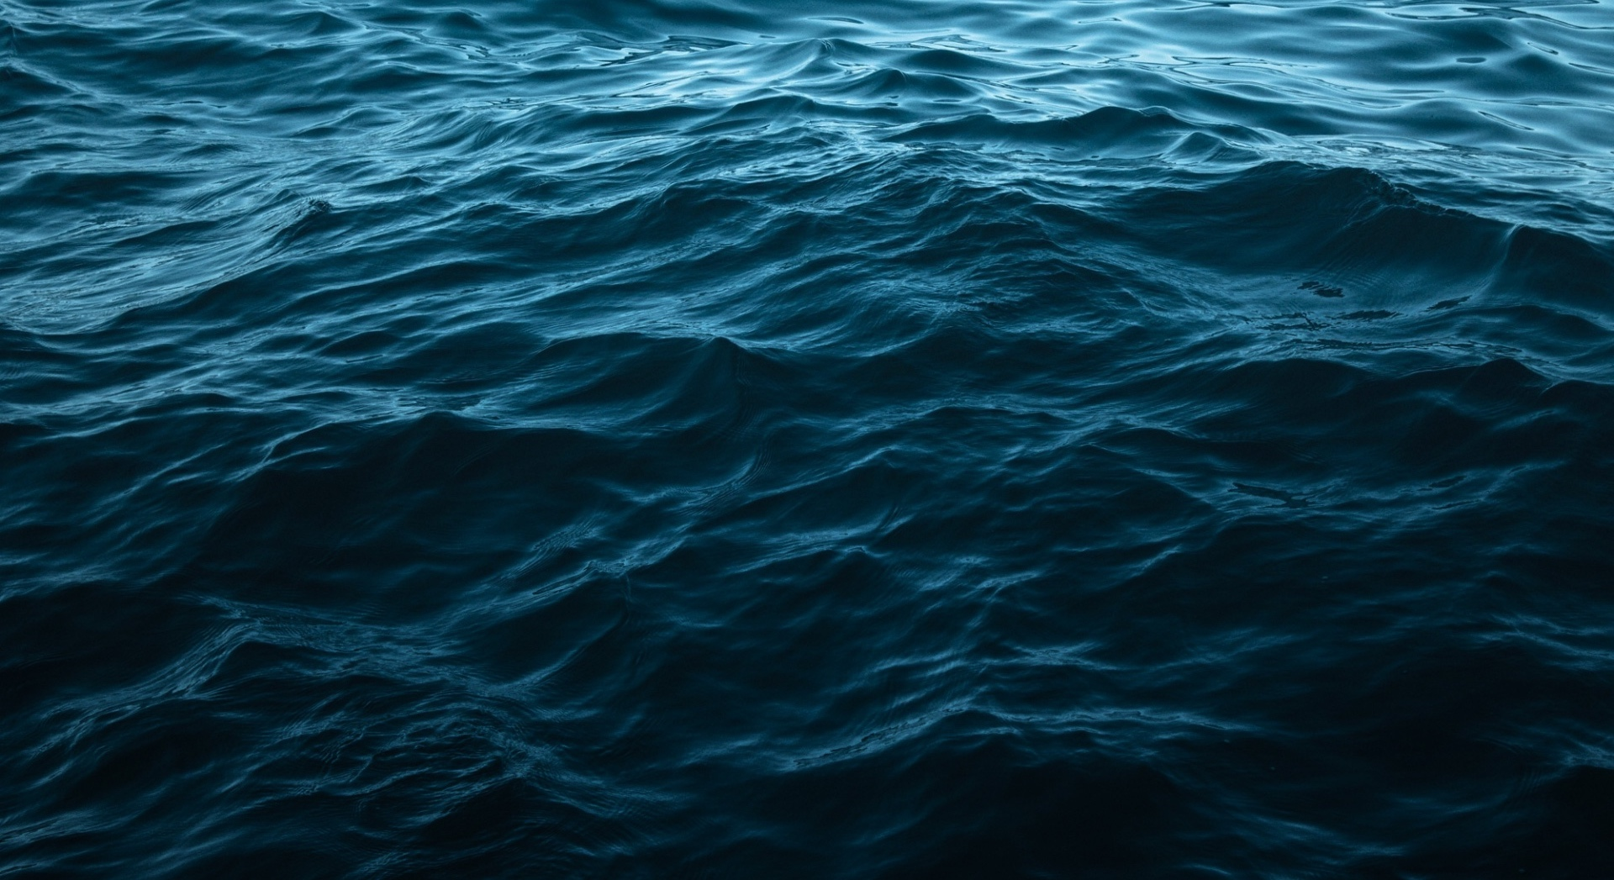
JOIN US TO
Liberate data for One Healthy Ocean!
www.oceandata.earth

