Slide 1






Biogeochemistry
Panel
Marine (Plastic) Debris as an
Essential Ocean Variable (EOV)
GOOS support for establishing global coordination of the Integrated Marine Debris Observing System (IMDOS)
Artur Palacz - IOCCP Project Officer, a.palacz@ioccp.org
Toste Tanhua - GOOS Co-Chair, ttanhua@geomar.de
Institute of Oceanology of Polish Academy of Sciences, ul. Powstańców Warszawy 55, 81-712 Sopot, Poland; Phone: +48 58 731 16 10 / Fax: +48 58 551 21 30, www.ioccp.org

Slide 2

offers the CAPACITY and RESOURCES to support a COLLABORATIVE effort to:
develop GLOBAL COORDINATION of an Integrated Marine Debris Observing System (IMDOS - Maximenko et al. 2019),
establish Marine (Plastic) Debris as a Human Pressure Essential Ocean Variable (EOV).
Institute of Oceanology of Polish Academy of Sciences, ul. Powstańców Warszawy 55, 81-712 Sopot, Poland; Phone: +48 58 731 16 10 / Fax: +48 58 551 21 30, www.ioccp.org

Slide 3


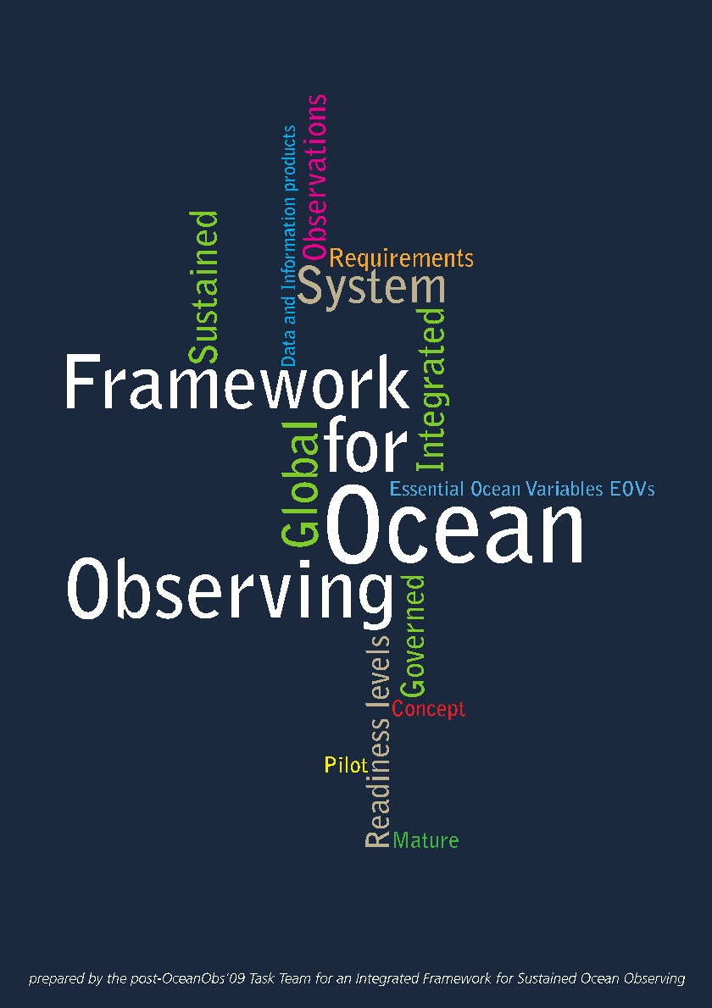




GOOS is a programme executed by the Intergovernmental Oceanographic Commission (IOC) of the UNESCO, but its success relies on the coordinated contributions of several people and organizations worldwide.
GOOS conforms to the methodology of the Framework for Ocean Observing (FOO).
FOO guides the ocean observing community as a whole to establish an integrated and sustained global observing system.
Sponsored by:

Slide 4

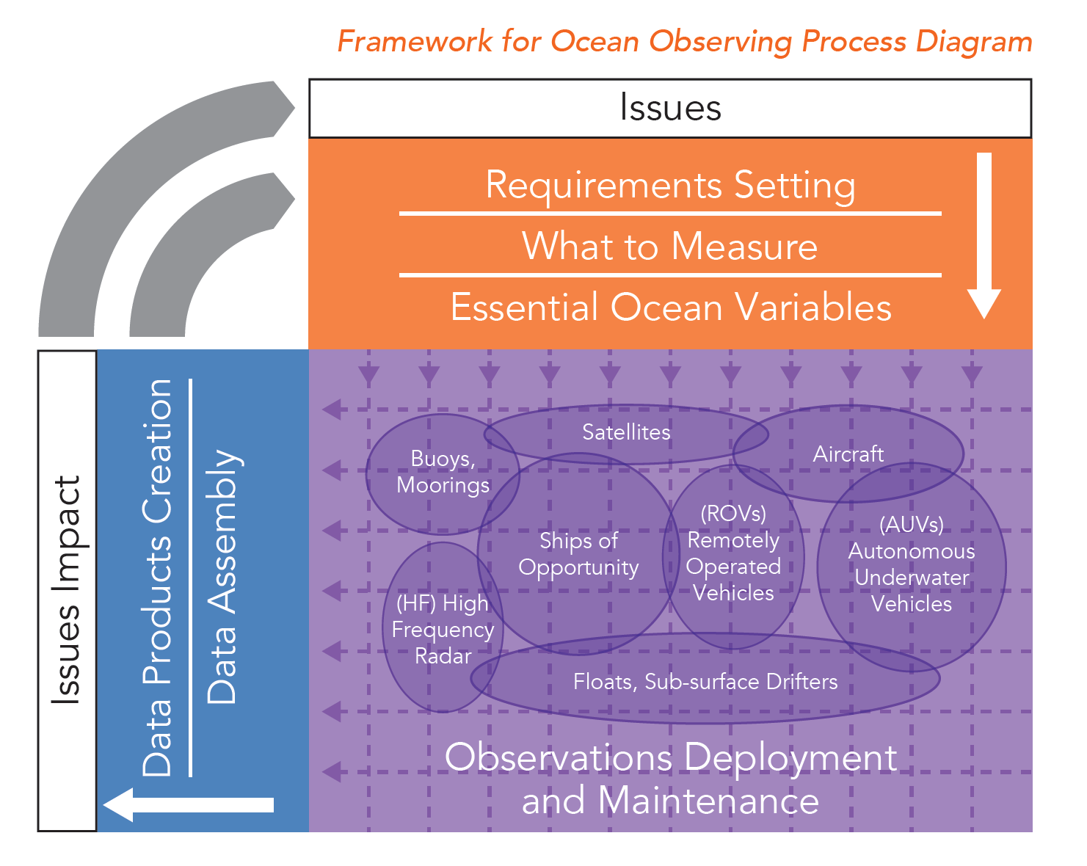
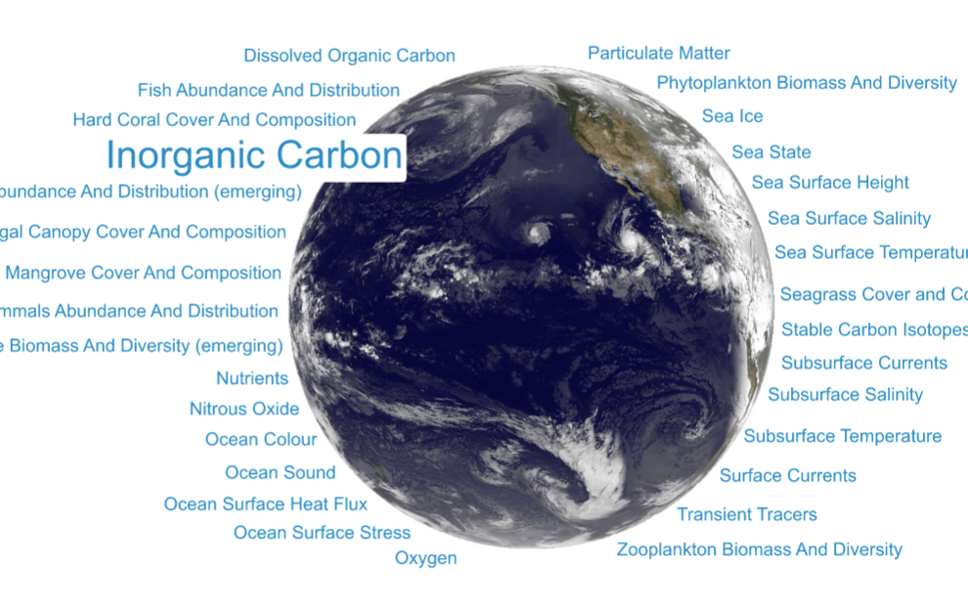
CAPACITY to implement the Framework for Ocean Observing using the concept of EOVs
Human Pressure Variables:
Marine (Plastic) Debris
www.ioccp.org/foo
EOVs
MATURE
PILOT
Increasing Readiness Levels
CONCEPT

Slide 5
Setting requirements for what to observe and how
Ex. Inorganic Carbon EOV
 |  |  | Resolution |  |  |  | Uncertainty |  | Application
EOV Sub-variable | Layer | Coverage | Spatial resolution: horizontal | Spatial resolution: vertical | Temporal resolution | Timeliness | Required measurement uncertainty | Phenomena
pH | subsurface ocean | global | 2000 km |  | decadal | 1 year | 0.003 | storage (carbon), ocean acidifcation
 |  |  |  |  |  |  |  |  | climate
 |  |  | 1000 km |  | seasonal | 6 months | 0.003
pH | subsurface ocean | coastal | 0.1-100 km |  | Weekly | weekly | 0.02 | ocean acidifcation | operational services
 |  |  |  |  |  |  |  |  | ocean health
 |  |  | 0.1-100 km |  | Daily | daily | 0.02
Threshold | The minimum requirement - the value that has to be met to ensure that data are useful.
Goal | The ideal requirement above which further improvements are not necessary. This is likely to evolve as applications and technologies progress.
Platform-independent, reflecting the needs of policy targets, scientific assessments, modelling comnunities, operational services –> broad and iterative consultation process

Slide 6
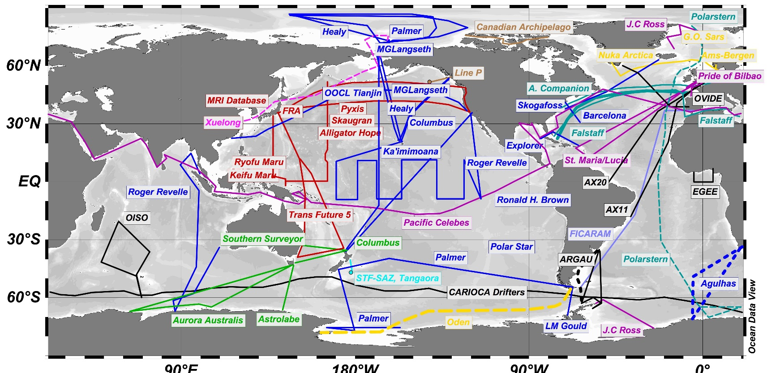



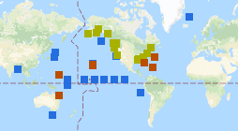

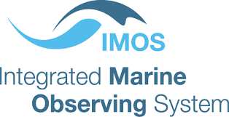

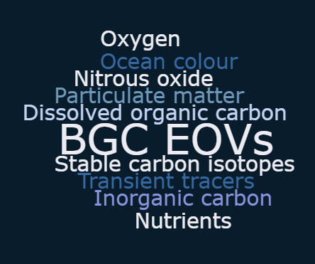
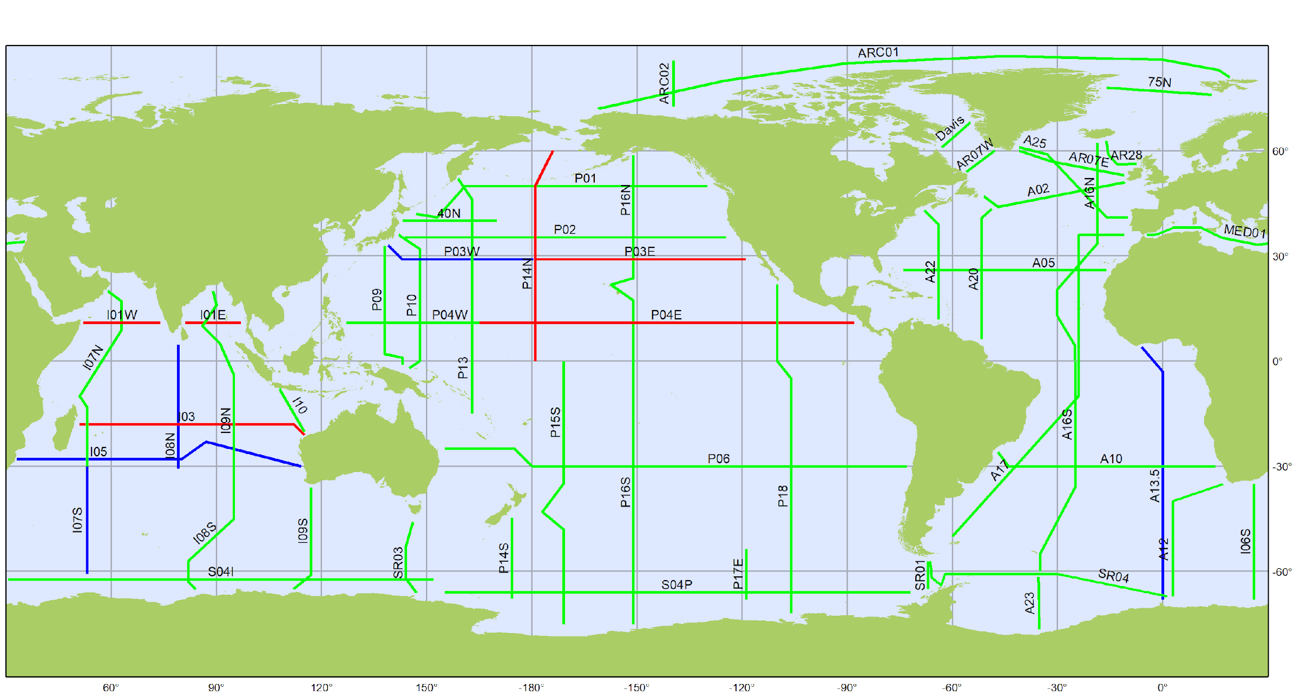

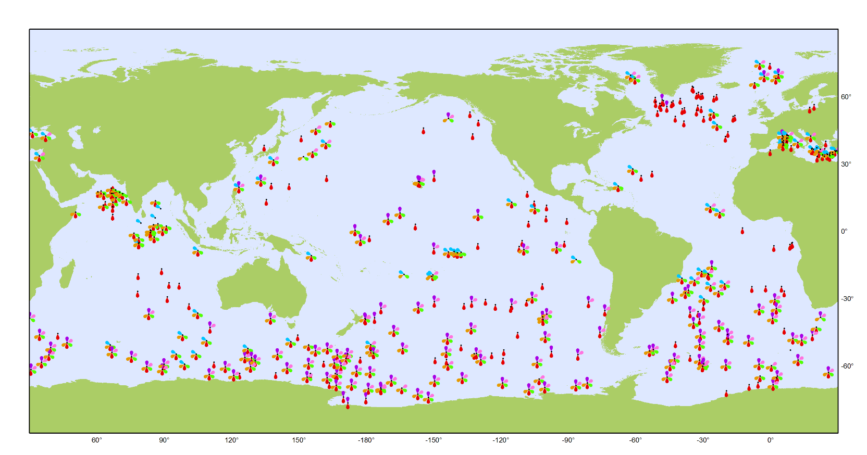


Knowing the status of multi-platform, EOV-based monitoring
Underway surface observations
Coastal observations status:
US IOOS, IMOS, ICOS, EMODnet, GOA-ON, ...
Moorings
www.ioccp.org/surface-co2-obs-home & www.socat.info
Moorings with pCO₂ measurements in open ocean, coastal and coral reef settings. From: US NOAA PMEL https://www.pmel.noaa.gov/co2/story/CO2+Data+Discovery
GO-SHIP Repeat Hydrography lines
Profiling floats
www.ioccp.org/foo
Can the system be co-designed?
2012-2023 Survey Lines
completed
funded
not planned
www.biogeochemical-argo.org
Status in Aug 2019
Status in Aug 2019
www.go-ship.org
& www.glodap.info
O₂, nitrate, pH, Chl-a, suspended particles, downwelling irradiance

Slide 7
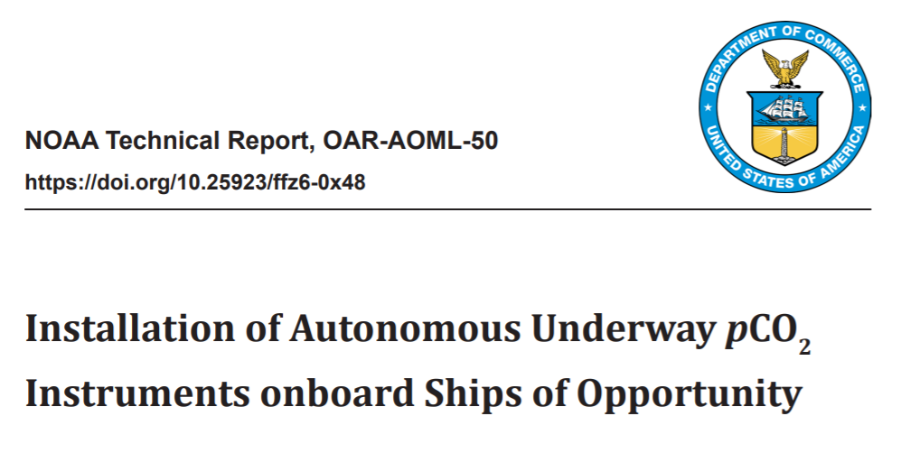
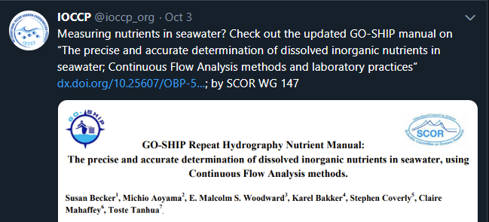


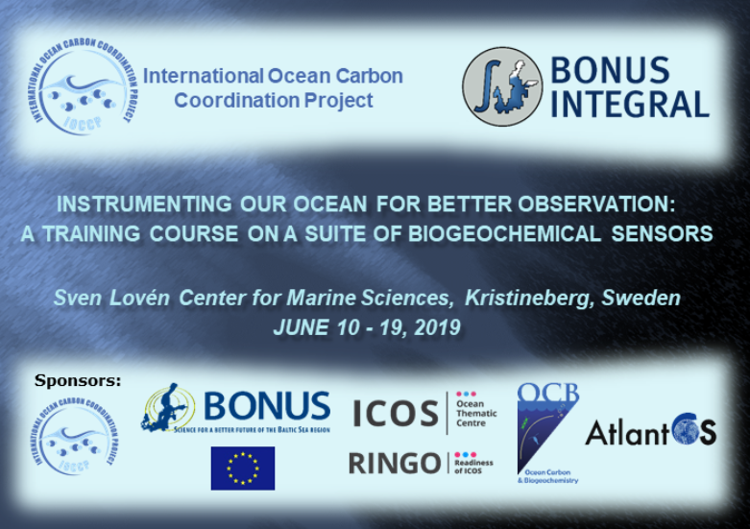
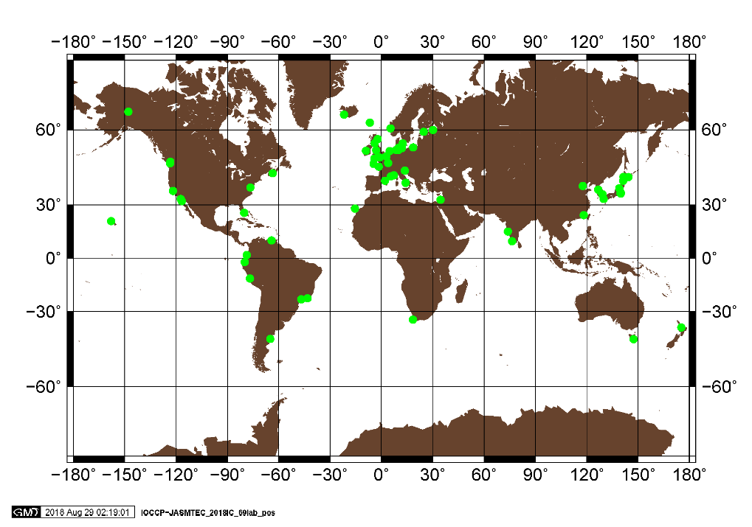


Standards, best practices, intercomparisons, technical training, ...
Revised GO-SHIP Repeat Hydro Nutrient Manual
IOCCP-JAMSTEC 2018 Inter-laboratory Comparison Exercise of a Certified Reference Material (CRM) for Nutrients in Seawater
Download from: http://dx.doi.org/10.25607/OBP-555
http://www.ioccp.org/images/D4standards/NOAA-Technical-Report_OAR-AOML-50.pdf
Global map showing the distribution of 69 laboratories from 30 countries/territories participating in the IOCCP-JAMSTEC 2018 Inter-laboratory Calibration Exercise of a Certified Reference Material of Nutrients in Seawater.
http://www.ioccp.org/index.php/nutrients
www.ioccp.org/training

Slide 8


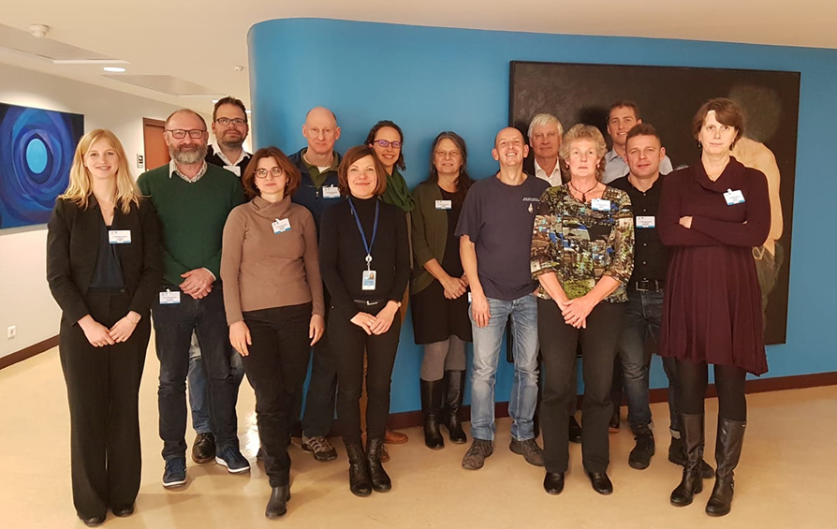


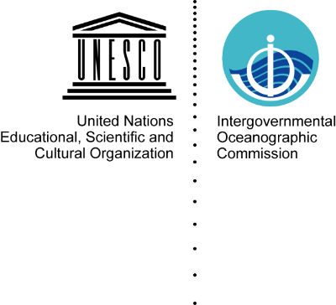
SDG Target 14.3: Minimize impacts of ocean acidification
Indicator 14.3.1: Average marine acidity (pH) measured at agreed suite of representative sampling stations
Contributed to the development of the methodology, approved by the IOC-UNESCO Executive Council.
The process considered:
Definitions,
Sampling approach,
Guidelines for measurements
Data collection process,
Data quality control,
Data analysis,
Data visualization
Data Reporting!!!

Slide 9
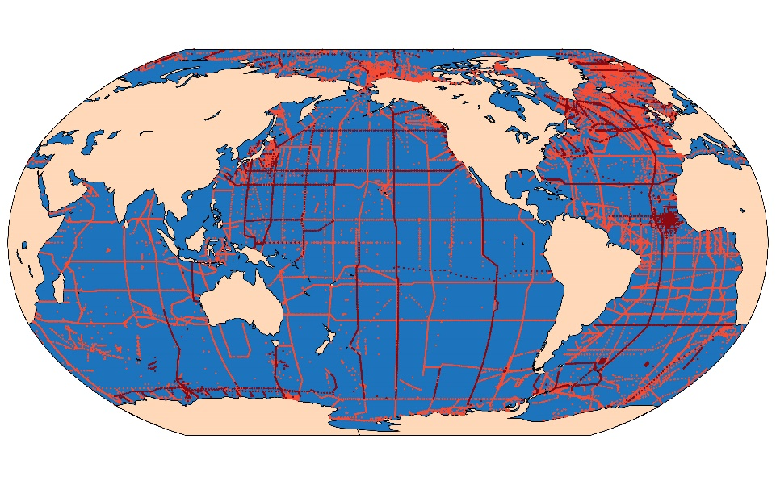
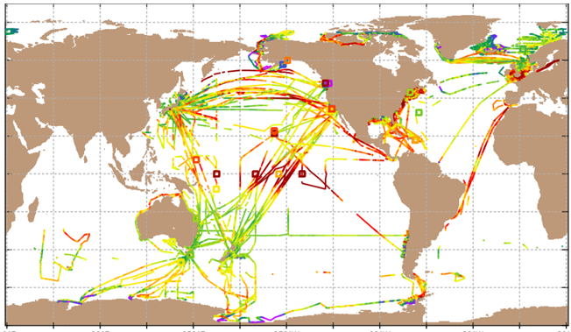
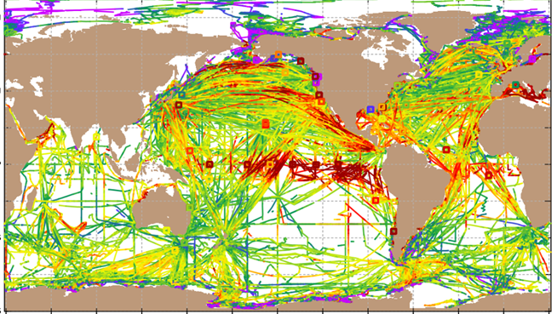
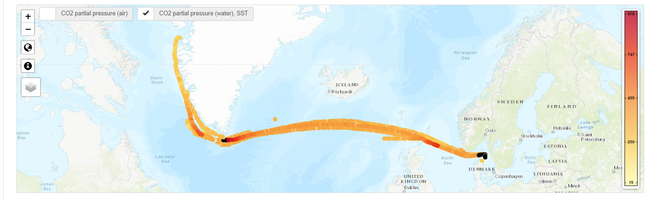
Inorganic Carbon EOV data products
Global Ocean Data Assimilation Project (GLODAP)
Release of GLODAPv2.2019 during 1st AtlantOS International Symposium
Data from 116 new cruises have been added and small errors in the previous GLODAPv2 data product have been corrected.
840 cruises, > 1.1 million Niskin bottle sample analyses, from 1972 through 2017
More at www.glodap.info
Location of samples include in GLODAPv2.2019
Surface Ocean CO₂ Atlas (SOCAT)
Release of SOCAT version 2019 in June 2019.
25.7 million QC surface ocean fCO₂ data from 1957 to 2018.
Still without sustained funding
More at www.socat.info
Data included in SOCAT version 2019 from 2018 (left) and all years (right).
First Near-Real Time pCO₂ data available from EU Research Infrastructure Integrated Carbon Observing System (ICOS) - Ocean Thematic Centre (OTC)
ICOS Carbon Portal: https://www.icos-cp.eu/
More at: https://tinyurl.com/y5qv7mnj
ICOS OTC NRT Product from M/S Nuka Arctica, 2019-04-24 – 2019-09-26

Slide 10
Inorganic Carbon EOV
Specification Sheet (excerpt)
www.goosocean.org/eov
Requirements partially based on characteristic scales and signals change of phenomena observed.

Slide 11
Inorganic Carbon EOV
Specification Sheet (excerpt)

Slide 12
Inorganic Carbon EOV
Specification Sheet (excerpt)

Slide 13
Inorganic Carbon EOV
Specification Sheet (excerpt)

Slide 14
RESOURCES for GLOBAL COORDINATION of sustained observations of marine plastic debris
EU H2020 EuroSea project (2019-2023)
Improving and Integrating European Ocean Observing and Forecasting Systems for Sustainable use of the Oceans
Coordinator: Toste Tanhua (GEOMAR, Germany; GOOS Co-Chair)
Goal: Establish global coordination of sustained observations of Marine Plastic Contaminants as a Human Pressure EOV; bringing together experts and leading authorities focused on marine debris and initiatives involved in monitoring, sensor development, and assessments (e.g. GESAMP WG40, UN Environment, GEO Blue Planet, SCOR WG FLOTSAM, EMODnet, HELCOM, JPI Oceans, ESA, ...).
This task contributes to the implementation of a vision for Integrated Marine Debris Observing System (IMDOS) laid out by Maximenko et al. (2019; OceanObs’19 CWP).

Slide 15
RESOURCES for GLOBAL COORDINATION of sustained observations of marine plastic debris
Planned outcomes:
      Develop a standard sampling protocol for marine debris monitoring
      Lack of standard methodologies applied as a critical stumbling block to the proposed Global Platform (Smail et al.) and IMDOS (Maximenko et al.)
      Building on existing international and regional guidelines and protocols (e.g. UN Environment, GESAMP, MSFD Task Team, HELCOM)
      Exact scope (compartments, size fractions, in situ, remote sensing) to be discussed, also at this workshop
      Consideration of impact and feasibility of global application of available methods
      Outcomes applicable globally

Slide 16
RESOURCES for GLOBAL COORDINATION of sustained observations of marine plastic debris
Planned outcomes:
      Develop a Marine Plastics EOV Specification Sheet
          Similar efforts already being performed for „complex” EOVs, such as Ocean Colour and Ocean Sound.
          Wide and iterative input from international experts on: (i) requirement setting, (ii) coordinated observing efforts, and (iii) data management and information product development.
          Requirement setting process involving policy makers, monitoring agencies, modellers and researchers in general
          Long-term process. First version to be available by end of 2023.
          EOV Specification Sheet as a living document.

Slide 17
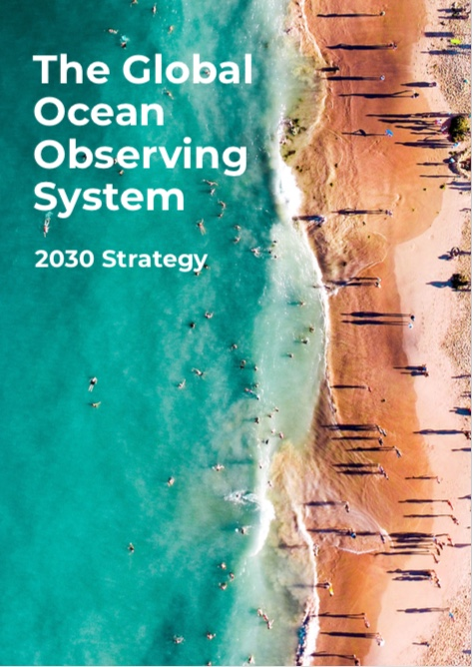
Strengthen PARTNERSHIPS for delivery of services to end users
Fully integrated 2030 ocean observing system providing the critical ocean information needed to address climate change, generate forecasts, protect ocean health and support sustainable growth, and with new partnerships and world-wide participation.
We are here to listen and engage as partners to support the community efforts towards integrated marine debris monitoring.
Institute of Oceanology of Polish Academy of Sciences, ul. Powstańców Warszawy 55, 81-712 Sopot, Poland; Phone: +48 58 731 16 10 / Fax: +48 58 551 21 30, www.ioccp.org

Slide 18
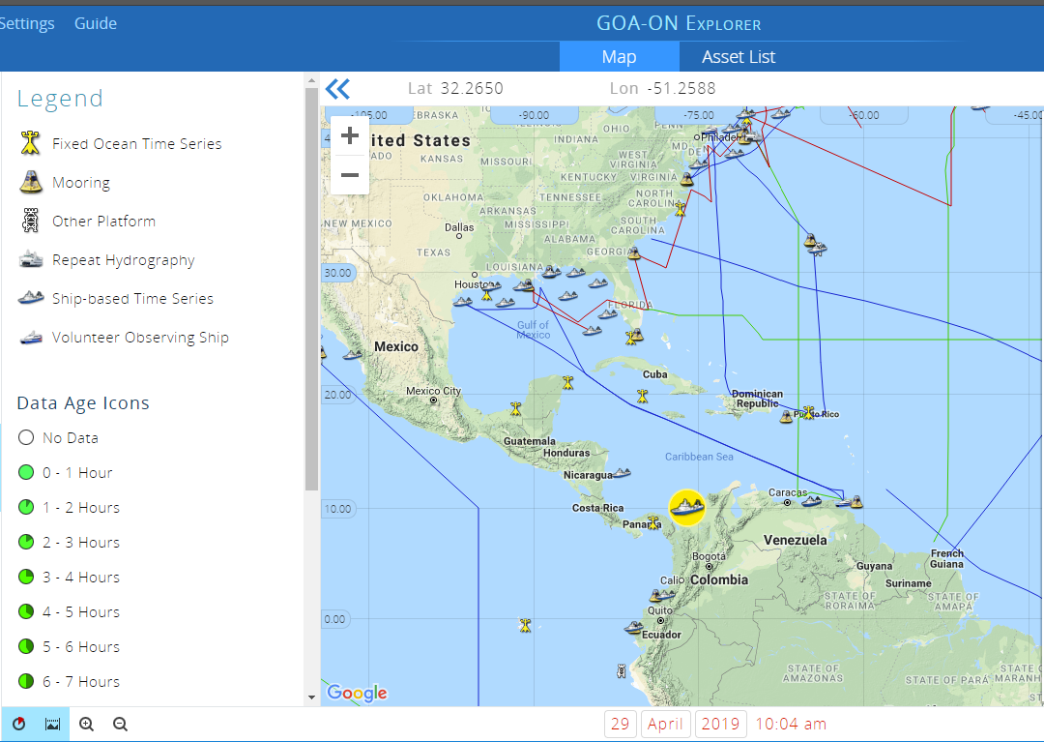



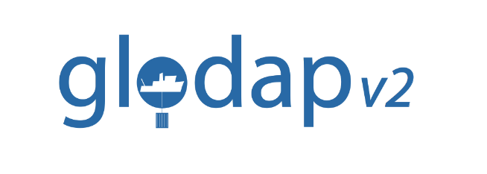
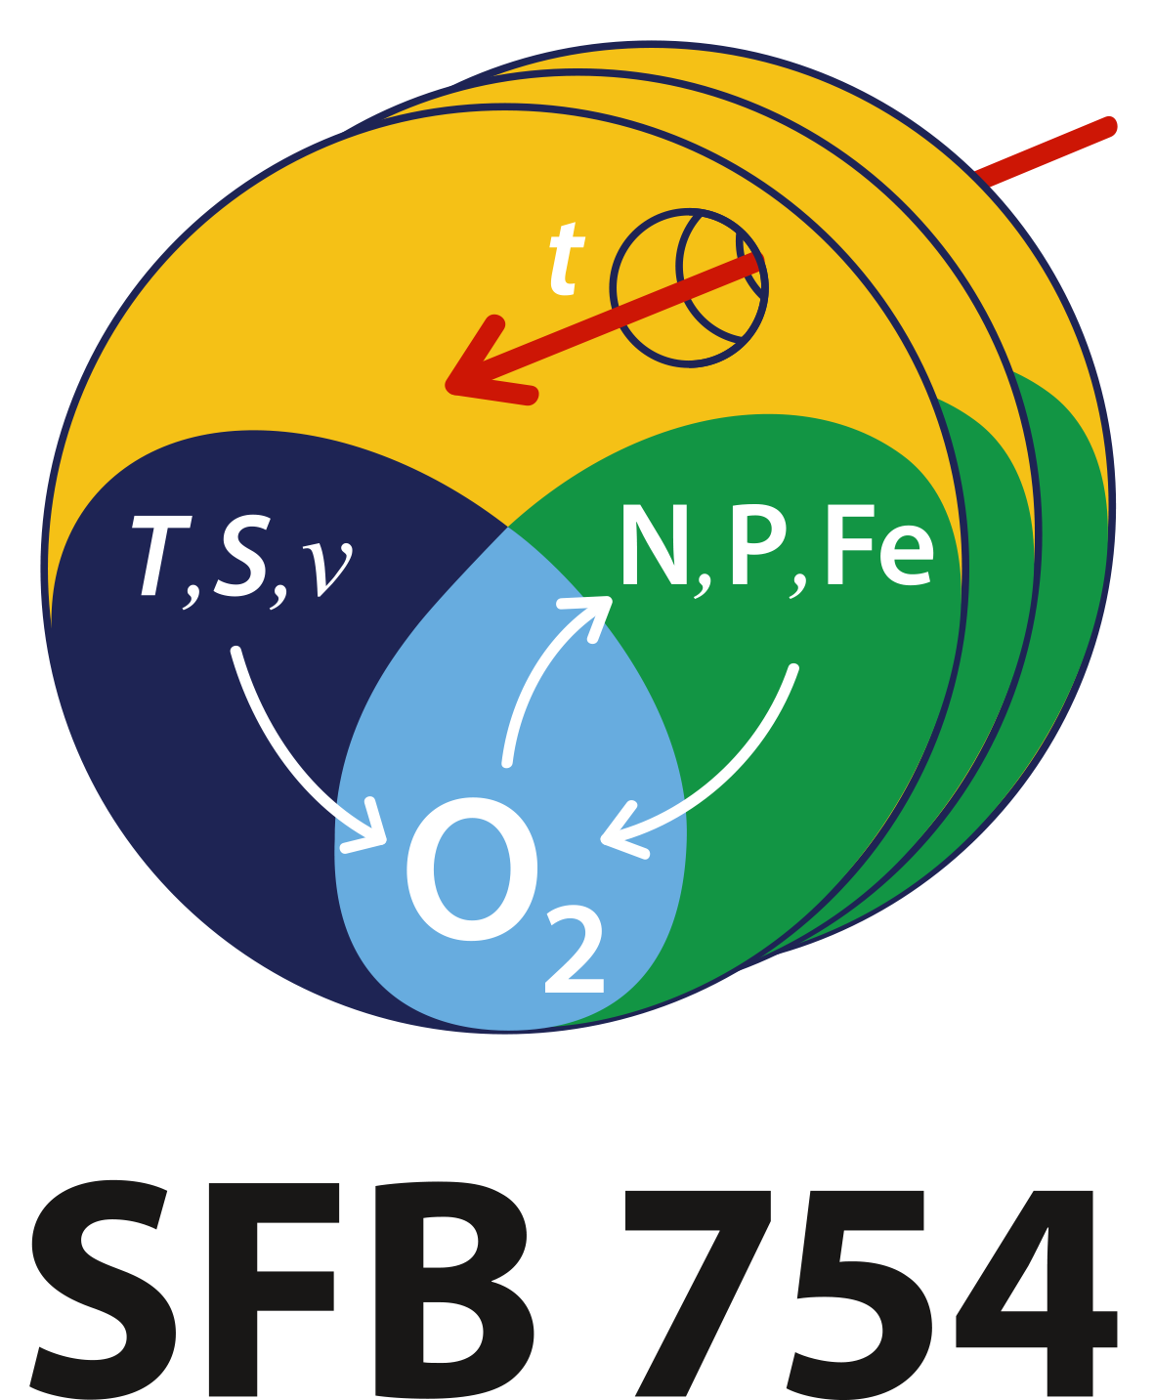

Phenomena-based data products
Global Ocean Acidification Observing Network
Data Portal
http://portal.goa-on.org/Explorer
Metadata on OA-relevant observations
Filter by region, platform, EOV, etc.
Visualize available time series data
Contact data providers
Oxygen Data Portal / Synthesis Product
(Scoping and design phase)
Joint effort by IOCCP, SFB754, GO2NE, IOC, NOAA NCEI & GLODAP
Aim to include all oxygen data from all relevant platforms
Like GOA-ON Portal, it will be a phenomenon-oriented product (i.e. Deoxygenation).
GOOS Biogeochemistry Panel engaged in building the framework in terms of aims, end users, structure, funding sources, community coordination, etc.
Scoping workshop in Sopot, Poland, on 11-13 November 2019

