Slide 1
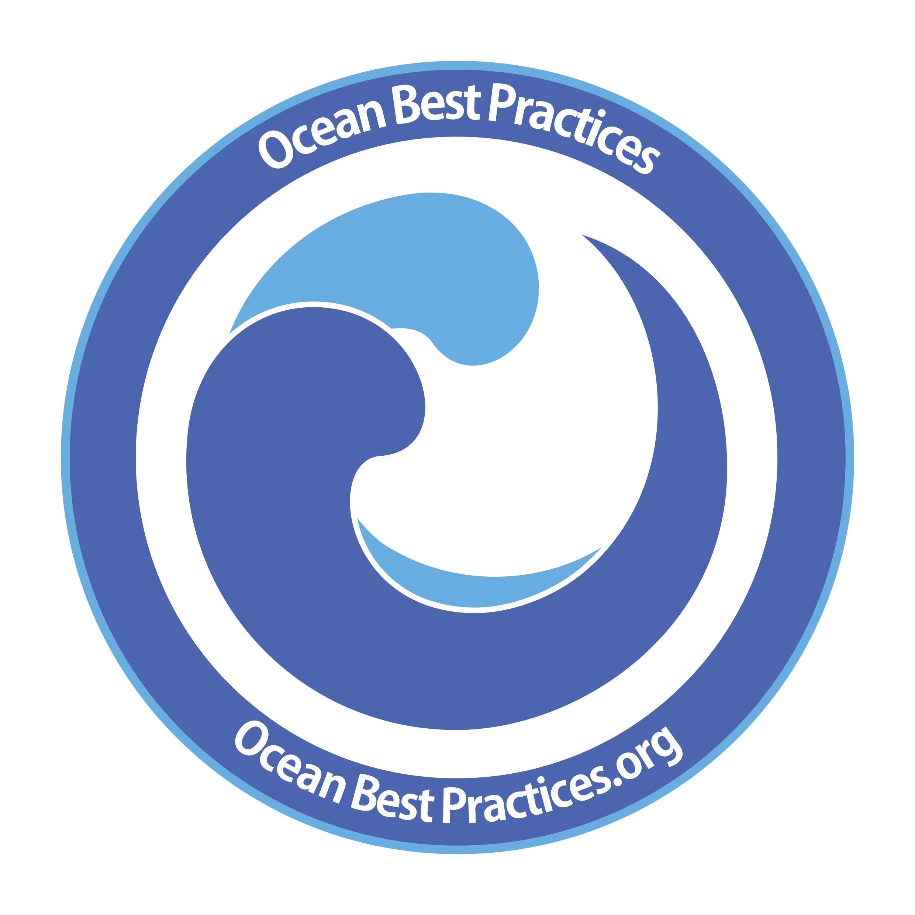

Best Practices
Single Repository and/or a Distributed Network?
Pier Luigi Buttigieg, Scott Caltagirone, Jay Pearlman
December 16 2019
1

Slide 2


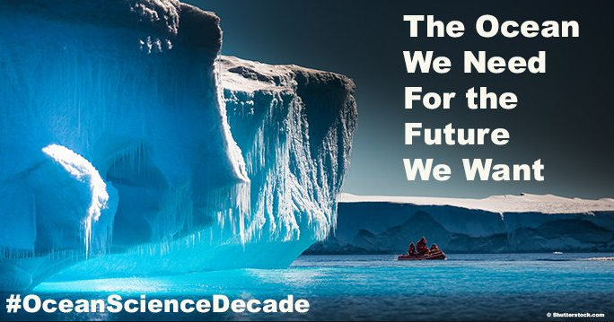






    Sustainability
Different structures, but all developing best practices
Notes:
Many groups have been conducting assessments at national and international levels regarding which variables need to be measured to monitor factors influencing sustainability. The groups are the SDG, Decade of ocean Science, The various GEO activities such as MBON and Blue Planet and the IOC organizations of GOOS and IODE. While each has a certain perspective and approach because of the way they are structured, there are underlying processes that support all of these efforts. Let’s look at one of these as a bottom up perspective of OceanObs19.

Slide 3
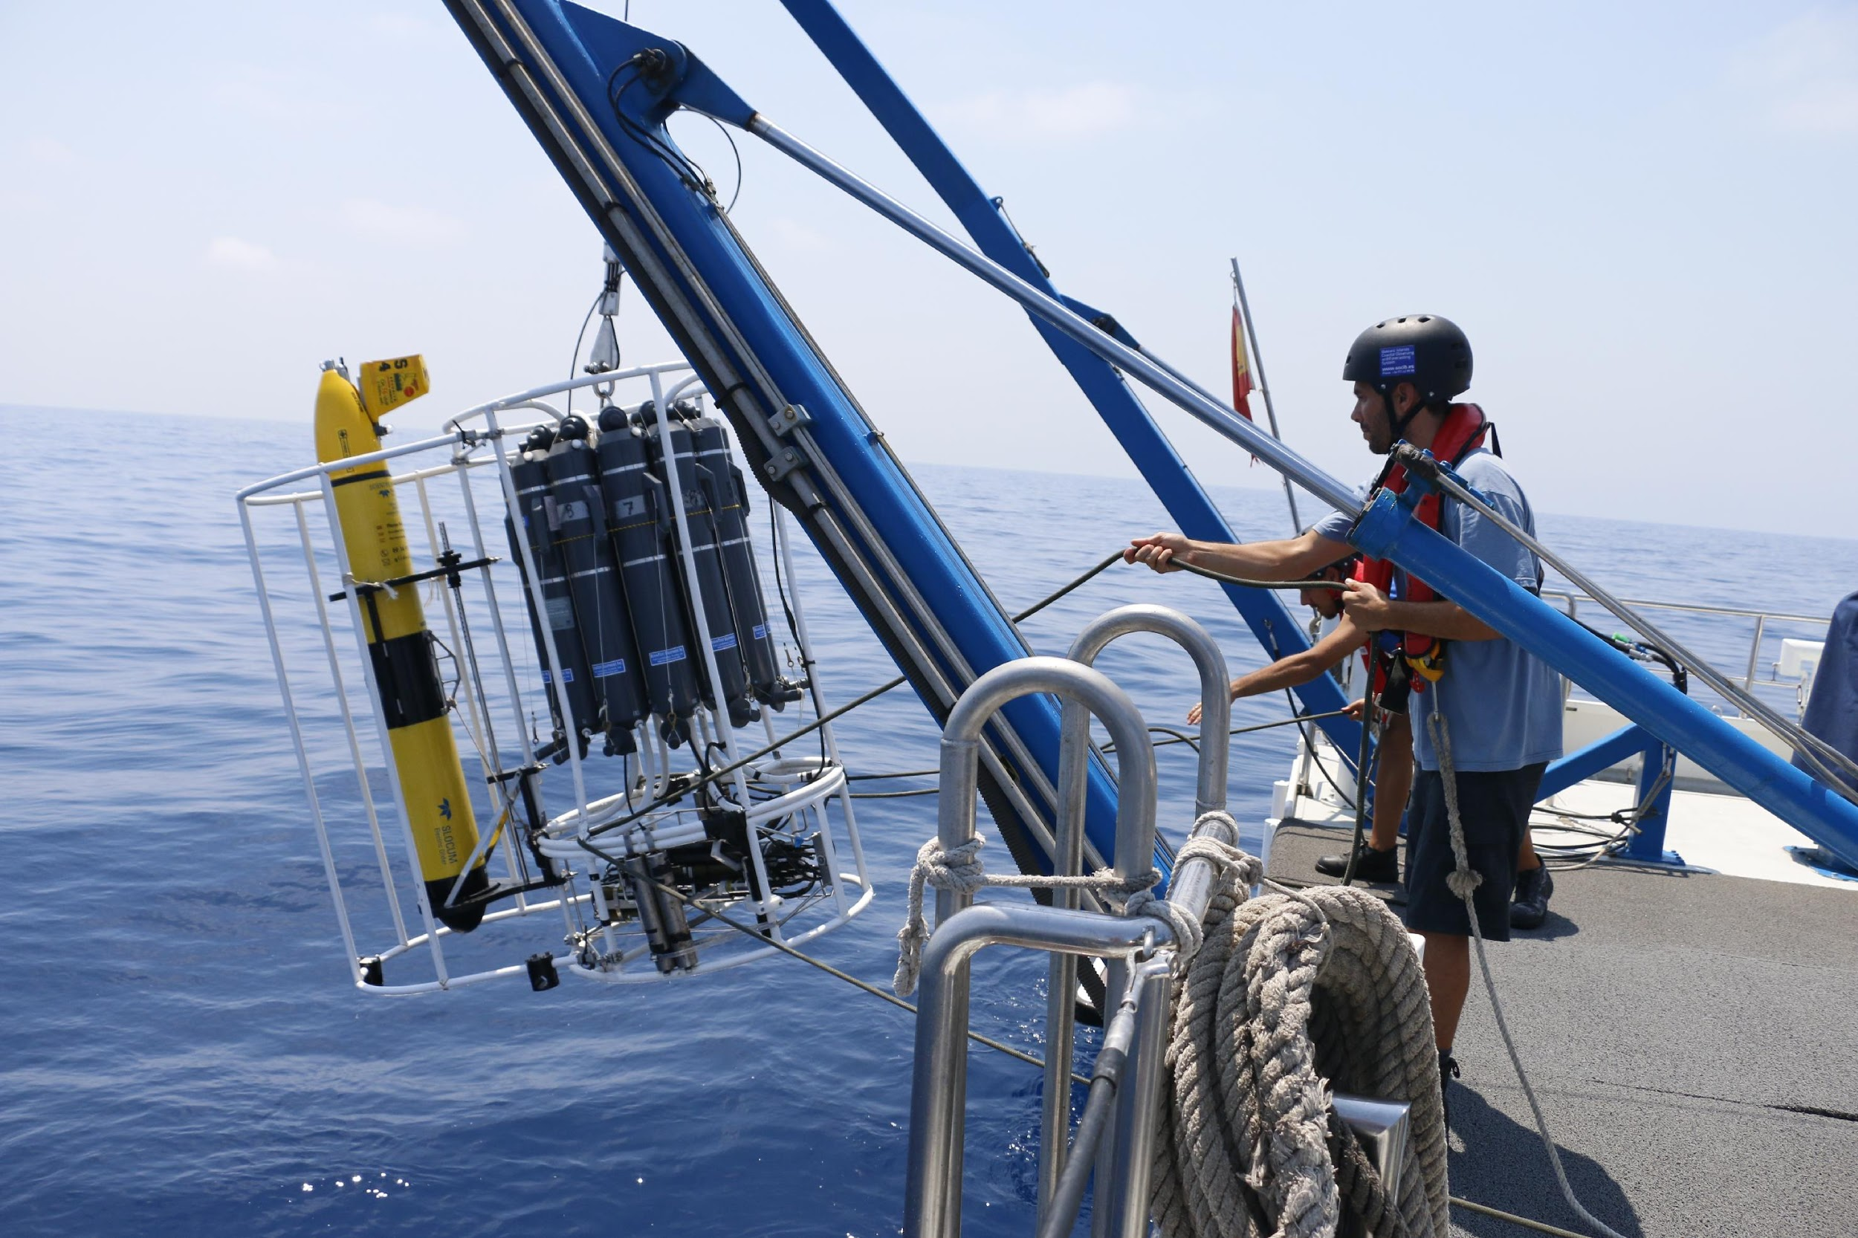
What is a Best Practice?
A best practice is a methodology that has repeatedly produced superior results relative to other methodologies with the same objective
Best practices can come in many forms such as standard operating procedures, manuals, guides, cookbooks etc.
However, they all have a common goal of improving the quality and consistency of processes, measurements, data and applications through agreed practices.
Repository – www.oceanbestpractice.org
Frontiers RT - https://www.frontiersin.org/research-topics/7173/best-practices-in-ocean-observing
OTGA - www.oceanteacher.org
Newsletter - https://tinyurl.com/y6pmases
Repository – www.oceanbestpractice.org
Frontiers RT - https://www.frontiersin.org/research-topics/7173/best-practices-in-ocean-observing
OTGA - www.oceanteacher.org
Newsletter - https://tinyurl.com/y6pmases

Slide 4


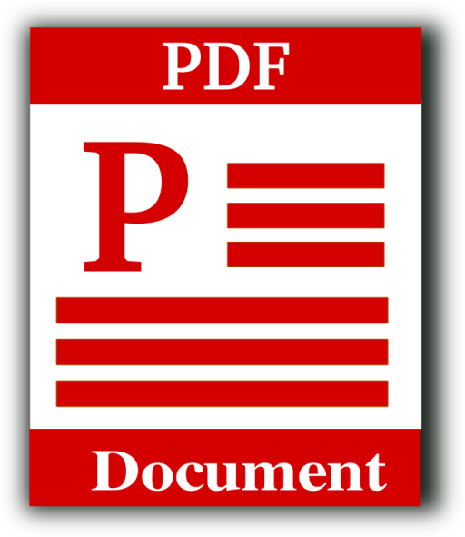





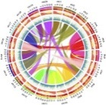














Slide 5
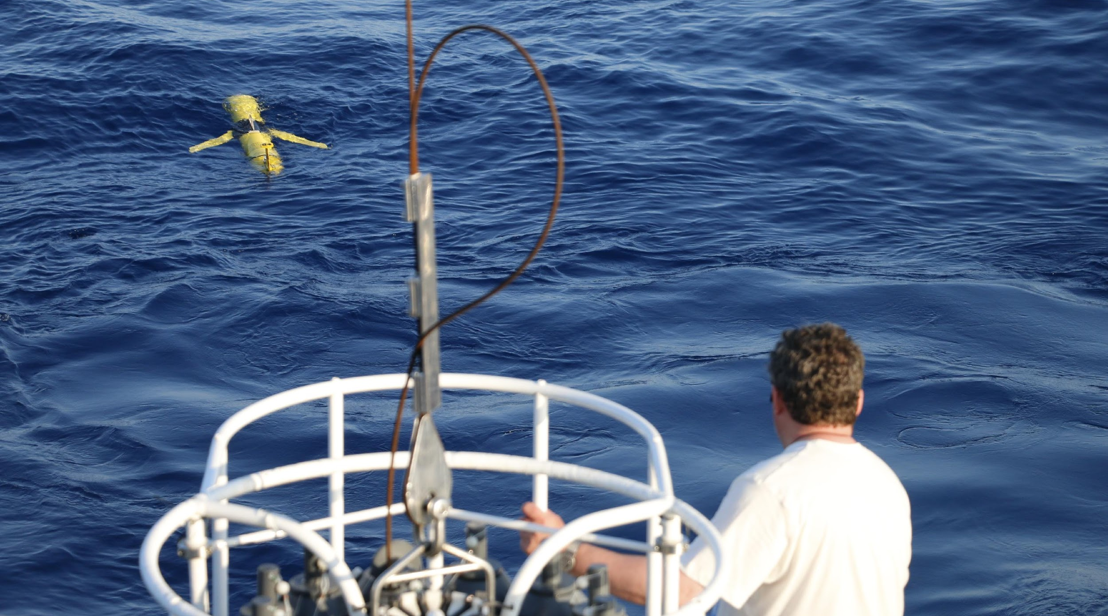
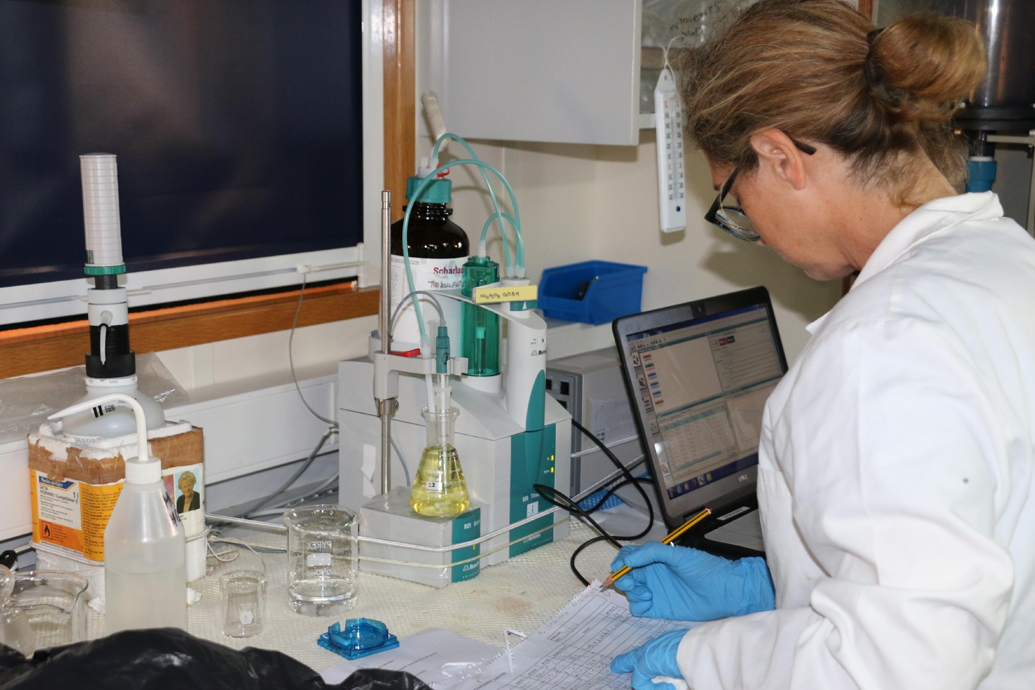
Ocean Best Practices
Best practices bring many benefits
Quality and consistency of observations
Interoperability of data
Efficiency (don’t re-invent the wheel)
Transparency - Data traceability and reproducibility
Connections between data, models and applications
Resource for training and capacity development
A system is needed for Ocean Best Practices
HOWEVER
Not all best practice knowledge is documented
They are scattered and can be hard to find
Can be lost when a project ends
Promising methods may not be shared
Work to create a best practice is often not acknowledged
or formally credited
5
Notes:
Large investments in high quality measurements, however:
Quality of OBP documentation varies widely
Data and metadata formats are inconsistent
Machine readability is limited (if at all)
Sustainability is often not guaranteed
Work creating OBPs is not often acknowledged
OBPs are scattered and hard to find
5

Slide 6
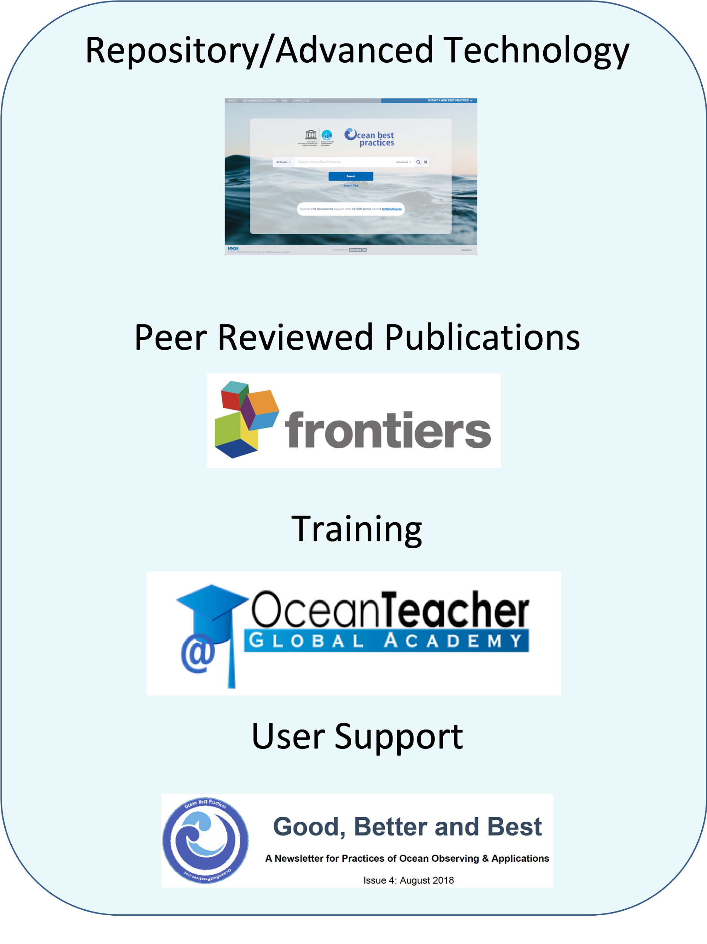
The Ocean Best Practices System (OBPS)
The OBPS is an operational system currently with 911 best practices
It supports methodological development across the entire ocean community, fostering ever more aligned best practices.
The OBPS follows the FAIR principles of findability, accessibility, interoperability and reproducibility.
www.oceanbestpractices.org
Repository – www.oceanbestpractice.org
Frontiers RT - https://www.frontiersin.org/research-topics/7173/best-practices-in-ocean-observing
OTGA - www.oceanteacher.org
Newsletter - https://tinyurl.com/y6pmases
Repository – www.oceanbestpractice.org
Frontiers RT - https://www.frontiersin.org/research-topics/7173/best-practices-in-ocean-observing
OTGA - www.oceanteacher.org
Newsletter - https://tinyurl.com/y6pmases

Slide 7
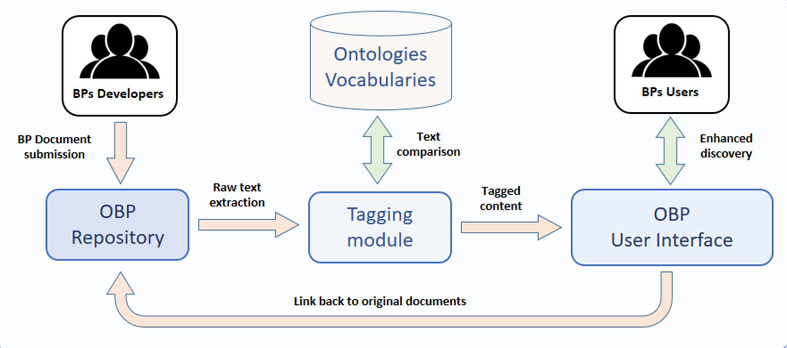
OBPS - Document Tagging

Slide 8
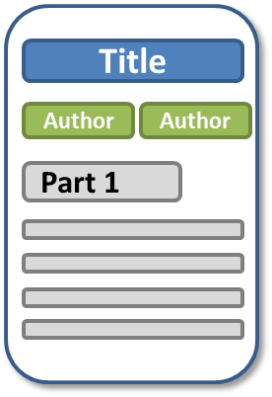
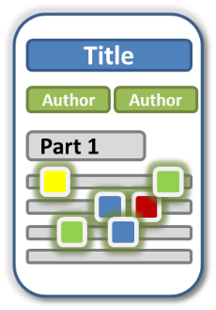

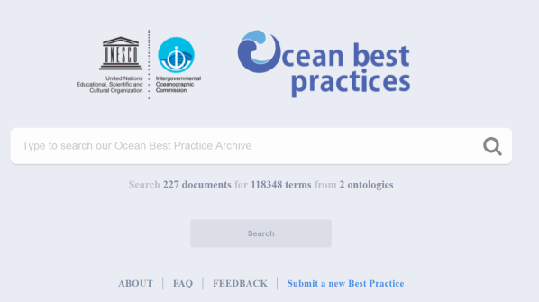

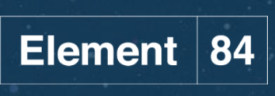

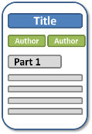
*
Tagging Module
*
Ontologies / Vocabularies
Merged triplestore
Raw text extraction
*
Semantic + ElasticSearch interface
For more information, see our Conference paper “The Ocean Best Practices System - Supporting a Transparent and Accessible Ocean” by Buttigieg, Caltagirone, Simpson and Pearlman.
Link back to
original documents
Submission
interface
*Developed by Element 84
BP Developers
Ocean Observation Section for BPs

Slide 9
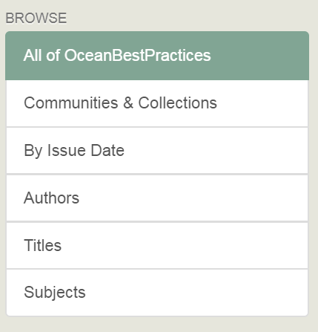
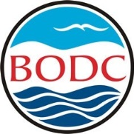

Their BP
Author
Author
Part 1
My BP
Author
Author
Part 1
Sensors and platforms, Environments, Chemicals, SDGs…
OBO Foundry Ontologies
NERC Vocab Server
ENVO, CHEBI, SDGIO

Slide 10










Links to SDG Agenda
Biological
processes
Chemicals
Environmental and
ecological entities
Food and
agriculture
AgrO

Slide 11
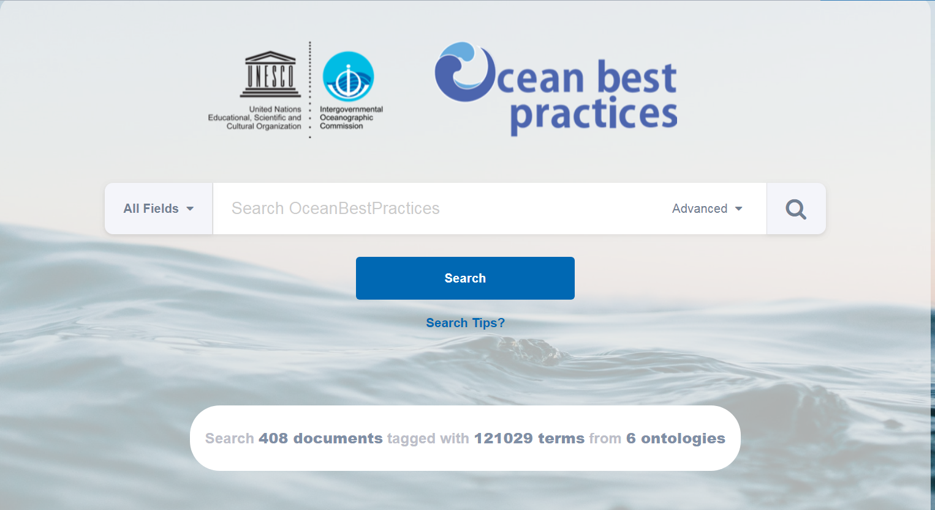
ENVO, CHEBI, SDGIO, & BODC sensor and platform vocabs

Slide 12
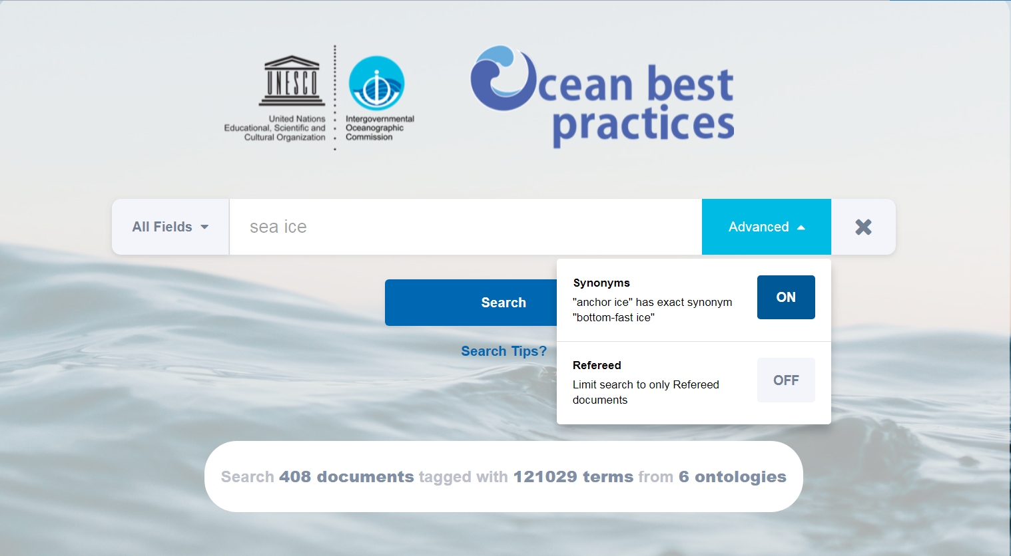

Slide 13
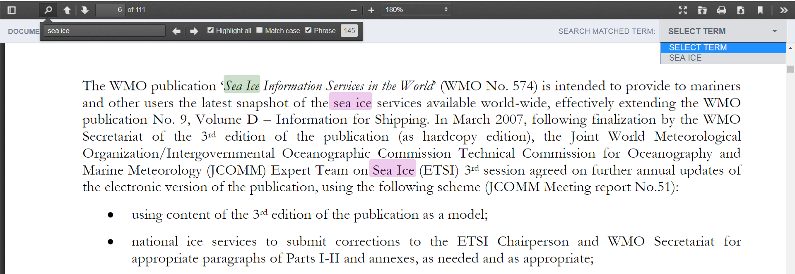
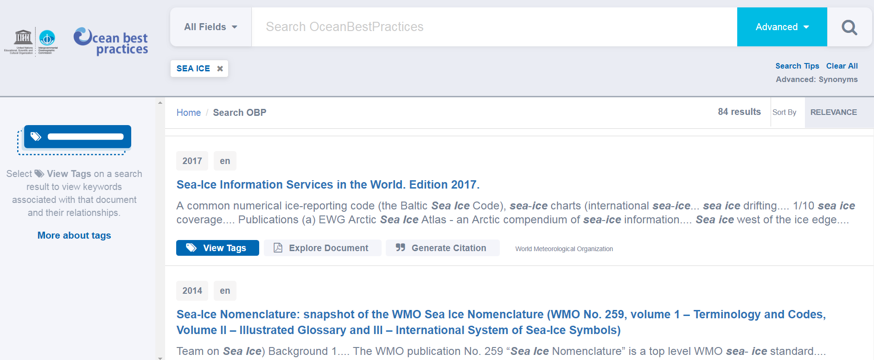
Rapidly access document parts linked to terms of interest

Slide 14
Explore terminology linked to machine intelligence

Slide 15
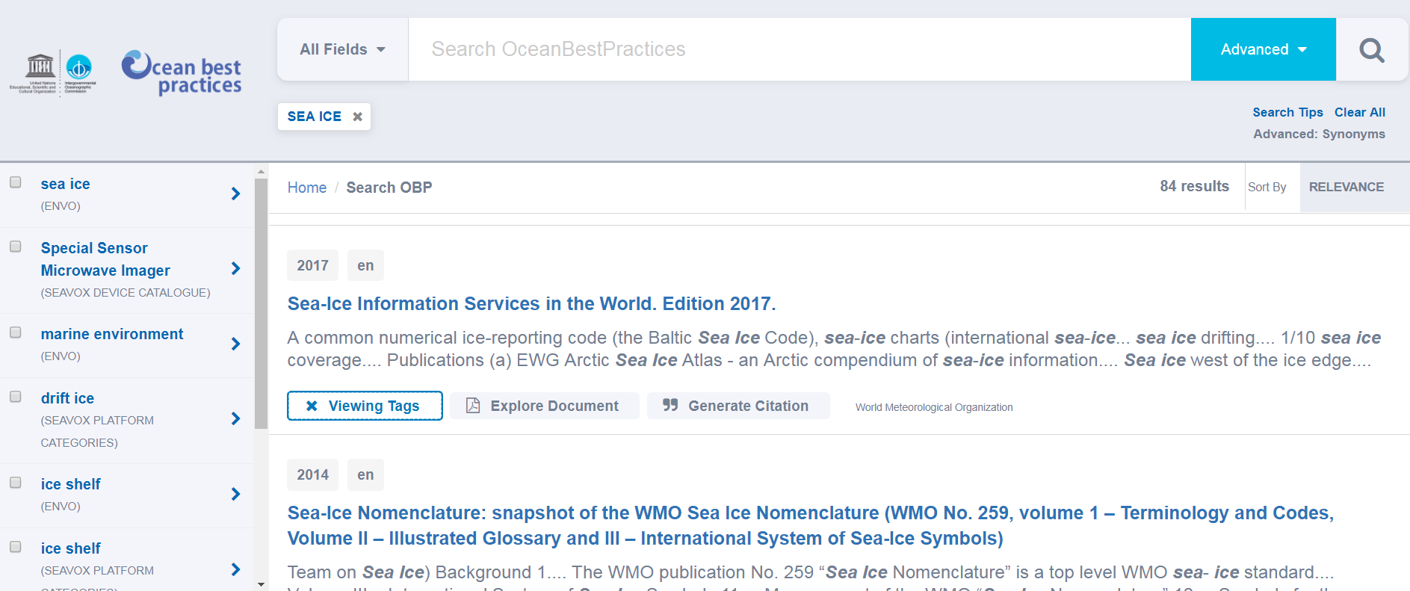
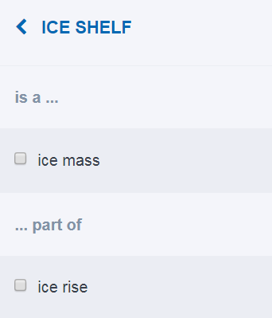
Constrain / Expand searches assisted by knowledge models
The semantic context of each term is sourced from ontologies and vocabularies…

Slide 16
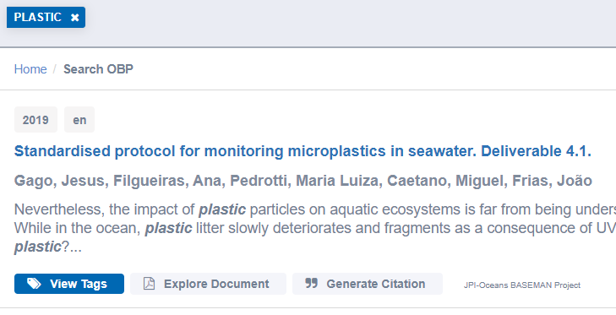
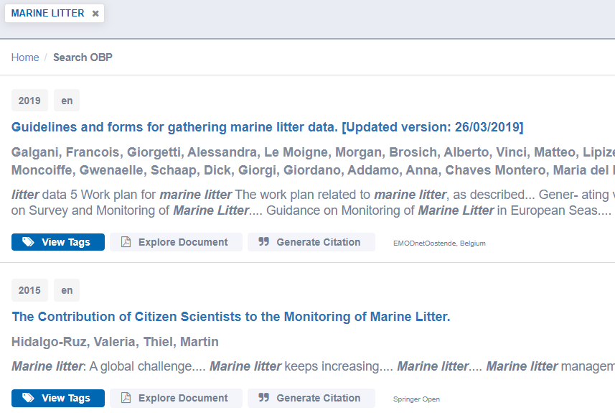
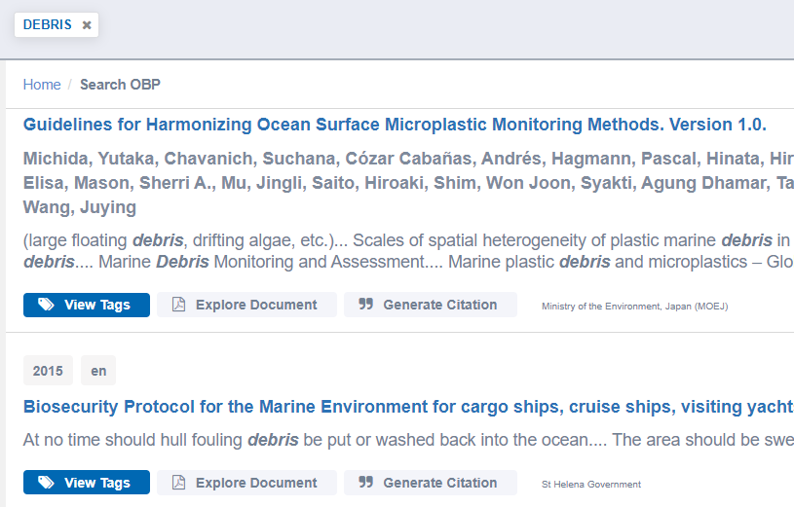
“Plastic”, “litter”, and “debris” in the OBPS corpus
~200-250 non-specific hits, but 20-30 with on topic
Need for a more specific filter – EOV?

Slide 17
Selected BP for Plastics in OBPS
Gago, J., et al (2019) Standardised protocol for monitoring microplastics in seawater. JPI-Oceans BASEMAN Project, 33pp. DOI: http://dx.doi.org/10.25607/OBP-605
Michida, Y. et al (2019) Guidelines for Harmonizing Ocean Surface Microplastic Monitoring Methods. Version 1.0. Chiyoda-ku, Japan, Ministry of the Environment, 68pp. DOI:http://dx.doi.org/10.25607/OBP-513
CleanSea Project (2016) Testing indicators for biological impacts of microplastics. Amsterdam, Netherlands, VU University, Institute for Environmental Studies, 5pp. (D2_2factsheet)
Boteler, B. et al (2015) Policy brief: Best practice examples of existing economic policy instruments and potential new economic policy instruments to reduce marine litter and eliminate barriers to GES. D. 4.13. Berlin, Germany, Ecologic Institute for CleanSea Project, 13pp. DOI: http://dx.doi.org/10.25607/OBP-198

Slide 18
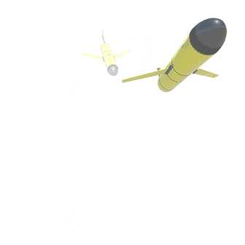
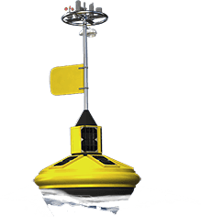
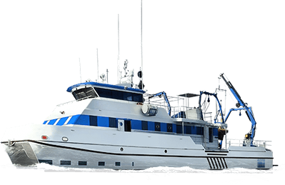

My Best Practice 2.0
Opening up BPs to informatics and linking
them to data and information holdings
1111
Author
Author
Author
Retrieve the common sensors across the protocols “McMussel mussel bed survey” and “OysterTech oyster reef survey”
Retrieve all BPs that use the software “ArcGIS”
Retrieve the advantages and limitations of the protocol titled “Sampling seawater for marine microbes”
Retrieve the protocols and the list of reagents for documents authored by E Hemmingway
Sensors
Reagents
Software
Environment
Addressing the value Chain
Procedure
1.
2.
3.
…
Advantages & Limitations
Marine data stores
1.
2.
3.
…
Marine data stores
Marine data stores
Warnings
1.
2.
3.
…
Inspired by https://smartprotocols.github.io/

Slide 19
Perspectives
Develop debris and plastic metadata indexing to refine search
Identify and create semantic content representing key indicators, debris types, debris-linked DPSIR patterns
Identify and create semantic links to central data stores
Seed a thematic “Debris Collection” and encourage submissions to link the community to the IOC-UNESCO and GOOS EOV systems
Explore endorsement protocols to provide some rallying points for a very active thematic community

Slide 20
Best Practices
Single Repository and/or a Distributed Network?
Either could work – but distributed systems must be truly interoperable and federated – what’s more pragmatic at the cusp of the Decade
December 16 2019
20

Slide 22
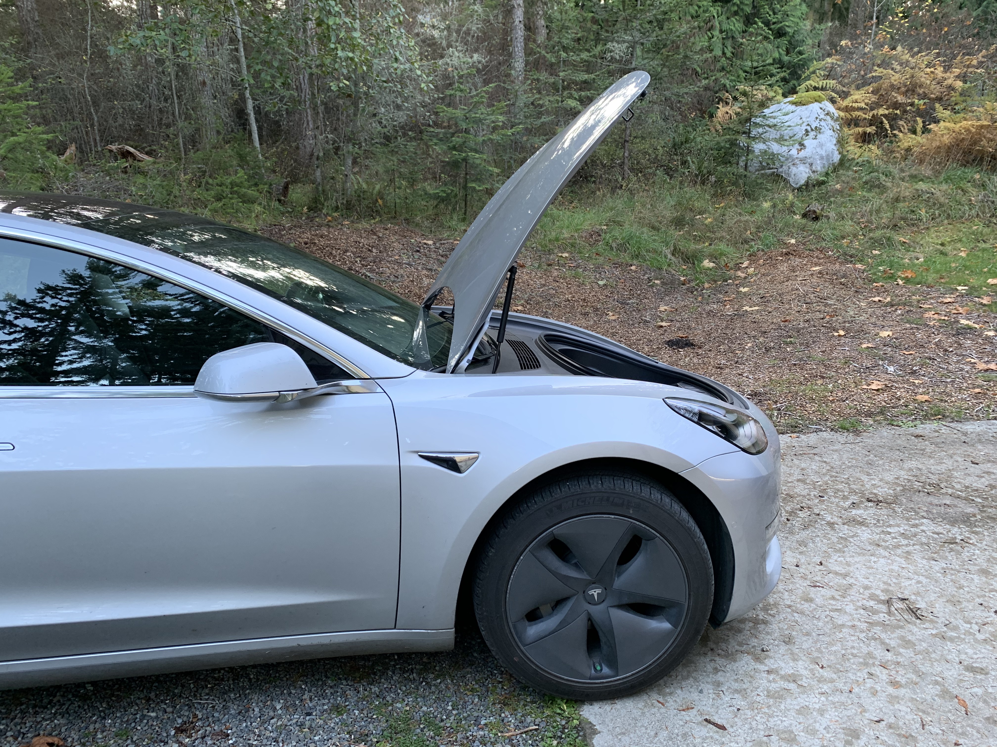
What is under the hood?
The User interfaces and search and discovery functions are done on AWS, drawing on data from the OBPS Repository (built on D-space)
The search and user interface operates as follows:
        Lambda functions on AWS fetch the document metadata and raw text.
        Document text is then percolated against an existing Elasticsearch “tags” index, which includes pre-defined queries matching
        Document metadata and raw text are then added to the Elasticsearch documents index
        Search and browse capabilities are exposed to clients via a high-availability and publicly accessible API built on top of AWS’ API Gateway service.
  The interface provides several options. Query execution retrieves contextualized search results, document preview combined with keyword localization options, and citation generation.
For more information, see our Conference paper “The Ocean Best Practices System - Supporting a Transparent and Accessible Ocean” by Buttigieg, Caltagirone, Simpson and Pearlman.

