Slide 1
Plastic Litter Projects 2018 and 2019:
exploring the detection of floating plastic debris using satellite images and UAS data
Dimitris Papageorgiou, Konstantinos Topouzelis

Slide 2
Contents
Quick overview of Plastic Litter Projects 2018 & 2019
Initial results
Planned Further Work

Slide 3
Plastic Litter Projects (PLP)
Exploratory study into using open-access satellite and UAS imagery for the remote detection of floating marine debris targets in a realistic marine environment/validation campaign.
Scope:
i) to explore the feasibility of detecting plastics in the aquatic environment using UAS and open access satellite missions, and
ii) to extract meaningful spectral measurements in near-real scenarios & collate the geospatial information ranging from moderate to very high resolution.
slide 1
MRSG – University of the Aegean Brest: Marine Debris Indicators – 2019

Slide 4
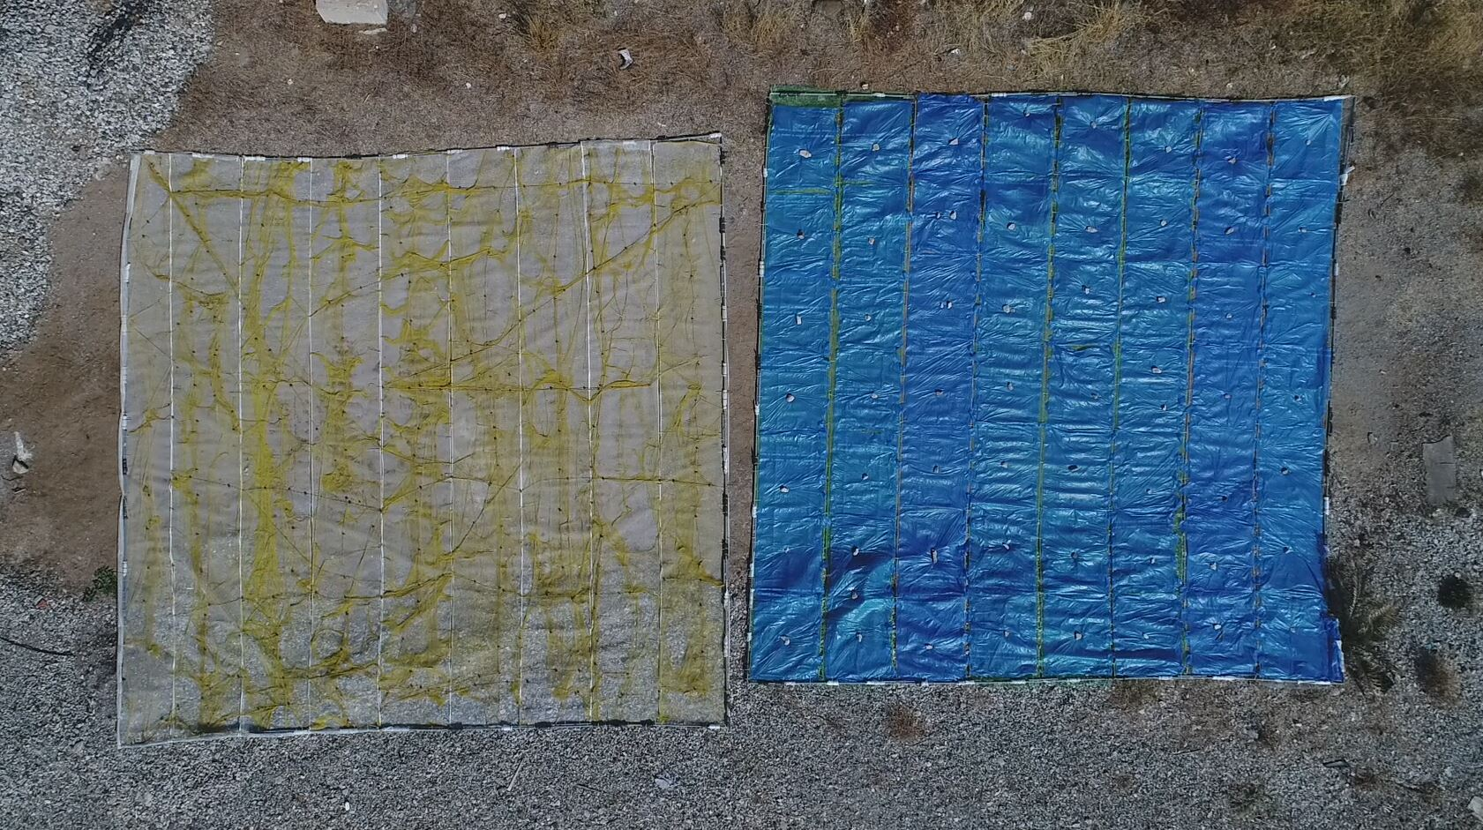
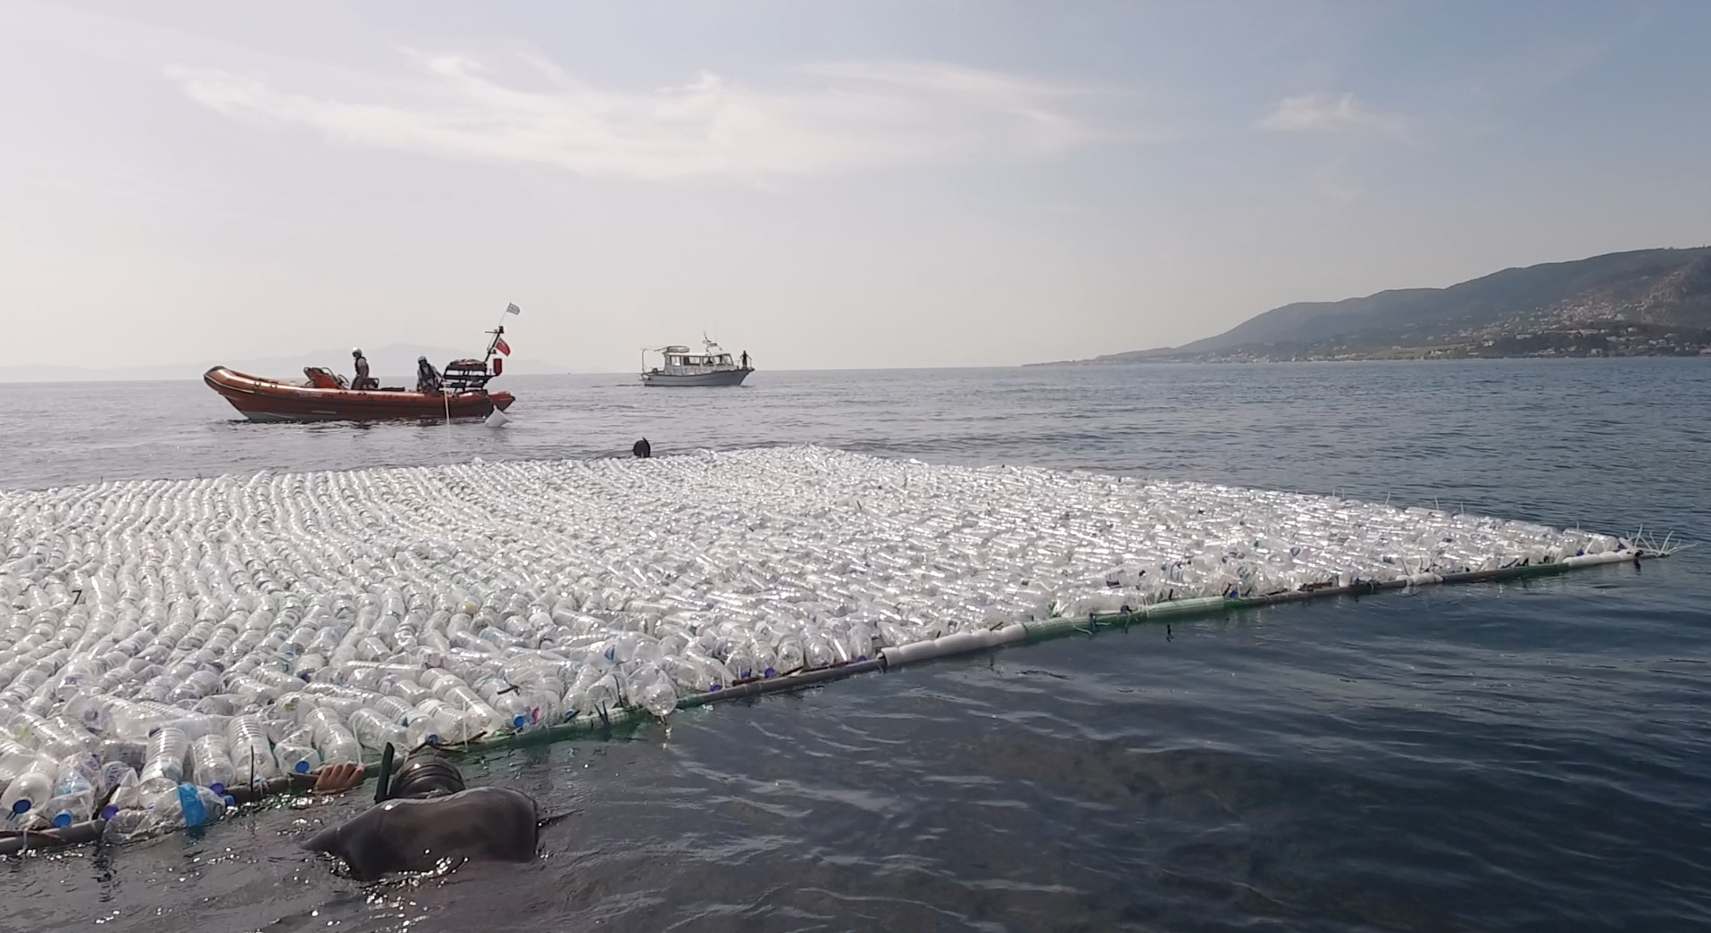
Plastic Litter Project 2018
Three 10x10m artificial targets:
1) 3600 x 1.5 L clear PET bottles,
2) 135 blue LDPE garbage bags and
3) 200m² yellow nylon fishing net.
slide 2
MRSG – University of the Aegean Brest: Marine Debris Indicators – 2019

Slide 5
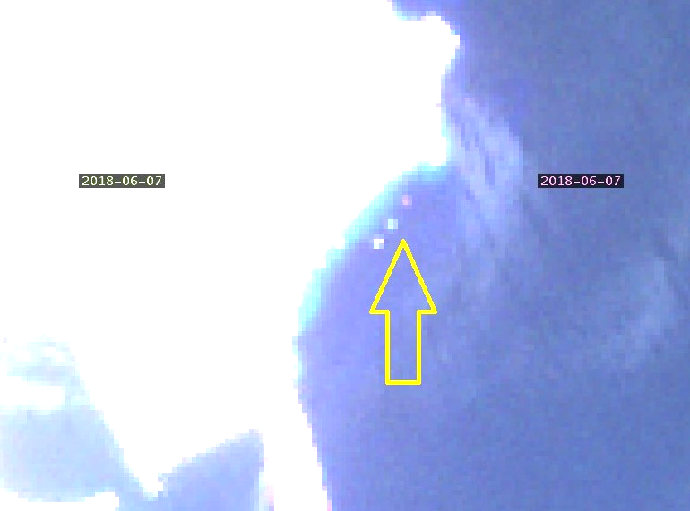
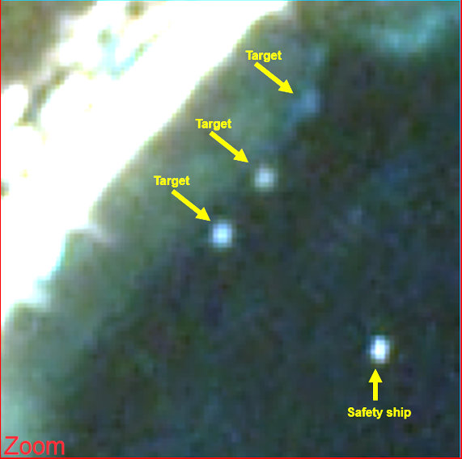
Plastic Litter Project 2018
Sentinel-2 satellite
7 June 2018
PlanetScope satellite
7 June 2018
slide 3
MRSG – University of the Aegean Brest: Marine Debris Indicators – 2019

Slide 6
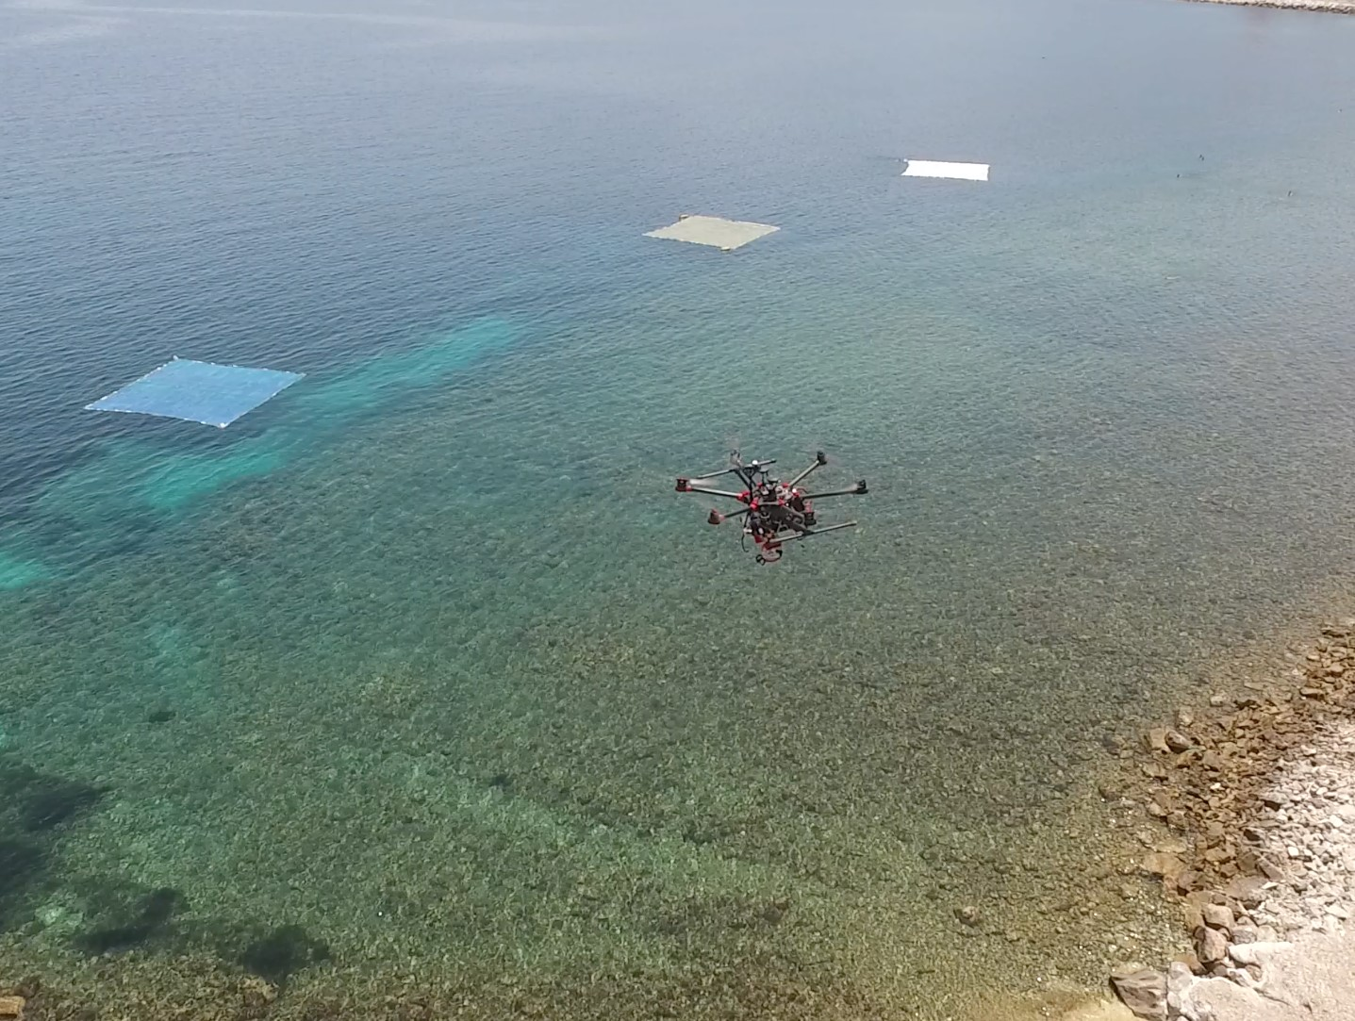
Plastic Litter Project 2018
UAS DATA
Number of raw images and geo-spatial resolution acquired using a suite of sensors attached to a S900-UAS.
Sensor | Number of Images | Resolution (cm/pixel)
Slantrange 3P | 394 | 4.84
Parrot Sequoia multispectral | 872 | 7.73
Parrot Sequoia RGB | 187 | 2.72
Sony A5100 | 243 | 2.14
FliR DUO R Thermal | 575 | 196.5
FliR DUO R Visible | 575 | 10.53
slide 4
MRSG – University of the Aegean Brest: Marine Debris Indicators – 2019

Slide 7
Plastic Litter Project 2018
Combining Sentinel-2 and UAS data
Percentage plastic coverage calculation for each Sentinel-2 pixel using the A5100 othophotomap.
slide 5
MRSG – University of the Aegean Brest: Marine Debris Indicators – 2019

Slide 8
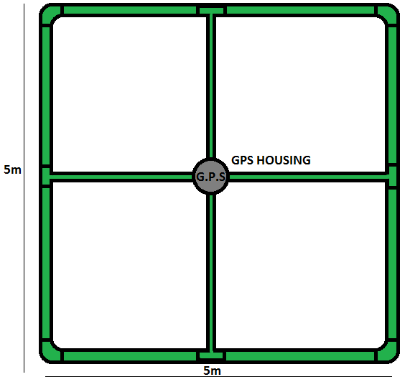
Plastic Litter Project 2019
EO tracking of marine debris in the Mediterranean Sea from public satellites (ESA: EO Science for Society permanently open call for proposals)
Argans
University of the Aegean
CNR-ISMAR
Universidad de Cádiz
slide 6
MRSG – University of the Aegean Brest: Marine Debris Indicators – 2019

Slide 9
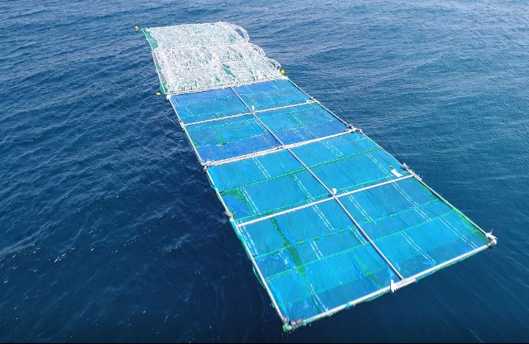
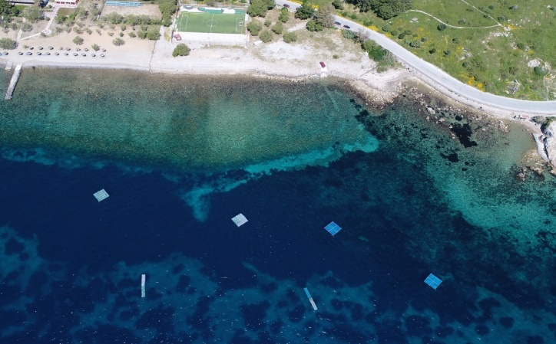
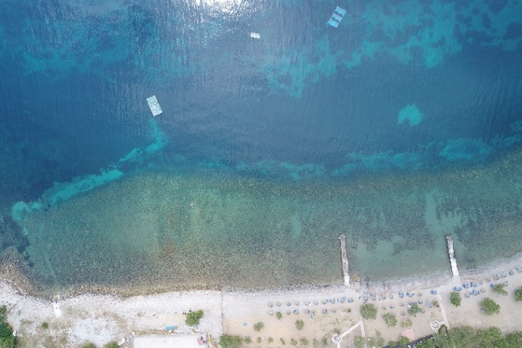
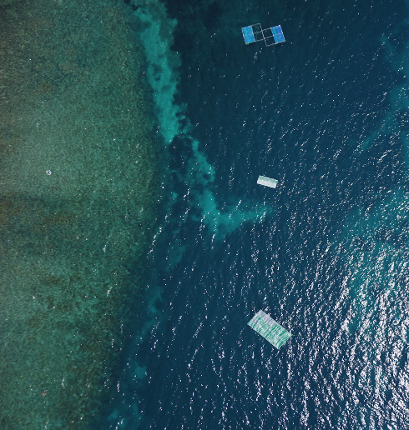
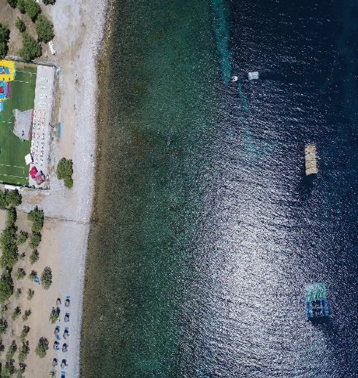
Plastic Litter Project 2019
18/4/2019
Targets in line 100% bottles, 100% bags (10x20m)
03/5/2019 Single targets 100% bottles, 100% bags & smaller mixed targets
18/5/2019 5x10m targets in line 75% bottles, 75% bags & smaller mixed targets
18/4/2019
03/5/2019
08/5/2019
13/5/2019
18/5/2019
23/5/2019
28/5/2019
02/6/2019
07/6/2019
12/6/2019
17/6/2019
22/6/2019
27/6/2019
28/5/2019
5x10m targets in line 50% bottles, 50% bags & smaller mixed targets
07/6/2019
10x10m 25% bottles, 25% bags & 5x10m 100% reeds
slide 7
MRSG – University of the Aegean Brest: Marine Debris Indicators – 2019

Slide 10
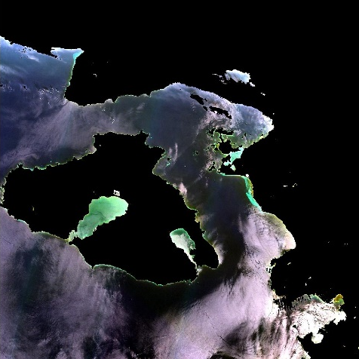
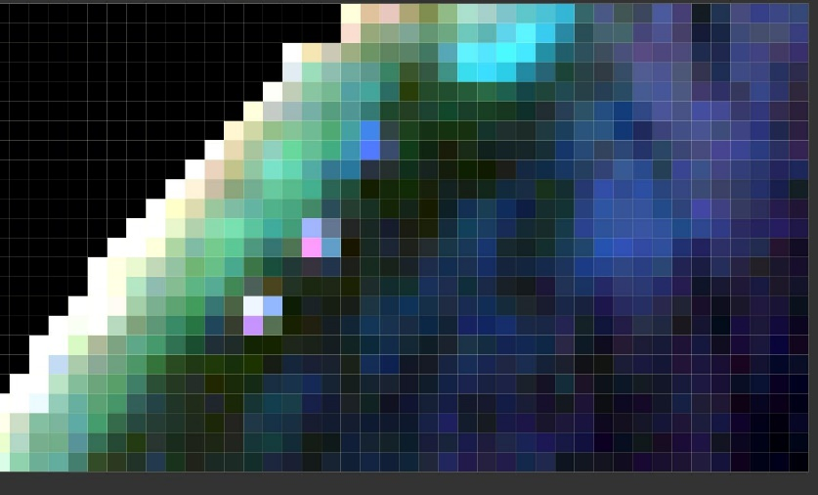
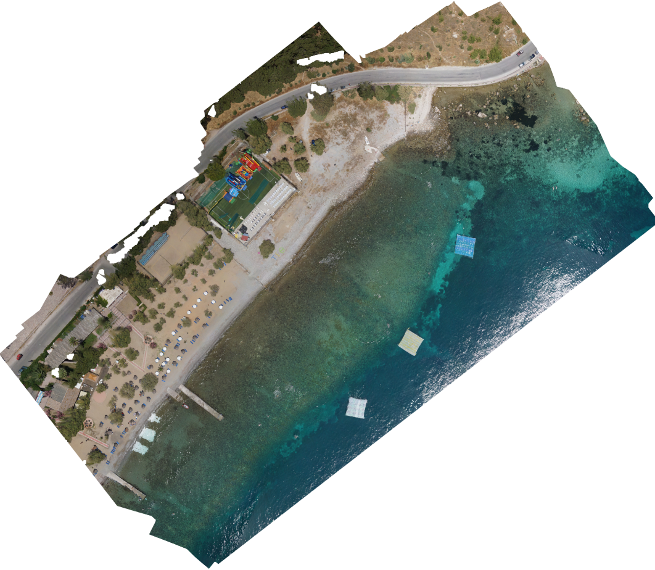
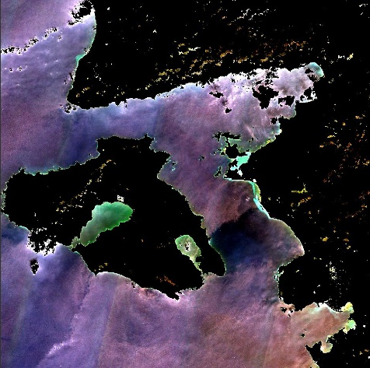
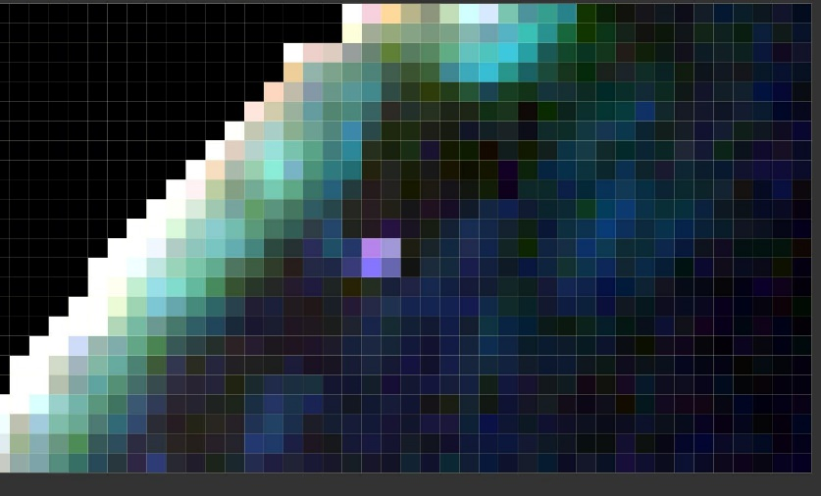
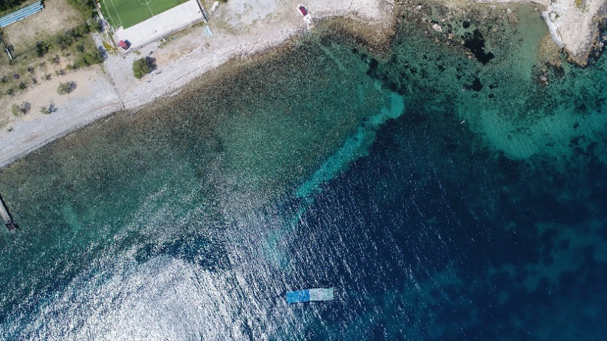
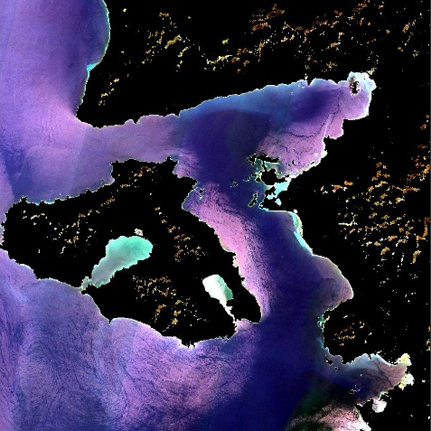
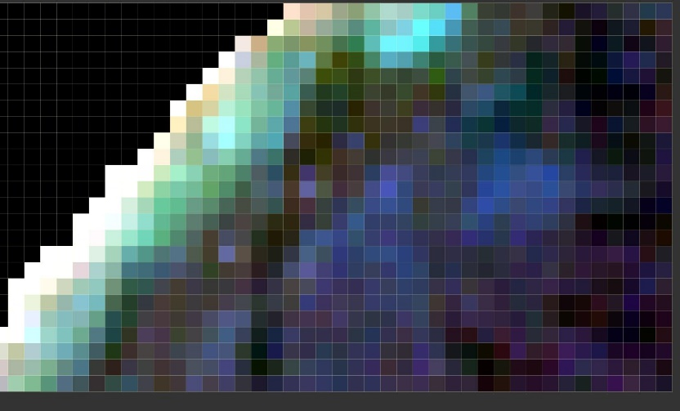
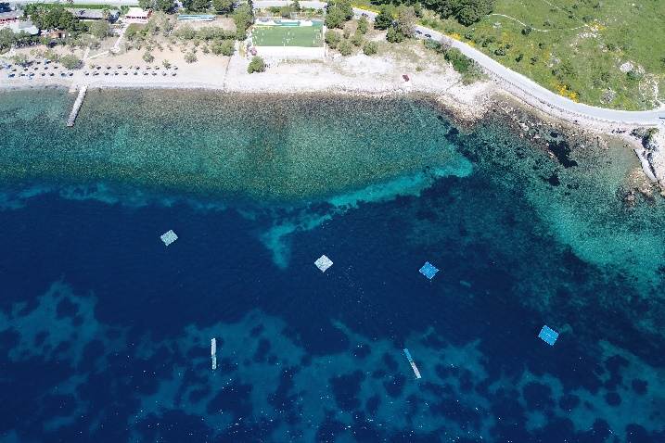
Sentinel 2 Data – PLP 2018 & 2019
20180607
10x10m targets: clr. PET bottles, blue LDPE bags & nylon nets, 100% target coverage
20190418
5x20m target: PET & LDPE, 100% coverage
20190503
5x5m targets: PET & LDPE, 100% coverage
slide 8
MRSG – University of the Aegean Brest: Marine Debris Indicators – 2019

Slide 11
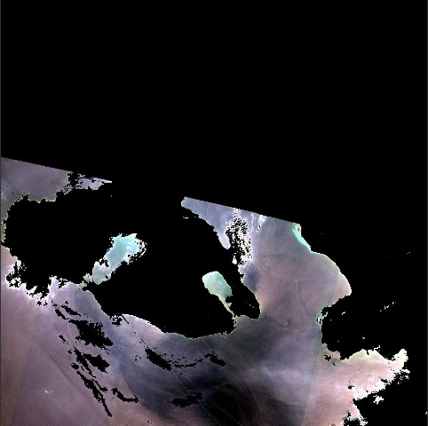
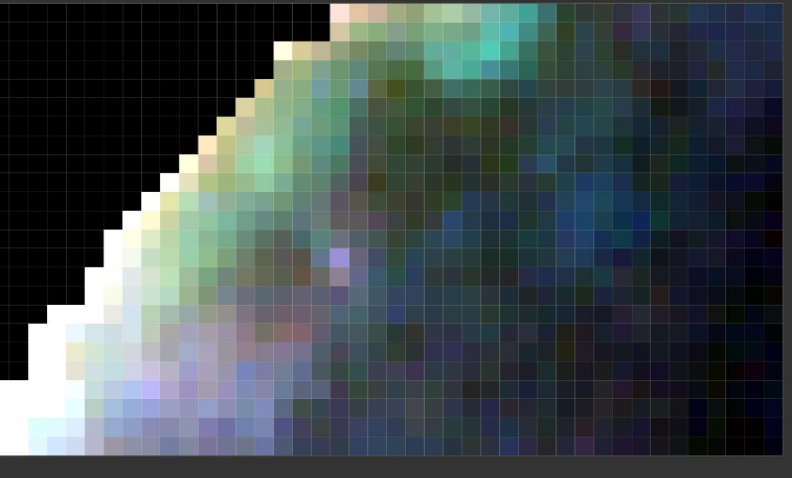
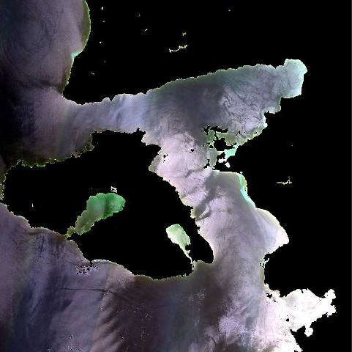
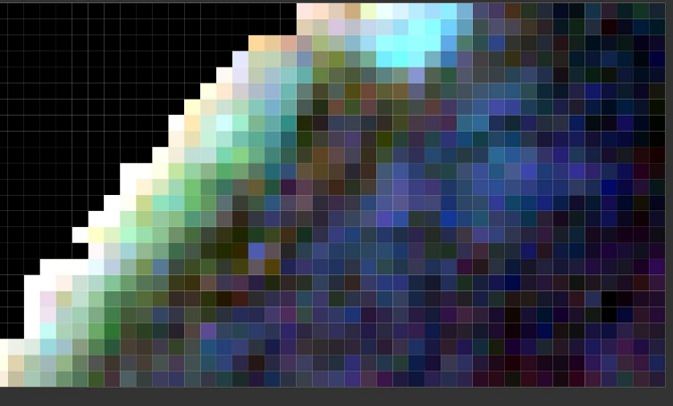
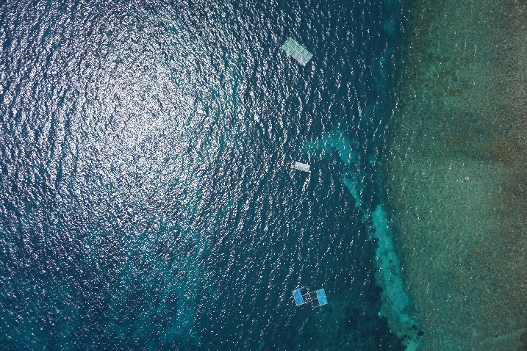
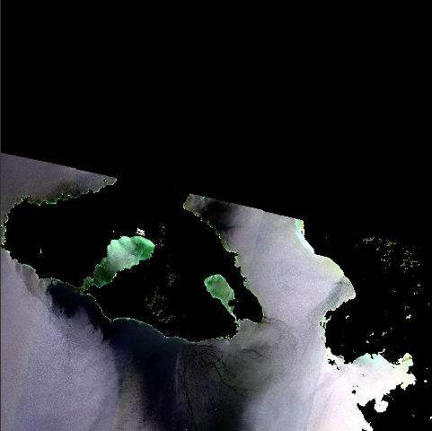
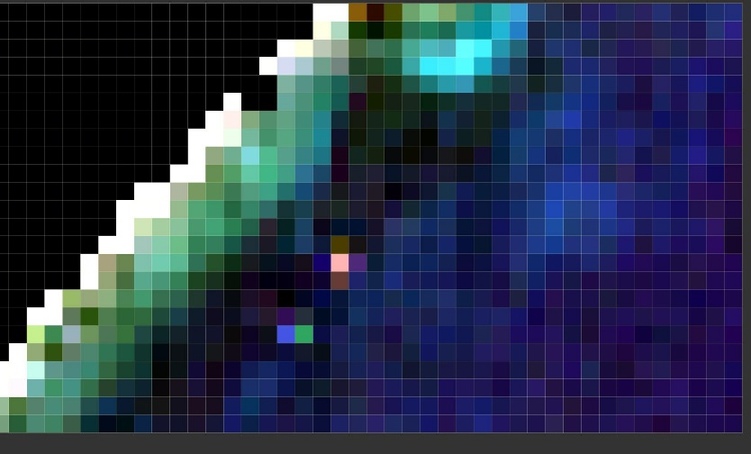
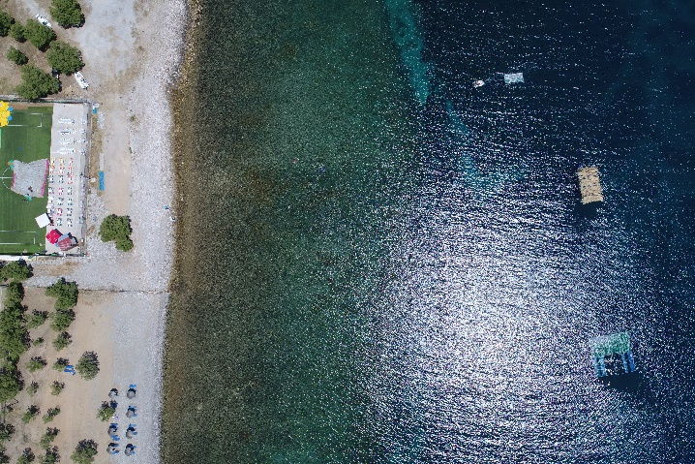
Sentinel 2 Data – PLP 2019
20190518
5x10m targets: PET & LDPE, 80% coverage
20190528
5x10m targets: PET & LDPE, 50% coverage
20190607
10x10m target: PET & LDPE, 25% coverage
5x10m: reeds,100%
slide 9
MRSG – University of the Aegean Brest: Marine Debris Indicators – 2019

Slide 12
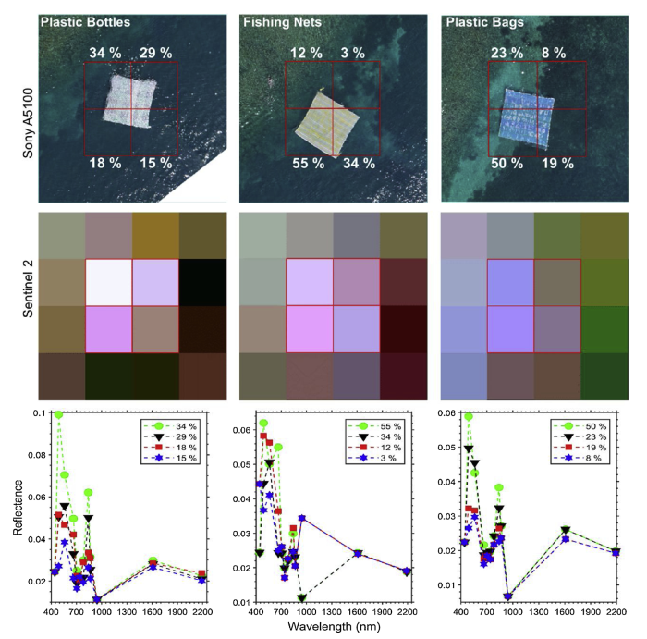
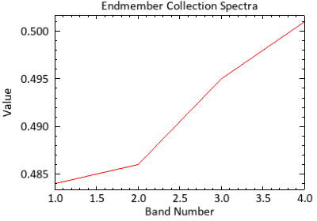
Data Analysis
Linear Spectral Unmixing:
$$Rt= f_{w}×R_{w}+f_{p}×R_{p} ⇒ R_{p}=\frac{R_{t}−(f_{w}×R_{w})}{f_{p}}$$
Source: Topouzelis et al, 2018
34%
21%
18%
9%
11%
4%
18%
8%
20%
11%
14%
6%
slide 10
MRSG – University of the Aegean Brest: Marine Debris Indicators – 2019

Slide 13
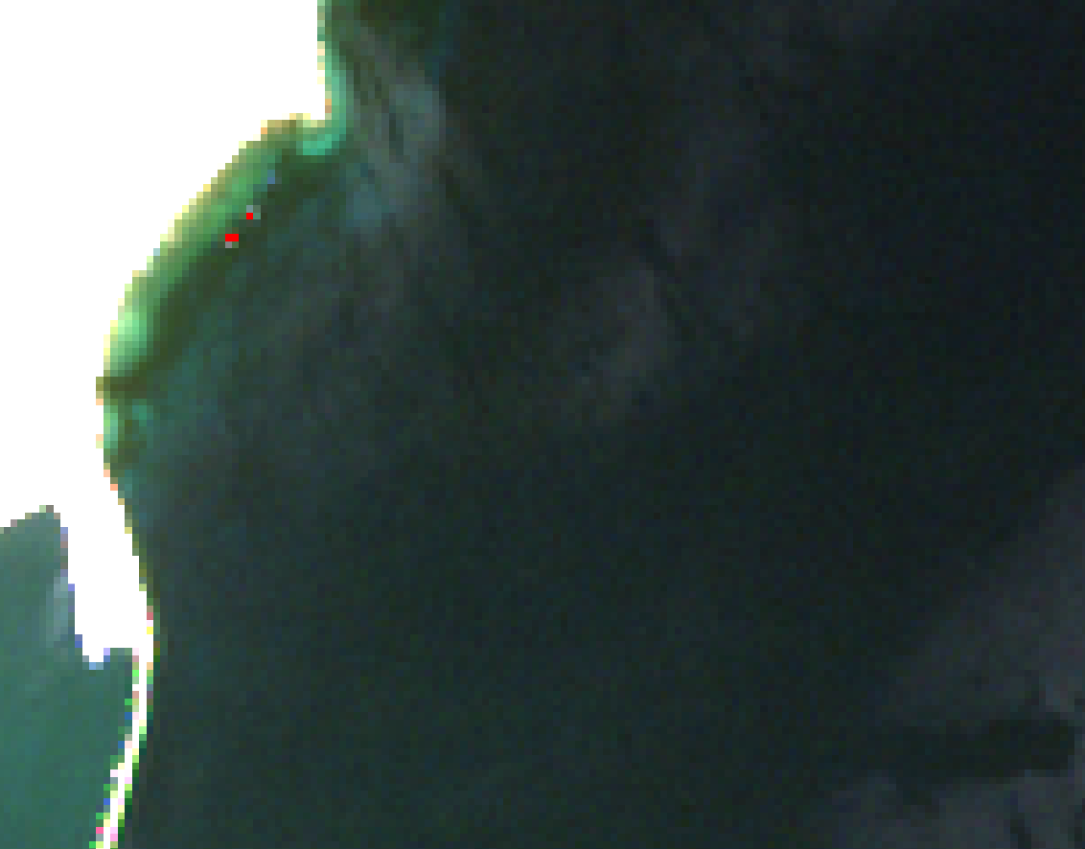
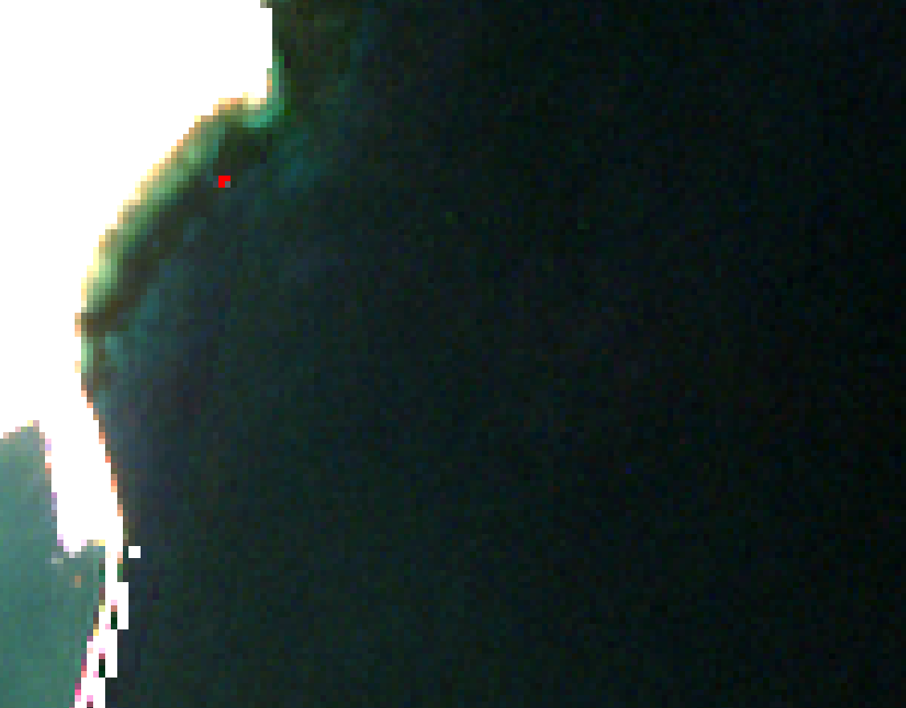
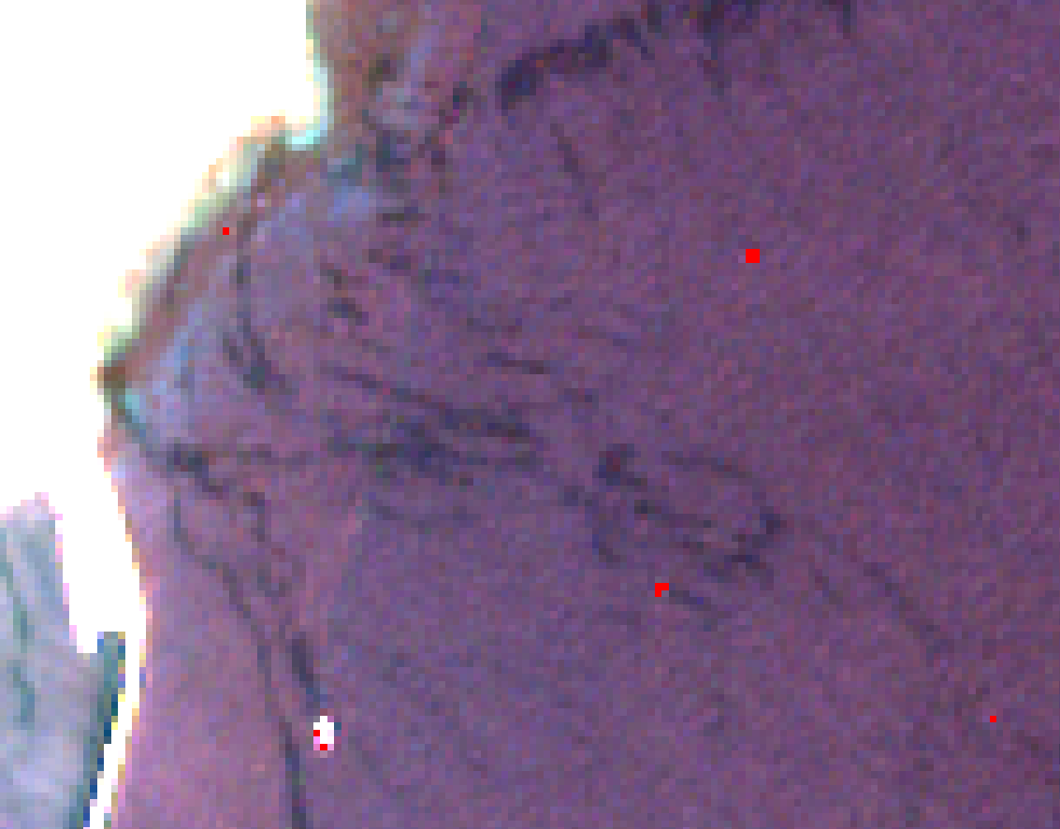
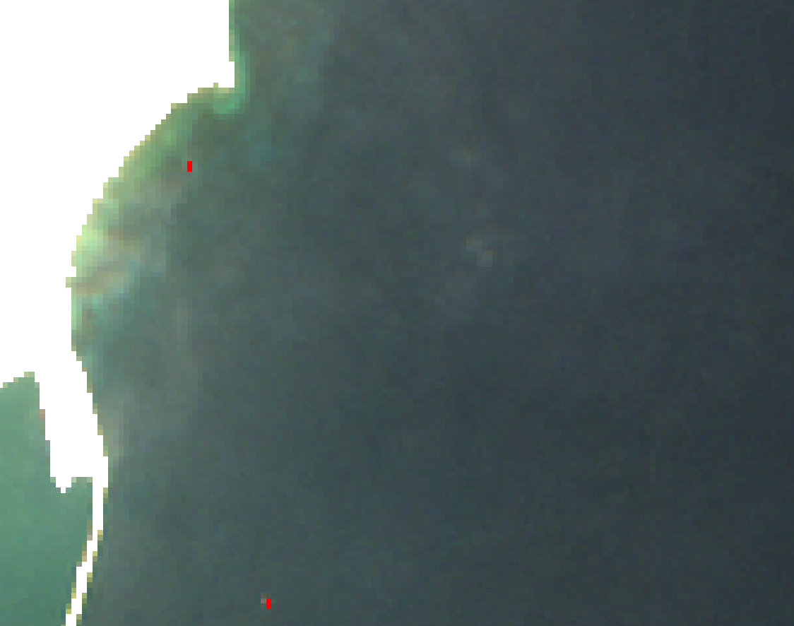
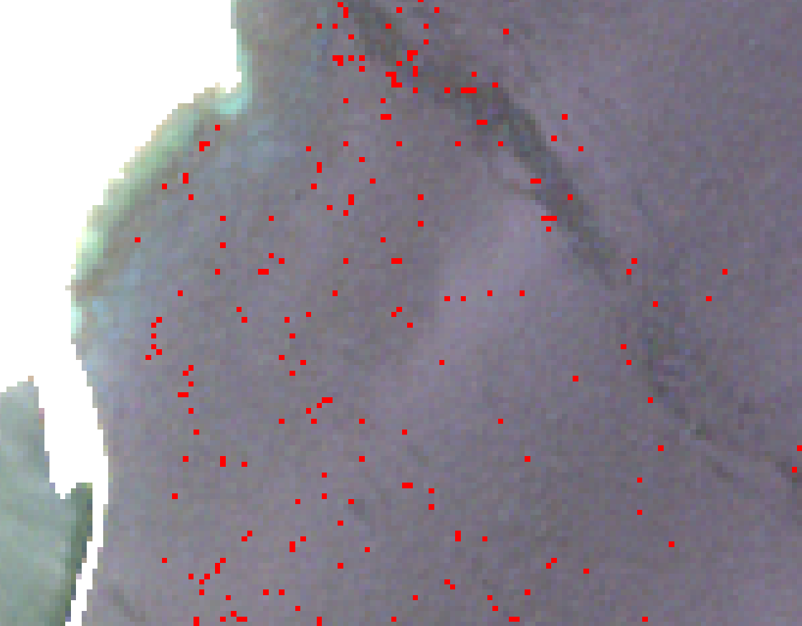
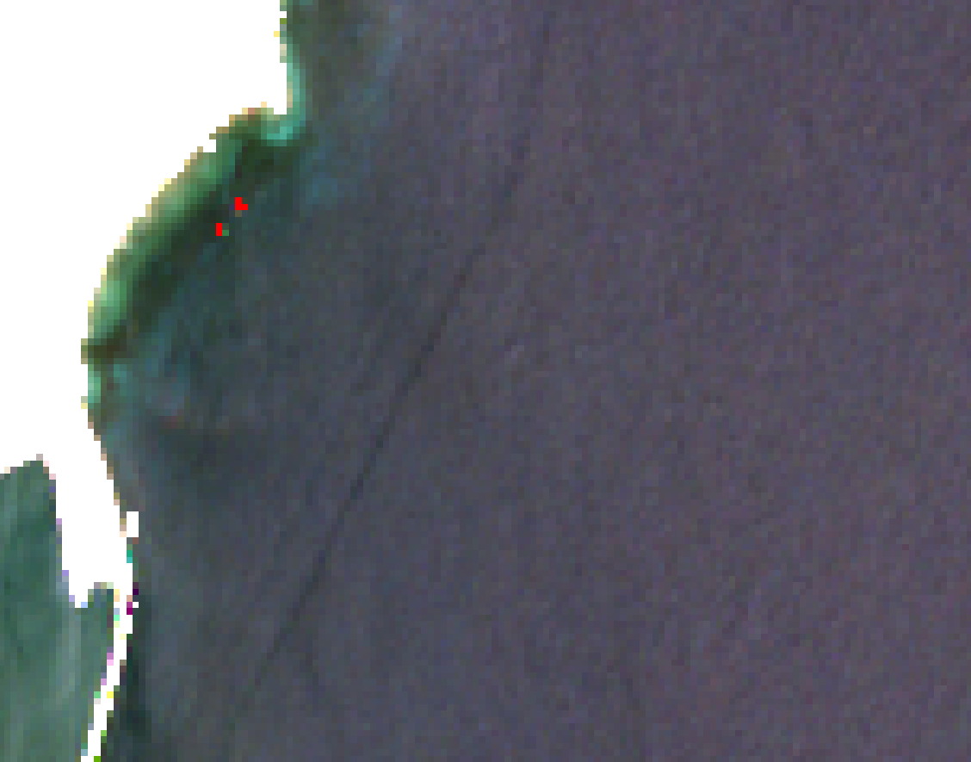
Initial Results
20180607
20190418
20190503
20190518
20190528
20190607
slide 11
MRSG – University of the Aegean Brest: Marine Debris Indicators – 2019

Slide 14
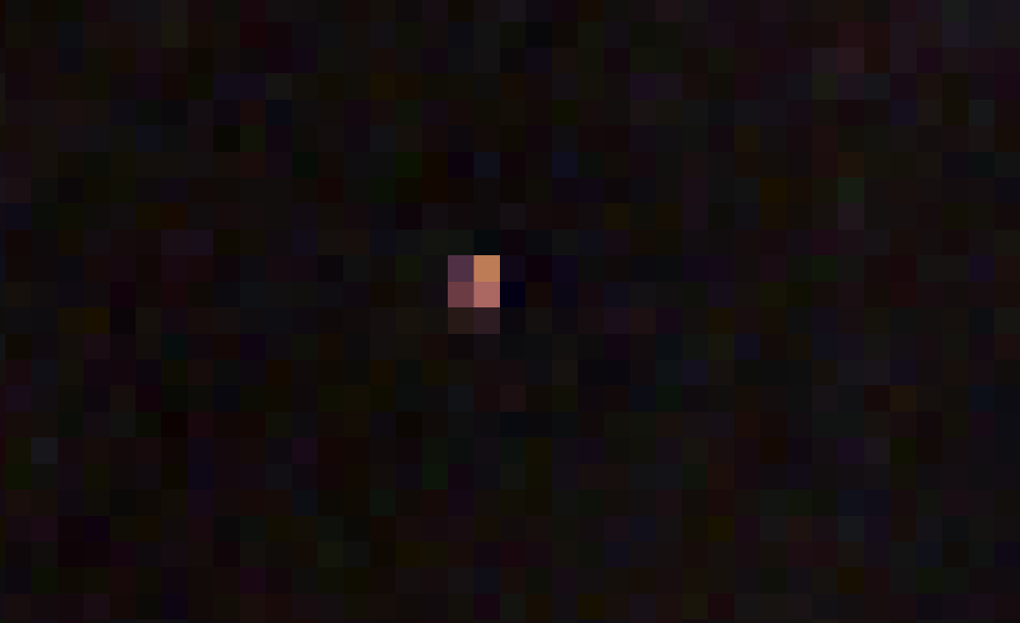
Initial Results
Flagged Pixels
slide 12
MRSG – University of the Aegean Brest: Marine Debris Indicators – 2019

Slide 15
Initial Results and Further Work
Factors affecting detection capacity:
plastic debris abundance fraction
sunglint
bottom reflectance
bidirectional reflection distribution function effects on Sentinel 2 images over water
band signal to noise ratios
aerosol/exhaust fumes/contrails, whitewater, cloud shadows, vessels/planes
Planned Future Work:
Development and construction of permanent at-sea infrastructure and re-deployable targets for calibration and validation of marine debris detection methodologies
Marine debris image database of characteristic polymers in realistic concentrations (satellite, UAS VHR multi- and hyperspectral imagery, field spectrometry)
Detection algorithm
slide 13
MRSG – University of the Aegean Brest: Marine Debris Indicators – 2019

Slide 16
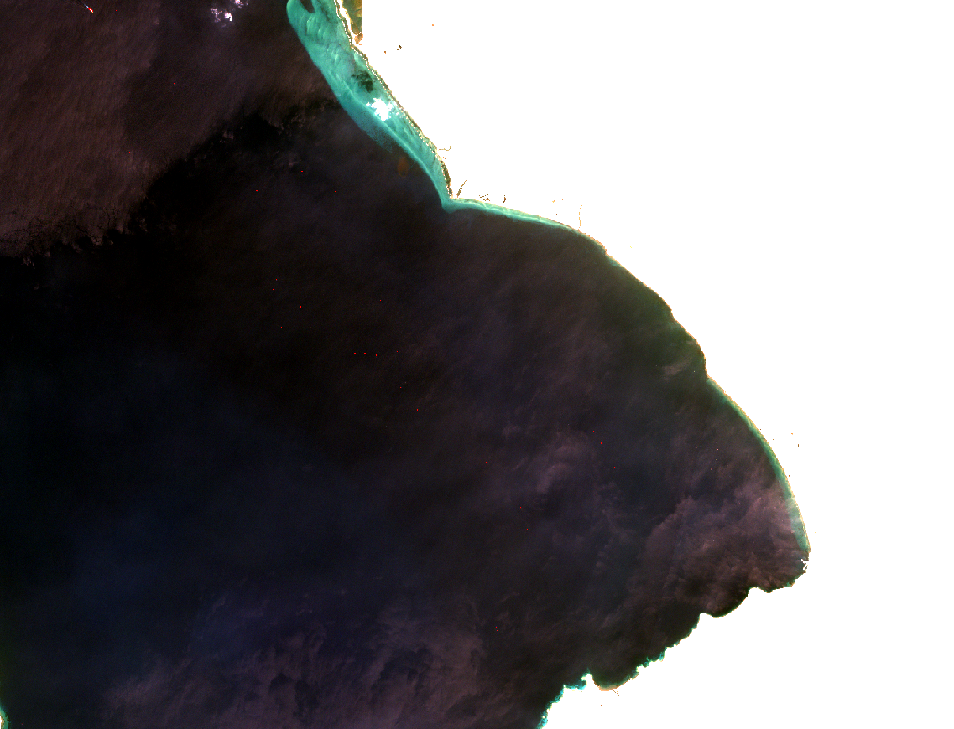
Thank you for your attention!
MRSG – University of the Aegean Brest: Marine Debris Indicators – 2019

