Slide 2


Companion modeling
Colaborative approach to reducing marine debris
16 12 2019
Julien Chupin, Consultant

Slide 3


Slide 4


Slide 7
Plan
Introduction
Tree problem
Systemic understanding - Madagascar
Driving change through a collective process - Cameroun
Conclusion
Notes:
Ce lance ds commod si le pb est un une question de prise de décision.
Si oui, il faut mettre du temps/budget ds plan de travail.
What are the problems you want to address?
Which problems is the road map addressing?
What do you retain? What needs to be further explored (interest/understading)?

Slide 8
Tree problem

Slide 9
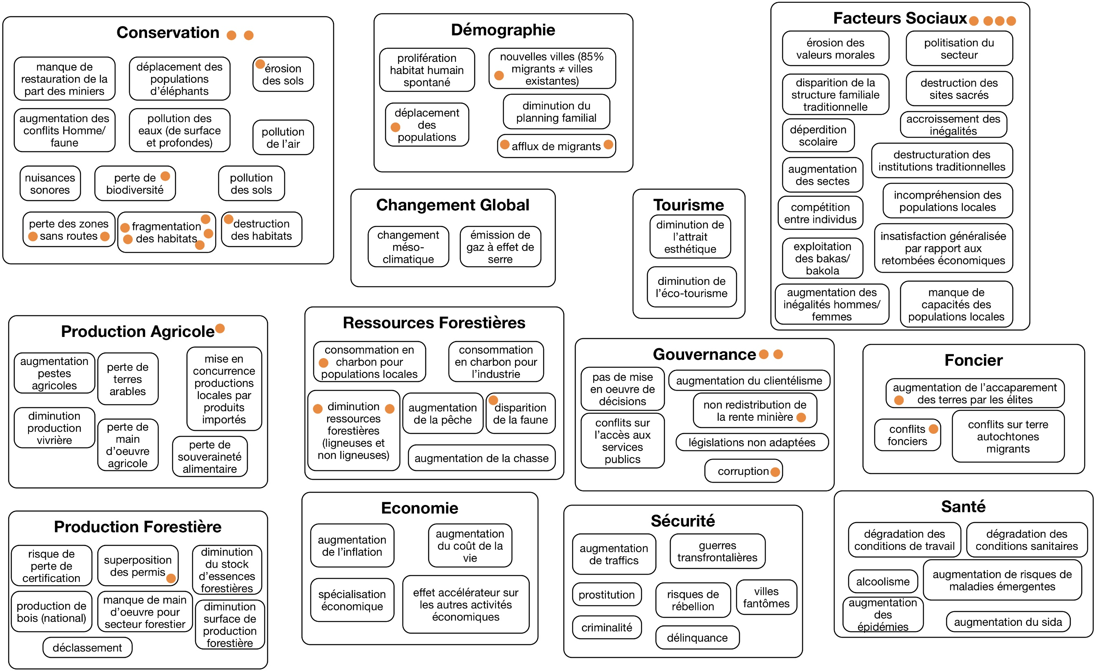

Slide 10
Group work
Hypothesis : you want to eradicate marine debris.
What are the problems you need to address?
Actors
Ressources
Dynamic
Internation

Slide 11
Which problems is the road map addressing?
Notes:
To what extent your contribution will contribute to resolve the problem?
Where to focus action?

Slide 12
Systemic understanding
Madagascar

Slide 13
Principles for how commons can be governed sustainably and equitably in a community. E. Ostrom
1. Define clear group boundaries
2. Match rules governing use of common goods to local needs and conditions.
3. Ensure that those affected by the rules can participate in modifying the rules.
4. Make sure the rule-making rights of community members are respected by outside authorities
5. Develop a system, carried out by community members, for monitoring
members’ behavior.
6. Use graduated sanctions for rule violators.
7. Provide accessible, low-cost means for dispute resolution.
8. Build responsibility for governing the common resource in nested tiers from the lowest level up to the entire interconnected system.

Slide 14

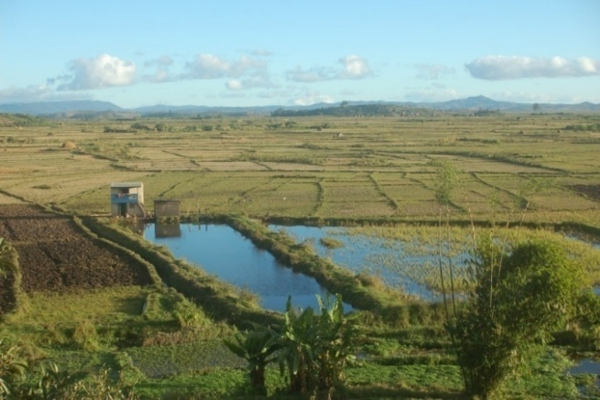
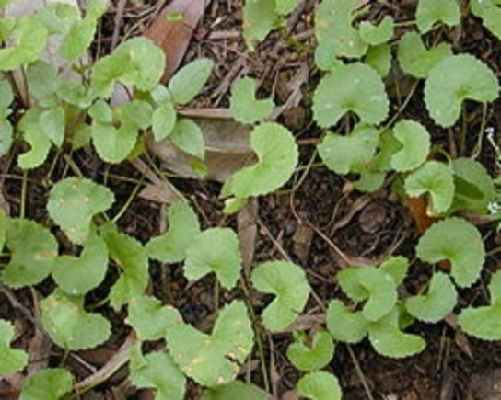
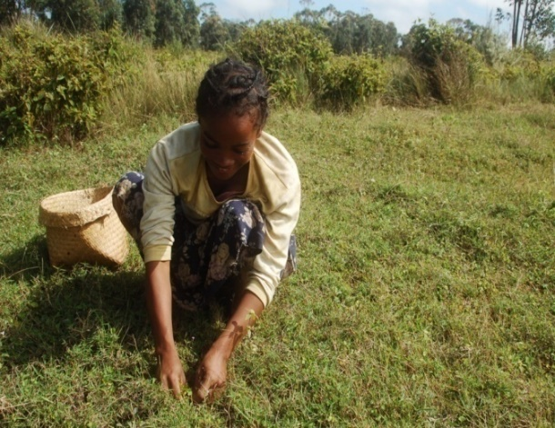
Centella asiatica, Madagascar
Notes:
Shortage of raw material
PovertyPoverty

Slide 15
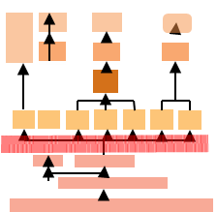
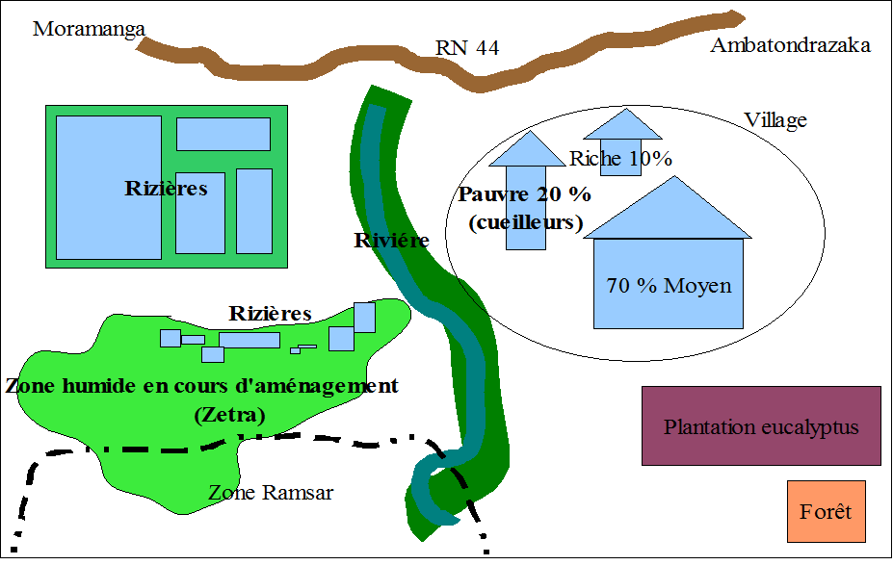
Notes:
L’augmentation de la demande pèse sur la régénération. L’exploitation repose sur l’extrême pauvreté des cueilleurs et un foncier peu sécurisé. Le contexte social, économique et politique est complexe et incertain.
Filiére :
_ Demande de gestion durable
des industriels
Coordination entre acteurs
par le prix et la qualité
du principe actif
Opportunisme des sous collecteurs
Territoire :
Régénération de la plante limitée
Cueilleurs vivent sous le seuil de pauvreté (0,5€ / jour)
Savoir faire des cueilleurs
(bonne technique de cueillette)
Centella contribue à leur
sécurité alimentaire
Exploitation reposant sur l’usufruit (foncier)
Ce projet de recherche/action traite des impacts des pratiques agricoles sur la biodiversité et aborde les enjeux de la valorisation des services écosystémiques avec
un ‘sourcing’ durable.
Maîtriser les impacts des pressions et des conditions pédoclimatiques sur la ressource et les taux de principes actifs
Équilibrer le développement de la chaîne de valeur et les impacts économiques et sociaux dans le territoire de production
Approfondissement :
Modélisation : validation et calibration du modèle avec les acteurs
Appropriation des solutions : exploration et simulation de scénarios avec les acteurs
Nouvelle plante, nouveau terrain : ?

Slide 16
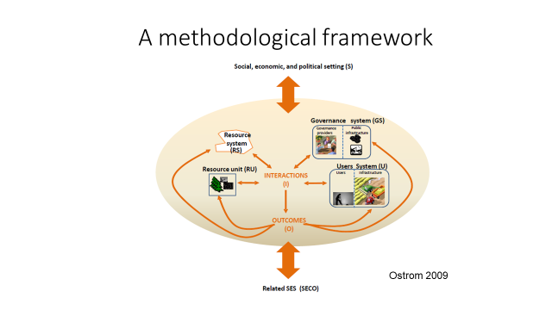

Slide 17
Scenarios : sustainable and fair exploitation
 | 1/ Curent system | 2/ Demand increase | 3/ Poverty increase | 4/ Climate change impacts increase | 5/ Centella is a star ingredient
Secure sourcing of raw material
Leafpicker income
Plant regeneration
Quality of the active principles
Notes:
L’avenir de la filière n’est pas garanti si des alternatives apparaissaient ou si les problématiques constatées s’amplifiaient
Biologie de la plante : teneur en principes actifs est sous contrôle à la fois de déterminants génétiques (Rakotondralambo et al., 2013), environnementaux (Alqahtani et al., 2015) ou à la pression de la collecte (Rahajanirina et al., 2012, 2016).
Organiser la filière de production : La filière et le mode d’organisation territoriale ne garantissent pas une gestion de la ressource ni un rééquilibrage du partage de la valeur ajoutée au profit des populations locales (Chupin et al., 2012).

Slide 18
Individually, actors are limited to adress these issues.
Quality
Demand for sustainable sourcing
Coordination
Opportunism
Technology
Price
Sub-collector
Food sovereignty
Regeneration plant
Land use
Usufruct
Hierarchy & social organisation
Leafpicker
Poverty
Notes:
There are many drivers to this situation. They all are interconnected between the supply chain and the production area.

Slide 19
Driving change through a collective process
Cameroun

Slide 20
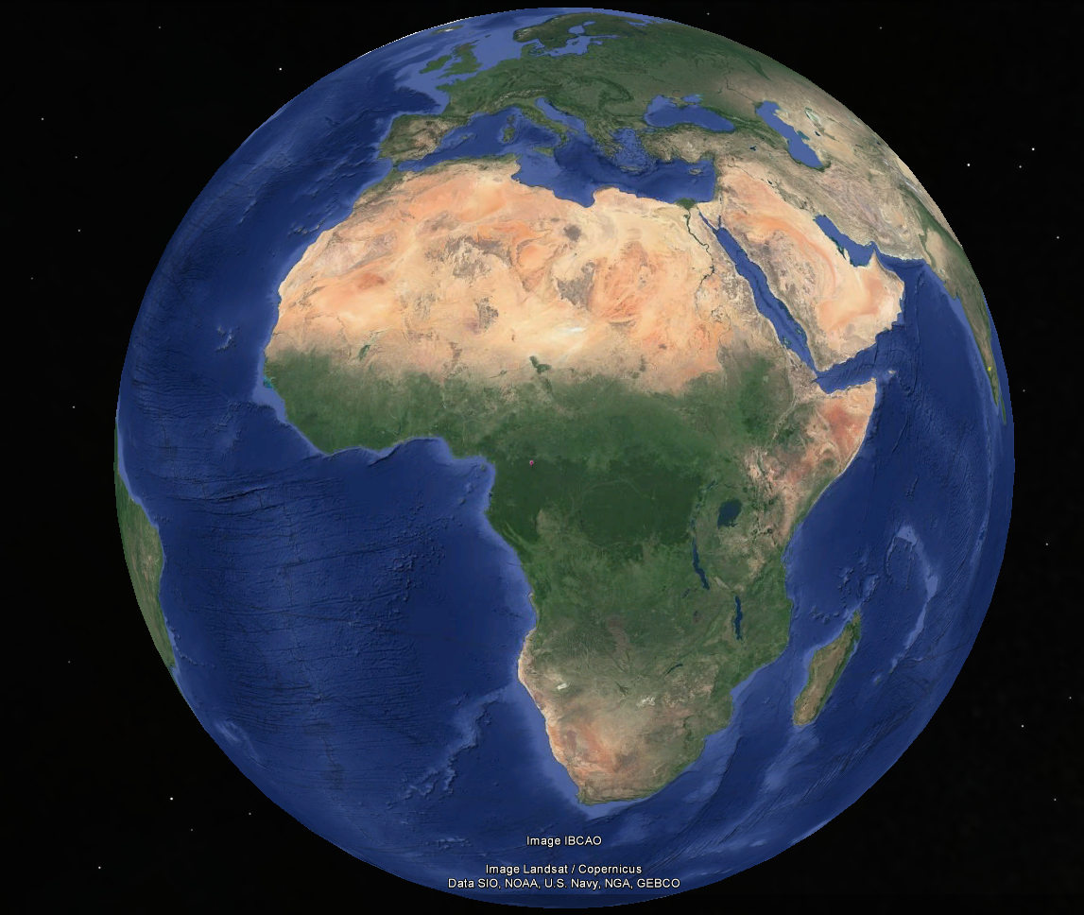
Central Africa

Slide 21
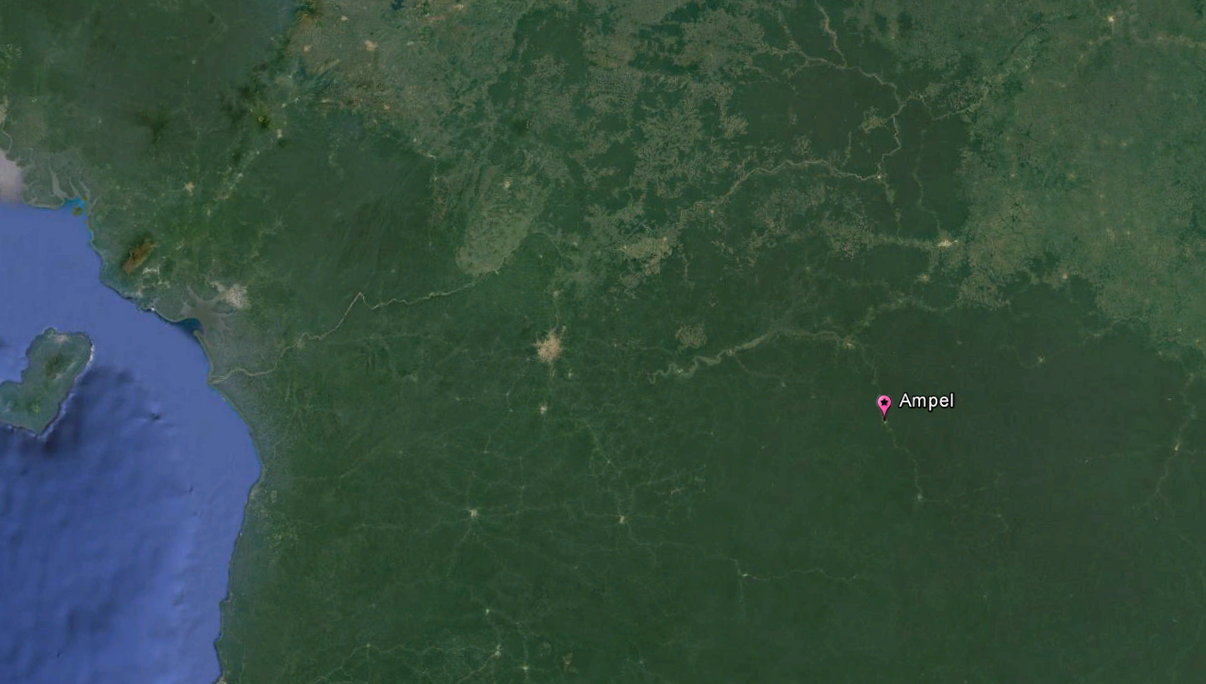

Slide 22
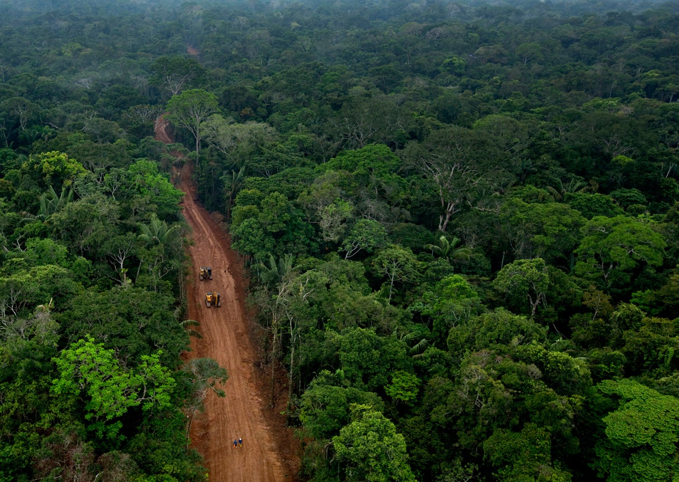
Notes:
Why are we loosing forests? Three main reasons : agricultural conversion – both large scale industrial projects and small scale local communities – infrastructure expansion – mining, roads, dams, cities – and logging. Fire and natural hazards also contribute, but less. We drive deforestation. This is the Anthropocene. Human decisions dwarf natural processes. Yet, agriculture, infrastructure and logging happens, always, because of a combination of five different factors – demography, ( migration, growth) ; economy ( markets, prices, funding mechanisms) ; technology ( caterpillars and chainsaws trump bicycles and machetes) ; policy and governance ( tenure rights, corruption); and culture (people’s aspirations, forests as a frontier). That’s it. That is all there is. Everyplace in the tropics you look, you will find these three main drivers, and an combination of these 5 underlying factors. Their relative weight will change. In Cameroon you will have demography issues, in Madagscar technology bottlenecks, in Indonesia market forces and in Bresil a culture of frontier development. But the point is, there are always there, in a complex web of interconnections and feedback loops. If you pull here, the system will push there. It is overwhelming. It is extremely difficult to anticipate how things will evolve. I cannot. I actually think nobody can. No brain is equipped to think through this complexity. It is like asking someone to play chess with a blindfold, with multiple opponents at the same time. Some people can. I can’t. And I think very few people can. So no wonder we have not yet managed to stop and reverse the trend of forest loss. We need to think the future of tropical forests to make them happen, but thinking the future requires a mental model of how things work. Else it is just daydreaming. So how do we do that? How do we imagine the futures of tropical forests?

Slide 23
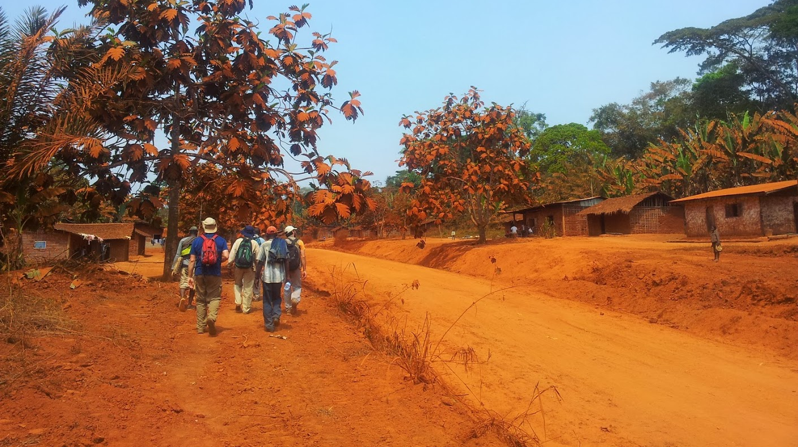

Slide 24
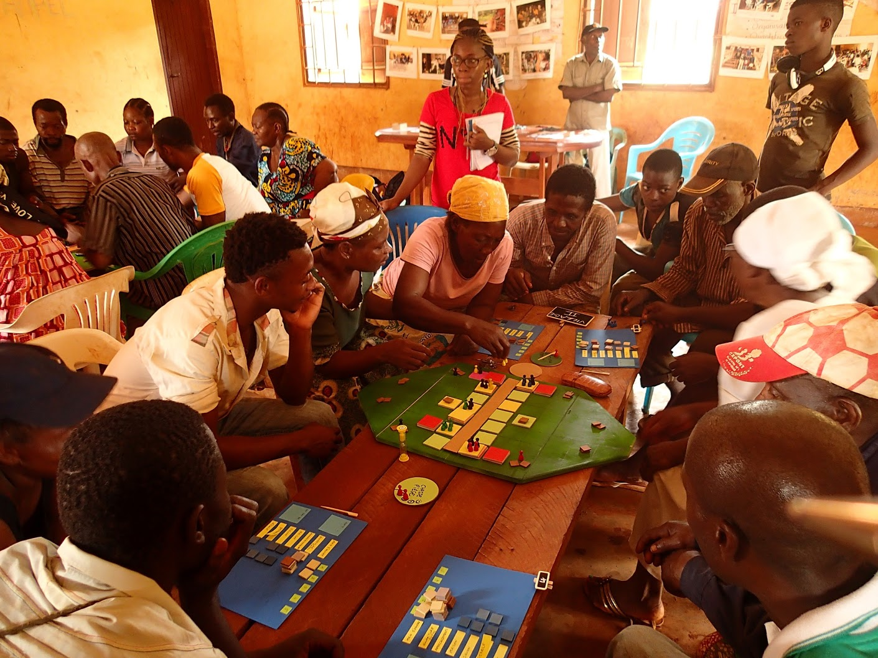

Slide 25
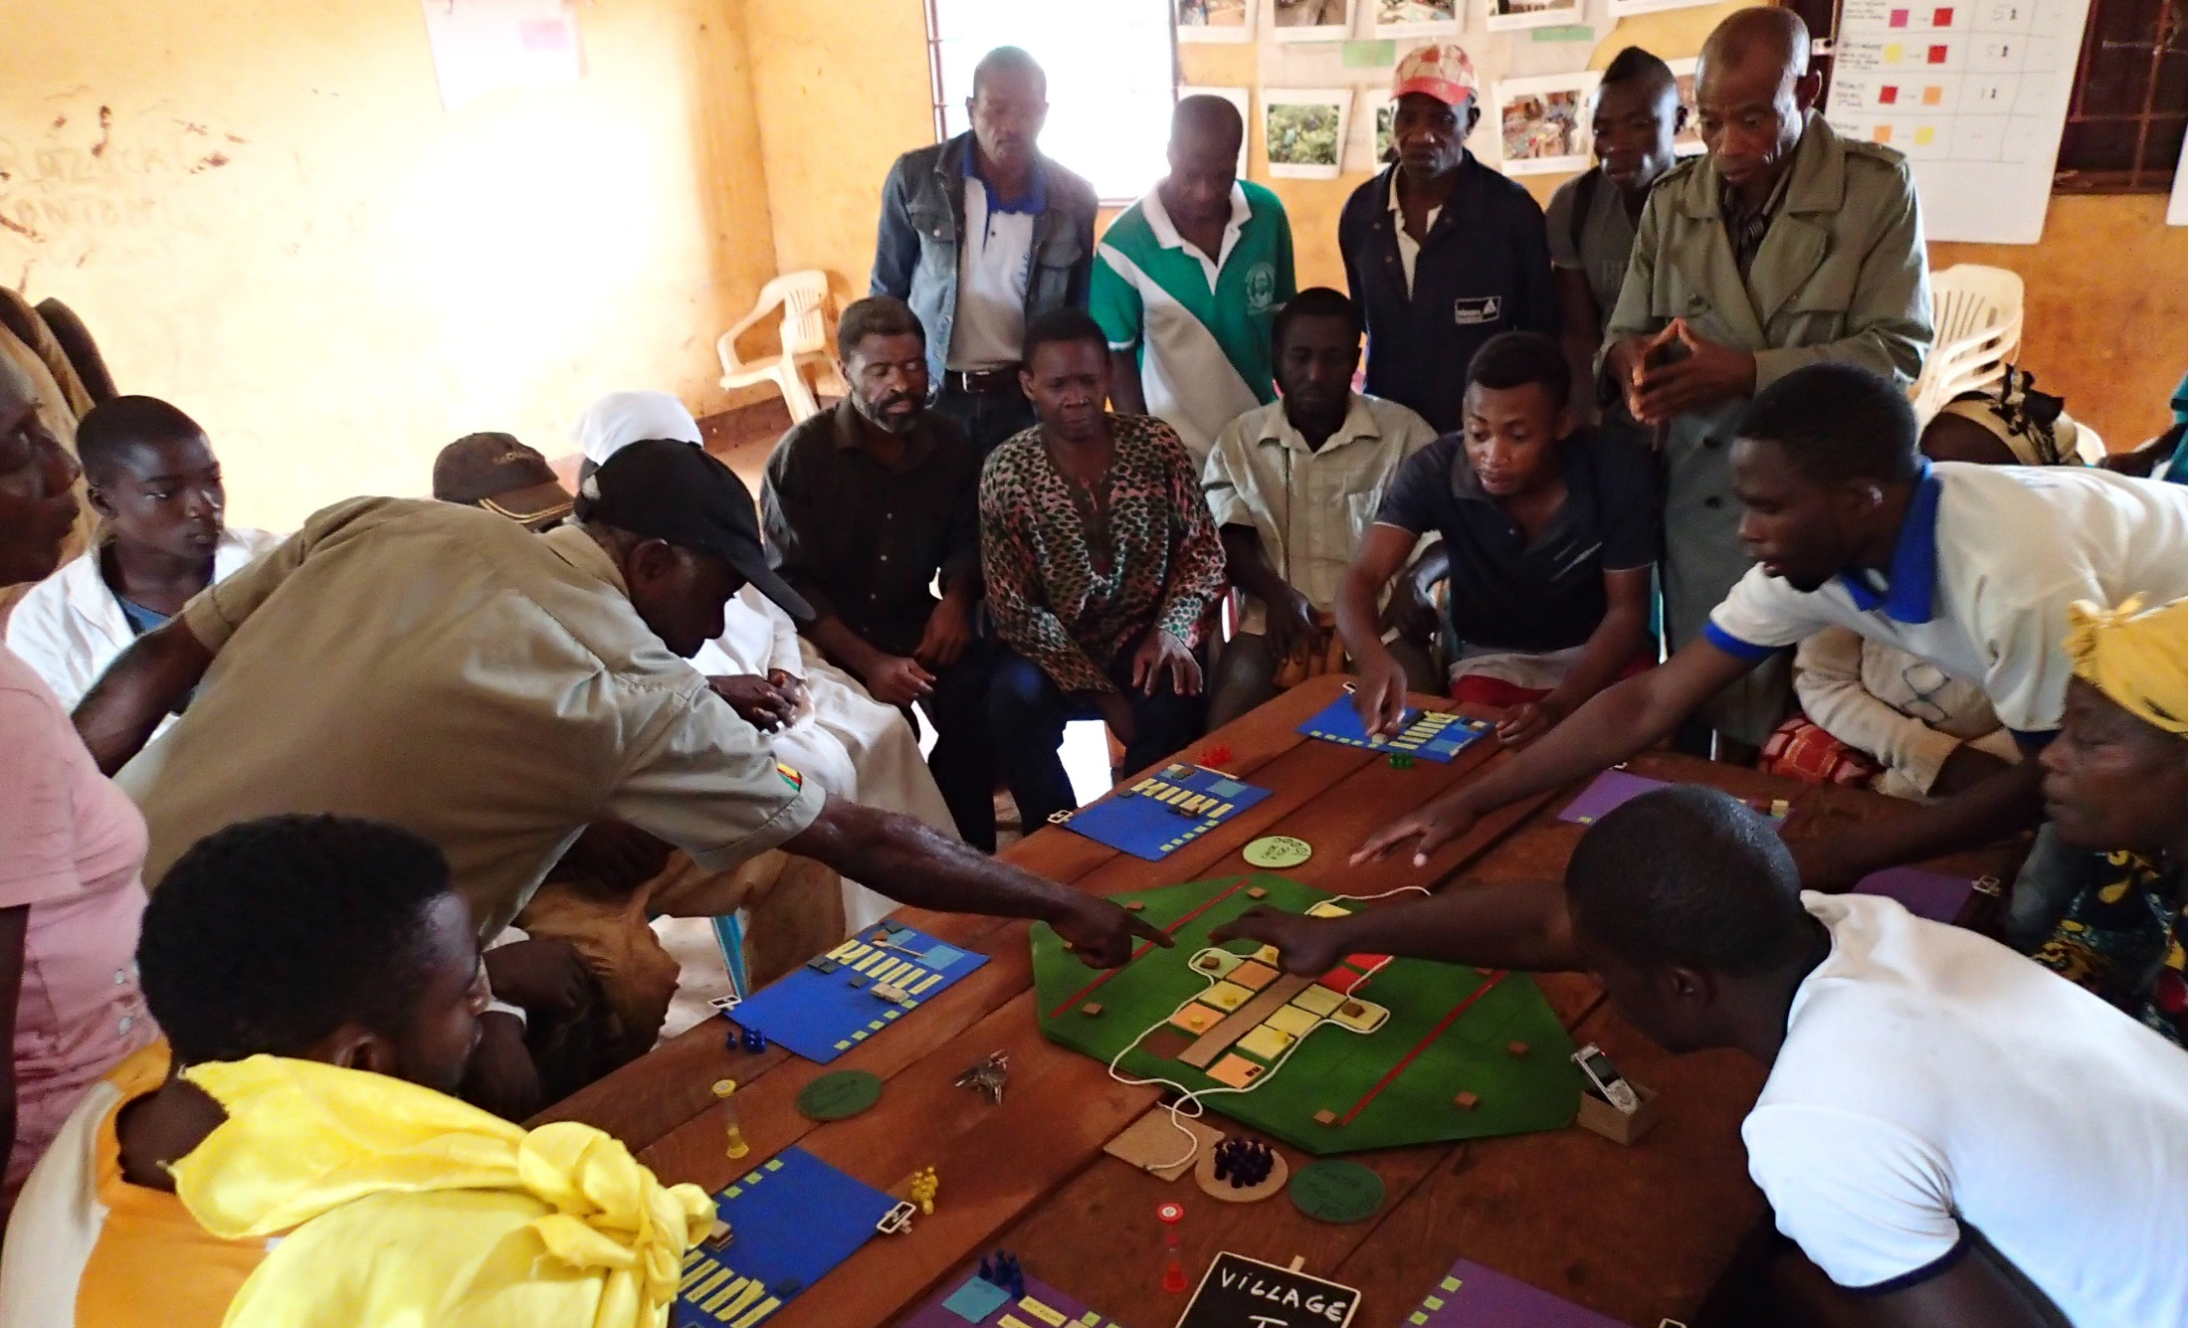
Notes:
Back to the village – to negociate tough problems – here the arrival of migrants and the need to renegociate access to land.

Slide 26
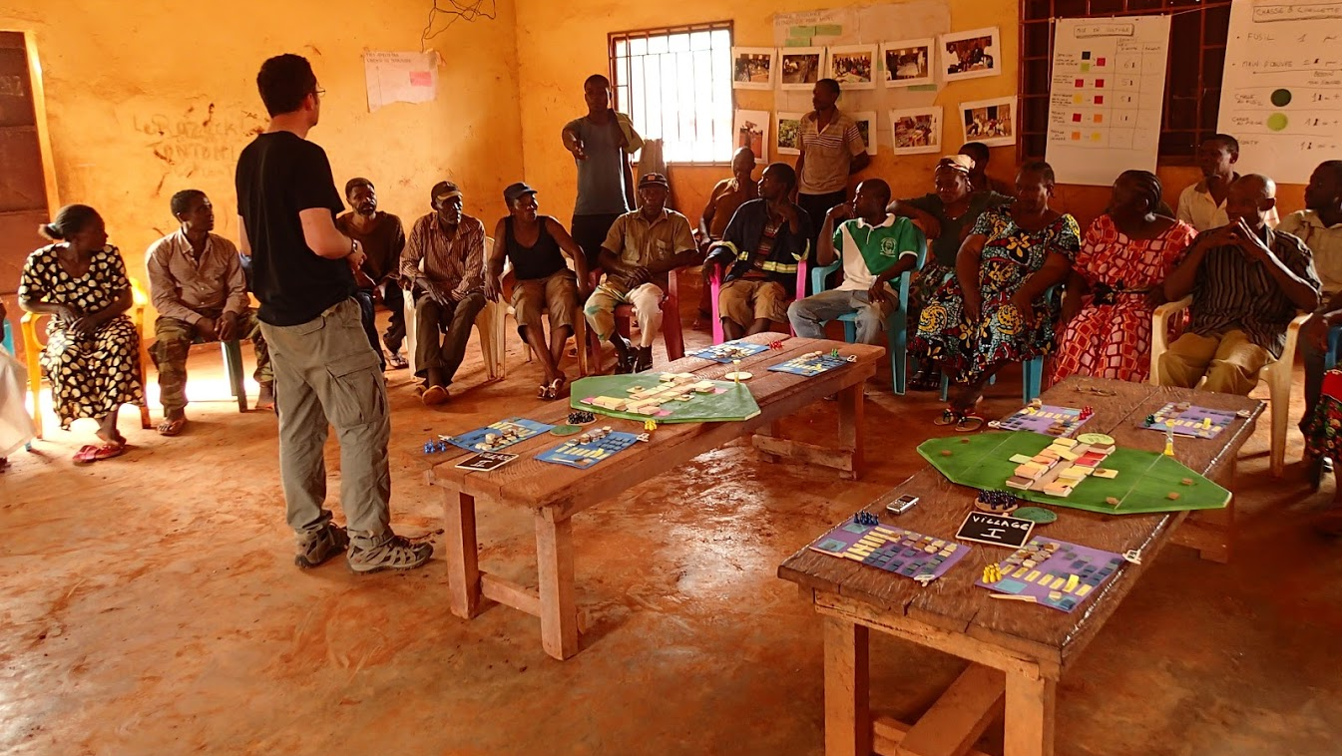

Slide 27
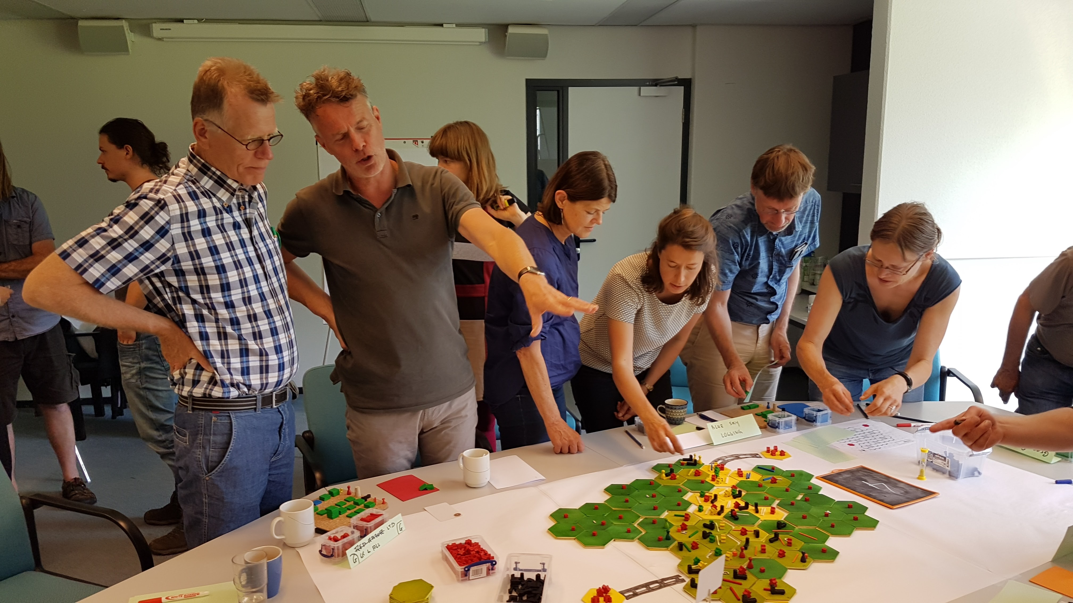
Notes:
In academia, with scientists from different disciplines, to map out gaps in knowledge and identify future research opportunities – here at Tropenbos international in the Netherlands

Slide 28
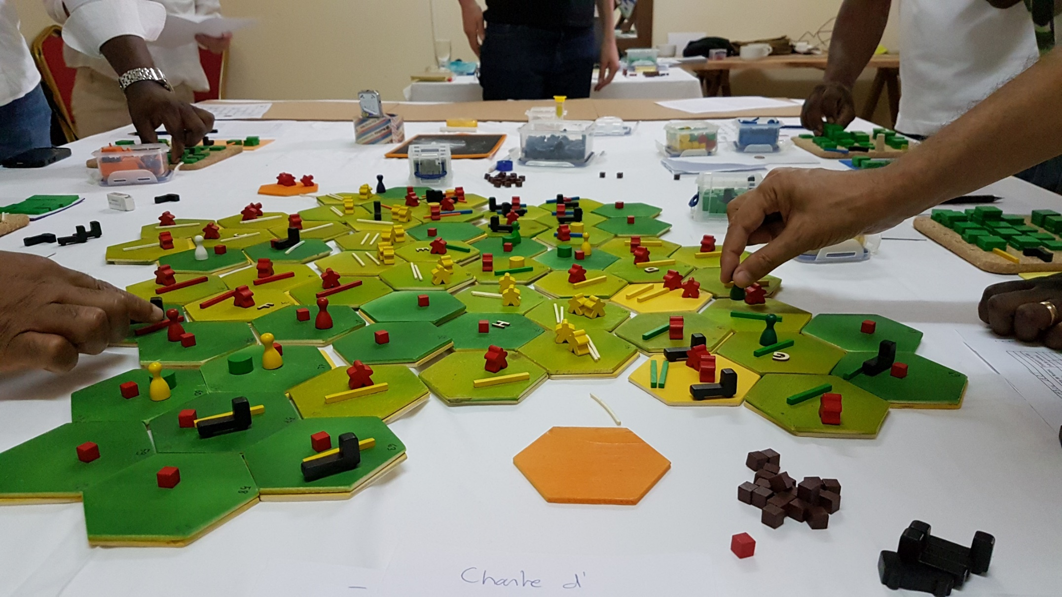
Notes:
We invited them to use one of our games. Originally designed to explore the interactions between mining and logging – but with all the elements that were relevant to the discussion about IFL.
This is when we came in. We offered FSC to use a game we had developed in parallel to explore the interactions between mining and logging. The model depicted the changes in an archetypical landscape of central Africa, with forests, biodiversity, local people, roads, markets, logging companies, governments and banks.
It was a difficult decision for FSC and for the negociators. They were running out of time and resources, and playing a game? Really?

Slide 29
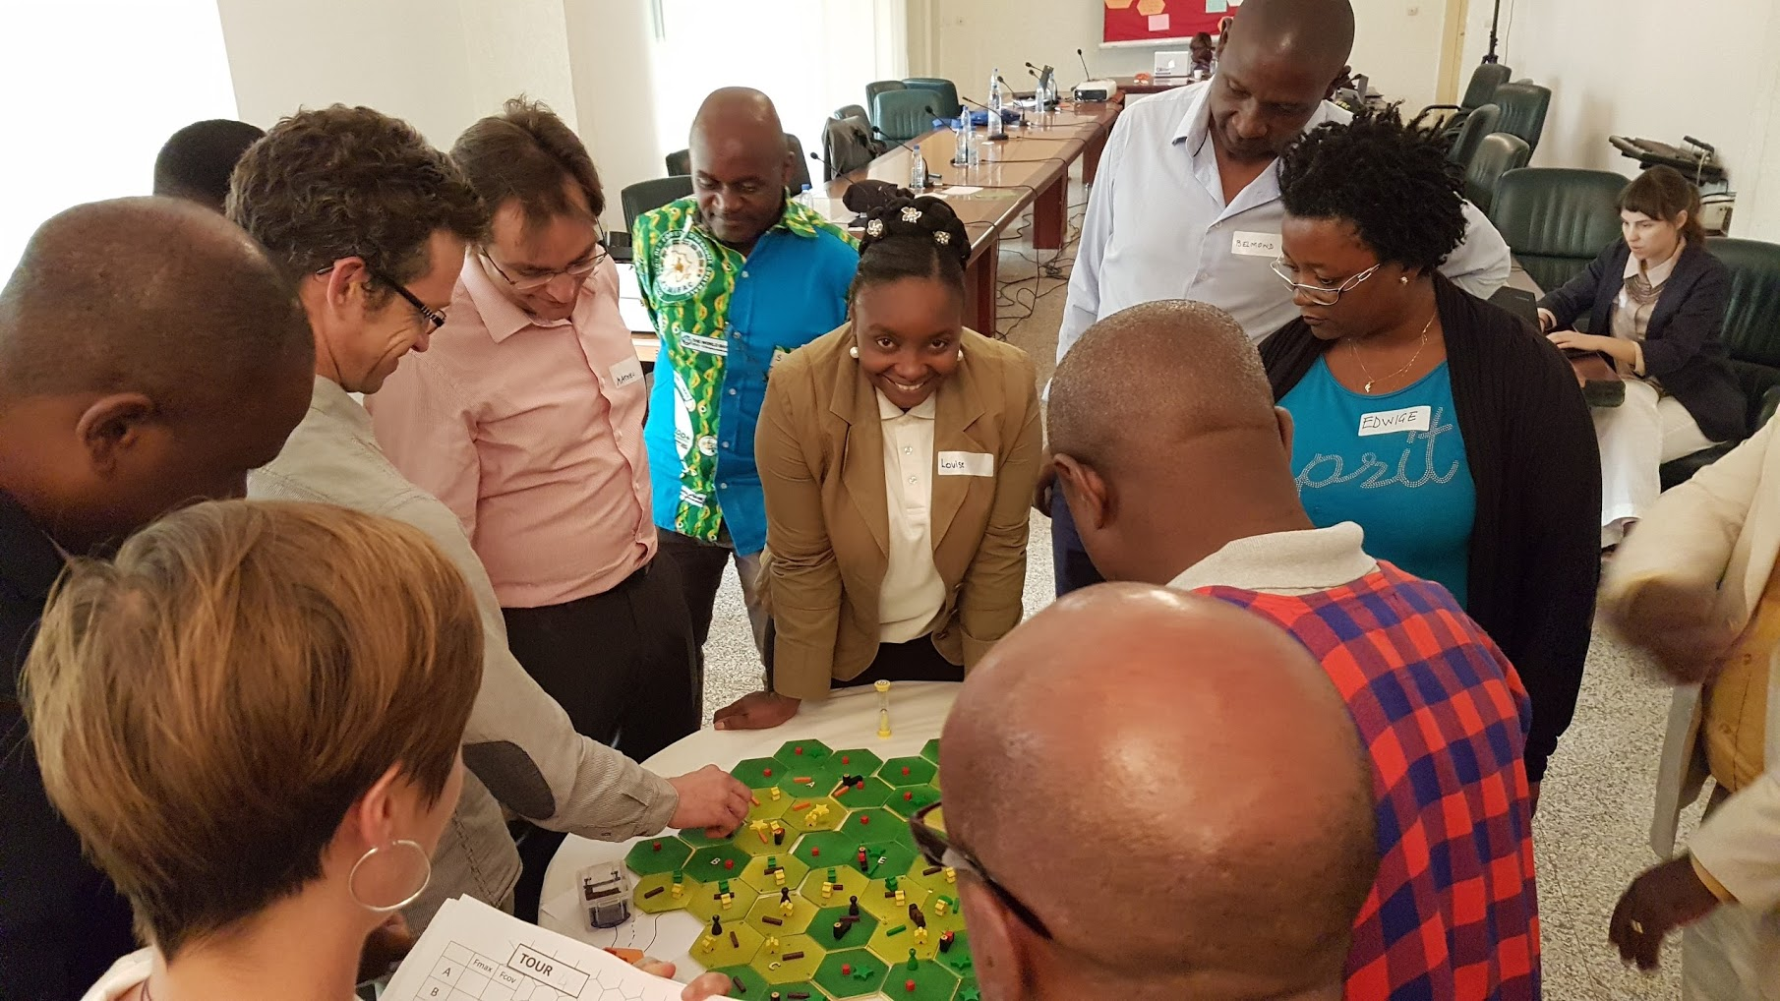

Slide 30
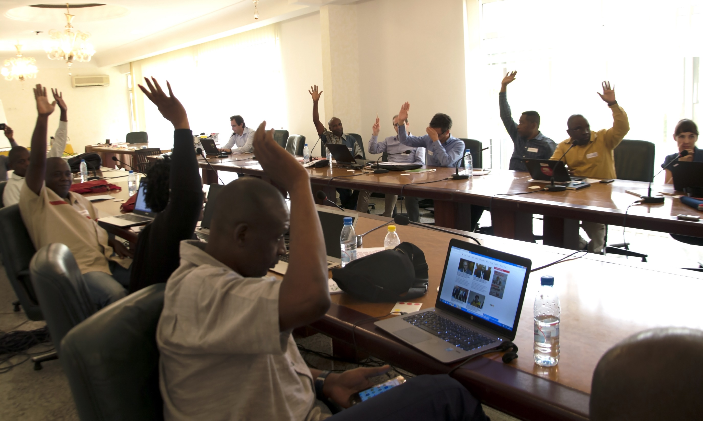
Notes:
And on the third day, we had that. We built agreement. In three days, the game took the participants from gridlock to agreement. That was the end of the workshop. The press came in. Outside observers came in. People put back on their official hats, and the team effectively disabled. Everybody reported to their superiors and it still took a while. But on April this year, the agreement we had outlined together was signed by all parties.
I don’t know what the future of the forests of the Congo Basin will be, but I know we changed it. Thanks to a game. Thanks to the players. And thanks to a bold convener that accepted the idea a game can be useful in a real, high stakes negotiation process.
The agreement has been critiqued since by people who either were not present or that did not want to join the discussion. That’s to be expected. That is how things work. The important things is to understand that this is what agreements are for. To lay the foundations of collaboration. The negotiators moved from a null-sum game where the choice was timber, land or chimps and muscle the only currency, to actively seek win-win outcomes, identifying strategies that would work for all parties. No doubt the agreement will evolve, as our knowledge increases. Life is full or surprises and sometimes they are good.

Slide 31
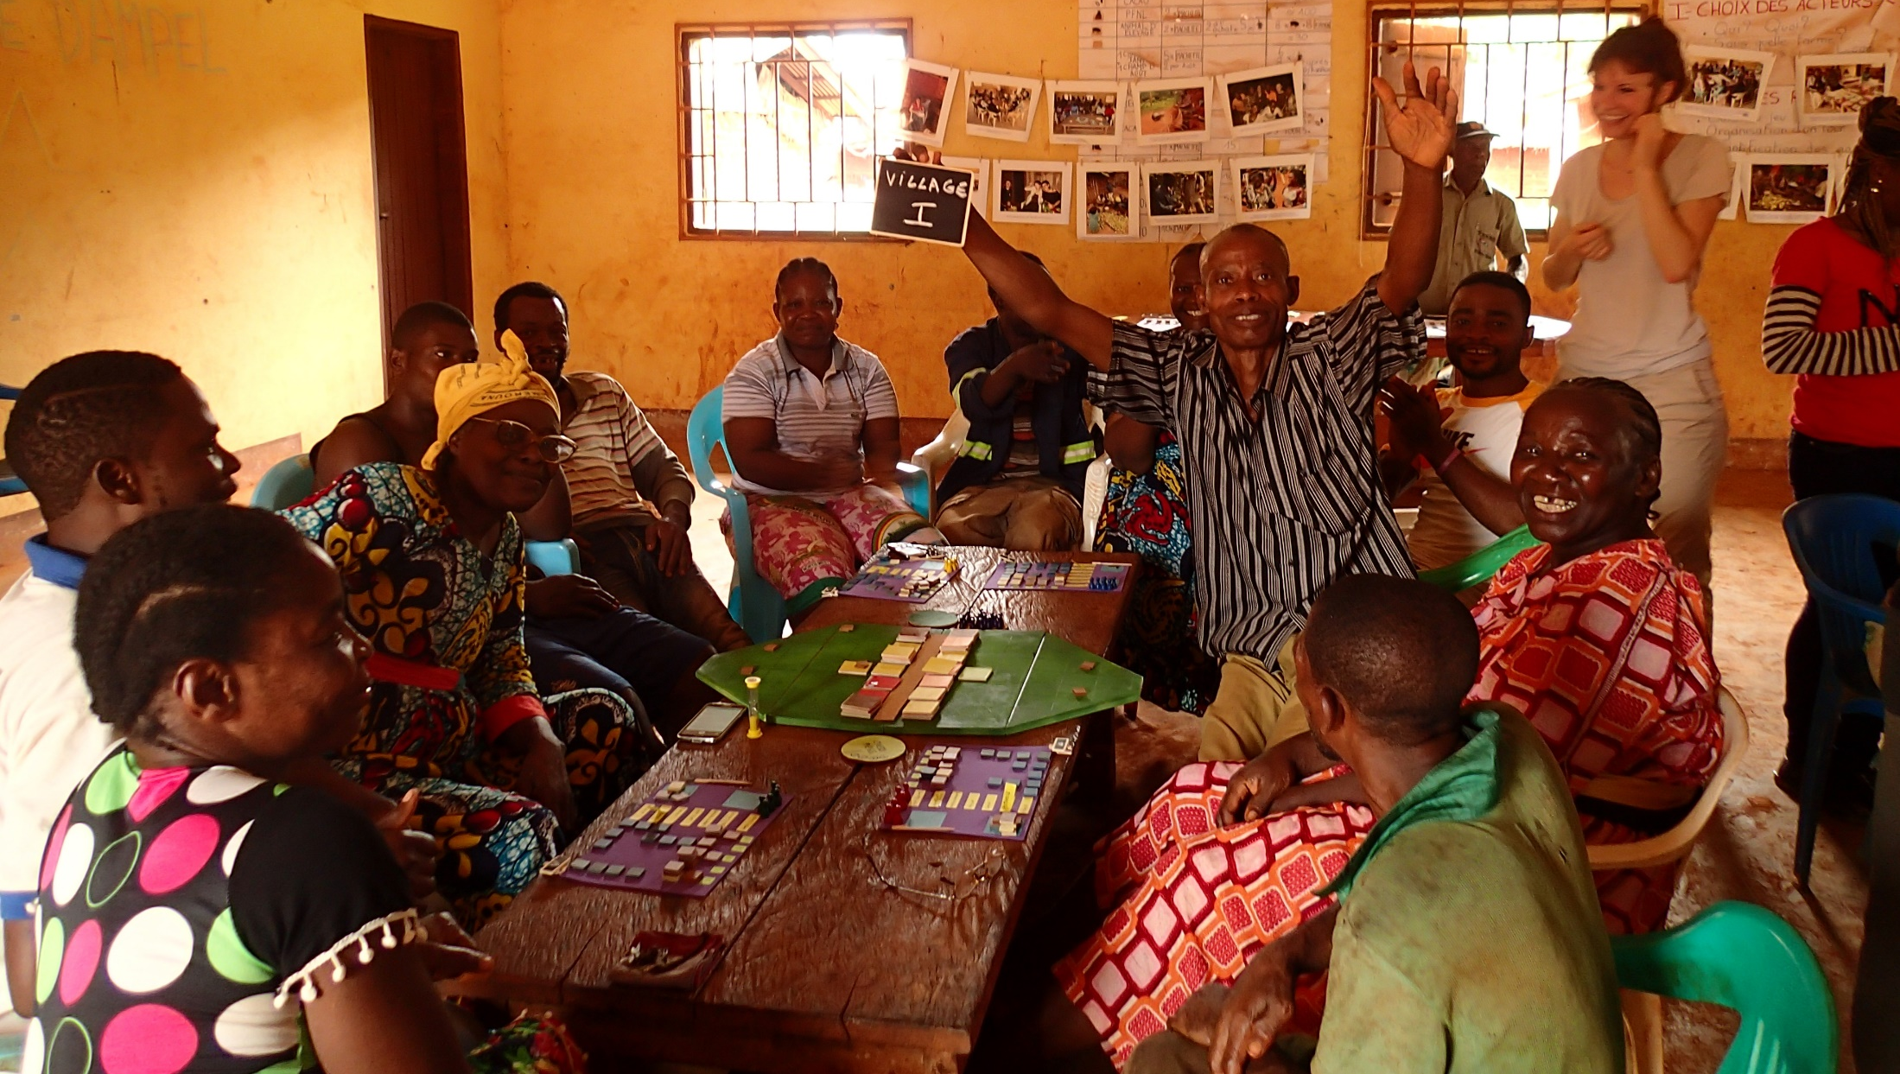
Notes:
In the end, this is what we seek. People empowered to take better decisions today about the future they want tomorrow. It works. It needs good games, and we know how to design them. It needs facilitation and we know how to listen. It needs the right players at the table. And more importantly, it requires a convener that is willing to change things and is not afraid of trying out new approaches. This is the role the FSC Program of the Congo Bassin played. We need more of these. Maybe you should try.

Slide 32
Scientific input a key success factor

Slide 33
Questions
What do you retain?
What should be further explored?

Slide 34
Plastique : thématique nouvelle. D’où besoin des scientifiques à la construction du modèle pour soutenir le dialogue
A rédiger…

Slide 35
Conclusion :
Théorie de changement
Comment ils pensent que leur contribution va aider à résoudre le pb?
Pourqouoi pas fait?
D nvl choses à faire?
Quel sont les pb ? Arbre à pb. Tour d’horizon. Ok road map. Mais, est ce qu’elle tape au bonne endroit?
Nous sur quoi on veut mettre l’accent?
Ce lance ds commod si le pb est un une question de prise de décision.
Si oui, il faut mettre du temps/budget ds plan de travail.
Echelle de participation :
Enjeux :
Ambition :
Objectif :
Plan :
 | Avantages | Challenges
 | Permet une compréhension nouvelle du système et des enjeux | Require a strong political ‘onwership’
 | Pose une fondation solide pour construire une nouvelle organisation et des partenaraits
In which context is companion modeling best suited?
Notes:
Questions :
Hypothéses sous jacentes.
Est-ce que leur contribution appuie la où ça fait mal.

Slide 36
Commod : prise de décision
Arbre à pb :
Avec 6, 1 an deplus : mada cam
Votre roadmap: appuie t’elle aux bons endroits?
  Si vous deviez retenir un point positif en sortant de la conf! Lequel ?
  Au vu de votre exp, quel point sur lequelle ctte approche mériterai d'etre approfondi

