Slide 1
SDG 14.1.1
Jillian Campbell, UN Environment

Slide 2
The SDGs Process
Slide numbers to be added
as shown alongside

Slide 3
Sustainable Development Goals
17 Sustainable Development Goals (SDGs)
169 targets
244 indicators
https://unstats.un.org/sdgs/indicators/indicators-list/
© NABU/Holger Schulz
Notes:
The SDGs represent a global commitment at the highest level. The framework includes 17 goals, 169 targets and 244 indicators. These indicators have been globally agreed and are reviewed by the High Level Political Forum (a General Assembly body) each year. The SDGs not only have elevated the recognition of the importance of oceans to the highest level through a dedicated goal on oceans, but they provide us with an opportunity to have science and data on oceans feed into high level national and global policy discussions.
However, currently many of these discussion focus on topics where data is available – it is a bit of a catch 22, you need data to demonstrate the importance of a topic, but you need to demonstrate the importance in order to stimulate an investment in data. For oceans, many countries have not been investing the systematic collection of marine related data and thus we need forums such as OceanObs to help move the dial in terms of developing data products which are comparable across all regions of the world and which have the granularity necessary to provide countries with information specific to their coastlines, including sub-national information.

Slide 4
SDG indicator framework
SDG Goals and Targets were set by Member States with the adoption of the 2030 Agenda for Sustainable Development (2015).
The General Assembly tasked the UN Statistical Commission with developing a monitoring framework.
Inter-Agency and Expert Group on the SDG Indicators (IAEG-SDG), 30 member state members, established to develop the indicator framework.
IAEG-SDG agreed on a framework of 244 indicators and designated UN agencies as custodians of the various indicators. (adopted by UN General Assembly in 2017).
© NABU/Holger Schulz
Notes:
https://unstats.un.org/sdgs/iaeg-sdgs/members
Just in terms of a bit of additional background on the topic, I want to share how data flows into the SDG global database. Basically, the process is rather rigid, academics and others who might have data cannot directly share the data into the SDG global database – the data can only be shared by custodian agencies which have a methodology which has been adopted by the IAEG-SDG.

Slide 5
The reality of SDG reporting:
Reporting on the SDGs
UNISDR
UNAIDS
WHO
ILO
FAO
National Data
ITU
UN Environment
SDG Custodian Agencies
UNCTAD
World Bank
UNSD
UNICEF
UNODC
…
UNESCO
OECD
Development of methodologies, support for data collection and analysis, quality assurance, harmonisation for international comparability, overview of regional and global progress, thematic reviews, analysis of data gaps or challenges
SG’s Progress Report and Annual SDGS Report
SDG GLOBAL Database

Slide 6
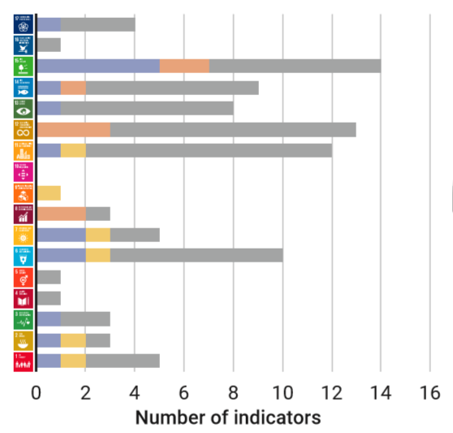
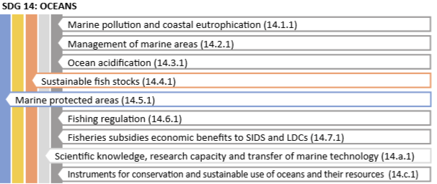
SDG 14 scorecard
Notes:
In an analysis of UNEP in March this year, Measuring Progress towards achieving the environmental dimension of the SDGs, we looked at which SDG indicators had sufficient data for tracking global level progress – we did this across the indicators which we see as environmental. For Oceans, we are only able to track progress for 2 of the 9 environmental SDG indicators. What this means is that the data that does exist in not currently feeding into this global level tracking. We need to upscale our efforts to ensure that the best available data is used, otherwise we will miss the opportunity to use this data to feed into policy. Additionally, the IAEG SDG is already in the process of identifying alternative indicators (proxies) which are often not related to the SDG targets or to oceanic data.
If we are not able to use real data to show what is happening to the oceans, then we will have no way to use this information to create change : or in simple terms, data is only useful if it is used.

Slide 7
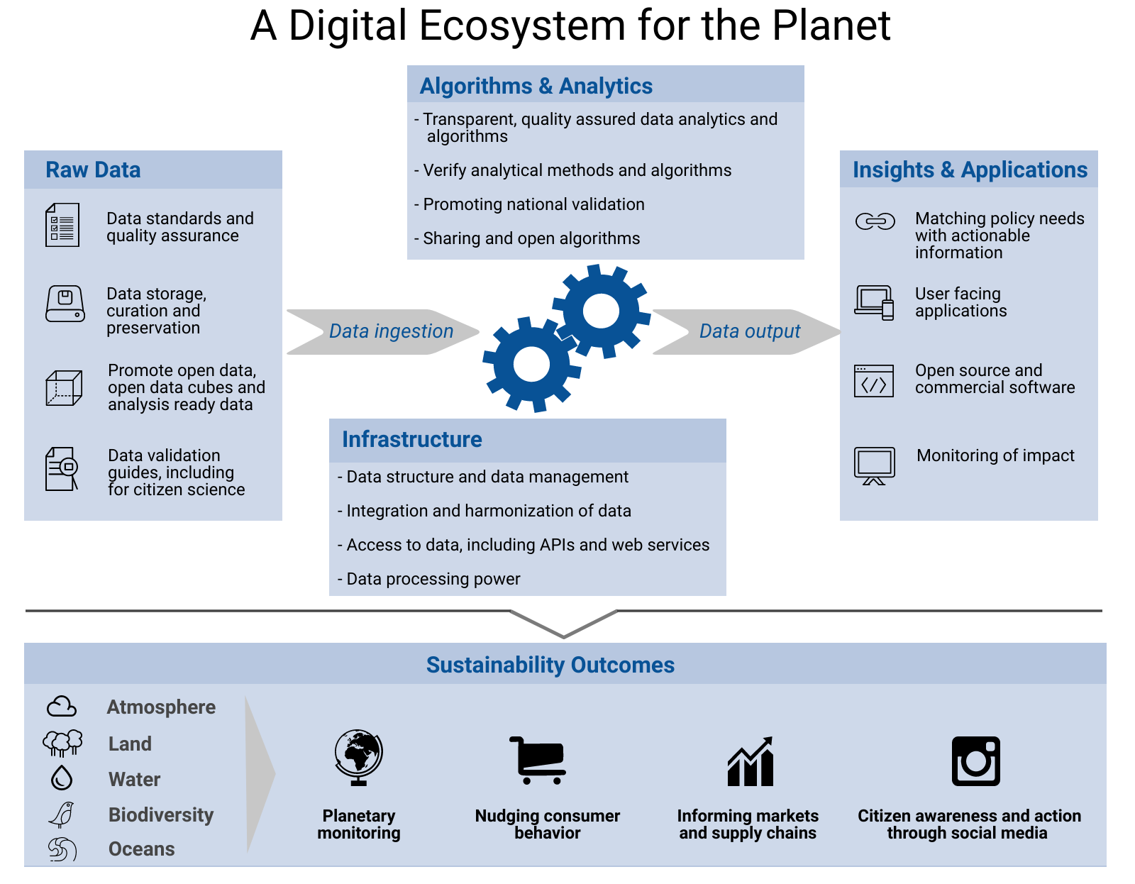
Notes:
In order to harness the opportunities that new technologies and data present, there is a need to make a concerted effort toward building a digital ecosystem for the environment as a global public good. This would involve:
identify what data and insights we need – matching policy needs with actionable information;
to promote data quality assurance, data sharing and openness;
to promote collecting new data in cases where there are persistent data gaps;
to create an underlying infrastructure for bringing together and making accessible public and private data still ensuring the privacy of individuals;
to promote a culture of innovation which can nurture the development of innovative algorithm and data analytics, and
Create insights and application which help people visualize planetary monitoring, nudge consumer behavior, inform supply chains and inform policy.
We already have a few examples, of where we have seen progress, but we need more. We are hoping that this workshop and opportunities like the Bloomberg Data 4 Good Exchange will help take us in the right direction.
Before I hand over to the other presenters, I will share a few quick examples. For more information, we also have recently published a medium article which

Slide 8
2. SDG 14.1.1
Slide numbers to be added
as shown alongside

Slide 9
Indicator 14.1.1
Goal 14:
Oceans
Target 14.1:
By 2025, prevent and significantly reduce marine pollution of all kinds, in particular from land-based activities, including marine debris and nutrient pollution
Indicator 14.1.1:
14.1.1a Index of coastal eutrophication (ICEP)
14.1.1b Plastic debris density

Slide 10
Approach:
Progressive monitoring approach
Level 1: Globally available data from earth observations and modelling
Level 2: National data which will be collected from countries (through the relevant Regional Seas Programme, where applicable (i.e. for countries that are a member of a Regional Seas Programme)
Level 3: Additional indicators which are suggested that countries might consider collecting (these are not discussed in this document)
Global data will be used to estimate some sub-indicators for ABNJ (Areas Beyond National Jurisdiction)
Notes:
Institutional and governance:
Materiality assessment
Sustainability strategy and/or principles related to sustainability
Management approach to address materiality topics
Governance structure, including for economic, environmental and social issues
Key impacts, risks, opportunities
Anti-fraud, anti-corruption and anti-competitive behaviour practices
Economic:
Direct measure of economic performance (revenue, net profit, value added, payouts to shareholders)
Indirect measure of economic performance (community investment, investment in infrastructure or other significant local economic impact)
Institutional and governance:
Materiality assessment
Sustainability strategy and/or principles related to sustainability
Management approach to address materiality topics
Governance structure, including for economic, environmental and social issues
Key impacts, risks, opportunities
Anti-fraud, anti-corruption and anti-competitive behaviour practices
Economic:
Direct measure of economic performance (revenue, net profit, value added, payouts to shareholders)
Indirect measure of economic performance (community investment, investment in infrastructure or other significant local economic impact)

Slide 11
Level 1: Global Data

Slide 12
Level 1: Global Data collection
Two sub-indicators for 14.1.1b:
14.1.1b: Global modelling of plastic originating from national land-based sources – every year
14.1.1b: Global modelling of plastic patches – annual, including for ABNJ

Slide 13
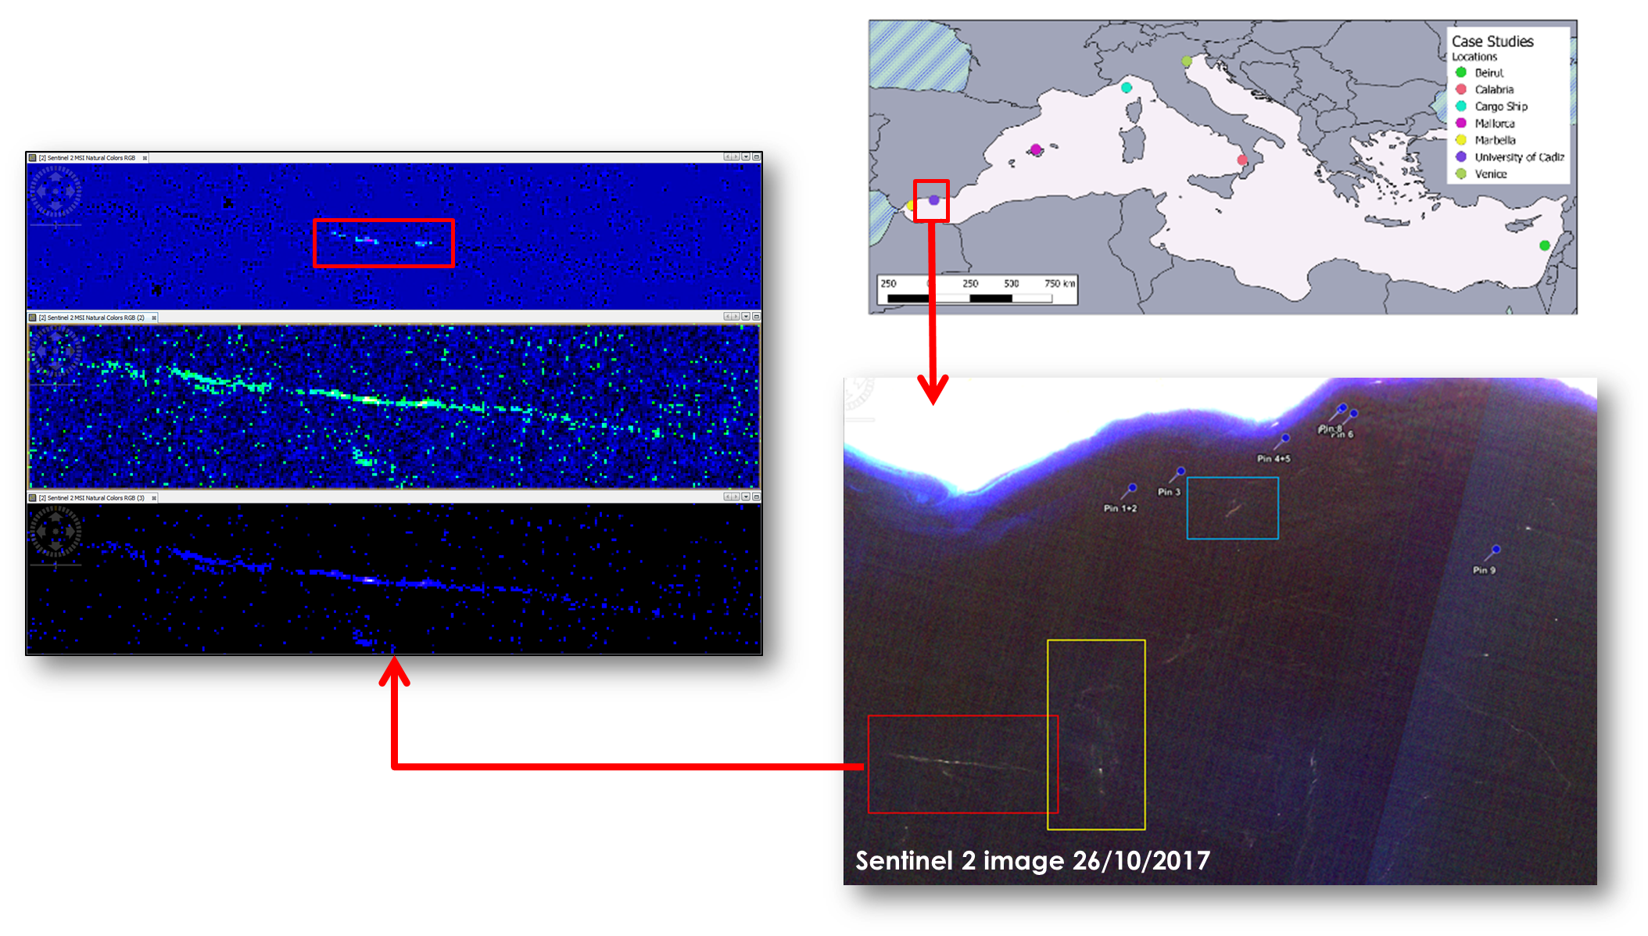
Example: Plastic patches
Under development (Photo credit: ESA)
© NABU/Holger Schulz
Notes:
Definition of ‘Company’:
Both the group and subsidiary/franchise levels counted individually, as separate entities (promotion of reporting at country level taking into account specific impacts)
Inclusion of a company under a specific country:
Multi-national companies are included in the country in which they are listed, or in the country where the head office is found.
When a multinational company produces specific separate reports, with disaggregated information per country, for the different countries they operate in, these would be counted separately under the indicator count for each country.
When the data for the indicator is aggregated at the sub-regional, regional and global levels, double-counting will be avoided, so a company may appear under several countries, but will only be counted once at regional and global levels.

Slide 14
Example: Plastic flow
Global model of marine litter using OceanParcels v2.0, a state-of-the-art Lagrangian Ocean analysis framework to create customizable particle tracking simulation using outputs from ocean circulation models. The ocean circulation model outputs used here are from the GOFS3.1, a global ocean forecast system based on the HYbrid Coordinate Ocean Model (HYCOM) and the Navy Coupled Ocean Data Assimilation (NCODA).
As a simple example, for Kenya, based on this model, of the plastic which ends up on Kenya’s beaches, 11% likely originated from Kenya, 60% likely came from countries in Africa and 29% likely came from outside the region. This model can be produced annually and updated as better waste emissions data becomes available for countries.
© NABU/Holger Schulz
Notes:
Definition of ‘Company’:
Both the group and subsidiary/franchise levels counted individually, as separate entities (promotion of reporting at country level taking into account specific impacts)
Inclusion of a company under a specific country:
Multi-national companies are included in the country in which they are listed, or in the country where the head office is found.
When a multinational company produces specific separate reports, with disaggregated information per country, for the different countries they operate in, these would be counted separately under the indicator count for each country.
When the data for the indicator is aggregated at the sub-regional, regional and global levels, double-counting will be avoided, so a company may appear under several countries, but will only be counted once at regional and global levels.

Slide 15
Example: Plastic flow
© NABU/Holger Schulz
Notes:
Definition of ‘Company’:
Both the group and subsidiary/franchise levels counted individually, as separate entities (promotion of reporting at country level taking into account specific impacts)
Inclusion of a company under a specific country:
Multi-national companies are included in the country in which they are listed, or in the country where the head office is found.
When a multinational company produces specific separate reports, with disaggregated information per country, for the different countries they operate in, these would be counted separately under the indicator count for each country.
When the data for the indicator is aggregated at the sub-regional, regional and global levels, double-counting will be avoided, so a company may appear under several countries, but will only be counted once at regional and global levels.

Slide 16
Level 2: National

Slide 17
SDG 14.1.1: National Indicators (level 2)
SDG 14.1.1b
© NABU/Holger Schulz

Slide 18
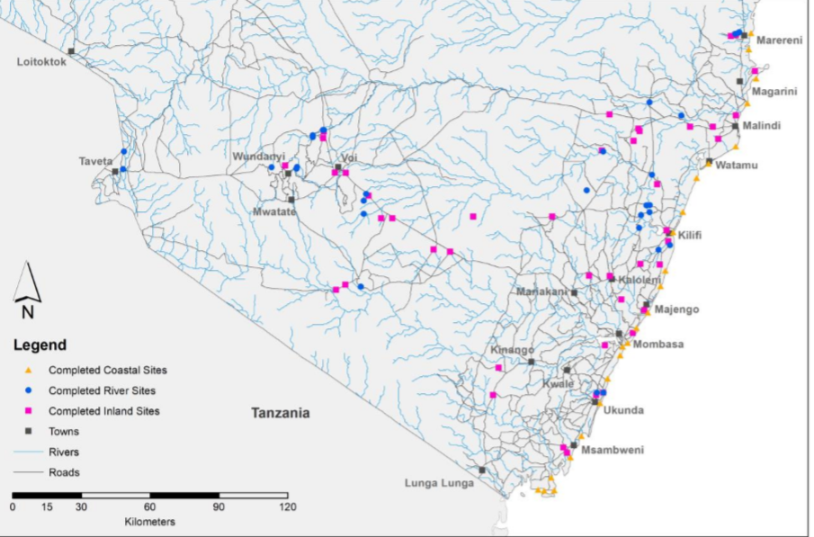
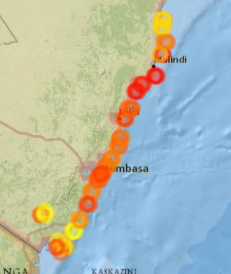
The process of development and testing of the methodology
In-country pilot testing of the draft methodology in various countries. For the SDG, this was done in Fiji, Colombia, Kenya and Seychelles. Through the GESAMP and GPA, other country experiences have also been compiled.
© NABU/Holger Schulz

Slide 19
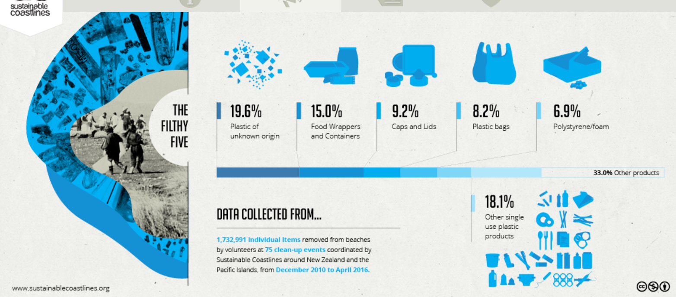
Recommendation for combining traditional and non-traditional data
We are continuing to look to better use citizen science for these SDGs, particularly for SDG 14.1.1b. In New Zealand, the Sustainable Coastlines’ Litter Intelligence initiative is a data source used officially by the NSO. UNEP will be publishing additional guidance on this topic in the upcoming months.
© NABU/Holger Schulz

