Slide 1
It takes a Global Village
Strengthening SDG Implementation in the Caribbean
Turning Passion for the Ocean into Powerful Partnerships
Prepared & presented by
Alwyn Ponteen
Chief Fisheries and Ocean Governance Officer
Government of Montserrat
January 2018

Slide 2
Our story
1. Introduction
2. Montserrat at a glance
3. SDG implementation & challenges
4. A case study
- Step 1: Fisheries & ocean governance roadmap
- Step 2: The execution plan
- Step 3: Partnership approach
- Results & Outcomes
5. Conclusion and recommendations
6. Vision for the future
Photo Courtesy; Google Maps

Slide 3
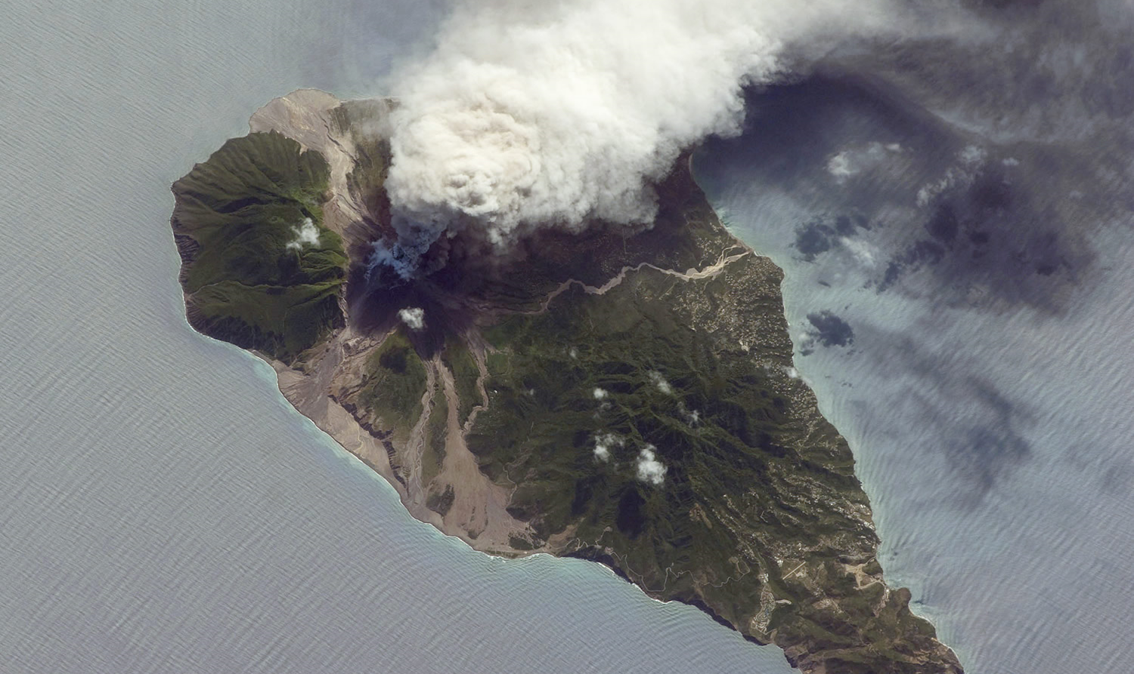
1. Montserrat at a glance
Geographically located in Eastern Caribbean United Kingdom Overseas Territory
Full CARICOM & OECS Membership
39 ½ mile² & Growing
Est. Population: [2016 -5,267] [1995 -13,000]
The island is self-governing, however HMG responsible for foreign affairs, internal security, defense, the public service and the offshore financial sector
Party to various UN convention through UK
Volcanic, rugged lush green mountains
Rugged 40km coastline & deep waters
Sea limit claim 3M, and EFZ 200nm
NSDP 2008 – 2020 based on the MDGs and we have just launched a new economic growth plan in December 2017
Photo Courtesy; NASA

Slide 4
2. SDG Implementation
Ministries with responsibilities for contributing to SDG implementation and monitoring in Montserrat.
Agriculture, Trade, Lands, Housing, & Environment
Finance, Economic Development Tourism & Culture
Health & Community Services
Communication
Works & Labour
Education, Culture, Youth & Sports Affairs
GoM
Notes:
To coordinate and harmonise the implementation of the SDGs in to their national policies and plans

Slide 5
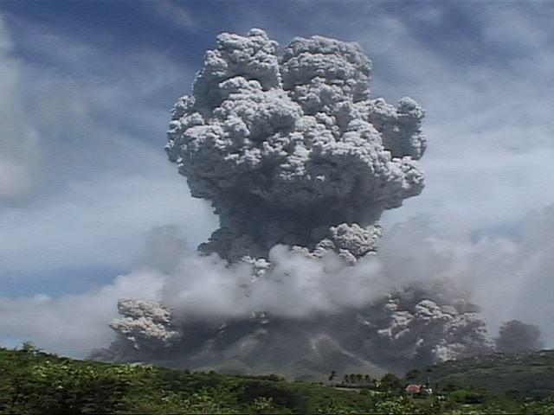
Cross Sector Challenges of Implementation & Monitoring of SDGs in Montserrat
3. Challenges
Cabinet appointed focal agency, NFP & alternate
Political & administrative will
Continuity of policy makers and staff
Ministries appear to be working in silos
National priorities
Limited capacity, evidence-base data, data sharing & finance to support policy
Updating NSDP to meet the 2030 SDGs agenda
Outdated legislation & policy framework to support implementation
Natural hazards
Appropriate partnerships (own agenda)
Information sharing and complacency
Status as a UKOT
Dedicated and adequate accredited staff
Notes:
Some of the cross sector challenges of implementation are:

Slide 6
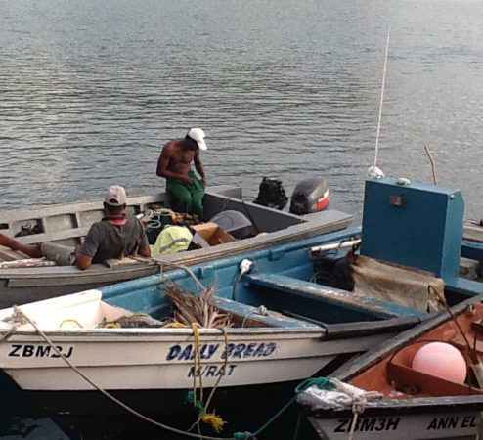
4. Case Study
A 3-step approach to improving Governance, Management & Sustainable Utilization of Montserrat’s Ocean Resources to achieve SDG 14 Targets
Notes:
If I went through all the challenges across GoM it would be a much longer presentation (smile)
GoM MAHLE through its fisheries unit have embarked on an ambitious programme to improve implementation and Monitoring in Montserrat’s Ocean Resources to achieve SDG 14 Targets and other related goals using what I call a ‘Three step change management programme’

Slide 7
Step One Accredited Institutional Capacity Development
Skills Gap Analysis
University of Portsmouth
MSc Coastal and Marine Resource Management
International
IOI
Institutional Training
Dissertation
Notes:
We did a skills gap analysis and realized that we need to build institutional capacity that would be retained within Montserrat. The key was to upskill new and existing staff rather than bring in short term consultants who may take the knowledge with them when they left
We were able to access overseas training and academic qualifications.
Through my dissertation we were able to develop the plan to develop and improve ocean governance management in Montserrat

Slide 8
Step Two Developing an Execution Plan
Human & Institutional capacity Development
Develop an effective MCS system
Revise and
update fisheries and ocean legislative, governance and management system
Dissertation
The Future of Fisheries in Montserrat “A proposed framework for management and governance reform”
Work with the natural process
Address boundary delineation related issues
Notes:
Out of the dissertation came various recommendations that included capacity building, working with natural processes, revising the legislative framework, boundary delimitation related issues and developing an effective monitoring, control and surveillance system (MCSS)
Plan helps to articulate the issue, challenges, possibilities and opportunities which are the basis for creating a compelling vision, a clear simple strategy and a plan with easy to follow roadmap.
Having this plan enabled Fisheries & Ocean Governance department to engage with multi discplinary stakeholders.
If you don’t know what you want, where you are going and how you can get there, it is very difficult to find organisations to help as it is critical that you are able to align with their objectives.

Slide 9
Step Three Identifying the right strategic partners with shared goals and values
Sustainable Use of Marine Resources in Montserrat Waters
Project
Development
Partnership
Financing
Integrated Approaches for Conservation and
Commercial Benefits
Notes:
As a result of my thesis by connecting with Rohan Smith via LinkedIN in collaboration with Katherine Winksing from UKOTCF developed the project
‘Sustainable use of marine resources in Montserrat Waters. Through our conversations we sourced funding to fund the project
LinkedIN, Skype and Whatsapp [leveraging technology to access the global village]
Finding the balance between integrated approaches that address conservation and economic development concerns in harmony and creating a compelling case for change for all multi-sector and disciplinary stakeholders.
Not just serving the needs of one group over the other. Serving the needs of all ocean dependent stakeholders

Slide 10
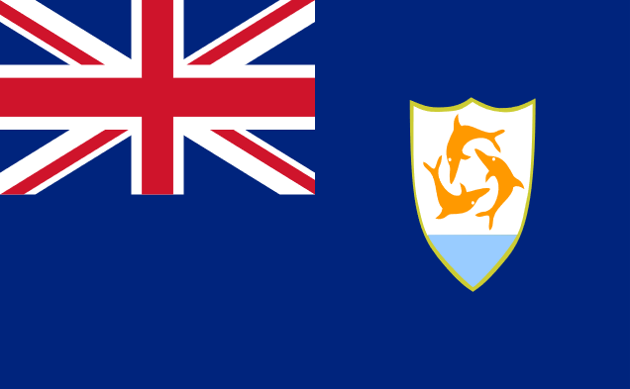
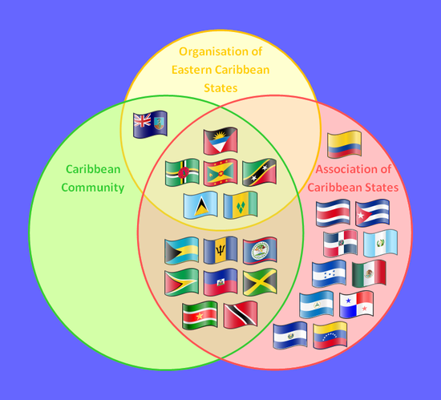
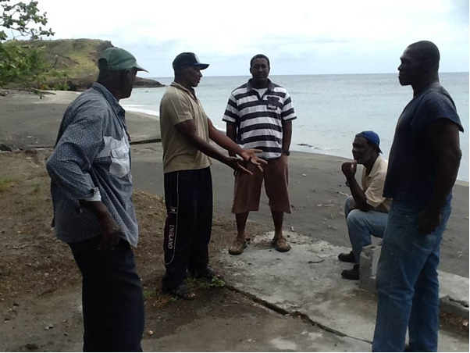
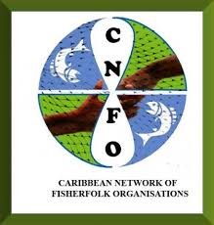
Local, Regional & International Supporting Partners
Notes:
Because we had a plan we were able to strengthen partnerships with public, private sector organizations, civil society, international development partners and academia who were aligned to our goals and values.

Slide 11
Results
3.0 Fisheries & Ocean Resources
GOAL 3.1
Expand and modernize infrastructure projects and capacity building programmes for the management of fisheries and ocean resources
GOAL 3.2
Strengthen the Fisheries Unit’s capacity to execute its Mandate and deliver services
GOAL 3.3
Modernize the legal framework for the Governance, management, Conservation and sustainable utilization of the Fisheries and Ocean Resources sub-sector
GOAL 3.4
Collaborate with stakeholders and strategic partners to promote increased consumption of local fish and other marine products
Notes:
MAHLE developed a strategy and marketing plan for Montserrat. Included is a goal to improve fisheries and ocean governance.
We have been able to develop a robust fisheries and ocean governance strategic goals and objectives to support the agriculture sector plan within MAHLE

Slide 12
Results Partnership finance to by 90% over 5 years, without which we would not have been able to achieve results due to limited budget.
Capacity Development
Socio-economic valuation and ​ qualitative analysis of the fisheries sector
Comprehensive Review of the Fisheries in December 2016
Strengthen Partnerships
Development of new legislative framework, revising and updating existing policies
Stakeholder awareness and sensitization of community ocean related issues
Agree in principle to protect 10% to 30% of Montserrat’s marine environment
Development of new sustainable fishery (FAD)
CCA Project in the fisheries of Anguilla and Montserrat
Economic Growth Strategy and Delivery Plan for Montserrat 2017
Turning the eradication of the invasive lionfish into a sustainable fishery & delicacy
Geothermal exploration, completion 2 of 3 wells
Notes:
As a result of the 3 step change management approach we are now considered as an important ministry to drive economic growth and have been able to deliver the following activities from the plan
We increased the annual budgetary allocation by 90% over 5 years which without which we would not have been able to achieve the results highlighted through this presentation.
Traditionally in the Caribbean we have been focused on tourism as a driver for growth; the impact of macro trends such as global recession, climate change and the opening up of locations in Asia, Africa and South America are competing with our traditional tourism market.
In order to support the SDG we can not fall into the trap of do the same thing over and over again and expecting different results.
We need to think outside the box and leverage the tools available to us. Just because we are only 5,000 people over 39sq miles does not limit us to accessing world class expertise and finances if we are able to identify stakeholders we can build mutually beneficial relationships with and demonstrate our ability to be innovation and creative in how we solve our challenges.

Slide 13
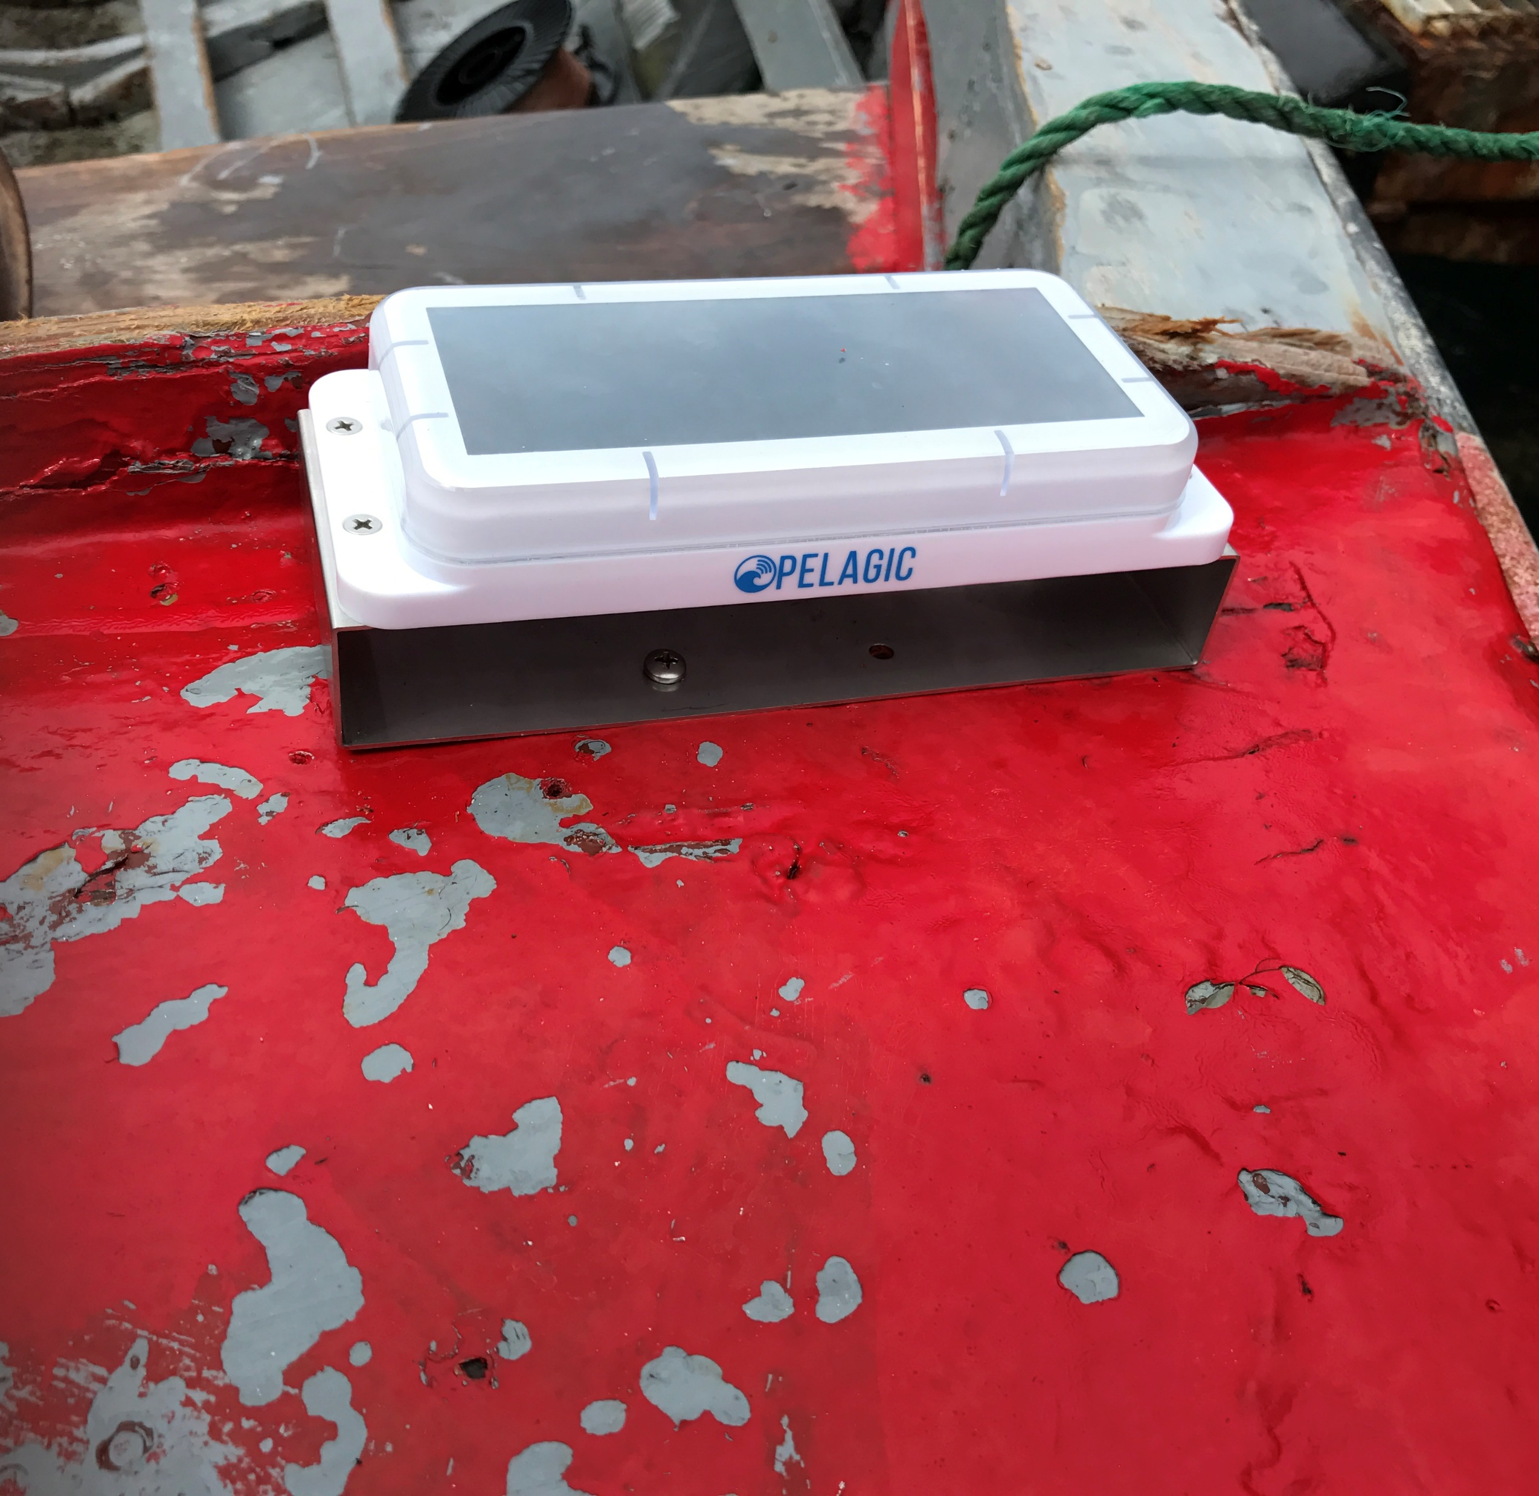
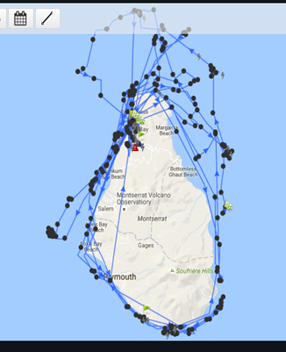
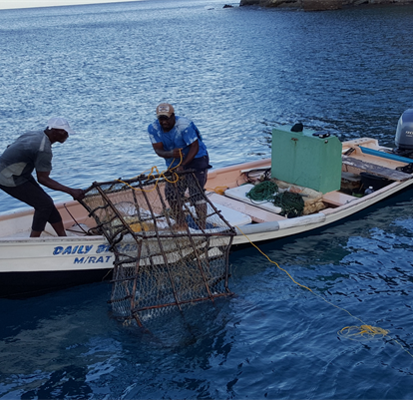
Results: A technological revolution in Montserrat’s Ocean Governance Integrating vessel movement and improving fisheries data collection for marine management, MSP and valuing ecosystem goods and services
Succorfish IVMS
Notes:
Some of the ongoing projects from the T2T

Slide 14
Results: Monthly Beach clean up campaign
Notes:
Some of the ongoing projects from the T2T

Slide 15
2017 Outcomes
Re-Naming the Fisheries Unit
Re-structuring
the Fisheries Unit
Adopting the OCTA 2017 Report Recommendations as an official Ocean Policy Document
Appointment of a NOGC
Strengthening the Institutional Framework and embedding recommendations into Cabinet policy papers
Notes:
In order to pull together all of the outcomes (Results) we are now focusing on the strengthening our institutional framework by:
Renaming the fisheries unit (WHY)
Appointing a NOGC
Restructing the fisheries unit
Adopting the OCTA

Slide 16
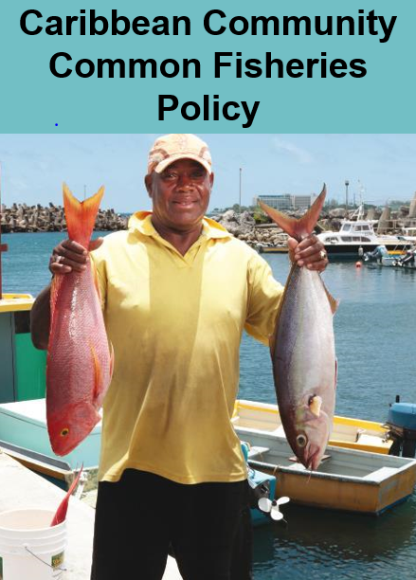
2017 Outcomes
Department of Environment
National Ocean Governance Committee (NOGC)
Lands and Survey Department
Department of Agriculture/ Fisheries Unit
Montserrat National Trust
Royal Montserrat Police Service
Development and Policy Unit
Disaster Management Coordination Agency
Airport Authority
Montserrat Fishers and Boaters Association
Attorney Generals Chambers
Customs and Revenue Services
Montserrat Port Authority
Physical Planning Unit
Strengthening the Institutional Framework
Notes:
In order to pull together all of the outcomes (Results) we are now focusing on the strengthening our institutional framework by setting up a National Ocean Governance Committee (NOGC) with 13 stakeholders.
Department of Environment
Lands and Survey Department
Department of Agriculture/ Fisheries Unit
Montserrat National Trust
Montserrat Fishers and Boaters Association
Royal Montserrat Police Service
Customs and Revenue Services
Development and Policy Unit
Disaster Management Coordination Agency
Airport Authority
Montserrat Port Authority
Attorney Generals Chambers
Physical Planning Unit

Slide 17
5. Conclusion and Recommendations:
Turning challenges into socio- economic opportunities
Cabinet appointed focal agency, NFP & alternate and supporting committee Political & administrative will Continuity of policy makers and staff Ministries appear to be working in silos National priorities Limited capacity, evidence-base data, data sharing & finance to support policy Updating NSDP to meet the 2030 SDGs agenda Outdated Legal and Policy Framework Natural hazards Appropriate partnerships (own agenda) Information sharing and complacency Status as a UKOT Dedicated and adequate accredited staff | Through legislative directives appoint an appropriate agency, focal-point, alternate and functioning working group, with responsibility for the overall coordination, implementation and monitoring of the SDG Prioritize and strengthen institutional capacity framework the implementation and monitoring of the SDGs Develop an appropriate evidence-base road map in close alignment with the SDG implementation into National Development Plans Strengthen cohesive partnership amongst all stakeholders, and national data systems to enhance sustainable the socio-economic development of the country Develop and implement harmonized legislations and polices simultaneously to guide progress across multiple sectorial SMART goals and targets Explore new and existing sources for most appropriate and available financing mechanisms to support critical development investments Aligning priorities, objective and values with potential partners in order to work together harmoniously to achieve desired strategic goals

Slide 18
5. Conclusion – recap
Turning Passion for the Ocean into Powerful Partnerships
2014 - present
STEP 3
Identifying the right strategic partners with shared goals and values
2014
STEP 2
Developing an Execution Plan
2013
STEP 1
Accredited Institutional Capacity Development
Notes:
It takes some time but by with using a simple methodical approach

Slide 19
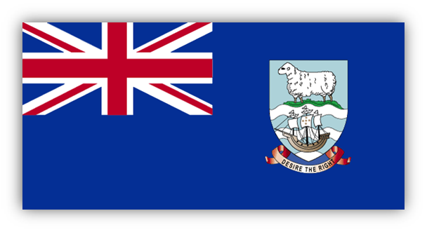
Focus for 2018 and beyond Territory to territory partnership (T2T)
Development and implementation of MSP
Improve legal framework for sustainable management, governance and use of the ocean resources
Enhanced data collection and management infrastructure systems
Transfer expertise and skills from the South Atlantic UK Overseas Territory to Montserrat
Notes:
Focus for 2018 to 2021

Slide 20
Focus for 2018 and beyond Territory to territory partnership (T2T)
National Ecosystem Assessment for Montserrat
Natural capital assessments, mapping and monitoring methods
Earth Observation based mapping and interpretation
Identify priority Natural Capital Assets & develop metrics to monitor change over time
Development of a GIS based value maps for Montserrat
Notes:
Some of the ongoing projects from the T2T

Slide 21
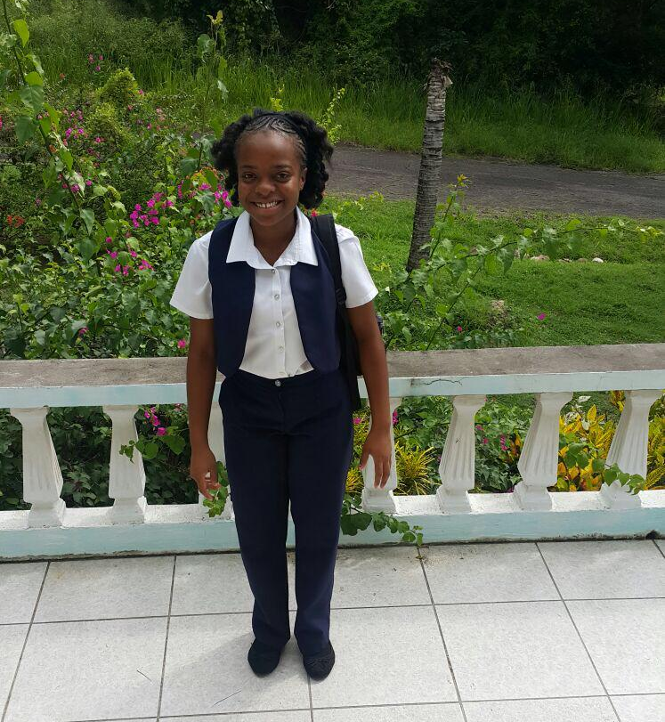
6. Vision for the Future
Photo: Courtesy Alyssa Ponteen
Inspiring and supporting the next generation to be able to build capacity and drive the implementation and monitoring process of the
Notes:
Young people like my daughter Alyssa who want to study subjects such as Environmental science are the future. We need to inspire and educate the next generation on the importance of the SDGs and provide them with the tools and knowledge to make a difference.

Slide 22
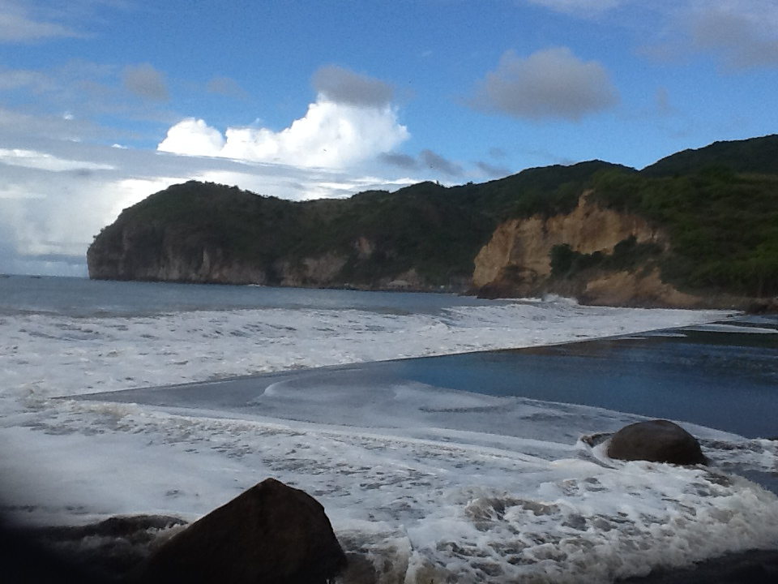
Looking forward not back
Thank you
Thank you for listening

