Slide 1
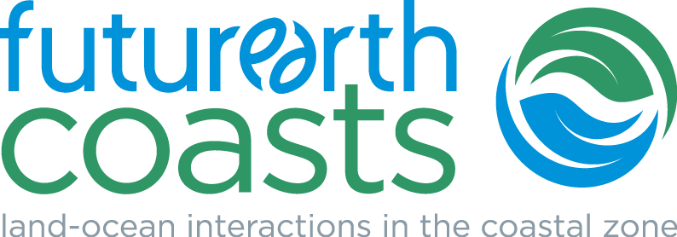
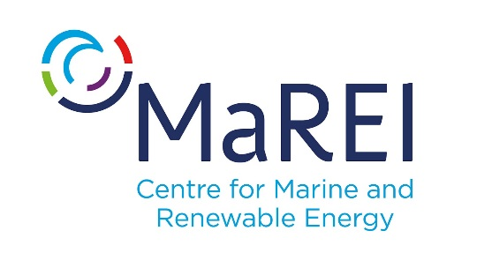
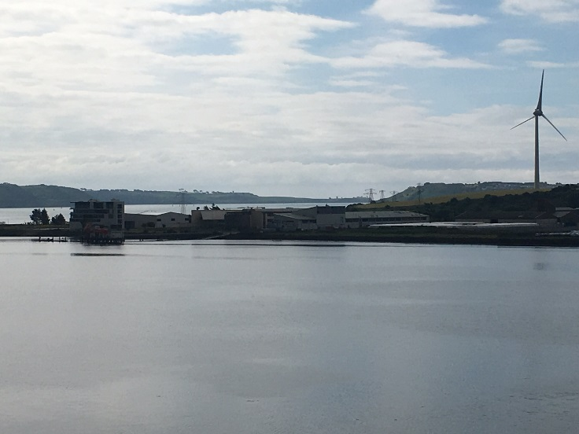
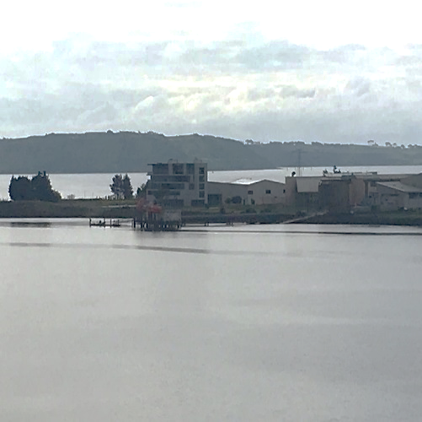
FutureEarthCoasts.org
GLOBAL CHANGE IN THE COASTAL ZONE
Shona Paterson
Science Officer
Martin LeTissier
Executive Officer
The Future Earth Coasts International Project Office is located at MaREI
SDGs and Communities
MaREI Centre for Marine and Renewable Energy Ireland Beaufort Building | Environmental Research Institute | University College Cork | IMERC Campus | Haulbowline Road | Ringaskiddy, Co. Cork | P43-C573 | Ireland
FutureEarthCoasts.org

Slide 2
The Challenges
Challenges ask complex and interrelated questions
Equity
Justice
Resilience
Economic opportunity
Infrastructure development
Ecological management
And more…....

Slide 3
The Re-Frames
Framing Agreements
Paris Agreement adopted under the UNFCCC
Sendai Framework for Disaster Risk Reduction 2015-2030
Vienna Programme of Action for Landlocked Developing Countries for the Decade 2014-2024
2030 Agenda for Sustainable Development, including SDGs
Small Island Developing States Accelerated Modalities of Action (SAMOA) Pathway
Istanbul Programme of Action for the Least Developed Countries for the Decade 2011-2020.
Addis Ababa Action Agenda of the 3rd International Conference on Financing for Development

Slide 4
The Opportunities
SIDs are at the forefront of scientific endeavours, innovative solutions, and collective action to confront global environmental change
Both landscapes and their populations are uniquely tuned to agents of change.
Despite the development challenges, small islands have placed sustainability prominently on their collective agenda:
Barbados Programme of Action Mauritius Strategy of Implementation
SAMOA Pathway CITES
Convention on Biological Diversity

Slide 5
Co-design
Linkage between
society and policy
Societal pressure for change from perceived or real injustice
Science
POLICY
ENVIRONMENT
&
SOCIETY
Transformation
Innovation between
policy and practice:
Non-linear changes in response to untenable conditions
Knowledge
Justice
PRACTICE
Driver between
society and practice:
Shifts in social values and priorities

Slide 6
Next?
Importance of partnerships
Social learning
Collective problem solving
Trans-disciplinarity and integration
What, where, why, and so what?
What to measure?
Social, economic, cultural, physical, ecological ….
How to measure ‘it’?
How to translate ‘it’?
How to use ‘it’?
Does the science contribute to SDGs etc?
Who is using ‘it’?

Slide 8
https://www.oa-africa.net

Slide 9
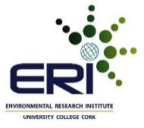
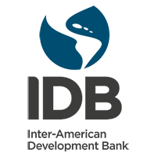
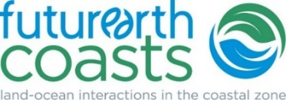
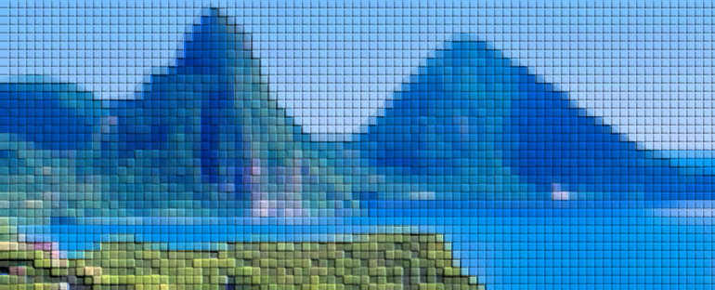
Supporting Blue Growth and Risk Management through Earth Observation
23-26 January 2018 | Saint Lucia

Slide 10
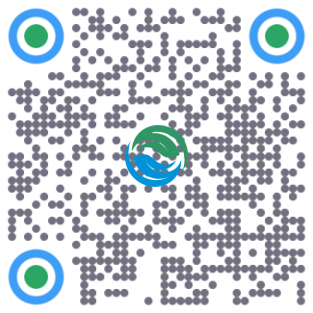
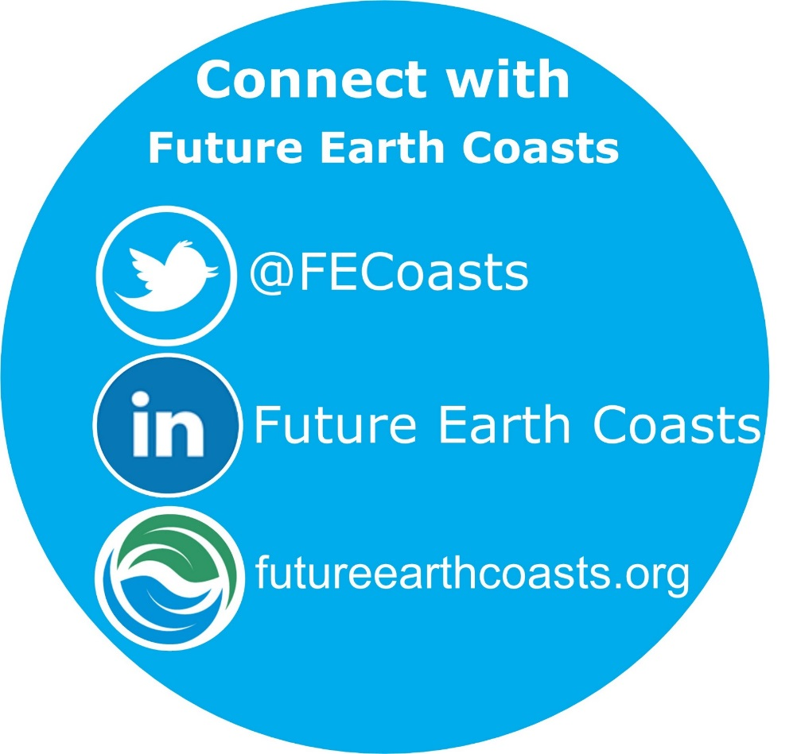
FutureEarthCoasts.org
GLOBAL CHANGE IN THE COASTAL ZONE
JOIN THE CONVERSATION
Become part of our community by joining our mailing list and find out more about how you can contribute to the delivery of the Future Earth Coasts project.
FutureEarthCoasts.org

