Slide 1
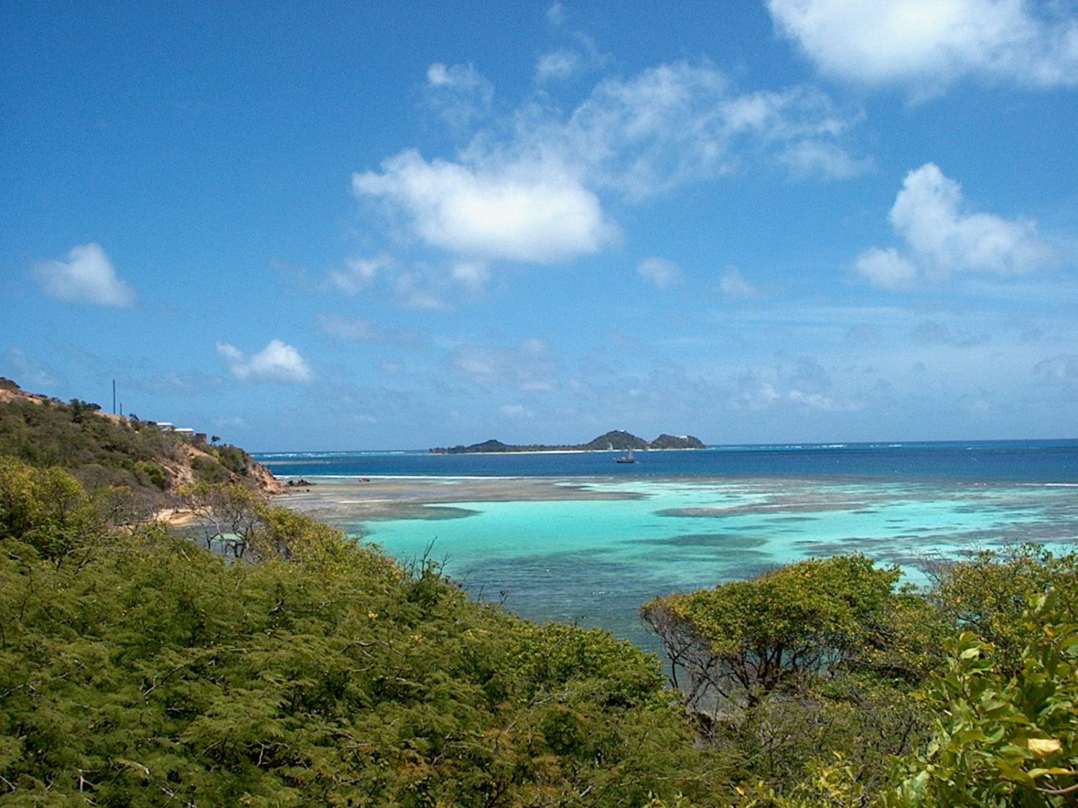
Workshop on Implementation and Monitoring of SDGs in the Caribbean: The role of the Ocean – January 17-19, 2018, Saint Vincent and the Grenadines
Implementing the Ocean Sustainable Development Goal in the Wider Caribbean: state of play and possible ways forward
Lucia Fanning¹ and Robin Mahon²
¹Marine Affairs Program, Dalhousie University, Halifax, Nova Scotia, Canada
²Centre for Resource Management and Environmental Studies (CERMES)
University of the West Indies, Barbados

Slide 2
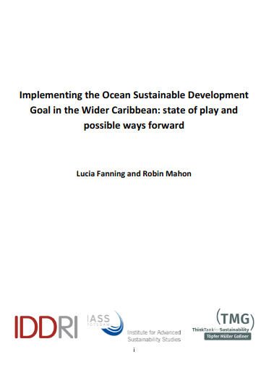
This talk – overview of…

Slide 3
Origin of the report
The Partnership for Regional Ocean Governance (PROG) - examining the role of regional cooperation and coordination in the implementation of the SDG14
PROG partners are:
Institute for Advanced Sustainability Studies (IASS), Potsdam, Germany
Institute for Sustainable Development and International Relations (IDDRI), Paris, France
UN Environment, Nairobi, Kenya
Funded by the Government of Germany
Notes:
Financial support provided by: Federal Ministry for Economic Cooperation and Development (BMZ) and the Deutsche Gesellschaft für Internationale Zusammenarbeit (GIZ) GmbH.

Slide 4
Purpose of the report
Scoping report on the role of regional ocean governance in implementation of SDG14 in the WCR:
Legal and institutional frameworks for the conservation and sustainable use of the Caribbean Sea;
Positions and activities of selected Caribbean States and regional oragisations on the implementation of SDG14;
Priorities, options towards regionally harmonized implementation of SDG14
Potential pioneer countries and/or regional actors

Slide 5
Approach
Review of literature
Telephone/questionnaire survey of:
13 intergovernmental organizations
5 regional NGOs
1 regional university
17 countries
2 regional projects.

Slide 6
Role of regional organisations
Over 26 regional organizations relevant to SDG14 targets:
12 indigenous IGOs
5 regional bodies of UN agencies
1 independent RFMO
8 regional NGOs
All organizations have a clear view of how WCR countries seeking to move forward via a coordinated regional approach
Due in part to their engagement with the CLME+ Project
Regional organizations play a crucial role in implementing agreements

Slide 7
Complexity and regional cooperation
Institutional complexity in the WCR underscores the need for regional cooperation and coordination
Need for an overarching coordinating mechanism for ocean governance in the WCR frequently noted
Promoting coordinated ocean governance at the regional level is a primary aim of the CLME+ Project SAP and the Project
Establishing an ICM to play this role while the permanent mechanism is explored

Slide 8
Key regional level activities linked to SDG14
The UN Multi-Country Sustainable Development Framework defines how the UN will jointly achieve development results in partnership with WCR SIDS and their associated regional level organizations
Several Caribbean States exploring policies for a ‘blue economy’
Forum of the Countries of Latin America and the Caribbean on Sustainable Development, under auspices of ECLAC is regional mechanism to follow-up and review implementation of the 2030 Agenda
CARISEC-ECLAC Regional Consultation and Training to Develop a Set of Core Indicators for Monitoring Implementation of SDGs - to support Caribbean SIDS.

Slide 9
Role of projects in SDG14 implementation
Many national, multilateral, sub-regional and regional projects, e.g.
The Caribbean Challenge Initiative (CCI) - 20% marine and coastal resources by 2020.
The Caribbean Marine Biodiversity Program (CBMP)
Integrating Water, Land and Ecosystem Management in Caribbean Small Island Developing States (GEF IWEco)
The GEF CLME+ Project:
Strategic Action Programme (SAP) for improved ocean governance 2015-2025 – 25+ countries
M and E framework for the SAP

Slide 10
Synopsis of activities by SDG14 target
Target 14.1 Pollution: primary responsibility of UNEP-CEP, CARPHA and CCAD. However, all organizations with a mandate for marine EBM have an interest in this target;
Target 14.2 Marine and coastal ecosystems: most broadly subscribed among regional organizations; interpreted as being mainly about reefs and associated systems;
Target 14.3 Ocean acidification: few activities address although all organizations recognize that could have huge potential impacts of ocean acidification
Target 14.4 Overfishing-IUU: primary responsibility of WECAFC, CRFM and OSPESCA, - extensive activities
Target 14.5 CMPAs: subset of 14.2 - same range of organizations wide range of capacity building activities;

Slide 11
Synopsis of activities by SDG14 target
Target 14.6 Fisheries subsidies: closely allied to Target 14.4; however, removal of subsidies in SSF not a high priority
Target 14.7 Benefits to SIDS: More WCR SIDS than any other region of the world; all organizations identify with this target.
Target 14a Science and technology: Specific mandate of IOCARIBE, however, most organizations have some orientation towards this target;
Target 14.b SSF: A prominent target for all fisheries organizations,
Target 14.c Governance: A major focus of the CLME+ Project and partner organizations, all on the CLME+ Project Executive Group and most on the Interim Coordinating Mechanism for the CLME+ SAP. CLME+ building a Regional Ocean Governance Framework through a learning-by-doing process.

Slide 12
National-Regional interfaces
Many countries, especially small ones, struggle to participate effectively in regional and global processes.
Effective regional approach needs effective national-regional interfaces
GEF IW projects (including LME) require national level intersectoral coordinating mechanisms (IMCs or NICs)
Few WCR countries have clearly established intersectoral coordinating mechanism for SDG14 or for all SDGs.
Considerable scope for strengthening these in the WCR

Slide 13
Needs - regional organisations
Regional organizations recognize the importance of having ocean issues together under SDG14 targets
Organizations and member countries have been addressing these issues for decades, and have plans to continue doing so.
In response to what is needed to support SDG14 implementation - “more support for what we have been doing and must continue doing”
Working on translating previous activities into an SDG14 frame of reference

Slide 14
Needs – Regional level
Support needed for full range of regional ocean governance framework building activities:
Developing lateral interactions among organizations that share responsibility for critical issues
Linking regional and global activities
Linking national and regional activities
Developing the overarching integration and coordination capacity for ocean governance

Slide 15
Broad recommendations
Support for implementation and monitoring of SDG14 targets be aligned with CLME+ SAP activities and foster sustainability of this initiative
There are numerous areas identified in the SAP that could not be funded with the GEF funds available
These provide an avenue for support of SDG14 implementation in the WCR that builds sustainable capacity

Slide 16
Conclusions
Substantial challenges to overcome in the implementation of SDG14 within the WCR
Opportunities for overcoming them through a harmonized regional approach are substantial
For almost two decades, WCR countries have been making a concerted effort individually and through regional organizations to understand and address the consequences of fragmented regional governance arrangements for living marine resources.
Engagement in CLME+ SAP implementation offers considerable potential for integration of ocean affairs, nationally and into regional sustainable development policy.

Slide 17
For more…..
CLME+ Project
https://clmeplus.org/
Ocean governance in the WCR
https://www.cavehill.uwi.edu/cermes/projects/ocean-governance/index.aspx

Slide 18
Thanks

