Slide 1
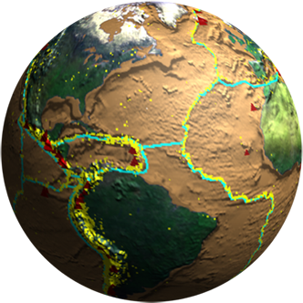
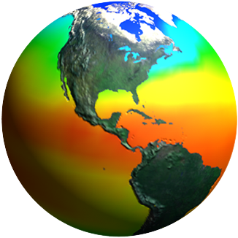
Ocean and sustainability-related variables: biology and biochemistry
Laura Lorenzoni
NASA
Session 3: Ocean-related variables and indicators essential for SDG implementation and monitoring in Caribbean Small Island States

Slide 2
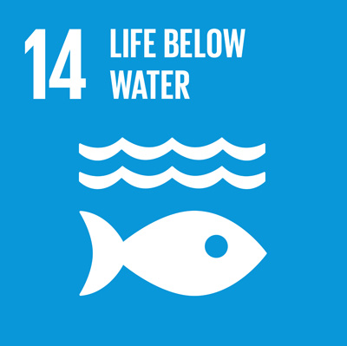
Prioritized list of variables essential for the development and validation of policies in support of SDG implementation
We already have a list of Essential Ocean Variables drafted by the Global Ocean Observing System (GOOS)
Sustainably manage and protect marine and coastal ecosystems.
Minimize and address the impacts of ocean acidification.
Increase the economic benefits to Small Island developing States from the sustainable use of marine resources, including through sustainable management of fisheries, aquaculture and tourism.
Increase scientific knowledge, develop research capacity and transfer marine technology to improve ocean health and to enhance the contribution of marine biodiversity to the development of developing countries, in particular small island developing States and least developed countries
Notes:
I hope to be thought provoking during this presentation, and hearing about things discussed over the past day and a half I realize I will also be repetitive, because some of the underlying ideas have been mentioned already. This is not a bad thing, but a good thing, it means we’re all on the same page.
We’re here to discuss SDG 14, which encompases some of these items I have put here, and I’ve put them here because what I will show you in a bit relates specifically to some of these goals.
The task assigned to us is to obtain a prioritized list of variables needed. I will Argue that we already have a list of prioritized observables essential for ecosystem management and policy development. What we need is to define what the existing observing capabilities are and match these with the variables that are mature enough to address the SDG requirements and understand the tools used to collect such information

Slide 3
Essential Ocean Variables (EOVs) goosocean.org/eov
Notes:
What are the EOV’s? They are a set of identified by a panel of Expert that GOOS pulled together, based on their Relevance: The variable is effective in addressing Climate, Operational Ocean Services, and Ocean Health. Feasibility: is technically feasible using proven, scientifically understood methods. And Cost effective: Generating and archiving data on the variable is affordable, mainly relying on coordinated observing systems using proven technology, taking advantage where possible of historical datasets.
There are three existing panels that defined these variables: physical biogeochemical and bio/eco.

Slide 4
There are different levels of “maturity” for each Essential Ocean Variables (EOV’s). This impacts the capacity of employing that EOV for assessment.
What is the existing observing capacity in sampling?
Consider requirements (input) and observing products (output) needed to inform about ocean state
Should we start with assessing baseline data ?
Sustainably manage and protect marine and coastal ecosystems.
Minimize and address the impacts of ocean acidification.
Increase the economic benefits to Small Island developing States from the sustainable use of marine resources, including through sustainable management of fisheries, aquaculture and tourism.
Increase scientific knowledge, develop research capacity and transfer marine technology to improve ocean health and to enhance the contribution of marine biodiversity to the development of developing countries, in particular small island developing States and least developed countries
Notes:
There are different levels of maturity within the EOV’s, with biology lagging the others because of complex systems. It is an evolving platform to which we have the opportunity to contribute. So I will turn the task around a bit and ask what are the existing capabilities that allow for appropriate sampling of the variables needed? For example, should we start with baseline data? This same question can be asked for each SDG task.

Slide 5
Earth Science Missions
Landsat 9
PACE
ISS Instruments
LIS, SAGE III
TSIS-1, OCO-3, ECOSTRESS, GEDI CLARREO-PF
GeoCARB
TROPICS (12)
MAIA
Sentinel-6A/B
JPSS-2 Instruments
RBI, OMPS-Limb
NI-SAR
SWOT
TEMPO
GRACE-FO (2)
Formulation
ICESat-2
CYGNSS (8)
NISTAR, EPIC
(DSCOVR / NOAA)
Implementation
Primary Ops
Extended Ops
SMAP
Landsat 7
(USGS)
QuikSCAT
SORCE,
TCTE (NOAA)
Suomi NPP (NOAA)
Terra
Landsat 8
(USGS)
Aqua
CloudSat
CALIPSO
GPM
Aura
OSTM/Jason-2 (NOAA)
OCO-2
Notes:
What can EO data do to address this? It is difficult and expensive to carry out in situ measurements, and sometimes impossible if it’s a large scale phenomenon – our ocean is all interconnected, which is where Earth Observations come in to play, provided by several space agencies around the world. An example of the current fleet
All of NASA’s data is freely available.
Our desire for this workshop is that you, the implementers, use EO data to further the SDG’s, to walk out of here with commitments and tangible outputs to move us forward.
Next, to get you thinking about what you can do with satellite data and products, I’m going to provide you with examples on just a few areas that are of interest to us all

Slide 6
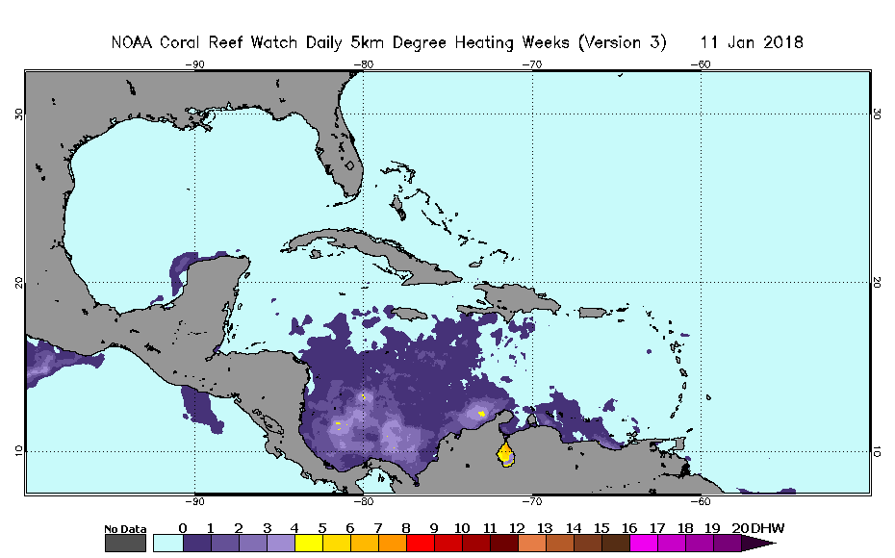
Coral Reef Health
Sea Surface Temperature
Turbidity
Manage reef ecosystems; an example is Coral Reef Watch
Temperature – coral reef watch
http://coralreefwatch.noaa.gov/satellite/index.php
Notes:
We heard a lot about reefs yesterday, both here and during our field trip. Remote sensing products can provide information that may help to sustainably manage and protect marine and coastal ecosystems. Knowing the pressure on ecosystems, management techniques can be applied, such a closing of a specific reef. This product that I’m showing is called degree heating weeks and it’s calculated using sea surface temperature. It shows how much heat stress has accumulated in an area over the past 12 weeks (3 months).
This addresses also one of the SDG14 goals – to Increase the economic benefits to Small Island developing States from the sustainable use of marine resources; it also Increase scientific knowledge, develop research capacity and transfer marine

Slide 7
Sargassum
All near real-time products including AFAI are available under SaWS (http://optics.marine.usf.edu/projects/SaWS.html), with Google Earth compatibility.
Sargassum Watch System (SaWS), based on satellite imagery and numerically-modelled surface currents, for near-real-time tracking of floating algae in the central Atlantic.
Sargassum slicks (white) detected on May 21th, 2015. Beaching alerts issued.
Notes:
Another example is with Sargassum. We heard about the beaching and economic impact yesterday as well. A Sargassum Watch system has been developed and it’s useful for caribbean island nations, specifically to address and predict potential beaching. This has the potential to Increase the economic benefits in order to meet SDG goal.
All near real-time products including AFAI are available under SaWS (http://optics.marine.usf.edu/projects/SaWS.html), with Google Earth compatibility.
. Islands contours in green, blue arrows=HYCOM surface currents. High risk of beaching alerts were released on these dates.

Slide 8
Primary productivity, water quality, Fishing
ºC
mg/m³
Coupled chlorophyll/sea surface temperature products can provide information on potential fishing grounds, enabling management.
Other products can provide information on coastal water quality.
Notes:
Coupled SST and Chl imagery can provide information on the best fishing areas, or spawning areas; some fish prefer fronts, for example, to hang out, and larvae do too. This can help draft better management tools. In addition, and we discussed this, tracking IUU’s can also be done utilizing satellite remote sensing data. There are several networks which already do this at a regional and global level.
True color images, as well as other products, also provide information about water quality, which may be an issue
Time-series of High resolution imagery, like that provided by a satellite called Landsat, can also be used to look at land use/land change and coastal erosion, which all ties into coastal water quality. All of these products are freely available.

Slide 9
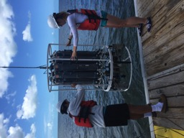
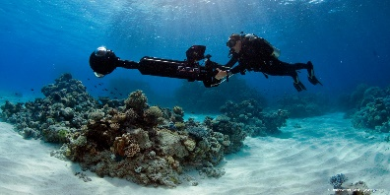
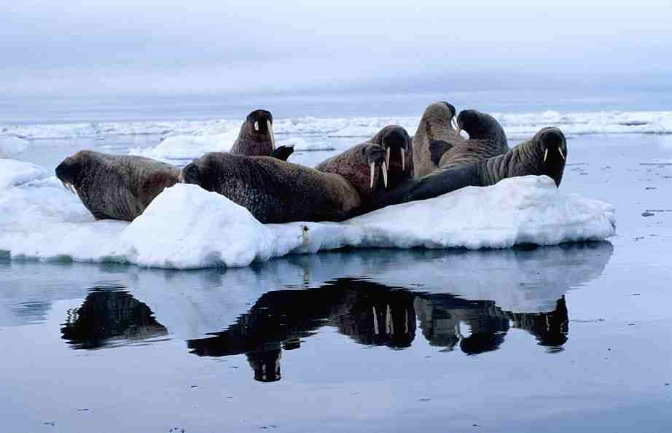
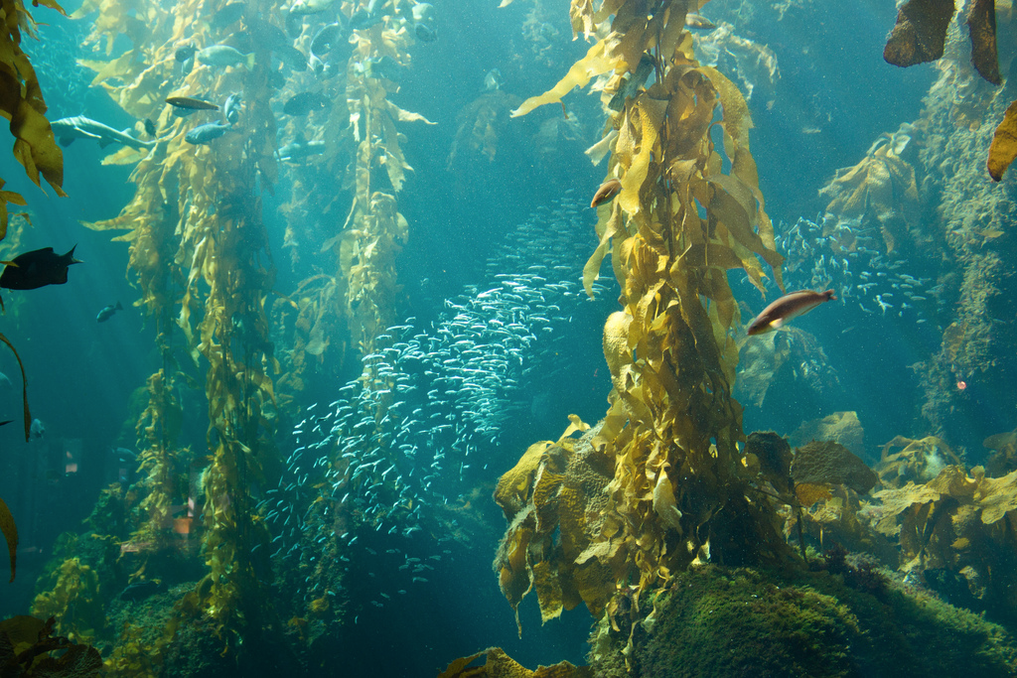
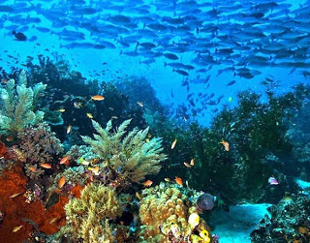
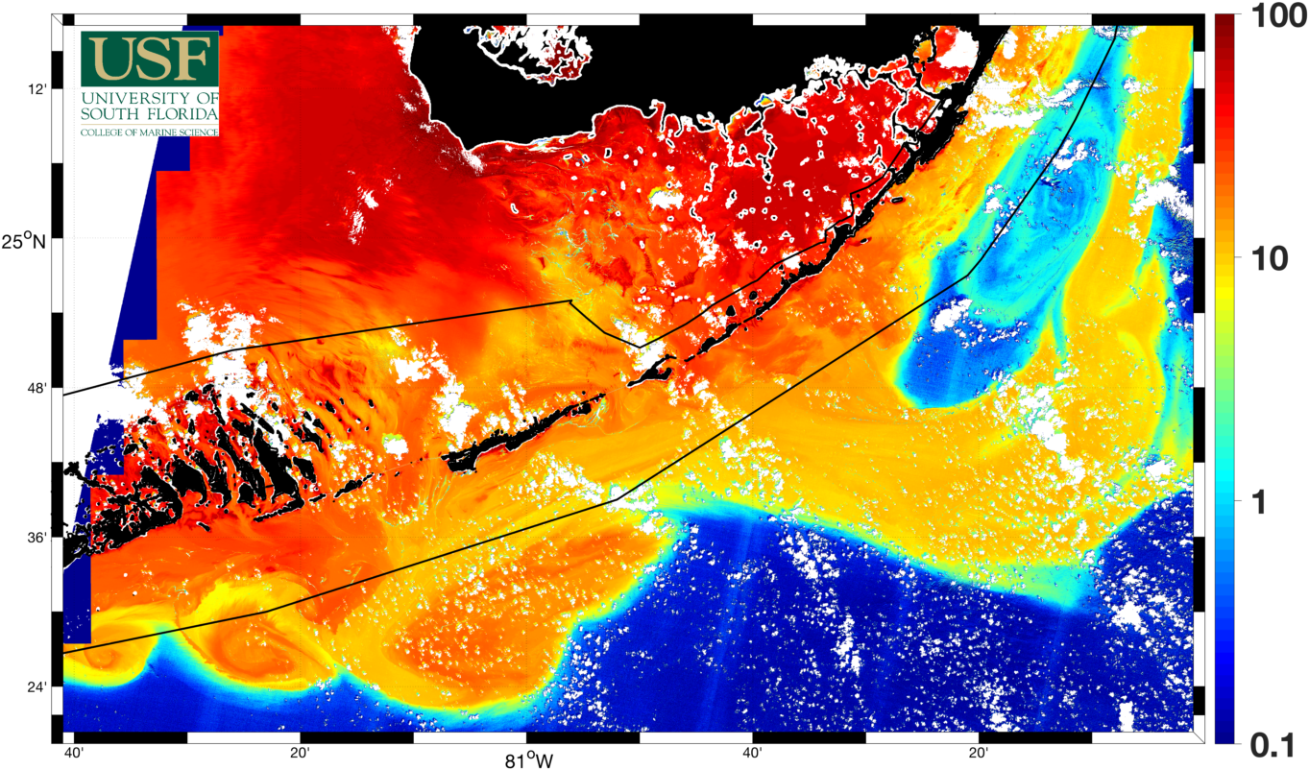
Biodiversity
http://www.marinebon.org/
End-to-end framework to define relationships among physical, biogeochemical, and biological processes.
Identify Essential Ocean Variables (EOV) to support understanding of biodiversity and ecosystem change.
Independent
monitoring
POLAR
Sea ice
Kelp
forests
eDNA
Coral
reefs
TROPICS
Satellite remote sensing
Notes:
The last example I am going to provide you is Biodiversity. NASA in partnership with NOAA/BOEM, has been funding the Marine Biodiveristy observing network, which started as a pilot project in three MPAs around the US and how has grown into a Pole-2-Pole effort through funding from Amerigeoss. The new effort targets the Americas. Network is the key word here. One of the goals of MBON is to Integrate global, multidisciplinary research and observations. Within the MBON Framework it’s a standardize methodology, and assessment of essential biodiversity variables.

Slide 10
Oh, that was great! (applause)
So what? Why do we care about what you just showed us?

Slide 11
Developing observing platforms to address SDG’s
Needs
What are the needs?
What type of observing system is required?
What phenomena are associated with the needs? (i.e. scales)
What existing strategies and Earth Observing data can address the needs?
What are the gaps?
Observations
Data/products
Notes:
Because everything I showed you has an economic application. But that’s just me. You tell me why you care about a specific variable. We heard yesteday that human capital has to be at the center of the SDGs. What we need is to Assessment of we are, what the needs are. Think about the examples and your needs when you think about vars needed. And this is an iterative process – once you have your data/products you go back to the observations, is this what I anticipated? Think about these questions, wich are not unlike the ones we have tasked to discuss for Topic 3.
Challenge you to walk out of here with the commitment of using EO data for SDG furthering. Difference between just monitoring and actually meeting the SGDs

