Slide 1
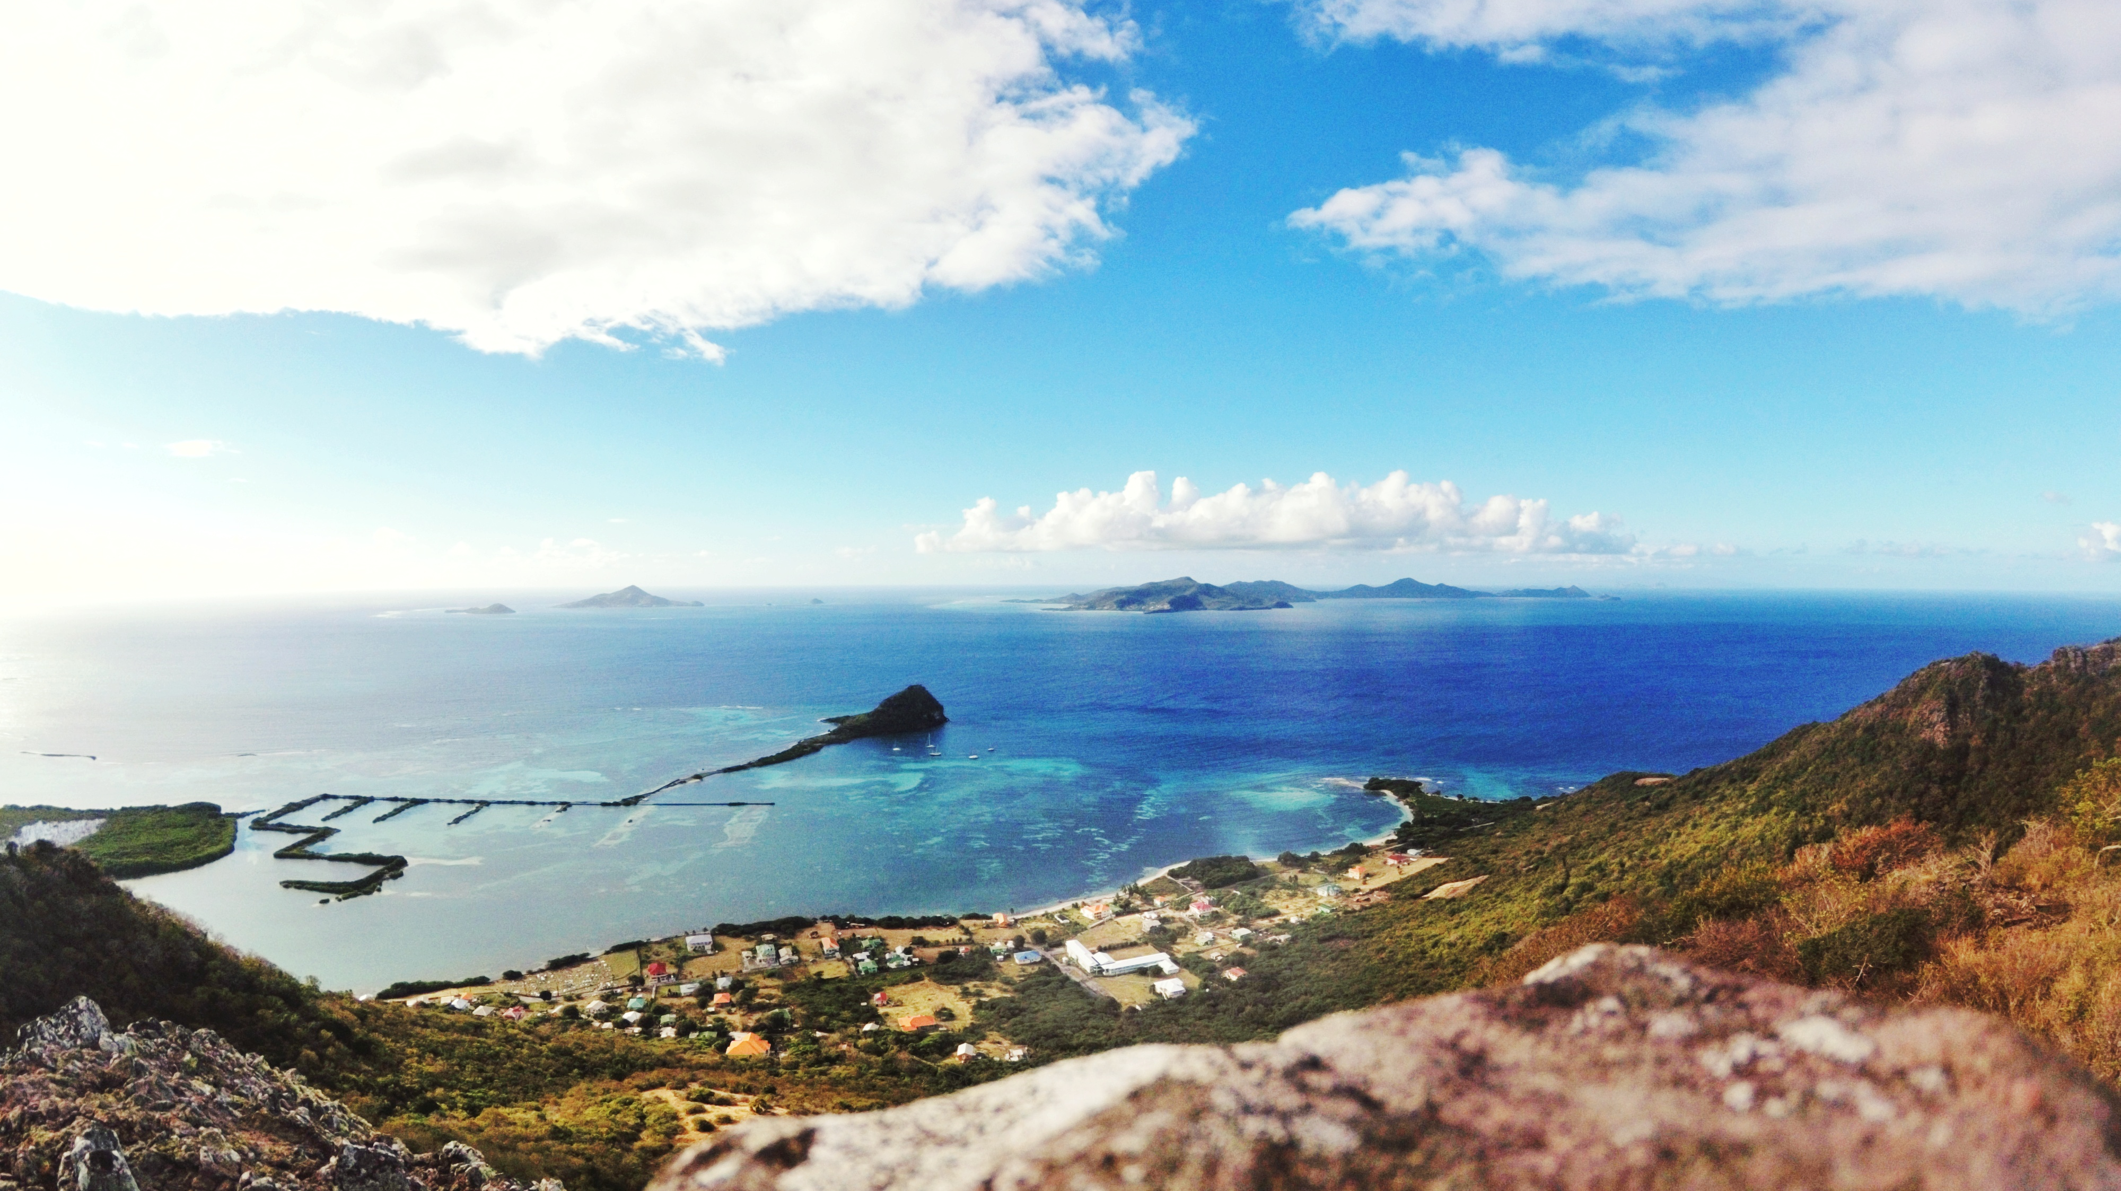
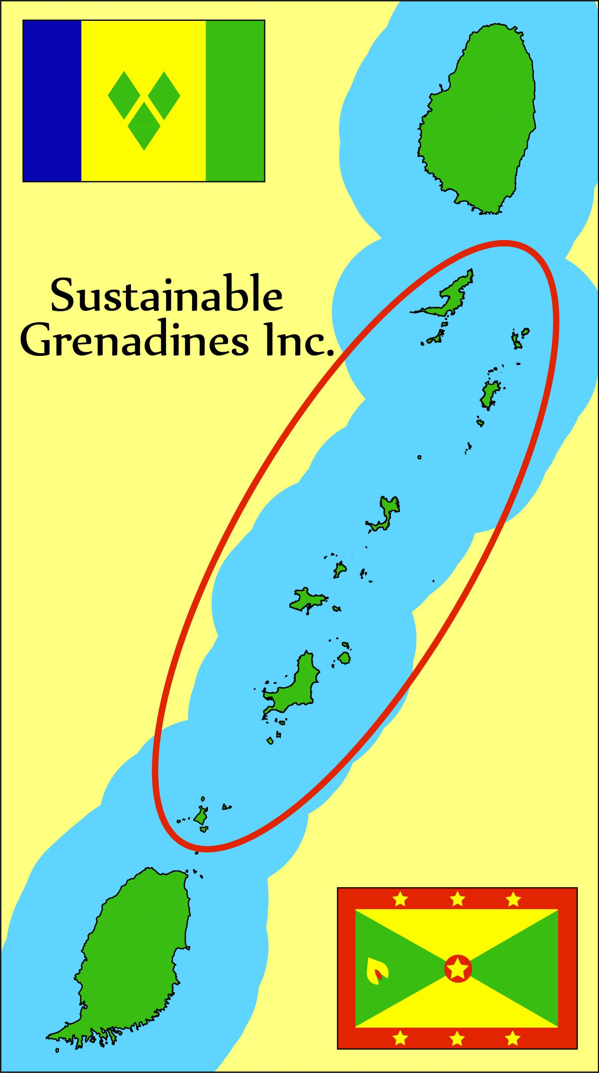
NGO contribution to implementing and monitoring SDG14: the example of Sustainable Grenadines Inc.
Workshop on Implementing and Monitoring the SDGs in the Caribbean:
The Role of the Ocean, Kingstown, Saint Vincent, 17th January 2018
Sustainable Grenadines Inc. (SusGren): Integrated biodiversity conservation and sustainable development in the Grenadines
Notes:
The workshop aims to facilitate a dialogue between the governments and people of the Caribbean Small Island States about their efforts to implement and monitor the SDGs and, by monitoring this dialogue, to extract knowledge needs, which then can be related to data needs.
T. The collaborate effort brings together governments and people of the Caribbean Small Island States, Earth observation providers, scientists, United Nations Agencies active in the region, and regional non-governmental organizations with the goal to link on-going efforts to implement and monitor the SDGs in the Caribbean Small Island States to required ocean observations and engage in the co-creation of the knowledge needed by those engaged in SDG implementation. The overarching goal is to fully map the requirements for ocean observations serving the implementation and monitoring of the SDGs

Slide 2
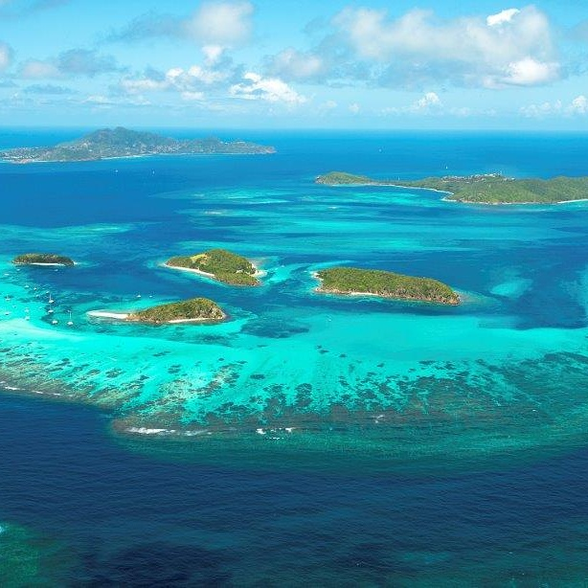
Overview
Brief intro to SusGren.
Main accomplishments toward SDG14.
Some ideas for collaboration.
Questions and discussion.

Slide 3
Introduction to SusGren
Vision:
Healthy coastal and marine ecosystems supporting sustainable livelihoods in the Grenadines.
Mission:
To empower the people of the Grenadines to manage their marine and coastal resources sustainably.

Slide 4
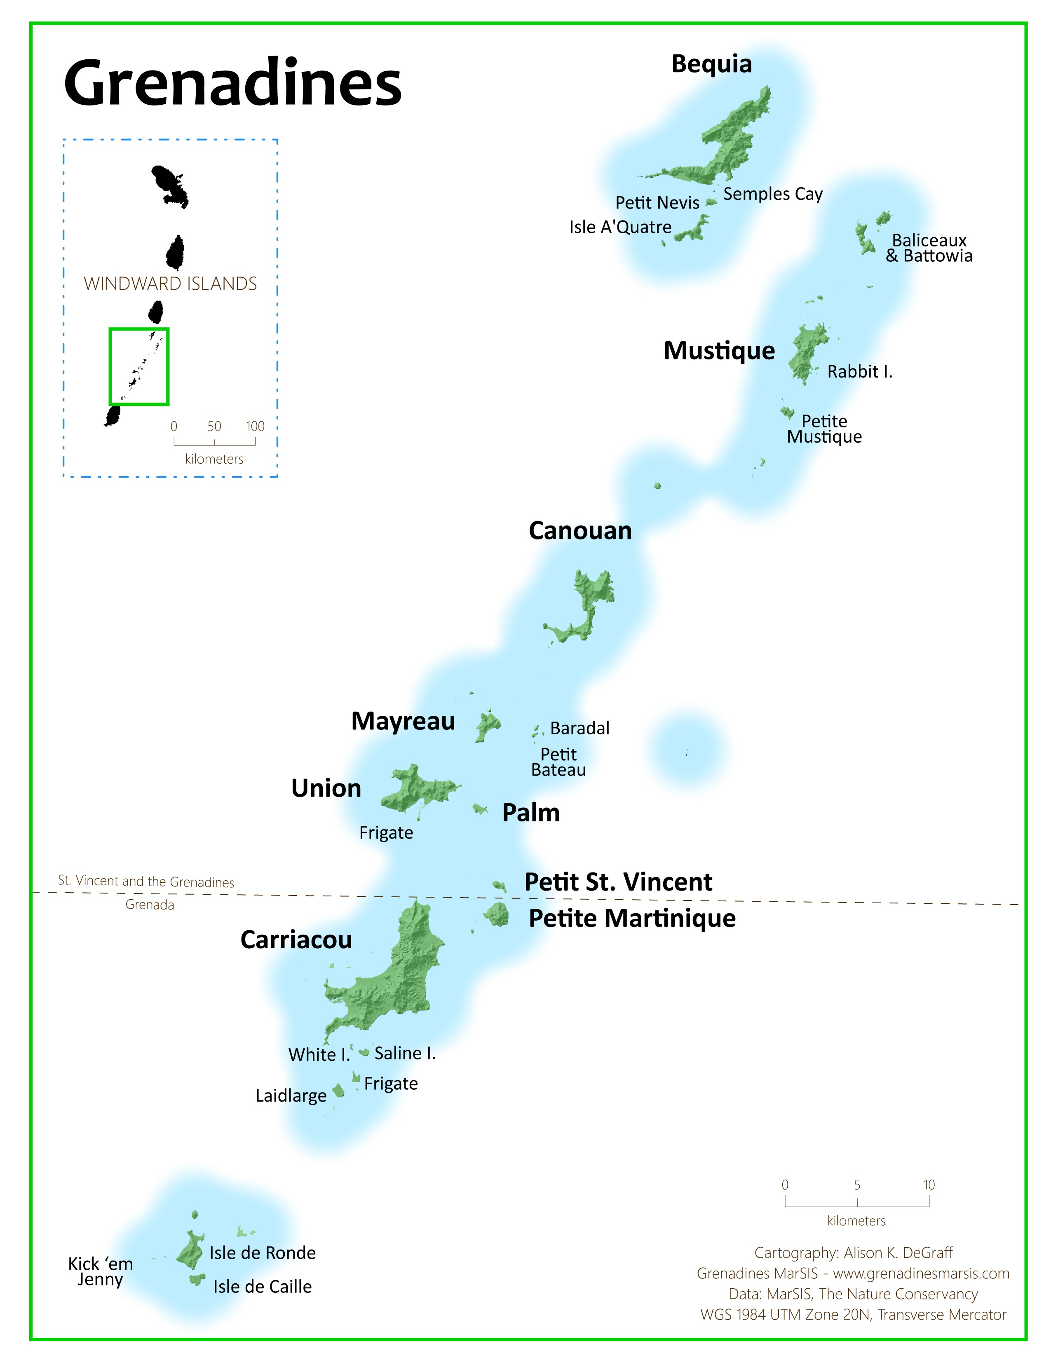
Introduction to SusGren
Started as UWI project: 2002
Founded as NGO: 2010
Board: Nine representatives of NGOs, government, private sector and academia.
Staff: 2-11 FT
Budget: US$260,000 yr⁻¹
Map by Ali DeGraff

Slide 5
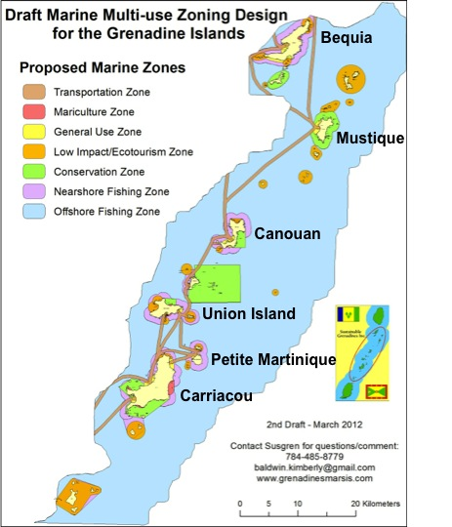
Multi-Use Zoning Plan for the Grenadines
Blueprint for sustainable marine use
>200 stakeholders participated
Incorporated into SVG Oceans Policy
Notes:
From 2010 to 2012, SusGren facilitated a multi‐use zoning plan for the Grenadines incorporating input from over 200 stakeholders —fishers, ferry operators, conservationists, sea moss farmers, tourism business owners and government officials — as well as new scien-tific research. The plan is a blueprint for sustainable use of the Grenadines’ marine re-sources and has been incorporated into Saint Vincent and the Grenadines’ Oceans Policy.
One of the key strengths of the SDGs is that they are common goals agreed upon by all nations. They address transboundary problems and require international collaboration to achieve.
SusGren’s transboundary nature enables us to facilitate collaboration between SVG and Grenada, for example on the MUZP, sustainable fisheries and GNMPA. NGOs can play a valuable role in facilitating dialogue between stakeholders toward beneficial policies and practice.

Slide 6
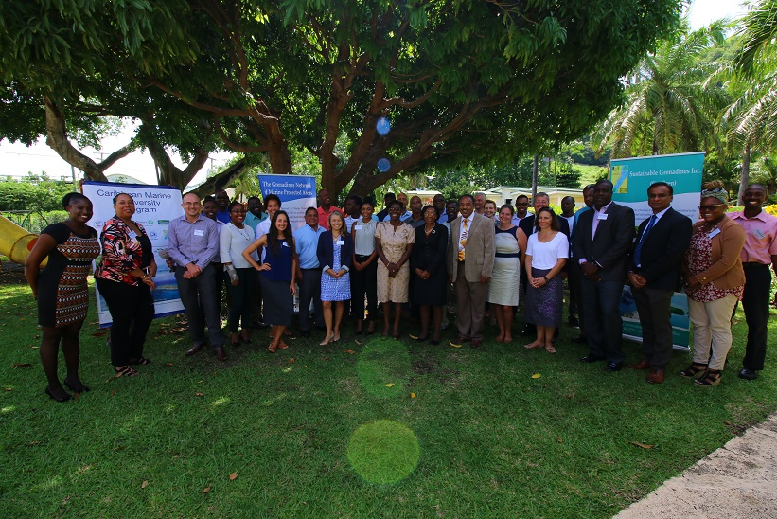
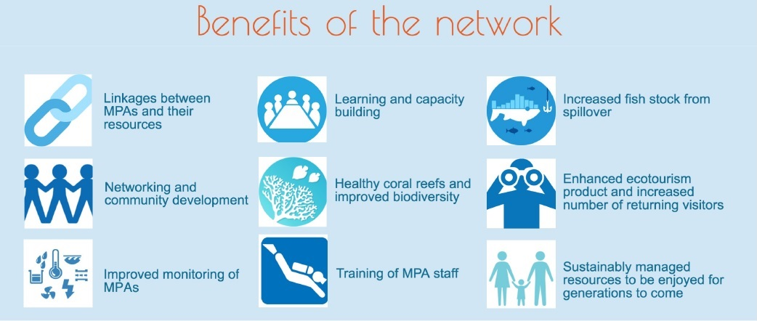
Grenadines Network of Marine Protected Areas
SusGren coordinates this network of seven MPAs in SVG and Grenada, which collaborate to build capacity and share best practice
Notes:
Also hired personnel for SIOBMPA.

Slide 7
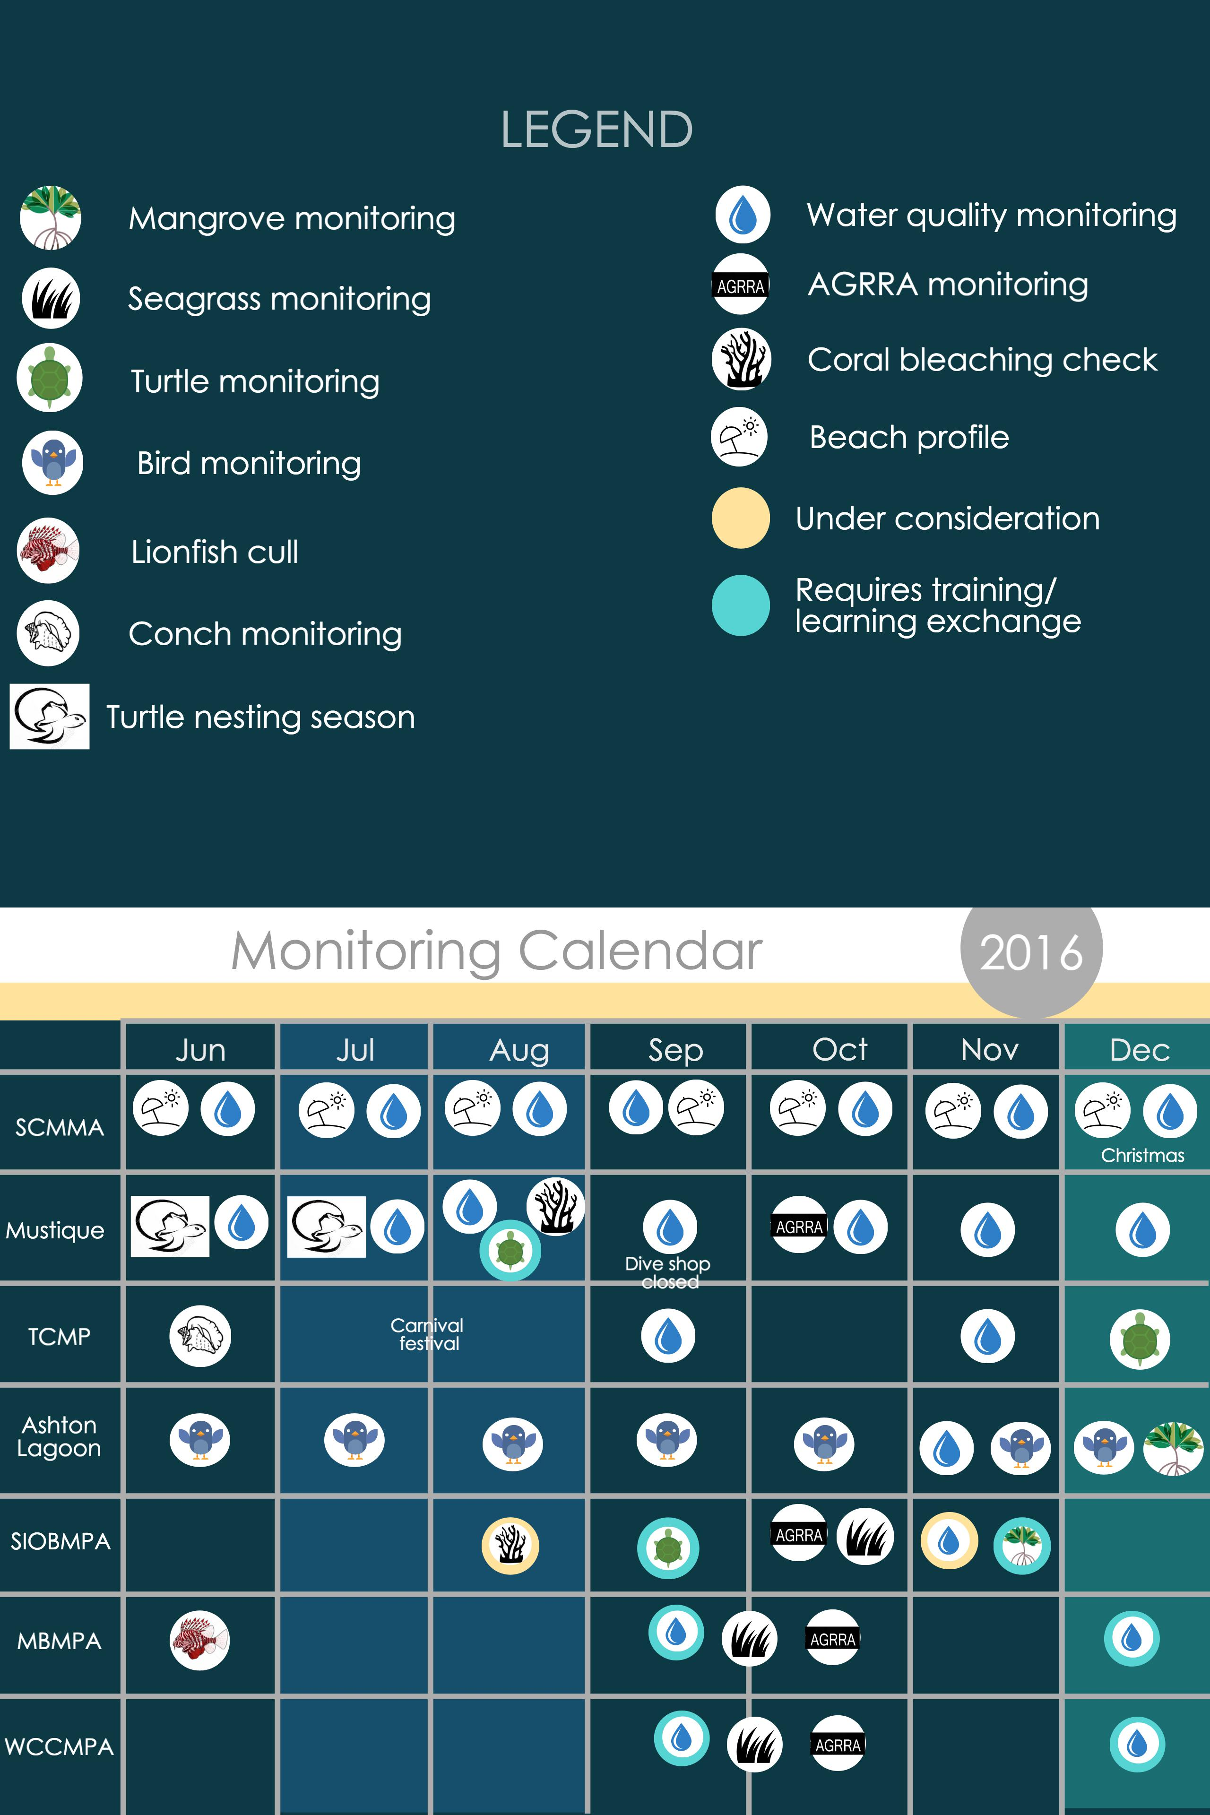
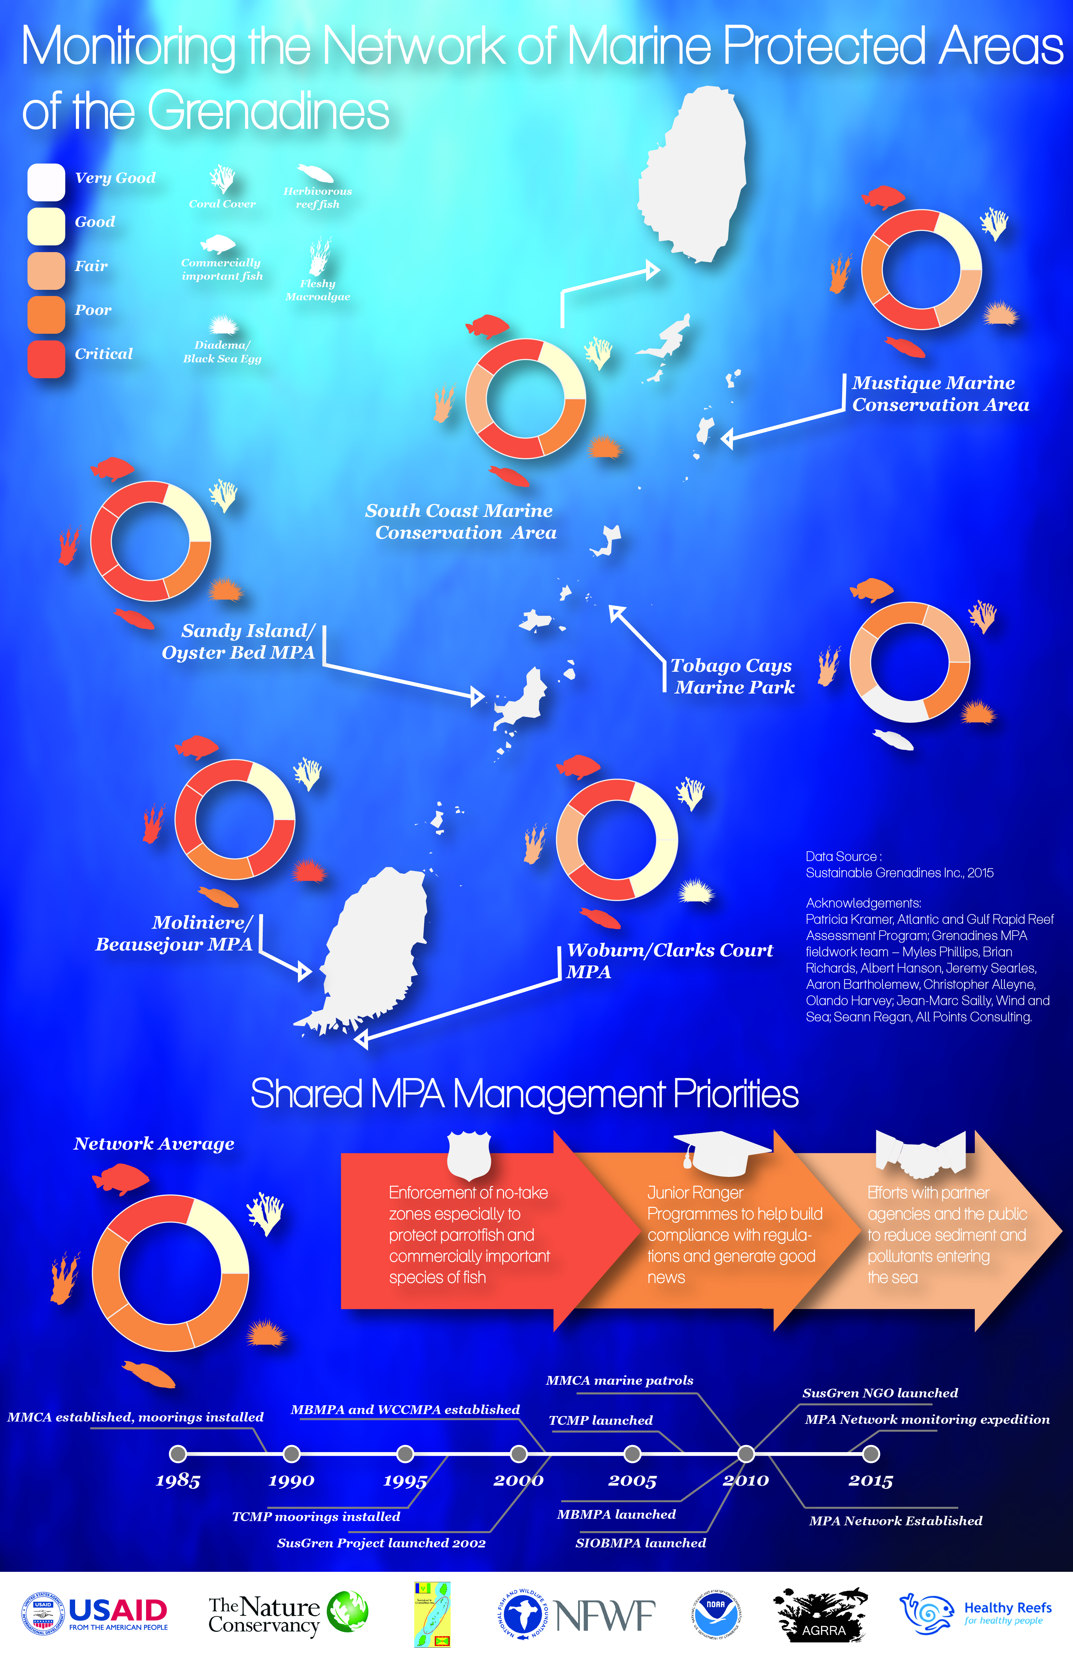
Coordinated bio-physical monitoring across the Network gives us a picture of marine health across the Grenadines.
Notes:
Coordinated bio-physical monitoring across the Network allows us to get a picture of marine health across the Grenadines.

Slide 8
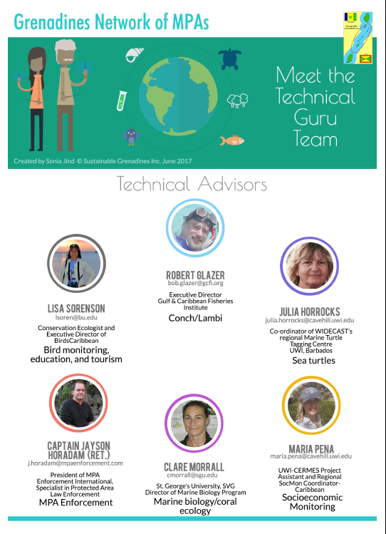
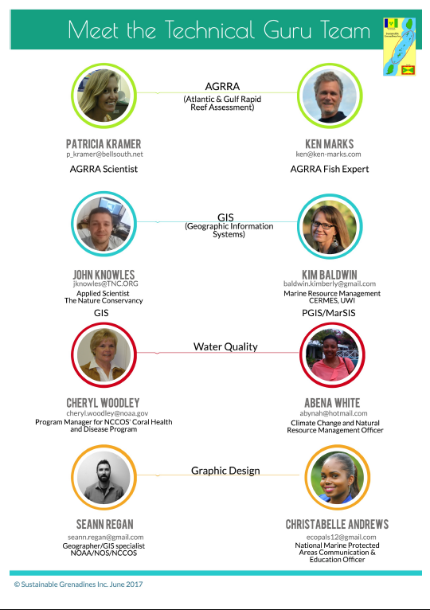
Notes:
Coordinated bio-physical monitoring across the Network allows us to get a picture of marine health across the Grenadines.

Slide 9
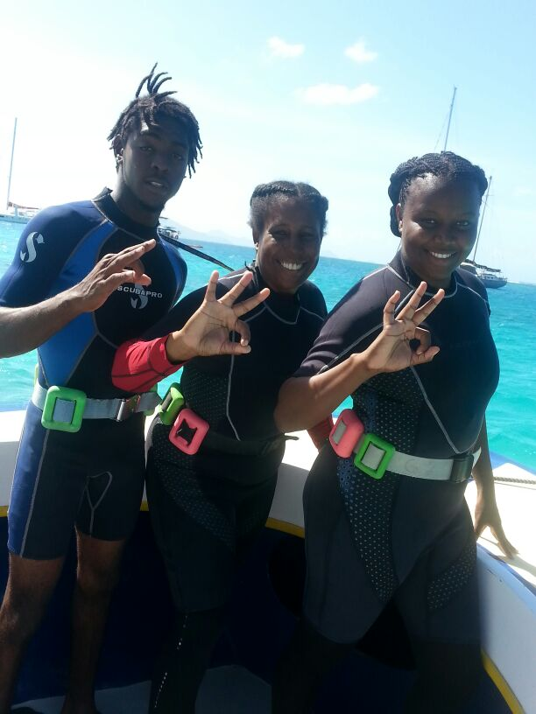
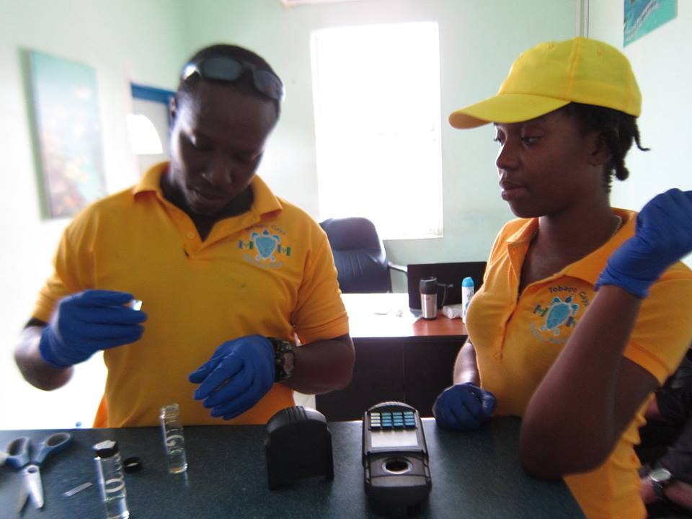
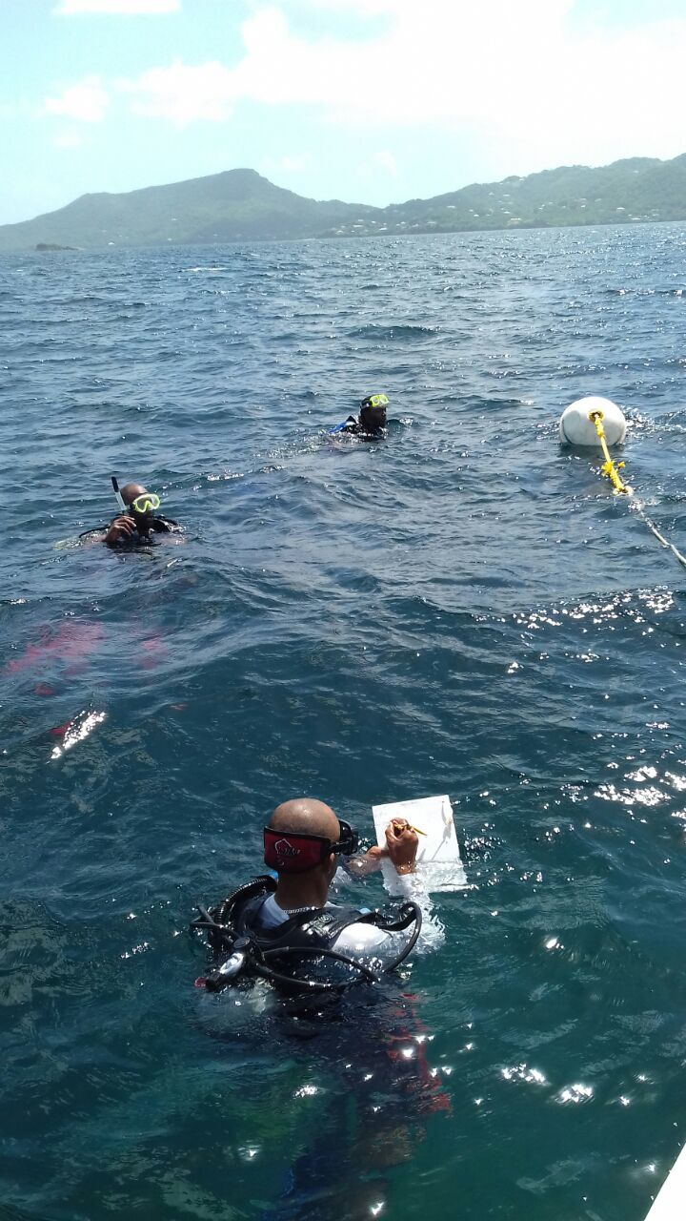
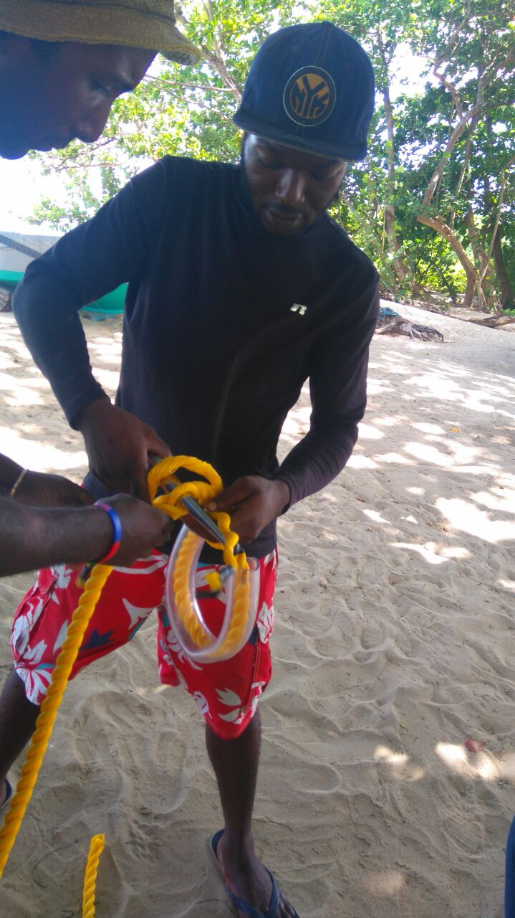
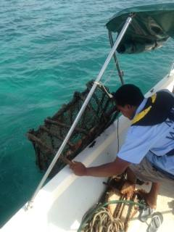
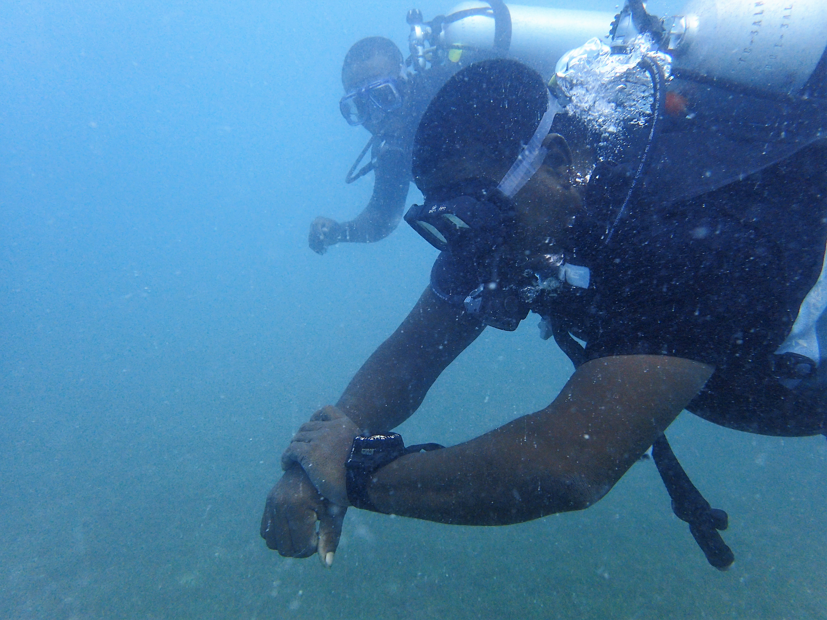
Grenadines Network of Marine Protected Areas
1,000s of hours of training to MPA personnel.
Tools to assist MPAs
Management plans
Moorings plans
SOP manuals
Architectural plans for ranger base
Provided physical assets
Computers, SCUBA gear, patrol vessel
Notes:
Training has been provided in governance, management planning, environmental education, law enforcement, moorings, lionfish control, coral reef monitoring, coral restoration, community development, first aid, SCUBA diving…

Slide 10
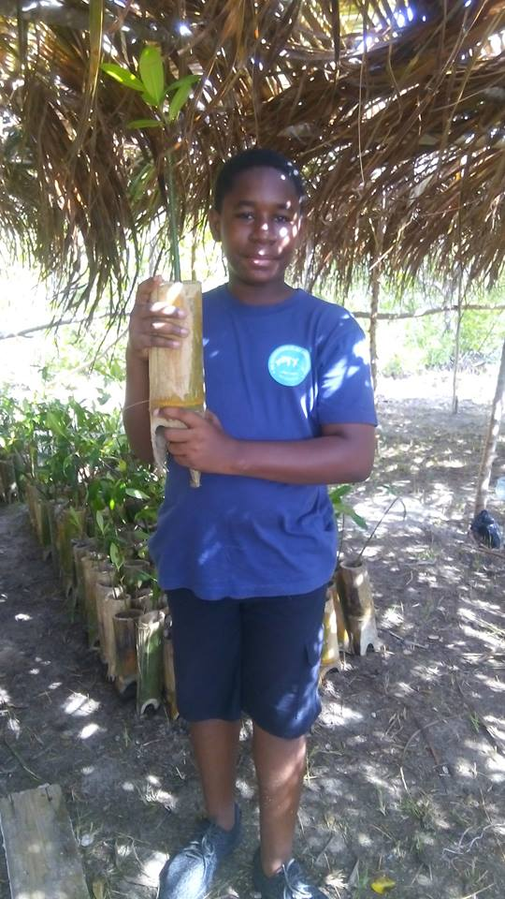
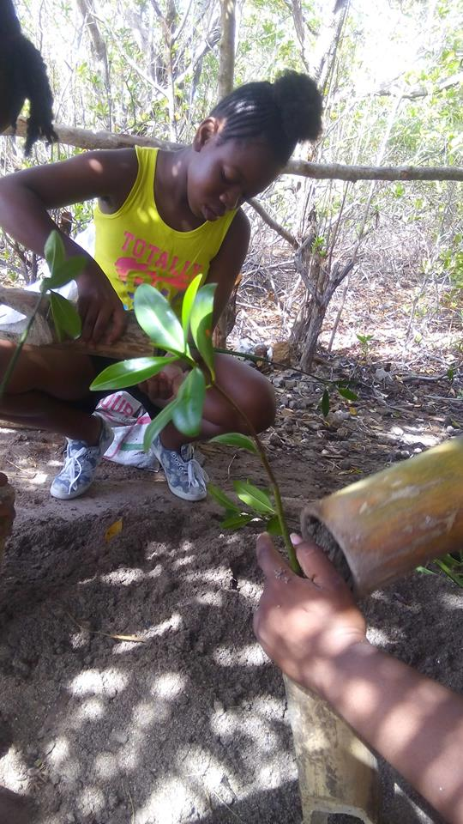
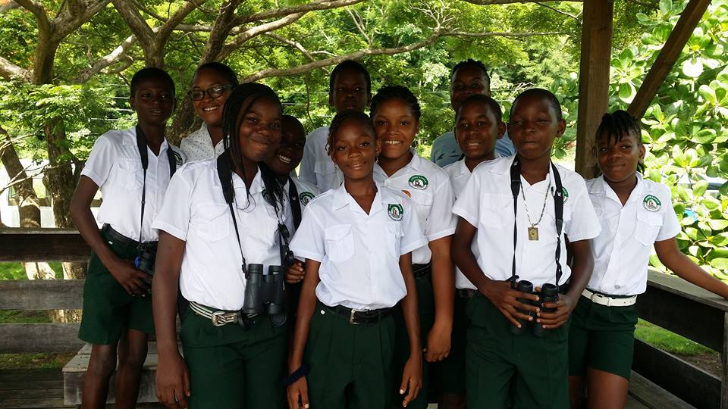
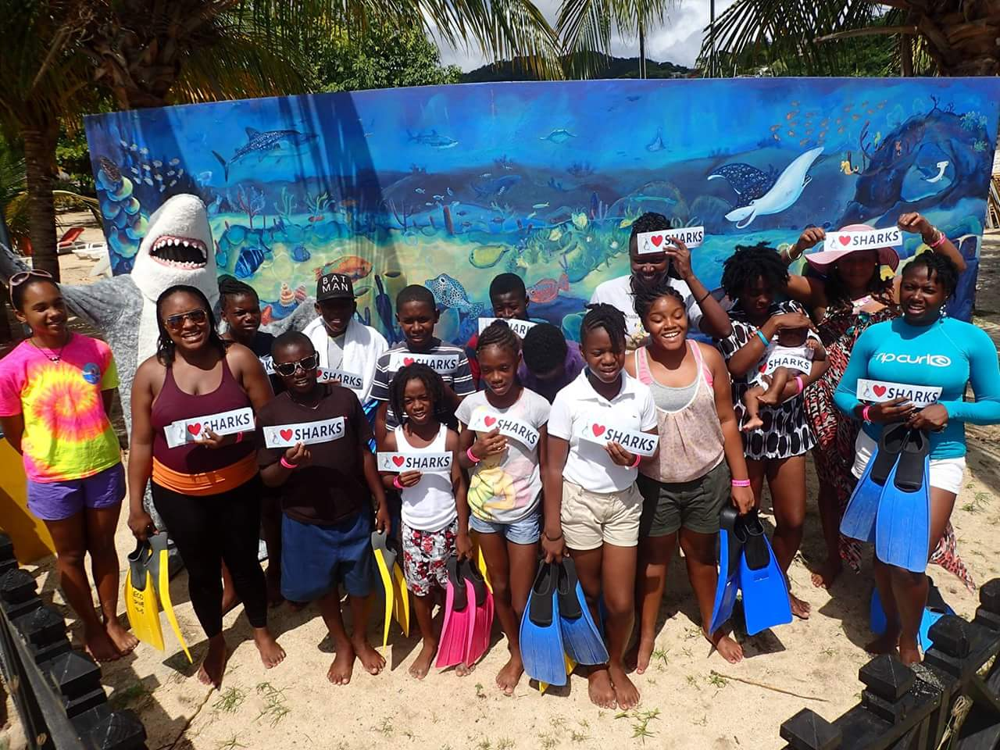
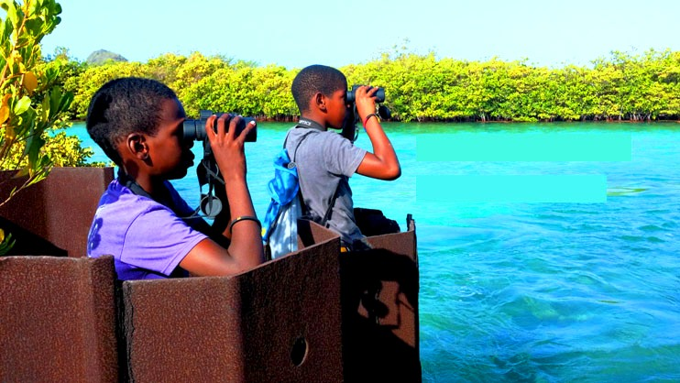
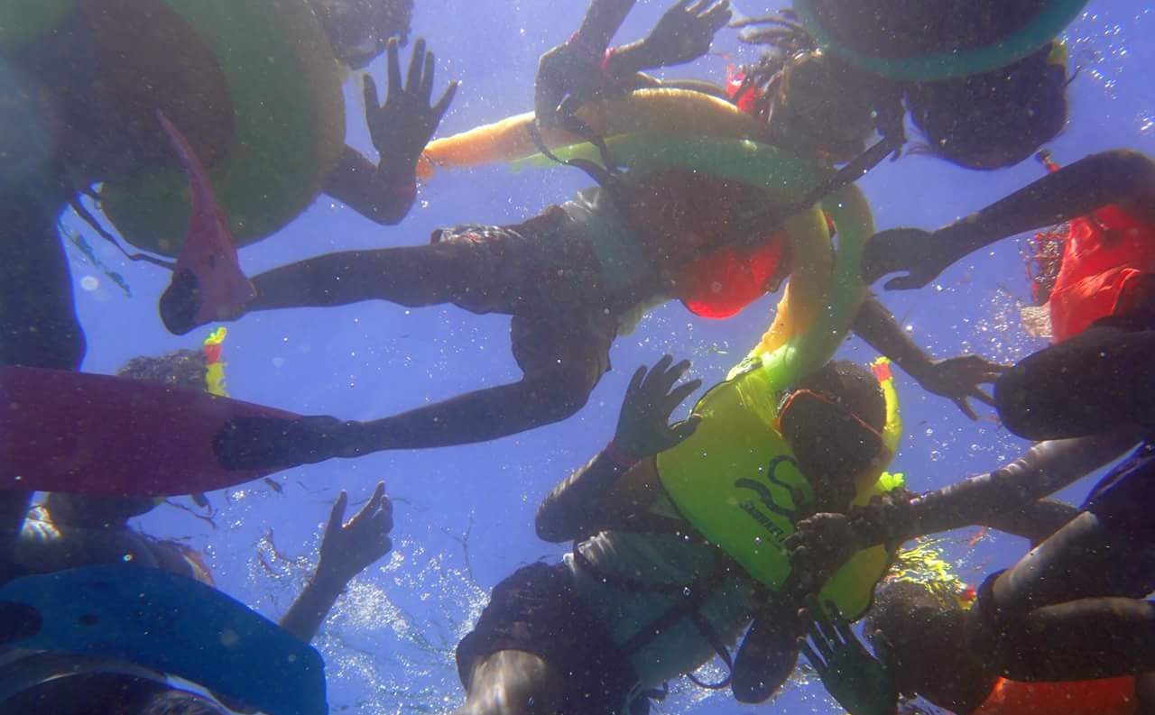
Junior Ranger Program: training the next generation of environmental professionals
Trained 12 young people in a pilot program.
Creating a competence-based curriculum.
Notes:
Research shows that MPA management effectiveness correlates with staff capacity.
We aim to train a generation of

Slide 11
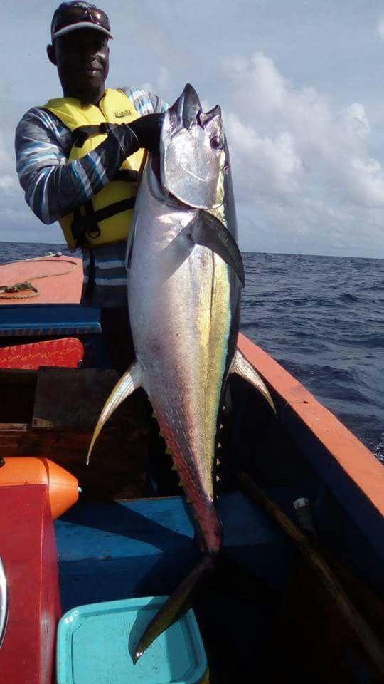
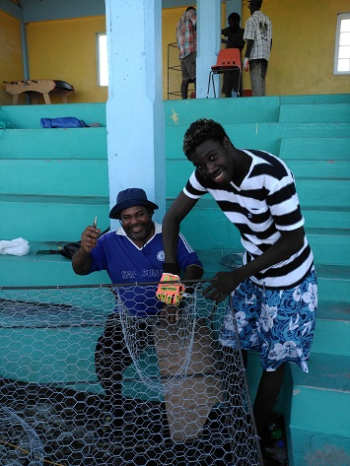
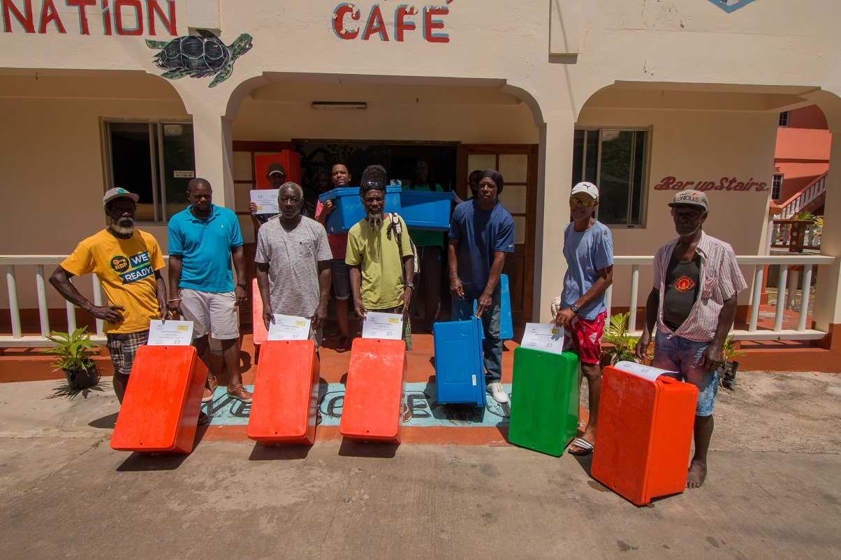
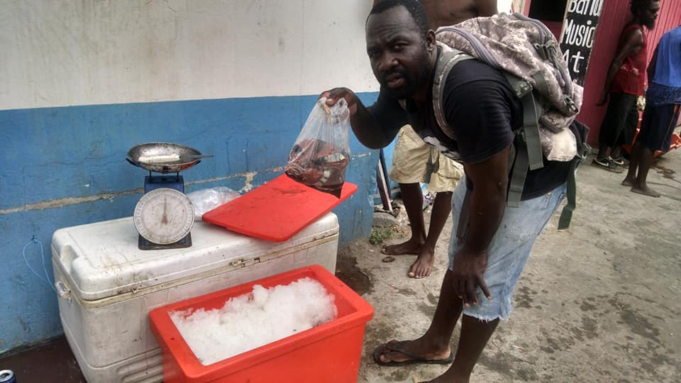
More sustainable fisheries
Enabled lobster fishers to transition to more sustainable gear.
Trained and equipped >50 fisherfolk in post-harvest handling of seafood.
Supported UNDP to train and equip fishers in drop-line fishing.
Notes:
Contributes to SDG14 target “By 2020, effectively regulate harvesting and end overfishing, illegal, unreported and unregulated fishing and destructive fishing practices and implement science-based management plans, in order to restore fish stocks in the shortest time feasible, at least to levels that can produce maximum sustainable yield as determined by their biological characteristics”

Slide 12
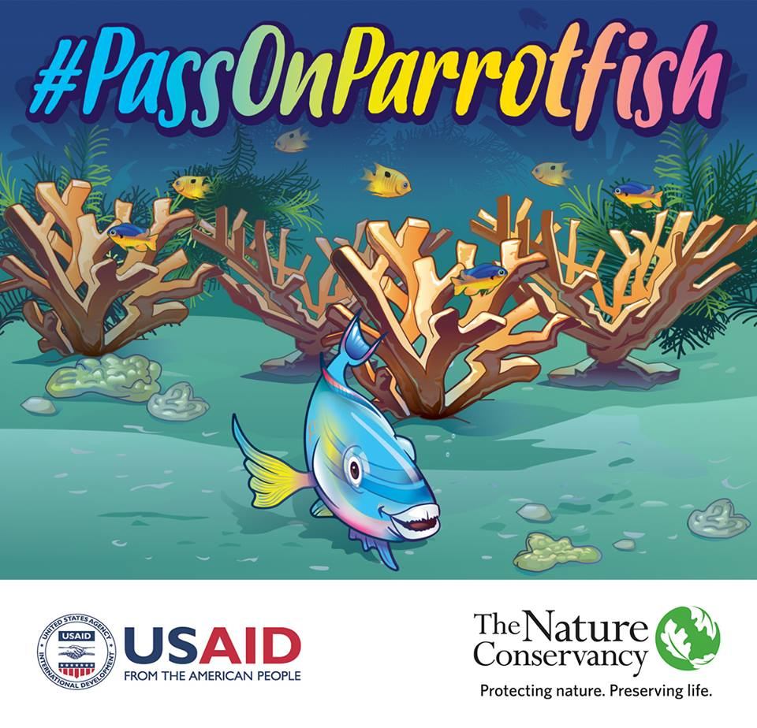
Supporting TNC’s #PassOnParrotfish social marketing campaign
Notes:
Also hired personnel for SIOBMPA.

Slide 13
Ashton Lagoon restoration
Ashton Lagoon was damaged by a failed marina development in 1995...

Slide 14
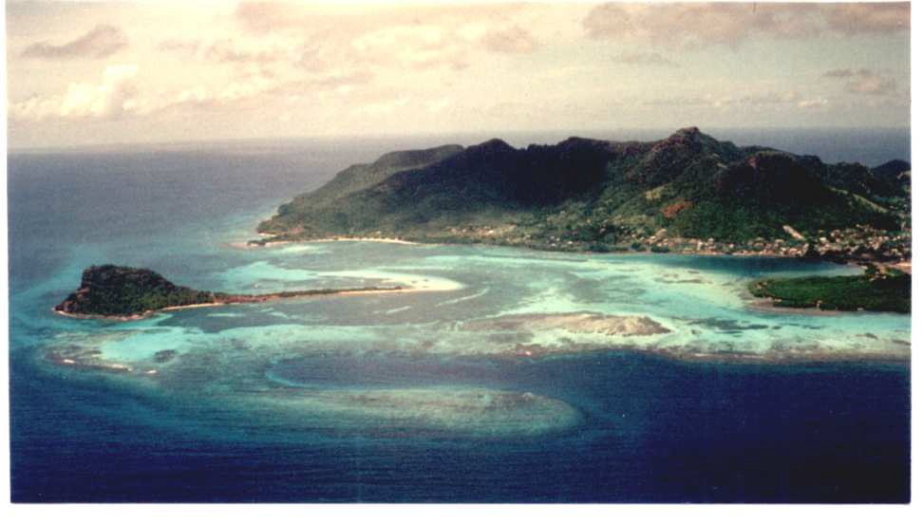
Before Marina Construction
Notes:
Ashton Lagoon was once a healthy and pristine environment. Local fishermen tell me the area used to be a rich fishing ground for conch and lobster.

Slide 15
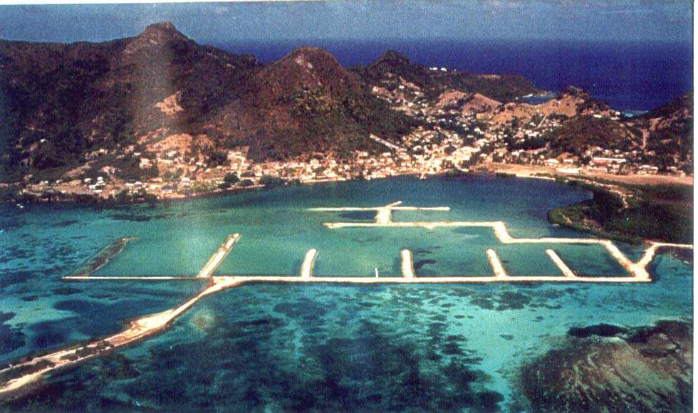
During Marina Construction
Notes:
Then in 1994, a company came promising big things. A 300-birth marina would bring economic prosperity to Union Island. Then in 1995, the company declared bankruptcy and the project was abandoned.

Slide 16
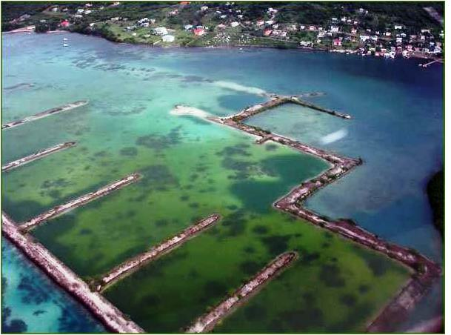
After Marina Construction
Notes:
The abandoned marina has caused a number of environmental problems. The marina has blocked water circulation. The stagnant water and build up of sediment on the leeward side of the marina has ruined the habitat. Corals have died, the seagrass is in poor condition. Conch and lobster can no longer be found in the area, hurting the local fishermen.

Slide 17
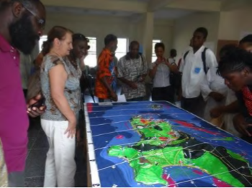
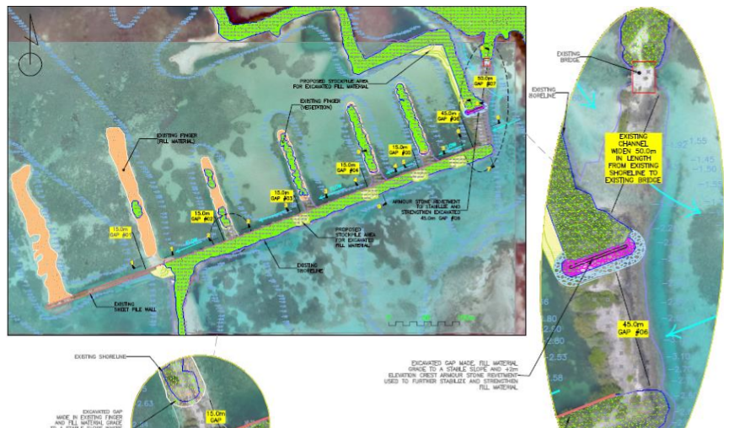
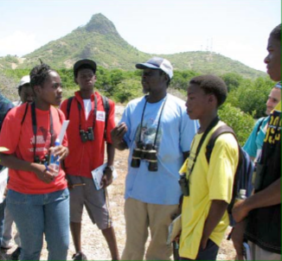
Ashton Lagoon restoration
Notes:
The GNMPA consists of seven MPAs in Grenada and SVG that collaborate to build capacity and share best practices. It is one of only three transboundary MPA networks in the world.
Training has been provided in governance, management planning, environmental education, law enforcement, moorings, lionfish control, coral reef monitoring, coral restoration, community development, first aid, SCUBA diving…

Slide 18
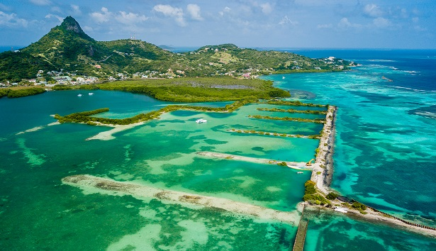
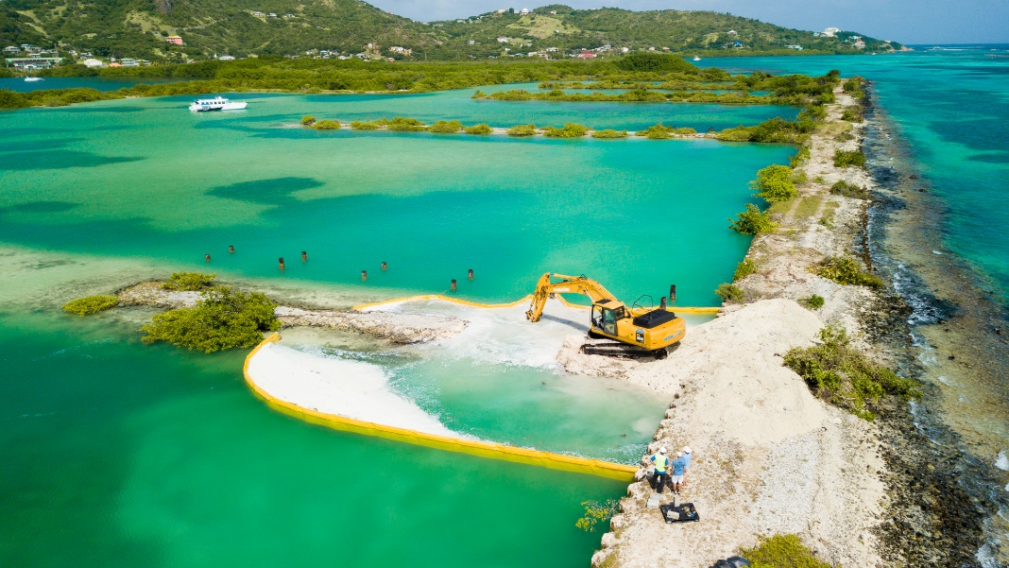
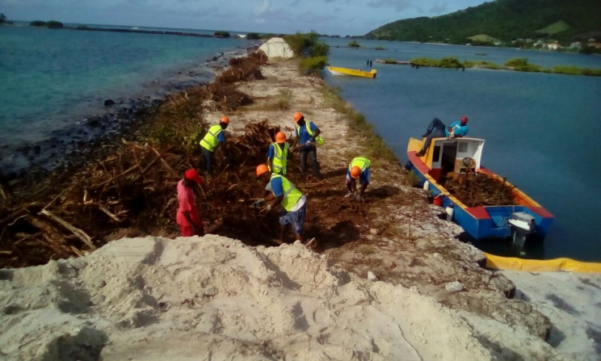
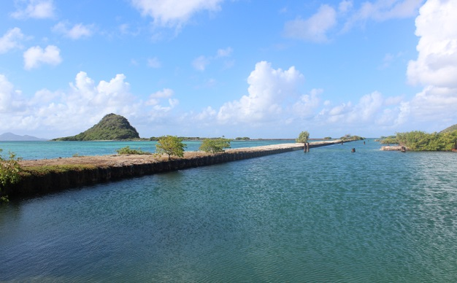
Notes:
The GNMPA consists of seven MPAs in Grenada and SVG that collaborate to build capacity and share best practices. It is one of only three transboundary MPA networks in the world.
Training has been provided in governance, management planning, environmental education, law enforcement, moorings, lionfish control, coral reef monitoring, coral restoration, community development, first aid, SCUBA diving…

Slide 19
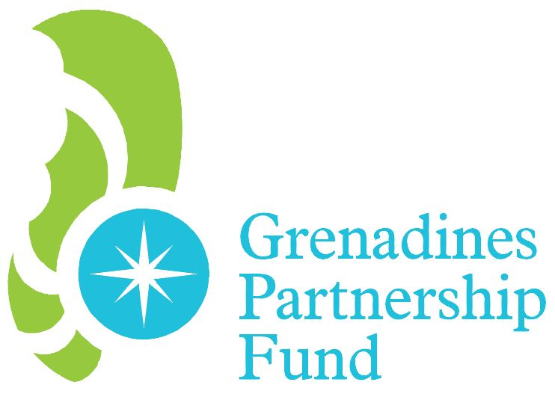
Thanks to our funders!
Notes:
Add KfW and Grenadines Partnership Fund

Slide 20
Ideas for collaboration
Incorporate Grenadines MUZP into national marine spatial plans.
Research into the status of pelagic fisheries in and around the Grenadines, and capacity-building in sustainable fisheries management for us and our stakeholders.
Research to identify which sources of nutrient pollution in the Grenadines would be best (most cost-effective) to address in order to improve coral reef health.
Collaboration with Ministries of Education and others to enable more children to benefit from our environmental education resources.

Slide 21
Questions and discussion
Contact : james.starkey.lord@gmail.com • (+784) 485 8779
Facebook: SusGren (Grenadines NGO) • Grenadines Network of Marine Protected Areas (GNMPA)
Sustainable Grenadines Inc. (SusGren): Integrated biodiversity conservation and sustainable development in the Grenadines
Notes:
Collaborate and coordinate efforts with government and research community to realize synergies and avoid duplication.
Communicate our research needs to research community to get information to inform our strategies: E.g. We are considering assisting fishers to transition from near-shore to offshore fisheries as a strategy to protect coral reefs, but there are concerns re. sustainability of offshore fisheries. Research community can help here by providing information to guide us, and by building our capacity and that of fishers in sustainable fisheries management.
Funding: collaborate to develop funding proposals.

Slide 22
SDG14 targets
“By 2030, increase the economic benefits to Small Island developing States and least developed countries from the sustainable use of marine resources, including through sustainable management of fisheries, aquaculture and tourism”
“By 2025, prevent and significantly reduce marine pollution of all kinds, in particular from land-based activities, including marine debris and nutrient pollution”
“By 2020, effectively regulate harvesting and end overfishing, illegal, unreported and unregulated fishing and destructive fishing practices and implement science-based management plans, in order to restore fish stocks in the shortest time feasible, at least to levels that can produce maximum sustainable yield as determined by their biological characteristics”
“By 2020, sustainably manage and protect marine and coastal ecosystems to avoid significant adverse impacts, including by strengthening their resilience, and take action for their restoration in order to achieve healthy and productive oceans.”
“By 2020, conserve at least 10 per cent of coastal and marine areas, consistent with national and international law and based on the best available scientific information”

