Slide 1
GEO & the SDGs
Douglas Cripe, GEO Secretariat
Implementing and Monitoring the SDGs in the Caribbean
17-19 January 2018

Slide 5
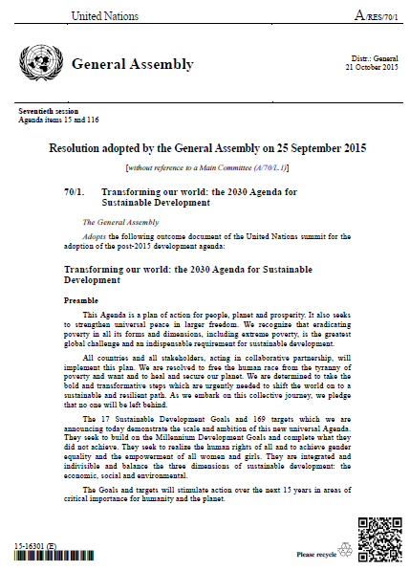
SDGs and Earth Observation
Transforming our World: The 2030 Plan for Global Action - Article 76: We will promote transparent and accountable scaling-up of appropriate public-private cooperation to exploit the contribution to be made by a wide range of data, including Earth observation and geo-spatial information, while ensuring national ownership in supporting and tracking progress.

Slide 7
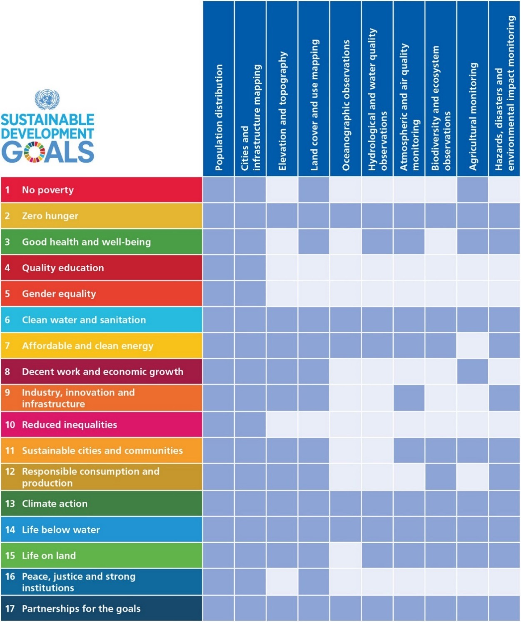
Positioning geospatial information to address global challenges
Notes:
Projects Develop, validate and deploy uses of Earth observations to support SDG tracking and reporting
Capacity Building Build skills for accessing and applying Earth observations data
Data and Information Products Advance discoverability and accessibility of products
Outreach and Engagement Promote the consideration and adoption of Earth observations for the SDGs

