Slide 1
Tracking Ghost Nets in the Pacific
Risa Lowy Sybrandy
Technologies for observing and monitoring plastics in the oceans
November 26th, 2018
Brest, France
Notes:
In 2015 Jambeck et. al. published the results from a model of plastic entering the ocean from 192 countries with cities along the coast generated between 4.8 and 12.7 million metric tons of plastic marine debris in the form of plastic bottles and packaging. The result is a growing accumulation of microplastics in the five global oceanic gyres.

Slide 2
Composition of the GREAT Pacific Garbage patch
Notes:
While this is alarming, this past March Lebreton et. al. find that within the Great Pacific Garbage Patch the majority of mass of plastic is fishing gear, not microplastics.
Jambeck, J. R., Geyer, R., Wilcox, C., Siegler, T. R., Perryman, M., Andrady, A., . . . Law, K. L. (2015, February 13). Plastic waste inputs from land into the ocean. Retrieved November 24, 2018, from http://science.sciencemag.org/content/347/6223/768.full
Evidence that the Great Pacific Garbage Patch is rapidly ... (n.d.). Retrieved from https://www.theoceancleanup.com/fileadmin/media-archive/Documents/Lebreton2018_SciRep.pdf

Slide 3
Ghost Nets
Notes:
Of that fishing gear, 46 percent is abandoned fishing nets. This nets are often referred to as “Ghost Nets”

Slide 4
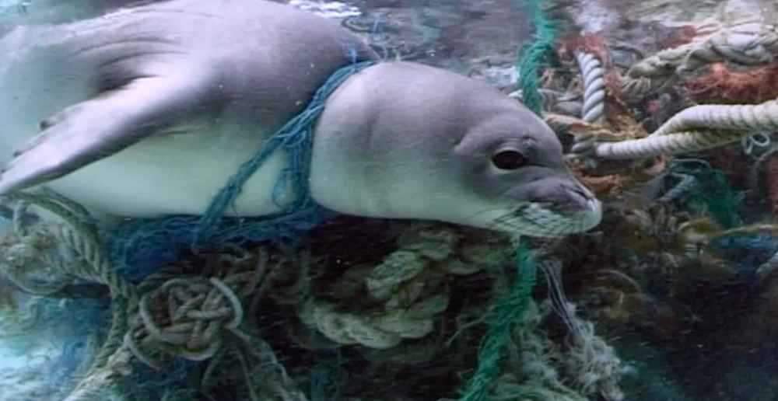
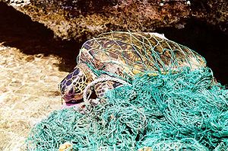
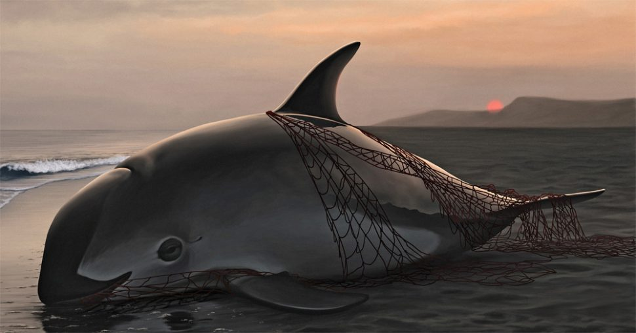
TrapPed Marine Animals
Trap
Notes:
The most obvious problem with Ghost Nets is they trap marine animals. These are just a few images of this tragedy.

Slide 5
Microplastics in our Seafood
Notes:
Ghost Nets also eventually breakdown and become microplastics. These plastics are ingested by marine animals and harvested seafood. Harmful chemicals in the plastics leach into the fish and then into us.

Slide 6
Ocean Voyages Institute’s Project Kaisei
Notes:
Mary Crowley founded Ocean Voyages in 1979 as a sail boat chartering company. Mary has traveled the oceans extensively including visiting the Galapagos archipelago 17 times. She previously served as Executive Directo of the Oceanic Society, publisher of Oceans magazine. She along with a group of international sailor, educator and conservationists also founded the Ocean Voyages Institute. The Institute is dedicated to providing sail training opportunity to youth on a worldwide basis as well as providing access to the ocean world and educational programs. In 2009, Project Kaisei was established to increase the understanding and the scale of plastic marine debris, its impact on our ocean environment, and how we can introduce solutions for both prevention and clean-up.
Andy Sybrandy of Pacific Gyre met Mary Crowley in 2011 at the International Marine Debris Conference in Honolulu, where they first began discussing solutions to tracking marine debris.

Slide 7
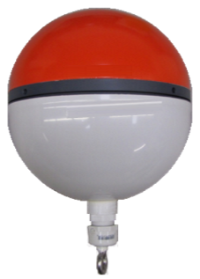
8” (20cm) Universal Tracker
Notes:
Pacific Gyre has worked with Project Kaisei and previously with GhostNets Austalia to track abandoned drift nets.
Building marine Lagrangian drifters, and trackers since 1994, the debris trackers are a modified Universal Tracker to include a special tether to attach the tracker to Ghost Nets.
These trackers calculate their positions using very sensitive GNSS receivers able to utilize GPS, GLONASS, and Beidou global positioning systems. Positions are transmitted back to Pacific Gyre servers using the Iridium Satellite telemetry system. The trackers include batteries with enough energy to power them for several years in the ocean.
Project Kaisei can then use this data to display Ghost Net tracks and raise awareness of the problem.

Slide 8
Tracked Ghost Nets in the Pacific
Notes:
Project Kaisei currently has an inventory of 50 trackers, with 15 deployed attached to Ghost Nets in the Pacific.
The project needs help finding vessels willing to take the time to deploy the debris trackers.
The engineering focus of the project is developing the best method of attaching the trackers to the nets. This will be evaluated by visiting the nets to be certain the trackers are still attached and to evaluate their current condition.
In the future Project Kaisei hopes to organize efforts to retrieve the nets.

