Slide 1
INTERREG
France (Channel) England Programme

Slide 2
What are we funding ? Que finançons-nous ?
1.1
Innovation
Innovation
3.1
Natural and Cultural Assets
Atouts du patrimoine naturel et culturel
1.2
Social Innovation
Innovation Sociale
3.2
Coastal and Transitional Water Ecosystems
Ecosystèmes côtiers et eaux de transition
2.1
Low Carbon Technologies
Technologies Bas Carbone
Notes:
Our program is financed by the European fund for regional development and support projects from organisations in the eligible area (around the Channel).
The objective of the cooperation programmes is to tackle issues that go beyond the national borders and seek joint-solutions by working together. Therefore, the partnership must be composed at least of one French partner and one English partner, but projects have most likely 6 to 10 partners.
We have 2 types of projects : regular ones and Micro projects
We are looking for projects seeking solutions to common issues in the following 5 specific objectives :
Increase the delivery and uptake of innovative products, processes, services or systems
Increase the service delivery to the most socially or economically disadvantaged groups through social innovation
- Increase the development and uptake of LCT for a reduction in greenhouse gas emissions
- Realise the potential of the common natural and cultural assets to deliver innovative and sustainable growth
- Enhance and protect coastal and transitional water ecosystems
All the projects will have to demonstrate that they can bring change to the programme area (results) through the production of a number of tangible, measureable outputs.

Slide 3
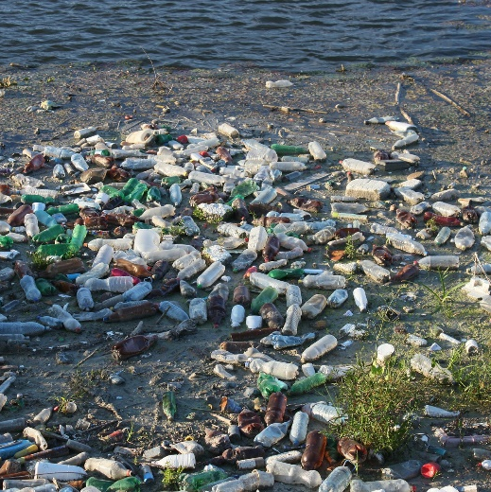
Plastic pollution Targeted Projects
Projets Ciblés sur la pollution plastique
1.1 Biodegradable fishing engine
3.2 Cities without plastic
3.2 Pathway to sea
Notes:
Since January 2018, the progamme has set targeted project calls for interests. They aim to tackle issues that have been identified by the Programme as being particularly important to the economic and sustainable development of the Channel area. The objective is to organise a project lab, gathering relevant participants, where project ideas will emerge. The last project lab was held here in Plouzané, and 3 project ideas came out of it :
1.1 : The project is aiming to reduce plastic pollution in the ocean. They will develop an innovative fishing gear by using biosourced and biodegradable plastic material. This means that the equipment created will have a controlled-lifetime and be biodegradable in the marine environment.
3.2 cities in England and in France will work to co-design and implement a scalable Plastic-Free Prospectus to reduce plastic pollution through behavioural change whilst supporting the circular economy
3.2 are focusing on the water quality and will be looking at catchment areas around estuaries, with rural areas, including small towns. If it is potentially of interest, I will send you the info, once I have got them.

Slide 4
I have and idea, what do I do next ? J’ai une idée, que dois-je faire ?
Bretagne
Anne Rouault
Tel: 02 90 09 16 17
Email: anne.rouault@
norfolk.gov.uk
www.channelmanche.com
Interreg VA France (Channel) England
@Channel_Manche

