Slide 1
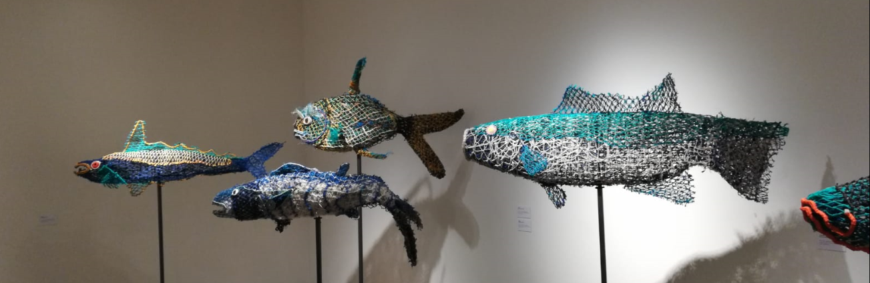
Remote sensing of floating plastics
in the aquatic environment
Shungu Garaba
shungu.garaba@uol.de
26.11.2018

Slide 2
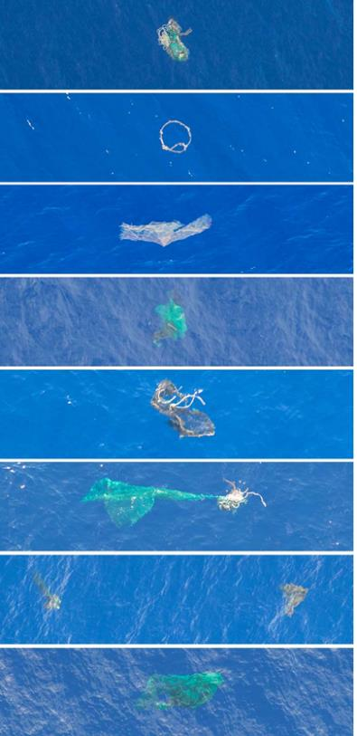
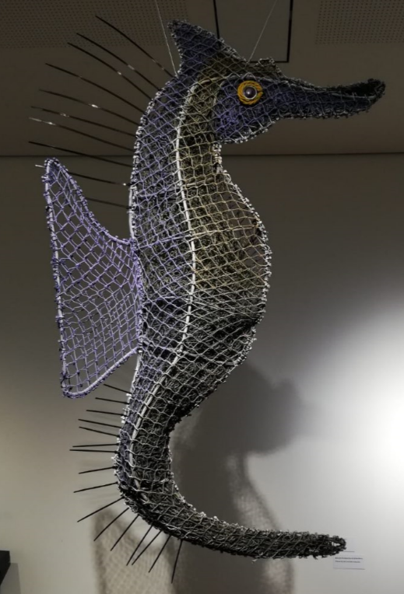
Talk Outline
Background
Motivation
Introduction
Related Works
What is next?
Artwork made using ghost nets

Slide 3
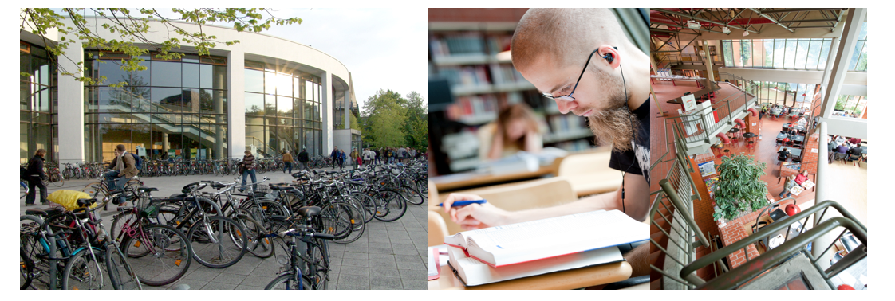
University Oldenburg → www.uol.de
Established 1974, based on teacher education started in 1793.
>15000 students, 230 professors, 1130 scientists, 960 staff.
71 study courses, strong in educational sciences, energy and nano sciences, hearing physics, interdisciplinary marine science.

Slide 4

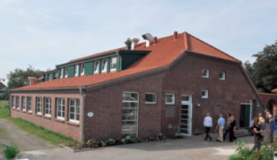
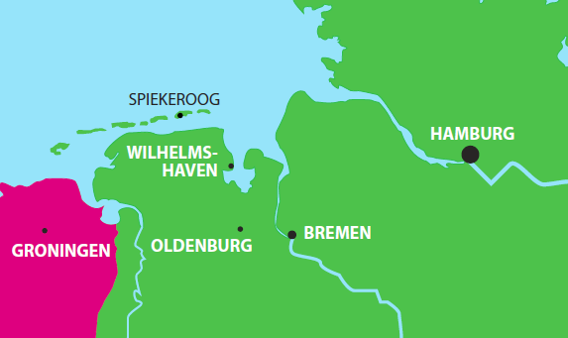
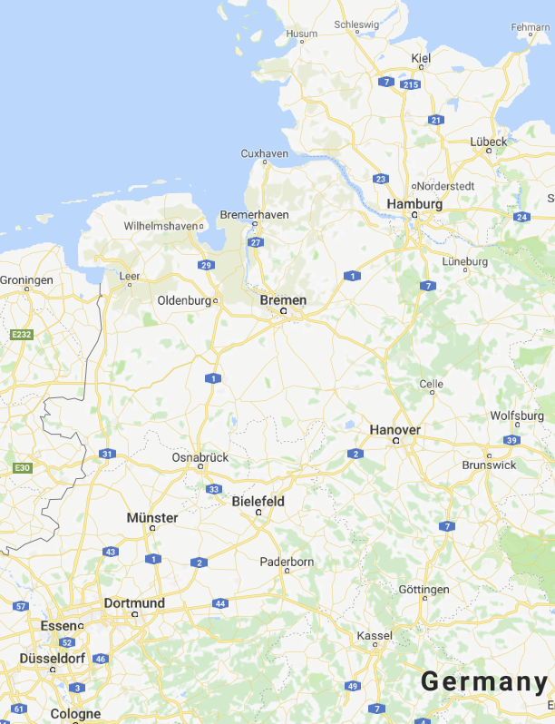
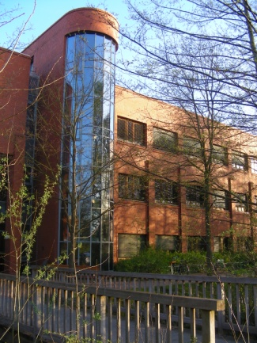
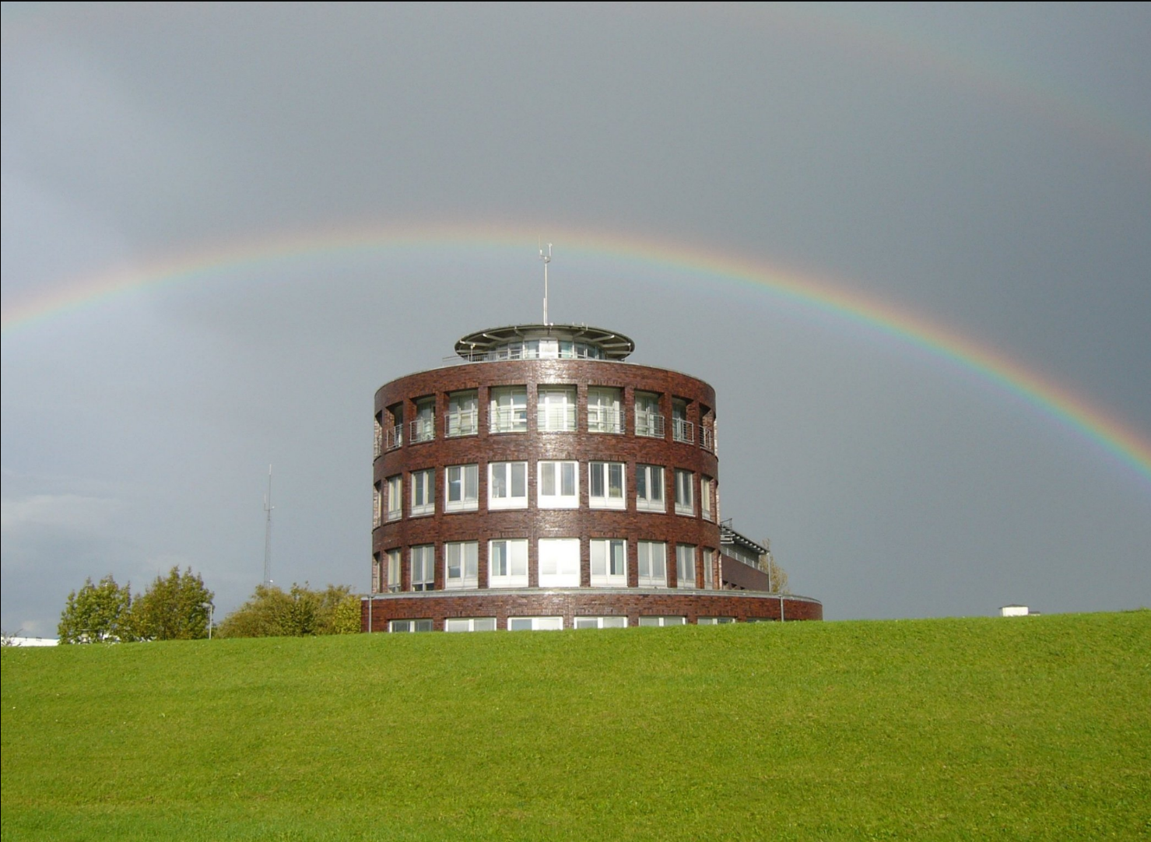
Institute for Chemistry and Biology of the Marine Environment
(ICBM)
Spiekeroog Island
since 2011
Wilhelmshaven
since 1994 Marine Station ‚Terramare‘
since 2008 part of ICBM
Oldenburg
since 1994
(ICBM establ. 1987)

Slide 5
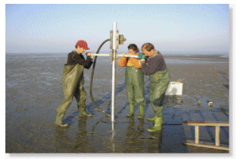
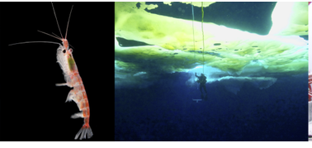
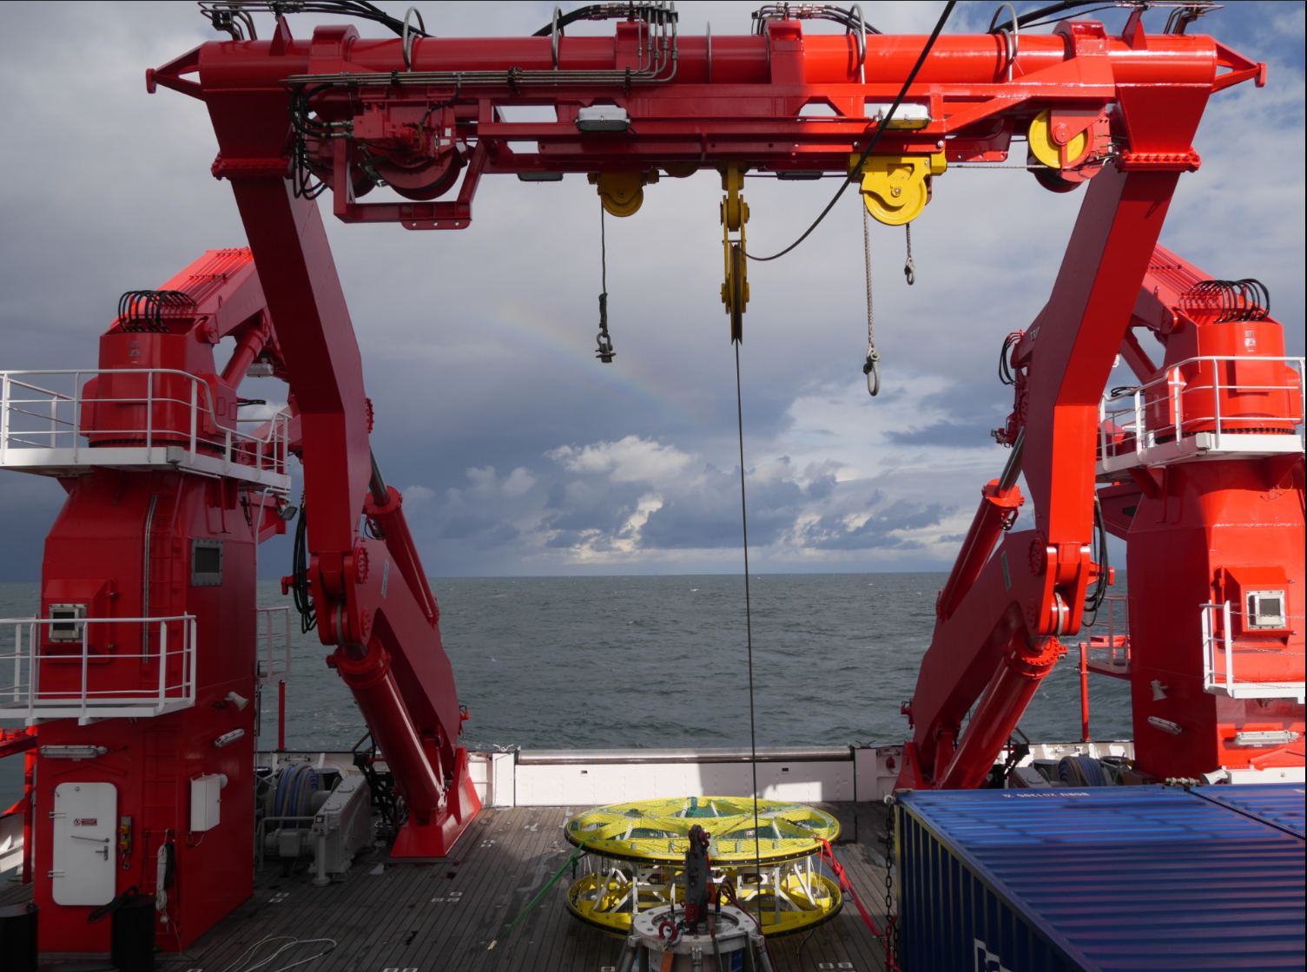
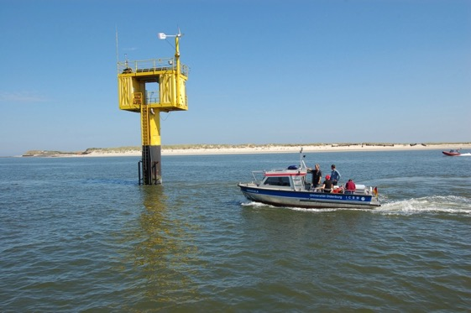
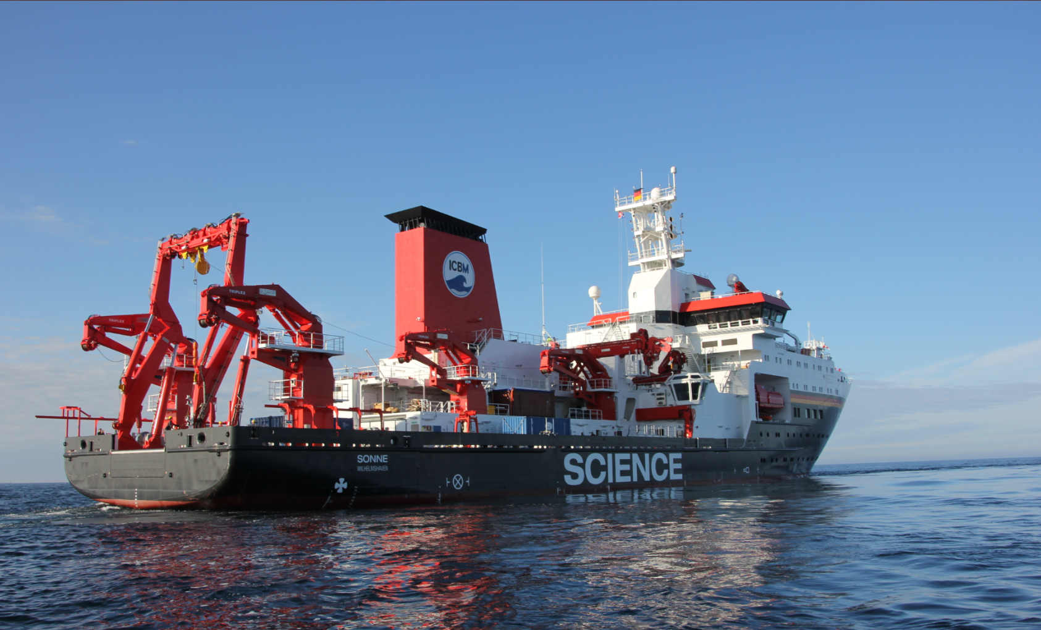
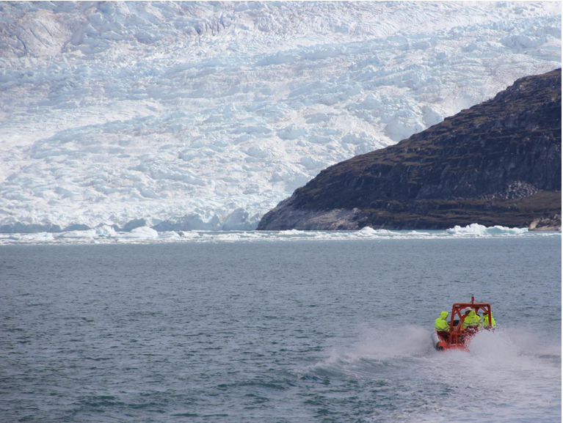
ICBM
ICBM is an interdisciplinary research institute.
Deals with fundamental and applied issues in global oceans, fjords, seas, lakes and estuarine environmental research.
Focuses on marine biogeochemical cycles and energy fluxes in the water and sediment and at the boundary layers between habitats and water masses as well as the functional role of marine biodiversity.

Slide 6
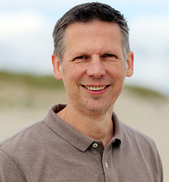





Director: Prof. Dr. Oliver Zielinski Executive Manager: Birgit Stein
Geochemistry / Analytics |  | Biology / Ecology |  | Physics / Modelling
Organic Geochemistry Prof. Heinz Wilkes |  | General & Molecular Microbiology Prof. Ralf Rabus |  | Theor.Physics/Complex Systems Prof. Ulrike Feudel
Microbiogeochemistry Prof. Hans Brumsack |  | Paleomicrobiology Prof. Heribert Cypionka |  | Mathematical Modelling Prof. Bernd Blasius
Environmental Biochemistry Prof. Peter Schupp |  | Biology of Geological Processes Prof. Meinhard Simon |  | Physical Oceanography (Theory) Prof. Jörg-Olaf Wolff
Marine Geochemistry Prof. Thorsten Dittmar |  | Planktology Prof. Helmut Hillebrand |  | Marine Sensor Systems Prof. Oliver Zielinski
Hydrogeology Prof. Gudrun Massmann |  | Geoecology PD Holger Freund |  | Coastal Research Prof. Emil Stanev
Marine Isotope Geochemistry Dr. Katharina Pahnke |  | Biodiversity and animal evolution Prof. Gabriele Gerlach
Sea Surfaces Dr. Oliver Wurl |  | Biodiversity & Biolog. Processes in Polar Seas Prof. Bettina Meyer
 |  | Benthos Ecology Prof. Ingrid Kröncke
Head count: ~200
6
Notes:
hellblau: Standort Oldenburg
mittelblau: Standort Wilhelmshaven
rot umrandet: Gründung seit 2010
Director: Prof. Dr. Bernd Blasius
Vice-Director: Prof. Dr. Oliver Zielinski
Executive Manager: Dr. Birte Junge
Staff: ~ 170

Slide 7
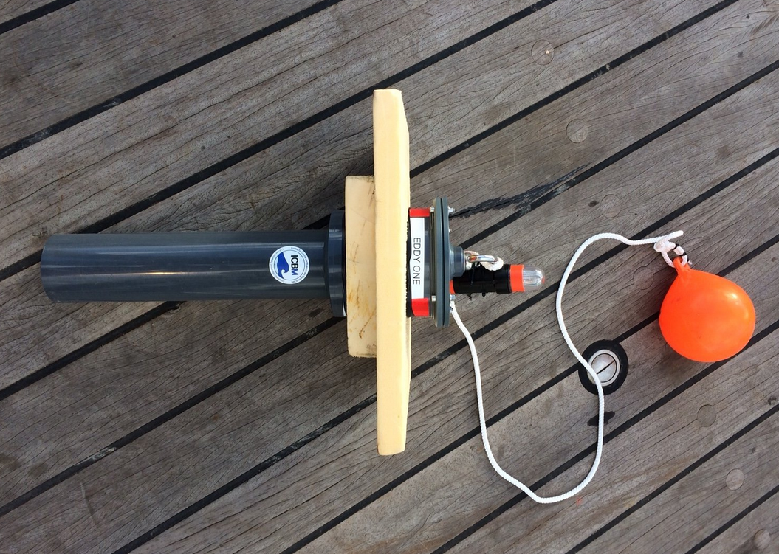
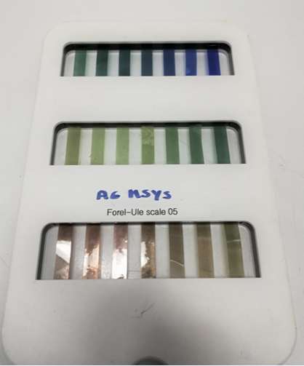
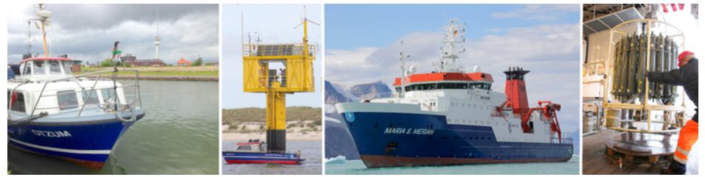
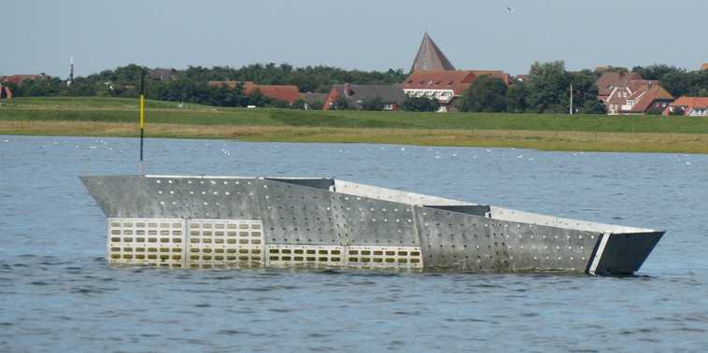
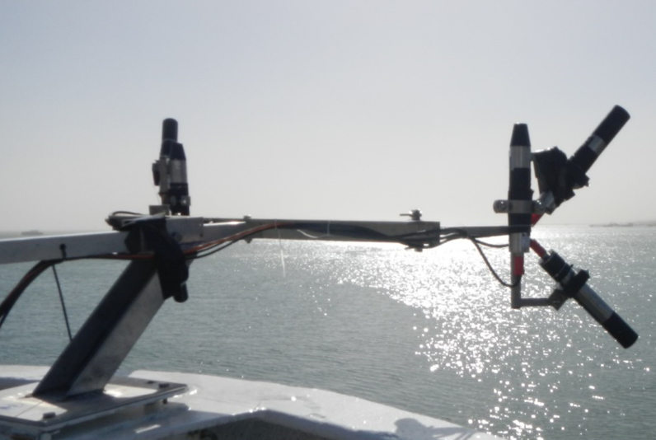
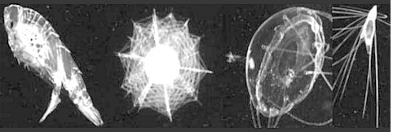
Marine Sensor Sytems Group (msys)
Design autonomous, automated, innovative and affordable sensors.
Sensors aimed for interdisciplinary environmental monitoring applications using in-water, fixed, ship-, air- and spaceborne platforms.
Biogeochemical and physical essential climate variables measured in global oceans, fjords, seas and estuarine systems by the group include
  oceanographic properties (salinity, temperature),
  ocean colour (optical properties),
  plastic litter,
  plankton images,
  acoustics.
www.icbm.de/en/marine-sensor-systems/

Slide 8

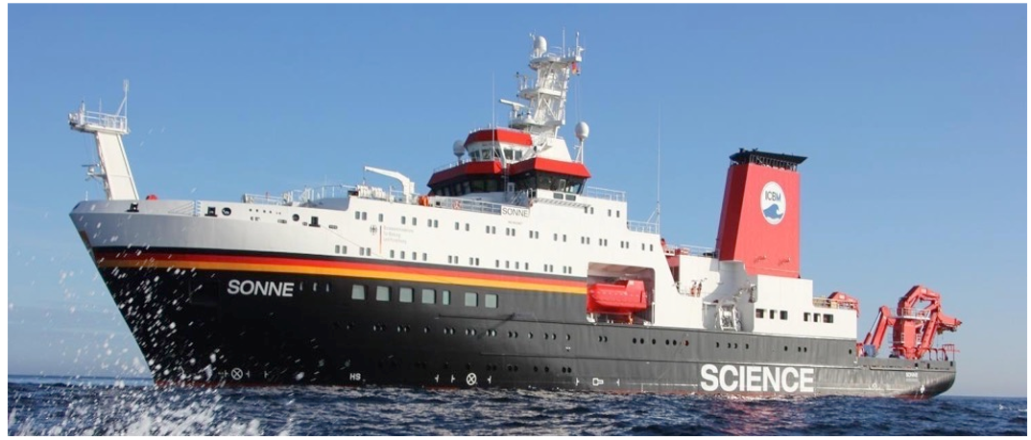
Kurzvorstellung des ICBM
Global Ocean Research
Home institute for the German research vessel SONNE.
A state-of-the-art floating laboratory active in the Pacific and Indian Ocean.
Room for 40 scientists and can be out at sea for 50 days.
Standort Oldenburg
Standort Wilhelmshaven
8

Slide 9
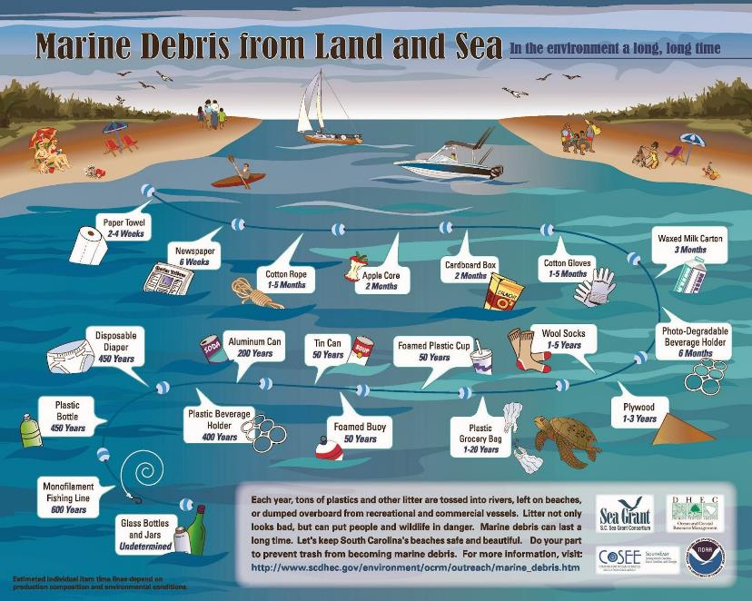
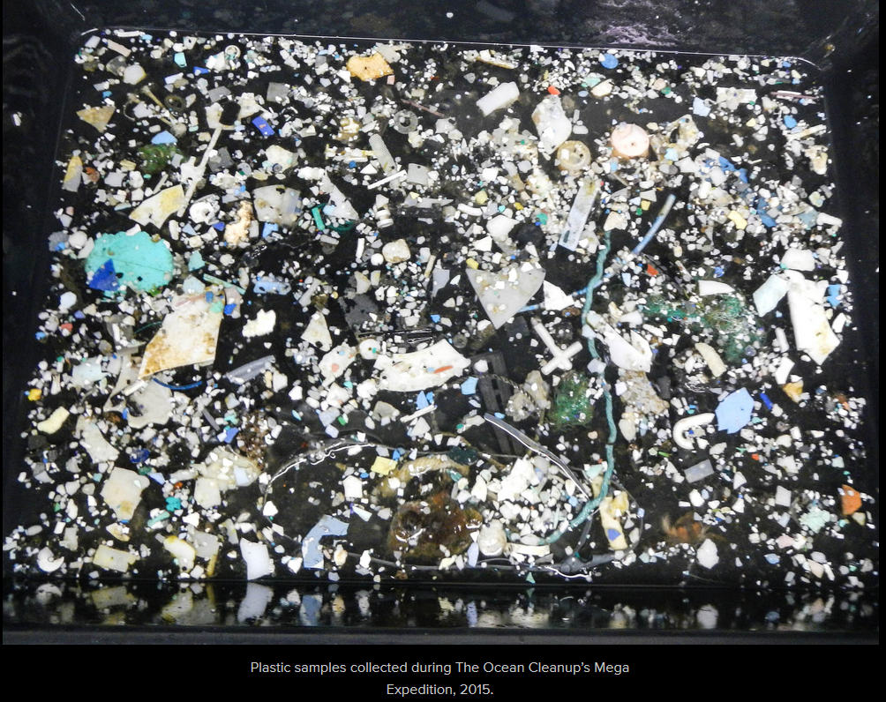
Motivation
Plastic waste is a major threat to the natural environment.
Plastic products have a long life span and most of it not necessarily bio-degradable.
Ivar do Sul and Costa, 2014
Trophic routes of microplastics across marine vertebrate and invertebrate groups.

Slide 10
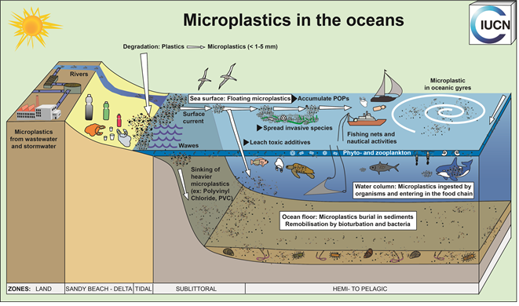
Motivation
Microplastics and macroplastics follow a nearly similar path to the open ocean.
Microplastics (< 5mm)
Macroplastics (> 5mm).
Mostly washed ashore or floating in the ocean.
Macroplastics tend to be entangled in ghostnets.
Image Courtesy of Florian Thevenon
Our goal is to better detect, identify, quantify and track ocean floating plastics in different size groups and zones using sustainable innovative technologies.

Slide 11
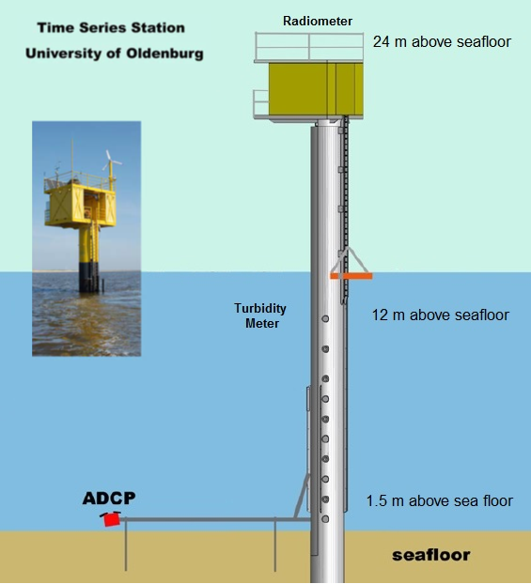
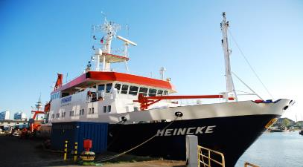
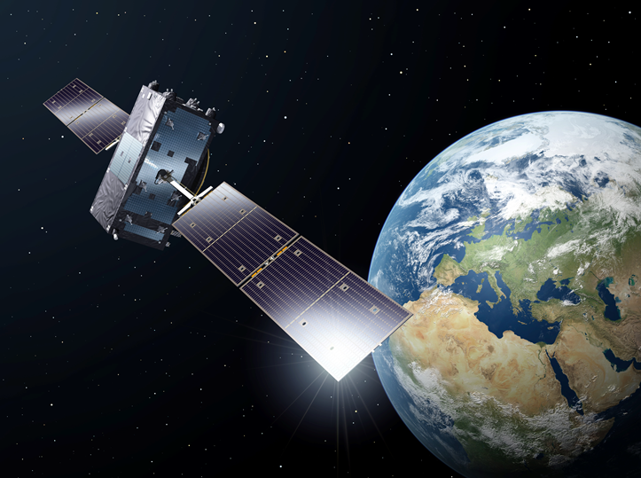
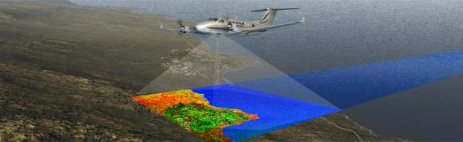
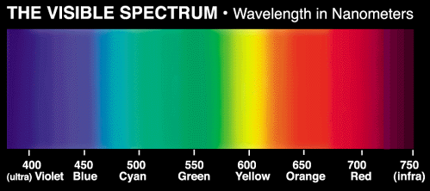
Introduction – Why remote sensing
It is a non-invasive approach to study the natural environment using light measured from a distance on different platforms.
Ocean colour remote sensing involves measuring light in the visible spectrum.
Source: http://www.northropgrumman.com/
Source: http://www.esa.int/

Slide 12
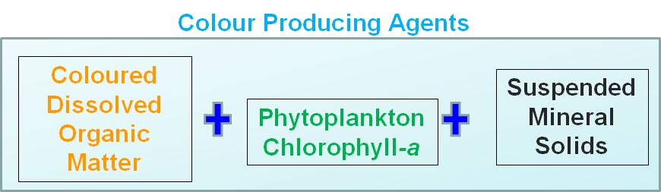
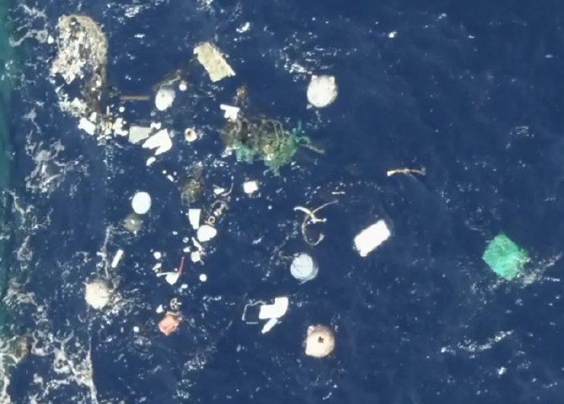
Introduction – Why remote sensing
Light is a carrier of information about environmental constituents with an optical signature.
Ocean colour is therefore a crucial proxy of colour producing agents of the ocean.
Optical sensor technology applicable to ocean colour remote sensing is available.
Airborne and satellite remote sensing offer wide geo-spatial coverage at variable time intervals.
Plastics

Slide 13
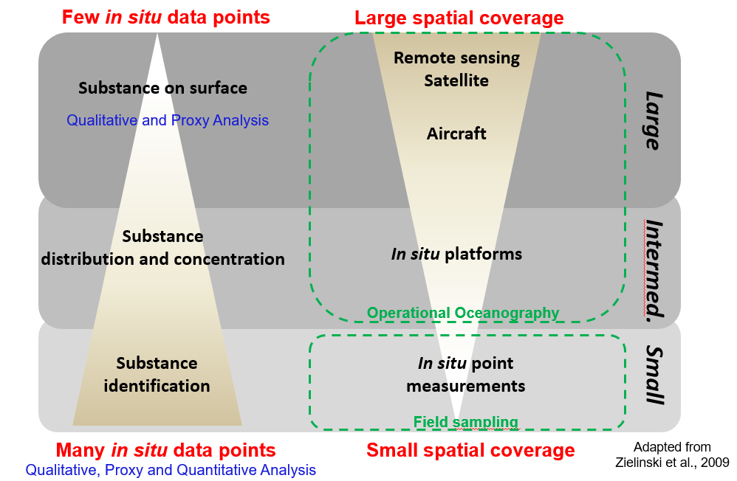
Introduction – Why remote sensing
There are trade-offs related to geo-spatial, temporal and information depth/value.

Slide 14
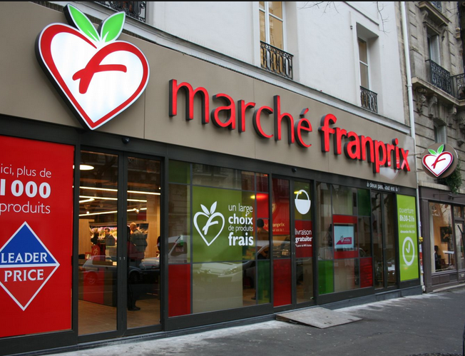
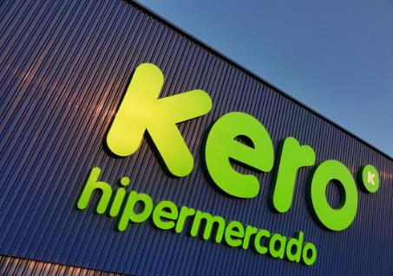
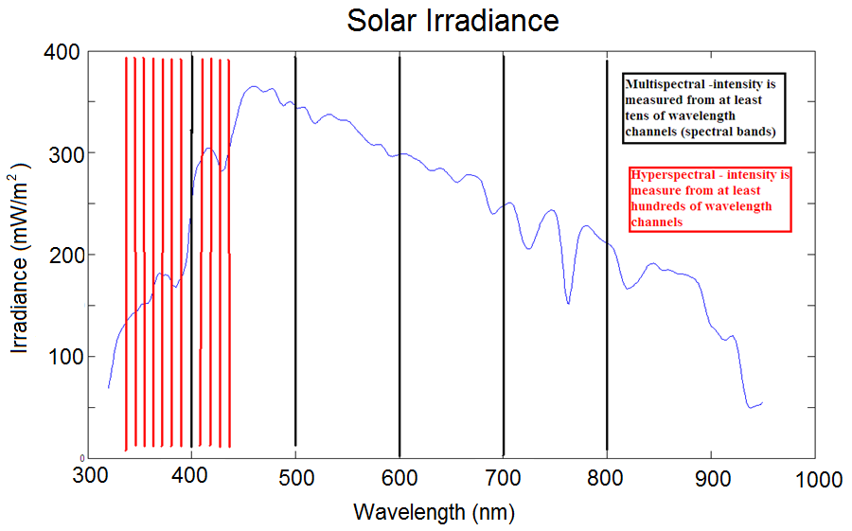
Introduction – Terminology
Multispectral remote sensing
Limited number of spectral bands.
Limited spectral information.
Hyperspectral remote sensing
High number of spectral bands.
More spectral information.
Limited Range
of Products
Wide Range of Products

Slide 15
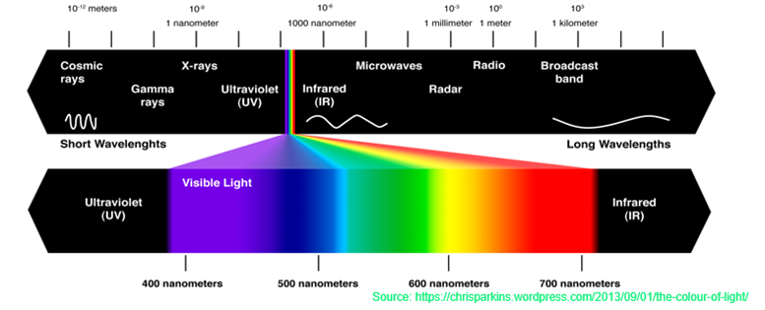
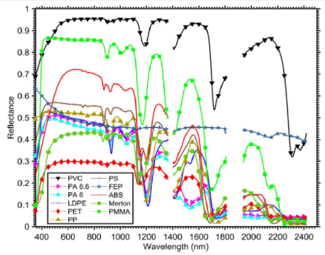
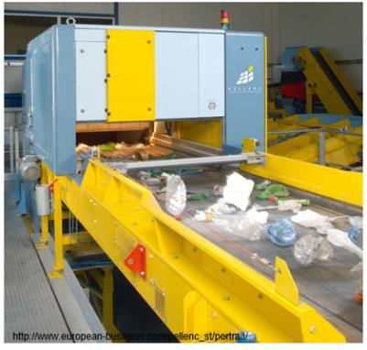
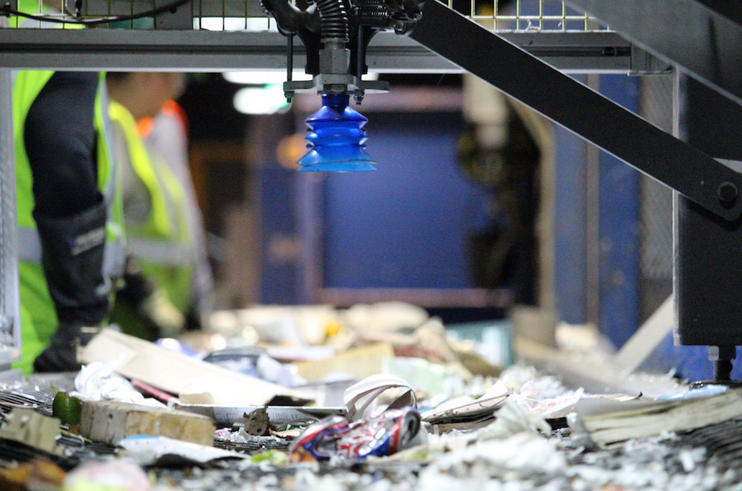
Introduction – Plastics and Light
Plastics have unique optical signatures in the IR (800 - 2500 nm).
A property that has been key in automated sorting of plastics at recycling centres.
http://www.cobizmag.com/Trends/Robots-and-recycling-unite-in-Denver/

Slide 16
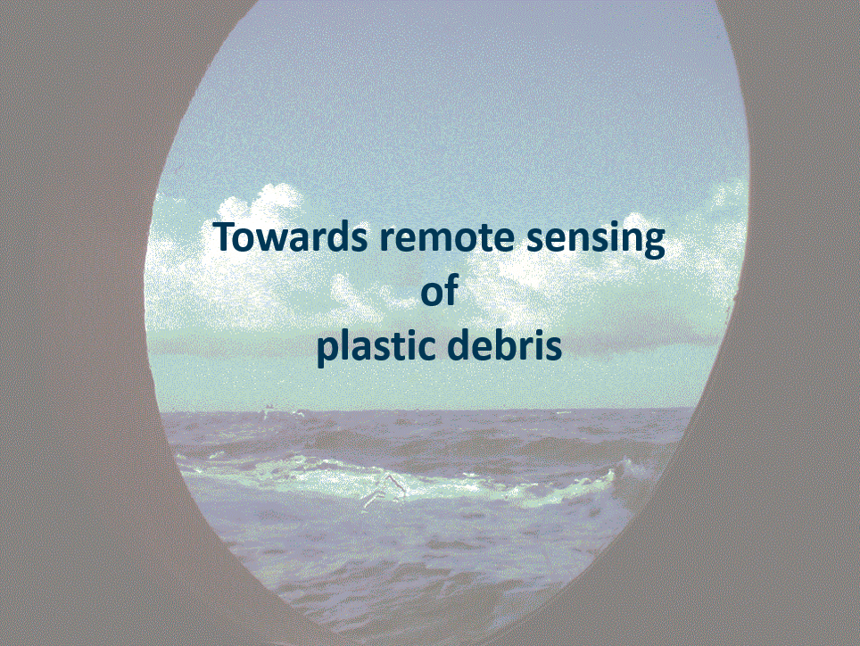

Slide 17
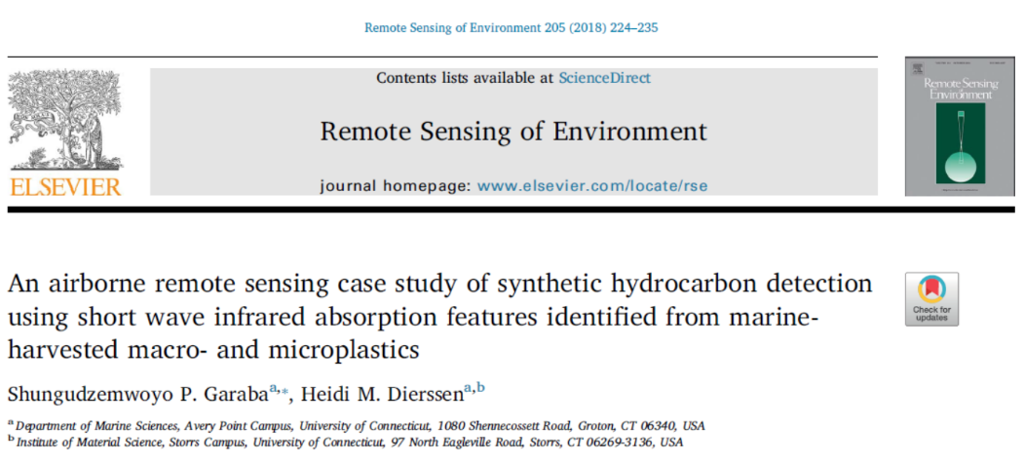
Related Works – (Garaba and Dierssen, 2018)

Slide 18
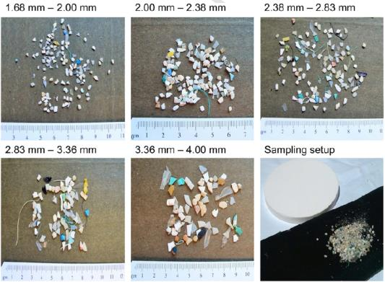
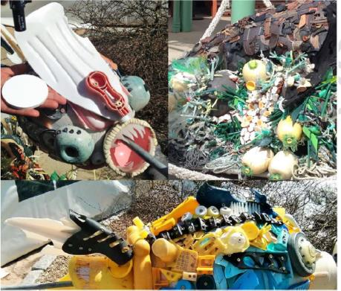
Methods – (Garaba and Dierssen, 2018)
Marine-harvested microplastics (< 5 mm) from North Atlantic and Pacific Ocean.
Washed ashore macroplastics (> 5 mm) from west coast USA.
microplastics
macroplastics

Slide 19
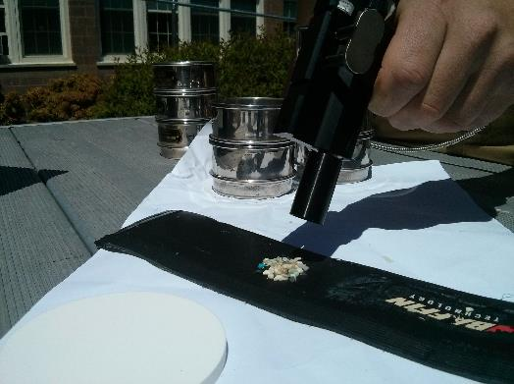
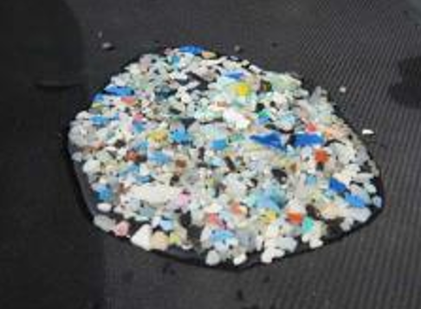
Methods – (Garaba and Dierssen, 2018)
Reflectance measurement 10 cm above target.
Spectral reflectance using ASD spectroradiometer (350 – 2500) nm.
Background material was neoprene sheet with negligible reflectance.
Sieves for microplastics size distribution
Particles were aggregated to create
an optically dense target
Labsphere Spectralon panel
Filtered seawater was used to simulate wet floating microplastics.

Slide 20
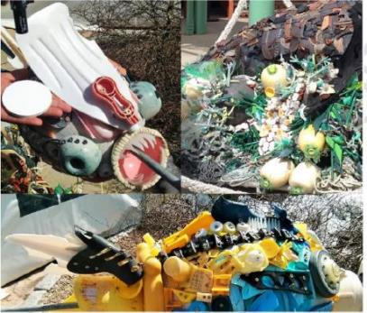
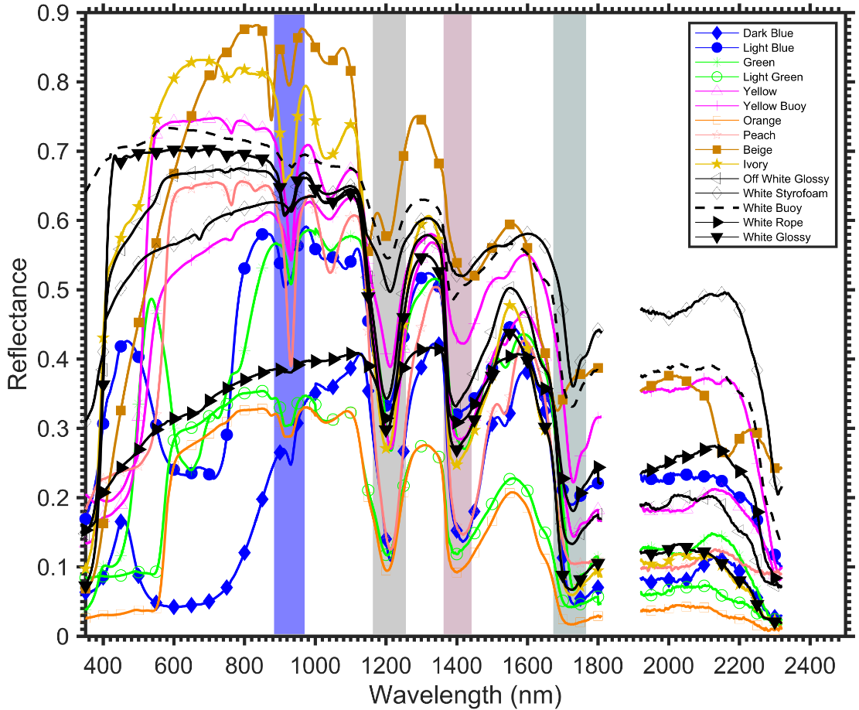
Results – (Garaba and Dierssen, 2018)
Macroplastics had unique absorption features around 931, 1215, 1417 and 1732 nm .
macroplastics

Slide 21
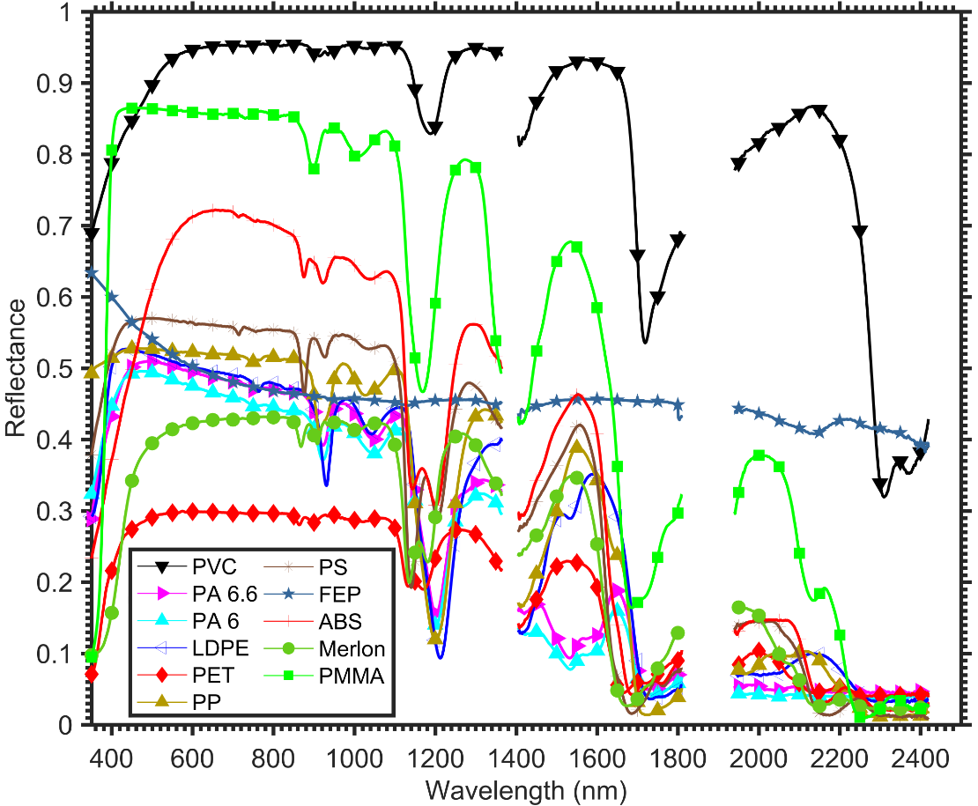
Results – (Garaba and Dierssen, 2018)
Generated an open-access hyperspectral reference library.

Slide 22

Results – (Garaba and Dierssen, 2018)
Classified marine-harvested plastics using our new spectral library of pure virgin pellets.

Slide 23



Results – (Garaba and Dierssen, 2018)
Microplastics had spectrally similar, same shape , signal
but varying magnitude.
Established a mean spectral signal for marine-harvested
microplastics.
Absorption features at 1215 and 1732 nm not affected by atmospheric gaseous
interaction with light.

Slide 24

Results – (Garaba and Dierssen, 2018)
The absorption features at 1215 and 1732 nm were observable through an intervening atmosphere.
Mapped the distributions of synthetic hydrocarbons using airborne imagery, indicating the potential to remotely sense dry washed ashore and land-origin plastics.

Slide 25

Results – (Garaba and Dierssen, 2018)
Demonstrate that spectral shape of dry and wet microplastics is similar but the magnitude is decreased due to wetness, water is strong light absorber.

Slide 26
Summary – (Garaba and Dierssen, 2018)
Measured reflectance of different plastics from 350 to 2500 nm.
Established a mean spectral signal for marine-harvested microplastics.
Classified marine-harvested microplastics using our new spectral library and validated our findings with FTIR.
Explored airborne remote sensing of synthetic hydrocarbons.
We showed that dry marine-harvested microplastics had higher reflectance compared to wet marine-harvested microplastics.
Our study provided scientific evidence-based proof that floating ocean plastics could be detected.

Slide 27


Slide 28




Methods – (Garaba et al., 2018)
Hyperspectral airborne survey of the Great Pacific Garbage Patch.
International Air Response Lockheed C-130 Hercules aircraft.
Survey altitude= 400 m
Aircraft speed= 140 knots
Survey time = 2.5 hours

Slide 29


International Air Response Lockheed C-130 Hercules aircraft
Methods – (Garaba et al., 2018)
ITRES SASI SWIR push broom scanner collected hyperspectral imagery from 100 wavebands (950-2450 nm) with a spatial resolution 0.5 x 1.2 m.
SASI Imager
RGB Camera Lidar
Optech CS-4800i 16MP RGB camera recorded true-colour images at one frame per second with a spatial resolution 0.1 x 0.1 m.

Slide 30

Results – (Garaba et al., 2018)
Litter observed was classified into 5 groups.
Size and colour was also recorded.

Slide 31


Results – (Garaba et al., 2018)
Absorption features common in hydrocarbons (plastics 1215 nm and 1732 nm) were identified.
Floating plastics had highest reflectance
compared to submerged objects and
seawater itself.

Slide 32

Results – (Garaba et al., 2018)
Using spectral we demonstrated floating plastics could be quantified per pixel coverage base on absorption features at 1215 nm and 1732 nm.

Slide 33
Summary – (Garaba et al., 2018)
Spectral features unique to plastics were observable through an intervening atmosphere.
Hyperspectral imagers on airborne platforms have a huge potential in marine litter detection and identification efforts.
Remote sensing provides a wide geo-spatial coverage.. think about this for a sec..?
  30 minute net trawl (1 x 0.5 m opening) at 2 knots = 0.00185 km² at best conditions
  vs
  5 hour remote sensing aerial survey at 140 knots = 311 km²

Slide 34
What next?
There is a need for open-access high quality spectral reference libraries.
Explore satellite and drone remote sensing approaches.
Open technical questions to be addressed
  1) Is hyperspectral really necessary for remote detection of plastics?
  2) What is reasonable geo-spatial resolution for monitoring plastics?
  3) What can and cannot be observed with this methodology in terms of characteristics and pathways plastics?

Slide 35



What next?
Drones are also showing promising results in the Great Pacific Garbage Patch.
Imagery from a drone at 25 m altitude captured
Around System001 in November, 2018 by Robin de Vries.

Slide 36

What next?
Drones are also showing promising results in the Great Pacific Garbage Patch.
Imagery from a drone at 25 m altitude captured Around System001 in November, 2018 by Robin de Vries.

Slide 37



What next?
Satellite combined with drone remote sensing has shown promising results although work is still ongoing https://mrsg.aegean.gr/?content=&nav=55

Slide 38



What next?
Satellite remote sensing has shown promising results although work is still ongoing.

Slide 39

I would like to thank my co-authors and
everyone who has made and keeps making this research possible!
Protect The Environment!
39

