Slide 1

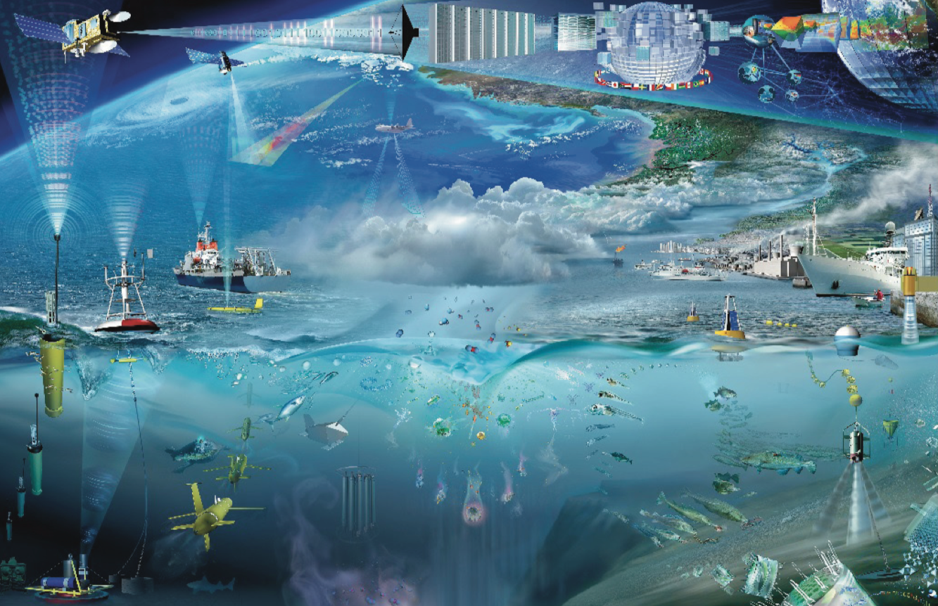
IEEE OES Technologies for observing and monitoring plastics in the oceans
26-27 November 2018 – Pôle Numérique – Brest, FRANCE
Global Ocean Observation System (GOOS) perspective on marine plastics monitoring
GOOS-Bio/Eco Panel
and
Sanae Chiba, JAMSTEC
Notes:
8 EOVs identified by the panel.

Slide 2

Marine Debris/Plastic Projects of JAMSTEC
Sanae Chiba
OceanObs’19
GOOS-BEP
JAMSTEC’S mid-term research plan (FY2019-2025)
Marine Plastics Research Group to be launched in April 2019
1. Deep-sea Macro-Debris study
2. Microplastics research

Slide 3
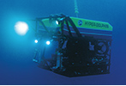
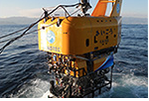
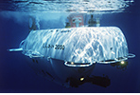

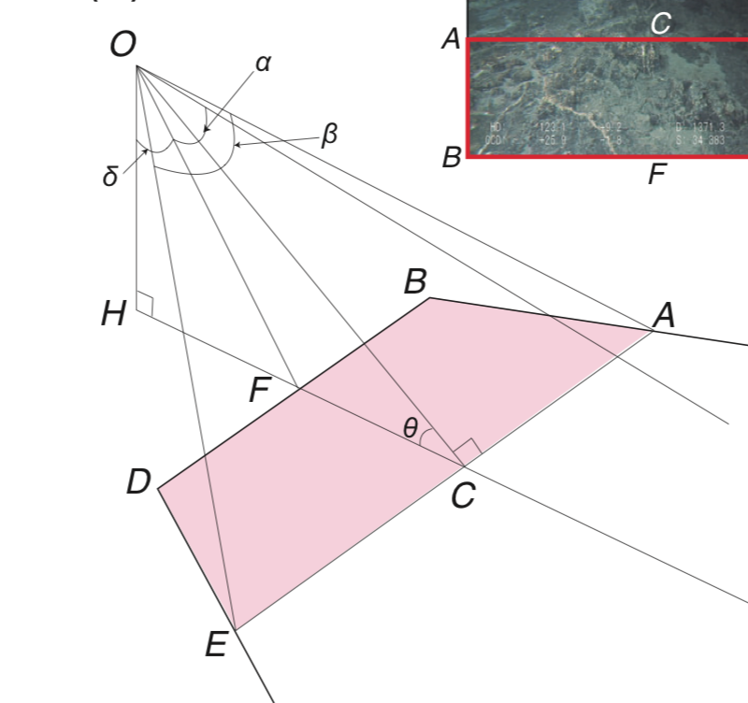
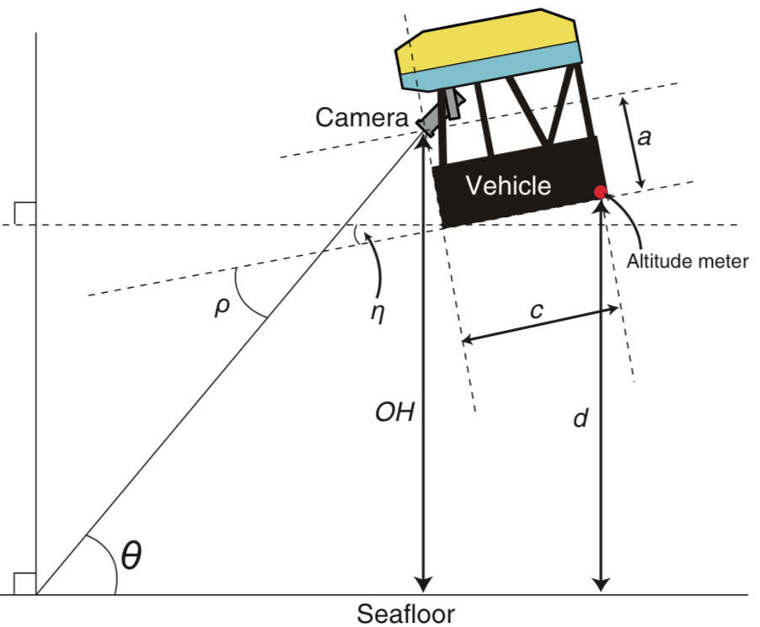
Marine Debris/Plastic Projects of JAMSTEC
Sanae Chiba
OceanObs’19
GOOS-BEP
1. Deep-sea Macro-Debris study
Deep-sea Debris Database
http://www.godac.jamstec.go.jp/catalog/dsdebris/e/index.html
launched in 2017
Image data since 1980s
> 5000 dives of manned submersible & ROVs
Max depth: > 10,000 m
Density analysis
Plastics: most abundant
c.a. 90% of plastic debris are single use plastics
http://www.godac.jamstec.go.jp/catalog/data/doc_catalog/media/JAM_RandD19_06.pdf
(Chiba et al. doi.org/10.1016/j.marpol.2018.03.022)

Slide 4
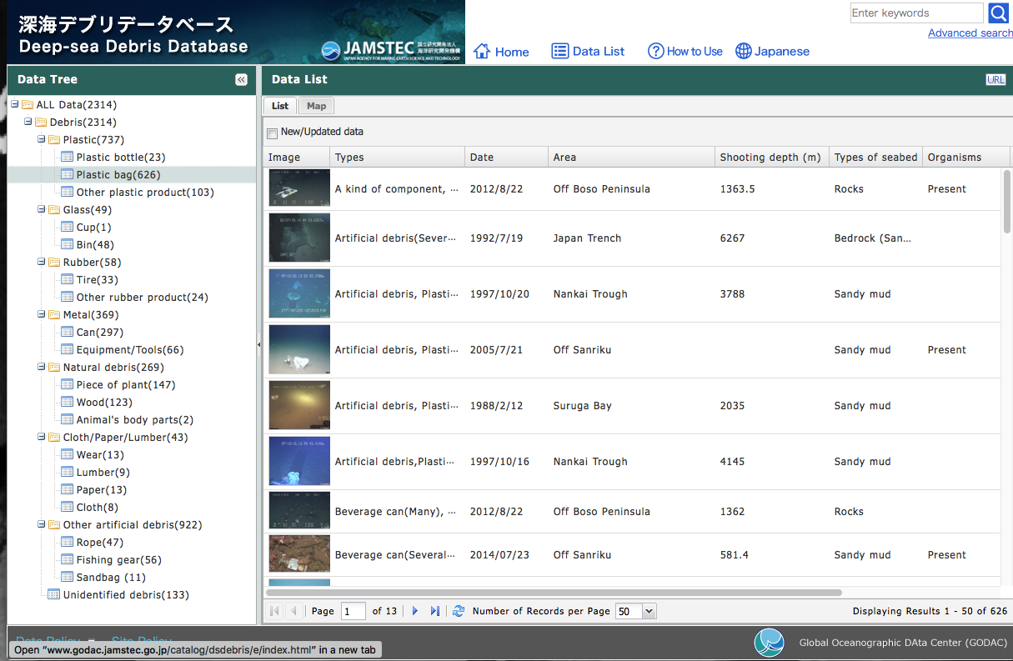
Marine Debris/Plastic Projects of JAMSTEC
Sanae Chiba
OceanObs’19
GOOS-BEP
Supplementary Slides

Slide 5
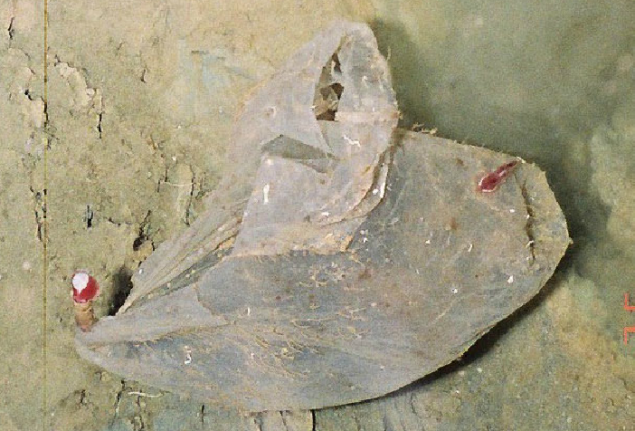
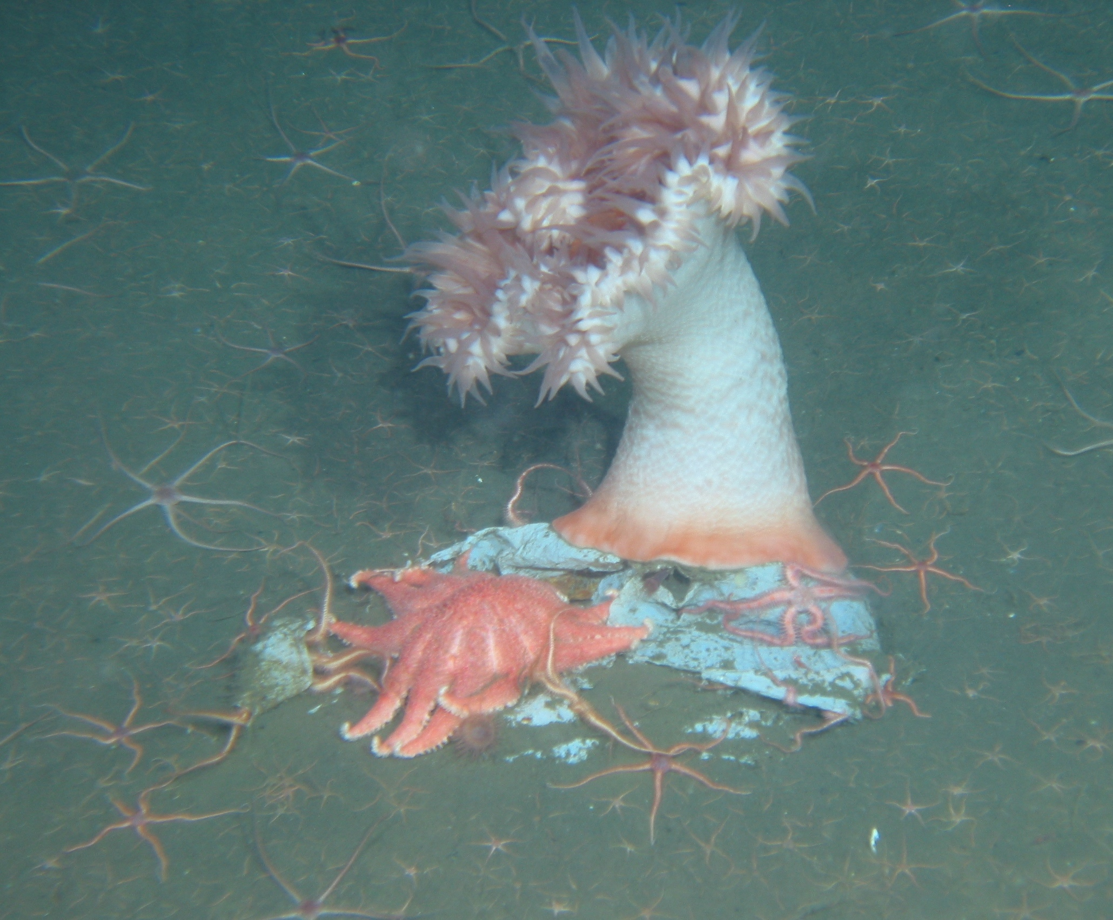
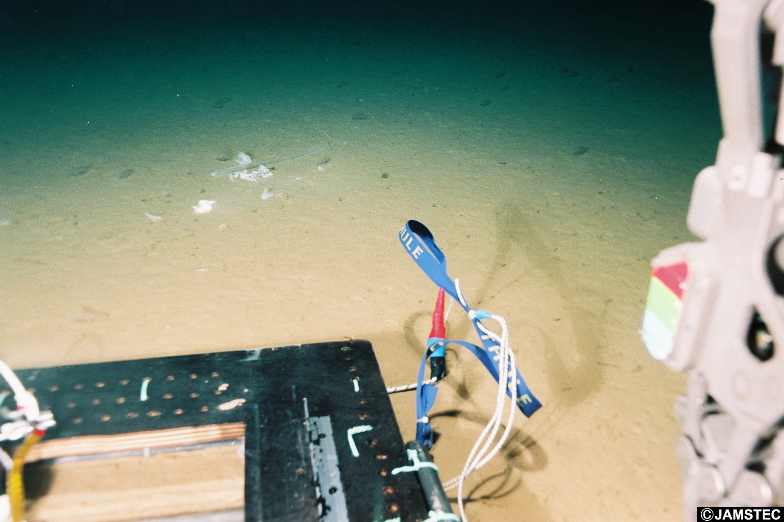
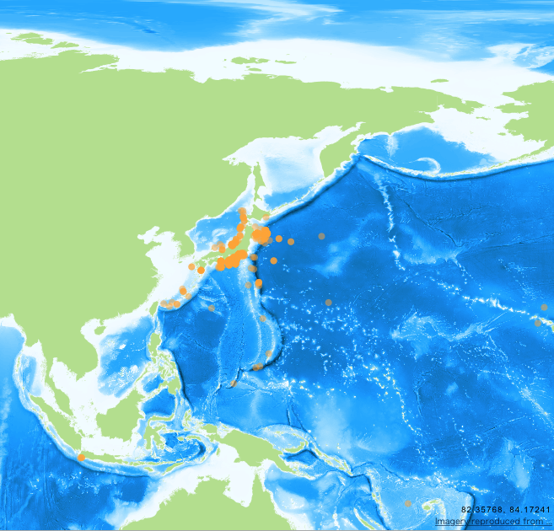
Marine Debris/Plastic Projects of JAMSTEC
Sanae Chiba
OceanObs’19
GOOS-BEP

Slide 6
Marine Debris/Plastic Projects of JAMSTEC
Sanae Chiba
OceanObs’19
GOOS-BEP
2. Microplastics study
Development of cost-effective MP monitoring methods using Hyperspectral
Camera imaging technique (e.g. applied to ship water intake system, CPR sample analysis)
In situ MP observation in the western North Pacific (including in the areas of garbage patch, deep-sea sediment)
MP impacts on deep-sea ecosystems

Slide 7
IEEE OES Technologies for observing and monitoring plastics in the oceans
26-27 November 2018 – Pôle Numérique – Brest, FRANCE
Global Ocean Observation System (GOOS) perspective on marine plastics monitoring
GOOS-Bio/Eco Panel
and
Sanae Chiba, JAMSTEC
Notes:
8 EOVs identified by the panel.

Slide 8
What is GOOS?
A sustained collaborative system of ocean observations, encompassing in situ networks, satellite systems, governments, UN agencies and individual scientists. We are organized around a series of components undertaking requirements assessment, observing implementation, innovation through projects…..
Why GOOS?
Ocean observations are needed to help us understand, manage and prepare for the impacts of climate system and human activities on marine environment and human society
The GOOS brings together people with diverse skills and from around the world to collaborate on an efficient and impactful observing system to address environmental and socio-economic issues.

Slide 9
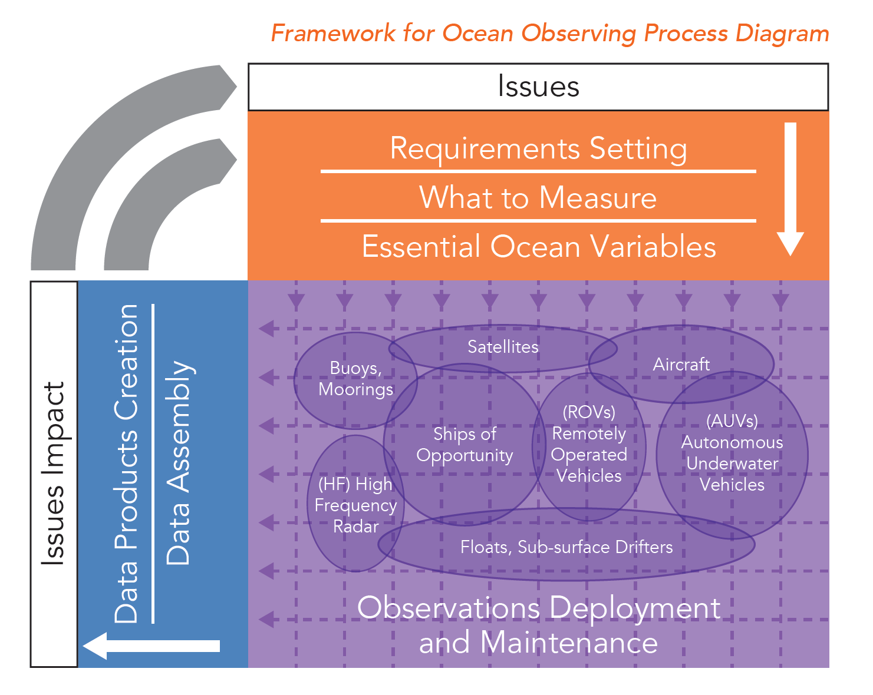
How does the GOOS Work?
Framework of Ocean Observing
SOCIETY
POLICY
GOOS
EOVs
Obs. Network
Coordination
DATA
OBSERVATION
Notes:
The framework was established after the OO’9 meeting to design the strategy of global ocean observing.
The framework is to streamline the link from socio-economic needs in ocean issues, observation, data sharing, and to policy making. implement global ocean observing according to this framework, GOOS has set three panels, for climate-physical O, BGC, Bio/Ecosystem.

Slide 10
GOOS Panels and Application Areas
Identification of and requirement setting for (EOVs)
Development of EOV implementation strategies and coordination of observations
Promotion of standards and interoperability of data and information products
Notes:
Three panels are responsible to address different GOOS application areas.
Climate and real-time service is the major focus of the physics panel, Ocean health is the focus of the BEP.

Slide 11
Criteria of EOVs: Impact vs Scalability
high
Target EOVs
Impact
-Relevant to help solve science questions and address societal needs
-Contribute to improve management of marine resources
Impact
low
low
high
Feasibility
Marine debris/plastics as a new GOOS EOV?
Feasibility
-Scientifically credible
-Technically practical, cost effective and within human capabilities
-Enduring

Slide 12
GOOS EOVs
Standardization of method and application of operational oceanography,,,, success in Physical Oceanography, and followed by BGC.
Notes:
list of the identified EOVs for three panels.
Physics and BGC panels aim to establish fully standardise the observation methods to measure the EOVs global scale.
Fully standardized the observation methods are difficult to apply to Bio EOVs at this moment due to the complexity of biodiversity. And regional programs conduct their research with various purpose. Therefore, better coordination of the existing monitoring programs is indispensable for implementation of the Bio-EOVs.

Slide 13
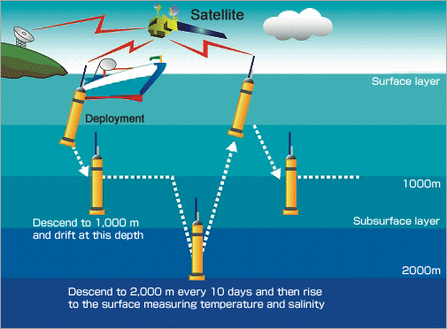
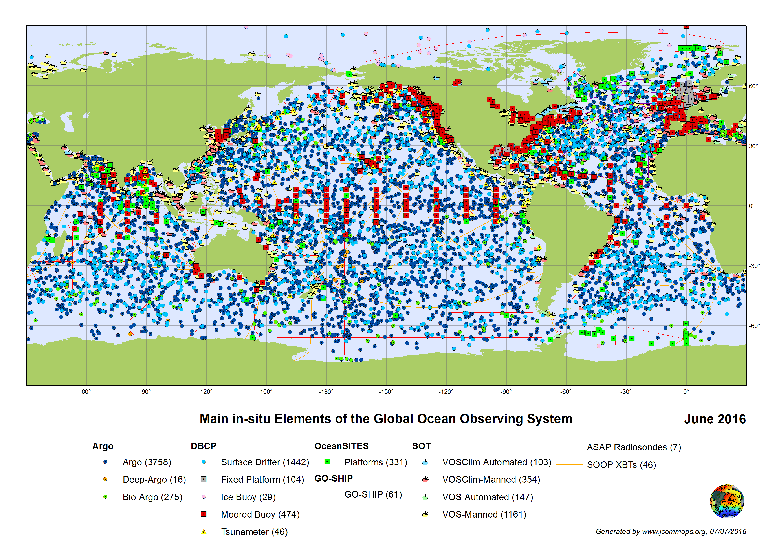
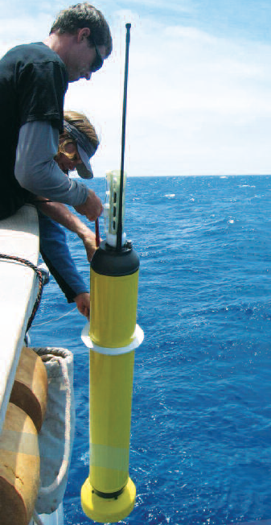
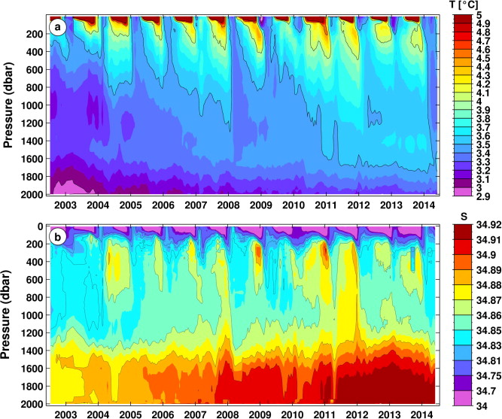
Argo project – Flagship project of GOOS Operational Oceanography
Notes:
Most successful example of GOOS Operational Oceanography is Argo project.
This floats can autonomously collect T & S data from surface to 1000s meter deep.
Currently more than 3000 floats are working night and day in the global ocean,
S and T profile and its time-series are available online for everyone.

Slide 14
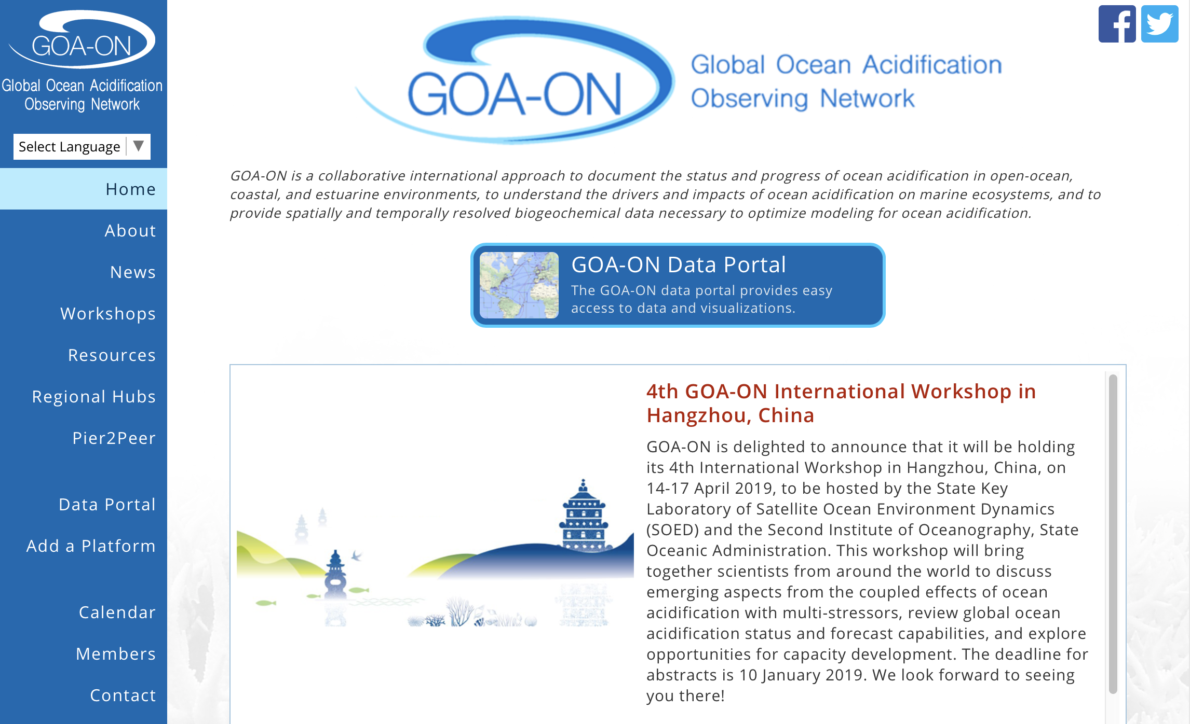

Slide 15
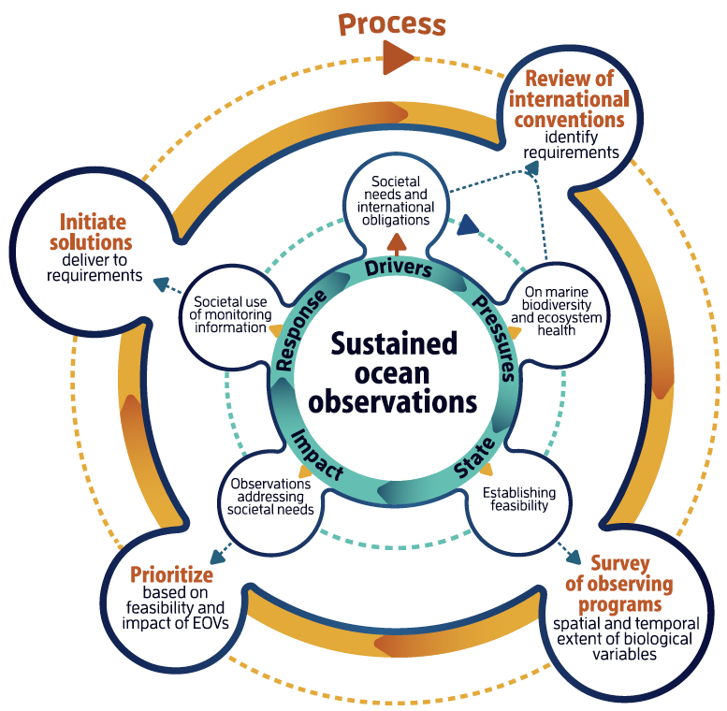
DPSIR Scheme to Identify Bio/Eco EOVs
FY2015~
Identify EOVs
Report to UN Decade of Ocean Science
Identify Capacity needs
~ FY2019
Implementation plan
Coordination
Notes:
We have made good progress on biology and ecosystems, with EOVs defined (and
published), the link to capacity development recognised (and published), and plans in place to
have a global monitoring system idenCfied by the end of 2019 with current progress against
that system reported annually through the Decade of Ocean Science

Slide 16
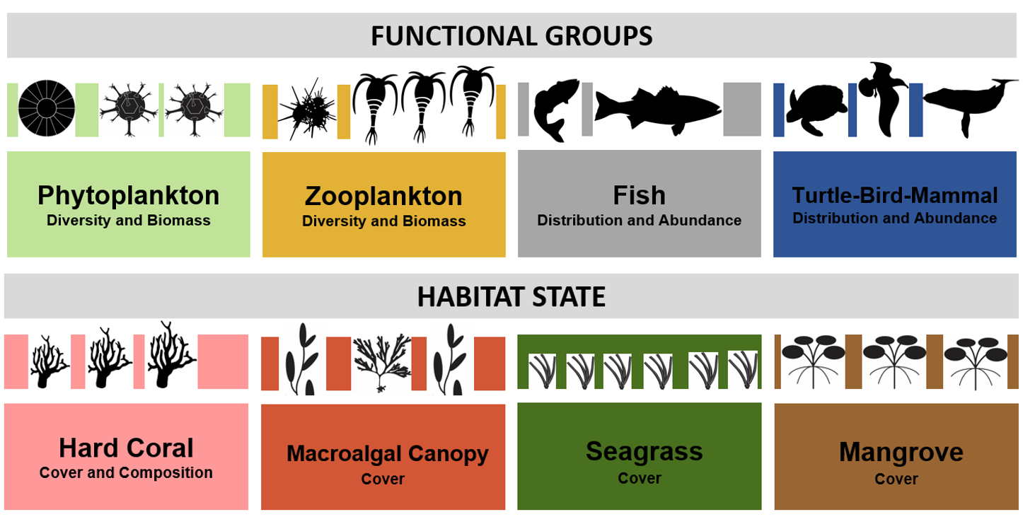
Essential Ocean Variables (EOVs) for Biology and Ecosystem
Should we now consider human pressure EOVs, e.g. Noise, Marine debris/plastics, and how?
Notes:
8 EOVs identified by the panel.

Slide 17
Human Pressure EOVs: Starting Point
GOOS will identify whether the sustained monitoring of human pressures (like marine plastics) is being addressed independently (eg. through GESAMP), and link to those initiatives, providing (non-financial) support for global uptake, coordination and consistency where needed and possible.
The GOOS BioEco panel stresses the need to be clear what key question are to be addressed by sustained monitoring, for example how important is it to monitor the origins of marine plastics as
well as their distribution in the oceans, for helping society to solve the problems.
HOW can GOOS collaborate with, contribute to Marine Plastics research community to benefit society?

Slide 18
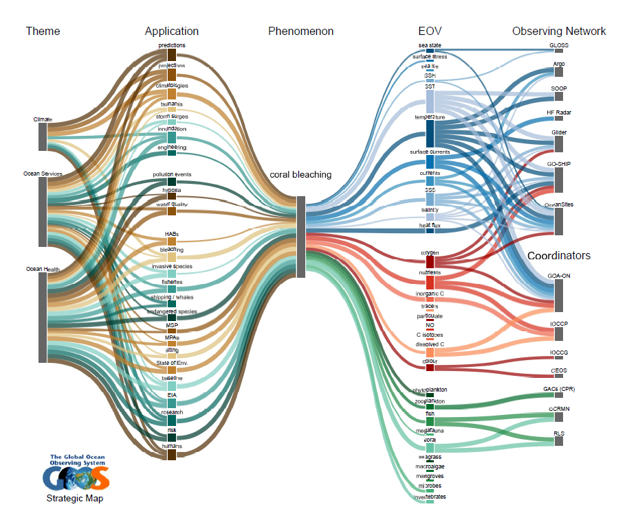
GOOS Strategic Map to address “phenomena”
Coral bleaching

Slide 19
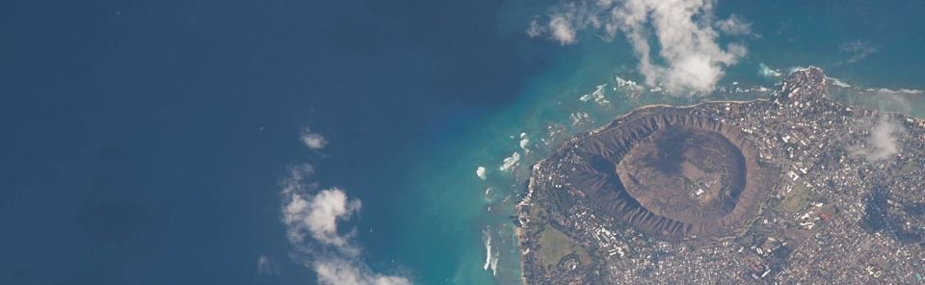
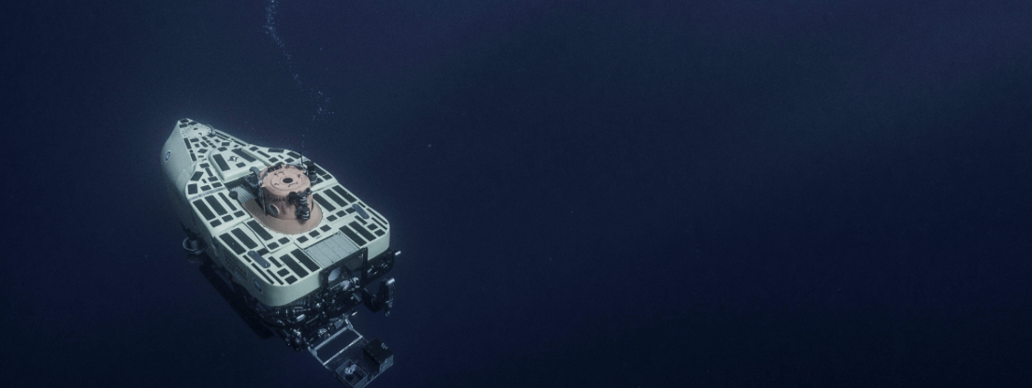
OceanObs’19
Honolulu Convention Center
16-20 September 2019
Community White Paper on Marine Debris observation out look, by N. Maximenko et al.

Slide 20



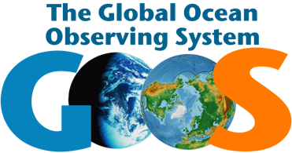
We want to keep in touch with the community….
Chairs: Nic Bax and Daniel Dunn
Project Officer: Patricia Miloslavich
Secretariat: Ward Appeltans
http://goosocean.org/
Valerie Allain – Pacific Community – New Caledonia
Sonia Batten – SAHFOS - Canada
Lisandro Benedetti-Cechi –UP - Italy
Sanae Chiba – JAMSTEC – Japan
Dan Costa – UCSC - USA
Emmett Duffy – Smithsonian - USA
Raphael Kudela – UCSC - USA
Frank Muller-Karger – USF - USA
David Obura – CORDIO – Kenya
Lisa Maria Rebelo – IWMI - Lao
Yunne Shin – IRD - France

Slide 21
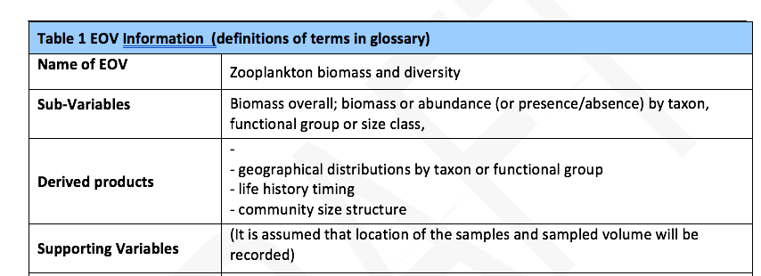
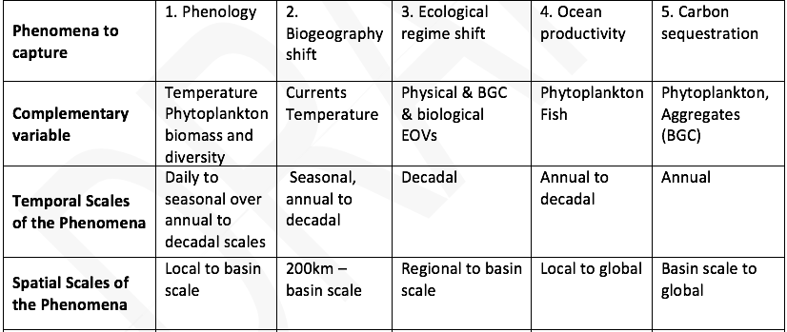
EOV Specification Sheet (e.g. zooplankton)
Notes:
Under each EOV, sub EOVs (more specific variables, but still generic) are identified.

Slide 22
FY2018~ Plan: Implementation & Coordination
Drafting the implementation plan
-global coordination and coverage
-intercomparable: best practices
-open access data
-support international reporting
needs
-aiming to build a network around
each EOV
EOV IP Workshops
Vision and mission
Needs and requirements
Capabilities
Impact - capacity development
Funding
Governance

Slide 23





GEO-BON EBVs vs GOOS-Bio/Eco EOVs
Data centre
EOVs
EBVs
M-BON
Ocean
Biodiversity
Biodiversity
Ocean
Have developed in parallel… but now communicating

Slide 24
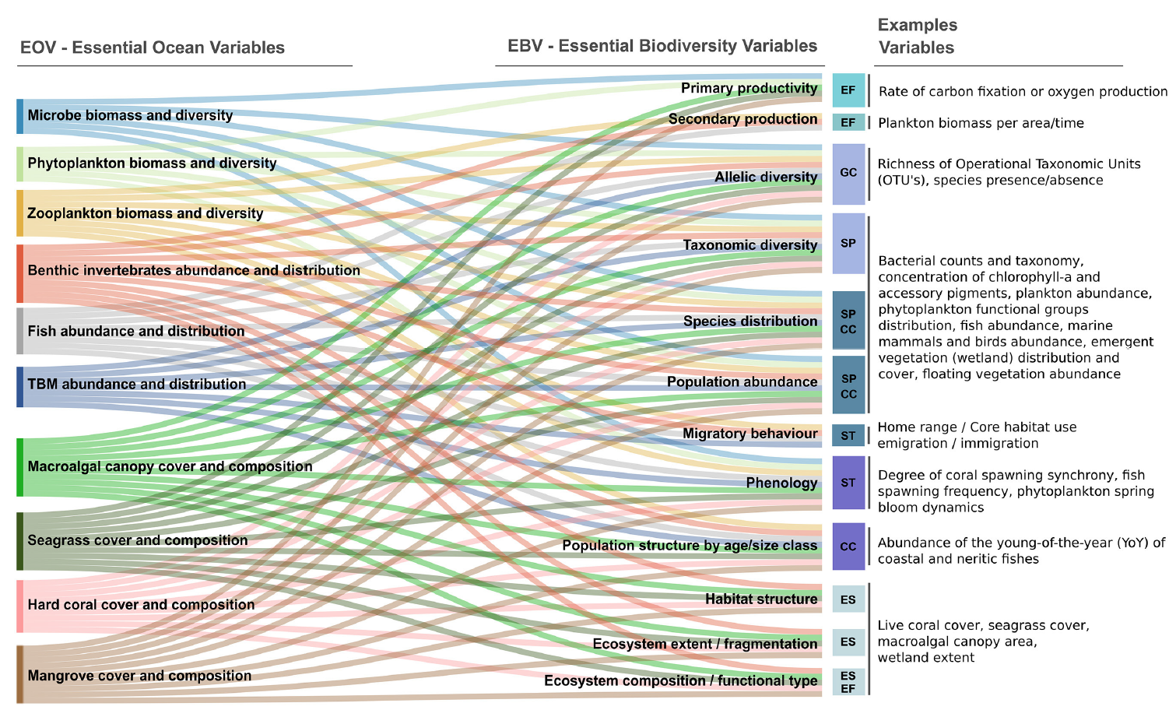
GOOS Bio/Eco EOVs vs GEO-BON Marine EBVs
(Muller-Karger 2018)
Working complementarily….

Slide 25
Challenges to develop global observation network
• There is a gap between policy (social) need and science efforts.
• We currently have communities of practice rather than observing networks
• Most mature observing networks are local/regional (IMOS in Australia, IOOS in the USA)
• There are many “individual” or local efforts contributing but not much integration
• Sustainability is not global but on a case to case basis
• There is heterogeneity in technology, capacity and funding – automatization very limited
• The best practices consist of a collection of methods rather than one method
• Some of the “networks” (e.g. International Group for Marine Ecological Time Series -IGMETS) only compile and synthesize past observations; there is no coordinate global plankton observation system
• There typically has not been a willingness to collaborate in a sustained manner without funding support.

Slide 26
DPSIR Scheme to Identify Bio/Eco EOVs
Important Drivers and Pressure => Impact Survey
: 26 bodies
(Miloslavich et al. 2018, GCB)
Notes:
Bio/Eco Panel applied the DPSIR model to develop the EOVs.
First major societal Drivers and Pressures related to ocean health, were identified through the interview of 26 international bodies.

Slide 27
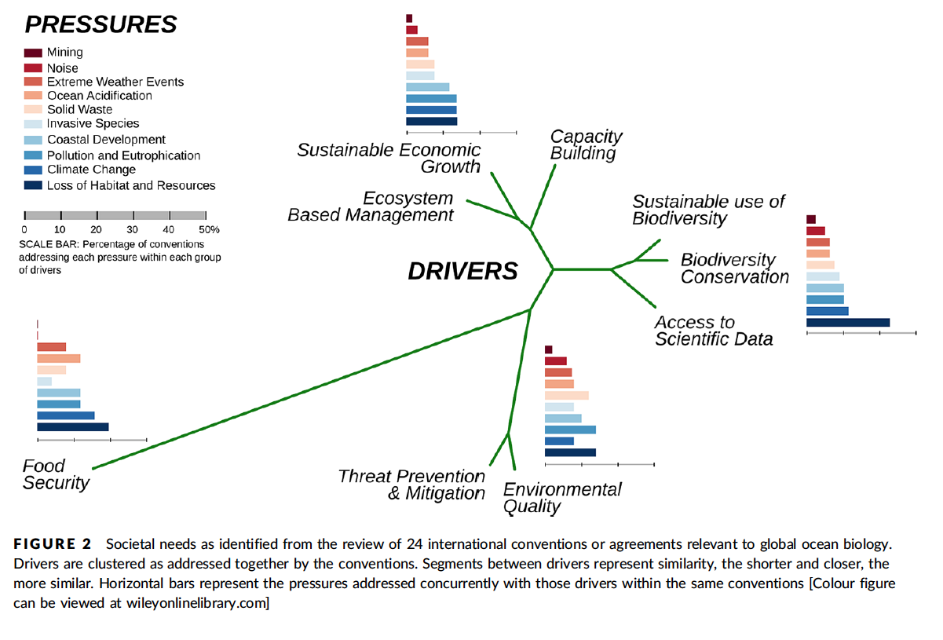
(Miloslavich et al. 2018, GCB)
Notes:
This is the outcome of the interview research, which shows the relationship and extent of each Drivers and Pressure.
I will not go to the details, so pls read …. If you are interested in.

Slide 28
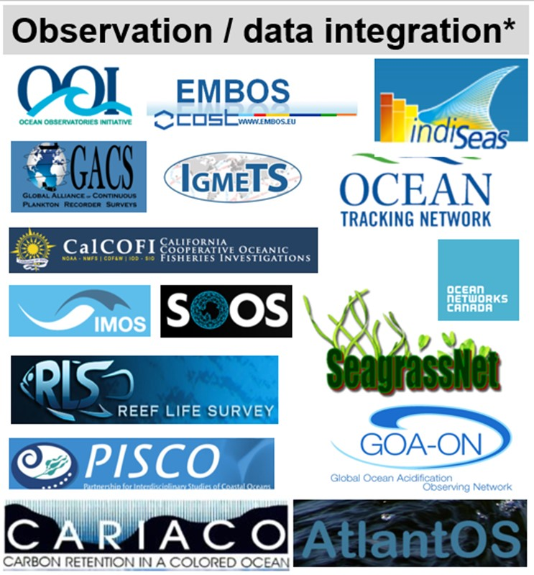
DPSIR Scheme to Identify Bio/Eco EOVs
State of variables => Feasibility survey :
>100 bodies
Notes:
Next the feasibility of observation of the EOVs was examined by research on more than 100 monitoring projects and/or organizations.

Slide 29
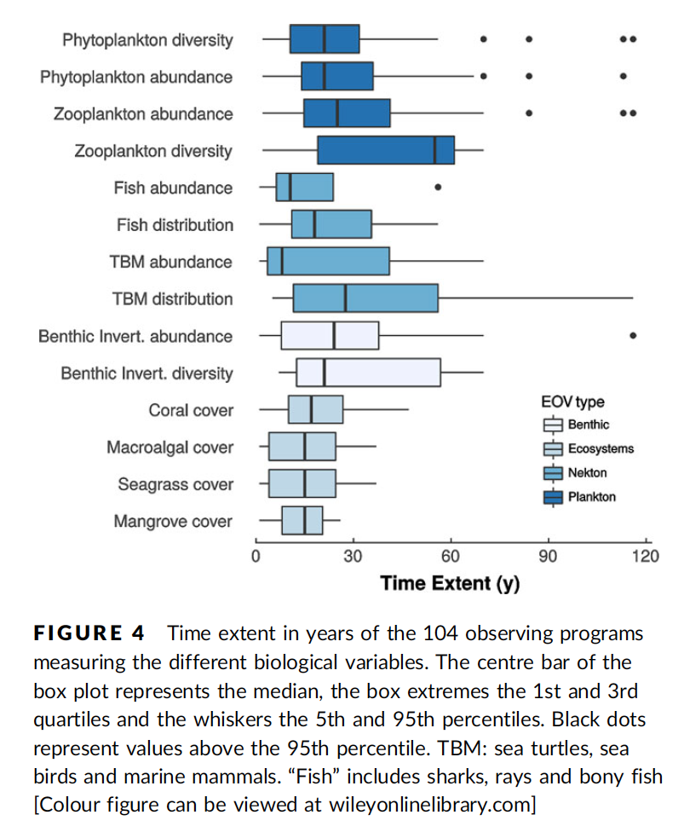
(Miloslavich et al. 2018, GCB)
Notes:
.

