Slide 1
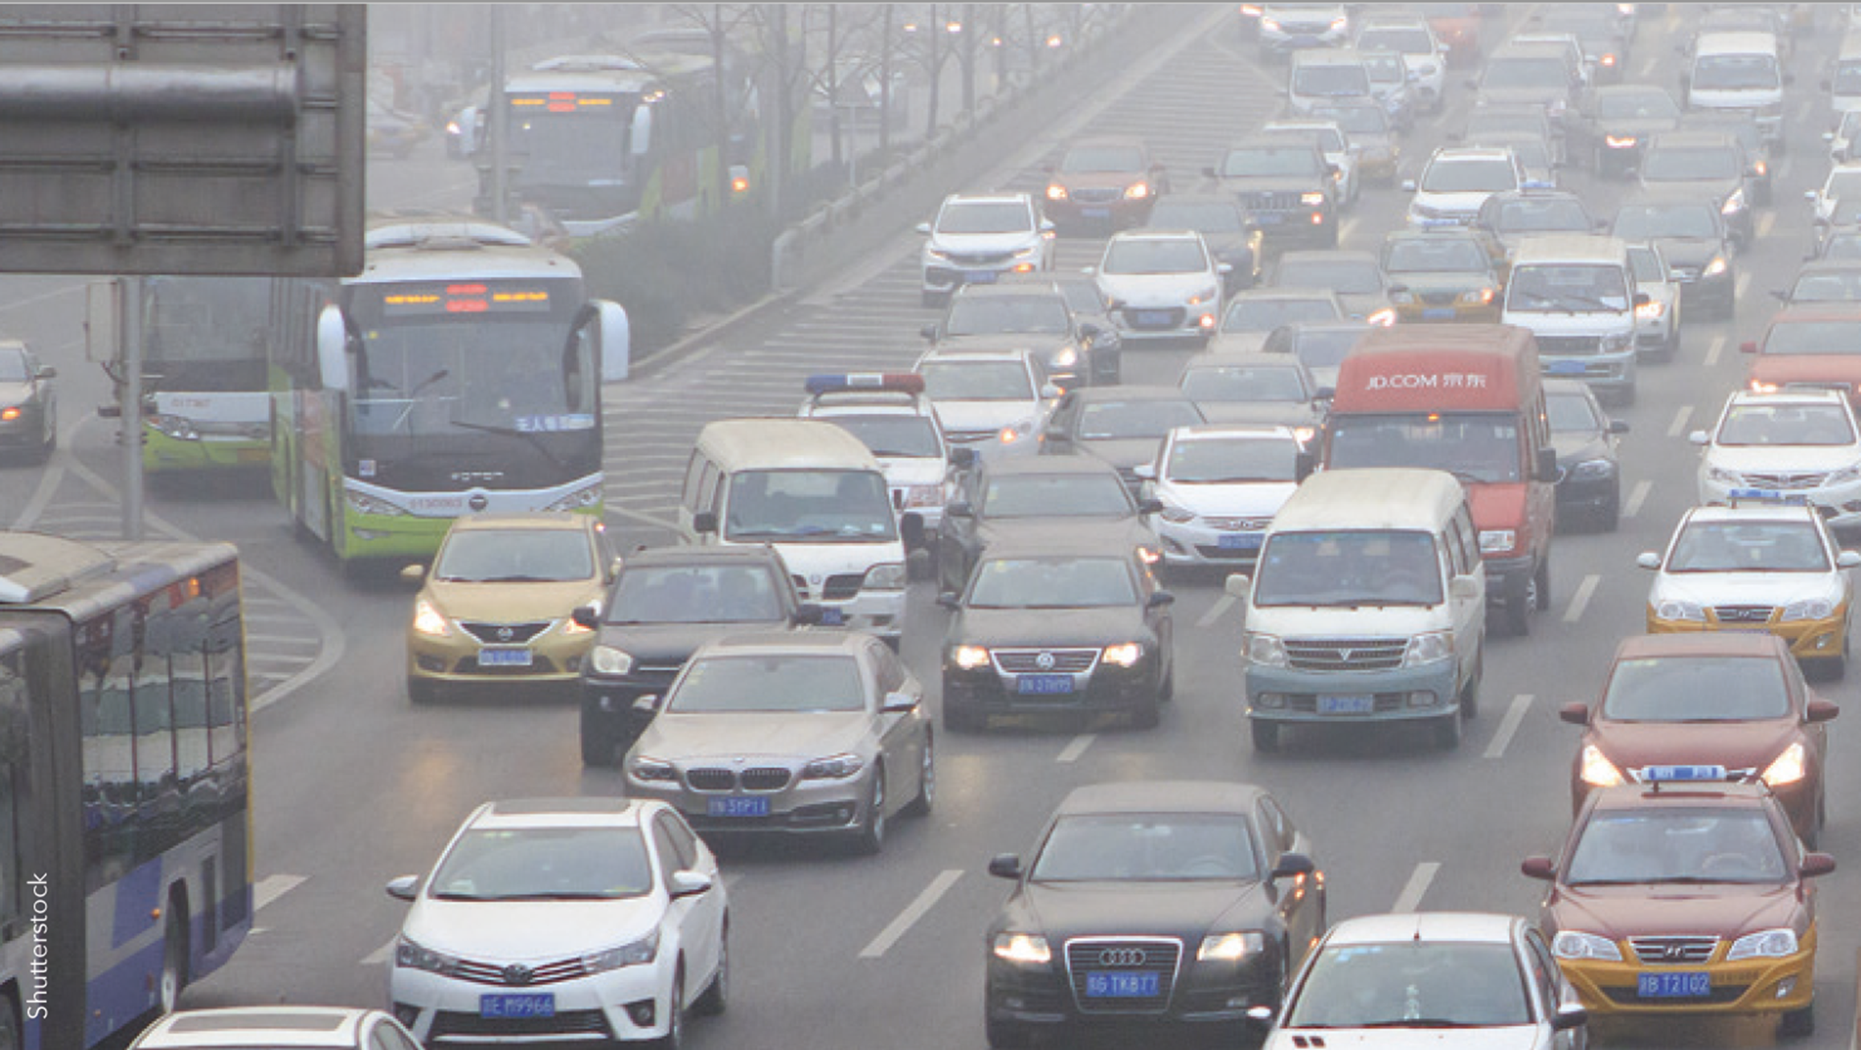
Air pollution – gaps in observations Kjetil Tørseth, NILU Short intro to AP Role of observations and monitoring gaps «my» lessons learned

Slide 2
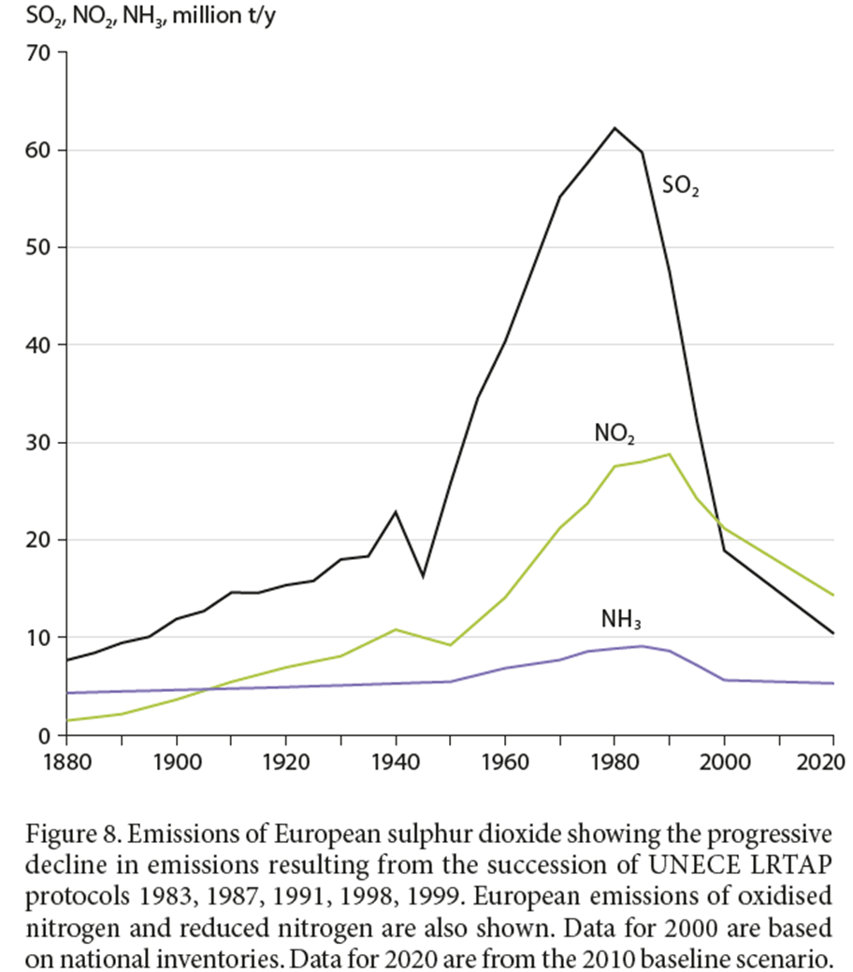
http://www.unece.org/fileadmin/DAM/env/lrtap/ExecutiveBody/35th_session/CLRTAP_Scientific_Assessment_Report_-_Final_20-5-2016.pdf

Slide 3
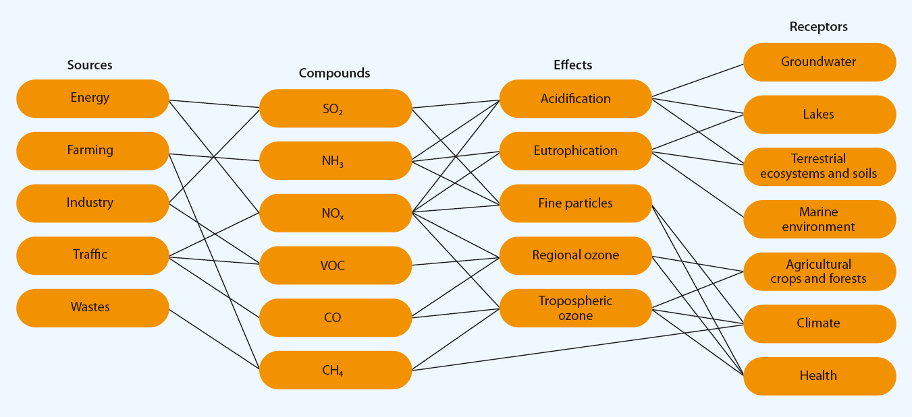
Multi component – multi effect approach

Slide 4
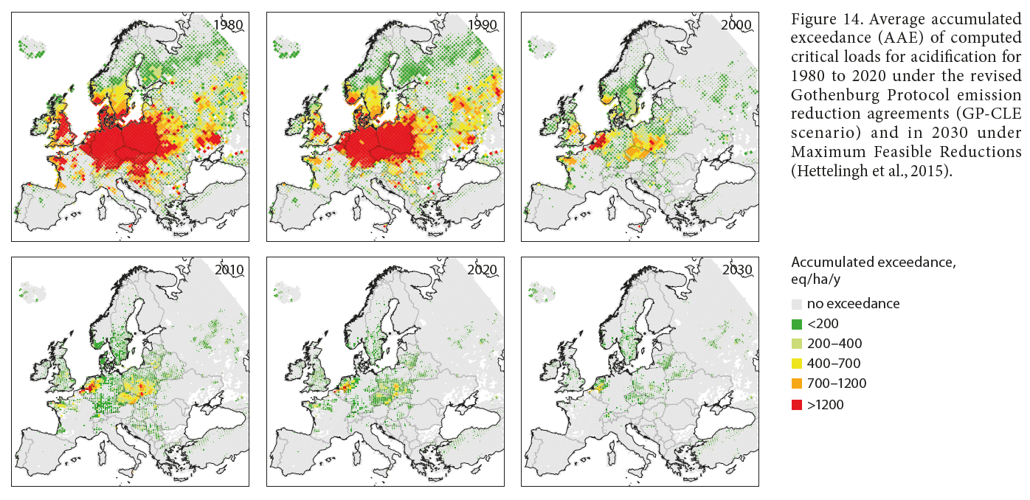
acidification

Slide 5
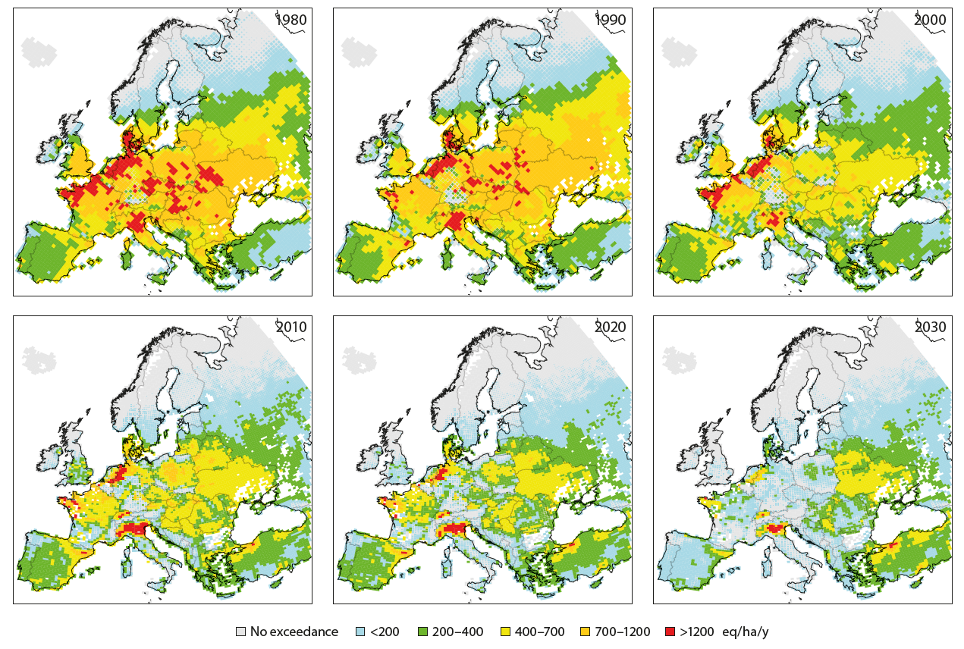
Eutrophication

Slide 6
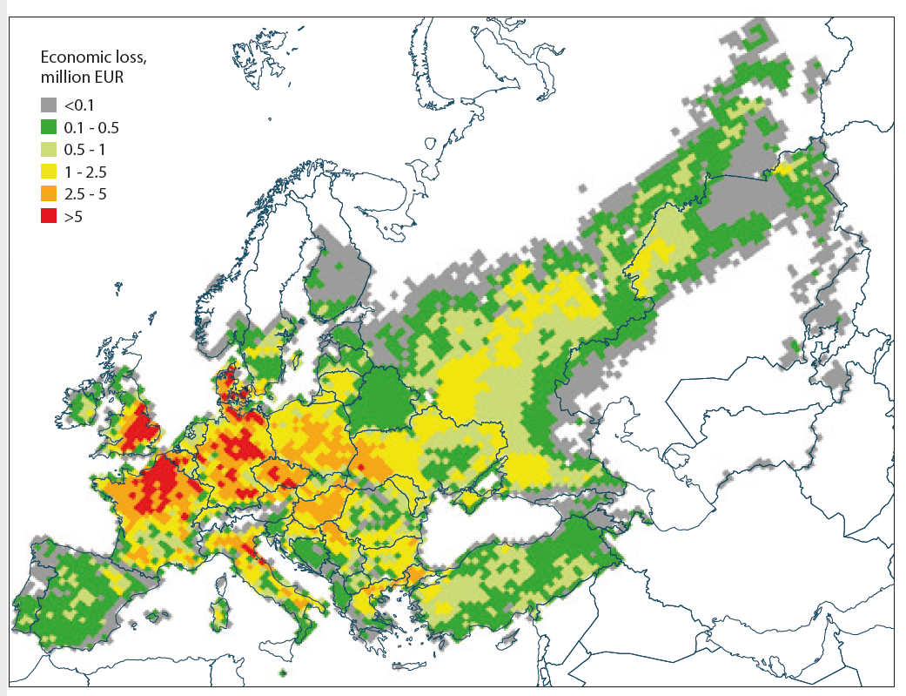
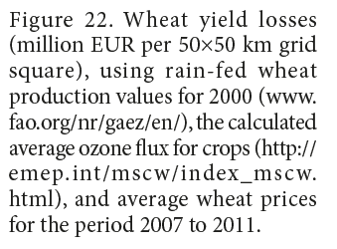
Yield loss from O3

Slide 7
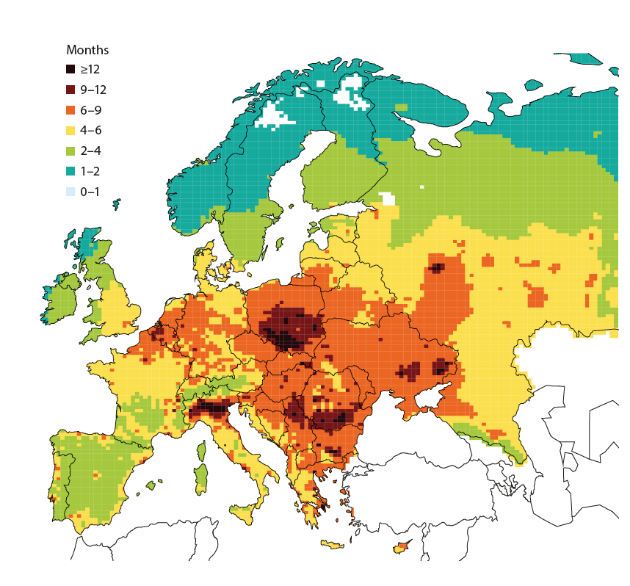
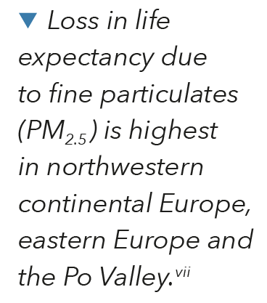
Reduced life expectancy, Particulate matter

Slide 8
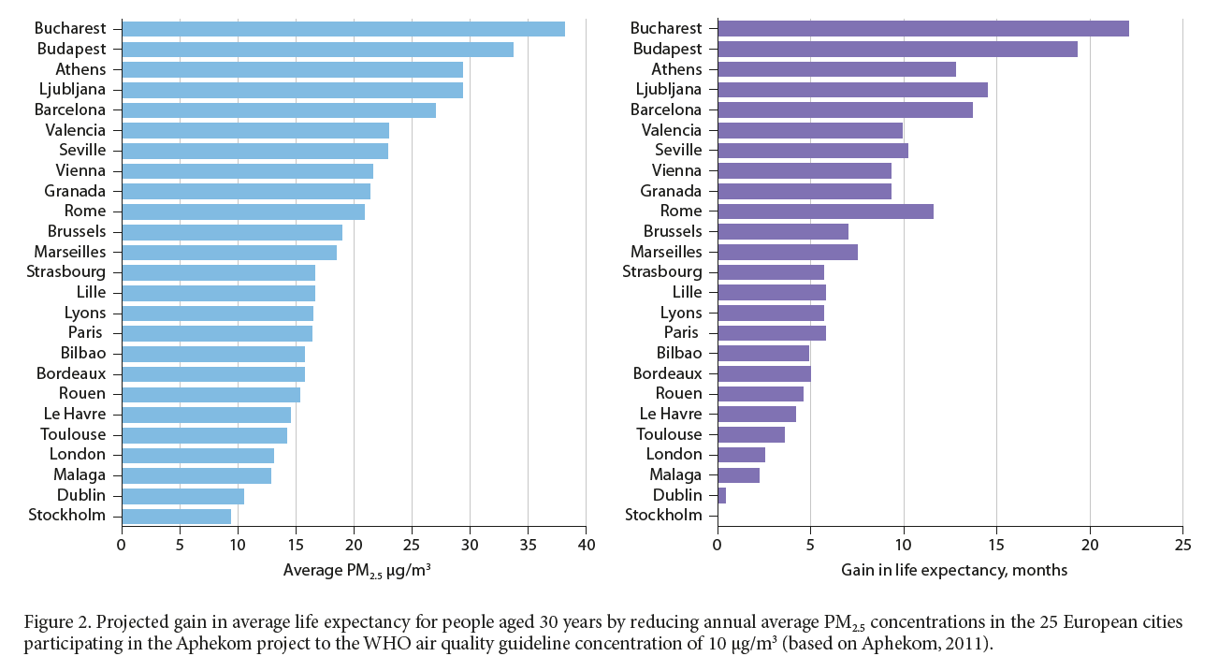

Slide 9
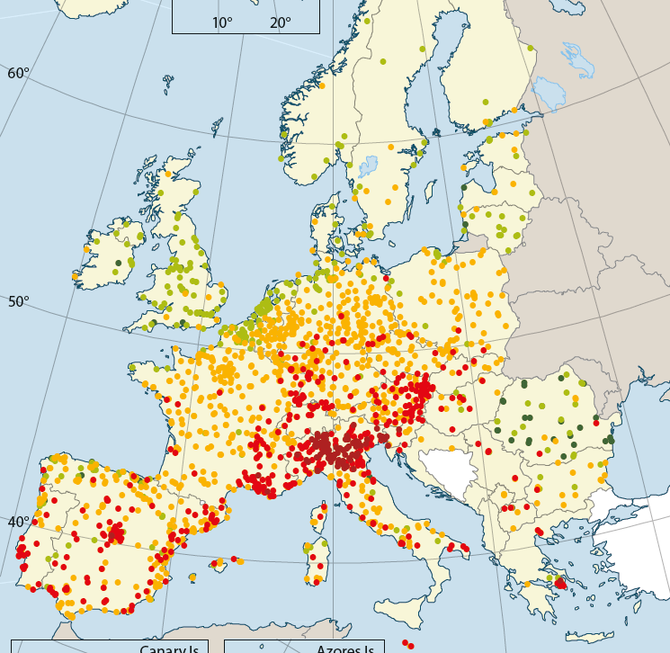
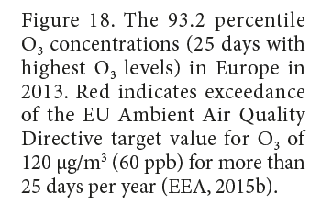
Ozone and health

Slide 10
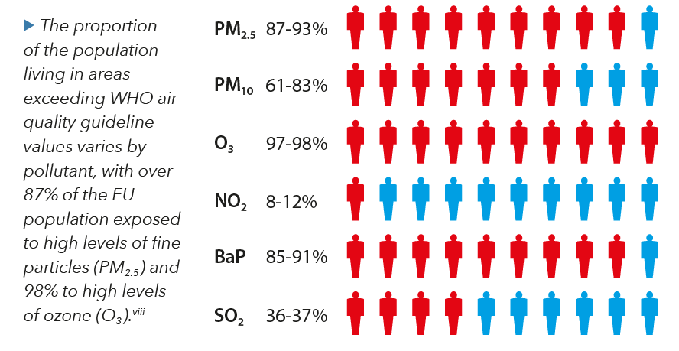

Slide 11
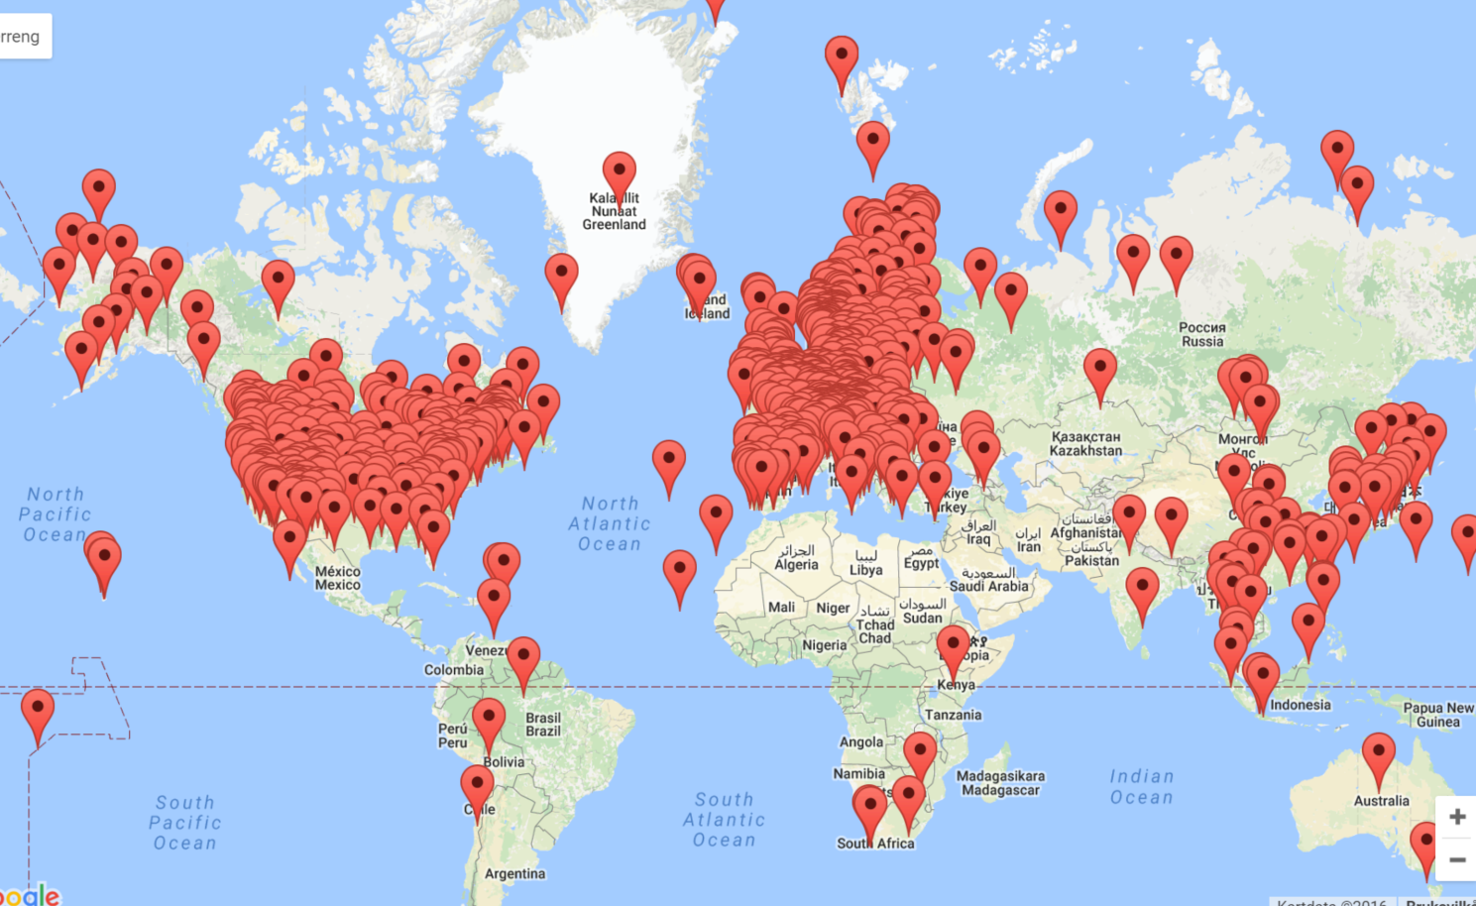
Observations are key, but typically also models and advanced interpretations are required to answer policy needs Observations serve to raise awareness Measurement efforts are more extensive than ever, but still, gaps are evident Very different perspectives on what are the «rational» needs,

Slide 12
Most «monitoring strategies» define:
Relevant species and metrics
Spatial resolution
Representativity
Temporal resolution
Data quality
Data availability
Duration
Intended use vs unintended use, topics of emerging interest etc.

Slide 13
«my perspective»…..
Researcher, 25yr, Atmospheric and Climate reseach, (local) – regional - global
EMEP Chemical Coordinating Centre
WMO Global Atmosphere Watch
EU Directives/EEA
Operator of Norwegian monitoring efforts
Data Centre provider for Conventions and projects

Slide 14
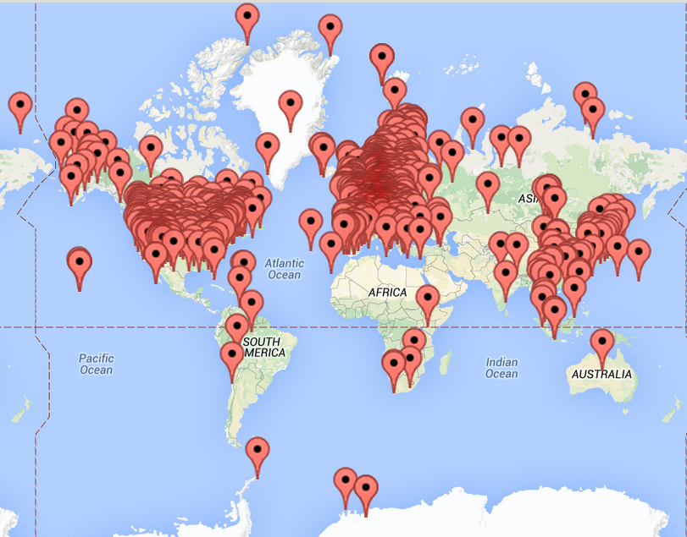
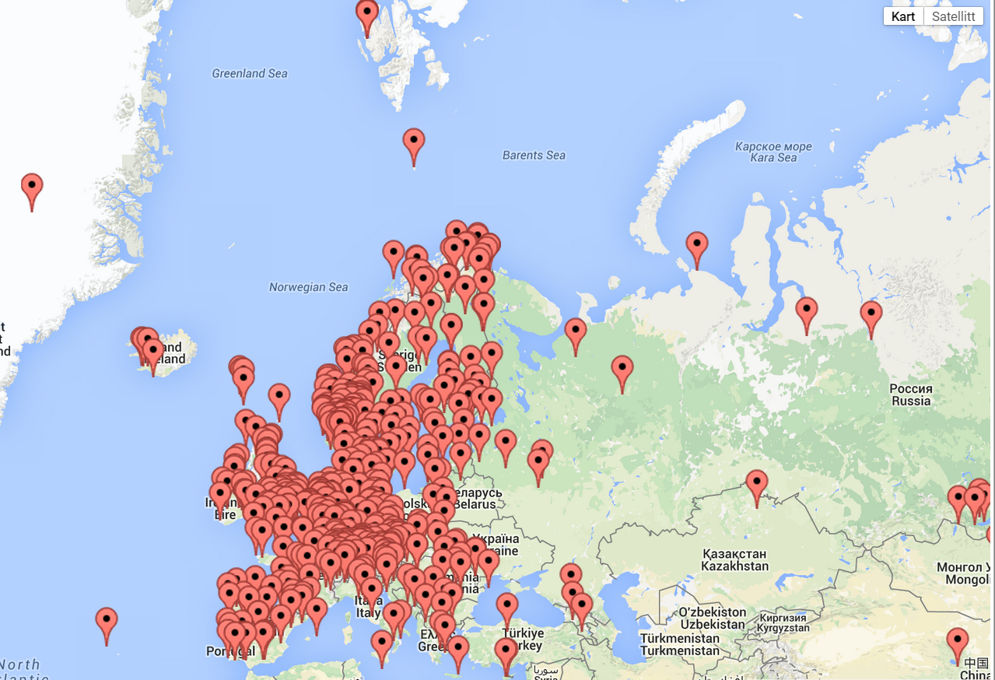
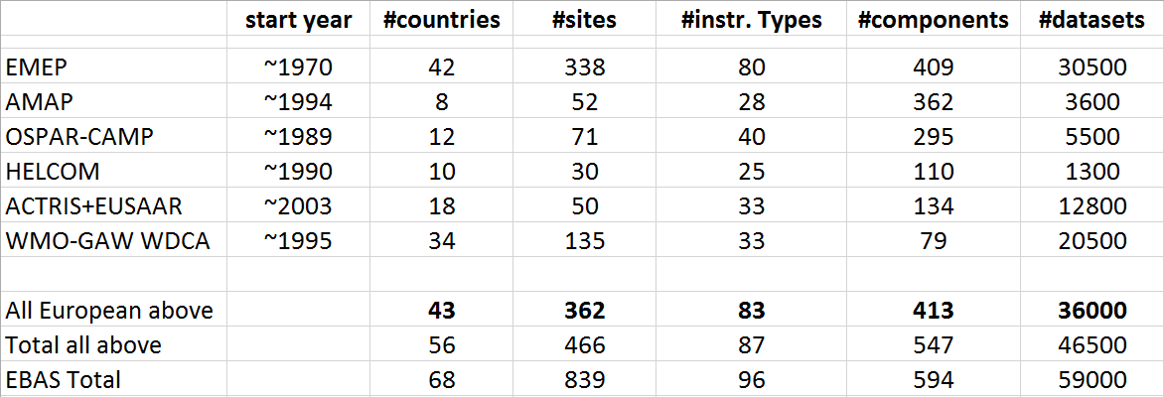
remote/background surface observations

Slide 15
Air Quality – is addressed by several conventions and initiatives
EU legislation
The Clean Air Policy Package
Clean Air Act
Conventions (UN, +)
WMO
UN-ECE
WHO
Science
Own funded measurements
Collaborative projects
Research Infrastructures
Academically rewarding
Atmospheric composition has a number of other stakeholders: climate, weather, ecosystems, corrosion, hazards ++
Monitoring strategies are fortunately evolving slovly
Public funding!
And very different magnitude

Slide 16
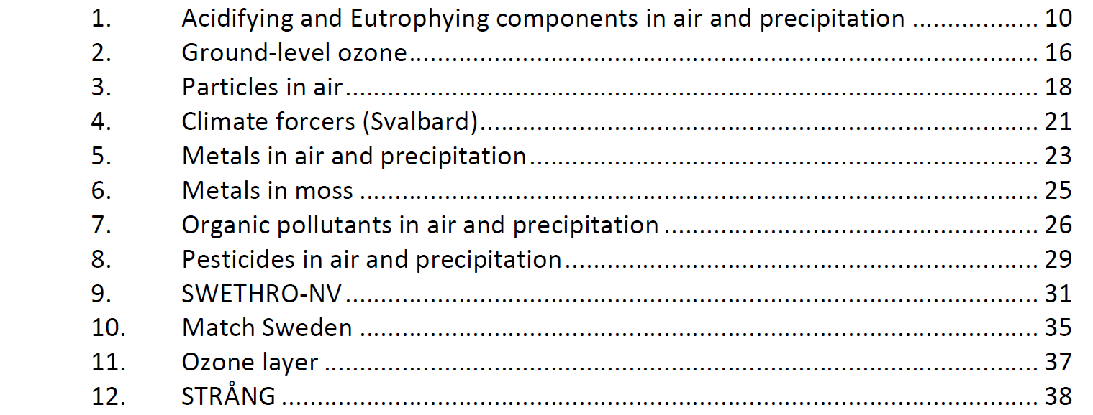
Annual cost of 1,5-2 mill Euro

Slide 17
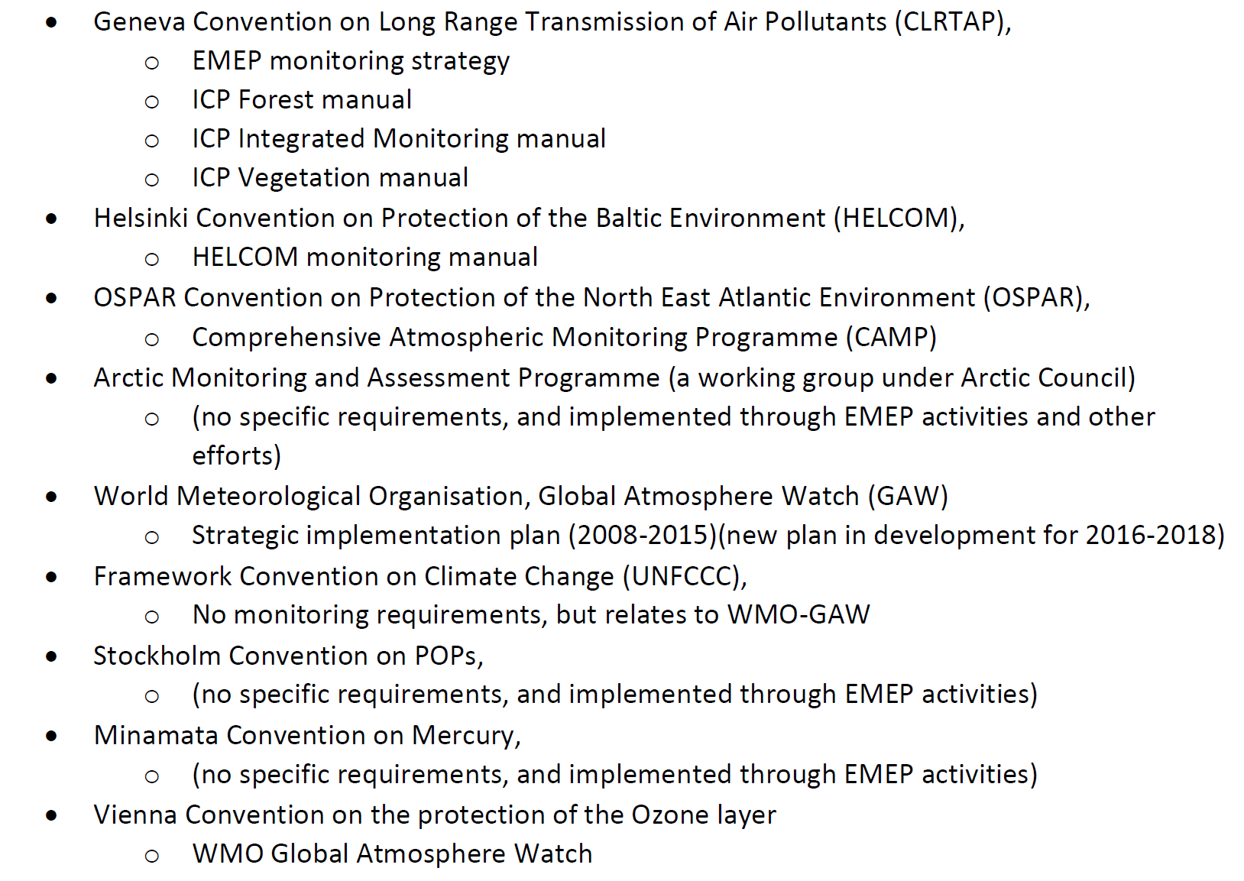

Slide 18
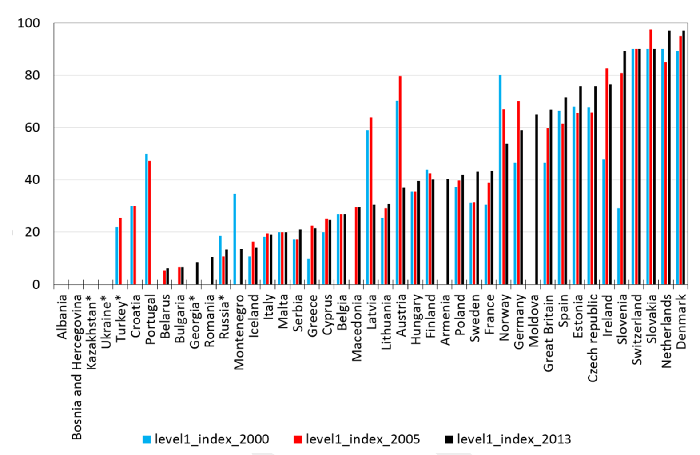
EMEP monitoring implementation Index

Slide 19
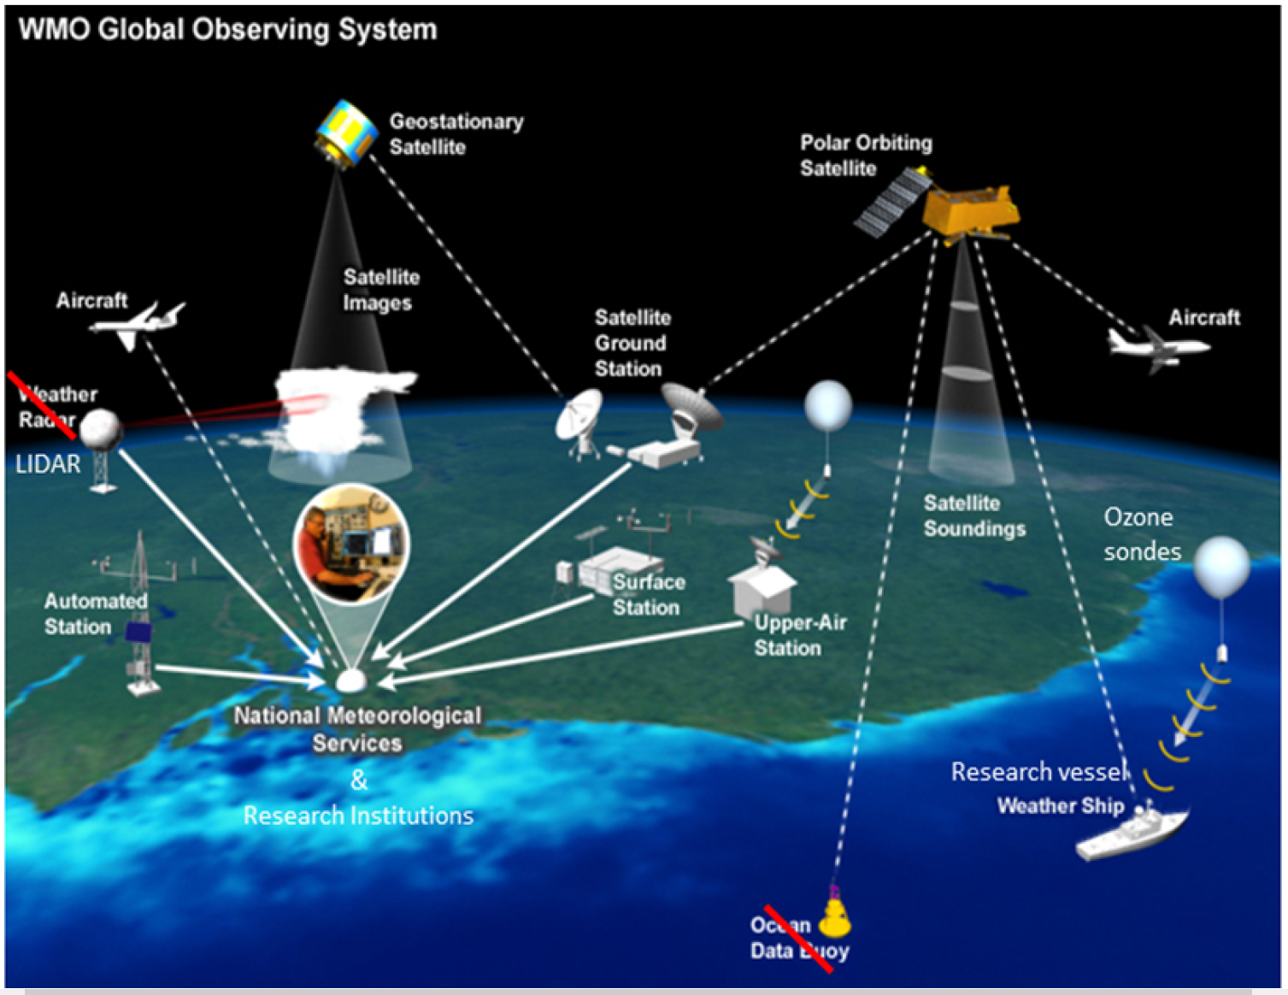
An ideal system?

Slide 20
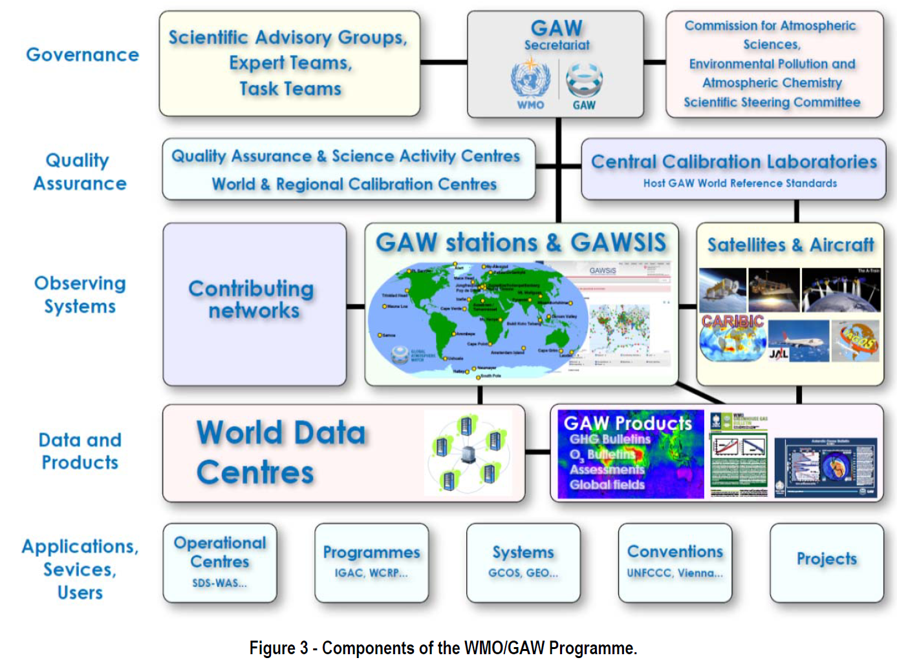

Slide 21
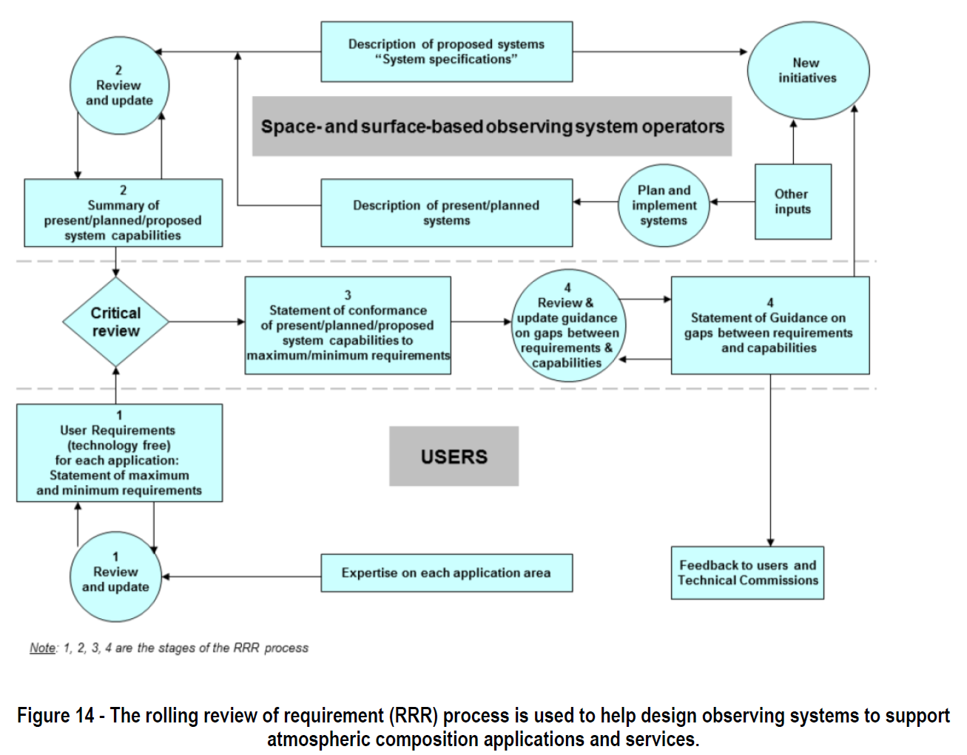

Slide 23
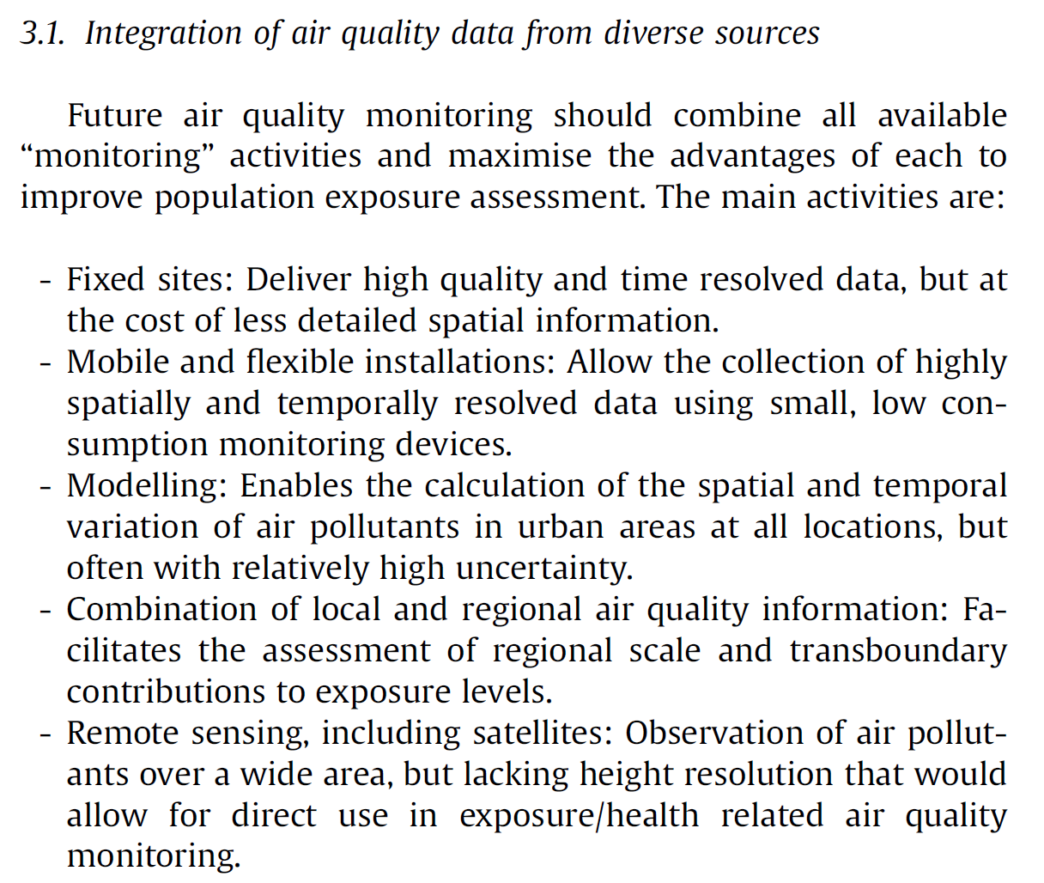

Slide 25
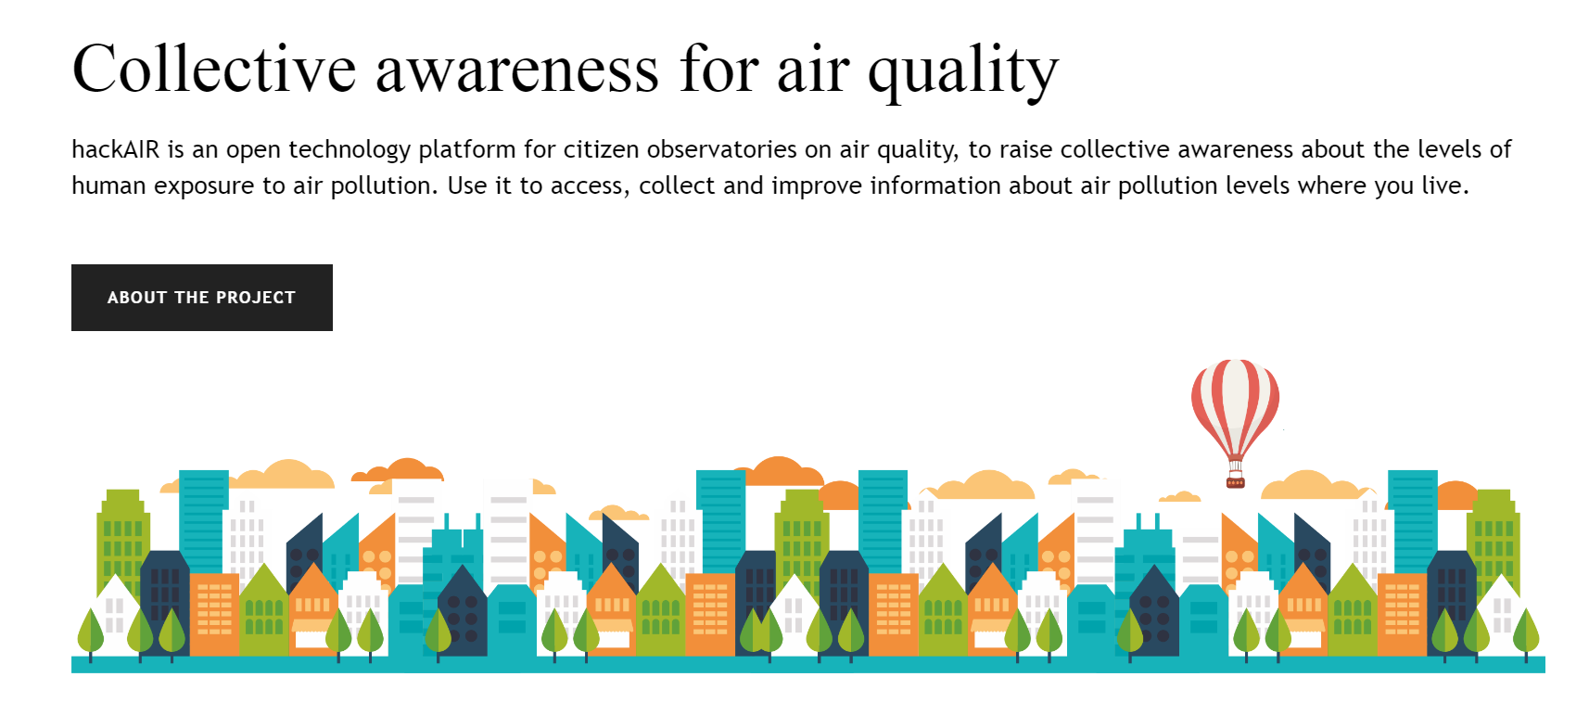
Dramatic shift in the focus of funding addressing the high-level «user», not other scientists

Slide 26
Final remarks
Everyone accepts the value of good observations
Needed for science, assessments and compliance
Key activity of institutes, organizations and programmes
Attracts media, the public and policy makers
Geopolitical dimension
While Air Pollution is not considered to be a solved problem, it is considered that the framework and underpinning basis is existing and being mature. Many countries are cutting cost.
Fairly easy to start something new, difficult to keep something running on decadal time scales
Funding mechanisms are very complex
Lots of competition, a variety of good intentions, and we present a confusing picture to funding agencies
Sometimes – the own interest of the provider dominates – «lobbying»

