Slide 1
GEO’s approach to user need definition and Gap Analysis process
Giovanni Rum
GEO Secretariat
ConnectinGEO Workshop on
Gap Analysis and Prioritization
IIASA 10-11 October, 2016

Slide 2
Table of contents
Strategic Plan provisions and general implications
Progress to date and next steps in defining the process
Preliminary approach to User Need definition and Gap Analysis
Challenges and Opportunities
Discussion points

Slide 3
GEO Strategic Plan 2016-2025: Implementing GEOSS References (1)
Part A Page 7 GEO’s strengths | “identify existing information and observation gaps, as well as gaps in institutional and technological capacities that hinder the use of information even when it is available;”
Part A Page 7 GEO’s scope | under “Through engagement with user communities, GEO will play a key role in systematically: identifying data needs while advocating the provision of, and access to, multiple sources of data; delivering tools, skills and services to allow the intelligent exploitation of the data by the user communities; and showcasing the value of Earth observation data in order to expand interest in, and usage of, those observations, as well as demonstrate their benefits to society. This end-to-end process of identifying needs, ensuring the availability of data with which to develop information to address societal challenges, and transforming that information into knowledge through the generation of products and services for end-users, defines the scope of GEO.”
Part B page 13 Communities of Practice | Under “…….These Communities demonstrate the convening power of GEO by engaging stakeholders along the full continuum of the data and information chain, from providers, to processors, to end users. Existing Communities of Practice may be mobilized to assist with engagement activities aimed at facilitating a comprehensive dialogue between Earth observation providers and end users in order to identify Earth observation products that address users’ needs.”

Slide 4
GEO Strategic Plan 2016-2025: Implementing GEOSS Core function, expected results, indicators

Slide 5
Core function, expected results, indicators

Slide 6
What outcomes
Geographical extent of the outcomes: Global, Regional, National
User needs and gaps for each SBA
How to document needs and gaps for each SBA
This may vary from one SBA to another
Web-based tool to document needs and gaps
Periodic Reporting (Yearly?): which form?

Slide 7
How to construct the process
Need of a well-defined and structured process engaging stakeholders from different domains, different regions, and different roles – including from end users to data providers and public and private sector.
The process should build on similar processes/activities already running
Contributions to the process should come from different sources, such as:
Similar processes running for a partial set of SBAs, such as those running within GFCS and WIGOS, under WMO leadership
Ad hoc processes to be gradually established with all GEO Initiatives and Flagships to “distillate” their needs
A systematic, SBA-related process to complement those identified above

Slide 8
Progress to date and next steps
A Working Group met in Geneva in May 2016 to define the key features of the process
A draft report of the WG meeting was issued by the Secretariat and received few comments
By end 2016, issue a document describing the SBA user needs process and how it will be implemented (based on the WG Report)
In 2017, activate the SBA-by-SBA process. WG recommended to start with Food Security and Sustainable Agriculture and Sustainable Urban Development
The Working Group comprises people with experience on similar processes coming from the following Institutions/projects: ConnectingGEO, EC-Copernicus, EARSC, ESA, GCOS, GFCS, IIASA, JAXA, NOAA, NASA, WMO.

Slide 9
Preliminary approach to User Need and Gap Analysis definition
(based on WG meeting results, to be consolidated)

Slide 10
Key general findings
A phased approach, first demonstrating suitability and feasibility of an SBA by SBA process and then progressively addressing the full scope of the GEO SP.
The needs for policy information (and consequently sound management and decision) by major international organizations and policy frameworks (e.g. conventions) are the reference.
Consider to take an holistic view (and SDGs can offer the proper framework)
A “rolling process”, update of needs and gaps through a systematic GEO action

Slide 11
Full scope of the User Needs and Gap Analysis
This GEO Core Function, as described in the Strategic Plan, has the whole “information value chain” as the reference and calls for three different but closely linked results:
Definition (for each SBA) of those Earth observations (DATA) most needed, relevant and useful to users
Definition (for each SBA) of the user-preferred products and tools (INFORMATION AND KNOWLEDGE), which contribute value to their decision making process (es);
Definition of global observational and informational gaps, so that commitments from providers and users can be obtained to ensure that these observations, products and tools are delivered and used.

Slide 12
What to document for each SBA
how the (SBA related) communities are organized on a global level and how so far common goals are managed;
policy analysis of each SBA, analyzing what are the main policy drivers for information and the main actors at global (international) and national scales;
extensive analysis of needs;
synthesis of gaps
Set of recommendations-priorities for action

Slide 13
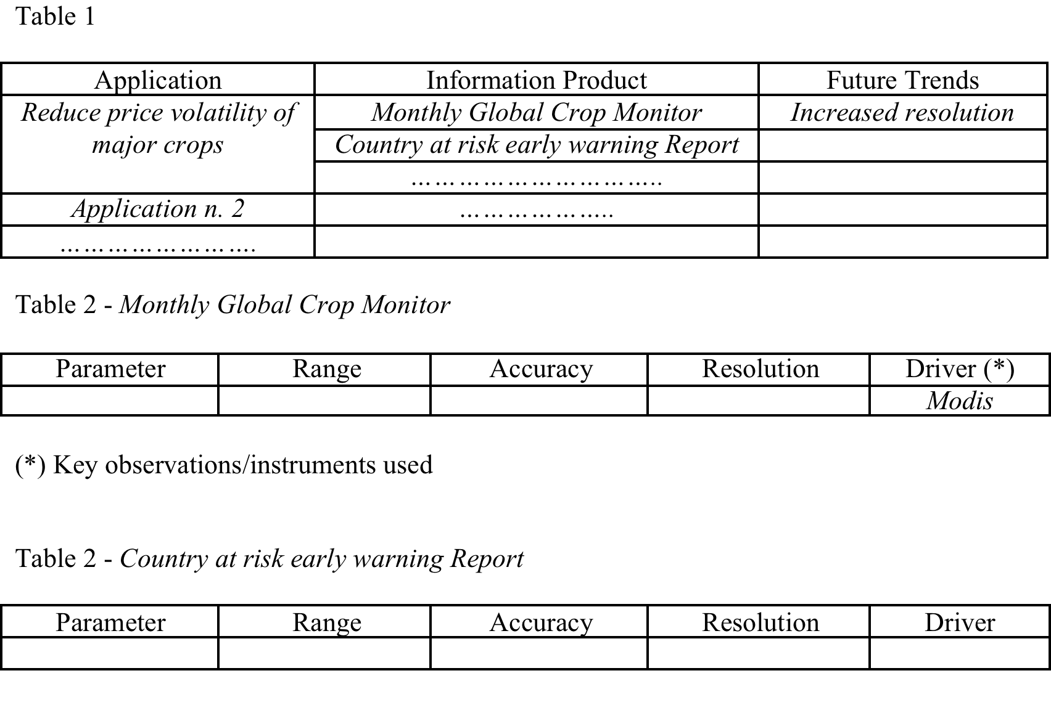
How to document needs and gaps for each SBA (Example for Food Security and Sustainable Agriculture

Slide 14
Challenges
SBAs are not monolithic, each of them includes different, consolidated user communities and it is a difficult, even impossible, to associate each user community to an SBA in a univocal fashion. The attempt would be to address the totality of issues in a structured way (by SBA) while keeping a fair level of flexibility on how different communities/users/initiatives will contribute to different SBAs.
GEO, even if global, is supposed to address user needs at global, regional and national level, at least.
Considering global frameworks as the reference
Defining different “levels” of users
Exploiting regional initiatives as the platform to implement the process at different scales

Slide 15
Opportunities (1)
Integrating/coordinating several processes of similar nature already running, so that they become an integral part of an overarching GEO process, avoiding duplications and focus on the closure of existing gaps (mainly in terms of user communities not addressed) and on providing an global outlook by SBA.
ConnectinGEO may become a key component of the process

Slide 16
Opportunities (2)
Contributions to the process may come from :
Consultation with international (e.g. UN-) organizations /constituencies /conventions to see how they can be supported in devising/establishing their (environmental) policies
Addressing the Agenda 2030 SDGs
Global processes of similar nature, addressing a partial set of SBAs, such as
those put in place by GFCS, for their five priority areas (Agriculture and Food Security, Water; Health, Disasters Risk Reduction, Energy)
the WIGOS Rolling Review of Requirements for Observational Data

Slide 17
Opportunities (3)
Contributions to the process may come from :
Regional and sub-regional processes (such as the one connected to the African Space Strategy and the one just activated by RCMRD (Regional Centre for Mapping of Resources for Development)
National processes
Ad hoc processes to be gradually established with all GEO Initiatives and Flagship to “distillate” their needs

Slide 18
Possible overall structure of the process
Three components:
a central coordination (ensured by the GEO Secretariat, with the support of a small Group), to ensure the coordinated execution of the overall process
the individual processes within each SBA, to define and document the user needs; these needs should have global relevance but may be structured at the three levels (global, regional, national), and
a “Synthesis function”, to ensure the consolidation of individual user needs into aggregated observational and information requirements and associated gaps.

Slide 19
Discussion points
Is the “Essential Variables” approach suitable for all SBAs? For all users?
EV definition, should be general or specific to SBA/User community?
To which level of user (global to local) the EV concept works?
To which level these EVs should be “ready to use”
The definition of a structured process (and of the main actors to involve) is key for systematic results
What role for SDGs as a reference (also in connection with the needs of individual global conventions). Are they representative of an holistic process?
Importance of a global synthesis on gaps to define priorities

