Slide 1


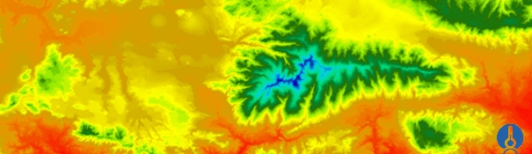
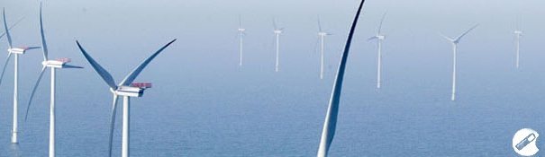
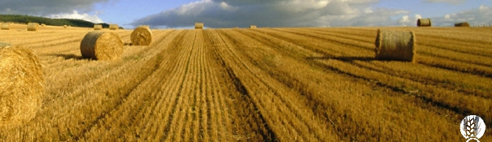
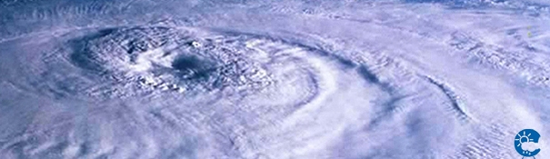
ENEON first workshop
Observing Europe: Networking the Earth Observation Networks in Europe
21-22 September, Paris
Total Carbon Column Observing Network (TCCON)
Thorsten Warneke, Justus Notholt, University of Bremen, warneke@iup.physik.uni-bremen.de
jnotholt@iup.physik.uni-bremen.de

Slide 2

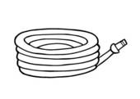
Atmospheric greenhouse gas observations
Satellite
Satellite
Satellite
(
column
average
)
(
(
column
column
average
average
)
100
)
100
Stratosphere
Stratosphere
Stratosphere
10
10
Aircraft
Aircraft
Free
Aircraft
Free
Free
Troposphere
Troposphere
Troposphere
(0
(0
(0
-
-
-
20km)
20km)
20km)
AirCore
(0-30km)
(km)
(km)
(km)
1
1
altitude
altitude
Tall
tower
Tall
Tall
tower
tower
(~500m)
(~500m)
Boundary
(~500m)
Boundary
Boundary
0.1
0.1
layer
layer
layer
0.01
0.01
Surface
Surface
Surface
air
air
air
sampling
sampling
sampling
FTIR
FTIR
TCCON
(
(
(
column
column
column
average
average
average
)
)
)

Slide 3
Role of TCCON in the global observing system
for greenhouse gases
  High accuracy
  Long-term data record
  Limited spatial coverage
  Derived fluxes are sensitive to
  assumed vertical transport
  Limited usefulness for satellite validation
  Sample the whole atmosphere
  Small dependency on vertical mixing
  Global coverage provided by satellites
In situ network
TCCON
is vital for the validation and calibration of GHG satellite retrievals and represents the reference network for GHG satellite validation.
In addition it provides complementary information to the in situ measurements for understanding the GHG cycles.
Remote sensing measurements

Slide 4
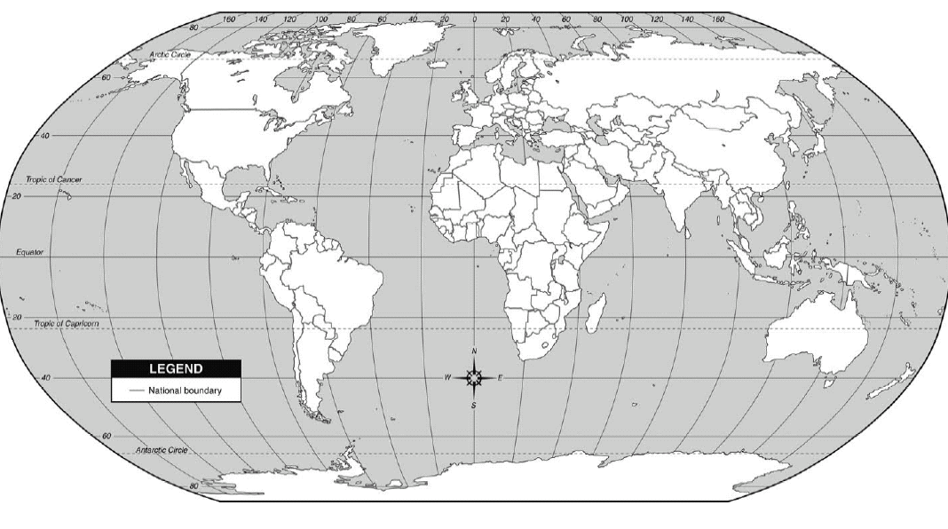
Total Carbon Column Observing Network (TCCON) in 2005
Spitsbergen
Bremen
Park Falls
Darwin
Lauder

Slide 5
Total Carbon Column Observing Network (TCCON) in 2015
Eureka
Spitsbergen
Sodankylä
Bremen
Park Falls
Bialystok
Orleans
Garmisch
Anmyeondo
Rikubetsu
Tsukuba
Caltech
Lamont
Karlsruhe
Isana
Saga
Manaus
Darwin
Ascension
Reunion
TCCON chair:
Paul Wennberg, California Institute of Technology
European TCCON co-chair:
Justus Notholt, University of Bremen, Germany
Asian-Australian TCCON co-chair:
David Griffith, University of Wollongong, Australia
Wollongong
Lauder

Slide 6
TCCON data
¹³CO₂
Near-IR spectral region
  Less interferences than in the mid-IR
  Contains O₂, which can be used as an internal standard to correct instrumental biases
  Same spectral region for CO₂ and CH₄ as satellites with high sensitivity to the ground (GOSAT, OCO-2)
O₂
CO₂
CH₄
N₂O
CO
H₂O
HDO
intensity
HF
λ (μm)
1.2 1.6 2.5
TCCON dataproduct
Data product are column averaged mole fractions
High standardisation among the network assures comparability
3) Data is freely available from the TCCON database one year after observation. Within the EU-project ICOS-INWIRE it has been shown that data can be available 3 days after the measurement. This fast data product can only be delivered with additional funding

Slide 7
TCCON calibration by in situ measurements
CO₂
CH₄
2 σ standard error by comparison with in situ profiles
CO₂: 0.8 ppm
CH₄: 7 ppb
N₂O: 3 ppb
CO: 4 ppb

Slide 8
TCCON model- and satellite validation
Kulawik et al., AMTD 2015

Slide 9
Publications in international journals (until May 2014)
Figure courtesy of
Paul Wennberg

Slide 10
Funding
  Currently most of the sites in the network are funded via short-term research projects
  The operation of many sites is financially not secured beyond mid 2016. However, it is expected that funding will become available for the Sentinel 5 precursor validation.
  For each site one PhD student + 20 kEUR/year is needed for standard operation.
  Fast data delivery (RD-TCCON) is possible with additional funding, which strongly depends on the infrastructure of the site.

Slide 11
Summary
TCCON is the reference network for the validation of GHG satellite retrievals and enables to link satellite retrievals to the WMO reference scale. TCCON has grown significantly over the last 10 years and is a vital component in the global observing system for GHGs.
TCCON itself has been used for carbon studies in the past and is a valuable addition to in-situ and satellite observations.
TCCON has a high degree of standardisation, ensuring comparability among the sites.
TCCON data is freely available one year after the measurement. A fast dataproduct (RD-TCCON) could be provided with extra funding. RD-TCCON data could be delivered a couple of days after the measurement.
Funding for many TCCON sites is not secured beyond short-term research projects.

