Slide 1
Case Studies on the Role of Earth Observations
in Environmental Policy Support
– A Synthesis
Senay Habtezion
International START Secretariat
4th GEOSS Science and Technology Stakeholder Workshop
CONCEPTS, TECHNOLOGIES, SYSTEMS AND USERS OF THE NEXT GEOSS
March 26-28, 2015, Norfolk, VA, USA

Slide 3
Data use capacity building …
Earth observations, such as NASA Landsat data, are becoming rapidly accessible to researchers around the world; however, many researchers are unable to access or use this data due to limited technical resources and training.
The data Initiative component of GOFC-GOLD seeks to increase scientists’ capacity to utilize the data needed for research and NRM, and foster regional and international networks of scientists interested in forest cover and land dynamics.
2014 Data Initiative fellows
Boston University
USGS EROS Center, South Dakota

Slide 4
Strengthening networks …
GOFC-GOLD REGIONAL NETWORKS
South-Central European Regional International Network (SCERIN)
Northern Eurasia Regional International Network (NERIN)
Baltic-Arctic Regional International Network (BARIN)
Red Latinoamericana de Teledeteccion e Incendios Forestales (RedLaTIF)
Southern African Fire Network (SAFNET)
Miombo (Southern Africa) Land Use Land Change Network (Miombo)
Western Africa Regional Network (WARN)
Observatoire Satellital des Forets d’Afrique Central (OSFAC)
Southeast Asia Regional Research and Information Network (SEARRIN)
Central Asia Regional Information Network (CARIN)
South Asia Regional Information Network (SARIN)

Slide 5
Case studies: Context
The EOs – Policy Interface
Timely and accurate information is critical for environmental policy making. Same true with all phases of the policy cycle.
Together with 'in situ' data (+ models and other data sources), EOs can help provide critical input to the environmental policy cycle.

Slide 6
EOs and the policy continuum
Detection
Formulation
Implementation
Monitoring & evaluation
Quality
Control

Slide 8
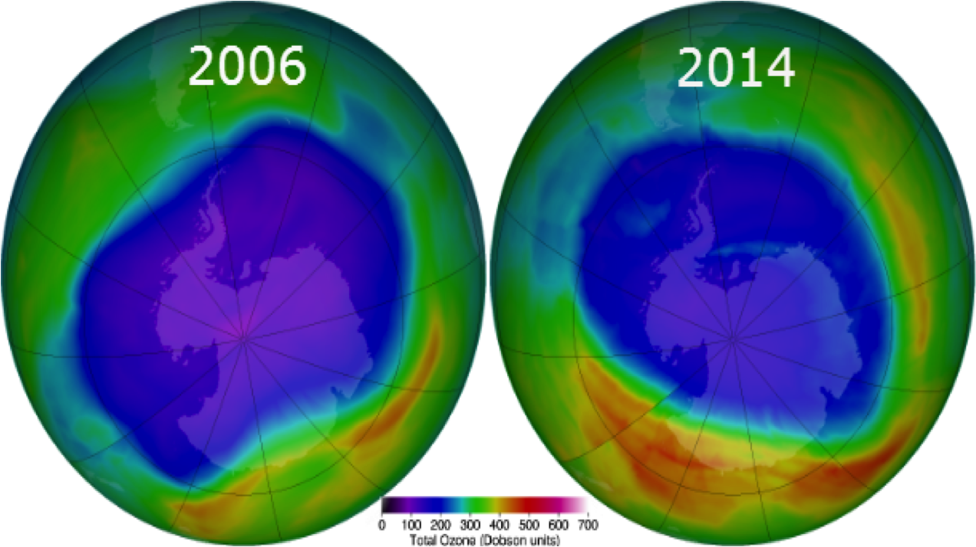
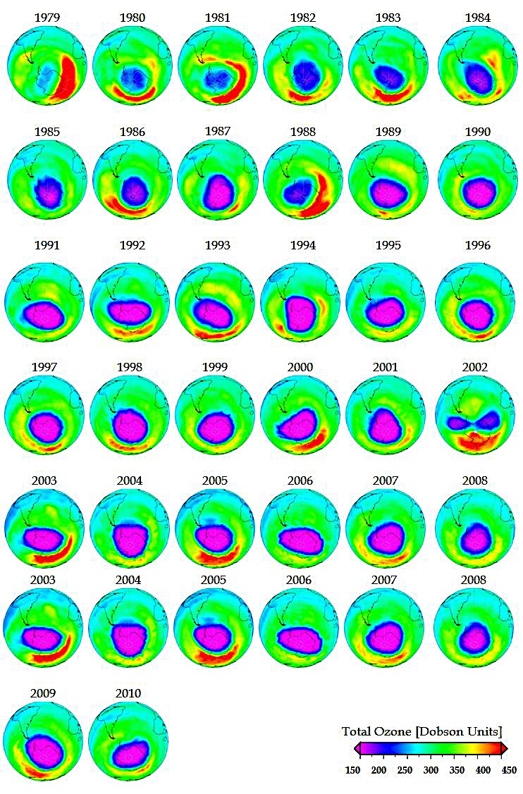
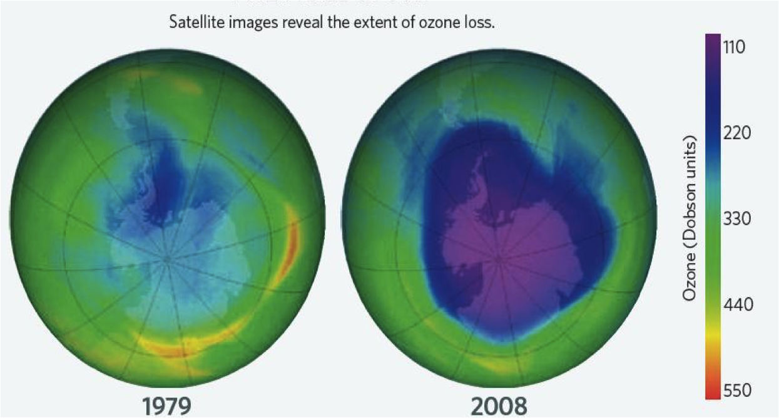
EOs and the policy continuum …
Notes:
xx

Slide 9
Policy support role of EOs in DCs
Premise for case studies
Big role for EOs in environmental policy support across sectors and scales
Limited application of EOs use in environmental policy, especially in Africa
Limited SDI
Awareness (policy community)
Capacity gaps

Slide 10
Case studies
 | Thematic focus | Authors
1 | Coastal policy - Ghana | O. PABI and C. GORDON
2 | Forest fire monitoring - Swaziland | W. DLAMINI
3 | National environmental policy - Kenya | E. KHAMALA
4 | Buffer zone policy - Ghana | B. BARRY
5 | Natural resources mgt - Nigeria | I. ADELEKAN
6 | Urban growth - Uganda | S. LWASA and R. SSEKITTO

Slide 11
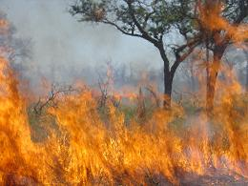
eg 1: Swaziland – forest fires

Slide 12
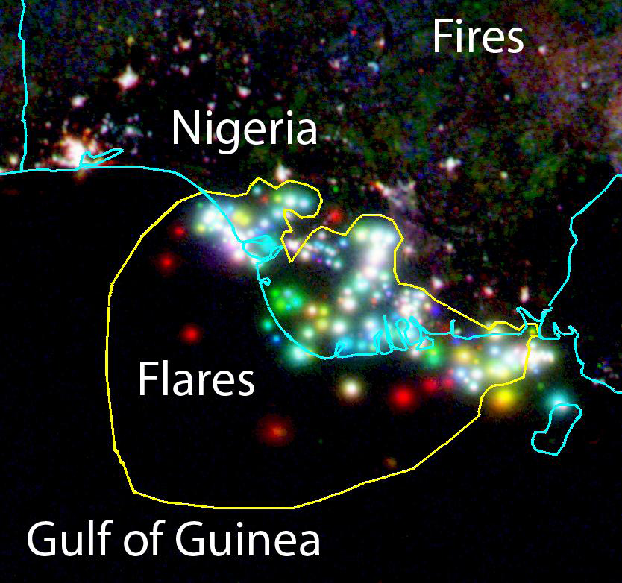
eg 2: Nigeria – Gas flaring

Slide 13
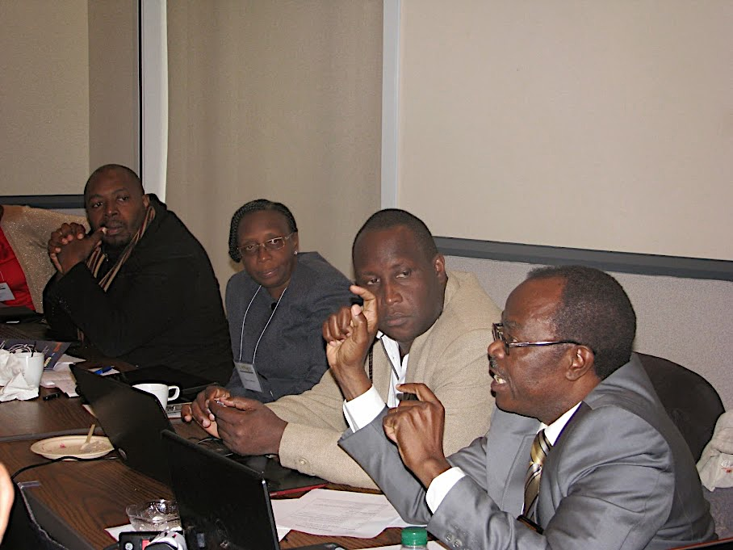
EOs-Evtal Policy Workshop Washington DC, Dec 2014

Slide 14
Synthesis: common themes and suggestions
EOs being used across policy cycle (more needed in review and monitoring and implementation)
Internet access is a major constraint on the uptake of remotely sensed data
There is a need for enhancing the collection, preservation, sharing and dissemination of in-situ data (also data rescue)
Developing research and technical and institutional capacity and geospatial infrastructure across countries in the region–
GEO SDI assessments?

Slide 15
Synthesis: common themes and suggestions
Scale-up training on data processing and analysis
Need for more engagement with the policy community
Review of the state of enabling factors on data access and sharing and the various applications of EOs across the policy continuum
What more can GEO do? Assessments? Advocacy/awareness?

Slide 16
Thank you !! www.start.org Email: shabtezion@start.org

Slide 17
Questions for the Break Out Group?
How important are public-private partnerships for the next GEOSS and who should be involved?
Are there new approaches to a sustainable business model for the next GEOSS?
How should a network of network be governed to ensure sustained observation and processing infrastructure for the next GEOSS?
What can be done to align the next GEOSS better to the needs of the developing world and sustaining capacity in developing economies?
What should the information system of the next GEOSS provide to users and how can we ensure that the system supports those users who are solution-oriented?

