Slide 1




The need for fine-scale global human settlement information
11-12 June 2015, Bari-Italy
Societal Benefit Area: Human Settlements
Names: Thomas Kemper
Martino Pesaresi
Institution: European Commission
Joint Research Centre
Coordinating an Observation Network of Networks EnCompassing saTellite and IN-situ to fill the Gaps in European Observations

Slide 2
The Urban Millennium
“The urban population in the developing world will double by 2030. The implications are staggering. One is that we have 20 years to build as much urban housing as was built in the past 6,000.”
“The informal sector already builds an estimated 70 % of all urban housing in the developing world, making it the leading actor in the housing supply chain.”
  (Reinhard Goethert, School of Architecture and Planning, MIT*)
  * “Incremental Housing: A Proactive Urban Strategy,” Monday Developments, September 2010, http://web.mit.edu/incrementalhousing/articlesPhotographs/pdfs/PagesMondayMag.pdf.

Slide 3
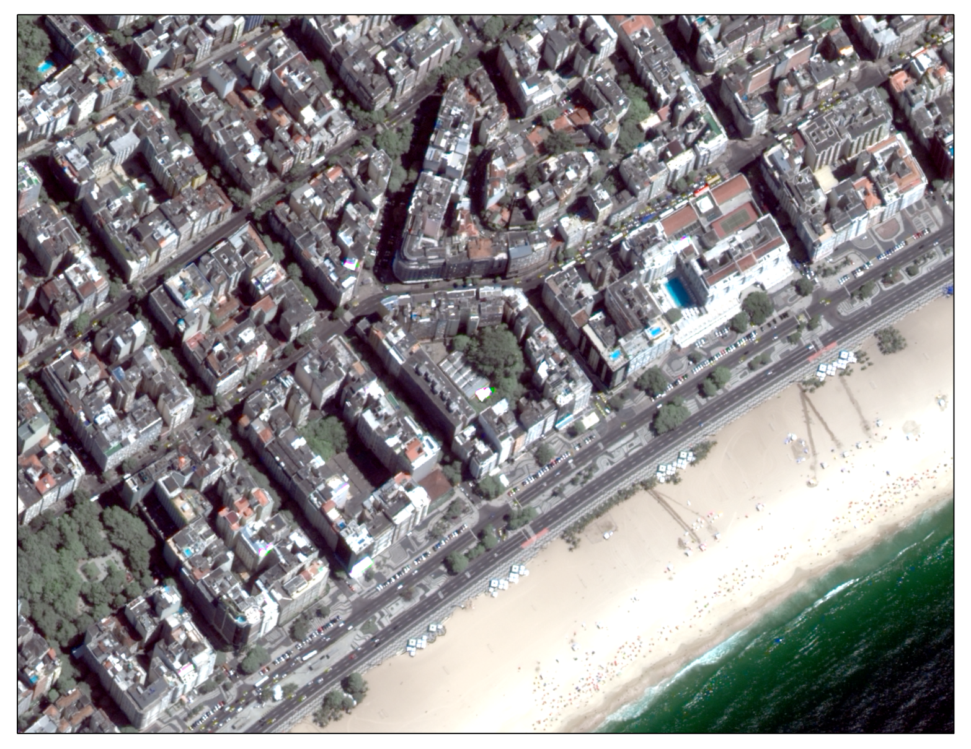

Slide 4
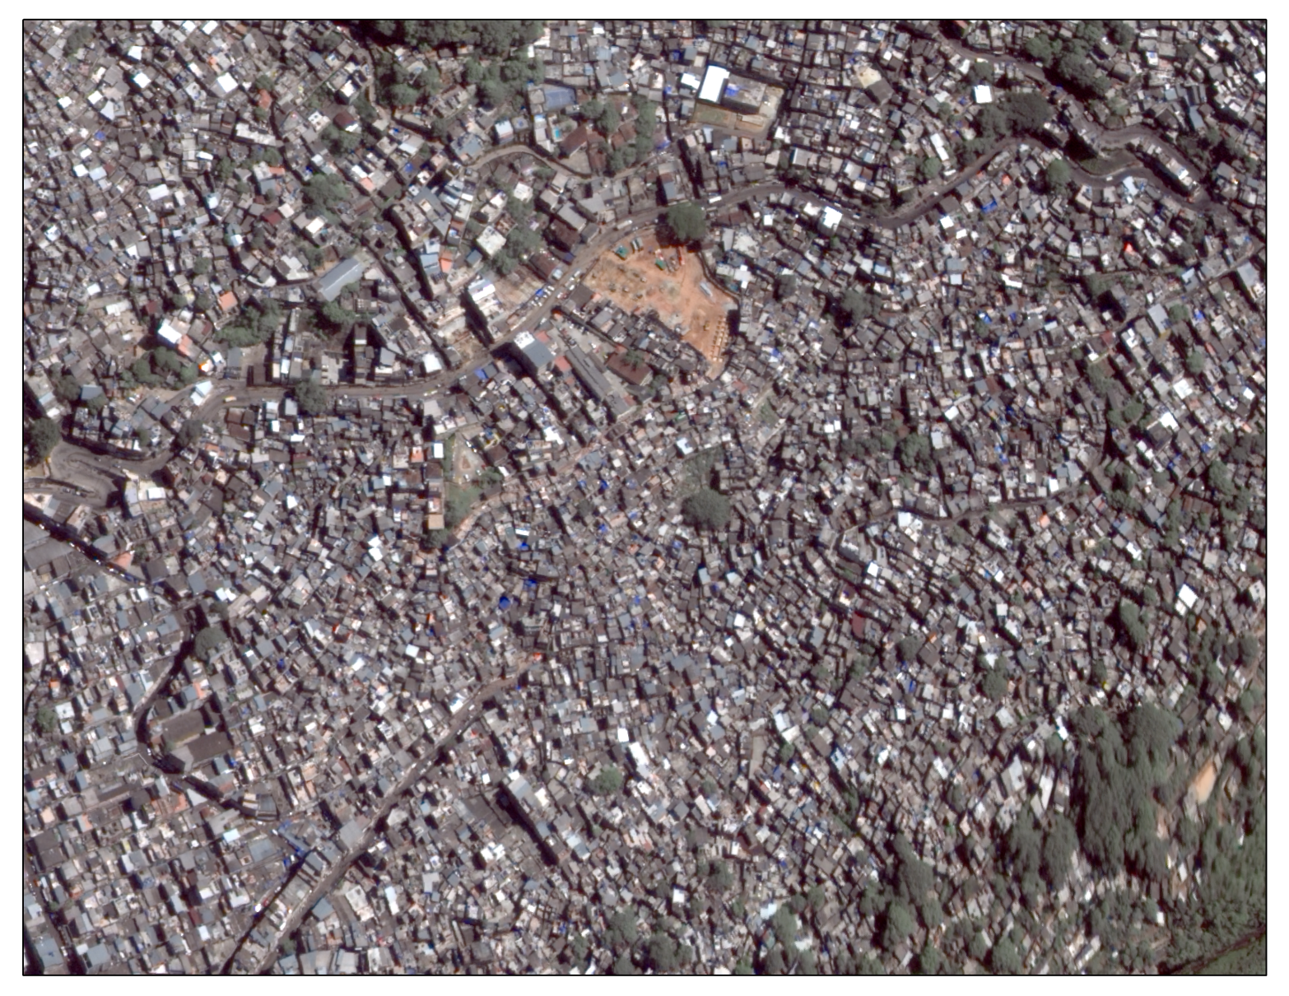

Slide 5
Human settlement information needs
DRR & Crisis Management
  Rapid mapping & damage assessment
  Disaster Risk Assessments (Exposure)
  Population estimations
Sustainability and resilience of cities
  Regional & local planning
  Poverty mapping
  Slum upgrading

Slide 6
Available information today
Global:
    MODIS urban layer (500 m spatial resolution)
    Night-light images (Suomi-NPP/DMSP, 750 m)
    Landscan population layer (1 km spatial resolution)
Regional/local:
    land use/land cover at different scales
Gaps between the needs of the users and the information layers:
  Inconsistency and incompatibility of data sets
  Very high semantic abstraction
  Globally consistent data sets are too coarse for many applications

Slide 7
The Global Human Settlement Layer
Multi-scale vision
      Global  Regional  Local
Multi-sensor approach
      Optical airborne/satellite data 0.5-10 m for local/regional scales
      Optical satellite data 10-30(60) m res data (Landsat, Sentinel) for regional/global scale
Automatic image information retrieval
      Quantitative information: built-up area, size, density
      Automatic = no free parameter policy
      Realistic data volume and quality scenarios
Inclusive concept of human settlements
      refugee/IDP camps, slums, rural hamlets

Slide 8
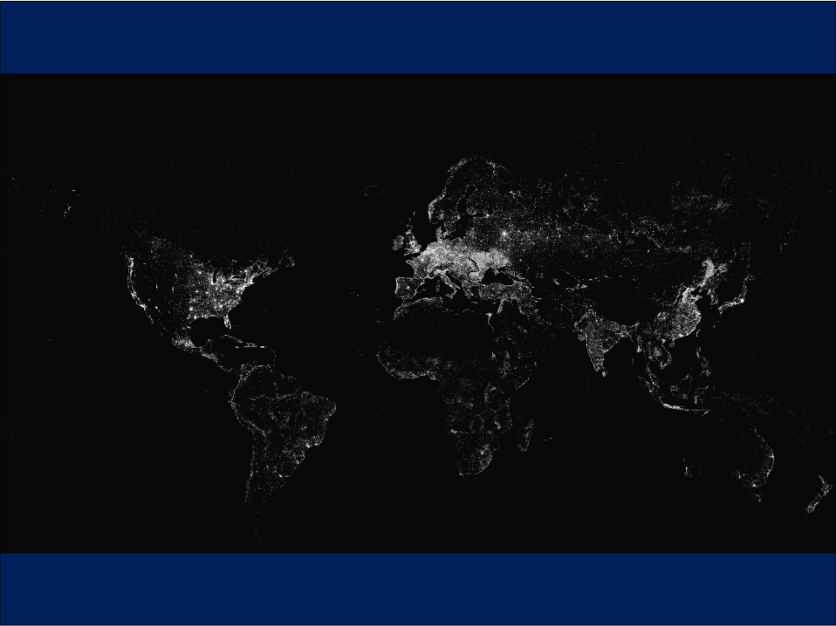
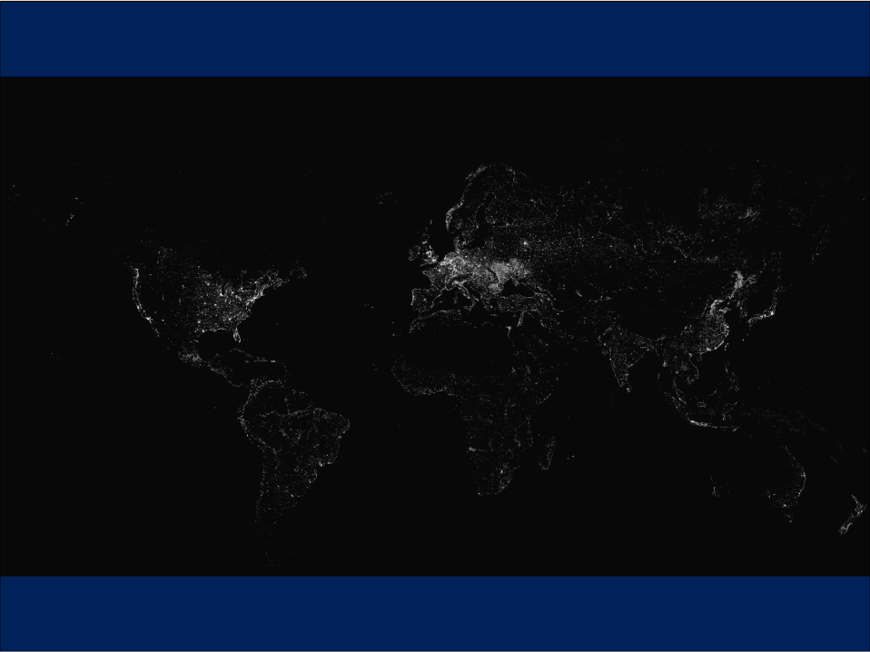
Landsat GHSL: first available global dynamical assessment
1975 ---------------1990----------2000--------------2014

Slide 9
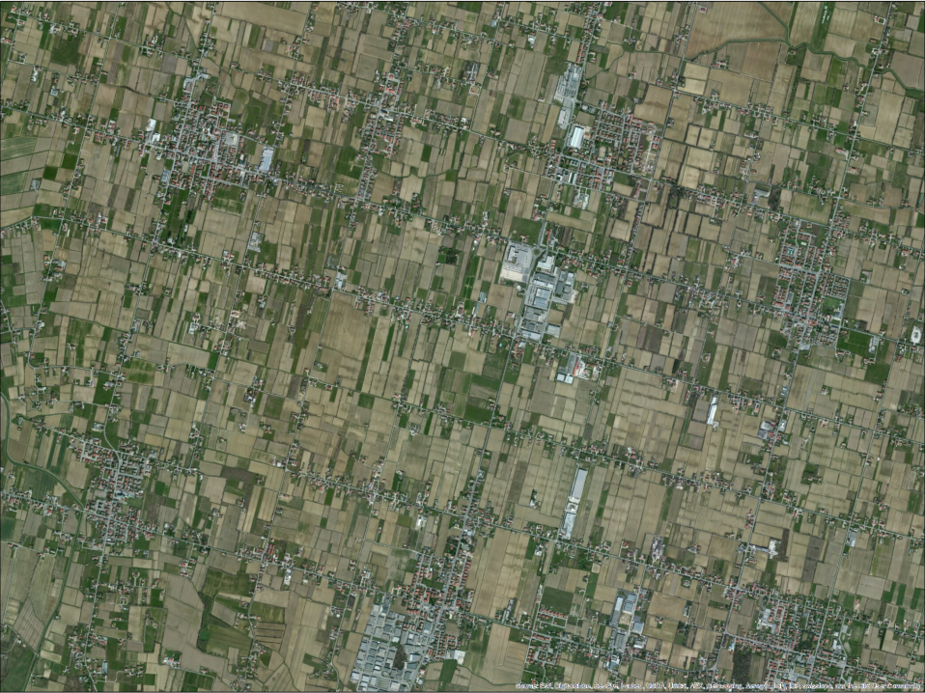
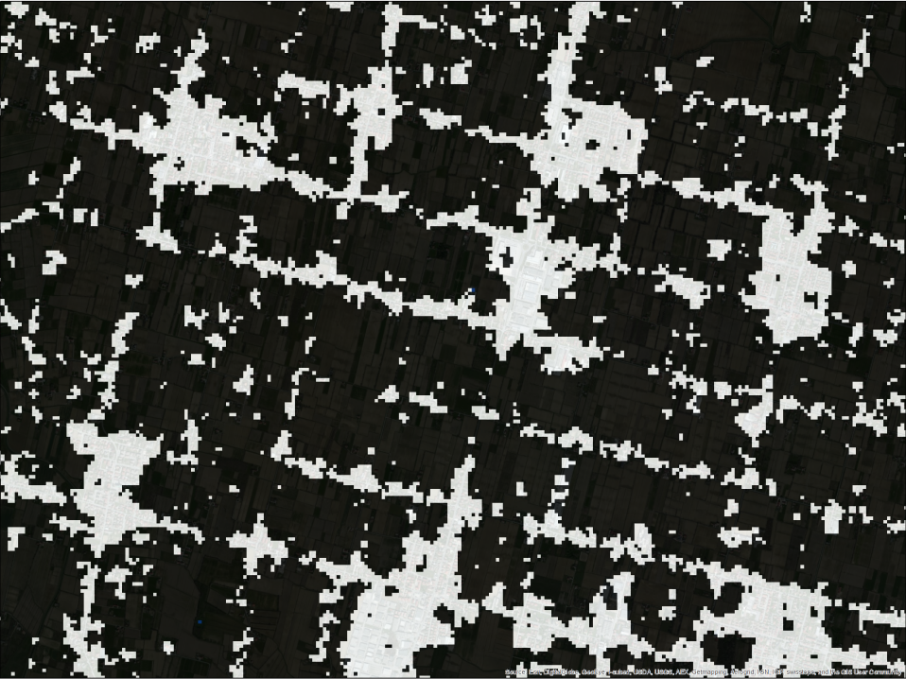
What we detect: “built-up area” = all spatial units (30x30m) where a building or part of a building can be recognized

Slide 10
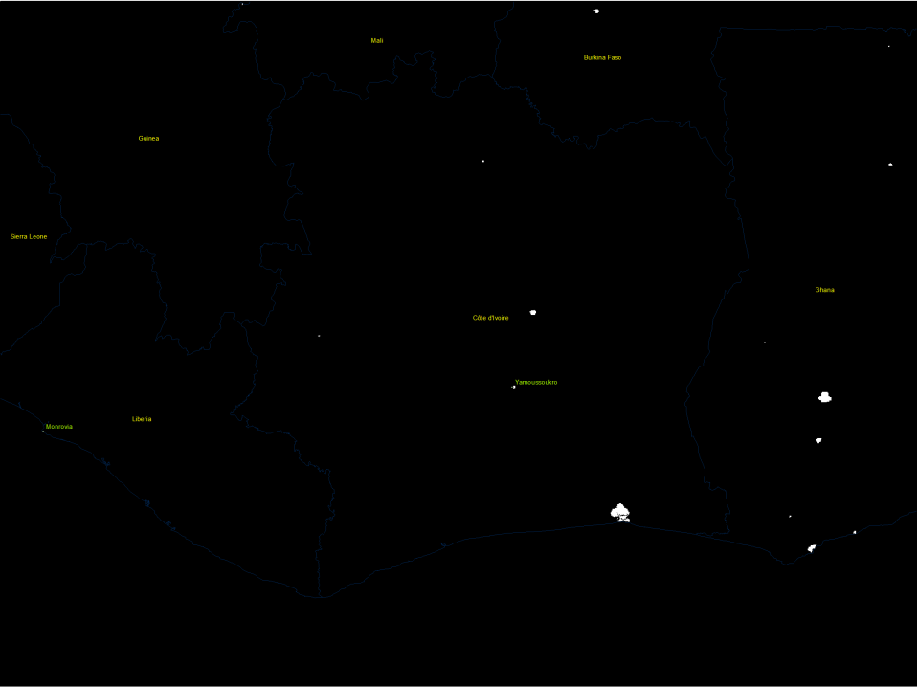
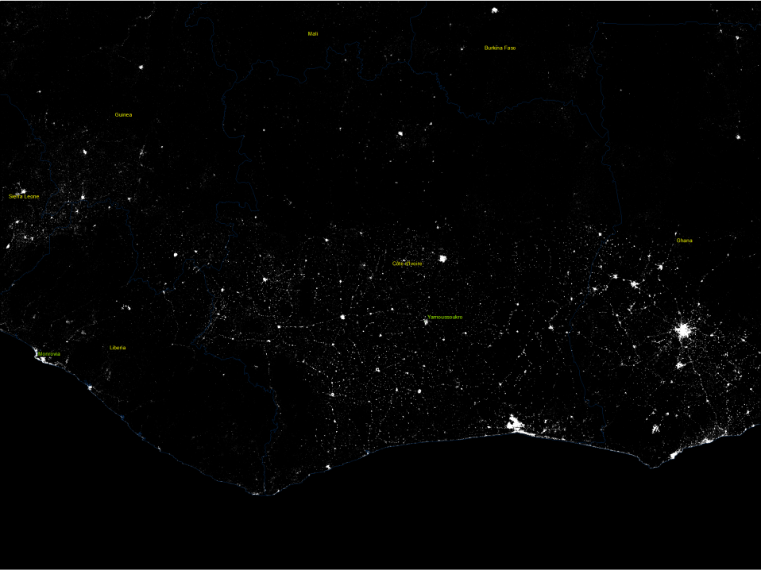
Sensor value-added: MERIS GLOBCOVER – Landsat GHSL

Slide 11
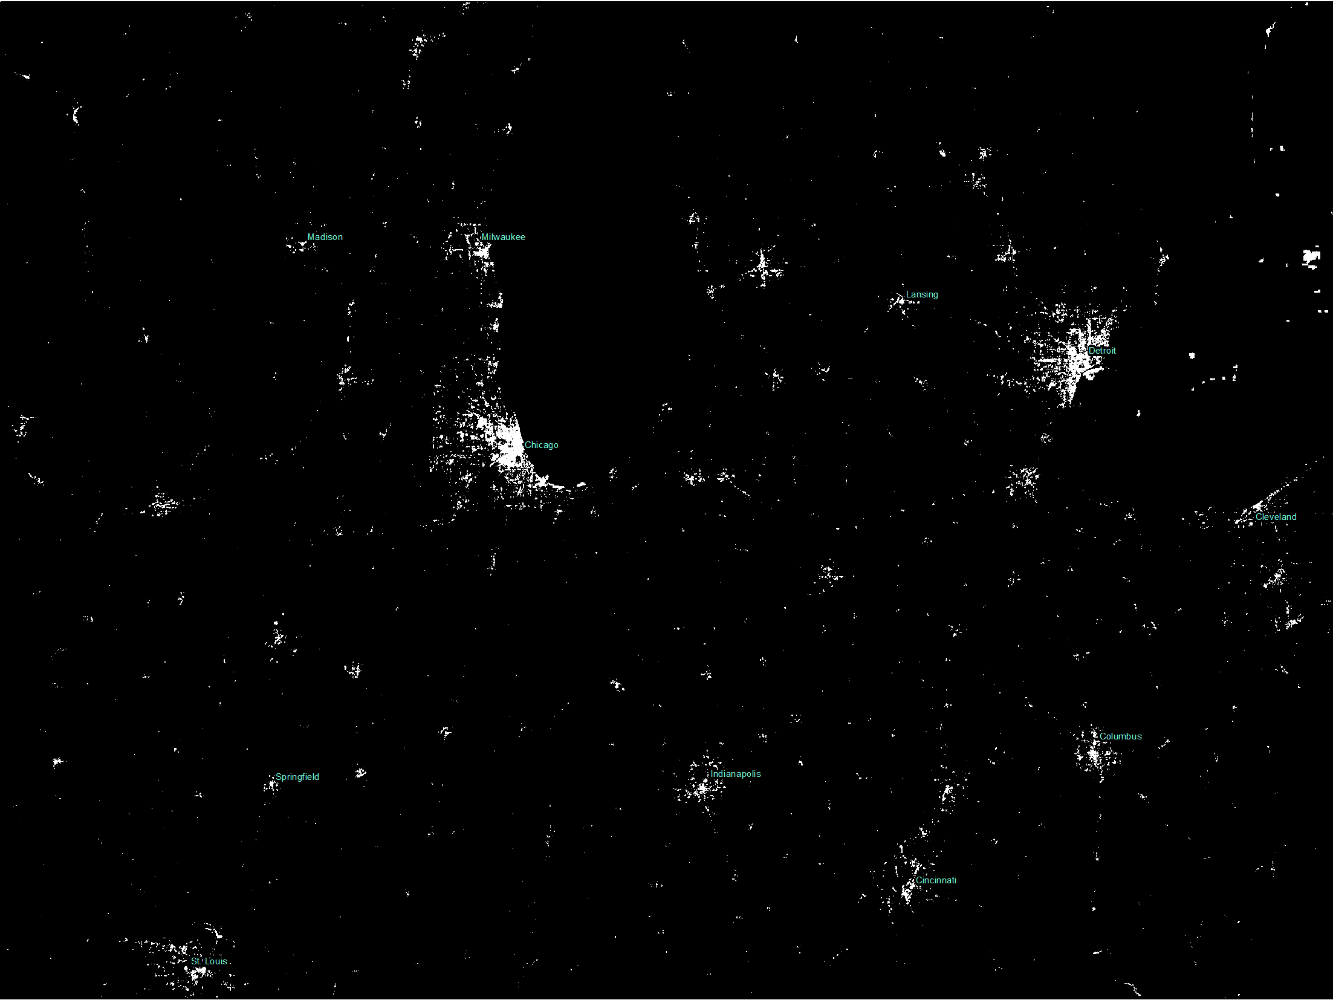
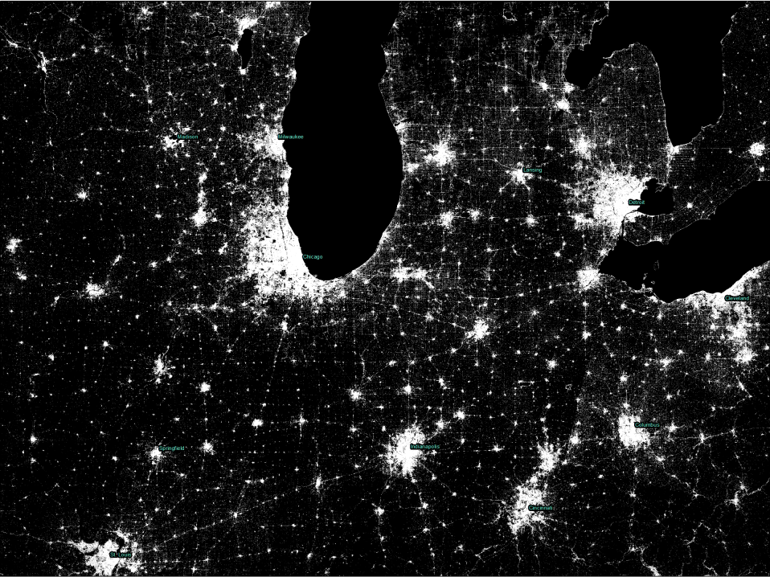
Sensor value-added: MERIS GLOBCOVER – Landsat GHSL

Slide 12
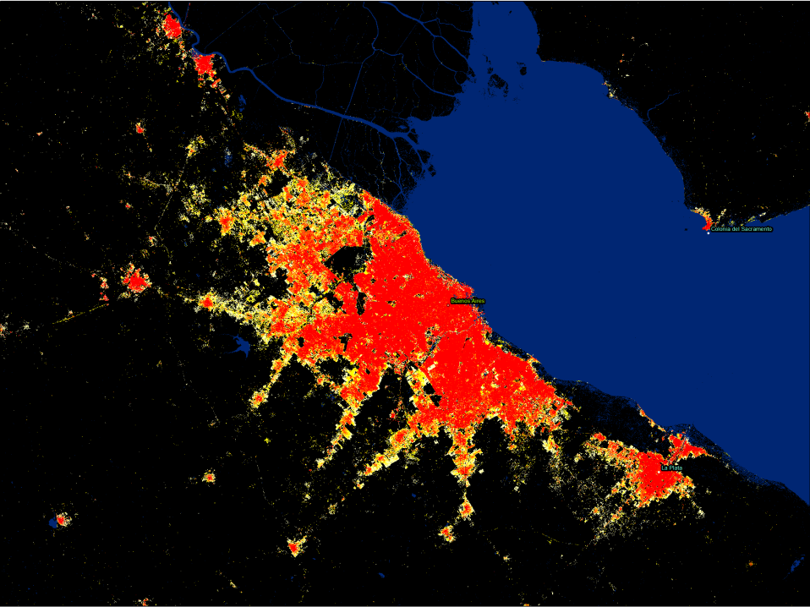

Slide 13
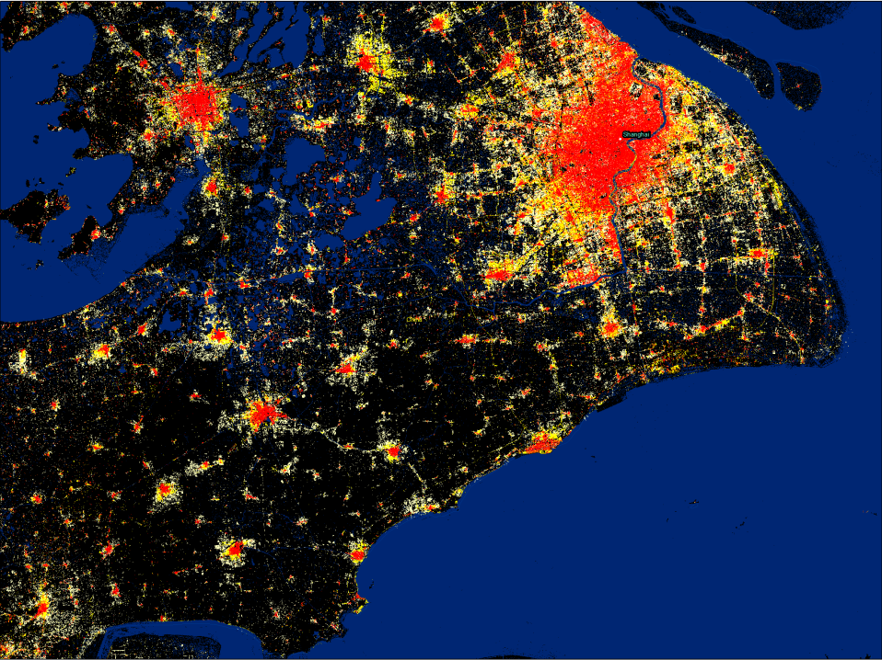

Slide 14

GEO Global Human Settlement Initiative
Launched in October 2014 at the JRC
To develop a new generation of measurements and information products assessing new scientific evidence on global human settlements
To support global policy processes with agreed, actionable and goal-driven metrics:
    Sendai Framework for DRR (March 2015)
    Sustainable Development Goals (September 2015)
    Habitat III UN Conference on Housing and Sustainable Urban Development (October 2016)
    UN Framework Convention on Climate Change December (2015)
Notes:
All these data are developed and discussed inside a new working group set inside GEO and chaired by JRC

Slide 15

Status of existing EVs in the domain
EV’s are currently being developed
EV’s should fulfil the following requirements:
  Global availability, but local detail
  Sustainable monitoring (feasible & affordable)
  Linked to specific framework goals/targets
  Accepted by the stakeholders

Slide 16
The process underlying EV definition
Development of multi-temporal, fine scale settlement maps at global scale
Combination with other global/regional/local socio-economic information to derive indicators at different scales
Develop indicators for monitoring of progress in specific targets

Slide 17
Built-up & population change in 40 years
Countries ranked by built-up change 1975-2014

Slide 18
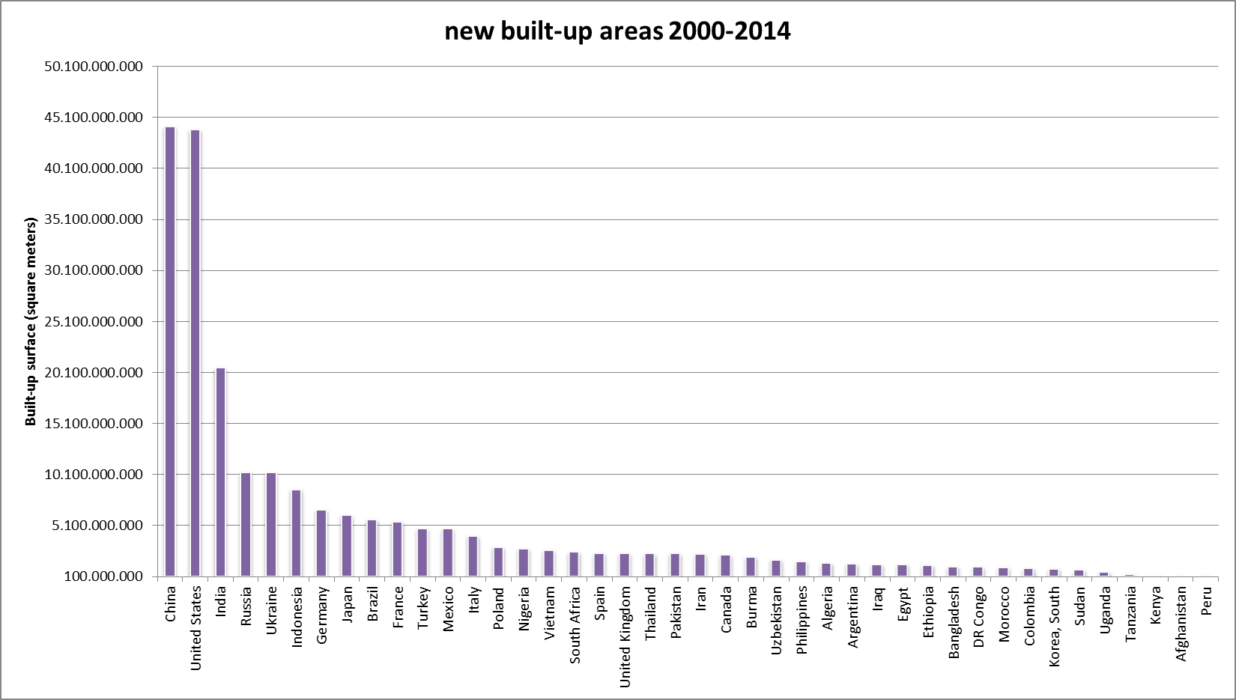
Built-Up Change 2000-2014

Slide 19
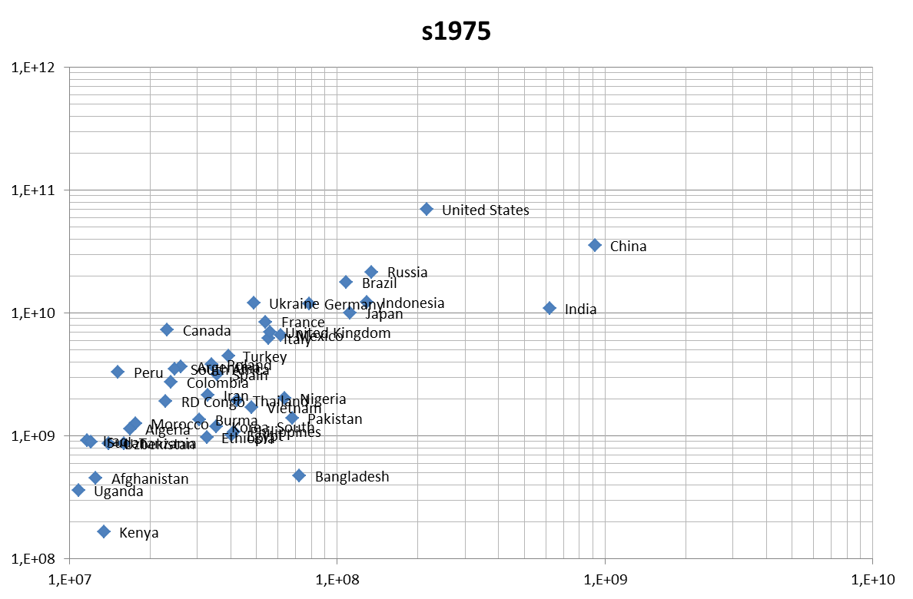
Built-Up & Population Change 1975-2000
Built-Up Area
Population

Slide 20
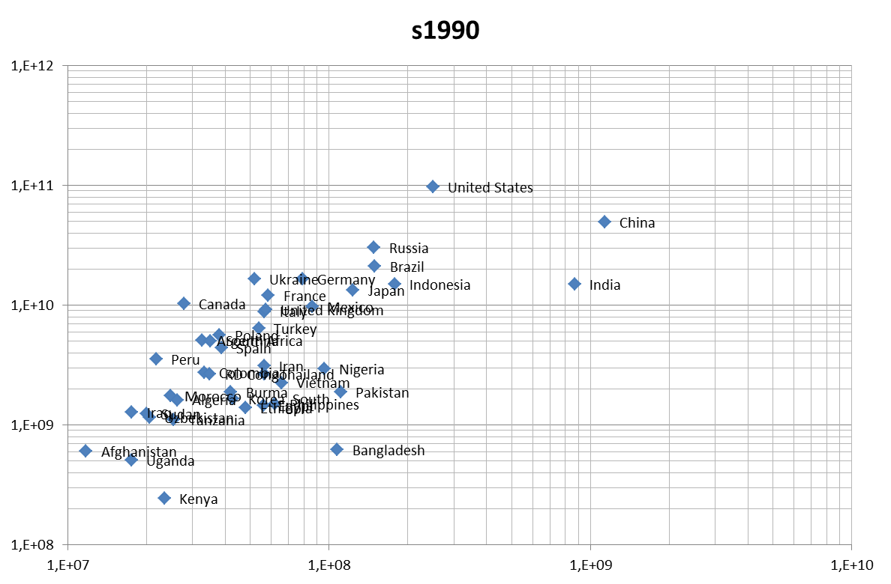
Built-Up & Population Change 1975-2000
Built-Up Area
Population

Slide 21
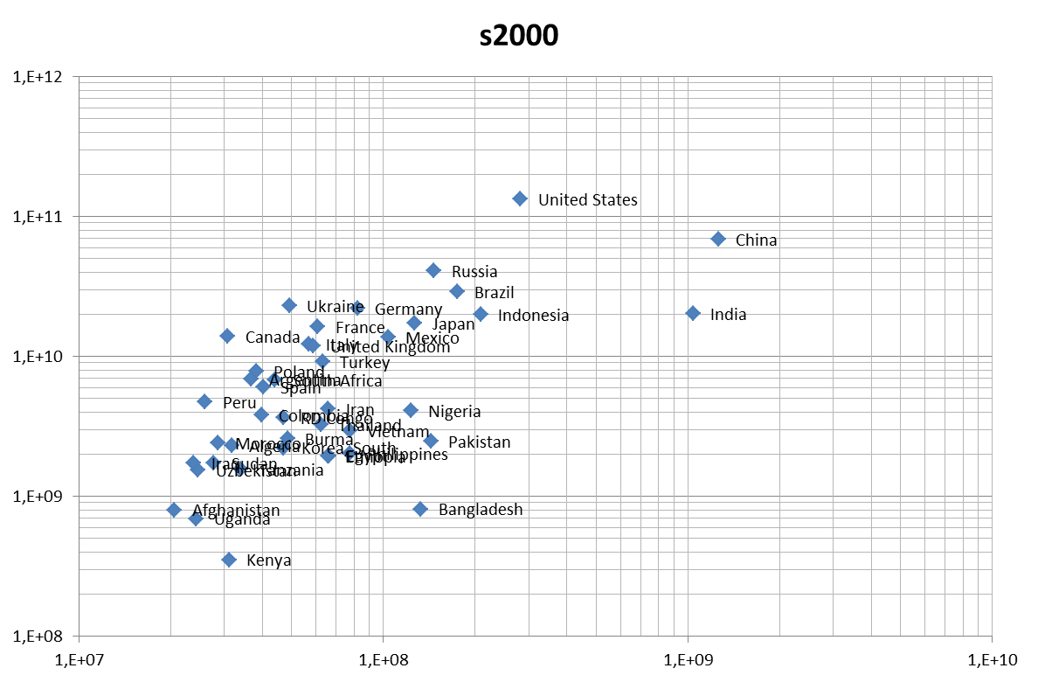
Built-Up & Population Change 1975-2000
Built-Up Area
Population

Slide 22
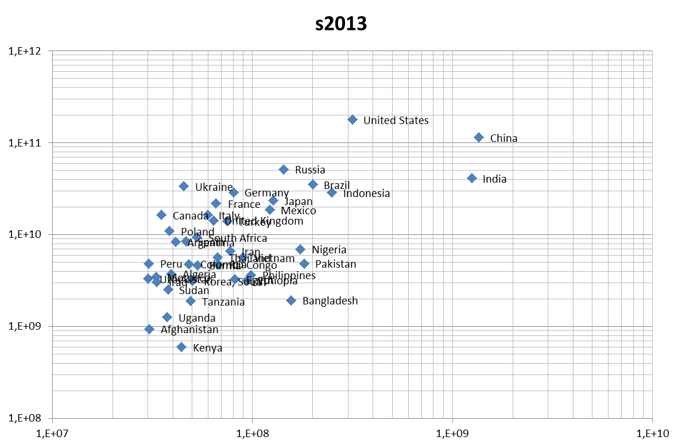
Built-Up & Population Change 1975-2000
Built-Up Area
Population

Slide 23
Built-Up & GDP per capita
Built-Up & GDP 2013/2014

Slide 24
Built-Up & GDP 2013/2014

Slide 25
Built-Up & GDP per capita
Built-Up & GDP 2013/2014

Slide 26
EVs validation and use
EVs are used to assess the impact of policies to achieve framework targets
Users
  European Commission: DG REGIO, DG DevCo
  UN-HABITAT
  Joint Development of EVs with the users
Active GEO community that is using the data in their work, for example:
  Worldpop project for population mapping
  UNICEF for DRR in Myanmar
Review through PEER publication in scientific literature

Slide 27
Monitoring networks currently operational
Today there is no adequate operational network for settlement information:
  Landscan population data (1km, annually updated)
  Regional landuse/landcover (e.g. CORINE for Europe)
  Singular data sets (e.g. Global Urban Footprint by German Aerospace (DLR))
EU COPERNICUS System may provide a platform for long-term monitoring
  Long-term satellite data acquisition (SENTINEL-1/2)
  Copernicus services for provision of EVs

Slide 28
Assessing EV observational needs and readiness
Observational needs:
  Temporal frequency: annual/biannual
  Spatial resolution: information derived from 30 m pixels or better
  Accuracy: not so relevant, if accuracy measures are provided
Challenges and how these are addressed
  Big Data: automatic information extraction
  Lack of reference data for validation: collaboration with GEO initiative for regional assessments

Slide 29
Gaps and requirements
  EO data availability is sufficient
  In-situ data availability is scattered, but open data policies and crowd sourcing (Open Street Maps) slowly improve the availability
  Data repositories for the long term preservation of EVs are available
  Infrastructure for EVs publication is available

Slide 30
Conclusions
Today it is possible to provide fine scale human settlement information at a global scale
Relevant information for other domains
Priority now is the acceptance of EVs by the user community as indicators of progress in the UN frameworks

Slide 31
Thank you
Dr. Thomas Kemper
thomas.kemper@jrc.ec.europa.eu
Links: http://ghslsys.jrc.ec.europa.eu

