Slide 1
Implementing and Monitoring the Sustainable Development Goals in the Caribbean: The Role of the Ocean in the Virgin Islands
Joseph Smith Abbott
Deputy Permanent Secretary, Ministry of Natural Resources and Labour
17 January 2018
Beachcombers Hotel, St. Vincent & The Grenadines

Slide 2
The unprecedented trio of Natural Hazards in the Virgin Islands in 2017
The unprecedented trio – extreme floods on August 7th, Hurricane Irma on September 6th and Hurricane Maria on September 19th – affected the lives and livelihoods of each and every resident of the British Virgin Islands.
These three events resulted in significant damages which exceeded the Gross Domestic Product (GDP) of the British Virgin Islands, which is estimated in excess of US$3bn .
Hurricane Irma, the most destructive of the three events, caused widespread damage to the housing stock, road infrastructure, ports, telecommunications, electrical infrastructure and critical facilities. Four lives were lost and 125 persons were injured in the devastation.
The hazard events of 2017 have severely arrested the progress and development path that the Virgin Islands had embarked upon over the last few decades.

Slide 3
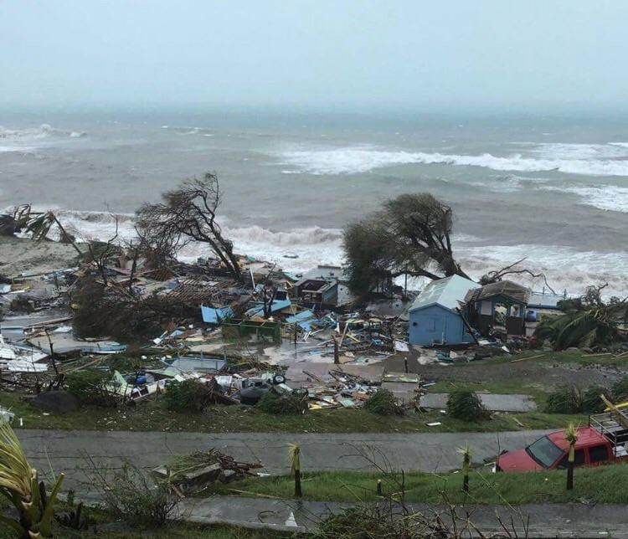
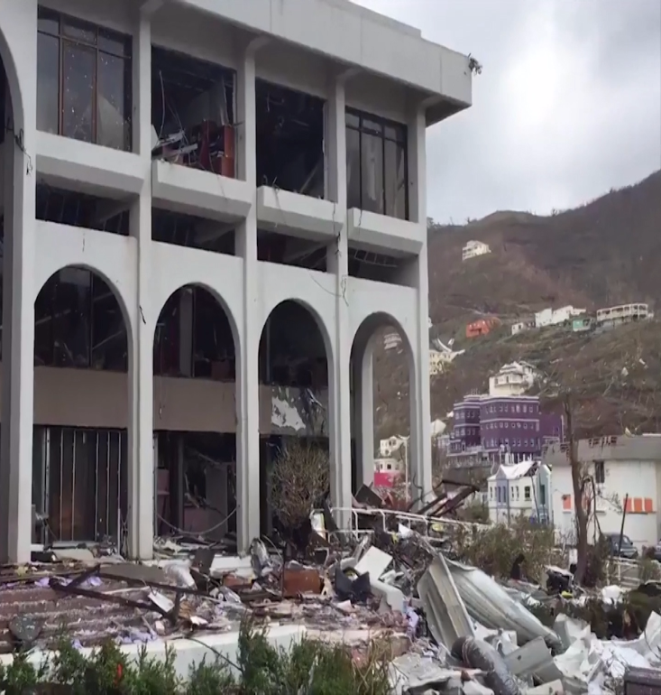
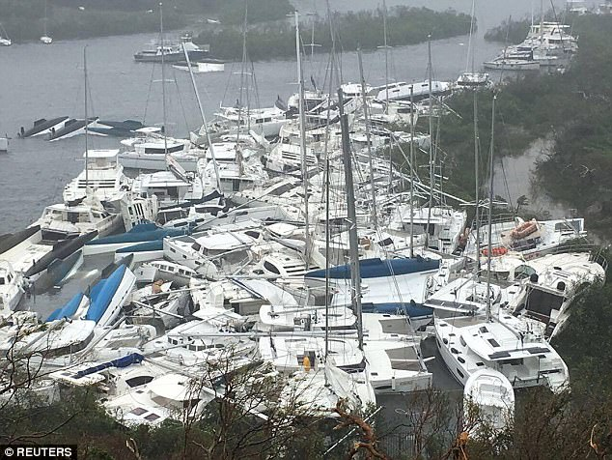
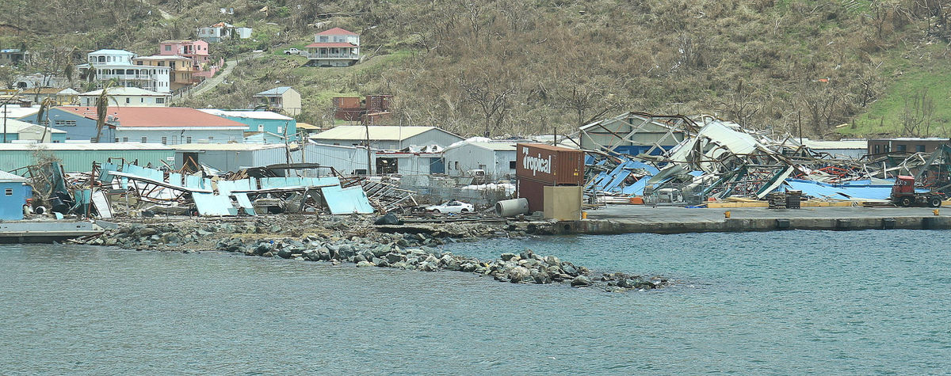

Slide 4
Statement by the Hon. Premier of the Virgin Islands in the Draft Recovery Plan
“The three extreme weather events have exposed the vulnerability that the BVI and other small islands face being on the frontline of climate change.”
“The trends in ocean warming, sea level rise and the diminishing economic value of the environment caused by these occurrences, all point to the undeniable truth that climate change is real.”

Slide 5
Context for the role of the ocean and ecosystems in the Sustainable Development of the VI
In addition to supporting the important tourism sector, the BVI’s ecosystems provide recreational opportunities for the local population, serve as hurricane shelters for vessels, protect coastal and inland infrastructure, prevent soil and beach erosion and provide research opportunities, among other benefits to the local economy.

Slide 6
Threats to Ecosystems
Notwithstanding the importance of nature for the subsistence and prosperity of the BVI, local ecosystems face numerous threats, such as natural hazards, climate change, invasive species, water and terrestrial pollution, land reclamation and conversion, sand mining and onshore developments.
As a result of natural and human induced threats beaches in the BVI have narrowed by an average of one meter, with extreme cases of up to three meters.
At the same time, extreme events in the region (e.g. high surface water temperatures in 2005) have resulted in the loss of over 40% of coral due to bleaching processes.

Slide 7
Overarching Goals for the Development of the Blue Economy
The Territory embarked on a path towards developing and augmenting various aspects of the Blue Economy beyond those which it has traditionally pursued.
The desire is to fully utilise the Economic Fisheries Zone and transform the same into an Economic Exclusive Zone (EEZ). The transformation requires the establishment of a framework that will demonstrate the Territory’s increasing ability to fully manage the marine domain throughout its maritime boundaries and sustainably use the marine resources.
A balance between economic activity and conservation will be sought throughout the process. To that effect, a National Ocean Policy, which clearly articulates the manner in which the Blue Economy will be planned and fostered over time, will be formulated which will aim to harness the tremendous opportunities within the (EEZ).

Slide 8
Ocean Governance Stakeholders

Slide 9
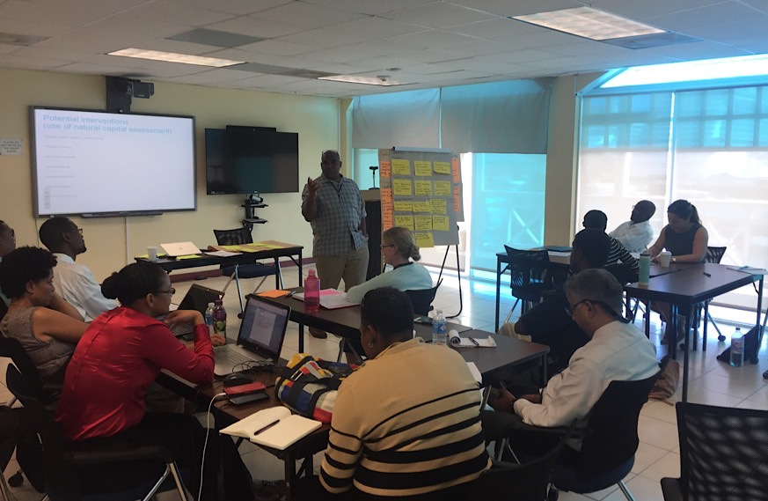
Workshop participants discussing potential applications of the proposed Natural Capital Assessment (February 2017)
Given the socioeconomic importance of the BVI’s ecosystems, the UK Joint Nature Conservation Committee (JNCC) in partnership with the BVI Government and supported by the UK Conflict, Stability and Security Fund (CSSF) scoped the performance of a Natural Capital Assessment in consultation with local stakeholders.
The proposed study aimed to provide insight into the socio-economic value of ecosystem services to be used as input for the refinement and implementation of existing and proposed policy instruments that support environmental management in the BVI.

Slide 10
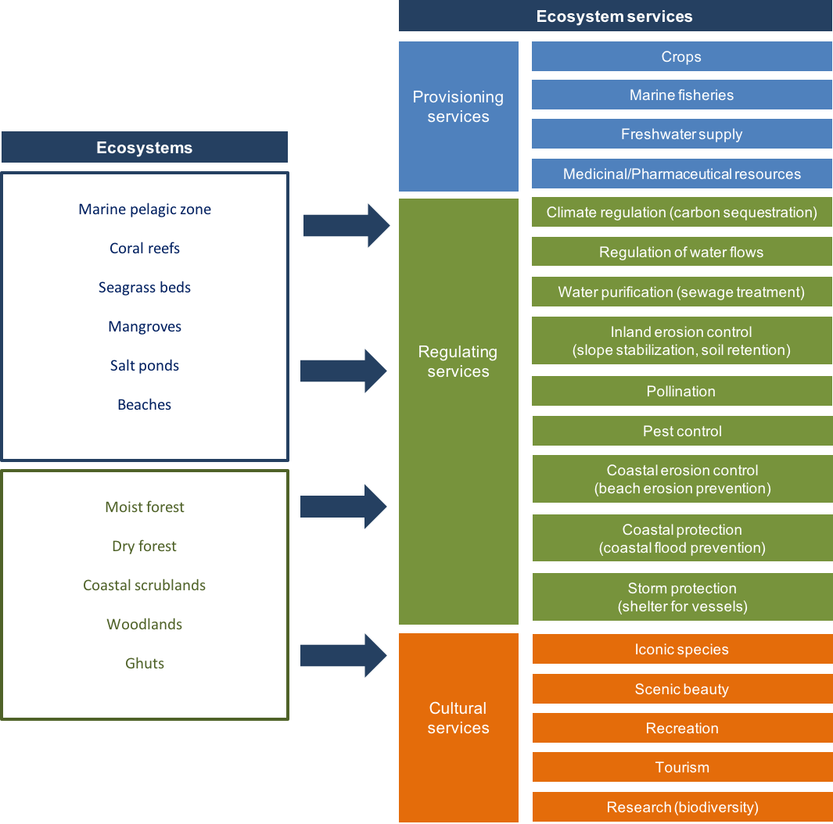
Relevant ecosystems and ecosystem services identified by stakeholders in the BVI

Slide 11
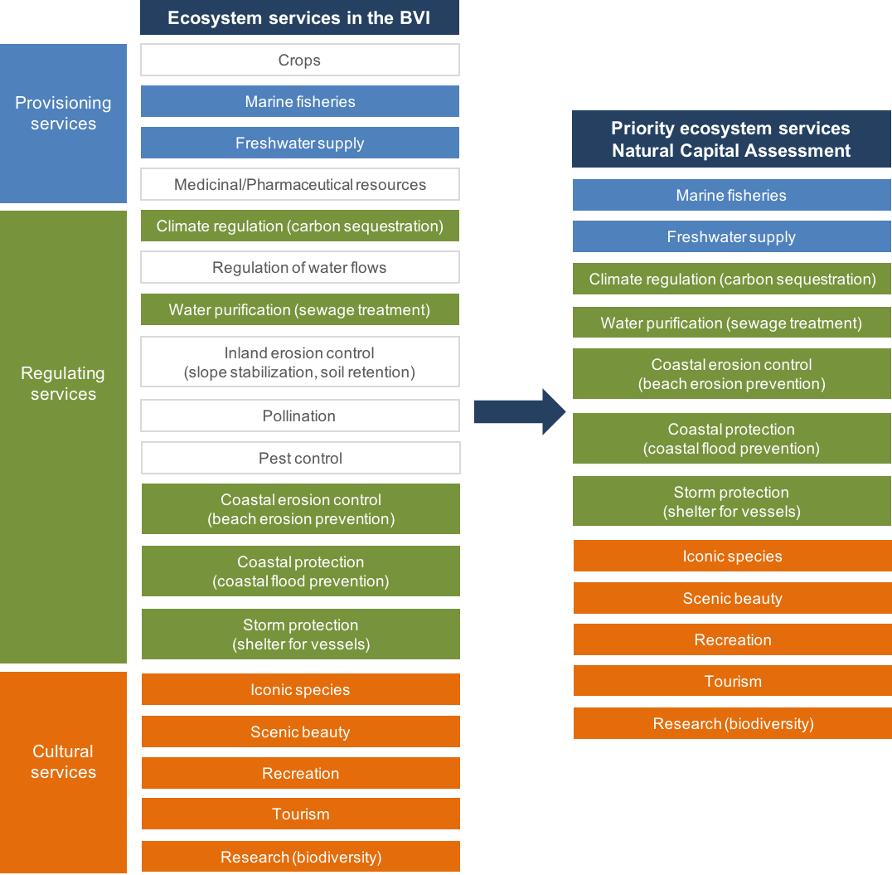
Priority ecosystem services for the Natural Capital Assessment in the BVI

Slide 12
Possible applications of the Natural Capital Assessment identified during stakeholder workshop
NCA Potential application | Examples provided by stakeholders | Frequency
Inform natural capital accounting | Developing environmental statistics and indicators to inform the BVI Government’s budget Estimating the value of fisheries and reefs | 6
Evaluate, justify, inform or advocate policies | Justifying and supporting increased environmental enforcement Advocating policies to ensure preservation and marine spatial planning Informing licensing and regulations for vessels, polluter and user fees, catch limits, and penalties | 5
Compare costs and benefits for decision support | Analyzing impacts of sewage disposal and runoff on environmental value Comparing development and conservation scenarios Developing sustainable development models | 3
Sustainable financing | Creating or adapting financing mechanisms for nature management (e.g. environmental tax, fees for mooring and penalties) Creating financial models to prioritize, increase or divert funding | 3
Damage assessment | Determining environmental costs of damage caused by ship groundings, oil spill, invasive species or other threats to the environment Determining penalties to environmental damage | 3
Awareness raising | Creating educational and sensitization material about the value of natural resources and the importance of environmental policy | 2
Spatial planning | Community planning Spatial planning of marine recreation and transportation uses | 2

Slide 13
Policies and instruments to be supported by the proposed Natural Capital Assessment
Fiscal planning instruments: Medium Term Fiscal Plan: presents the development and fiscal objectives of the BVI Government for a three-year period, assesses the fiscal macroeconomic performance of the Virgin Islands and provides the foundation for the Medium Term Budget. The achievement of the vision of the development strategy for the territory is outlined under Social, Economic, Environmental and Direction/Governance (SEED) goals. Budget: This document presents aggregate figures for revenue, expenditure and debt over a three-year period. For each Government’s Programme, the budget framework establishes key performance indicators. Output Indicators are defined to monitor “the quantity of output or services delivered by each programme”, and Outcome Indicators serve to assess “impacts of the programme and/or effectiveness in achieving programmes objectives”. Environmental Bill: Currently in the drafting phase, the new Environmental Bill will regulate institutional and functional aspects of the Ministry of Natural Resources and Labour. Natural Resources Inventories (NRIs): This environmental management instrument is envisioned as a collection of streams of data to regularly inform about the status and state of the BVI’s ecosystems. The information contained in the NRIs should serve as an input for the Environmental Sensitivity Index and the assessment of future developments. Environmental Sensitivity Index (ESI): The devising of an ESI based on ecological and socioeconomic indicators has been proposed to, for example, inform the evaluation of certificates of environmental clearance.

Slide 14
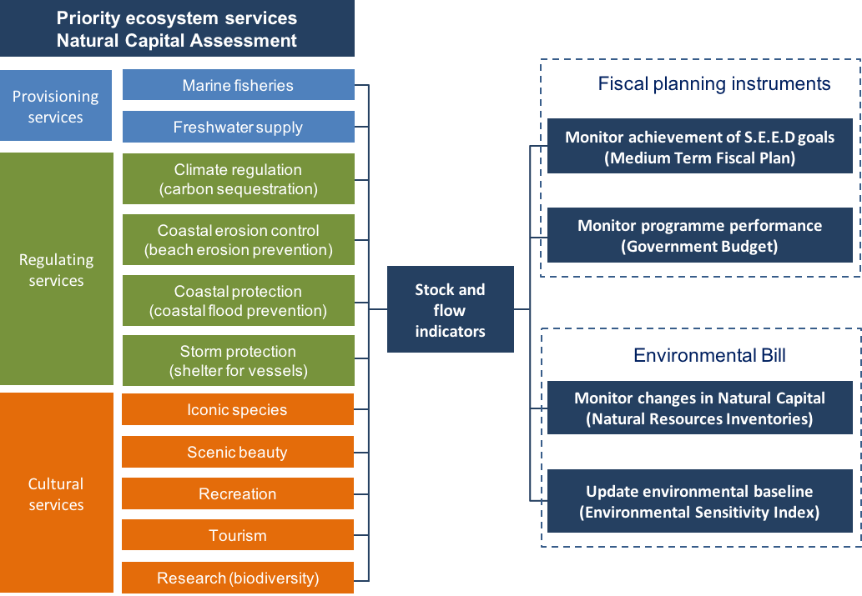
Priority Ecosystem Services Natural Capital Assessment

Slide 15
Relevant SDG 14 Goals and Targets to the BVI
14.1 By 2025, prevent and significantly reduce marine pollution of all kinds, in particular from land-based activities, including marine debris and nutrient pollution | 14.1.1 Index of coastal eutrophication and floating plastic debris density
14.2 By 2020, sustainably manage and protect marine and coastal ecosystems to avoid significant adverse impacts, including by strengthening their resilience, and take action for their restoration in order to achieve healthy and productive oceans | 14.2.1 Proportion of national exclusive economic zones managed using ecosystem-based approaches
14.3 Minimize and address the impacts of ocean acidification, including through enhanced scientific cooperation at all levels | 14.3.1 Average marine acidity (pH) measured at agreed suite of representative sampling stations
14.4 By 2020, effectively regulate harvesting and end overfishing, illegal, unreported and unregulated fishing and destructive fishing practices and implement science-based management plans, in order to restore fish stocks in the shortest time feasible, at least to levels that can produce maximum sustainable yield as determined by their biological characteristics | 14.4.1 Proportion of fish stocks within biologically sustainable levels
14.5 By 2020, conserve at least 10 per cent of coastal and marine areas, consistent with national and international law and based on the best available scientific information | 14.5.1 Coverage of protected areas in relation to marine areas
14.6 By 2020, prohibit certain forms of fisheries subsidies which contribute to overcapacity and overfishing, eliminate subsidies that contribute to illegal, unreported and unregulated fishing and refrain from introducing new such subsidies, recognizing that appropriate and effective special and differential treatment for developing and least developed countries should be an integral part of the World Trade Organization fisheries subsidies negotiation[c] | 14.6.1 Progress by countries in the degree of implementation of international instruments aiming to combat illegal, unreported and unregulated fishing
14.7 By 2030, increase the economic benefits to small island developing States and least developed countries from the sustainable use of marine resources, including through sustainable management of fisheries, aquaculture and tourism | 14.7.1 Sustainable fisheries as a percentage of GDP in small island developing States, least developed countries and all countries
14.a Increase scientific knowledge, develop research capacity and transfer marine technology, taking into account the Intergovernmental Oceanographic Commission Criteria and Guidelines on the Transfer of Marine Technology, in order to improve ocean health and to enhance the contribution of marine biodiversity to the development of developing countries, in particular small island developing States and least developed countries | 14.a.1 Proportion of total research budget allocated to research in the field of marine technology
14.b Provide access for small-scale artisanal fishers to marine resources and markets | 14.b.1 Progress by countries in the degree of application of a legal/regulatory/policy/institutional framework which recognizes and protects access rights for small-scale fisheries

Slide 16
Applied Research in Support of SDG14
NPTVI partnered with the UK based organisation Centre for Environment, Fisheries and Aquaculture Science (CEFAS) and the UK Hydrographic Office (UKHO) from 2014 – 2016 on a UK Darwin Initiative PLUS funded project entitled, “British Virgin Islands MPA and hydrographic survey capacity building”.
Project Accomplishments:
New Data Collection
36 km² of new hydrographic data were collected in July-August 2014 between Road Harbour, Beef Island and the Rhone Marine Park. The survey used the latest state-of-the-art seabed mapping technology, providing very high resolution 3D visualization of the underwater world around the British Virgin Islands for the very first time.
Over 5,000 high resolution photographs were collected at locations across the survey area. The photographs captured rich as well as damaged coral ecosystems, coral rubble, extensive seagrass beds, fish, rays and sharks. These data have been used to describe the biological communities and assess biodiversity health in previously unexplored parts of the BVI.
Increased Seagrass Coverage Mapped
The video and hydrographic data showed good correlation between both datasets, allowing seagrass beds to be mapped in detail. Within the area surveyed, the known extent of seagrass beds increased by nearly 800%.
New Habitat Map
Biological community analysis has allowed dominant habitat classes to be delineated throughout the survey area. Eleven distinct classes were found to occur between the shallow coastal waters and the deeper waters of Sir Francis Drake Channel.
Capacity Building
Stakeholders from the British Virgin Islands were involved during all stages of data acquisition. Staff from the National Parks Trust also participated in a researcher exchange programme, spending two weeks onboard an ocean going research vessel gaining experience of a wide range of survey tools and techniques.

Slide 17
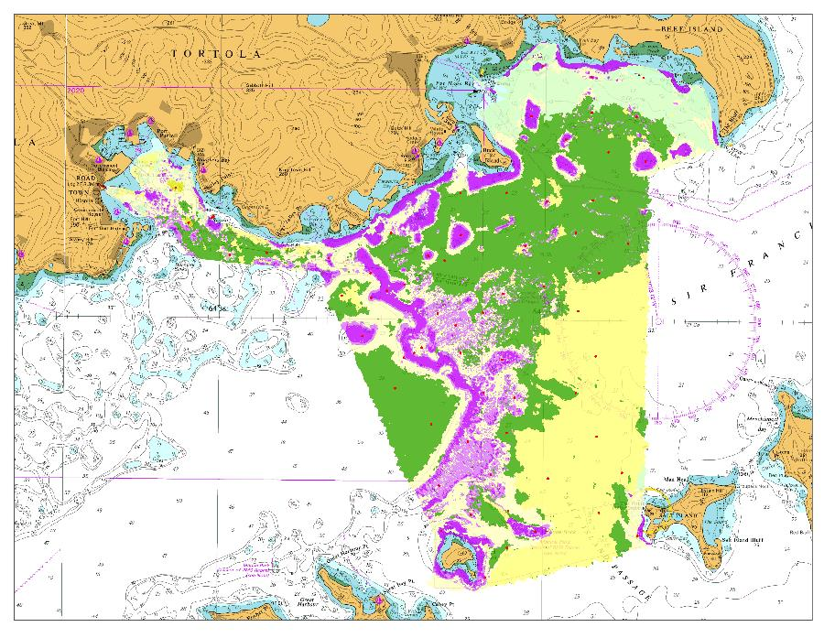
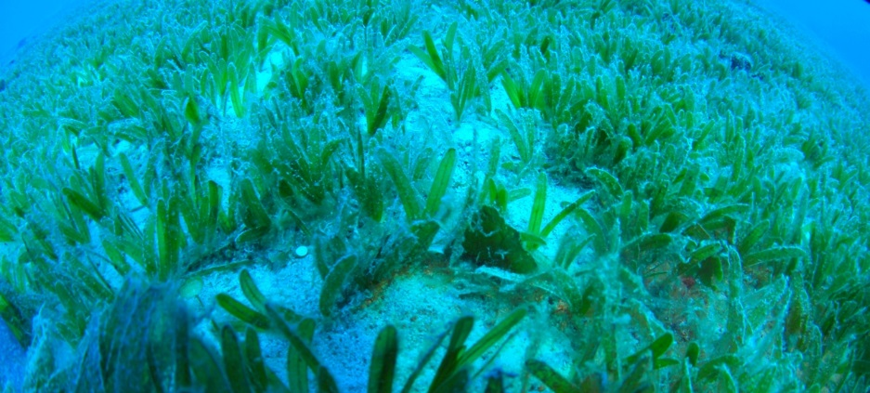
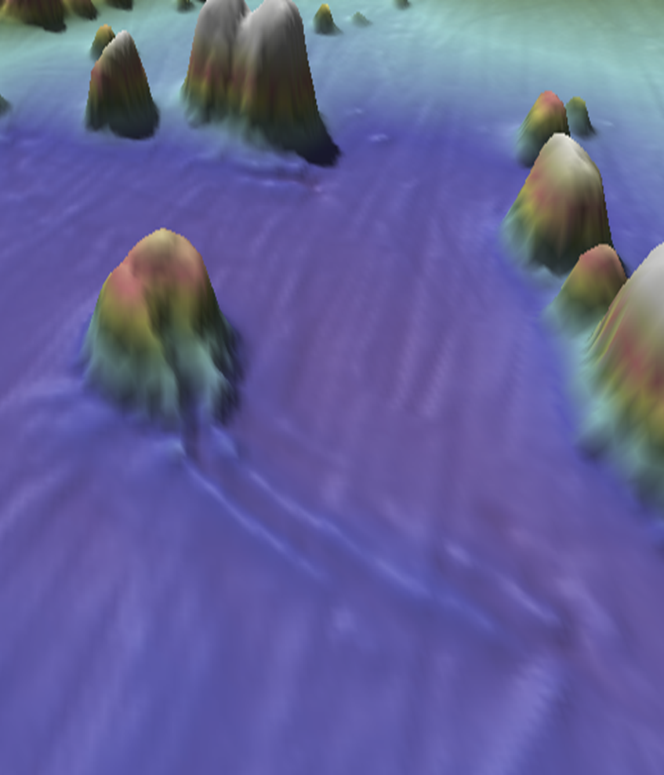

Slide 18
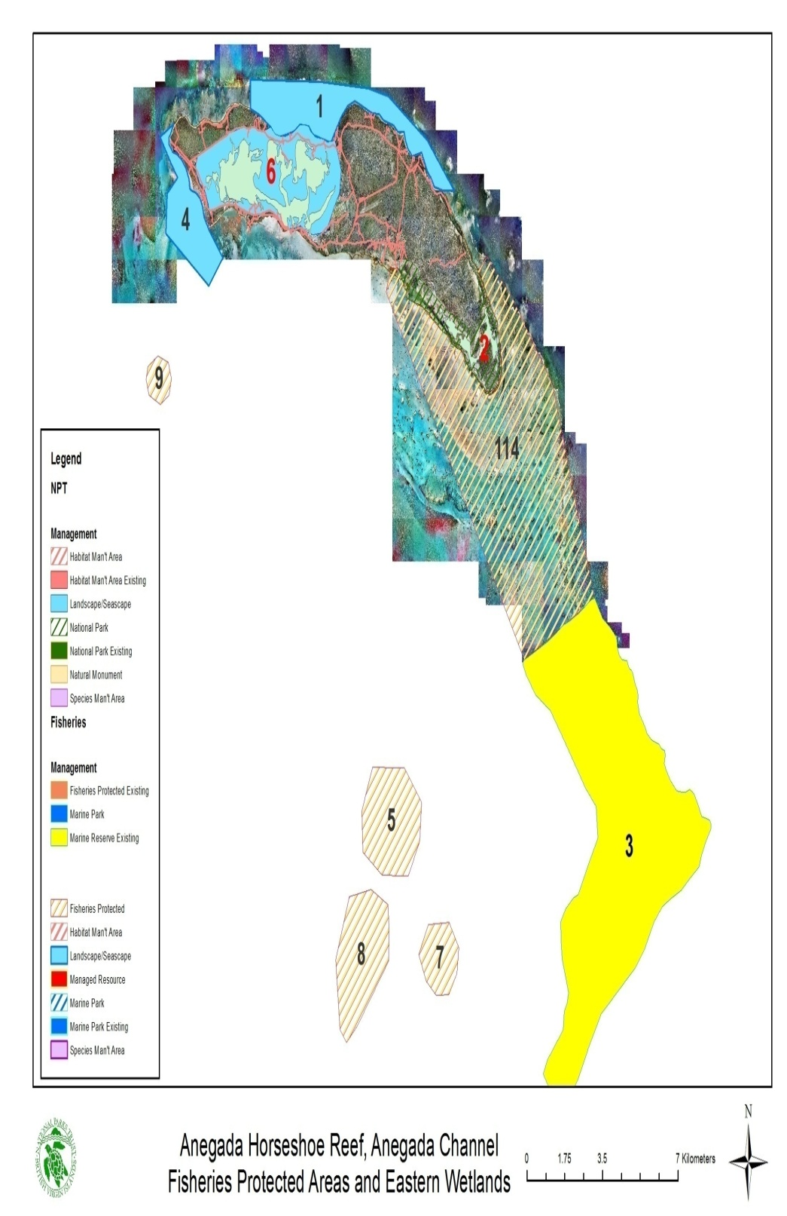
Protected Area Designations
New Protected Area Designation of several key sites with rich marine biodiversity were approved in 2017

Slide 19
Applied Research in Support of SDG14
NPTVI partnered with the Jost Van Dykes Preservation Society, the Anguilla National Trust and the Royal Society for the Protection of Birds on a UK DPLUS funded project from 2013 – 2015 entitled, “Using Seabirds to Inform Marine Planning”.
Based on a pilot seabird monitoring and tracking project undertaken in Anguilla in 2013, and the reporting of significant numbers of dead Magnificent Frigatebirds found entangled in fishing line in the BVI colony in 2012, this project aimed to identify important foraging areas of globally and regionally important seabird populations breeding in Anguilla and BVI using GPS tracking technology.
Data Collected on Threatened Seabirds
Over 200 seabirds were tracked within Anguilla and BVI, comprehensive seabird surveys were undertaken, local staff were trained in survey techniques and long- term monitoring programmes have been established. GIS shapefiles were created and shared with project partners.

Slide 20
Sustainable Tourism Initiatives: Sustainable Tourism
The Government of the Virgin Islands partnered with Virgin Unite, the Caribbean Council, the Foreign and Commonwealth Office and the OECS in March 2016 to hold a two-day regional meeting conference on Sargassum: assessing the problem, finding solutions and harnessing the economic benefits.
It convened political, business, senior technical and scientific leaders to assess the current state of understanding of the Sargassum weed and discuss an effective partnership between all sectors to harness related opportunities and benefits.
Research and commercial pathways were explored and the meeting catalyzed further action to mitigate the impacts and derive benefits, both ecologically and economically of Sargassum. Participation from a representative the African states impacted provided a trans-Atlantic perspective to the phenomenon and the opportunities for cross-collaboration.

Slide 21
Recovery Plan’s Goals and Objectives for Natural Resource Management
Our vision for recovery is a stronger, smarter, greener and better BVI that is more resilient and sustainable. That means a BVI that is economically vibrant, socially cohesive, environmentally sustainable, structurally resilient and adhering to the principles of good governance and the rule of law.
Strategic Outcome: Sustainable natural resources managed by the principles of climate change adaptation and mitigation that meets the social and economic needs of the Territory
Natural Resources and Climate Change: The Plan recognizes the critical importance of the environment and its vulnerability and focuses on restoration, protection, management and monitoring of the environment. It also focuses on the economic value of the environment and the sustainability of its use. Priorities include:
Food security with a focus on accelerating the development of fisheries and agriculture into significant contributors to the Territory’s GDP;
Strengthening the environmental management framework and network;
Restoring terrestrial forests and landscapes given the devastation to endemic species.

Slide 22
THANK YOU
jsmith-abbott@gov.vg

