Slide 1
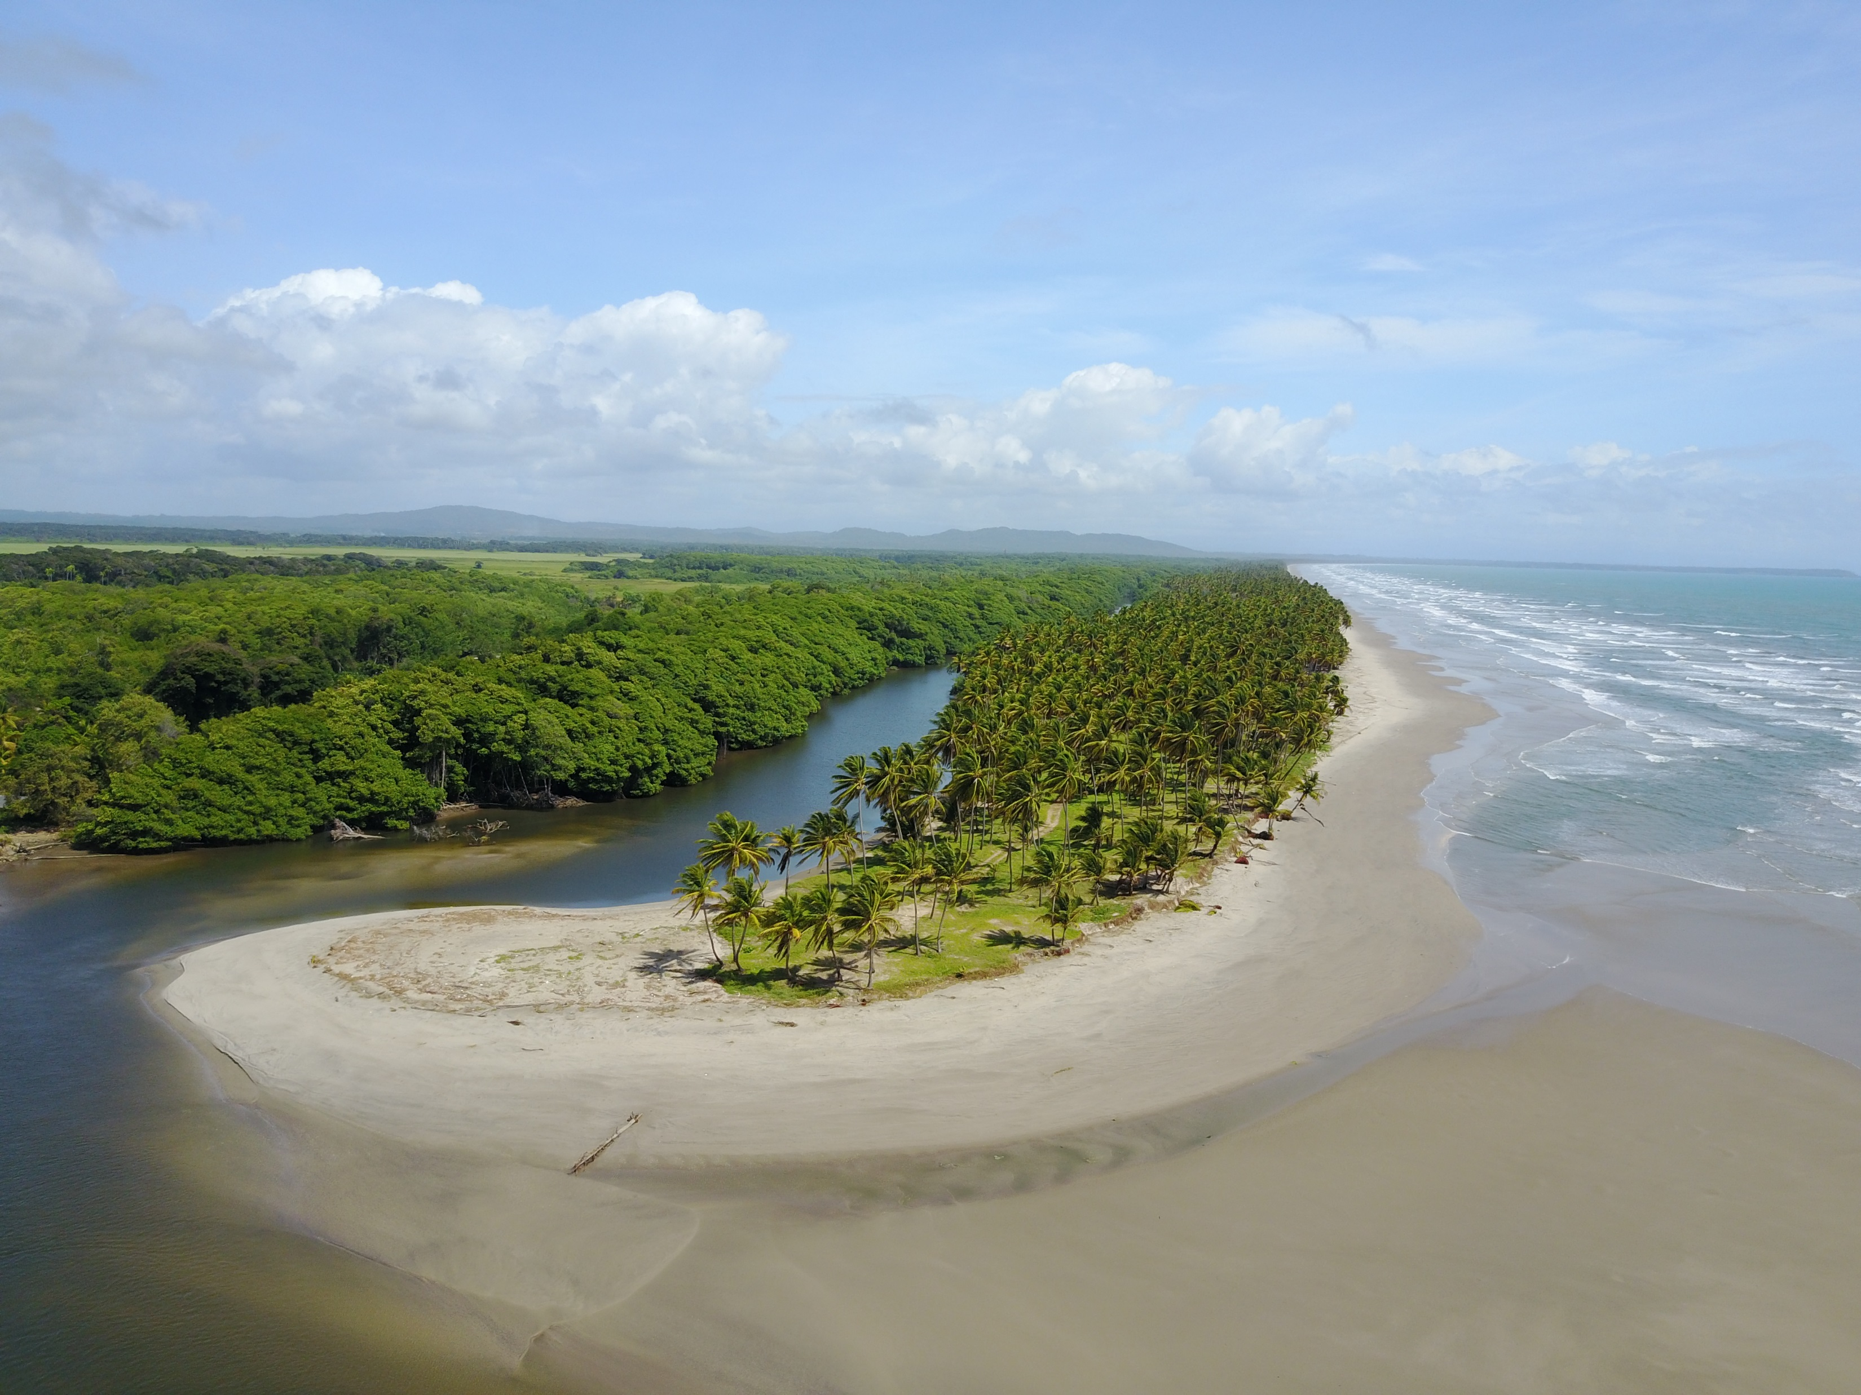
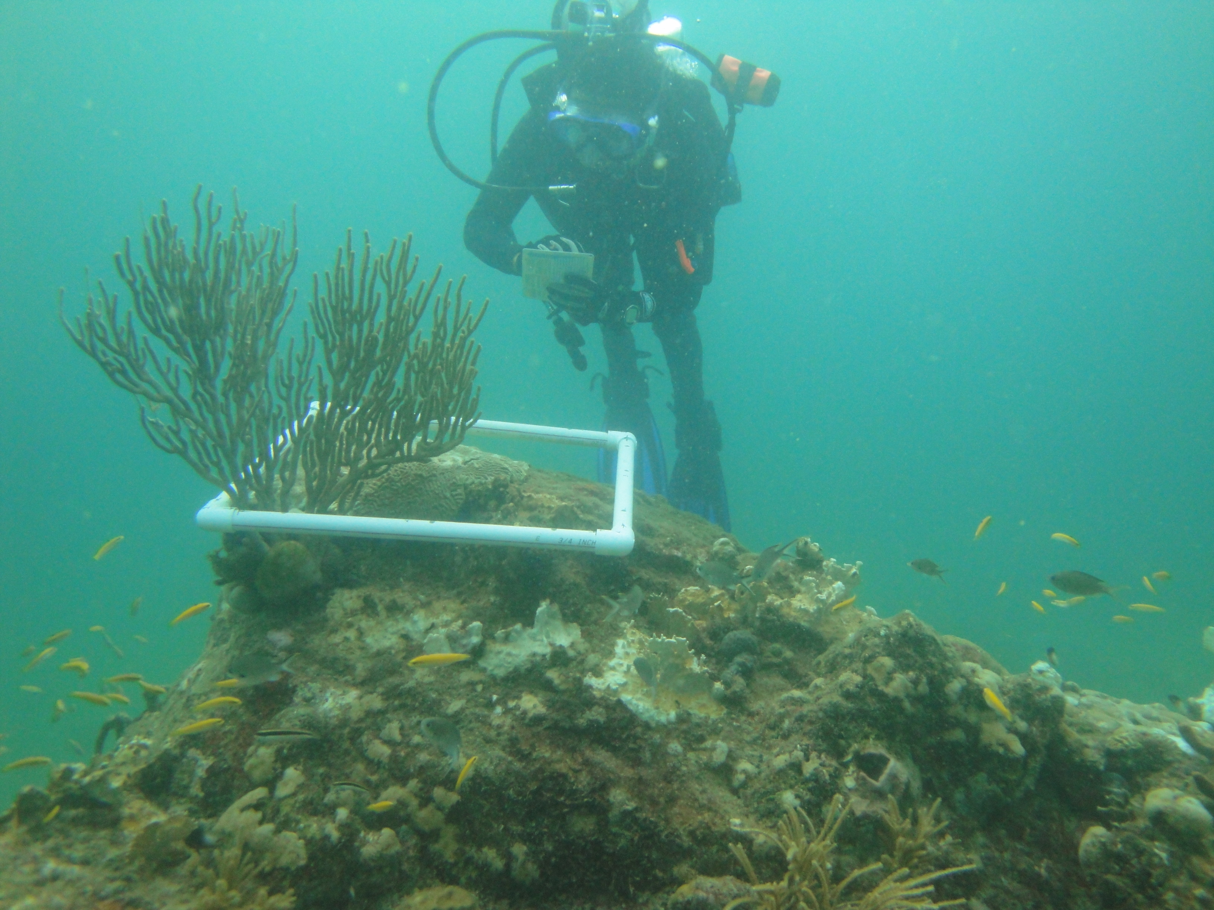
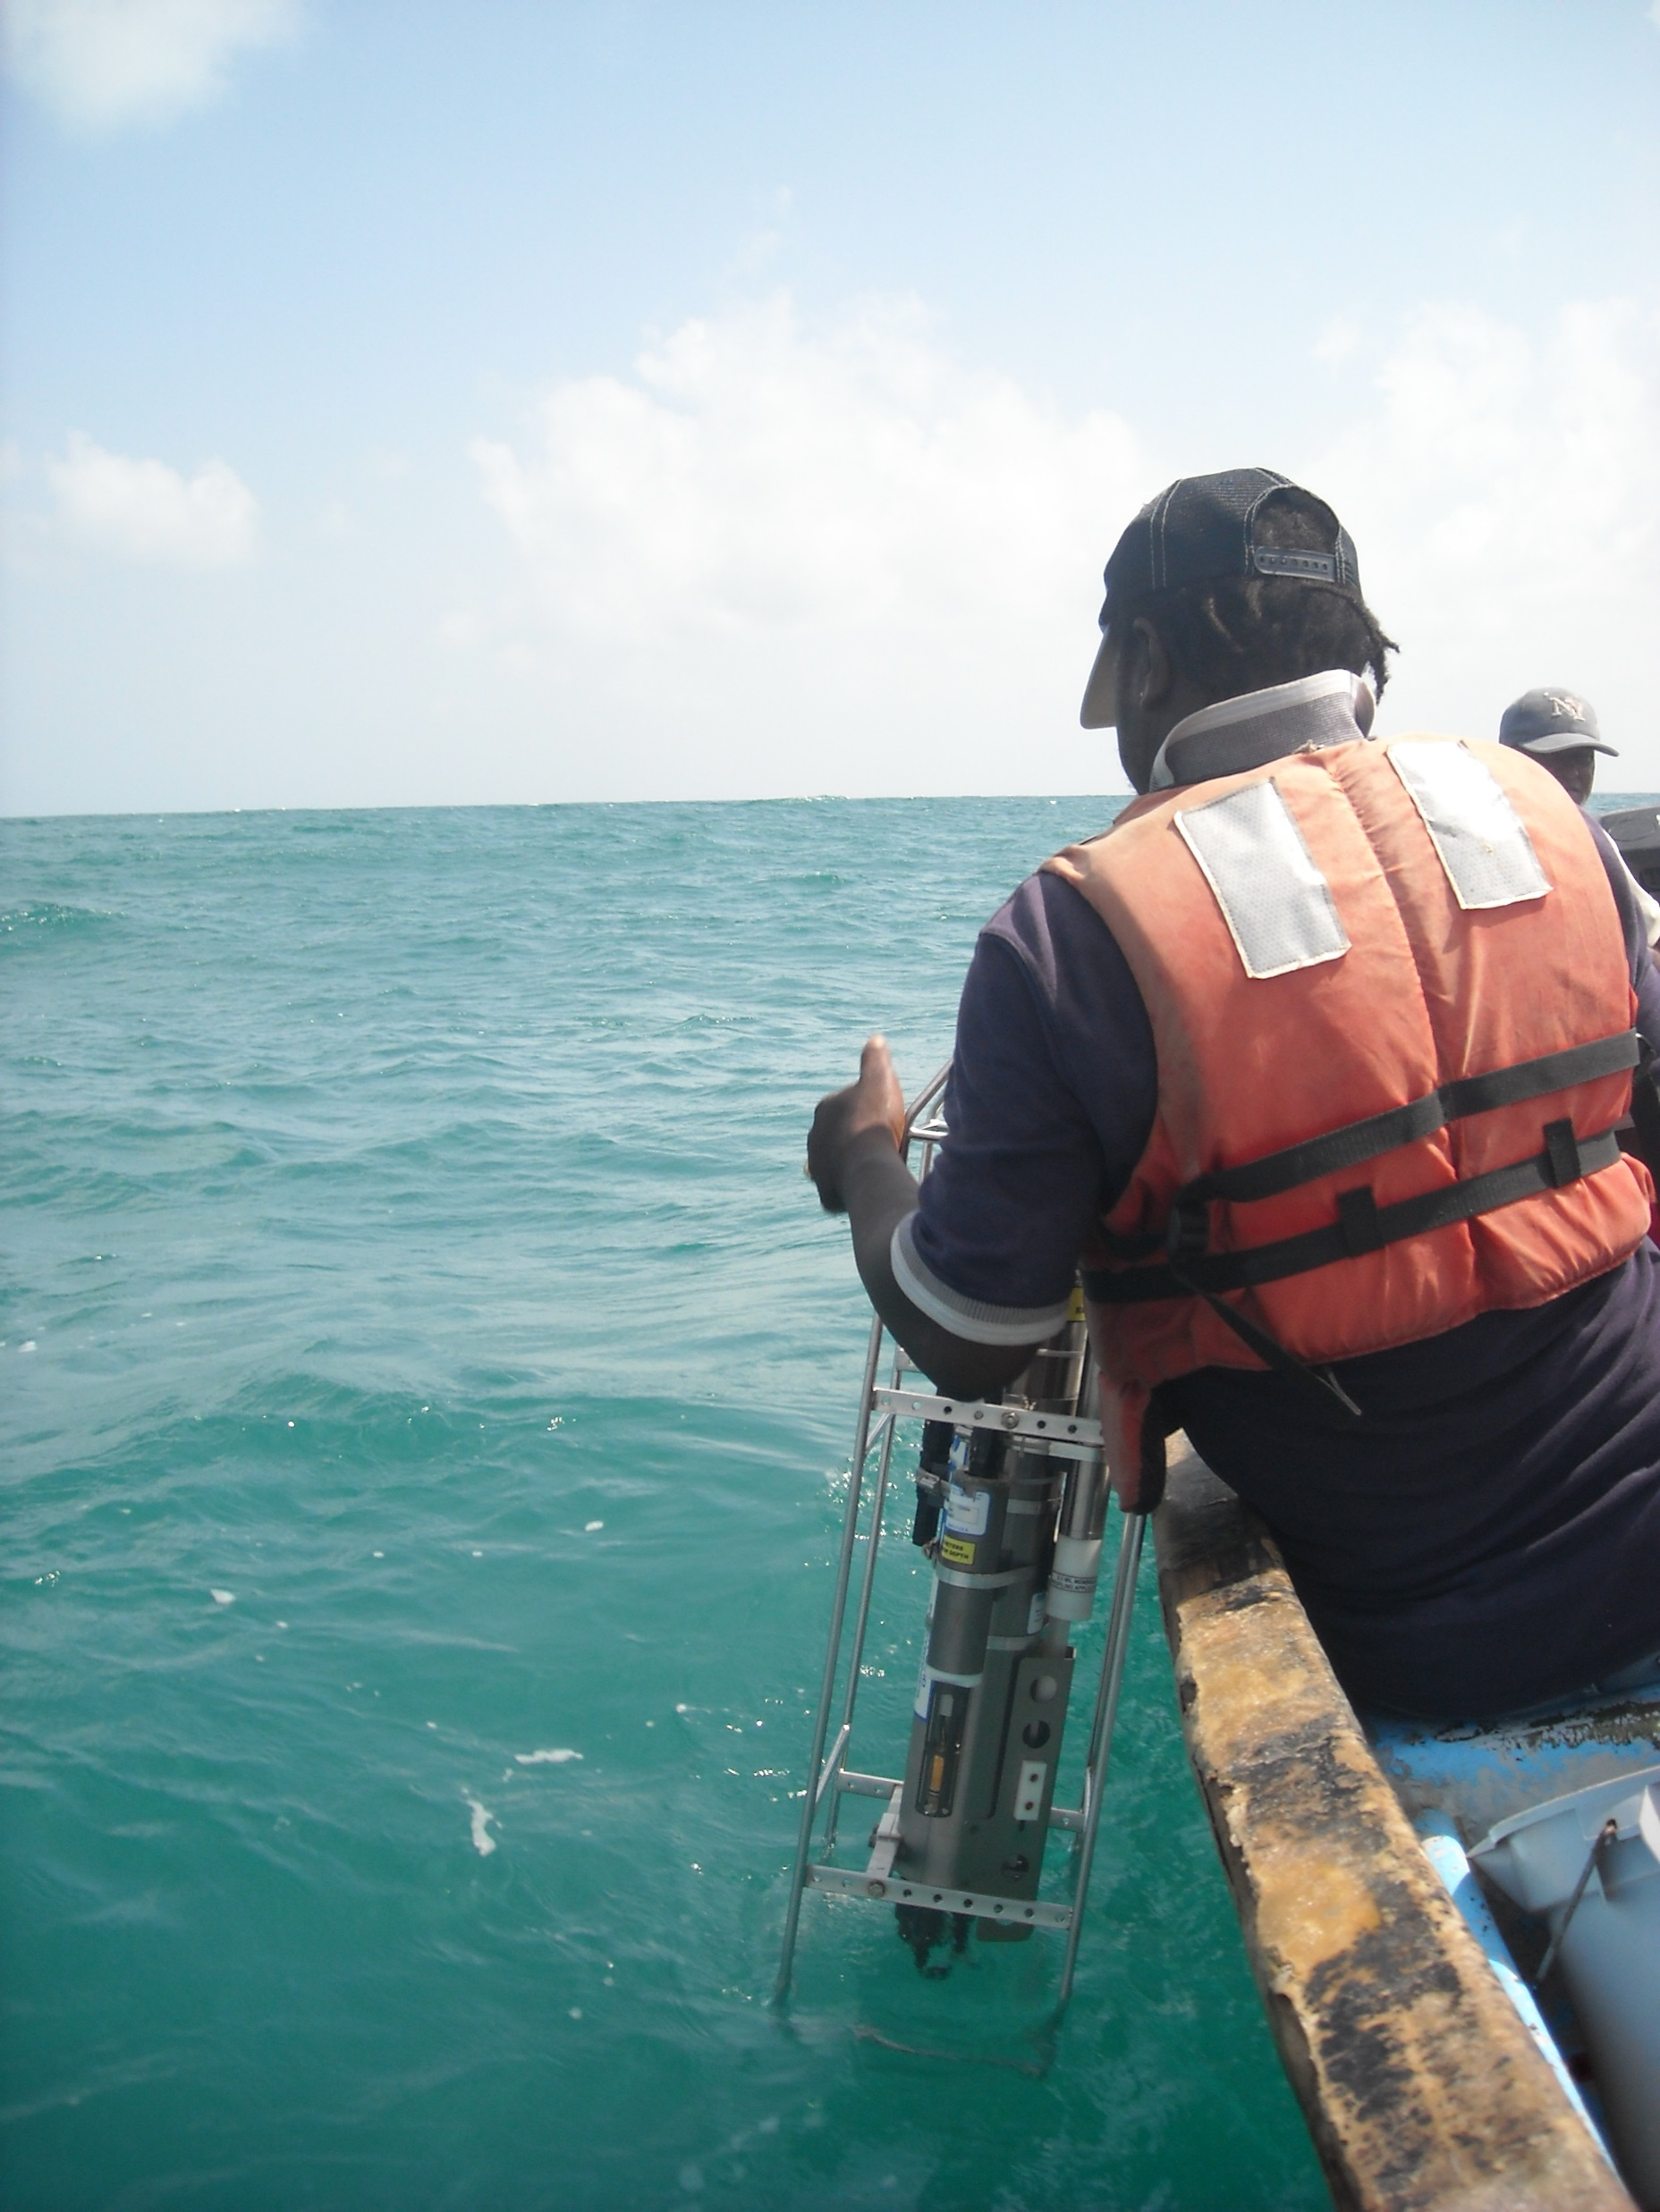
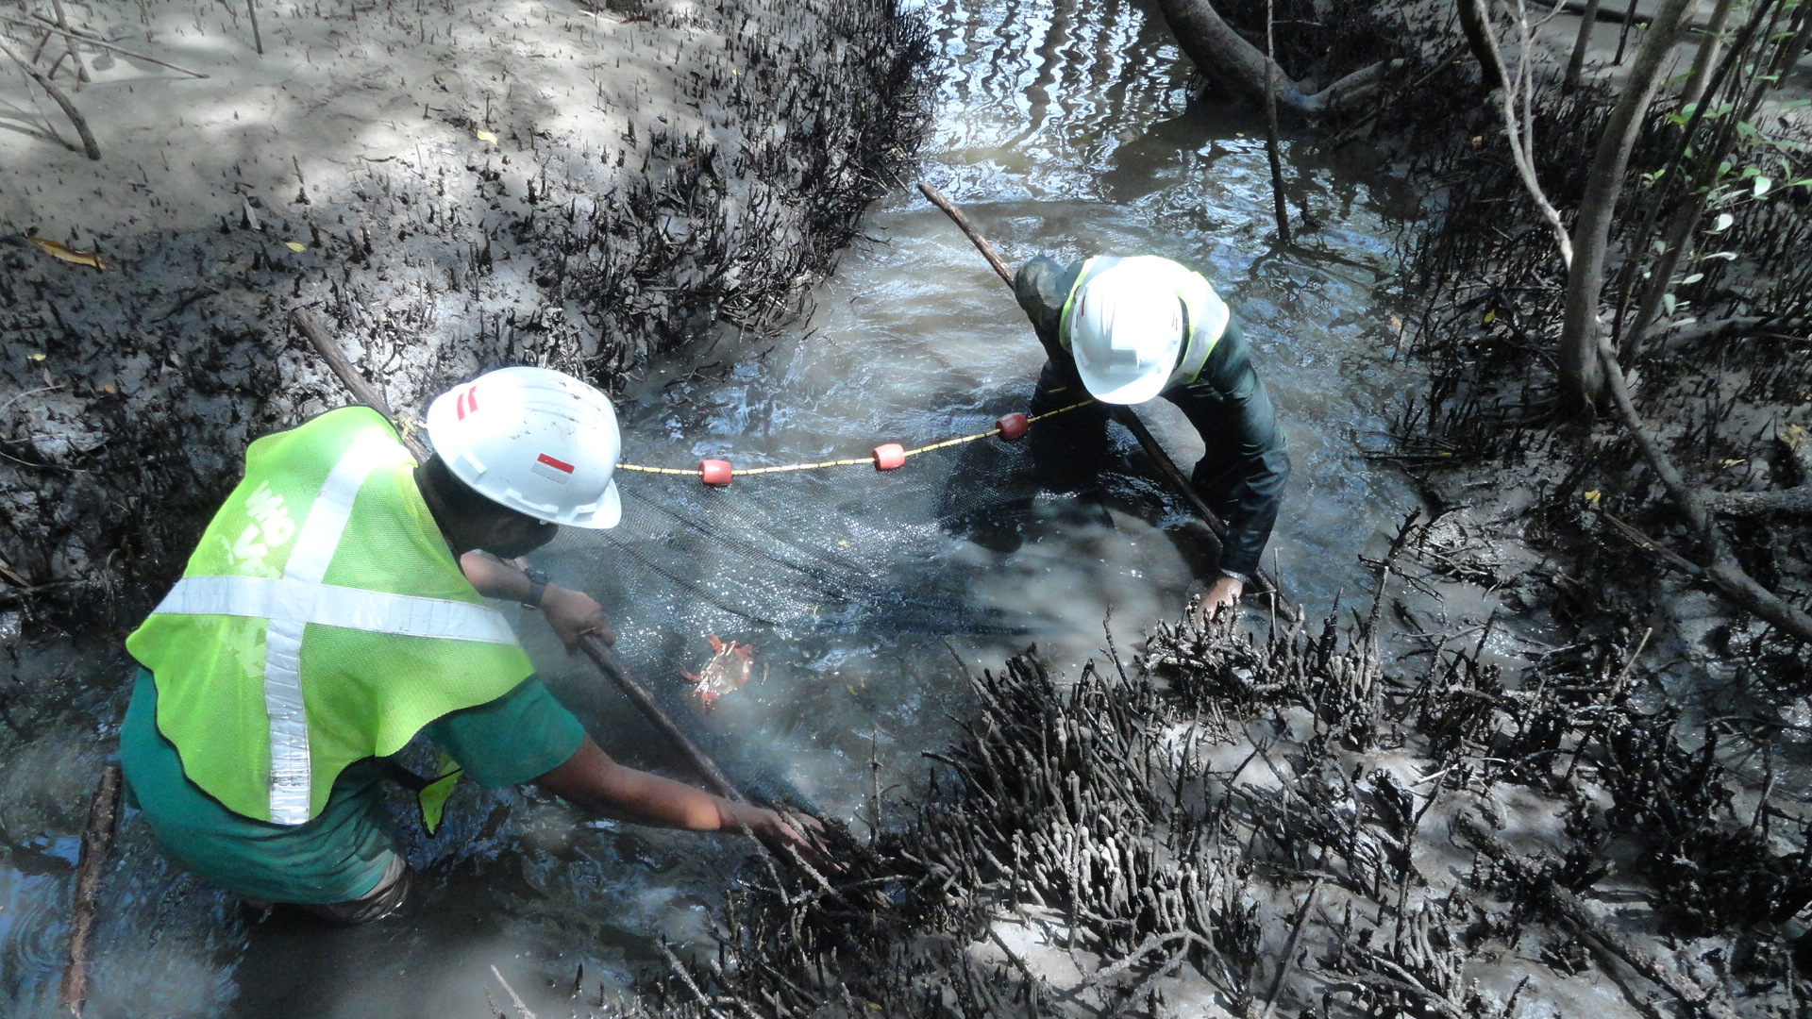
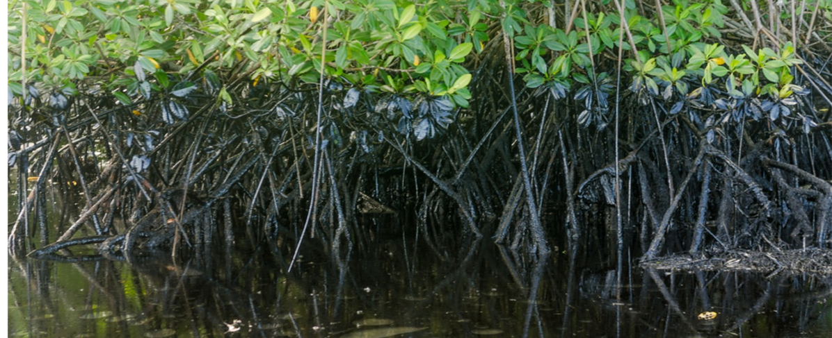
Observational requirements for variables related to industry activities
Nazeer Gopaul
Coastal Dynamics Limited
Trinidad and Tobago
Notes:
CDL – mainly conducting impact assessments – primarily oil and gas and shoreline assessment and management
In order to address these variables I will consider the data streams involved in assessments and monitoring

Slide 2
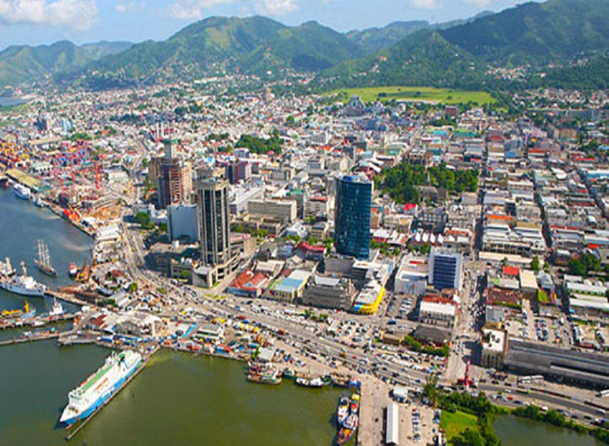
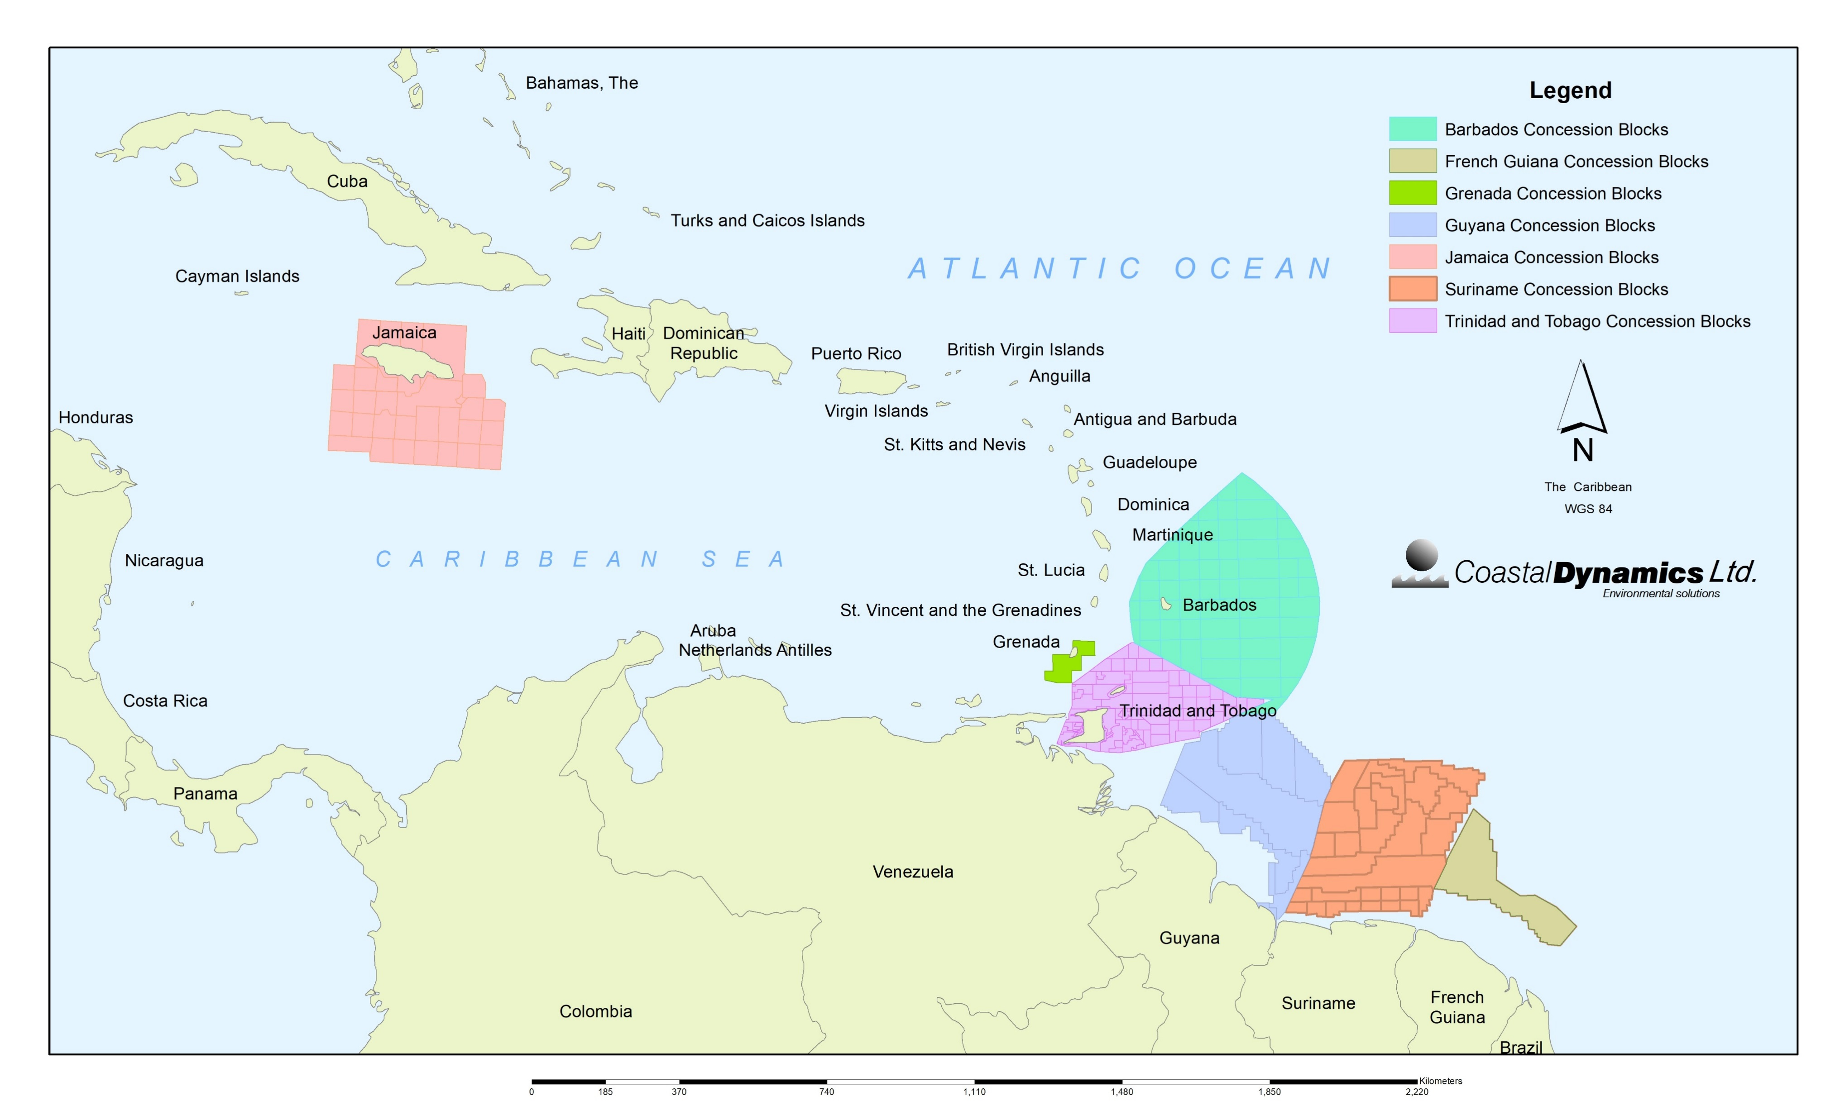
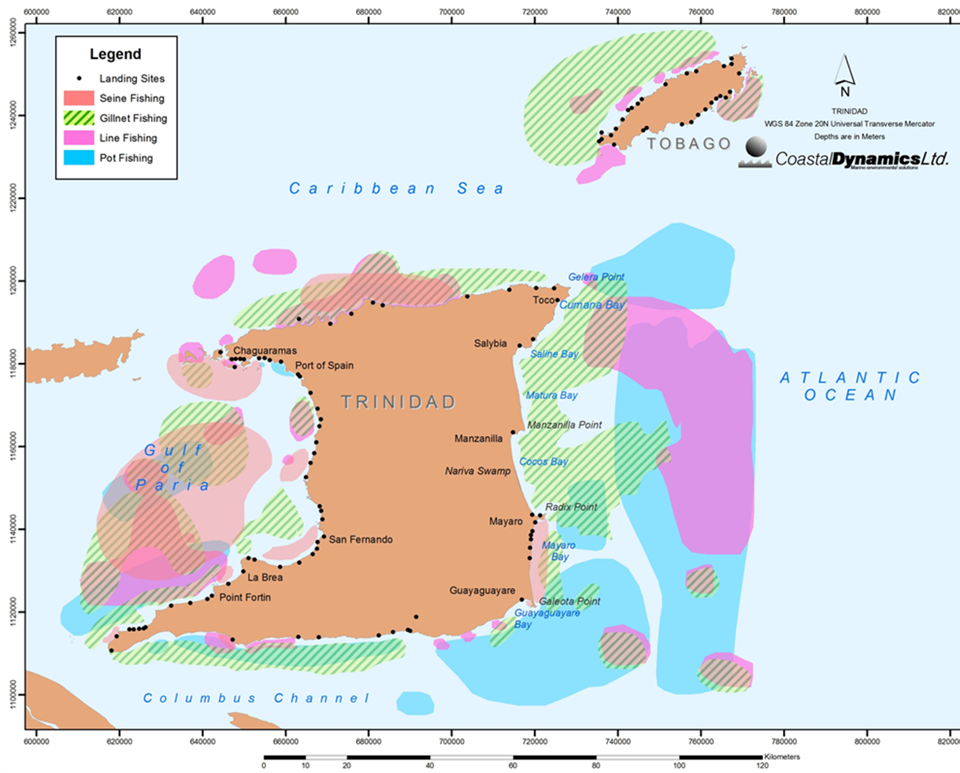
Industrial Activity
Oil and gas exploration
Port development and operations
Marine transportation and transshipment
Fishing
Tourism
Notes:
Industrial activity includes Oil and Gas Exploration possibly one of the main industrial activities with potential for damage to ecosystem
The Gulf of Paria increasingly used as a safe hub for trans-shipment
Increased risk of spills for both hydrocarbons and other material
The fishing areas depicted on the map are not georeferenced, and are based largely on the artisanal inshore fisheries, though it covers the non-artisanal trawl fisheries. The map is not comprehensive with regard to the areas of operation of the semi-industrial fishpot/line fleet, and does not cover the semi-industrial longline fleet. The latter operates on the high seas, which covers several hundreds of kilometres beyond.
With regard to the management framework for fisheries resources an “open access” situation exists. This means that any person with a sea-worthy craft can harvest fish. The exception is the industrial shrimp trawl fishery operating largely in the Gulf of Paria and at some times of the year on the north and south coasts.

Slide 3
Environmental Management Authority (EMA)
Initiates the CEC process
Repository of data from CEC process
Notes:
So what data streams are collected as part of the compliance process by the Environmental Management Authority (EMA)
This involves data collection of both at the assessment stage and monitoring phases

Slide 4
Data collection
Notes:
Data collection sites for mainly oil and gas based assessments
These data sets are primarily based on CDL work. There is a significant amount of un-QC’ed data in EMA database

Slide 5
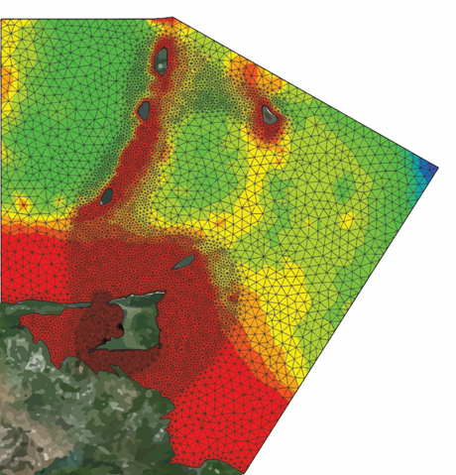
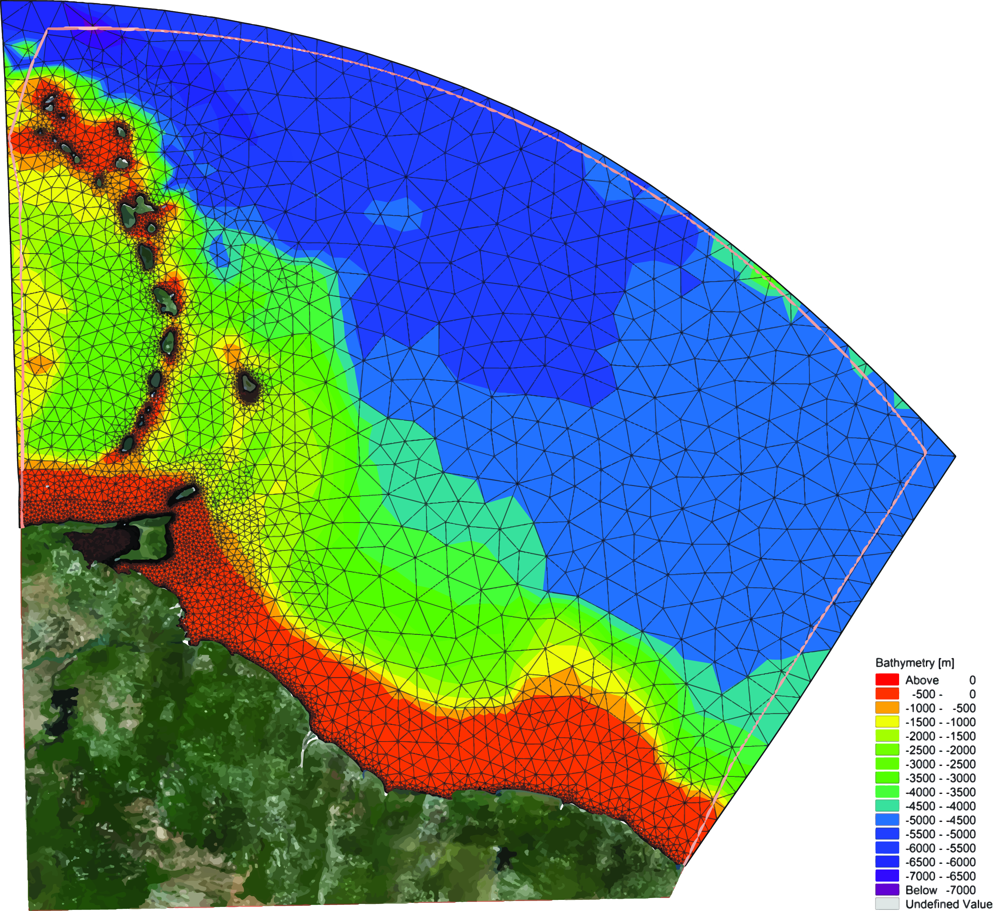
CDL Models – currents and waves
Notes:
CDL generates for our purposes data on waves and 3D currents
Dispersion modelling for drill cuttings and spill trajectories
Greater need for better monitoring systems for river discharges

Slide 6
Data Streams
CEC Process generates
Data Streams
Geological
Biological
Physicals
Chemical
Social/Economic
Macro and Meiofauna as indicators of change
Mangrove, seagrass coral, fish, birds, marine mammals and reptiles
Land use
Demographics
Soil
Formation
Shoreline morphology
Bathymetry
Satellite imagery SS Elevation
SST
CTD
pH turbidity weather waves currents
Water Quality
Sediment quality
Mainly related to local requirements as set by EMA
Air Quality
Notes:
Both from baseline data collection
And compliance monitoring
Site dependent – so for example Tobago has sensitive receptors such as coral reefs, coastal lagoons and mangrove

Slide 7
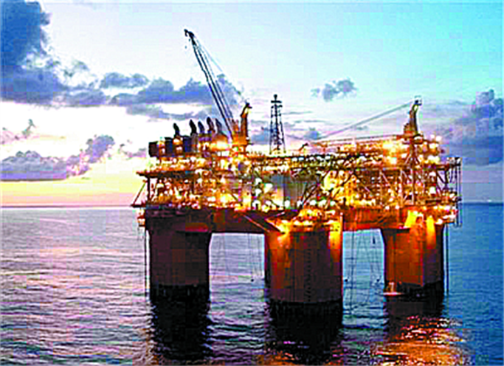
Expanding options to meet data gaps
Oil and gas Platforms provide a stable location for housing of instrumentation for many variables:
Weather
Waves
Currents
Air quality
Water quality

Slide 8
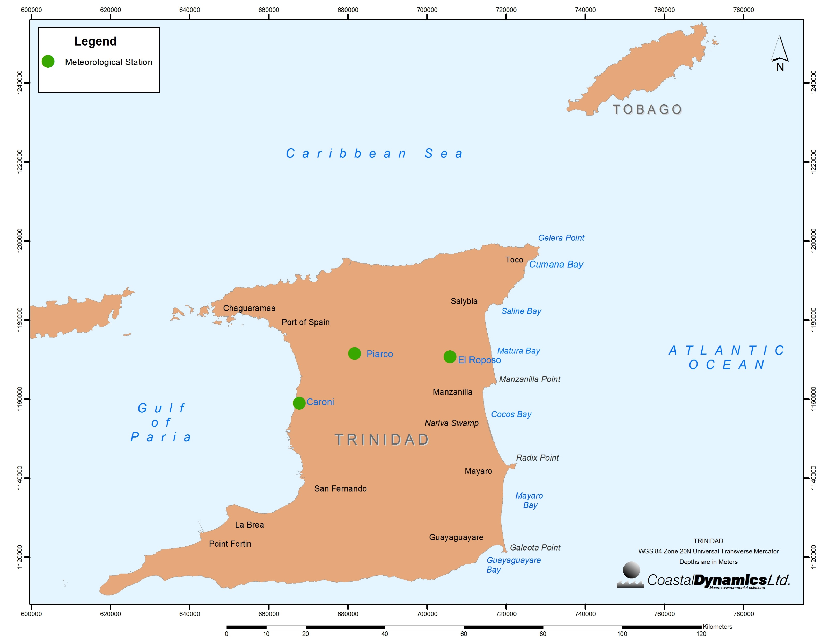
Met-Ocean
Gaps
Paucity of data along vulnerable coastlines
Limited ground based measurements for validation
Met Office collects data at three sites around Trinidad (Piarco, Caroni, El Reposo)
Data collection at one site in Tobago (Scarborough)
Data Needs
Wind
Waves
Sea Level
River Flow
Notes:
River outflow is a major problem as most unmetered. Trinidad and Tobago sits in the path of the Orinoco so freshwater and suspended material is a significant concern

Slide 9
Air Pollution
The fallout of air borne pollutants into the ocean can potentially influence the various marine water cycles and processes
Sources of air pollution affecting ocean systems:
Industrial sites
Agricultural sites
Marine operations; oil & gas, port, commercial marine traffic and transshipment and bunkering
Main parameters of concern:
Particulate Matter (PM_{2.5} and PM₁₀)
Nitrogen Dioxide
Nitric oxide
Sulphur Dioxide
Hydrogen Sulphide
Volatile Organic Carbons
Carbon Monoxide
Ozone
Metallic Substances (Cadmium and Lead compounds)
Organic Substances (Formaldehydes and Ethylbenzene)
Notes:
NOx example. As a by-product of combustion, nitric oxide (NO) from vehicles, biomass burning and energy production is emitted to the atmosphere. Additionally, a substantial amount of nitrogen enters the atmosphere as ammonia from agricultural activity.

Slide 10
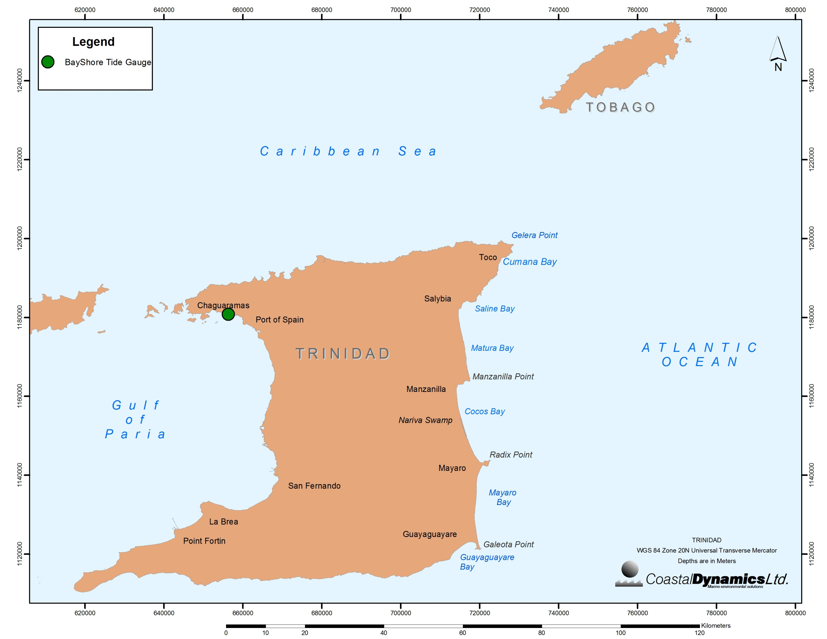
Sea Level and Sea Level Rise
Current Situation
No long-term, quality controlled tidal/sea level monitoring systems
CDL’s Initiative
Sea surface elevation
Tide gauge deployed – November 2017
Permanent
Levelled to chart datum
Monitored monthly
Notes:
Lack of adequate data on SS elevation from local sources

Slide 11
At present
Prior to 2001 – unmonitored. Pre-2001 sources of pollution can remain outside of CEC requirements for discharges
No prescribed standard for data collection
No prescribed standard for analysis
Notes:
For many parameters the major issue is standardization of measurements

Slide 12
The Way Forward
Local sources of data are available, however
Standardized methods for data collection, storage and presentation
Scales are many times not suitable for small scale applications.
Quality control of datasets
Confidentiality of data - Clarification of data ownership
Accessible to public – data sharing
Enforcement of management plans and policies
Training and capacity building (continuous QA of the data and methodology as staff is not continuous)
Inter-agency and inter-regional collaboration and agreement and execution of policies/goals - Many sources not well known to local users, such as satellite derived data etc.
Encourage funding from the private and public sectors
All of the above needs to be initialized to avoid changes during government transition.

