Slide 1
Facilitating the Creation and Use of Knowledge
17-19 January 2018 Implementing and Monitoring the SDGs in the Caribbean
Douglas Cripe
GEO Secretariat

Slide 3
A SHARED VISION
TO REALIZE A FUTURE WHERE
DECISIONS AND ACTIONS,
FOR THE BENEFIT OF HUMANKIND,
ARE INFORMED BY
COORDINATED, COMPREHENSIVE AND SUSTAINED EARTH OBSERVATION INFORMATION AND SERVICES.

Slide 6
programmes

Slide 9
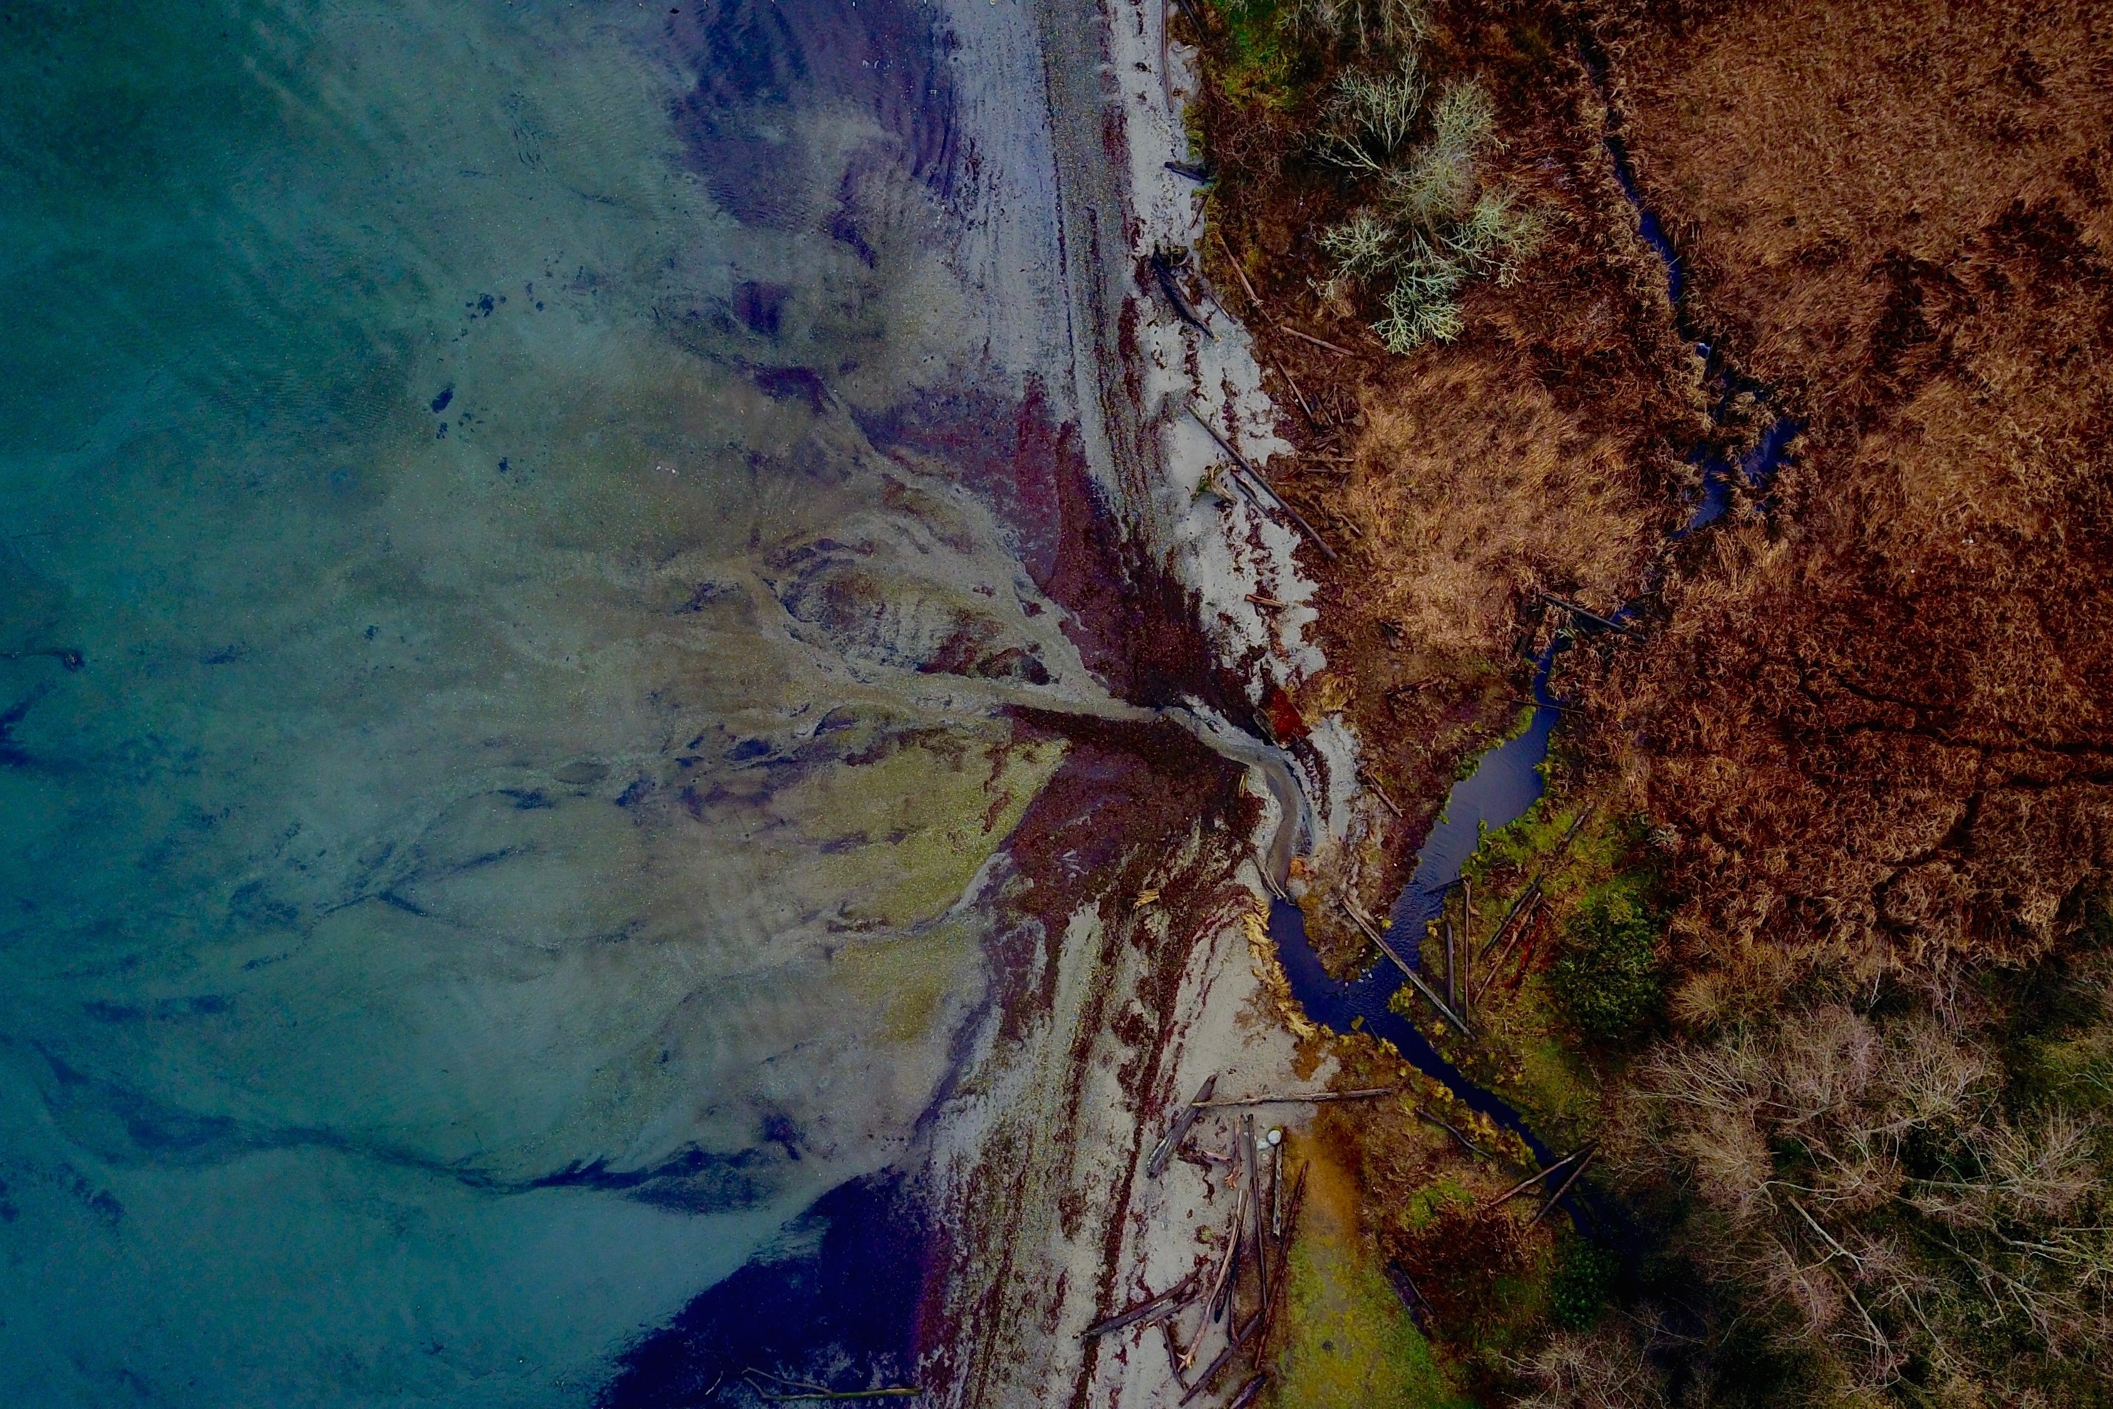
GEO Work Programme
2017-2019
70+:FLAGSHIPS, INITIATIVES & COMMUNITY ACTIVITIES
SCORES OF COUNTRIES
THOUSANDS of collaborators
hundreds of millions invested
IMPACT ON BILLIONS OF LIVES

Slide 10
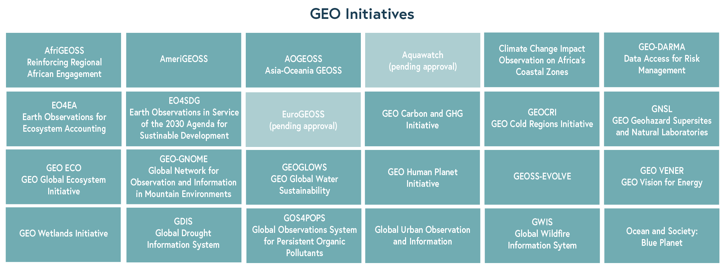
GEO Work Programme
INITIATIVES

Slide 11
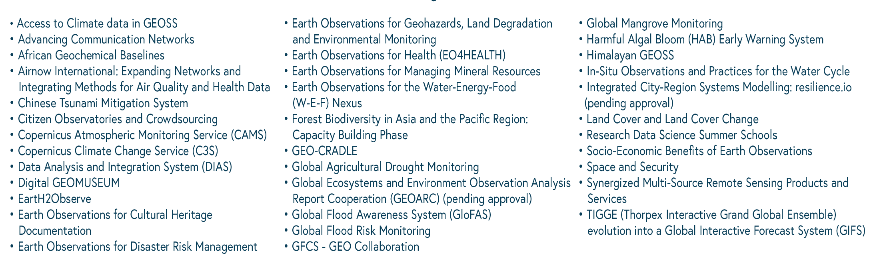
GEO Work Programme
COMMUNITY ACTIVITIES

Slide 12
Notes:
We want to focus on via the website: lessons learned and the sharing of best practices and experiences to facilitate scaling of successful methods and transfer of knowledge from country to country and region to region.
Positioning geospatial information to address global challenges EO4SDG INITIATIVE CO-­‐CHAIRS Eduardo De La Torre Mexico/INEGI Chu Ishida Japan/JAXA Lawrence Friedl USA/NASA EXECUTIVE SECRETARY Argyro Kavvada USA/NASA-­‐BAH
Partners: FAO, GPSDD, IISD, SDSN, UNCCD, UNECE, UNECA, UN ECLAC, UN Environment, UN ESCAP, UNFCCC, UN-GGIM, UNISDR, UNSD, WFP, WHO, WMO
EO4SDG Organize and realize the potential of Earth observations and geospatial information to advance the UN 2030 Agenda and enable societal beneﬁts through achievement of the SDGs. Key Emphasis: Collaboration with statistical community, national statistical oﬃces, line ministries and custodian agencies. Also, communication role in federated approach to GEO community
Projects Develop, validate and deploy uses of Earth observations to support SDG tracking and reporting
Capacity Building Build skills for accessing and applying Earth observations data
Data and Information Products Advance discoverability and accessibility of products
Outreach and Engagement Promote the consideration and adoption of Earth observations for the SDGs

Slide 13
FT: User Needs and Gap Analysis
Establish comprehensive overview of user needs and observational requirements.
Carry out gap analyses to identify gaps in observations and derived products meeting these requirements and needs.
Develop knowledge base tool to document relations between user needs and data/processes (models, workflows, algorithms) needed to develop the information meeting these user needs.

Slide 14
GEO REGIONAL INITIATIVES

Slide 15
GEO Strategic Plan
GEO is a coalition of governments and participating organizations having as its mission the implementation of the Global Earth Observation System of Systems (GEOSS) to meet the need for timely, quality long term global information as a basis for sound decision-making.
Earth observations from diverse sources, including satellite, airborne, in-situ platforms, and citizen observatories, when integrated together, provide powerful tools for understanding the past and present conditions of Earth systems, as well as the interplay between them.
(GEO Strategic Plan 2016-2025)

Slide 16
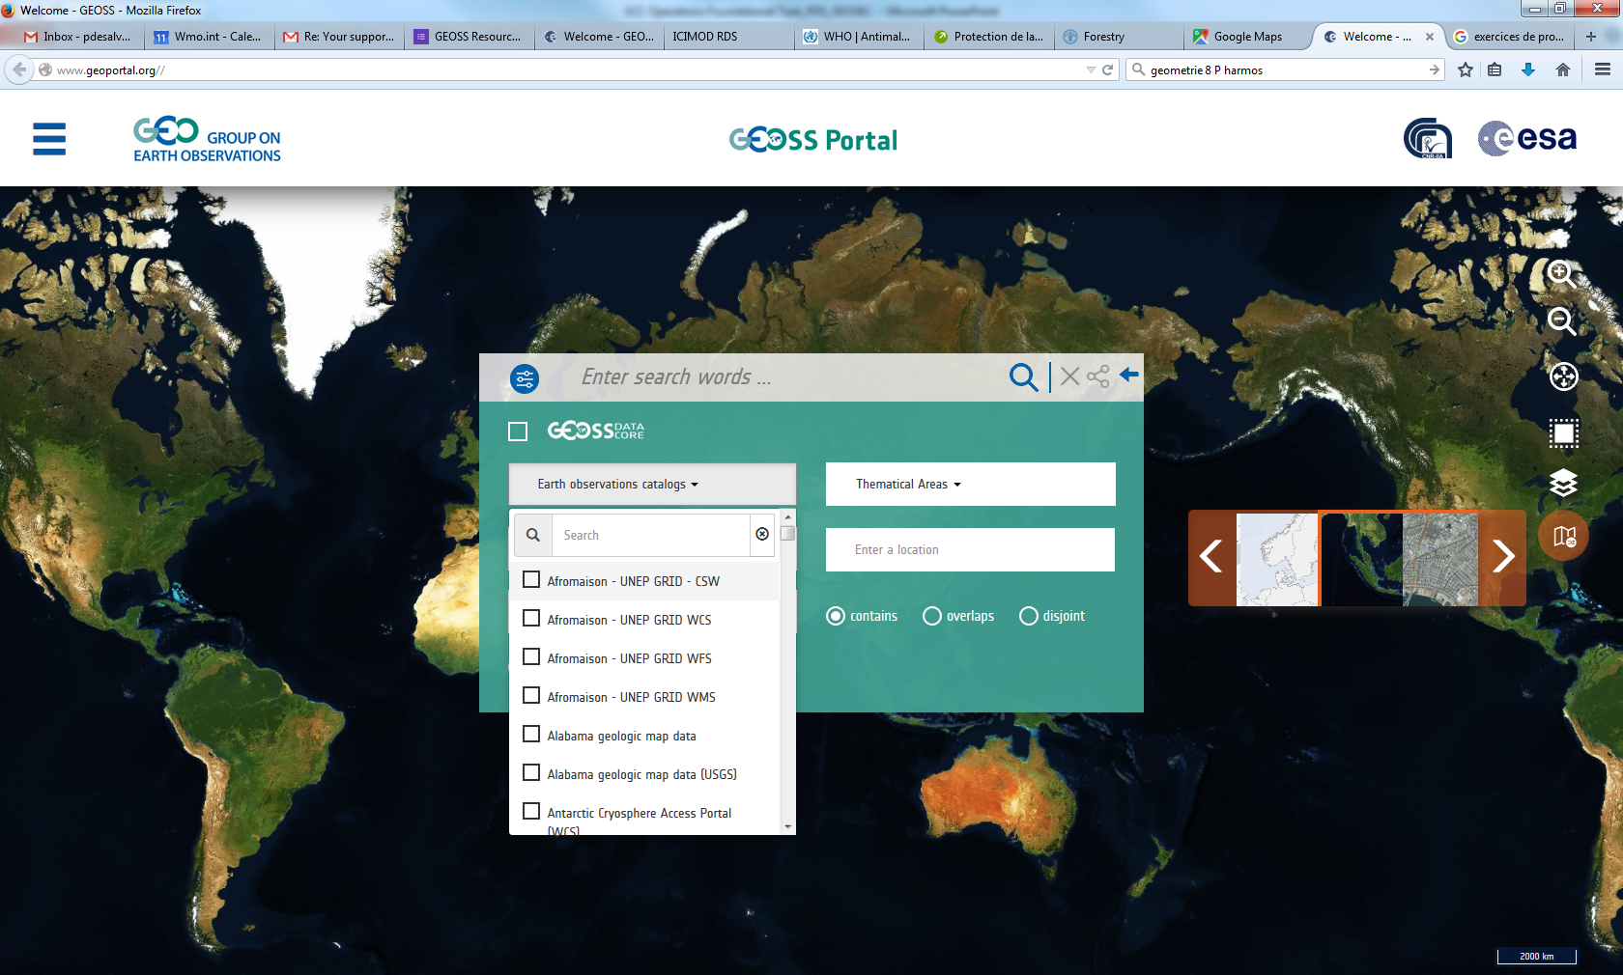
The Enhanced GEOSS Portal
Infrastructure
functionalites

Slide 18
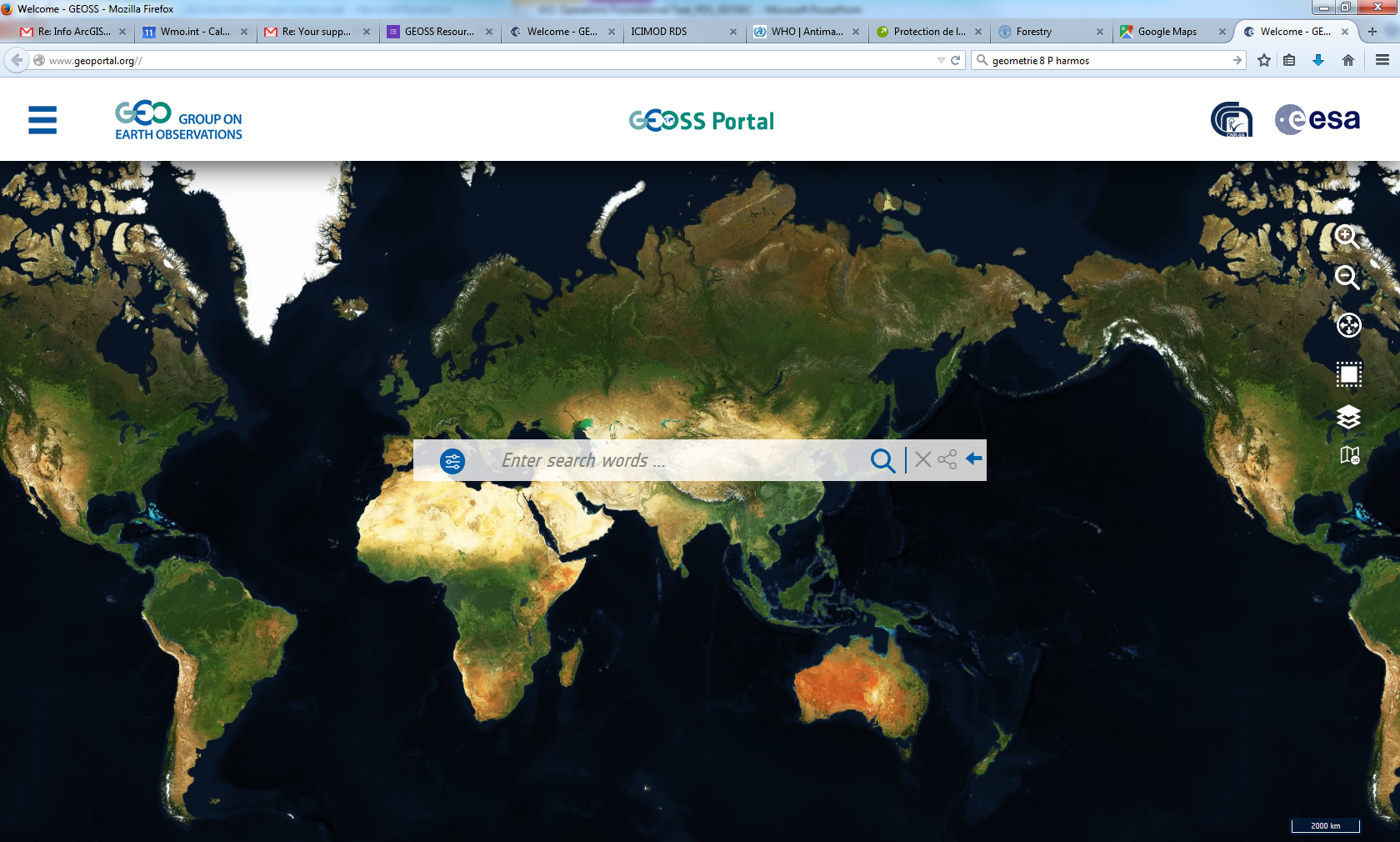
Some numbers on GEOSS Assets
Content
More than 166 brokered catalogs,
More than 5000 different Data Providers
More than 400 ml resources

Slide 19
Self Assessment process in the Yellow pages

Slide 20
Open Data Cubes A Big Data Solution for Global Capacity Building
January 2018
Brian Killough
CEOS Systems Engineering Office
NASA Langley Research Center

Slide 21
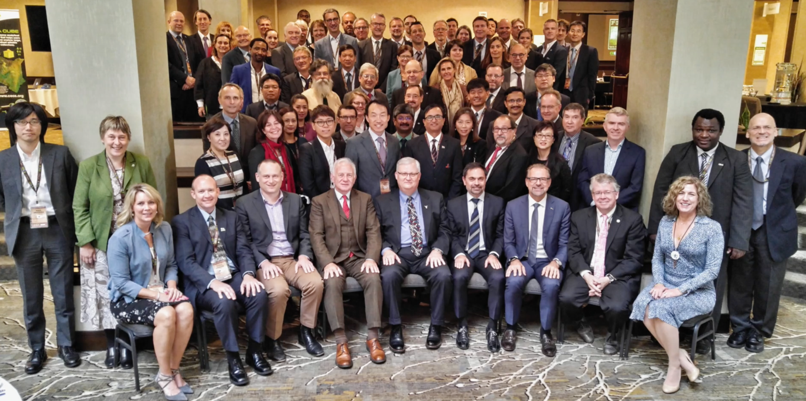
What is CEOS?
www.ceos.org
The Committee on Earth Observation Satellites (CEOS) serves as a focal point for international coordination and data exchange to optimize societal benefit from space-based Earth observations. CEOS represents 22 countries through its 32 space agencies and 28 associate members and is operating 137 satellites.

Slide 22
What is changing?
Free and Open Resources
Free and open Satellite Data
Open Source Software and Tools
Global Engagement
Improved communication technology
Increased global cooperation and collaboration
Satellite Data Philanthropy
Google Earth Engine
Governments, Foundations and World Bank
Improved Technology
Cloud Storage and Computing
Data Cubes

Slide 23
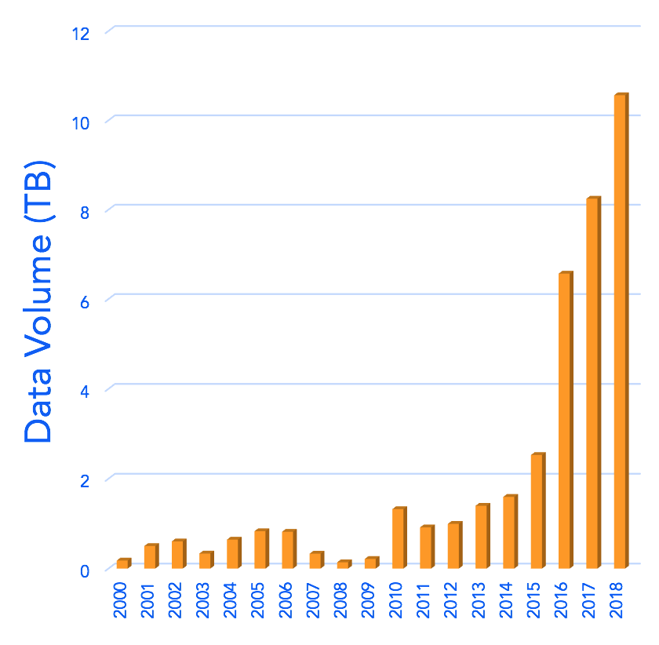
The Big Data Problem
A significant growth in FREE/OPEN land imagery data (e.g. Landsat, Sentinel) has increased data volumes by 10x in the last 5 years.
Many countries lack the knowledge, infrastructure, and resources to access and use the available space-based data.
Countries have requested support from CEOS for data access, processing, and analysis to support their country needs.
Colombia Data Growth
The new Open Data Cube provides a solution and new opportunities

Slide 24
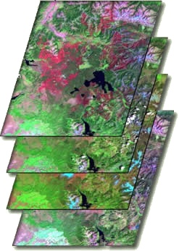
What are Data Cubes?
Data Cube = Time-series multi-dimensional (space, time, data type) stack of spatially aligned pixels ready for analysis
Proven concept in Australian and now working in Switzerland, U.K. and Colombia.
Analysis Ready Data (ARD) ... Dependent on processed products to reduce processing burden on users
Open source software approach allows free access, promotes expanded capabilities, and increases data usage.
Unique features: common architecture, flexible deployment, exploits time series, increases data interoperability, and supports many new applications.
TIME

Slide 25
Benefits of Data Cubes
Expanded use of satellite data
Reduced data preparation burden
Enables data interoperability
Efficient time series analyses
Free and open access
Flexible deployment (local or cloud)
Use of a common architecture
Community development and sharing
Our goal is to provide a SOLUTION that has VALUE and increases the IMPACT of satellite data.

Slide 26
The Data Cube Vision
A solution supporting priority objectives …
Build capability of users to apply CEOS satellite data
Support Group on Earth Observations (GEO) and United Nations agendas
Involves CEOS Agencies …
Through provision of processed satellite data products
Contributing to development and uptake of solutions
Customer focused …
Easy to install and maintain with training materials
A brand that people know and trust
Scalable solution …
Operational Data Cubes in 20 countries by 2022
Key partners (e.g. World Bank, Google, Amazon) supporting the data cube development and its use
opendatacube.org

Slide 27
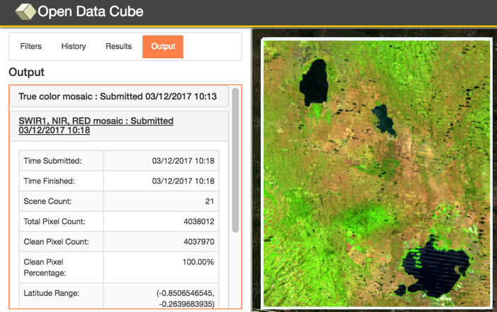
Amazon Cloud (AWS) Demo
Data Cubes
16 cubes with 10+ years each.
Kenya, Cameroon (Lake Chad), Togo (coastal Africa), Ghana, Colombia, Tonga (Pacific Island), Vietnam, Uruguay, Australia (Menindee Lakes), Bangladesh.
User Interface Features
10 applications: cloud-free mosaics, fractional cover, NDVI anomaly, water detection, water quality, landslides, coastal change and urbanization.
Outputs in GeoTIFF and GIF animation.
http://tinyurl.com/datacubeui
Free and Open!

Slide 28
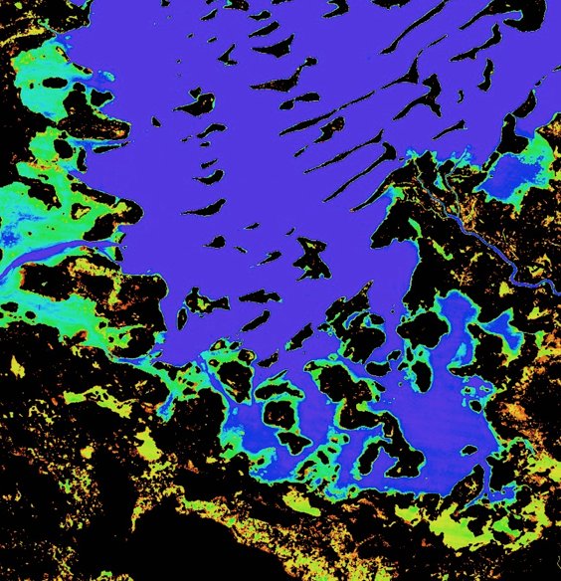
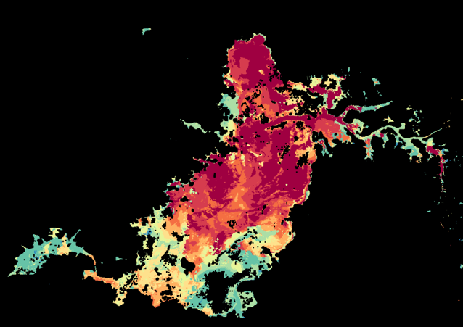
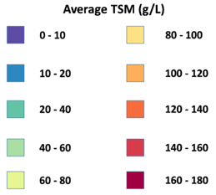
Water Detection / Water Quality
Percent of observations detected as water over the 17-year time series (water observations / clear observations) for Lake Chad, Africa.
Purple/Blue:Frequent or permanent water
Red/Yellow: Infrequent water and/or floods
Average Total Suspended Matter (TSM) in 2016 using Landsat 8 and the Lymburner (GA) TSM Index Algorithm. TSM is closely related to turbidity which is an indicator of water condition for drinking or fisheries

Slide 29
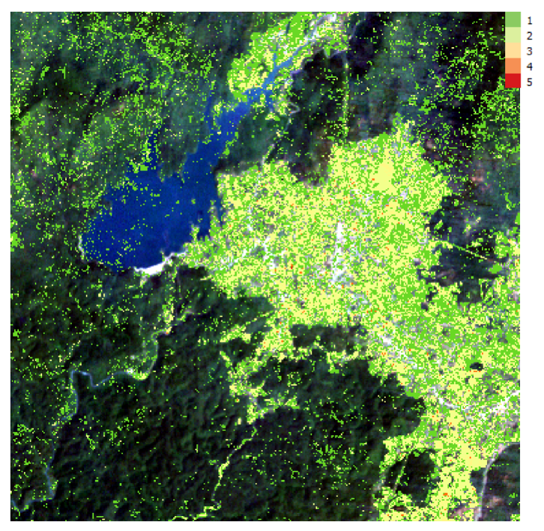
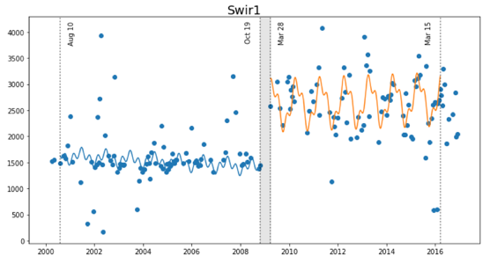
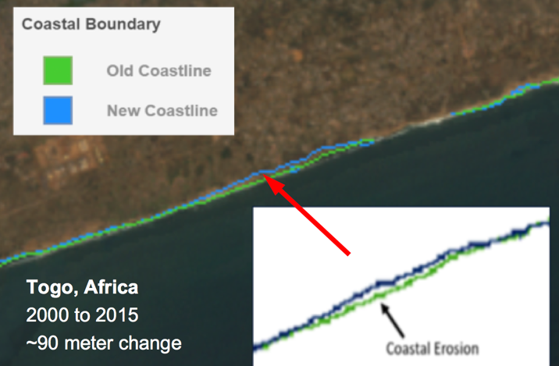
Land Change / Coastal Change
PyCCD (Zhu and Woodcocj, 2012) time series model fits 7 bands to 6 weighted SINE and COSINE functions in order to find “breaks” that equate to potential land change.
Coastal Change Example Togo, Africa: 2000 to 2015
Bediaye, Vietnam Example (above) PyCCD Change Results 2000 to 2016, 192 Landsat scenes

Slide 30
The Future
We expect to complete several operational Data Cube deployments in 2018: Vietnam, Taiwan, Uganda and an African Regional Data Cube (5 countries).
We are collaborating with Google, Amazon and World Bank.
We are planning a dedicated Data Cube Paper Session at the IGARSS Conference in Valencia, Spain (July 2018).
We will develop many new technical elements: Python Notebook demos, User Interface tools (pixel plotting, transect plots, clustering), QGIS Plugin.
We will develop and validate new applications: Land classification clustering and Water Quality (TSM and Chlorophyll).

Slide 31
Engaging with Communities
*SAVE THE DATES*
“The GEOSS Platform (r)evolution around U “
Data Providers meet Users
3rd GEOSS Data Providers workshop
20-23 rd March 2018 at ESA, Frascati; Italy

Slide 32
Earth observations: Delivering insight for decisions (Overview)
dcripe@geosec.org

