Slide 1
Bringing SDGs to the people and creating ownership in Saint Vincent and the Grenadines
Presented by: Mr. Jai Rampersad IMBA (Distinction) BSc (First Class Honours)

Slide 2
Saint Vincent and the Grenadines
Population: 109,643 (2016) World Bank
Life expectancy: 73.05 years (2015)
Fertility rate: 1.95 births per woman (2015)
GNI per capita: 11,530 PPP dollars (2016)
Population growth rate: 0.2% annual change (2016)
Official languages: English, Spanish
Source: World Bank

Slide 3
Millennium Development Goals (2015): Highlights
Goal 1: Eradicate Extreme Poverty and Hunger
Global number of people living in extreme poverty reduced from 1.9 billion in 1990 to 836 million in 2015
Goal 2: Achieve Universal Primary Education
Sub-Saharan Africa primary school enrolment rate increased from 52% in 1990 to 80% in 2015
Goal 3: Promote Gender Equality and Empower Women
90% of countries have more women in parliament from 1995 to 2015
Goal 4: Reduce Child Mortality
Global under 5 mortality rate has declined from 90 to 43 deaths per 1,000 live births between 1990 and 2015
Source: The Millennium Development Goals Report 2015 – United Nations

Slide 4
Millennium Development Goals (2015): Highlights
Goal 5: Improve Maternal Health
Maternal Mortality rate has declined by 45% globally between 1990 and 2015
Goal 6: Combat HIV/AIDS, Malaria and Other Diseases
New HIV infections fell by 40% between 2000 and 2013
Goal 7: Ensure Environmental Sustainability
1.9 billion people have gained access to piped drinking water between 1990 and 2015
Goal 8: Develop a Global Partnership for Development
Internet penetration has increased globally from 6% in 1990 to 43% in 2015
Source: The Millennium Development Goals Report 2015 – United Nations

Slide 5
Millennium Development Goals Review: Ongoing Issues
Gender Inequality
Huge wage gaps
Climatic Change and Environmental degradation continues
Conflicts hamper human development
Millions still live in poverty and hunger, without access to basic services
Source: The Millennium Development Goals Report 2015 – United Nations

Slide 6
Millennium Development Goals Review: Ongoing Issues (SIDS)
‘One Size Fits All’ Policies that does not cater to the needs of the SIDS
Data collection and analysis issues
Public sector driven
Lack of technical support
Lack of Infrastructure
Financing
Problems: Inconsistencies, planning, lack of accountability, monitoring issues and delays
Little to no ICTs support
Lack of Political directive

Slide 7
Small Island Developing States (SIDS) Requirements
Enhance international cooperation, exchanges and investments
Increased public and private investment in infrastructure
Foster entrepreneurship and innovation and sustainable industrial development
Development of the financial services industry
Job Creation/ Technical support
Improve working conditions
Greater ICT integration
Promote and enhance gender equality
Set national regulatory and policy frameworks to improve transparency, accountability, and corporate social responsibility.
Source: Samoa Pathway (2014 Outcomes)

Slide 8
Sustainable Development Goals (2030)
Source: United Nations

Slide 9
Sustainable Development Goals in Saint Vincent and the Grenadines: Theory
“The successful implementation of the SDGs globally is dependent on the establishment of ‘Geo Spaces’ with a targeted concentration of efforts from a coordinated interventions from State and Non State actors”
- Hon Minister Saboto Caesar (SVG)

Slide 10
Background of Thesis
The Honourable Saboto Caesar coined the idea of the establishment of ‘Geo Spaces’ globally, with a strategic approach to achieving the SDGs by working with ‘manageable’ population grouping. The idea first surfaced during a presentation he made, on behalf of the FAO (United Nations) to the Pan African Parliament in South Africa on 1st August 2016, that focused on SDG 2: No hunger.
Mr Jai Rampersad (Strategic planning and management specialist) was called upon to further develop this concept, which was then reviewed by Mr. Chad Blackman (International trade specialist) and Ms Celes Jules (Renewable Energy), with scientific support from Mr. Hans-Peter Plag (Professor ocean, earth and atmospheric sciences)

Slide 11
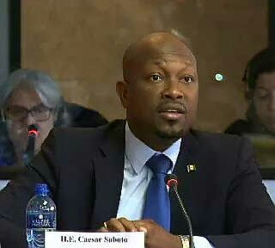
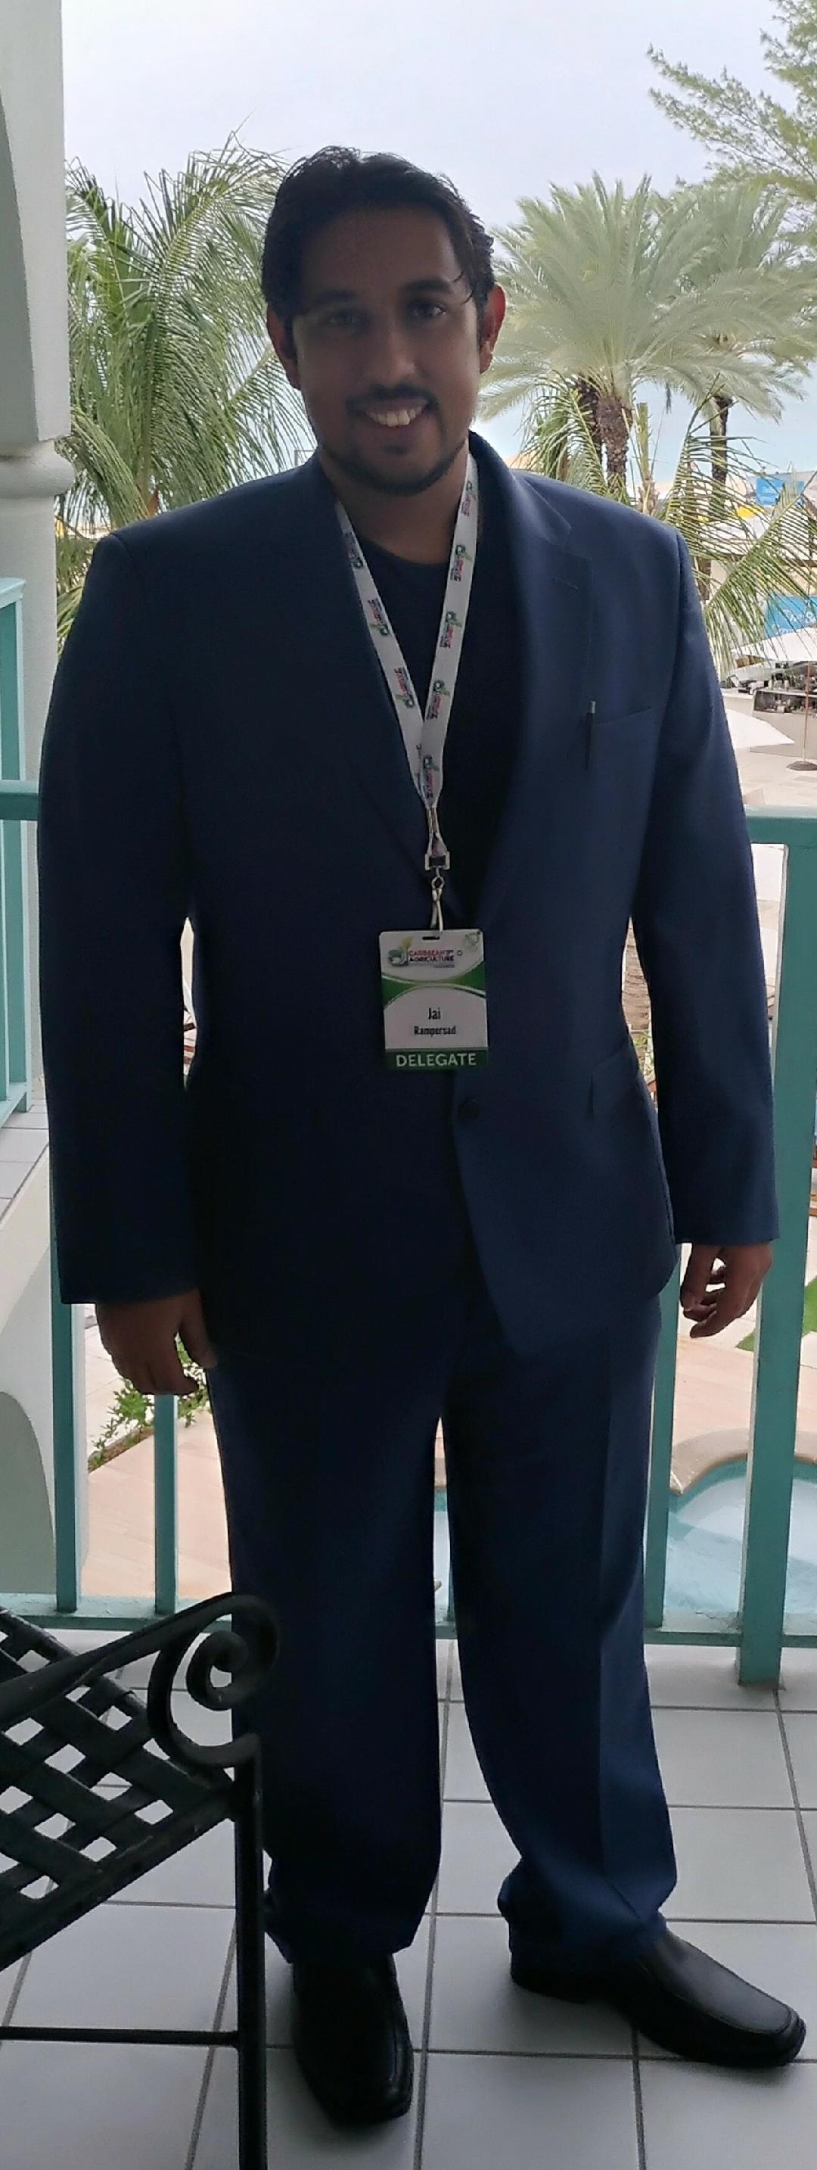
Background of Thesis
Hon Minister Saboto Caesar
Minister of Agriculture, Forestry, Fisheries and Rural Transformation
Lawyer
Youngest elected member of Parliament in SVG (36 years)
Executive chairman for Parliamentary fronts against hunger in the Caribbean
Mr Chad Blackman
Mr Jai Rampersad

Slide 12
Sustainable Development Goals in Saint Vincent and the Grenadines
What is a Geo-Space ?
A designated area that is selected with an intensified and organised effort to achieve the sustainable development goals
Notes:
Can you move a mountain? This is what 17 huge goals may seem, but in smaller pieces it can be achieved. That mountain can move piece by piece.

Slide 13
Sustainable Development Goals in Saint Vincent and the Grenadines: Expected Outcomes
Improve data management: Collection and Analysis
Monitoring and Accountability
Ease of Implementation
Targeted goals
Expandable based on successes
Maximum utilisation of limited resources
Accelerated reaction time
Notes:
Can you move a mountain? This is what 17 huge goals may seem, but in smaller pieces it can be achieved. That mountain can move piece by piece.

Slide 14
Sustainable Development Goals in Saint Vincent and the Grenadines: Global ‘Geo Space’ Platform
Image Source: http://cdn.nextgov.com
Notes:
Can you move a mountain? This is what 17 huge goals may seem, but in smaller pieces it can be achieved. That mountain can move piece by piece.

Slide 15
Sustainable Development Goals in Saint Vincent and the Grenadines
Some examples of Metrics being utilised:
Identified Percentage of Participants earning less than USD 1.25 a day
Target: Reduced to Zero by 2030
Wage rates for men and women in similar job portfolios
Target: Equal wages based on tasks performed by 2030
Increase the Agriculture productivity and incomes of small scale producers
Target: Double the output and income of small scale producers
End all forms of malnutrition with a special target towards stunting and malnutrition in children under 5 years old
Target: End all forms of malnutrition by 2030
Source: UN Indicator framework
Notes:
School feeding program

Slide 16
Sustainable Development Goals in Saint Vincent and the Grenadines: Implementation
In 2014/15 SVG set up the Ministry of Sustainable Development
Oversee and monitor the implementation of the SDG’s
Creation of a Parliamentary Front: This is a motion supported by both the Political party in power and the Opposition. All activities would be free from political bias.
Notes:
FAO / UN Representatives convinced the Opposition

Slide 17
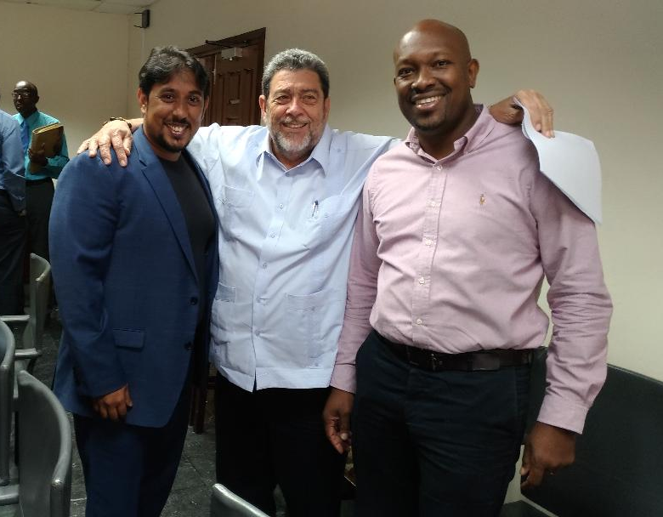
Sustainable Development Goals in Saint Vincent and the Grenadines: Implementation
‘Zero Hunger’ Trust Fund: 2% of every dollar spent on phone calls (incoming and outgoing) is placed in this fund.
School Feeding Program and Physically Challenged Individuals
Reduction in Pollution: Bans on the use of Styrofoam
Notes:
FAO / UN Representatives convinced the Opposition

Slide 18
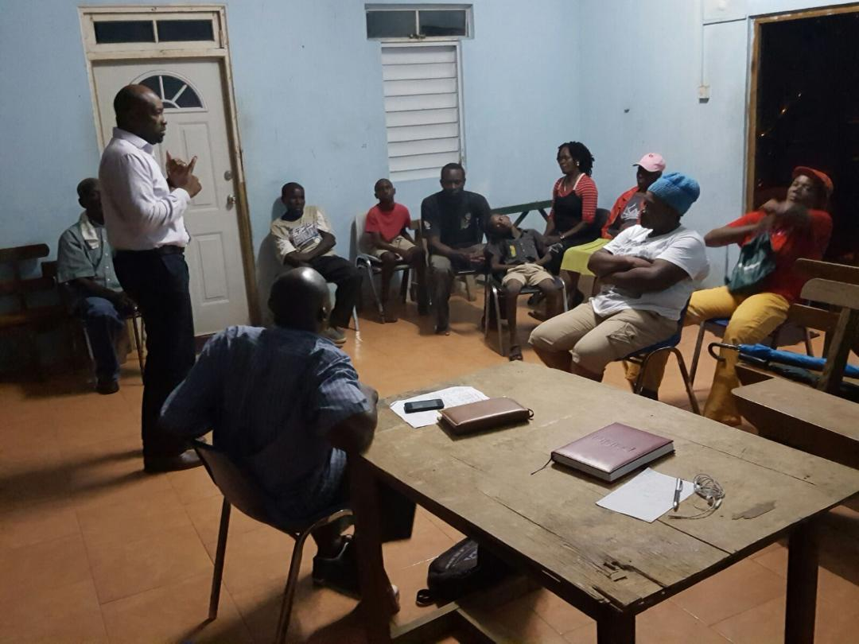
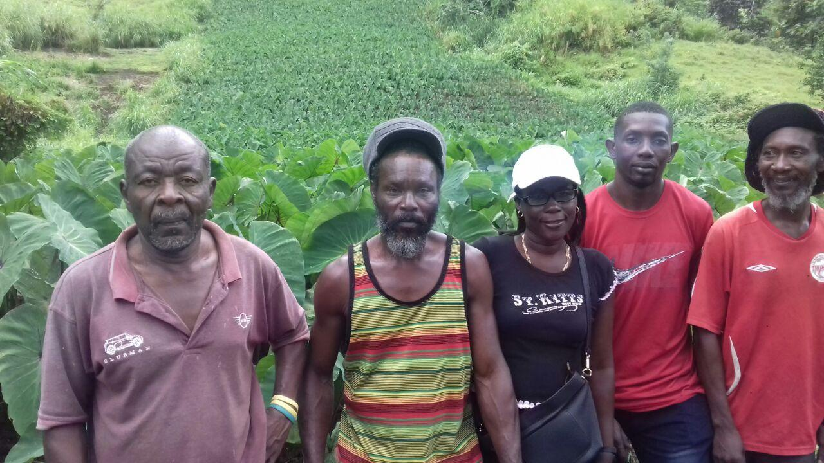
Sustainable Development Goals in Saint Vincent and the Grenadines: Implementation
Cooperatives formed: These small groups would work together to aid the implementation and development process.
Notes:
FAO / UN Representatives convinced the Opposition

Slide 19
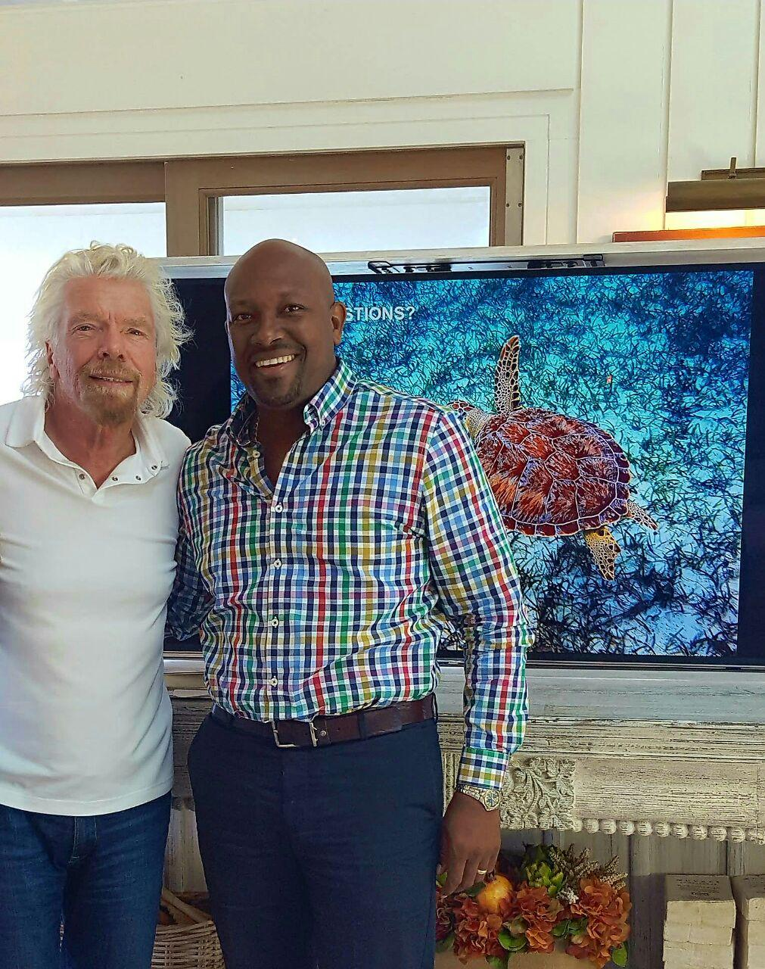
Sustainable Development Goals in Saint Vincent and the Grenadines: Implementation
Ban on the consumption of ‘Turtle Meat’
Notes:
FAO / UN Representatives convinced the Opposition

Slide 20
Sustainable Development Goals in Saint Vincent and the Grenadines: Implementation
Geo-Space
7,000 acres
Parish, Town and or Constituency
Cooperatives
Surveys and Interviews conducted (Government Institutions)
All applicable SDG’s ranked (Scale 1 -10) based on current status vs 2030 expected outcomes
Performance monitored on an annual basis
Metrics are kept in line with achieving the SDGs outcomes by 2030

Slide 21
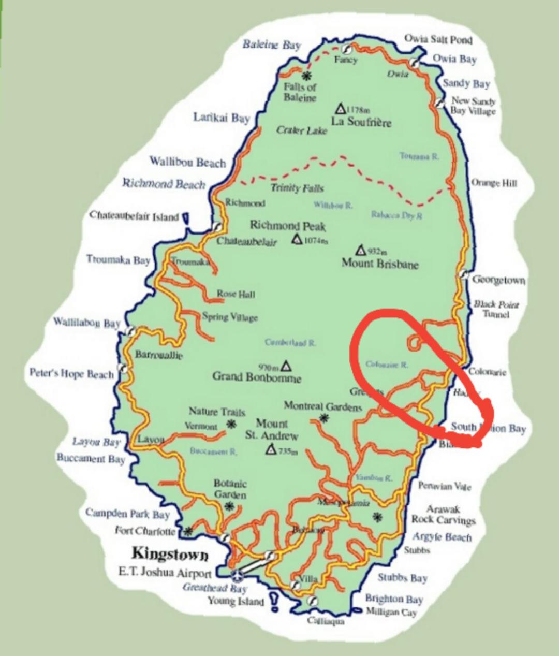
Sustainable Development Goals in Saint Vincent and the Grenadines: Implementation
Geo-Space (cont.)
12 Continuous Villages
6,500 People
Coastline: Borders with the Atlantic Ocean
Agriculture based: : Dasheen, Plantain, Banana
One Secondary School and Five Primary School
Zero Police Stations, Three Health Clinics and Five Sporting Facilities
Topography: Undulating hillsides and coastal dry lands
15 more projected for mid 2018

Slide 22
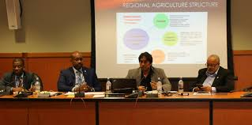
Sustainable Development Goals in Saint Vincent and the Grenadines: Implementation
Regional Agriculture Revitalisation
People - Support - Market (PSM) model for small island development states (SIDS)
Production Planning
Infrastructure enhancement: Physical and ICT
Quality: Certification (International)
Consistency (Supply and Income)
Reduction in wage gap
Reduction in gender inequality
Regional controlled (OECS) NGO to oversee implementation
SDG goals targeted: 1, 2, 3, 5,8, 9, 10, 12 and 17
Notes:
PSM Presented at the Regional Meeting of the Ministers of Agriculture and Caribbean Week of Agriculture

Slide 23
Sustainable Development Goals in Saint Vincent and the Grenadines: Implementation Process
Stage 1: Political Support
Parliamentary Front
Support by International Agencies
Ministry/ Authority that takes responsibility for all activities
Stage 2: Financial Support
Identify / develop funding mechanism to facilitate implementation of activities
Stage 3: Identify cluster for ‘Geo-Space’ integration
Selected area must be large enough to make an impact yet small enough to manage (Population of between 5,000 and 10,000 is suggested)

Slide 24
Sustainable Development Goals in Saint Vincent and the Grenadines: Implementation Process
Stage 4: Introduce policies and practices aimed at achieving the Sustainable Development Goals
Infrastructure development
Technology introduction
International Certification
Cooperatives
Pollution reduction e.g. Banning the use of Styrofoam
School Feeding Programs
Job Creation
Stage 5: Monitoring and Contingency measures (Achieve 2030 targets)
Data Collection and Analysis: Surveys and interviews
Reviewing the progression of each activity and ensuring it is keeping up with the suggested timeline
Enhancing activities to improve performance
Making suggested alterations of activities to maximize effectiveness and increase efficiencies

Slide 25
Effects of Climate Change in the Caribbean
Hurricane IRMA and MARIA: Path of Destruction
Dominica: 27 Fatalities
Cuba: 10 Fatalities
St. Martin: 12 Fatalities
Thousands Displaced: Puerto Rico, US Virgin Islands and British Virgin Islands
First time in 300 years no one live in Barbuda
Goal 13: Climate Action – Take urgent action to combat climate change and its impacts
Global Warming effects
Solutions
Stronger Policies/ Penalties for use of Fossil fuels and greenhouse gas emissions
Increased investment in clean/green energy development and use
Public/ Private Sector collaboration and investment

Slide 26
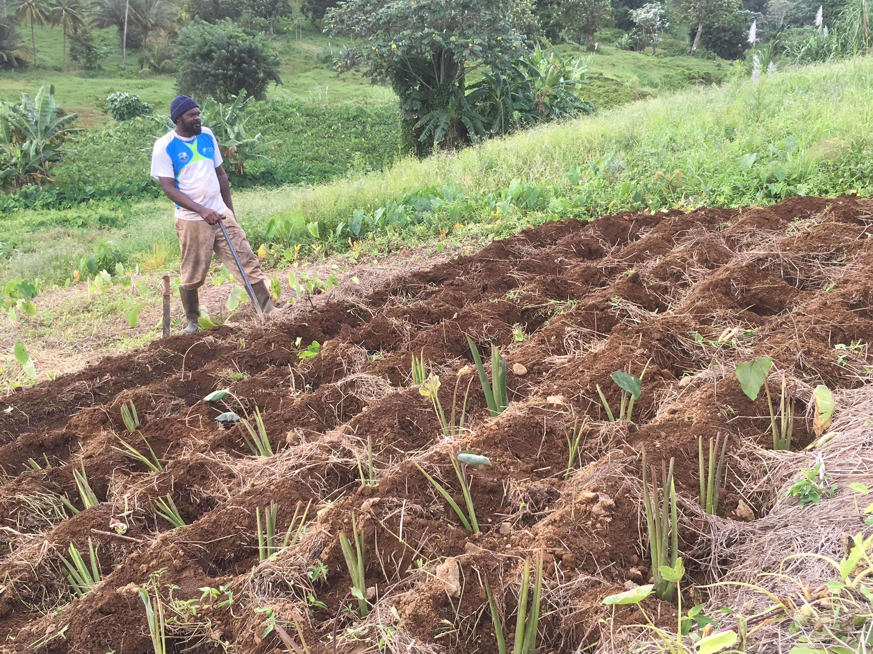
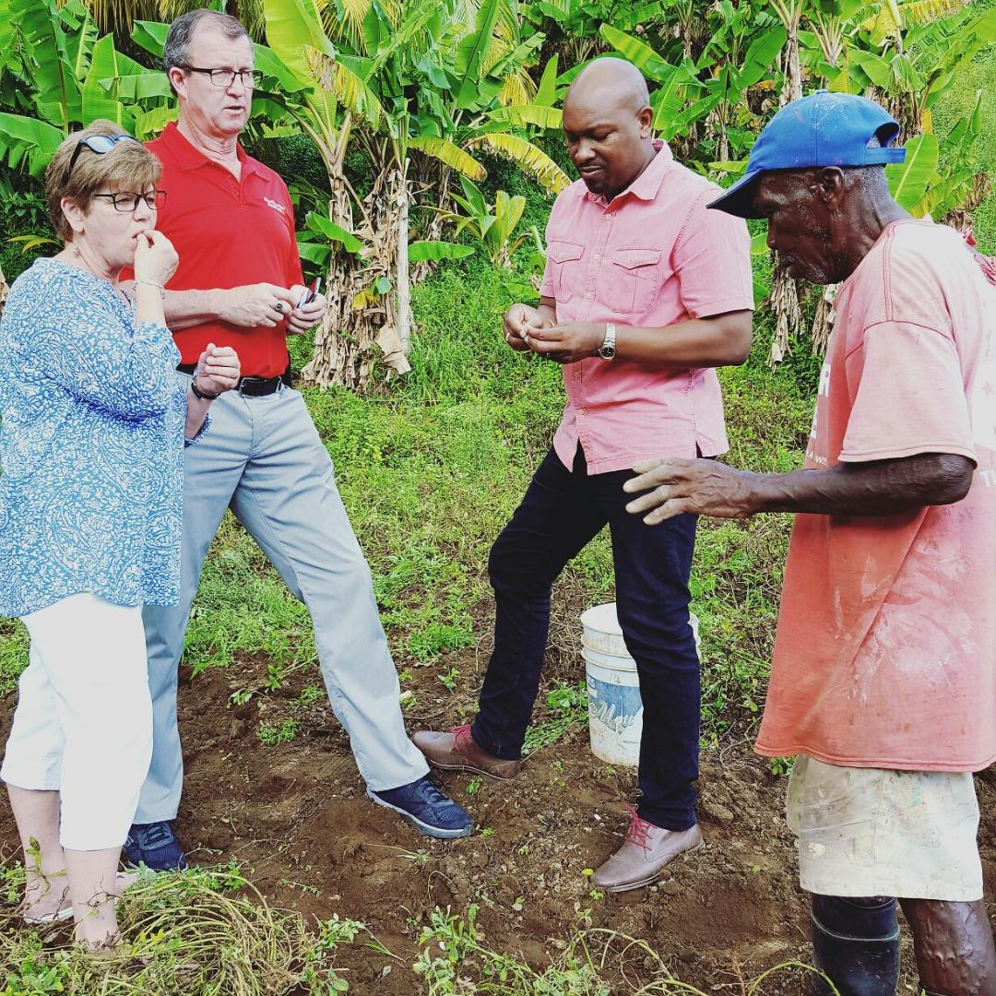
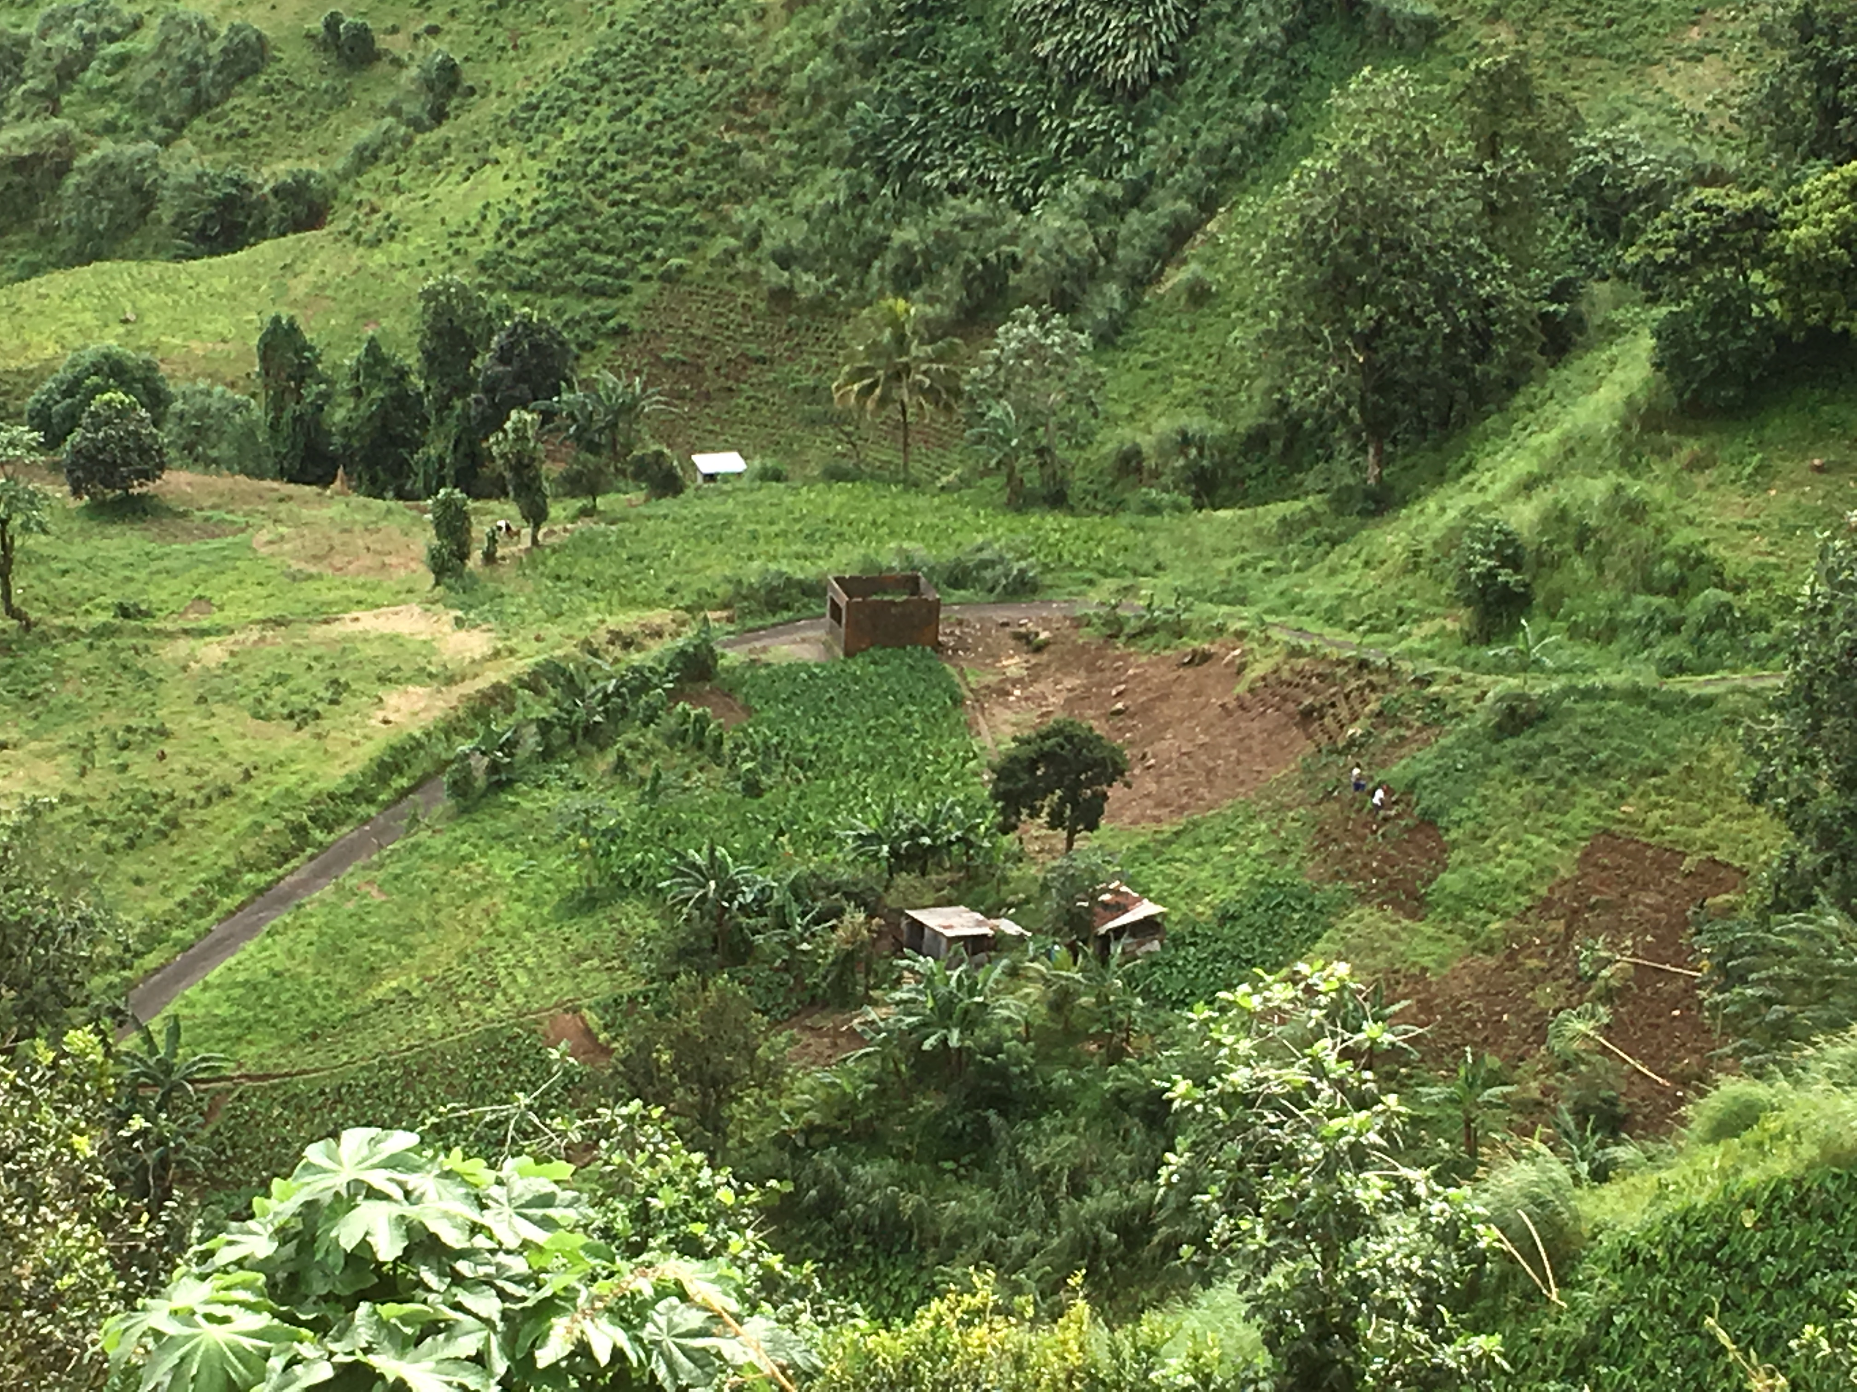
St Vincent and the Grenadines: Small Farmers

Slide 27
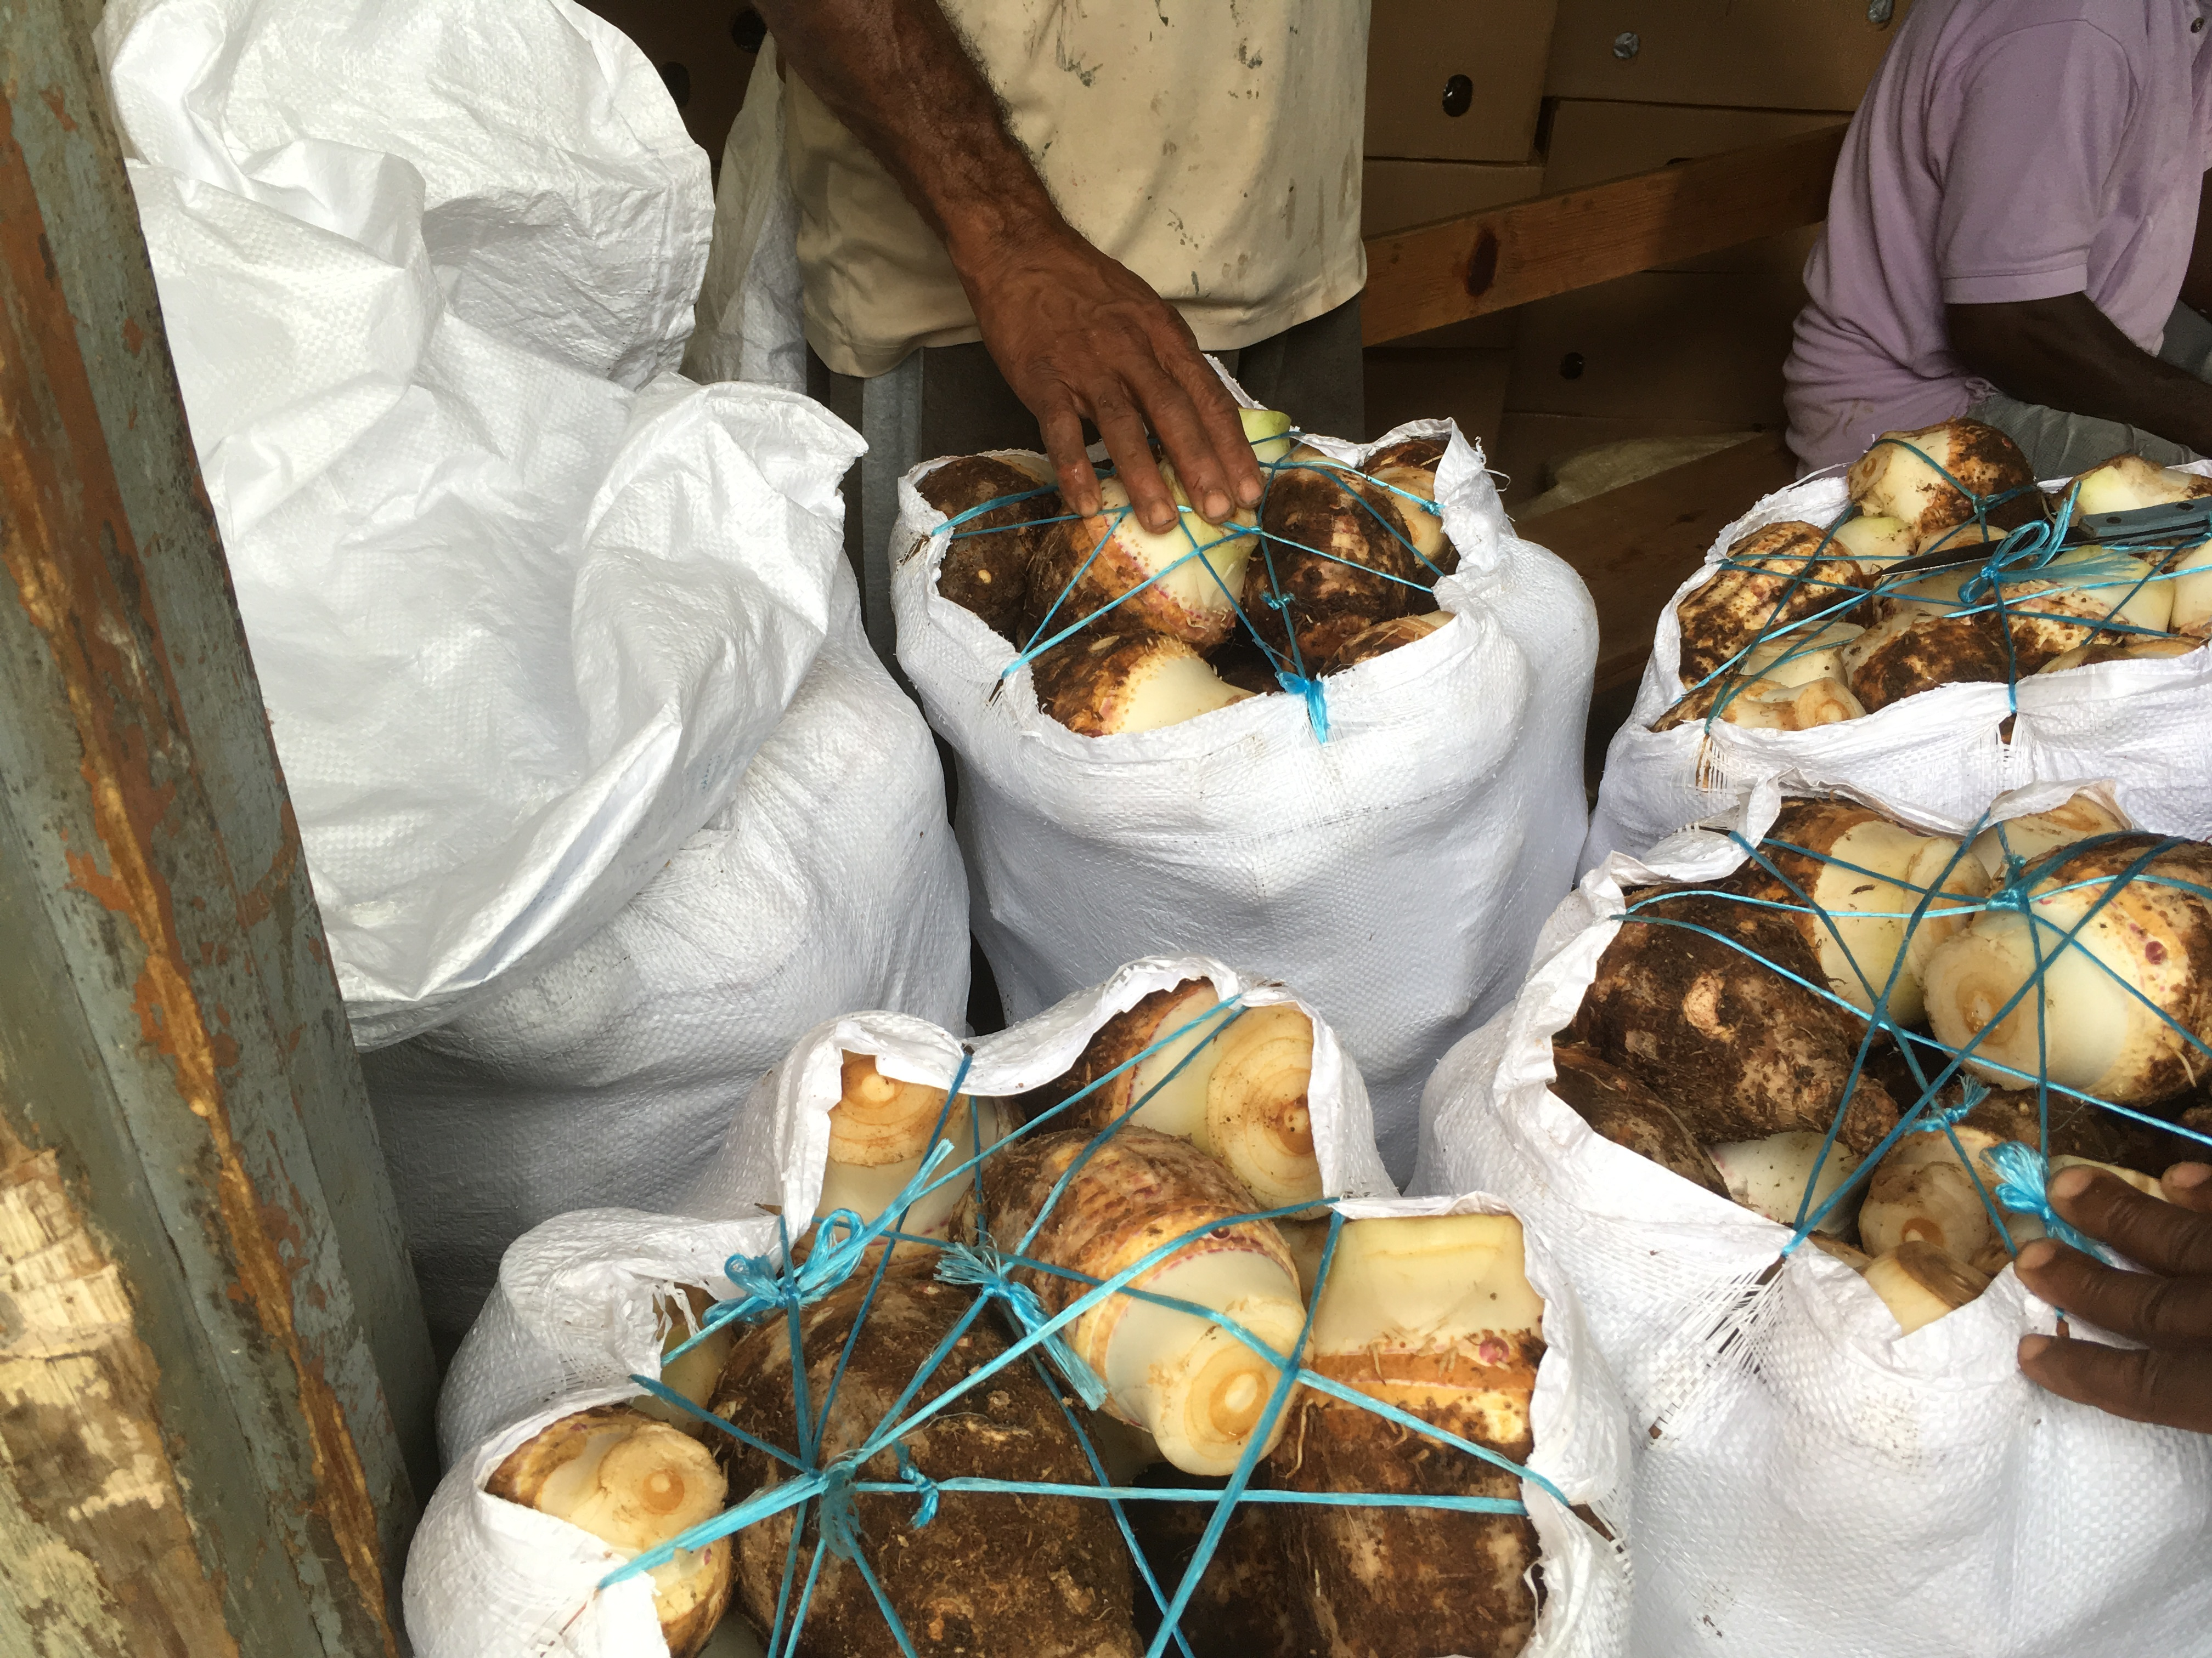
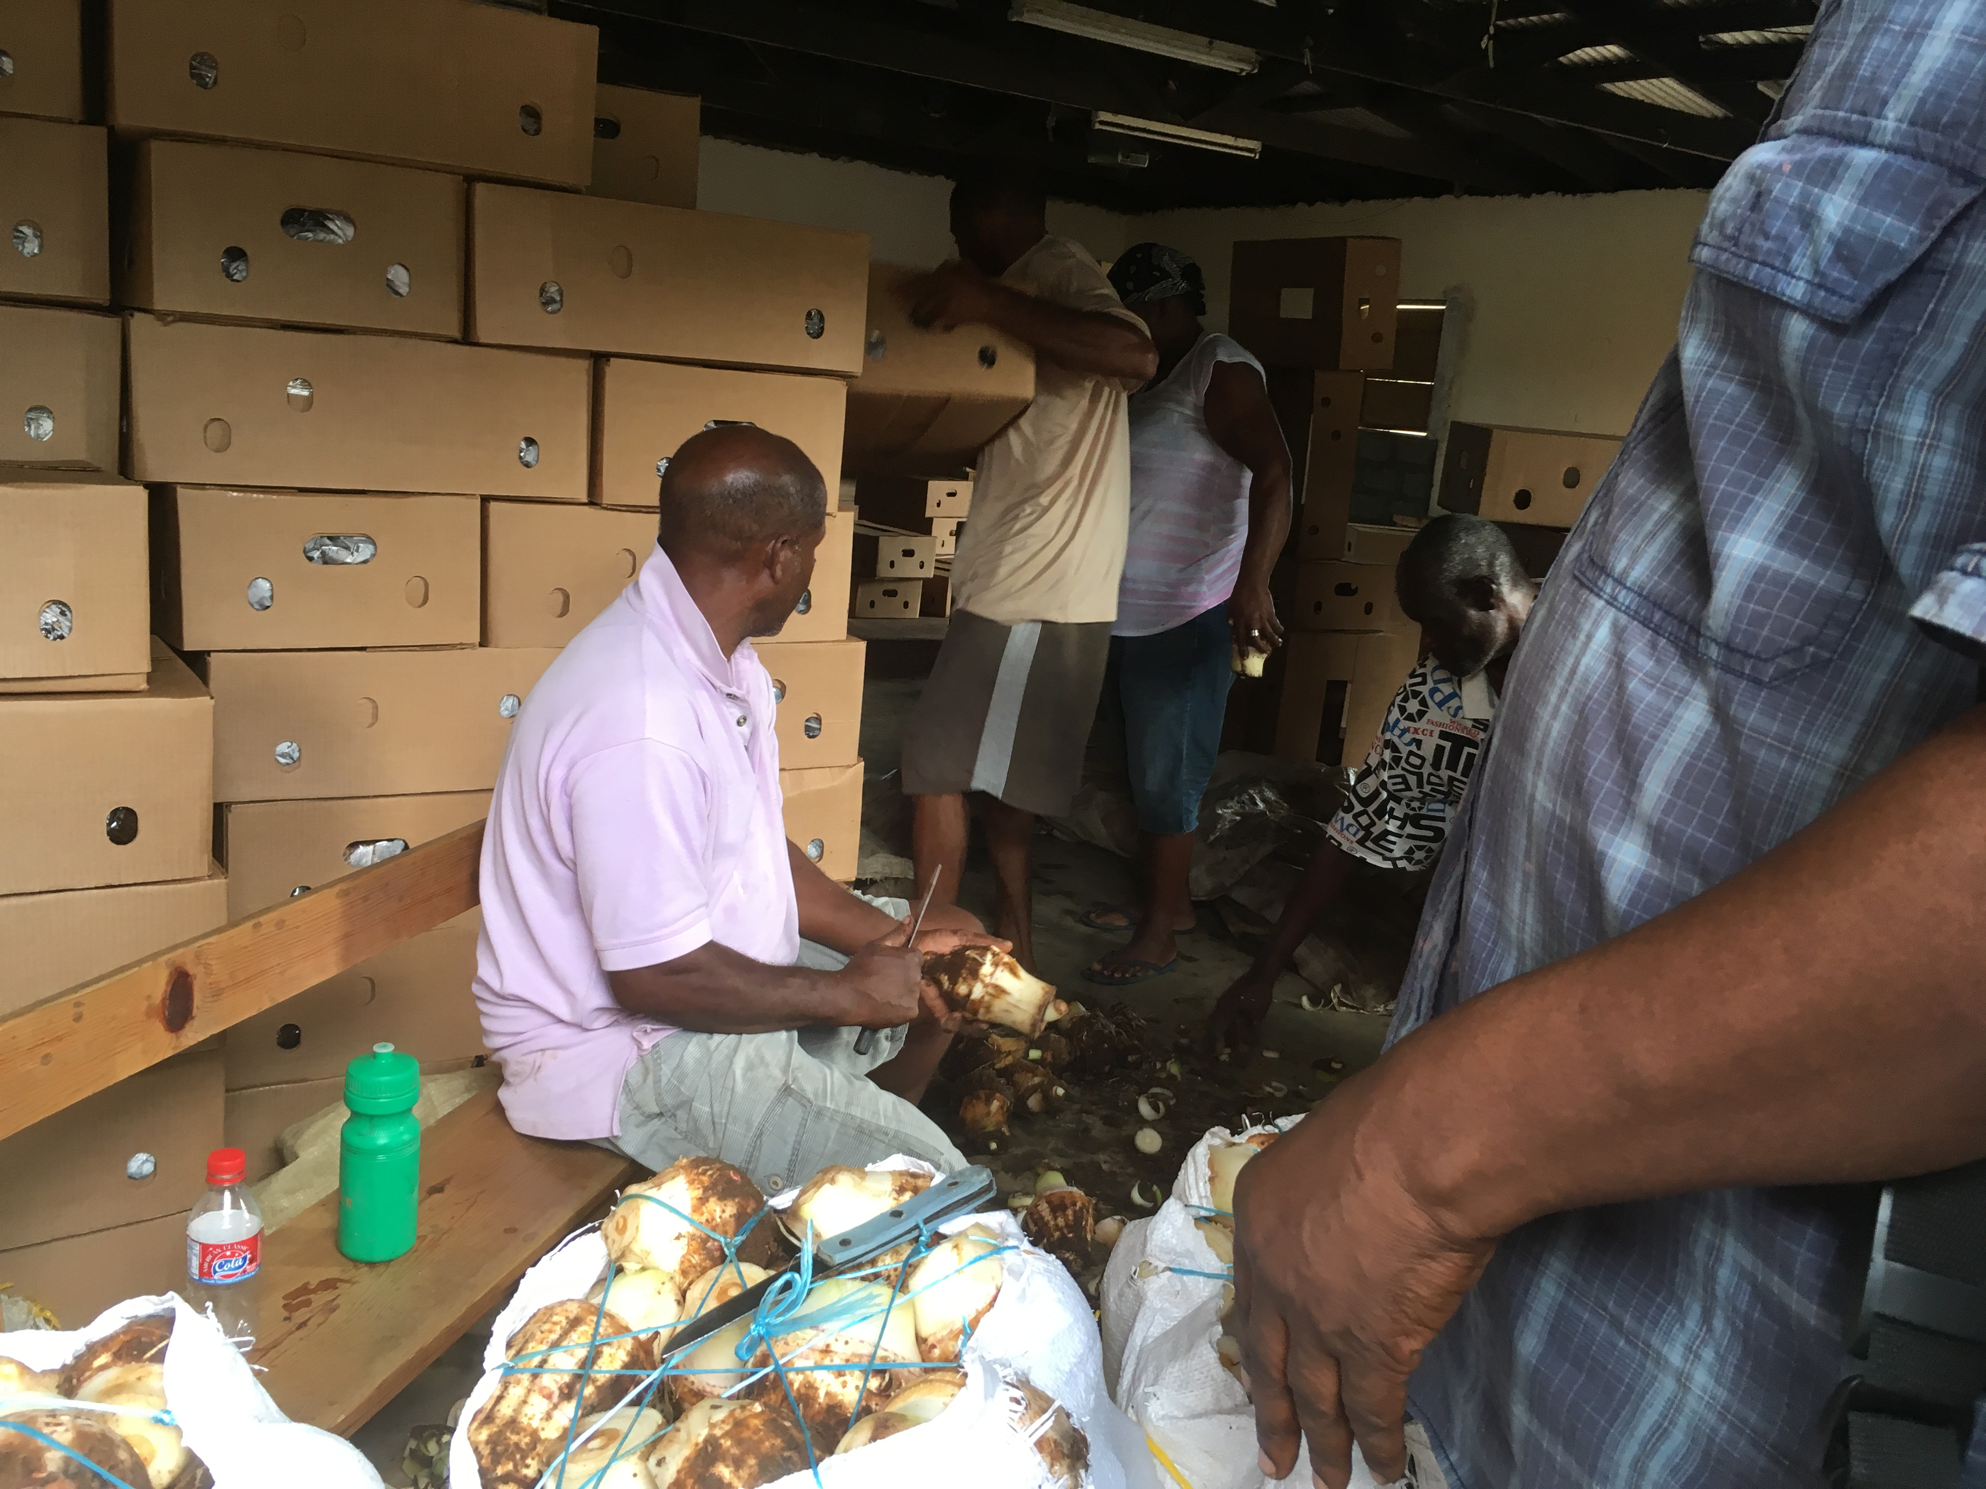
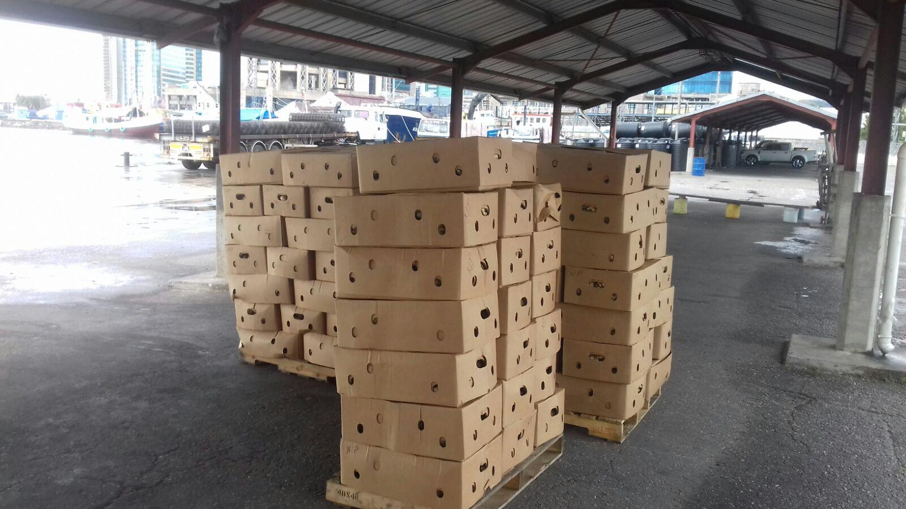
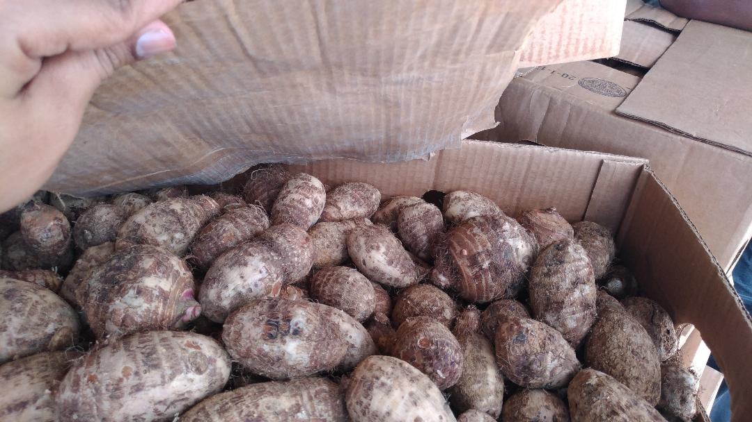
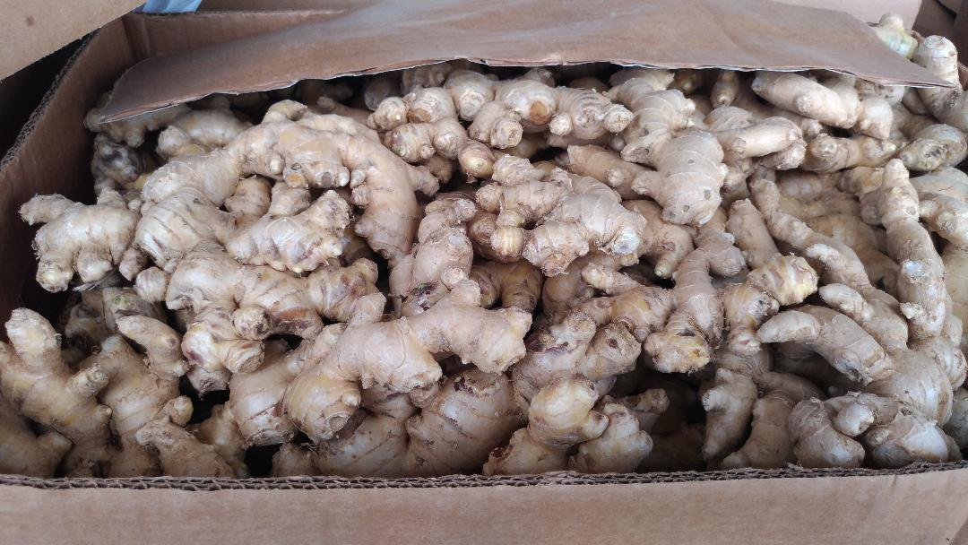
St Vincent and the Grenadines: Improvement in Packaging/ Produce Standards

Slide 28
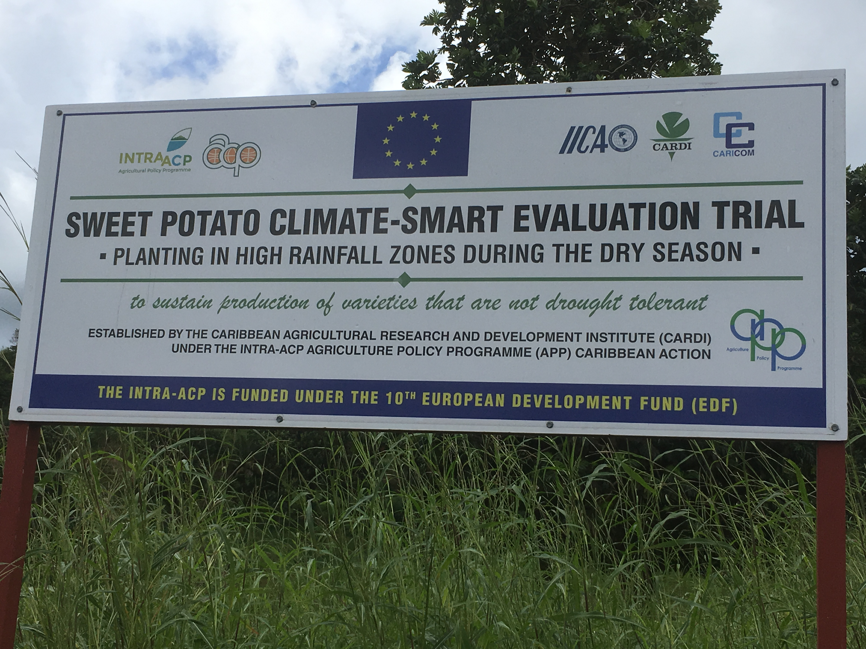
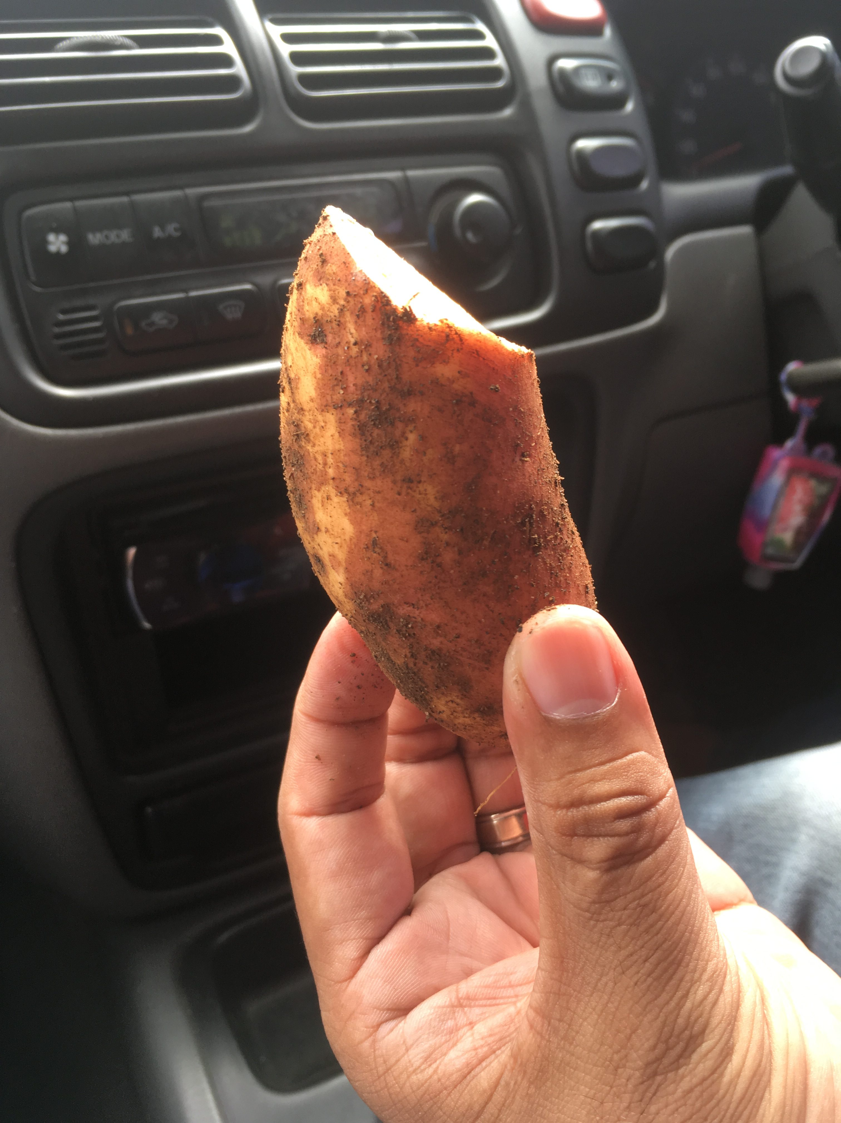
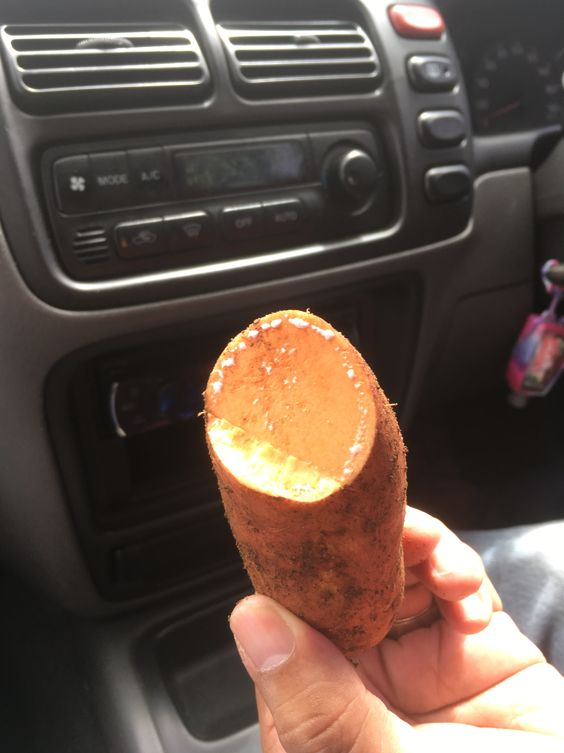
St Vincent and the Grenadines: International Collaborations to Improve Agricultural Standards

Slide 29
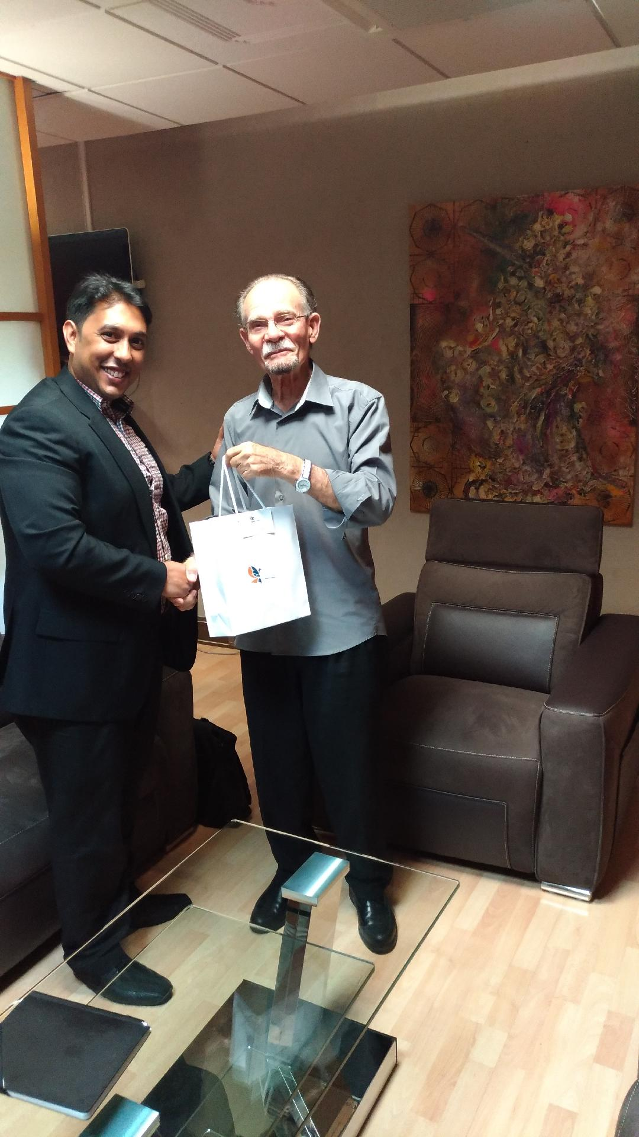
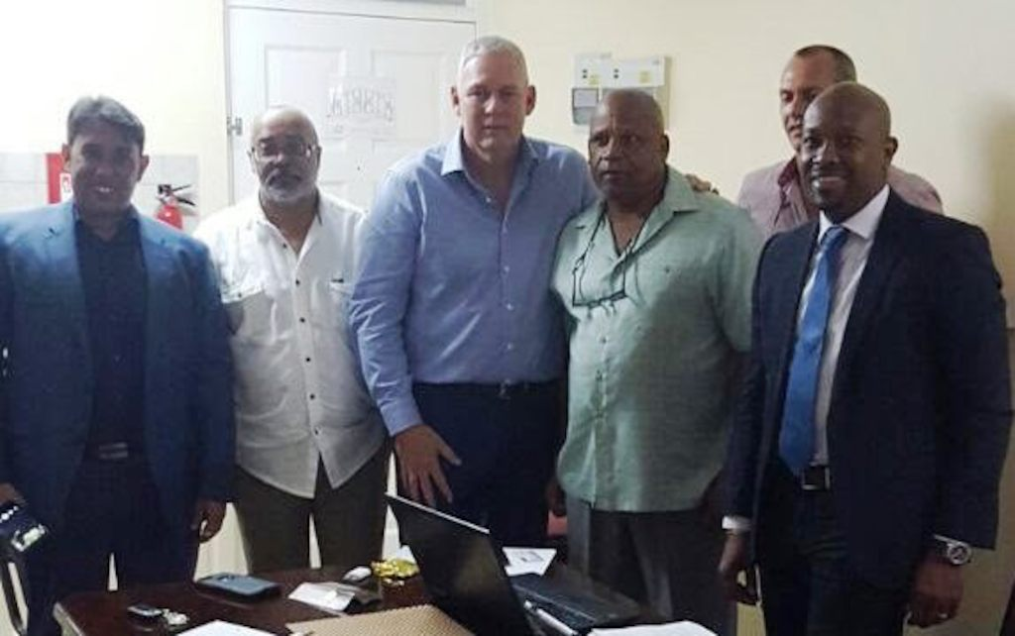
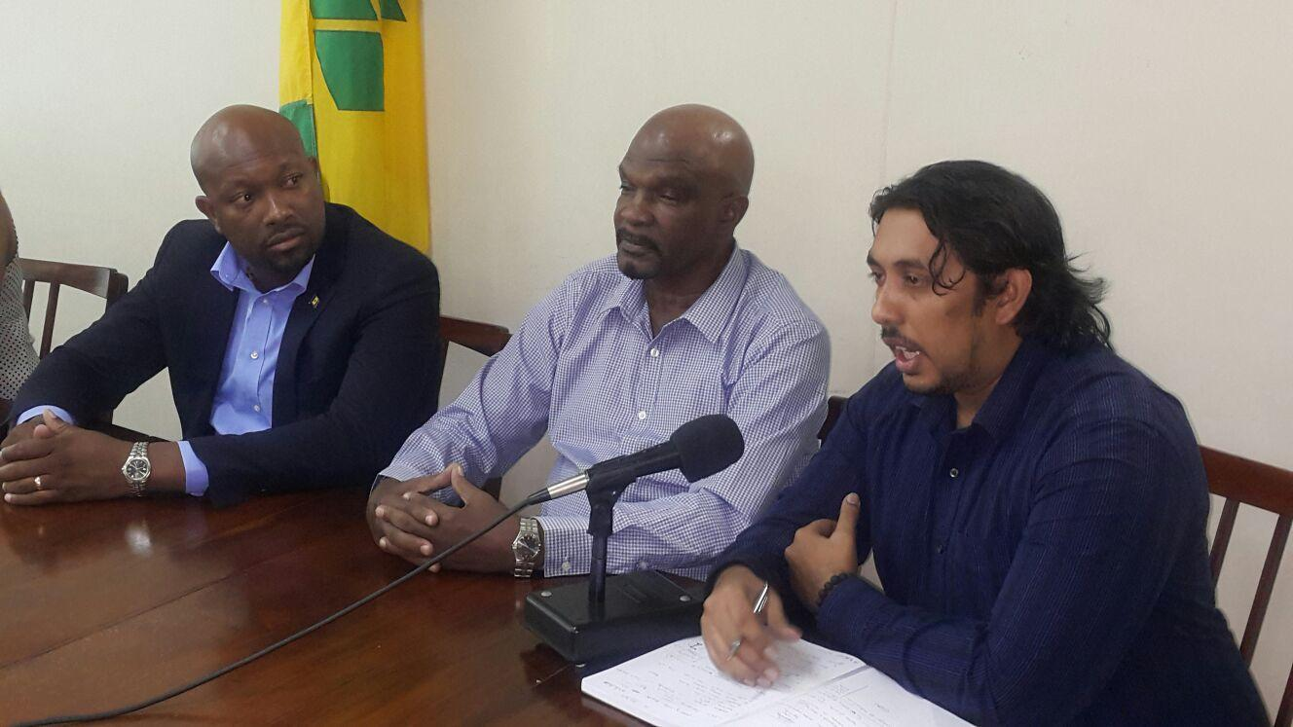
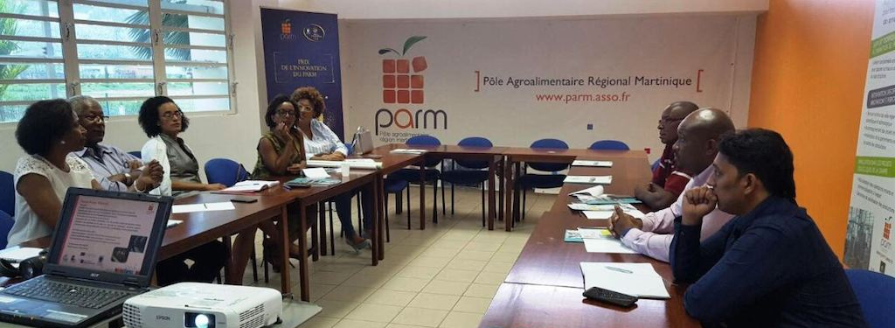
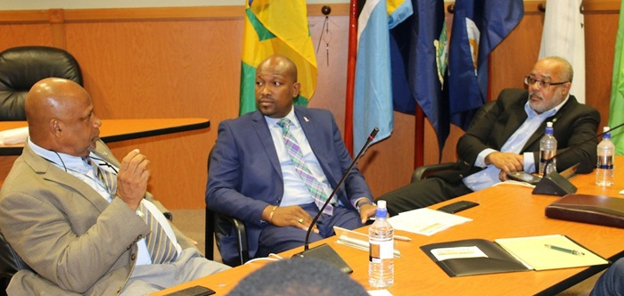
St Vincent and the Grenadines: Regional Collaboration

Slide 30
Contact Information Mr. Jai Rampersad IMBA (Distinction) BSc (First Class Honours) jairampersad@yahoo.com

