Slide 1
Daniele Ehrlich, Martino Pesaresi and Thomas Kemper, Laxenburg, October 10-11, 2016 ConnectinGEO Workshop on Gap Analysis and Prioritization
The GHSL framework for implementing International Framework Agreements

Slide 2
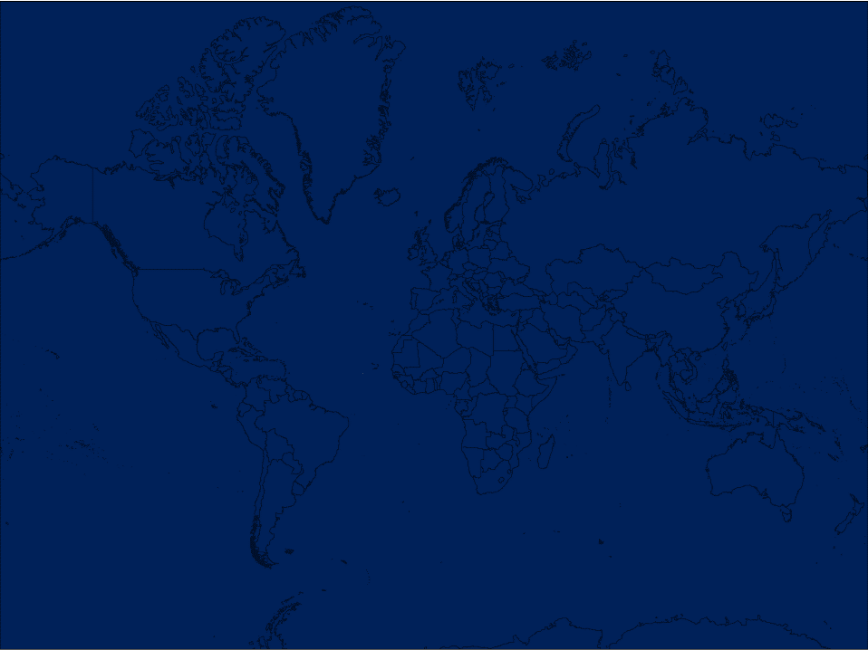
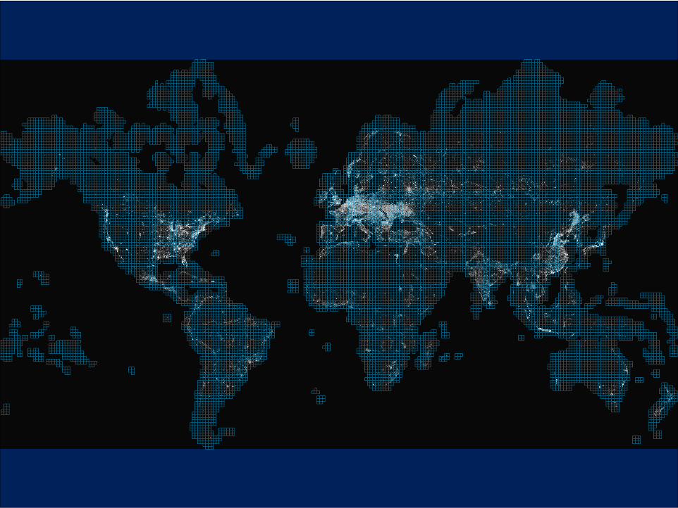
What is GHSL?
Is GHSL addressing the GAPS?
GHSL is more than built-up
GHSL applications
International Frameworks
Way forward next steps
2014 – first tests on automat. assessment of global built-up areas using Landsat data
GLS 1975,GLS 1990,GLS2000, and Landsat 8
Notes:
Global mosaic of the density of buildings as estimated

Slide 3
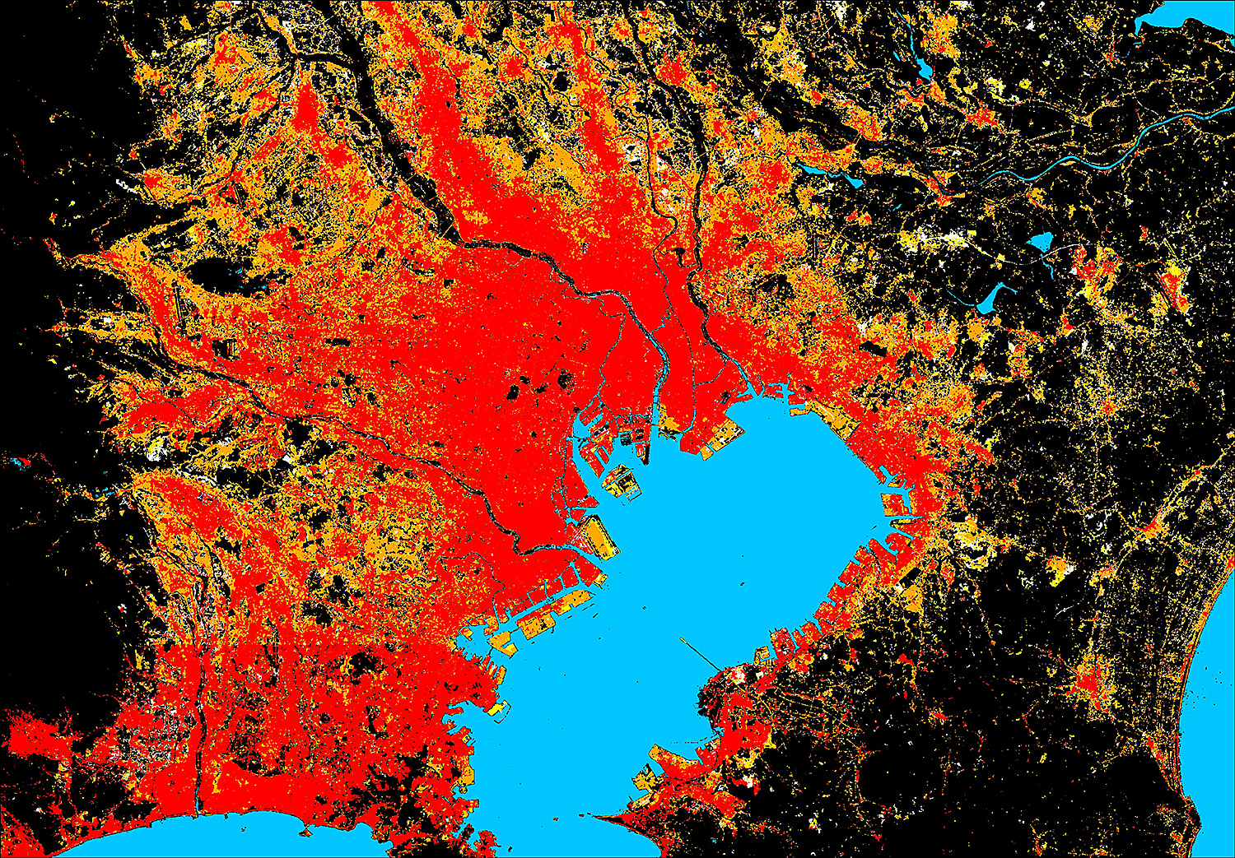
Tokyo
Water No Built-up
BU in 2014
BU in 2000
BU in 1990
BU in 1975
Notes:
The GHSL provides also maps of settlement extent over 4 different epochs, 1975, 1990 2000 and 2014. Please see legend.
Tokyo, one of the largest urban agglomeration of the world

Slide 4
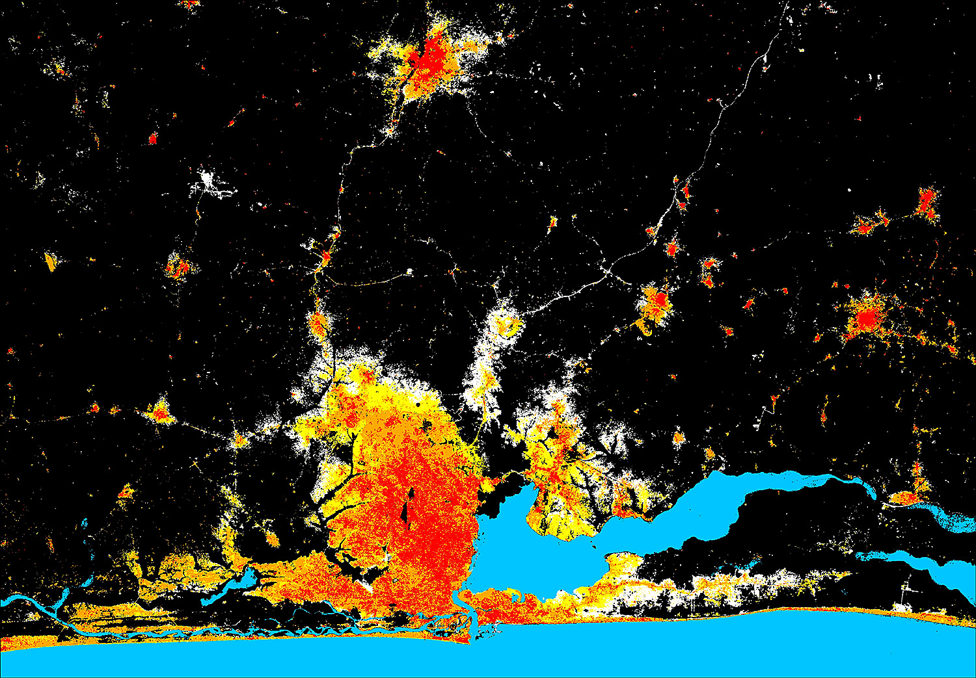
Lagos
Water No Built-up
BU in 2014
BU in 2000
BU in 1990
BU in 1975
Notes:
The GHSL provides also maps of settlement extent over 4 different epochs, 1975, 1990 2000 and 2014. Please see legend.
Spurred by population growth and urbanization developing countries large cities continue to growth

Slide 5
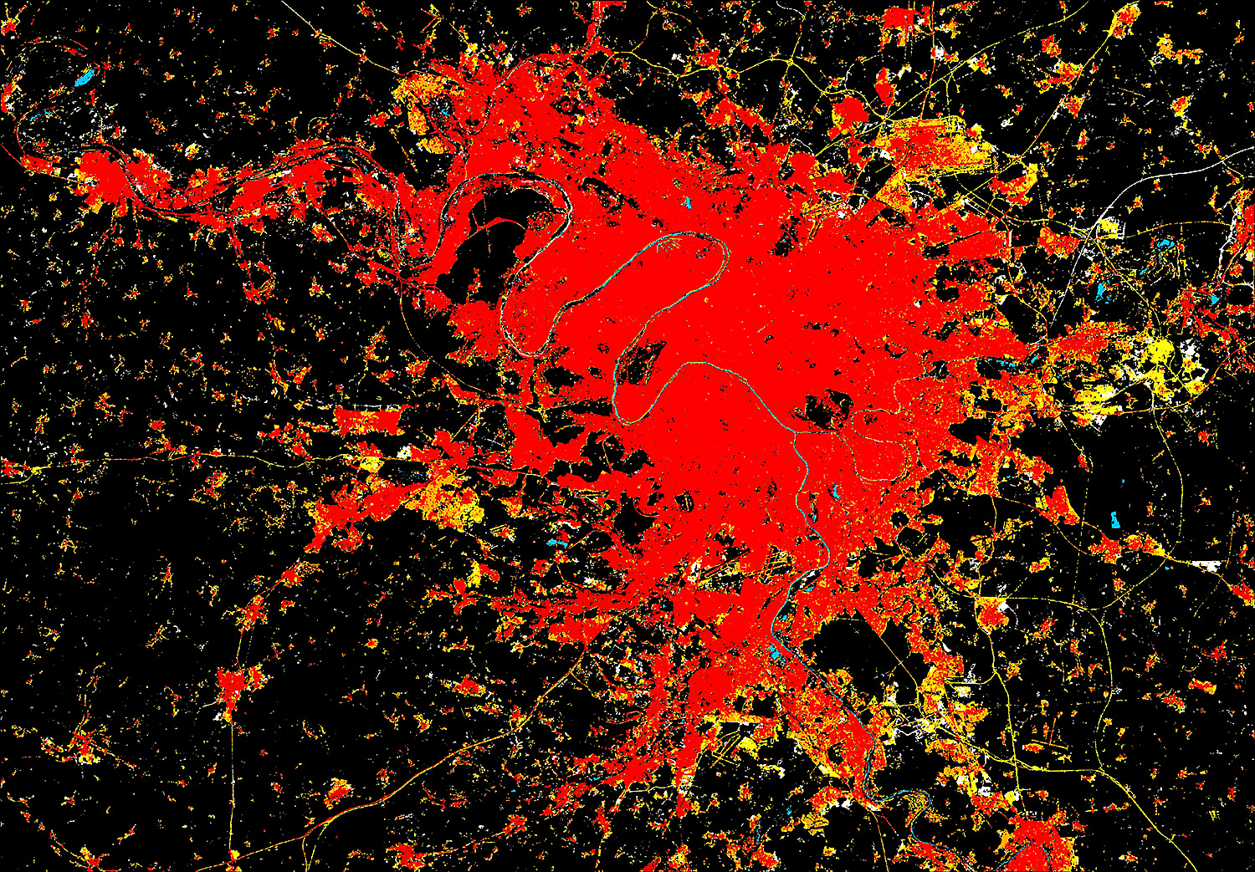
Paris
Water No Built-up
BU in 2014
BU in 2000
BU in 1990
BU in 1975
Notes:
The GHSL provides also maps of settlement extent over 4 different epochs, 1975, 1990 2000 and 2014. Please see legend.
Large European cities do not expand as the cities of developing world → see Lagos

Slide 6
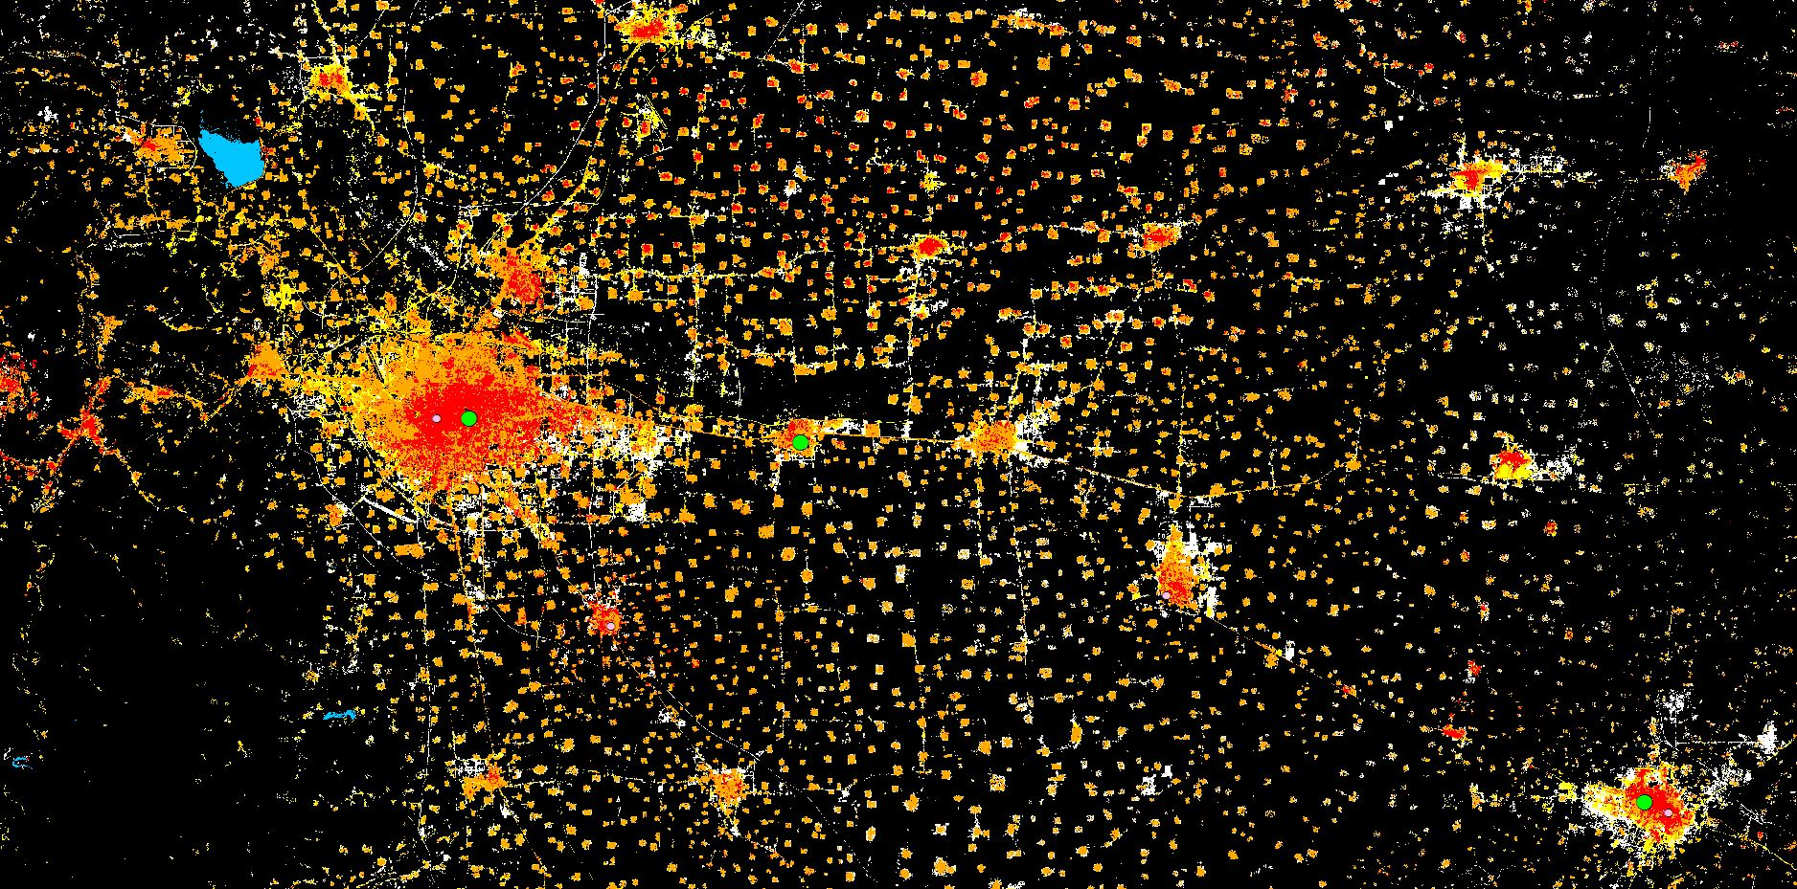
Discovering new elements in the universe of cities (China)
Cities accounted in the UN World Urbanization Prospect 2015

Slide 7
GAPS
Definition of built-up inclusive of all settlements (consistent)
no built area is left out
Processing global datasets automated (reproducible)
consistent in space
Monitor global settlements in time (reproducible)
consistent in time
Improved global population density (inclusive)
(socializing the pixel)
Adapting it to the needs of policy makers (flexible)
Rural, Sub-urban, cities models.

Slide 8
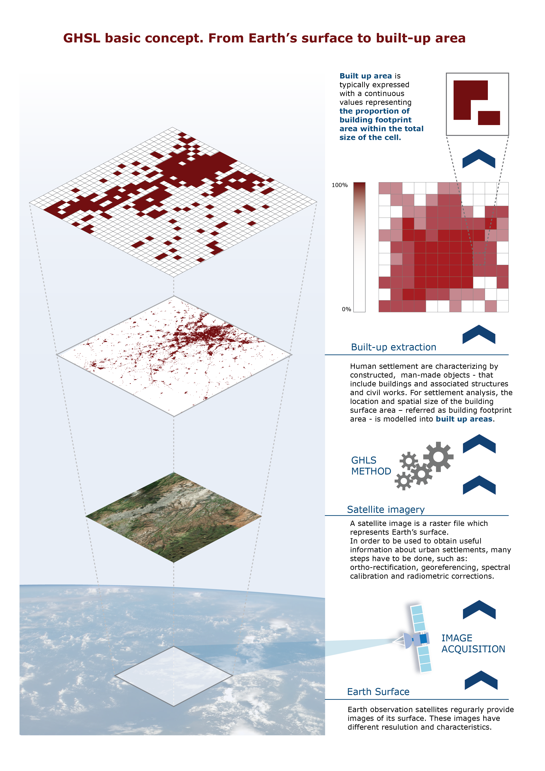
What is GHSL
Processing framework
Big data sets
Heterogeneous (imagery, vector, categorical, continuous)
Mix knowledge data tools
Human Settlements
Built-up Population
Settlement Classification

Slide 9
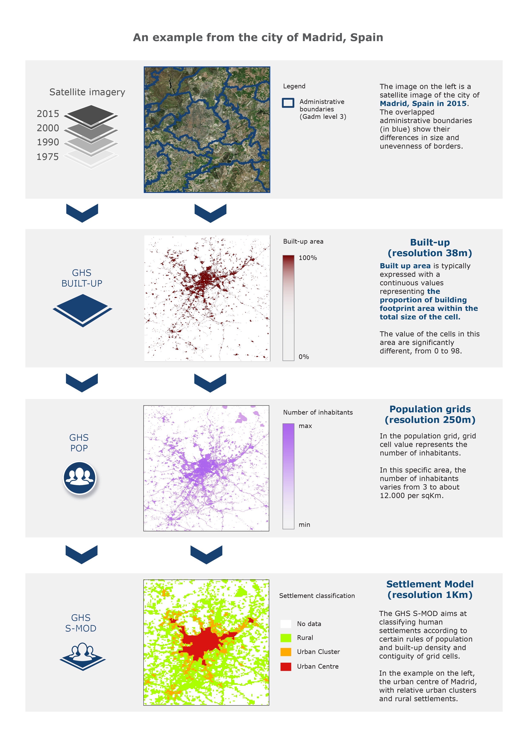
GHSL “products”
Human Settlement is more than just
built-up
Population density
Settlement type
(population + built-up)

Slide 10
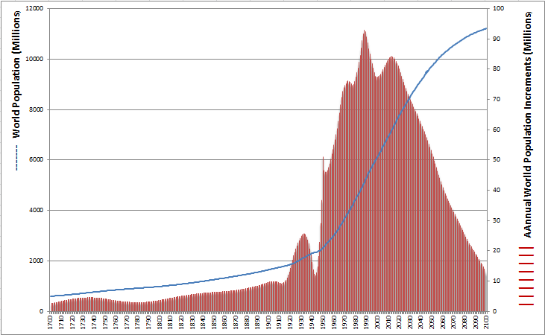
Population
Disaggregating population census information based on the built-up

Slide 11
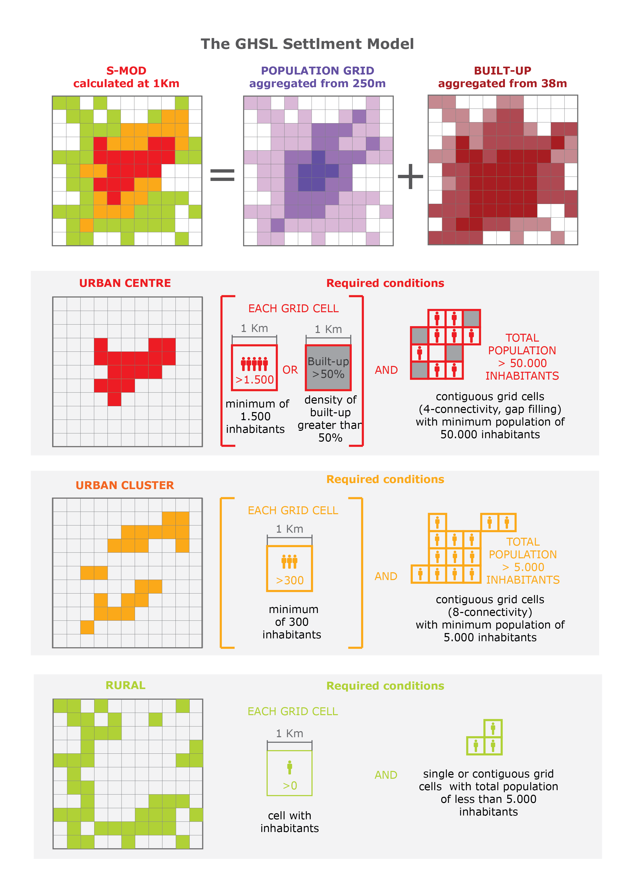
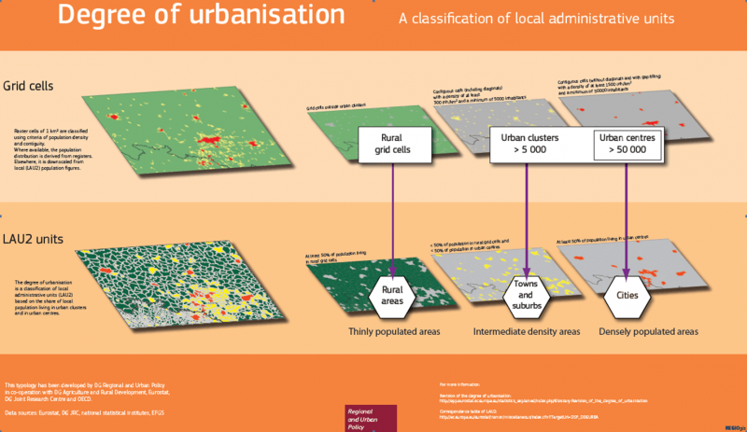
Settlements Model
Takes into account of bot population density and built up density

Slide 12
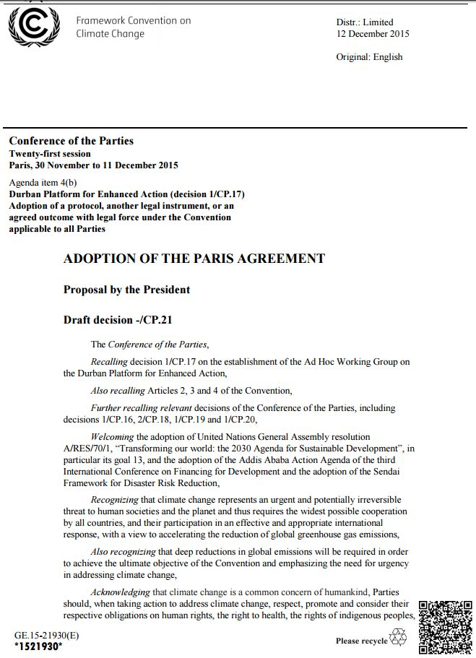
United Nations Frameworks
Transforming our world: The 2030 Agenda for sustainable development
Draft 1 August 2015
Sendai Framework for Action 2015-30
March 2015
Sustainable
Development Goals
Sept 25-27, 2015
Art. 25
1. Loss Data
2. Satellite data and geospatial technologies Human Settlements Population
By 2030, decrease mortality, physical losses due to disasters, by
By 2020 increase by [x] per cent the number of cities and human settlements
…. , resource efficiency, mitigation and adaptation to climate change, resilience to disasters, develop and implement,
By 2030, decrease mortality, physical losses due to disasters , by
By 2020 increase by [x] per cent the number of cities and human settlements
…. , resource efficiency, mitigation and adaptation to climate change, resilience to disasters, develop and implement,
JRC Scientific Support to Frameworks
(UN)
Percentage of urban population living in slums or informal settlements
By 2020, increase by [x] per cent the number of cities and human ….., resource efficiency, mitigation and adaptation to climate change, resilience to disasters, develop and implement,
By 2020 increase by [x] per cent the number of cities and human settlements
Percentage of urban population living in slums or informal settlements
Climate
Change Conference
Dec 12, 2015
Paris
HABITAT III
Quito
October 17-20, 2016 Quito
Notes:
Percentage of urban population living in slums or informal settlements

Slide 13
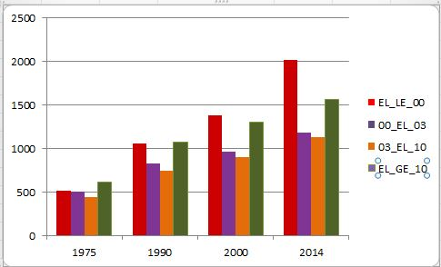

Slide 14
14
Notes:
The 2030 agenda for the SDG tackles the challenges of urban development through development goals 11 which aims at making cities and human settlements inclusive, safe resilient and sustainable.
There are ten targets for SDG#11 that start to unpack the SDG’s meaning and philosophy, and also imply actual measures of progress:
Now comes the hard part—activating the indicators. Three of these indicators are strong candidates for using new geospatial technologies in what could become a revolutionary way to bring policy-relevant information to public and private decision-makers.

Slide 15
Urbanization: Global Facts and Figures (per SDG 11):
By 2030, almost 60 per cent of the world’s population will live in urban areas
95 % of urban expansion in the next decades will take place in developing world
828 million people live in slums today and the number keeps rising
The world’s cities occupy just 3 per cent of the Earth’s land, but account for 60-80 % of energy consumption and 75% of carbon emissions
Notes:
Crucial to the success of the SDGs will be strong government systems and, in particular, strong statistical systems that can measure and incentivize progress across the goals [1]. The production and use of quality data is therefore becoming increasingly recognized as being a fundamentally important task for the measurement, monitoring, and tracking of the SDGs.
Open geospatial data and technologies are expected to be useful for implementing a geospatial information-based monitoring framework for the SDGs. Both developed and developing nations will be asked to monitor the implementation of the SDGs based on their national spatial data infrastructure (NSDI), but many developing nations will likely find this task difficult because of financial and technical problems. Thus, open geospatial technologies could help to alleviate this burden for developing countries because the access costs for data and software used to implement the NSDI are typically much lower when such technologies are employed. The use of open geospatial technologies could also help to make the methods and results for SDG measurements globally interoperable since they comply with open geospatial standards. The literature review findings suggest that geospatial information could play an important role in overcoming the aforementioned data challenges and in strengthening the capabilities of governments and agencies that are tasked with analyzing and reporting on the SDGs. In fact, the final 2015 MDG Report raises the need for geospatial information and notes that geospatial data can support monitoring in many aspects of development [5]. In the Future We Want report, the UN emphasized the importance of the use of geospatial technologies for driving sustainable development and supporting data-driven evidence-based policy making [6]

Slide 16
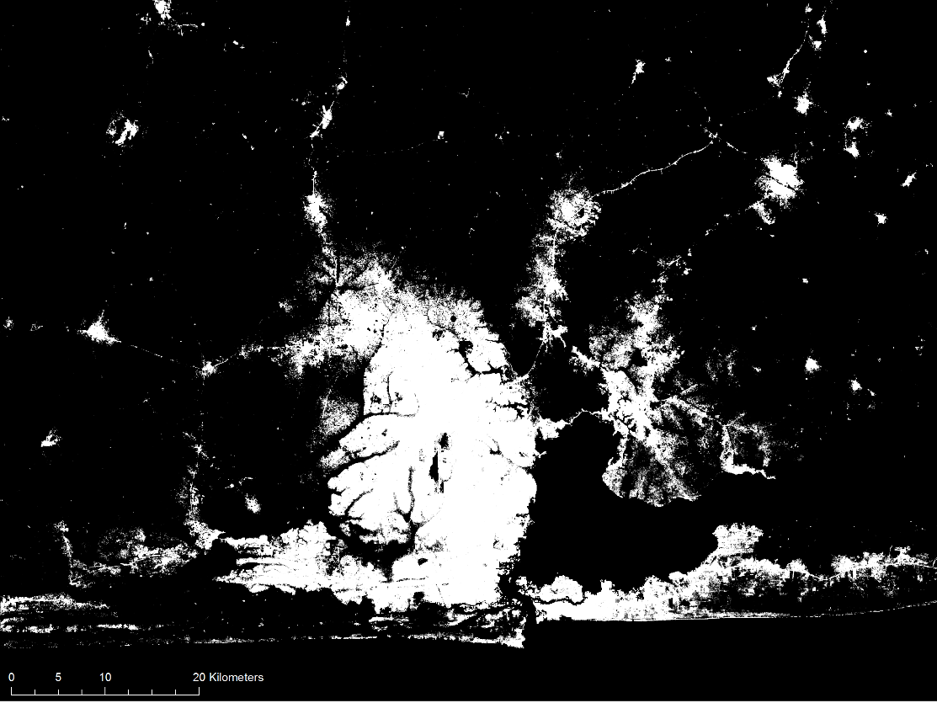
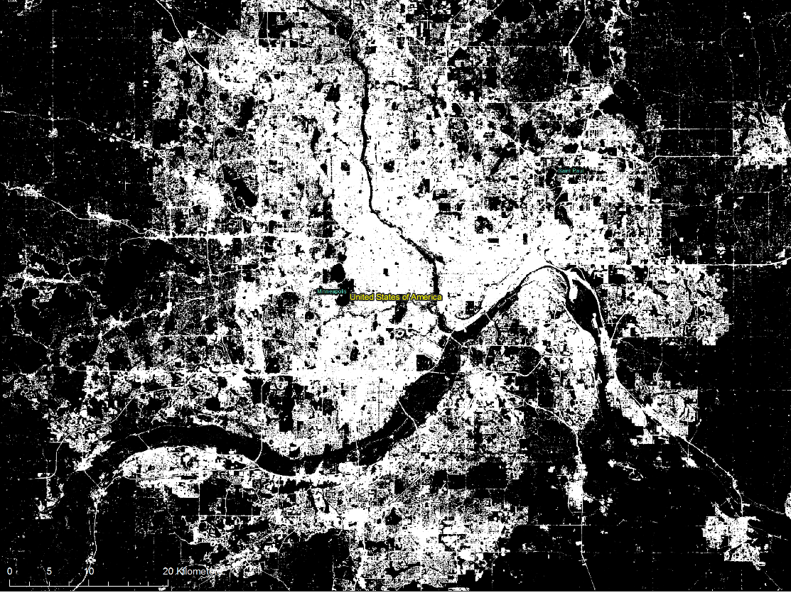
GHSL enables objective comparison
Lagos, Nigeria, 2015
~5 millions inhabitants
Built-up areas, Landsat 30m-res sensor
Minneapolis, US, 2015
~0.5 millions inhabitants
Built-up areas, Landsat 30m-res sensor
Notes:
Measuring progress towards target 11.3 at global level requires harmonized global datasets on urban areas ,

Slide 17
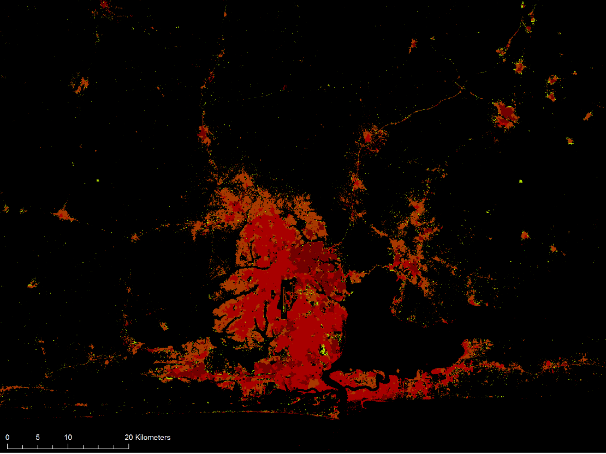
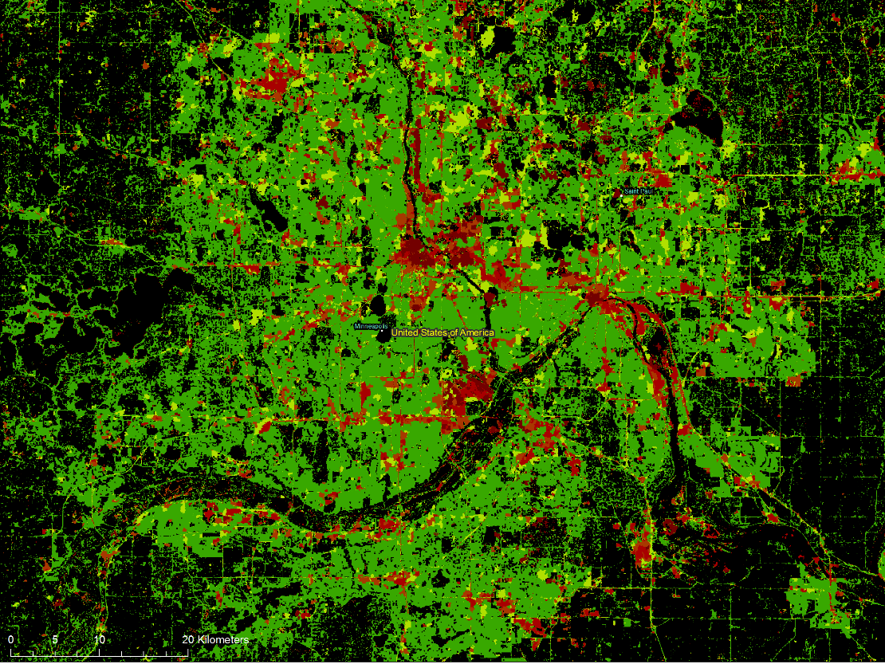
GHSL enables objective comparison
Lagos, Nigeria, 2015
~5 millions inhabitants
Vegetation component in built-up areas,
Landsat 30m-res sensor
Minneapolis, US, 2015
~0.5 millions inhabitants
Vegetation component in built-up areas,
Landsat 30m-res sensor
Notes:
t can also monitor green space, as the two images below represent, by showing the inverse of the built up area, which can be used to calculate open space.

Slide 18
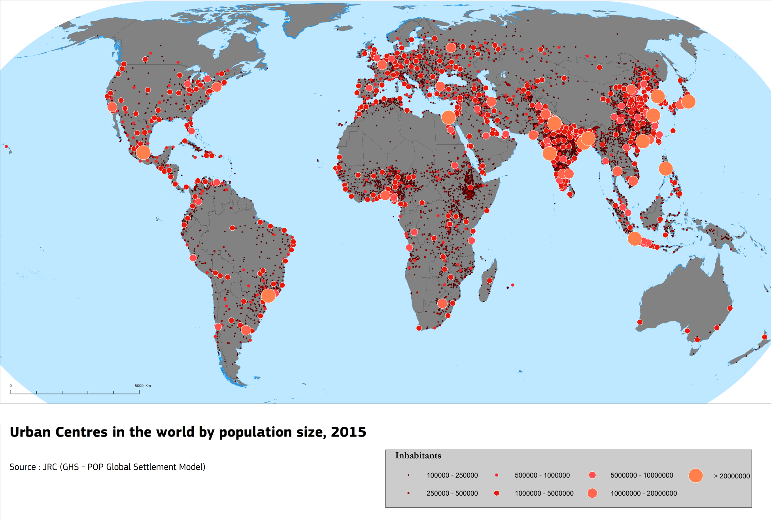
Urban Centers in the world by population size
source: European Cities Report, European Commission, DG REGIO
Notes:
High-density cluster (or urban centre):
Contiguous (5) grid cells of 1 km 2 with a density of at least 1 500 in -habitants per km 2 and a minimum population of 50 000.
• Urban clusters: Clusters of contiguous (6) grid cells of 1 km 2
with a density of at
least 300 inhabitants per km
2
and a
minimum population of 5
000.
• Rural grid cells:
Grid cells outside urban clusters.
• Density:
Population divided by land area

Slide 19
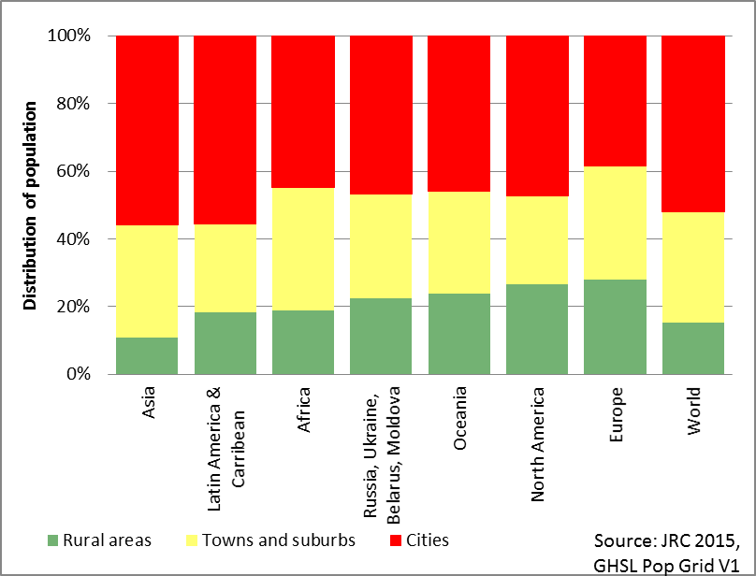
Population share by degree of urbanization per part of the world, 2015
source:
European Cities Report, European Commission, DG REGIO

Slide 20
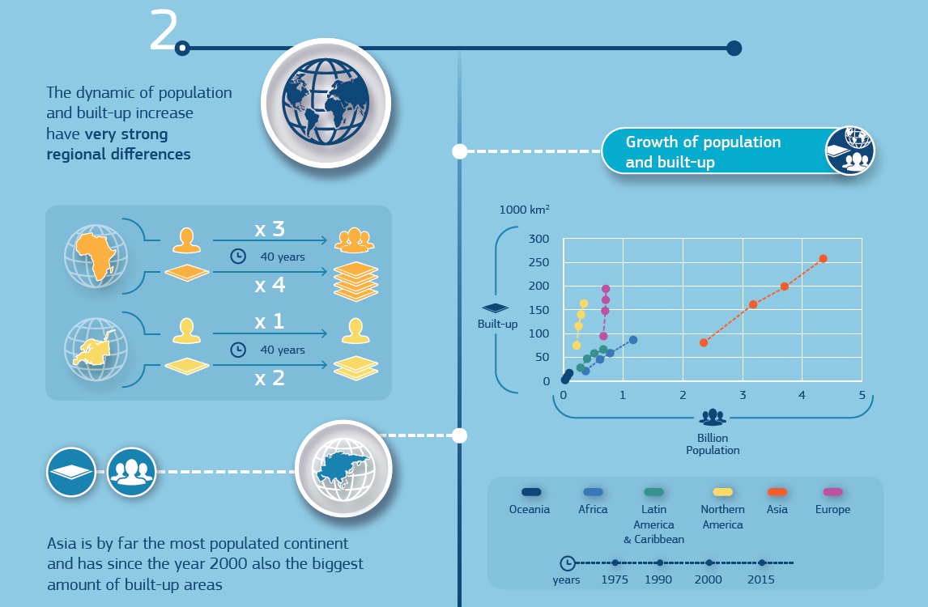

Slide 22
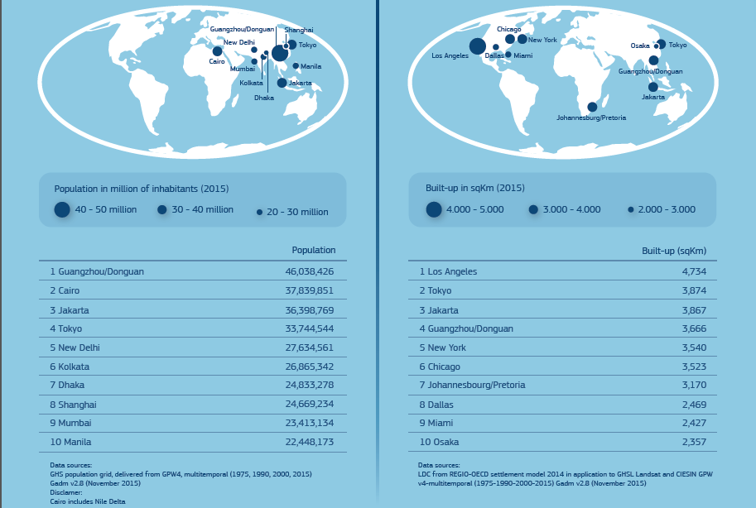

Slide 23
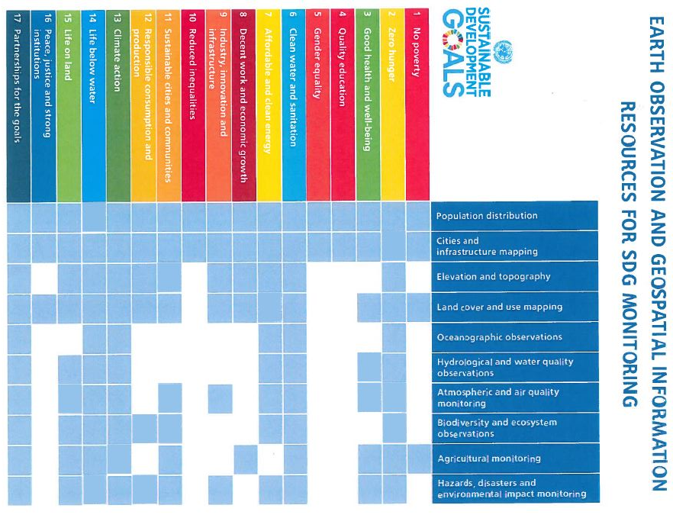

Slide 24
Way forward
Continue mapping settlements with improved datasets (Sentinel)
Improve detail and assure continuity
Develop a system of validation of settlement maps
Characterization of settlements (slums, other)
Measure height and estimate volume of settlements
Combine with socio-economic variables
Address current and new information needs
Exposure to natural hazards – Energy demands and consumption

Slide 25
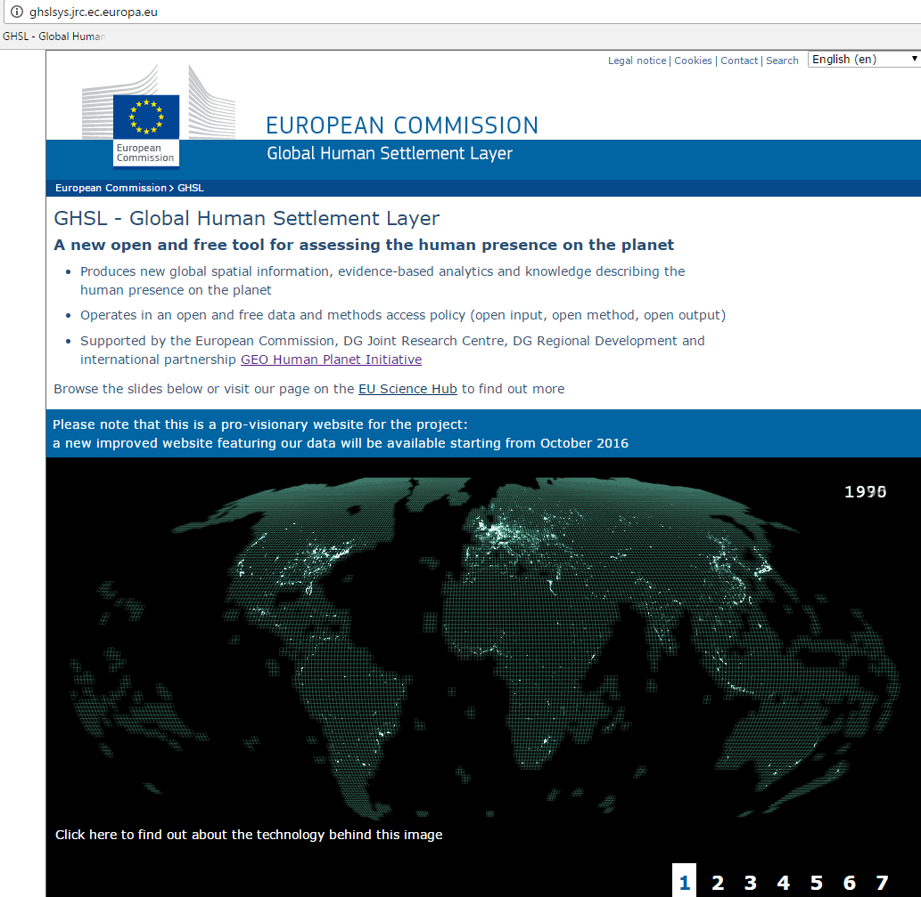
https://ec.europa.eu/jrc/en/global-human-settlement-layer
Notes:
Ghslsys.jrc.ec.europa.eu

