Slide 1
Workshop on Gap Analysis and Prioritization
Providing Earth Observation Support to the Monitoring and Implementation of the Sustainable Development Goals: Gaps and Priorities
The ConnectinGEO project
Ivette Serral
10 - 11 October 2016
IIASA. Schlossplatz 1 - A-2361 Laxenburg, Austria

Slide 2
Introduction
2 year H2020 funded project (641538). Now in the last months (ending by January 2017).
Coordinate and Support Action (CSA)
15 partners
A contribution of the EC to GEOSS
Main objectives
Perform a gap analysis in EO data, mainly in-situ
Propose priorities for addressing this gaps
Manage an European Network of Earth Observation (ENEON)
Link gaps to EV and SDG

Slide 3
Main results - EV review and analysis
EVs are variables that have a high impact and should have priority in designing, deploying and maintaining observation systems and making data and products available
Coming from a Workshop in Bari, June 2015 and reported in the public D2.3: Proposal of EVs for selected themes
147 EVs reviewed
Some of the EVs are not a single variable, but a cluster of several ones
The community that has defined the highest number of EVs is currently the Climate one, lead by the Global Climate Observing System (GCOS)
Most of the ECVs are relevant to the other GEO SBAs or themes
Other communities already working on a mature set of EVs are Weather (lead by WMO/GAW) and Ocean, lead by the Global Ocean Observing System (GOOS)
EV discussion and related work is growing fast in Biodiversity and Water. Energy community follows.
Agriculture, Disasters, Ecosystems, Health, and Urban Development, are still in the initial stage

Slide 4
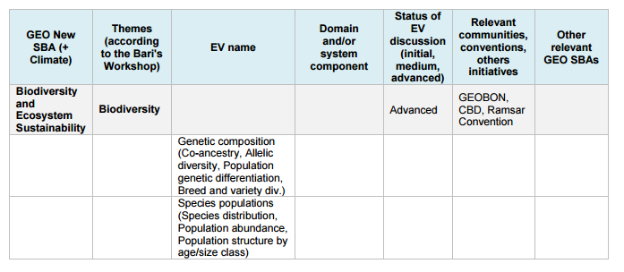
Conclusions
Many SBA can rely on a number of EVs already available in other areas
Better to concentrate efforts on those variables that are cross-cutting different domains and check if the requirements are the same
Fragment of the summary table available in the deliverable

Slide 5
Main results - SDG review and analysis
UN approved 17 SDGs articulated in 169 targets and 240 indicators to measure progress towards these targets
How many indicators can be measured using Geospatial information and which subset can be measured with EO using EV?
231 of the 240 indicators can be calculated with socio-economic data,
only 30 can be extracted with the combination of socio-economic data and Earth observation (in-situ, airborne or remote sensing),
only 9 indicators by Earth observation alone,
…, but Earth observation can be used to understand global processes that can help to retrieve other indicators.
In ConnectinGEO, an effort has been done to link SDG with EV → available in the D2.3 Proposal of EVs for selected themes

Slide 6
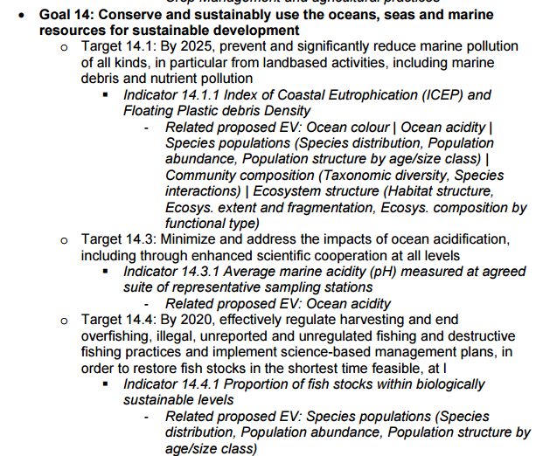
Example

Slide 7
Organizing the European Contribution to GEOSS
Instruments:
European data hub - NextGEOSS
ERA-Planet
European Network of Earth Observation Networks
Via:
Participation in GD-06
Report provided on the status of in-situ observations
ENEON workshops
ENEON website
ENEON activities
E.g. Mapping the Networks
SOS Web service for the networks linking data to GEOSS

Slide 8
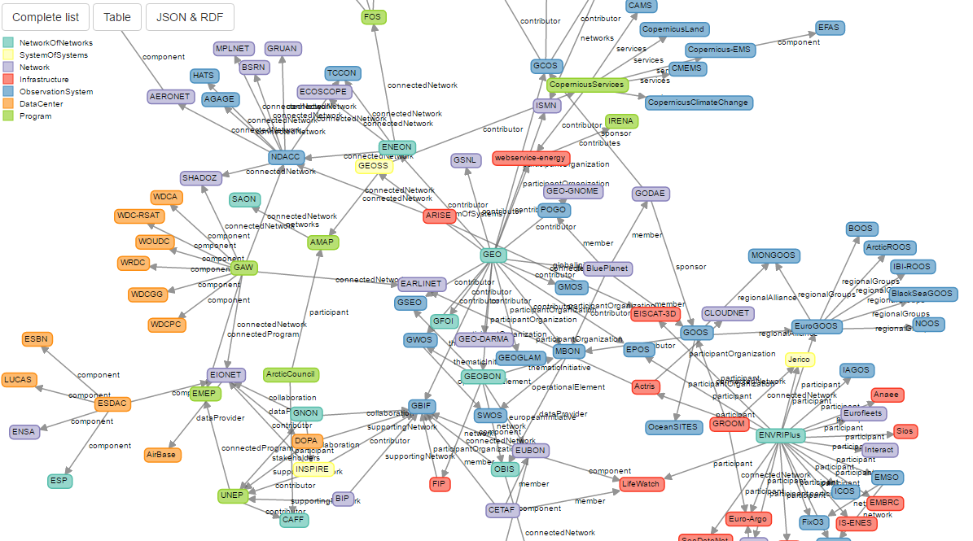
Main results – Map of the EO networks
A dynamic graph of the existent EO networks in Europe in JSON-LD format - http://www.eneon.net/graph
Anyone can contribute! User feedback system integrated to enhance this first draft version

Slide 9
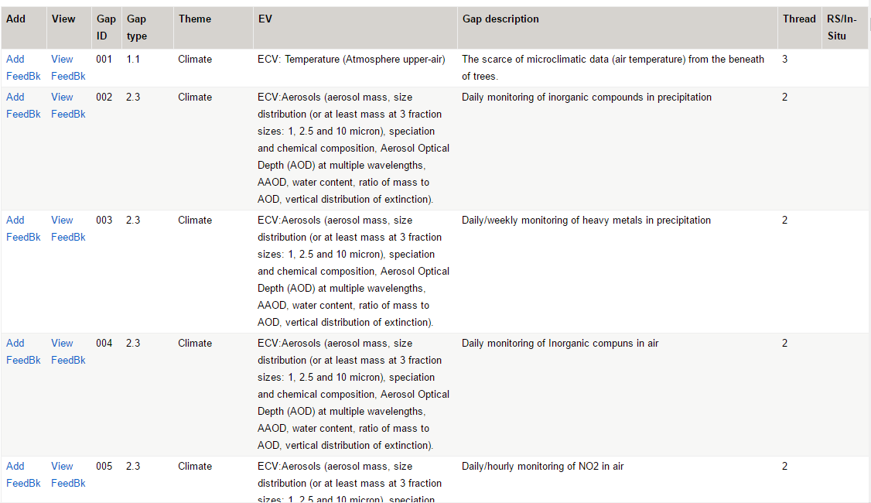
Main results – EO gaps analysis
176 gaps identified coming from the ConnectinGEO methodology
Collected in a collaborative table were anyone can contribute:
http://twiki.connectingeo.net/foswiki/bin/view/ConnectinGEOIntranet/GapAnalysisTable
User feedback system integrated for a given gap

Slide 10
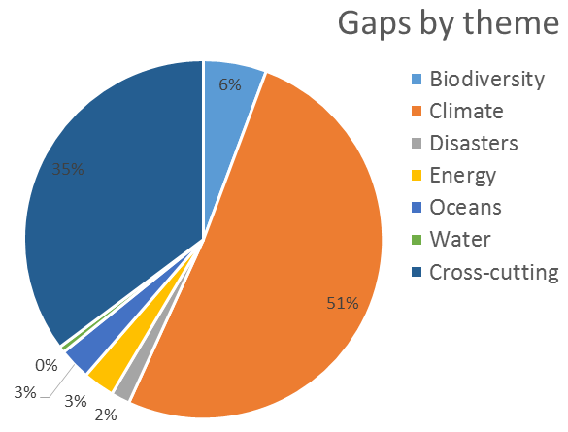
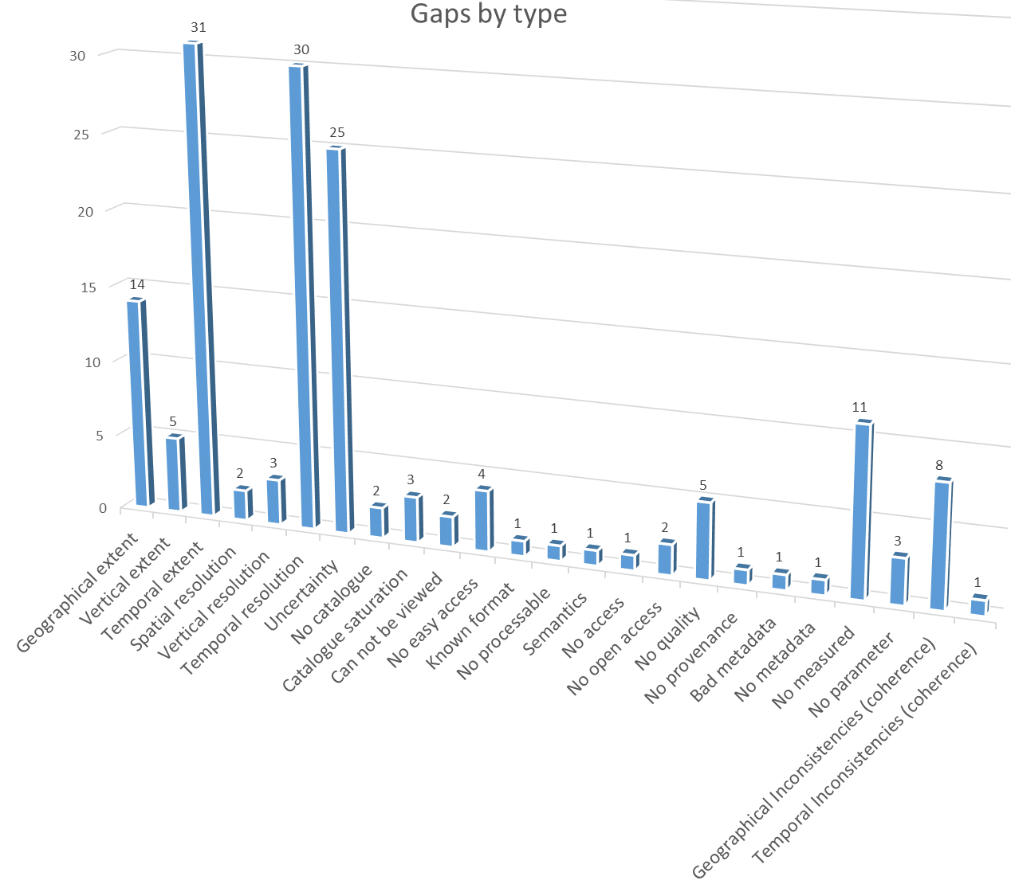
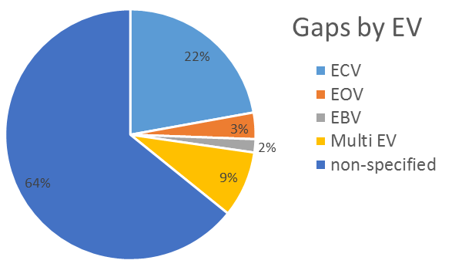
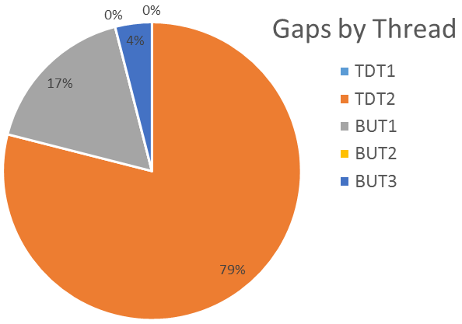
Some preliminary statistics extracted from the gaps

Slide 11
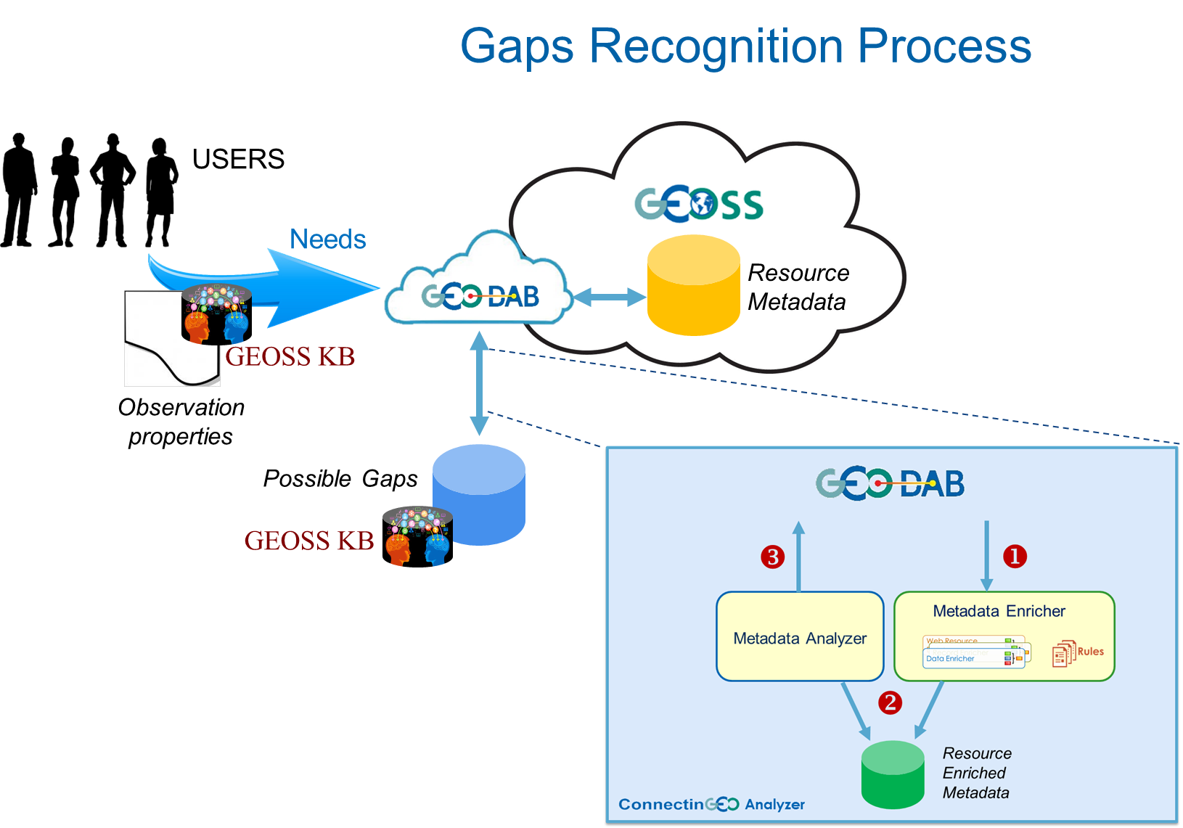
Other results – gaps inventory
Linked to the GEO DAB and the GEOSS KB
Metadata enrichers and data filters
Formulating the right questions to assess the gaps

Slide 12
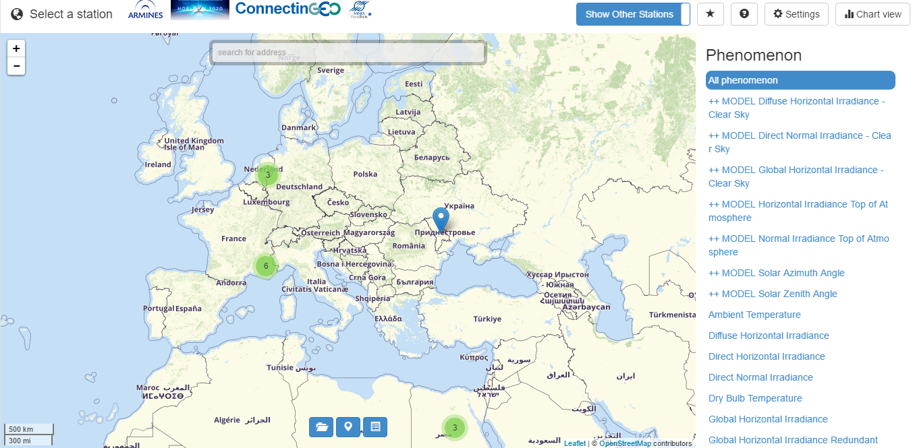
Other results – A WebGIS Client providing access to in-situ measurements:
Based on the 52N SWE (Sensor Web Enablement) solution following OGC SOS (Sensor Observation Service) standard and GEOSS recommendation on interoperability
http://insitu.webservice-energy.org/jsClient-0.2.0/#map
visualization of sensor locations
visualization of measurements as time series
display of sensor metadata
computation and statistical representation of time series
download data

Slide 13
Challenges
Sustainability and engagement in the ENEON
Analyzing alternatives including social network or merging with other initiatives (ERA-Planet, NextGEOSS, ENVRI+…)
Keep the network mapping updated
Activate Bottom-Up Thread 2 and 3 to collect their gaps
Apply the gap analysis methodology regularly
Setting the right priorities for the current gaps
Scientific Special Issue on Environmental and socio-economic methodologies and solutions towards integrated Essential Variable definition and generation

