Slide 1
5th gsts workshop
Session 6
GEO SDG Initiative: EO in Service of the 2030 Agenda and capacity building
Argyro Kavvada, BAH-NASA

Slide 2
Initiative: Implementation Plan
SDG Initiative
SDG Initiative Vision
Countries, stakeholders, and the global community desire additional Earth observations and geospatial information to continue progress on improved social, economic, and environmental sustainability.
SDG Initiative Purpose
Organize and realize the potential of Earth observations and geospatial information to advance the 2030 Agenda and enable societal benefits through achievement of the Sustainable Development Goals.

Slide 3
Initiative: Implementation Plan
SDG Initiative
Goal I: Demonstrate how Earth observations, geospatial information, and socio-economic and other data contribute in novel and practical ways to support achievement of the SDGs.
Goal II: Increase skills and capabilities in uses of Earth observations for SDG activities and their broader benefits.
Goal III: Broaden interest and awareness of Earth observations support to the SDGs and contributions to social, environmental, and economic benefits.

Slide 4
Initiative: Implementation Plan
SDG Initiative
Implementation Mechanisms
(done in conjunction with existing GEO efforts)
Projects:
A portfolio of projects conceive, develop, test, validate and deploy uses of Earth observations to support the tracking of and reporting on the SDGs, including integration with national statistical accounts for the indicators. Federated approach within GEO.
Capacity Building:
Activities provide support to institutions and individuals in the ideation, development, and implementation of methods, building capabilities directly with the SDG methods and more broadly with accessing and applying Earth observations.
Data and Information Products:
Activities advancing the provision, access, discoverability, and applicability of Earth observations and geospatial information for use with the SDGs.
Outreach and Engagement:
A portfolio of activities and events to promote the consideration and adoption of Earth observations for the SDGs by nations and stakeholders.

Slide 5
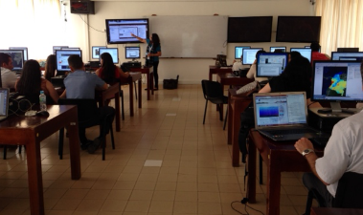
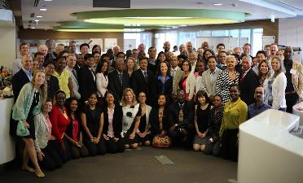
Capacity Building Program
Engaging current and future decision makers in a spectrum of activities to improve skills and capabilities in the United States and developing countries to access and apply NASA Earth science
Collaborating with GEO, CEOS, CGMS capacity building activities
2015 By The Numbers
4,104
People Engaged
135
Countries Reached
47
Long-Term Projects
78
Trainings Provided
67
EO Assets Utilized
93
Feasibility Projects
ARSET
Online and hands-on NASA remote sensing training
DEVELOP
Dual workforce capacity building through feasibility projects
SERVIR
Building international capacity in developing countries
Notes:
NASA Applied Sciences’ program that collaborates with decision makers to conduct environmental research projects using NASA Earth observations.

Slide 6
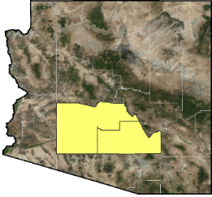
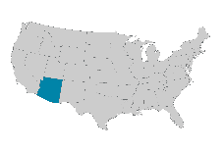
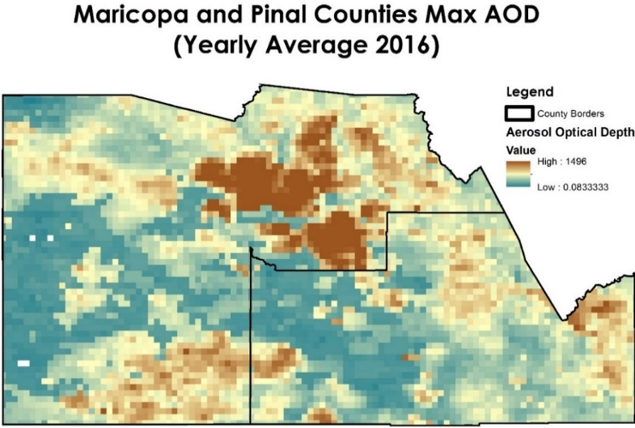
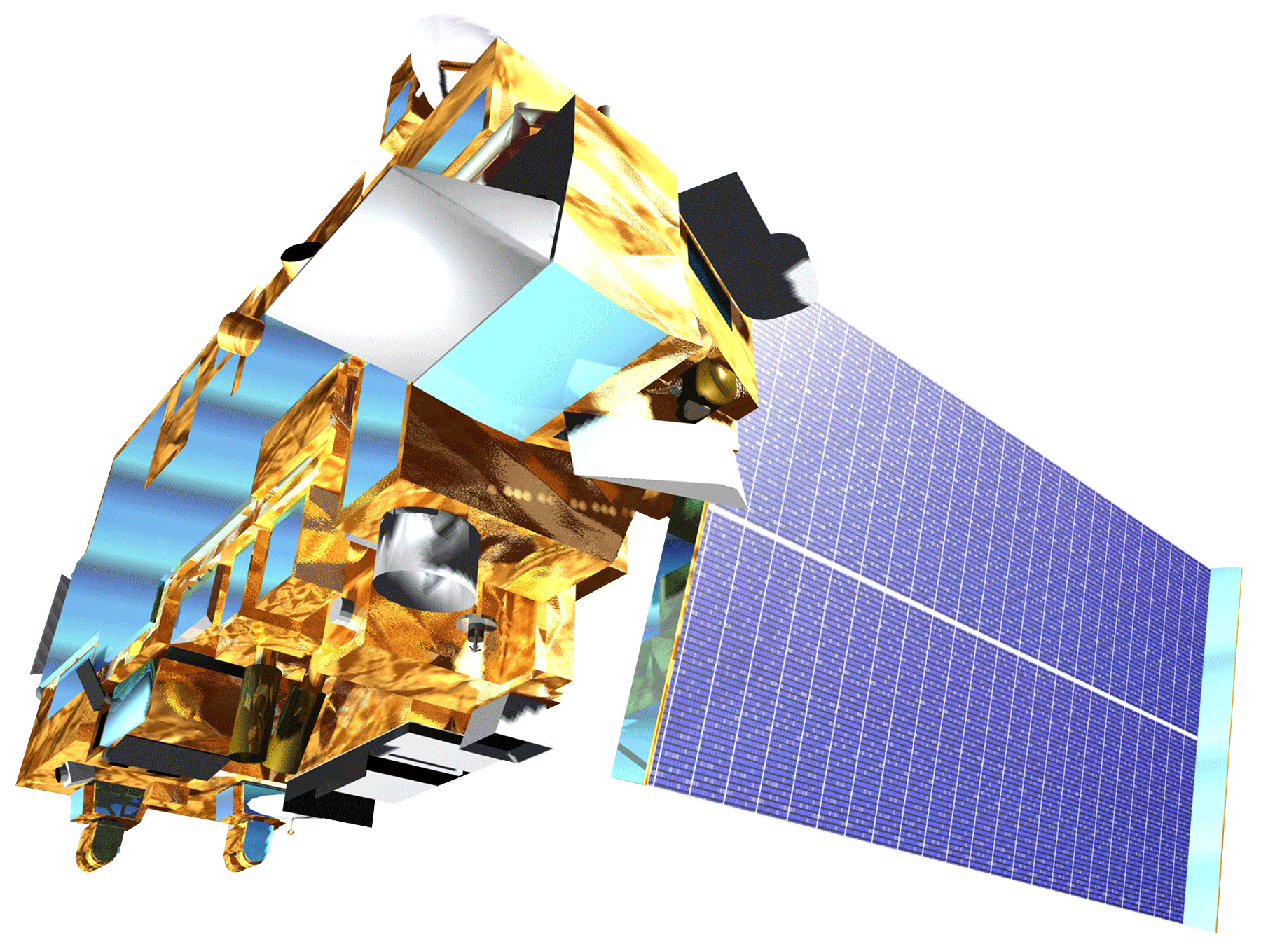
11.6.2: Annual Mean Levels of Fine Particulate Matter in Cities
11.6.2: Annual Mean Levels of Fine Particulate Matter in Cities
Arizona
Case Study: Maricopa County Health & Air Quality
Monitoring PM10 Concentrations with MODIS Aerosol Optical Depth Measurements for Enhanced Public Health and Air Quality Decision Making and Epidemiology
Maricopa County
Pinal County
MODIS AOD Rasters
Apply PM10
mixed model
Monthly PM₁₀ Surface
Pm_{ij} = (α + u_{j}) + (β₁ + v_{j}) AOD_{ij} + (β₂ + k_{j}) Temperature_{ij} + β₃ Elevation_{i} + β₄ Major Roads _{i} + β₅ OpenSpace_{i} + ε_{ij} (u_{j}v_{j}k_{j})~ [(0 0 0), Σ]
=
one month of raster images
11.6.2 is a reporting of annual mean levels of PM2.5 and PM10. The Maricopa County HAQ Team’s methodology is annual mean max levels of AOD. However, it illustrates the potential for EO air quality data to be applied.
Aqua
MODIS
Terra
MODIS
Notes:
The primary focus of the project was to correlate measured PM10 concentrations from ground-based air quality instruments with MODIS satellite data to better predict PM10 concentrations in areas without ground-based monitoring
Created mixed model to correlated MODIS AOD with PM10 concentrations
Included period variables including meteorological and environmental factors
Calculated monthly and yearly mean maximum values of AOD

Slide 7
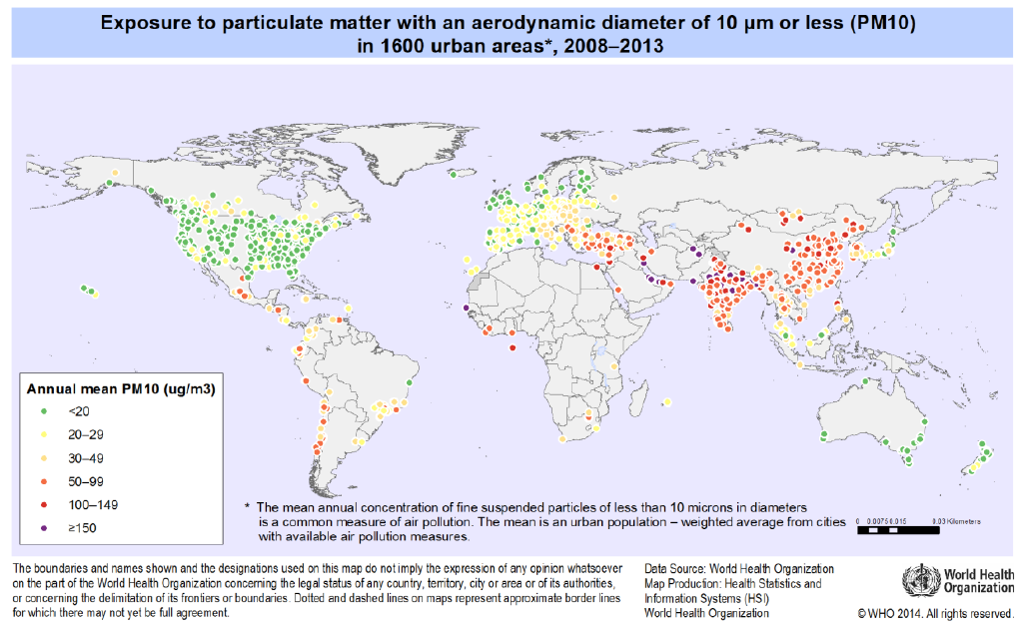
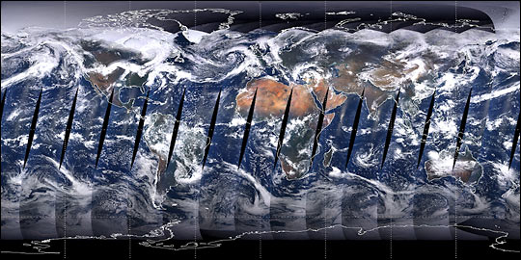
11.6.2: Annual Mean Levels of Fine Particulate Matter in Cities
11.6.2: Annual Mean Levels of Fine Particulate Matter in Cities
Case Study: Maricopa County Health & Air Quality
The current proposed methodology for 11.6.2 is to use the WHO Ambient Air Pollution in Cities Database. As the WHO coverage map above illustrates, there are many data gaps around the world, particularly in Africa. Utilizing an EO-driven methodology like the one shown here with MODIS may provide a useful supplement in filling the data gaps, as many EO satellites have global coverage.
Notes:
Micrograms per m3

Slide 8
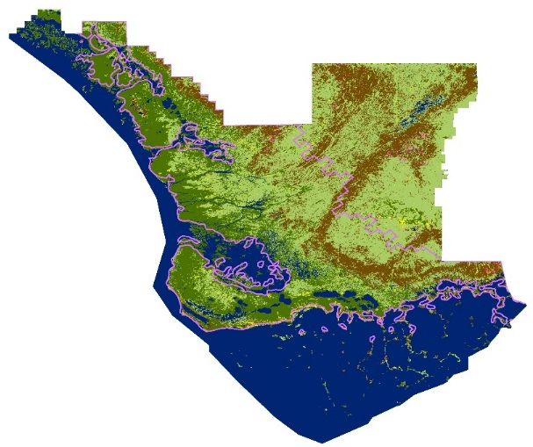
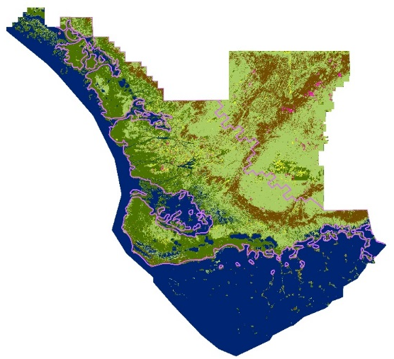
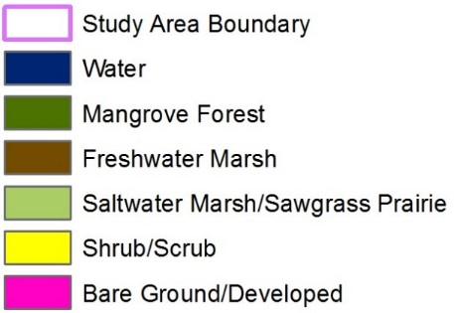
15.2.1: Progress Towards Sustainable Forest Management
15.2.1: Progress Towards Sustainable Forest Management
Case Study: Everglades Eco Forecasting
Change in Forested Area | 2010 - 2015
Overall Change | -0.03840
Est. Annual Change | -0.00768
% Est. Annual Change | -0.768%
Year | Total Forested Area
2010 | 1081246.5 km²
2015 | 1041258.6 km²
2010
2015
Utilizing an EO-driven methodology in an open platform like Google Earth Engine as shown here with Landsat may provide a useful supplement in filling data gaps. This feasibility study shows that these methodologies are applicable and transferable to a broad array of forest types and thus can aid in constant monitoring supplementing the FAO Forest Resources Assessment which was recently published in 2015.
Notes:
This project conducted a spatial analysis using NASA Earth observations and Google Earth Engine to create a replicable methodology that will map and monitor mangrove forest extent and the mangrove-marsh transition in the Everglades National Park.
Landsat Data Acquired for 1995, 2005, & 2015 and Fmask Cloud Removal
Stratified Random Sampling
Annual Image Aggregation
Supervised Classification in Google Earth Engine & Validation
Extracted Forest Class from LULC
Clipped Forest Cllass to Protected Areas Boundary
Calculated Protected Share of Forested Area

Slide 9
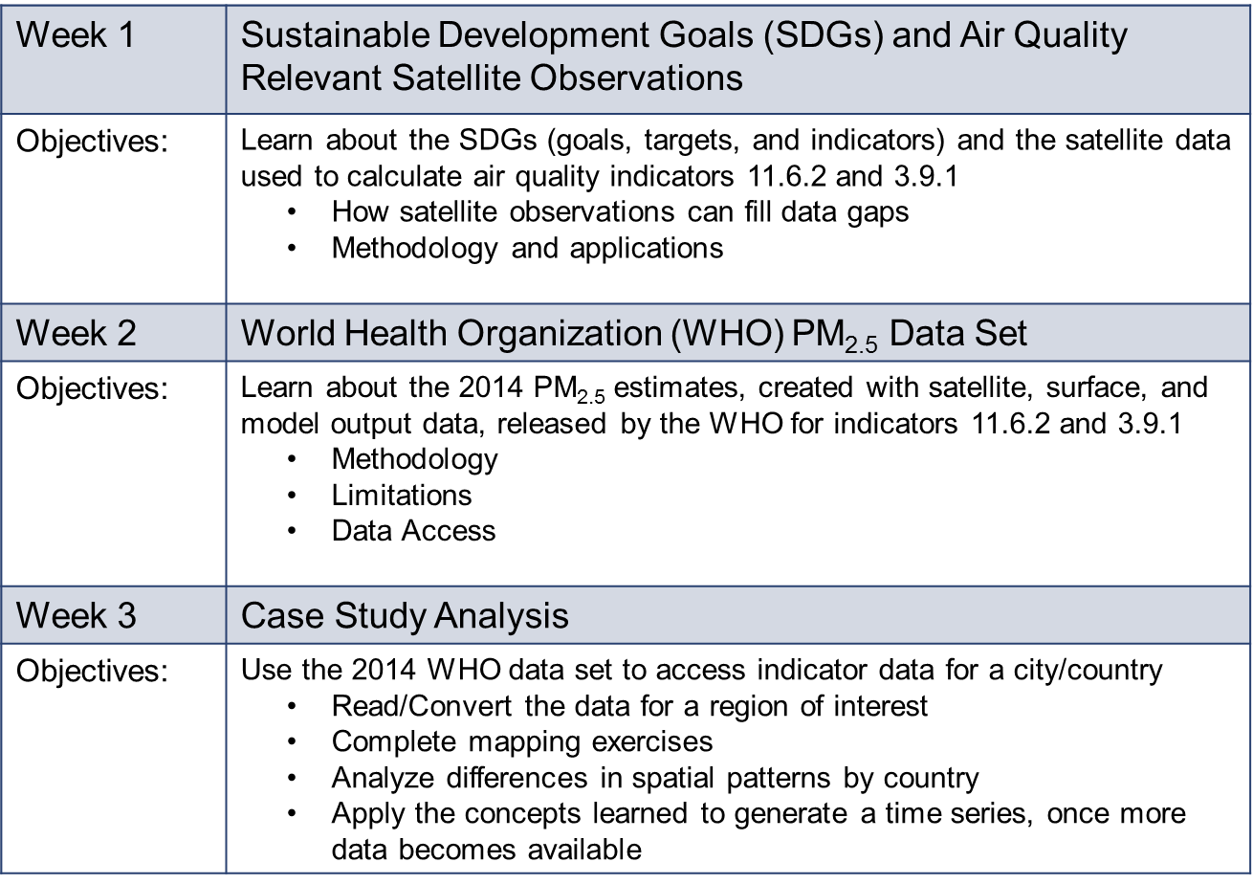
NASA Webinar Series on SDGs – March 2017
SDG Initiative
Satellite-derived PM2.5 Data Sets for SDG 3.9.1 and SDG 11.6.2
Capacity Building:
Activities provide support to institutions and individuals in the ideation, development, and implementation of methods, building capabilities directly with the SDG methods and more broadly with accessing and applying Earth observations.
Goal 3 – Good Health and Well Being
Target 3.9; Indicator 3.9.1
Mortality rate attributed to household and ambient air pollution (mean annual levels of air pollution level (PM_{2.5})
Goal 11 – Sustainable Cities and Communities
Target 11.6; Indicator 11.6.2
Annual mean levels of fine particulate matter (e.g. PM_{2.5} and PM₁₀) in cities (population weighted)
http://arset.gsfc.nasa.gov

Slide 10
Support from GEO Foundational Task:
Capacity Building Coordination
SDG Initiative
This GEO CB task team has agreed to review the SDG Initiative’s Implementation Plan and 2017-2019 Work Plan for the capacity building elements.
Capacity Building:
Activities provide support to institutions and individuals in the ideation, development, and implementation of methods, building capabilities directly with the SDG methods and more broadly with accessing and applying Earth observations.
Based on their experience with capacity building, they will provide suggestions for items the Initiative team can consider, including other Work Programme activities for coordination.

Slide 11
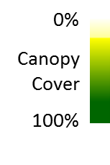
Indicators 15.1.1 & 15.2.1
Forest area as a percentage of total land area Progress Towards Sustainable Forest Management
SDG Initiative
Target 15.1
By 2020 ensure the restoration & sustainable use of terrestrial and inland freshwater ecosystems and their services …
Target 15.2
Promote implemen-tation of sustainable management of all types forests
Supplemental Method in Development: Percent of national land area in forest
Metadata
Draft Developed:
Institutional Information
Concepts and Definitions
Methodology
Data Sources
Data Availability
References
Basis: Forest cover of >10%
tree canopy and >5m trees
Landsat tree-cover based estimate; coordinating with US Forest Service’s method
Method is portable; supports sub-national estimates
33%
for 2015
Credit:
U.Maryland;
Hansen et al.
Notes:
Data Source: University of Maryland laboratory for Global Land Analysis and Discovery, (Hansen et al. 2013)
http://earthenginepartners.appspot.com/google.com/science-2013-global-forest
1. sdg.data.gov is the official national reporting platform for the US.
2. http://unstats.un.org/sdgs/ is UNSD's site for metadata & database of what countries report (tabular files, can be shown per Indicator or per country)

Slide 12
Indicators 15.1.1 & 15.2.1
Forest area as a percentage of total land area Progress Towards Sustainable Forest Management
SDG Initiative
Target 15.1
By 2020 ensure the restoration & sustainable use of terrestrial and inland freshwater ecosystems and their services …
Target 15.2
Promote implemen-tation of sustainable management of all types forests
Supplemental Method in Development: Percent of national land area in forest
Steps toward country-level implementation include:
Pre-processed data delivery on work stations or existing computing infrastructure
Training analysts using an ‘active learning approach’ to iteratively map forest cover extent
Good practice accuracy assessments are performed in establishing definitive area estimates
Subsequent updates dependent on delivery of new image inputs
Credit:
U.Maryland;
Hansen et al.
Notes:
Data Source: University of Maryland laboratory for Global Land Analysis and Discovery, (Hansen et al. 2013)
Analysts are trained to iteratively map forest cover extent and change for a defined baseline period, and good practice accuracy assessments, upon completion of mapping, to establish definitive area estimates and associated uncertainties. The team is also working on pre-processing of Sentinel data, mainly QA, at the moment, and will eventually also incorporate it in the forest characterization system. They have also performed comparisons among satellite-derived estimates and forest inventory estimates for forest cover extent for the US, at both state and national levels for 2000, 2010, and 2015
http://earthenginepartners.appspot.com/google.com/science-2013-global-forest

Slide 13
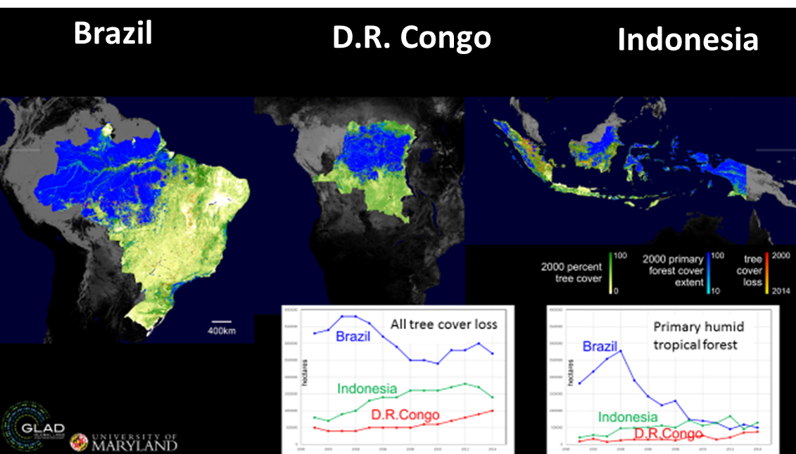
Indicators 15.1.1 & 15.2.1
Forest area as a percentage of total land area Progress Towards Sustainable Forest Management
SDG Initiative
Target 15.1
By 2020 ensure the restoration & sustainable use of terrestrial and inland freshwater ecosystems and their services …
Target 15.2
Promote implemen-tation of sustainable management of all types forests
Supplemental
Method in
Development
Beyond tree cover, there are other definitions relevant to policy objectives
e.g. forest of high conservation value for both biodiversity and carbon stocks
Quantified by land use allocation (e.g. protected areas) and by long-term forest history as observed through the Landsat satellite data archive
Official land use data are intersected with monitored map themes to assess the efficacy of land use allocations at national levels
Credit:
U.Maryland;
Hansen et al.
Credit: U.Maryland; Hansen et al.
Notes:
Look at the convergence in primary forest loss. In addition to tree cover, we may apply other definitions relevant to policy objectives – here we are mapping what is essentially primary humid tropical forest, the remaining high conservation value forests of Brazil. This what a lot of the SDG/REDD work is focused on, and we need to add context to height/cover thresholds to map it. In this case that context is a long-term record of stable forests that are tall and dense. Really, this is the part that informs Indicator 15.2.1.
Annual area of natural forest cover by land use allocation, e.g. protected areas
Data Source: University of Maryland laboratory for Global Land Analysis and Discovery, (Hansen et al. 2013)
http://earthenginepartners.appspot.com/google.com/science-2013-global-forest

Slide 14
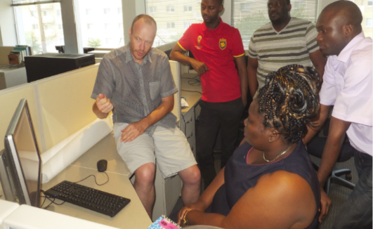
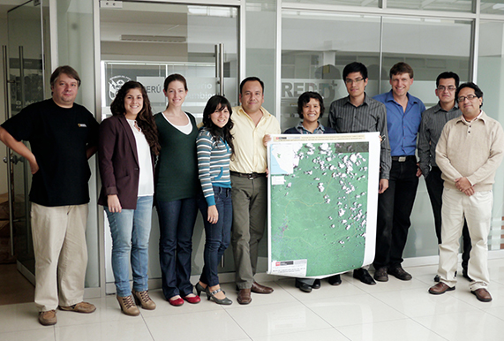
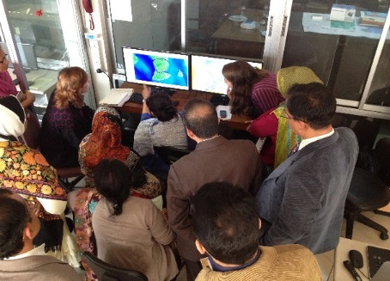
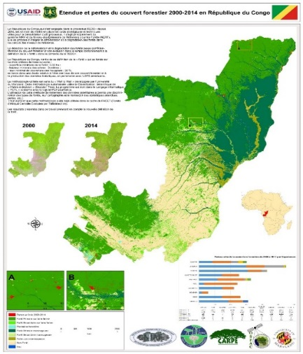
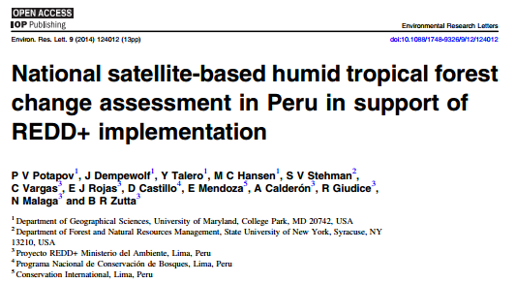
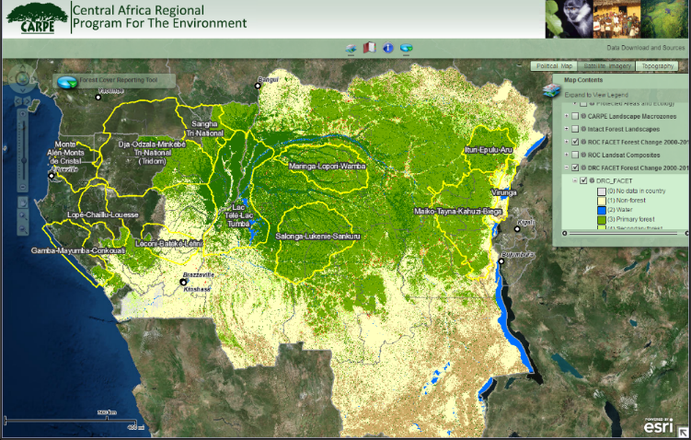
National Implementation of GLAD Forest Monitoring
Republic of Congo
Ministry of Forestry
Peru
Ministry of Environment
Bangladesh
Ministry of Forests and Environment
National forest extent and change baseline data sets
On-line maps and reports
Joined peer-review publications
Notes:
Work to install methods in other countries so they can produce their own data suitable for SDG/REDD reporting. The following slides are from work in Vietnam, just started. Support for our capacity building work comes from USAID. Work also with Colombia, Ecuador, DRC, Bangladesh, Vietnam and Indonesia, with new work planned for Nepal and Cameroon. Note that Peru uses the method for official reporting. SilvaCarbon is a U.S. technical cooperation program to enhance capacity worldwide in monitoring and managing forest and terrestrial carbon.

Slide 15
Challenges & Opportunities
SDG Initiative
Identify candidate countries for field testing of EO-based methods (e.g., 15.1.1 & 15.2.1)
Initiate more activities on cross-cutting themes across the SDGs and the opportunity for relevant Earth Obs & Geospatial Information contributions (e.g., population, ecosystems, climate, food security)
Link existing/ upcoming SDG projects with UN custodian agencies, NSOs, ‘line ministries’, and development agencies
Connect international efforts in a more coordinated manner to regional and country-level efforts to facilitate knowledge sharing and avoid overlap
Help harmonize and share the work completed by different country institutions to enable coordination and support existing, and emerging, national SDG monitoring and reporting platforms, and foster national ownership of the SDGs

Slide 16
5th gsts workshop
Session 6
Thank you!

Slide 17
Additional Slides

Slide 18
High-level Political Forum
SDG Initiative
HLPF 2017
The High-level Political Forum on Sustainable Development will take place from 10-19 July 2017. This includes a three-day ministerial meeting on 17-19 July.
The following countries present their national voluntary reports for review:
The following SDG goals will be reviewed:
Argentina
Belarus
Belgium
Chile
Costa Rica
Cyprus
Czech Rep.
Denmark
Ethiopia
Guatemala
Honduras
Iran
Italy
Japan
Jordan
Kenya
Luxembourg
Malaysia
Maldives
Monaco
Netherlands
Panama
Peru
Portugal
Qatar
Slovenia
Sweden Thailand
Togo
Uruguay
Notes:
Slides on
where help is needed
Specific activities to support
Places to sign-up
Example: What people can do at Plenary to articulate interest in SDG Init.
In addition, this can address:
what we want to see achieved by Plenary XIV
What are key items on the schedule
How would we spend 1M Euro

