Slide 1
Towards a sustainability process for GEOSS Essential Variables
11-12 June 2015, Bari-Italy
Societal Benefit Area: Weather
David Richardson
ECMWF
Coordinating an Observation Network of Networks EnCompassing saTellite and IN-situ to fill the Gaps in European Observations

Slide 2
Status of existing EVs in the domain
Is your community developing a set of area-specific EVs? If yes
How do you define EV?
If not, is the community planning to start this in the near future?
Have you attended previous meeting?
Are you considering reference documents from other domains?

Slide 3
Weather EVs
under World Meteorological Organisation (WMO)
WMO Resolution 40 (Cg-XII)
Decision of WMO Congress X11, 1995
WMO policy and practice for the exchange of meteorological and related data and products including guidelines on relationships in commercial meteorological activities

Slide 4
WMO Resolution 40 (Cg-XII)
“Members shall provide on a free and unrestricted basis essential data and products which are necessary for the provision of services in support of the protection of life and property and the well-being of all nations, particularly those basic data and products, as, at a minimum, described in Annex 1 to this resolution, required to describe and forecast accurately weather and climate, and support WMO Programmes”

Slide 5
WMO essential data (Resolution 40)
Minimum set of data and products which are essential to support WMO Programmes
Protection of life and property and the well-being of all nations
To describe and forecast accurately weather and climate

Slide 6
WMO essential data (Resolution 40)
Six-hourly surface synoptic data from RBSNs
All available in situ observations from the marine environment
All available aircraft reports
All available data from upper air sounding networks
All reports from the network of stations recommended by the regional associations as necessary to provide a good representation of climate
Products distributed by WMCs and RSMCs to meet their WMO obligations
Severe weather warnings and advisories for the protection of life and property targeted upon end-users
Data and products from operational meteorological satellites that are agreed between WMO and satellite operators

Slide 7
The process underlying EV definition
What criteria, methodology, and process are used to identify EVs?
Bottom-up: from what EO data can provide for the specific domain (e.g., NDVI index from MODIS)?
Or Top-down: from what predictive modeling requires as inputs to the selection of the most appropriate sensors?
Do you have a template to document a EV?

Slide 8
WMO rolling review of requirements
review of technology-free Members' requirements for observations, within an area of application
review of the observing capabilities of existing and planned observing systems, both surface- and space-based;
Critical Review of the extent to which the capabilities (ii) meet the requirements (i)
Statement of Guidance based on (iii)

Slide 9
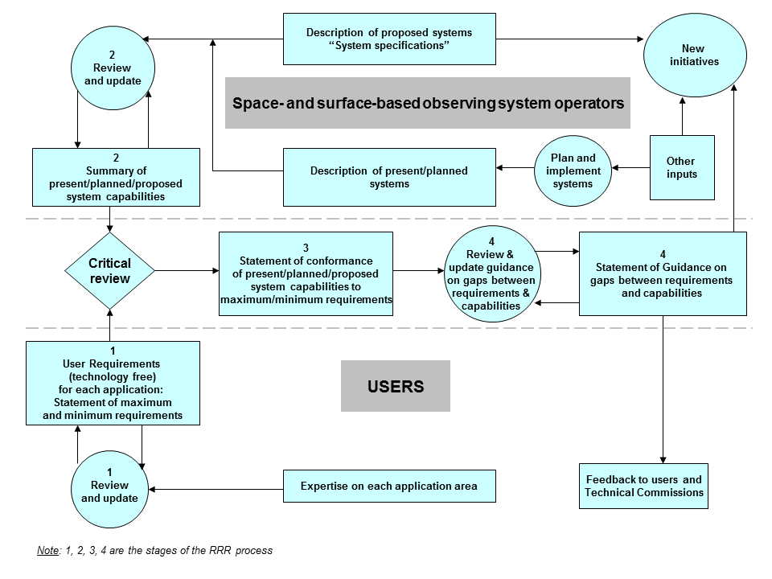
WMO rolling review of requirements

Slide 10
WMO rolling review of requirements
Statement of Guidance
Gap analysis
Recommendations to address gap
RRR including Statements of Guidance guides the
Evolution of Global Observing System
http://www.wmo.int/pages/prog/www/OSY/GOS-RRR.html

Slide 11
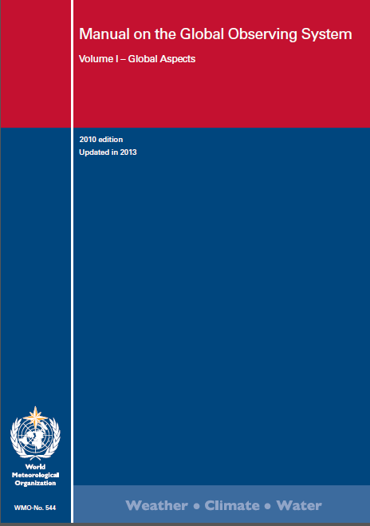
WMO rolling review of requirements
Rolling Review of Requirements (RRR) process defined by the Manual on the Global Observing System (WMO-No. 544) (Part II, Requirements for observational data)

Slide 12
EVs validation and use
To what extent these EVs (if any) are validated and used
Are the EVs linked to applications and users?
Who the users are?
How is a community agreement reached?
Is a community review process in place?
Are the EVs linked to an international body (i.e. a UN convention or similar) and is this body involved in accepting the EVs?

Slide 13
Users - WMO Application Areas
Services contributing to
public safety
socio-economic well-being
development
related to weather, climate and water

Slide 14
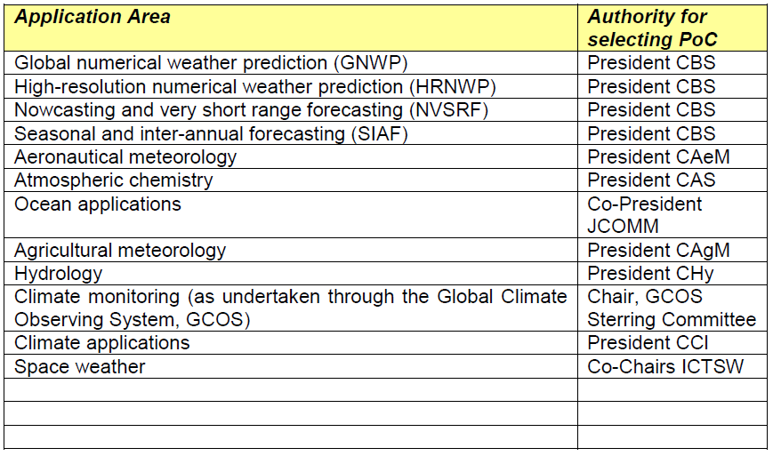
Users - WMO Application Areas

Slide 15
Describing the monitoring networks currently operational
Do you have a database with information on the EVs?
Do you know network currently operational for medium-term/long-term monitoring?
Are the current operational networks operated by your community measuring the EVs?

Slide 16
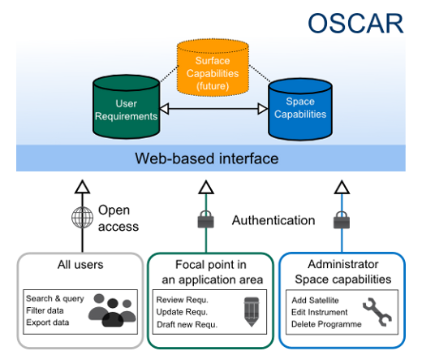
WMO Observing Systems Capability Analysis and Review Tool
http://www.wmo-sat.info/oscar/

Slide 17
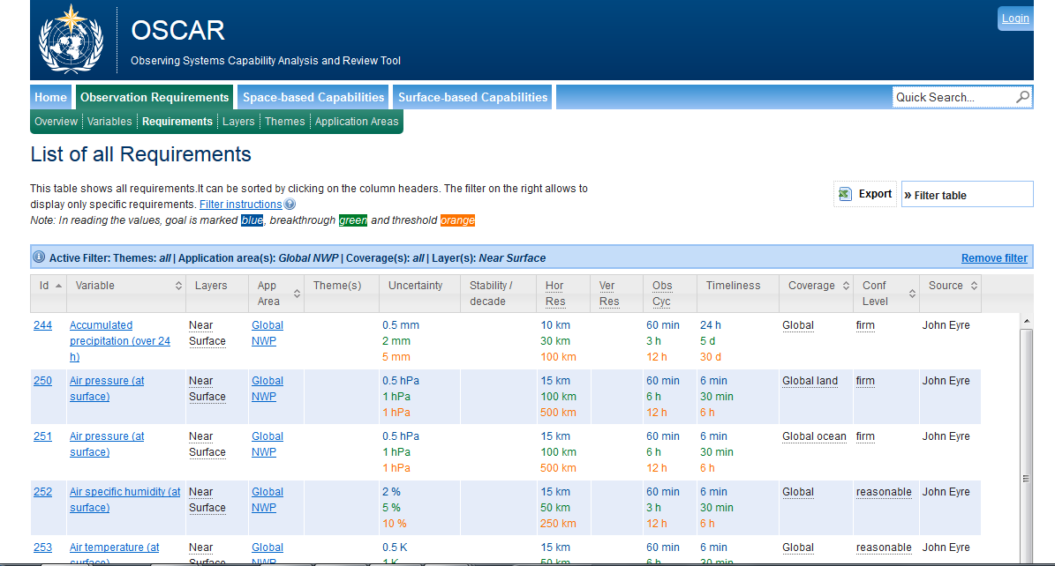
OSCAR
http://www.wmo-sat.info/oscar/

Slide 18
Assessing EV observational needs and readiness
For some Use Case, have you already focused on Evs’ features:
Temporal frequency
Spatial resolution
Accuracy
etc.;
Challenges and how these are addressed (if any)

Slide 19
Use case: RBSN
Regional basic synoptic network:
Essential observations for weather
Co-ordinated by WMO Regional Association
Subset of the Global Observing System
Defined criteria for frequency, accuracy, timeliness, spatial resolution

Slide 20
Use case: RBSN
Regional basic synoptic network:

Slide 21
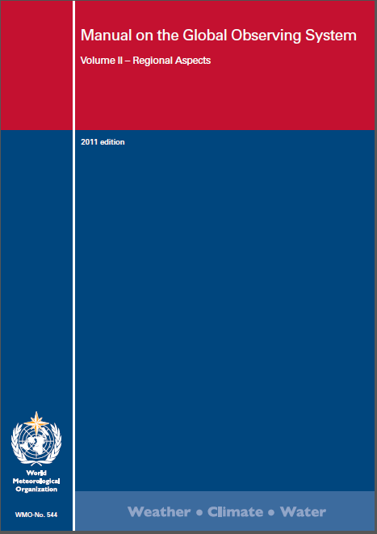
Use case: RBSN
Target requirements (TRQs): desired
Minimum requirements (MRQs): necessary
stations meeting all TRQs are classified as OK
Those stations meeting all MRQs are classified as IP (incomplete programme)
Operational stations not meeting all MRQs are classified as BC (below criteria)
Silent stations are classified as NO (not operating)

Slide 22
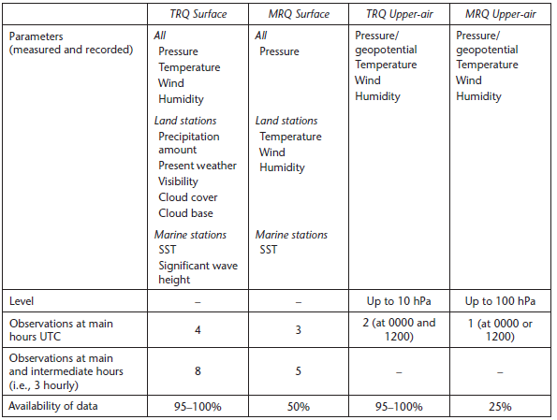
Use case: RBSN

Slide 23
Use case: RBSN
Horizontal spacing:
Stations classified as OK are acceptable if at a distance of at least 60 km from the nearest network station;
IP stations are acceptable if at a distance of at least 90 km from the nearest station.
Stations classified as BC and NO are not acceptable as network stations.

Slide 24
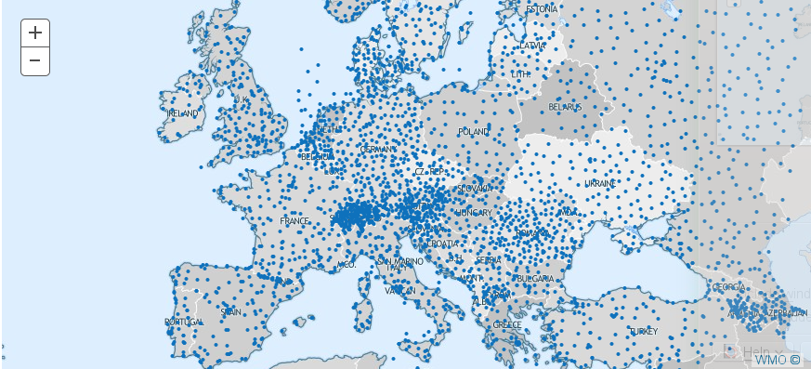
Use case: RBSN
Global Observing System synoptic network:

Slide 25
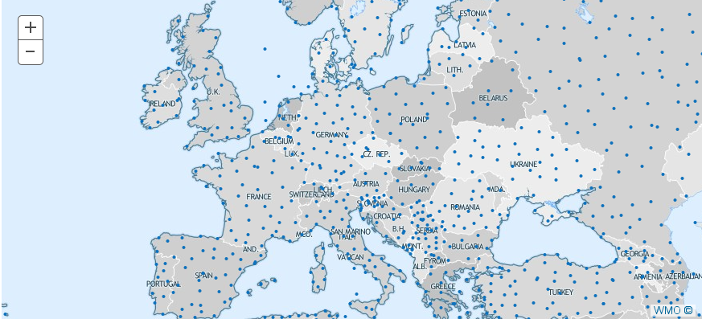
Use case: RBSN
RBSN synoptic network:

Slide 26
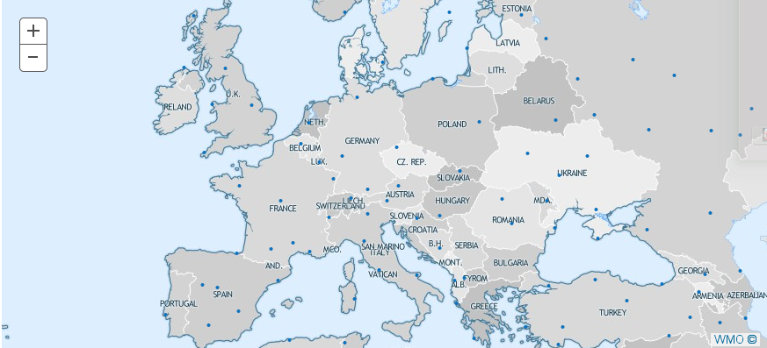
Use case: RBSN
GSN (GCOS Surface Network): ECVs

Slide 27
Gaps and requirements
Have you already carried out a gap analysis utilizing the EVs to identify gaps and priorities in terms of:
EO data availability
In-situ data availability
Models (algorithms) for EV extraction: direct measurements or proxies
Data repositories for the long term preservation of EVs
Infrastructure for EVs publication

Slide 28
Conclusions
WMO governance of weather variables
Defined procedures for defining, reviewing, monitoring
Database of requirements
WMO Application areas – links with other GEO SBAs
JCOMM for ocean; WMO Commision on Hydrology, …
Plans – review of monitoring, operational OSCAR database

