Slide 1
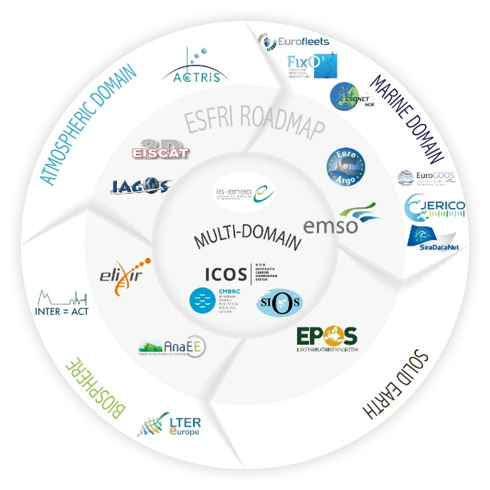
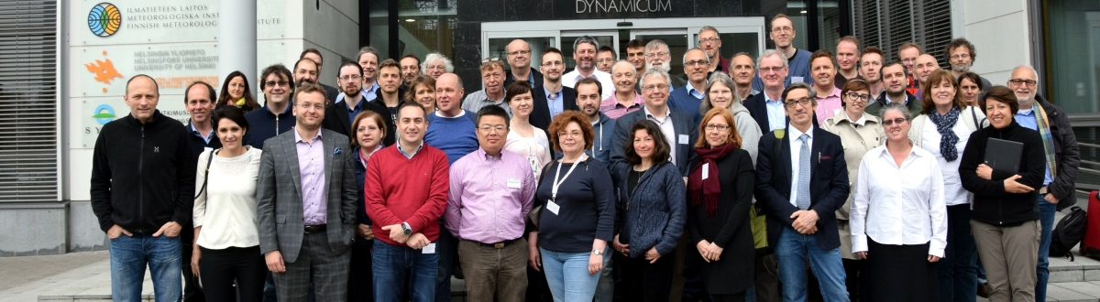
The ENVRIplus approach of cooperation
Werner L. Kutsch, Director General of ICOS RI and Coordinator of ENVRIplus,
Helsinki, Europe

Slide 2
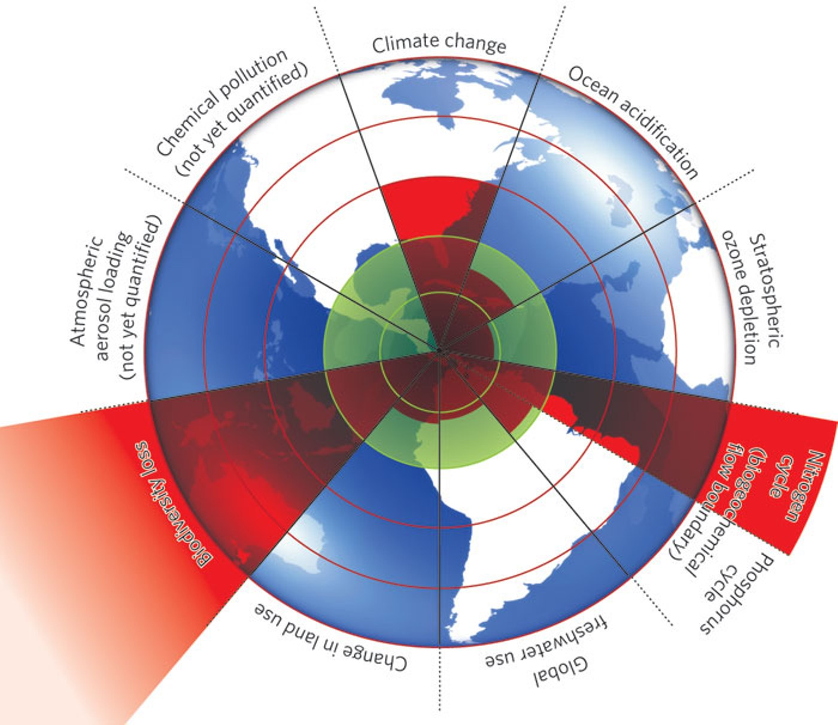
Nine planetary boundaries of the Anthropocene
What are the properties of
observing systems that cover
these environmental problems?
http://www.stockholmresilience.org
Rockström et al. 2009, Ecology and Society

Slide 3
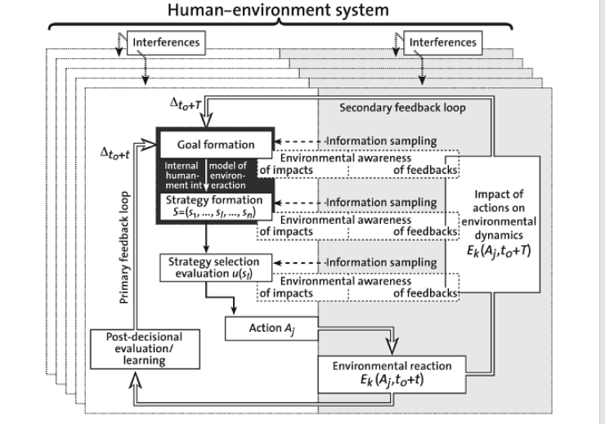
Socio-ecological innovation through environmental literacy
Provide the right information!
Provide the information in the right format!
Understand the lanuage of your partners!
Environmental Literacy
in Science and Society: From Knowledge to Decisions
By Roland W. Scholz, Claudia R. Binder

Slide 4
Research Infrastructures
Society faces many future challenges. […] Research Infrastructures are one key instrument in bringing together a wide diversity of stakeholders to look for solutions to many of the above-mentioned problems. They can be seen as a focal point for such interactions, in addition to inspiring new research ideas and attracting young enquiring minds. (ESFRI Roadmap 2006)

Slide 5


Sustainability concept
2006
2007
2008
2009
2010
2011
2012
2013
2014
2015
2016
2017
2018
2019
2020
The ENVRI Community
(growing towards a solid structure)

Slide 6
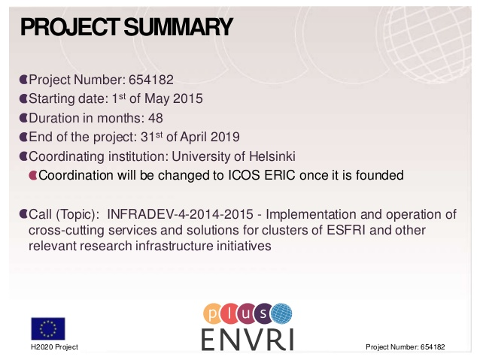

Slide 7
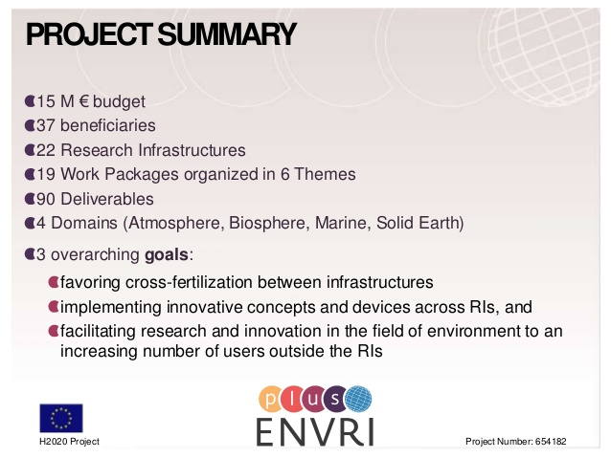

Slide 8

Infrastructures participating in ENVRIplus

Slide 9
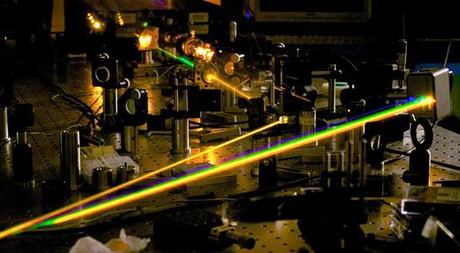
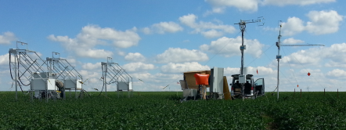
Technological innovation in environmental science
New technologies
Standardization
Remote, distributed observations
Pictures: Gianluca Galzerano, Politechnico Milano, W. Kutsch

Slide 10
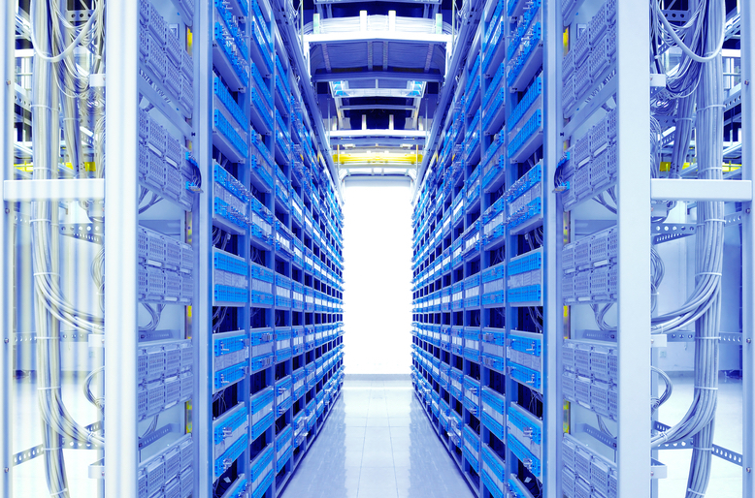
Innovation in data science
Big data
Open data
Connected data
as consequence of global perspective and socio-ecological responsibility.

Slide 11
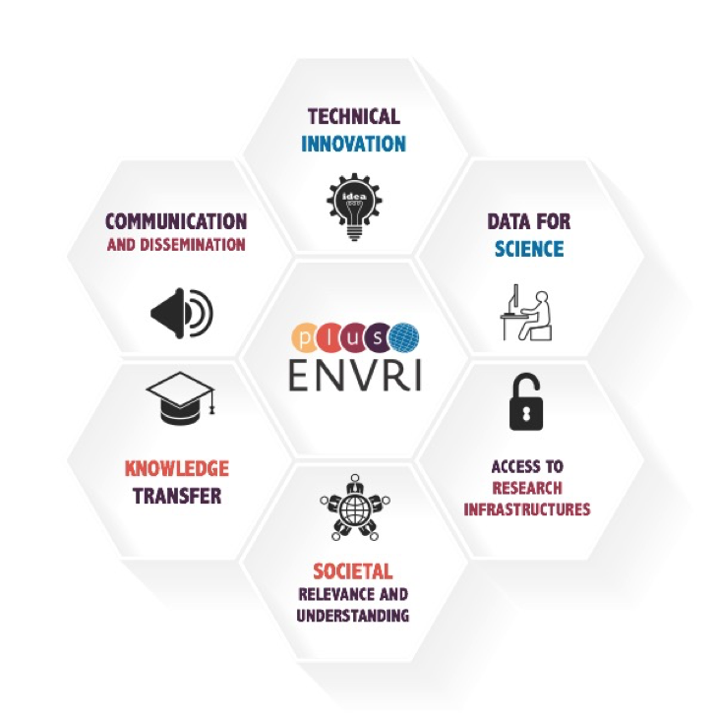
ENVRIplus structure

Slide 12
ENVRIplus structure
New sensor technologies: innovation and services
Improving measurement networks: common technological solutions
Joint operations across the Research Infrastructure domains
Metrology, quality and harmonization
Reference model guided RI design
RI data identification and citation services
Data processing and analysis
Data curation and
cataloguing

Slide 13
ENVRIplus structure
Coordination of Research Infrastructure communication, development and implementation of the ENVRI Strategy
Dissemination, Liaison and Collaboration

Slide 14

Board of Environmental Research Infrastructures
BEERi is an advisory panel consisting of directors or coordinators of the environmental Research Infrastructures giving direct guidance to the ENVRIplus project management and giving strategic view to the project progress, acting as internal advisory board representing the needs of environmental Research Infrastructures.

Slide 15
ENVRIplus, GEO, and ConnectinGEO
Dissemination, Liaison and Collaboration
Interoperability via common metadata
systems
ENVRI community shares the same vision as GEO

Slide 16
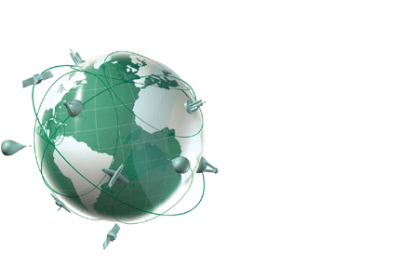


Cooperation
Common solutions and developments among and within Research Infrastructures
Connection to GEO,
Transfer of data to GEOSS
Transfer of data from the Infrstructures to GEOSS

Slide 17
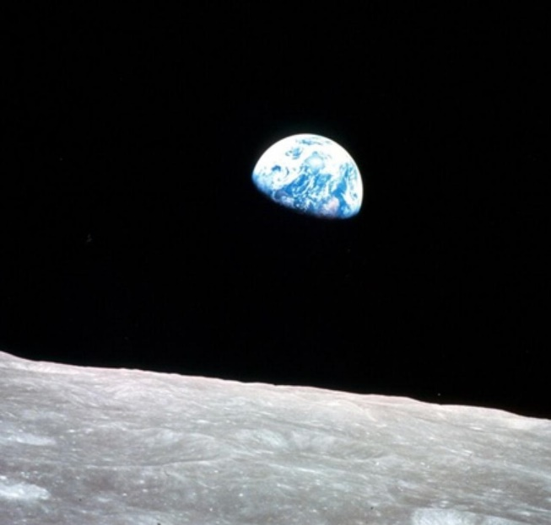
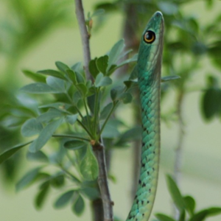
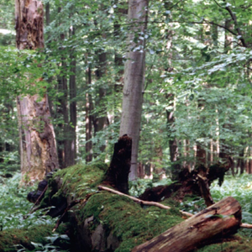
Conclusion
Thank you for your attention!

