Slide 1
Future Earth Research Challenges
Dennis Ojima
US Hub of Future Earth Secretariat
Data and Observations Task team
Mario Hernandez
Chair of Data and Observations Task Team
GEOSS 4th Technical Workshop (24 March 2015)
CONCEPTS, TECHNOLOGIES, SYSTEMS AND USERS OF THE NEXT GEOSS Norfolk, VA, USA 24-26 March 2015

Slide 2
Complex challenges in the Anthropocene
Feeding nine billion people within planetary boundaries
Understanding ocean and coastal transitioning under changing climate and biodiversity conditions
Adapting to a warmer and more urban world
Reducing disaster risks
Valuing and protecting nature’s services and biodiversity
Providing income and innovation opportunities through transformations to global sustainability
Improving equity
Estimating wealth and well-being, not GDP
Aligning governance with stewardship
... mostly complex social-ecological issues
... highly policy relevant

Slide 3
Future Earth Mission
Through partnerships and involving stakeholders, so that jointly they can find the knowledge
required for societies in the world
to face risks posed by global environmental change and to seize opportunities
in a transition to global sustainability

Slide 4
Science and Technology Alliance for Global Sustainability
WMO
Notes:
Further information on the Science and Technology Alliance for Global Sustainability

Slide 5
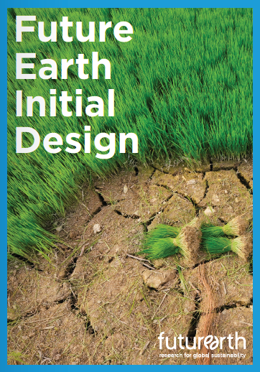
Transition Team 2011-2012
B
Building on decades of research
excellence across multiple
earth system disciplines

Slide 6
FUTURE EARTH:
Assisting with research
in support decision making for:
UN Conventions: UNFCC, CBD, UNCCD
Sustainable Development Goals (SDG’s)
Supporting discovery and innovation to
address the demands and requirements of
evidenced based decisions

Slide 7
Future Earth – GEO Partnership
RESEARCH
(earth system/
social-ecological
system)
INFORMATION
Observations
and
Data
KNOWLEDGE
OPERATIONS
(earth system/
social-ecological
system)
DECISION
MAKING

Slide 8
FUTURE EARTH RESEARCH FOCAL AREAS
Dynamic Planet
And cross-cutting issues: Observing systems, models, theory development, data management,
research infrastructures
Global
Development
Transformation to
Sustainability

Slide 9
FUTURE EARTH INITIATIVE
Dynamic Planet
Research activities to inform
decision makers and practitioners in
CO-DESIGN, CO-DEVELOP, AND
CO-PRODUCE
NEW KNOWLEDGE
and
ACTIONABLE RESEARCH
Global
Development
Transformation to
Sustainability

Slide 10
Developing a vision and high profile goals for Future Earth (2013)
Established initial framework for development of Future Earth
Short-term initiatives: things we try to do near-term, and things we initiate through FTI/cluster calls, establish governing bodies, build new communities of engagement, and develop a more integrated system approach for research and science-based solutions

Slide 11
FUTURE EARTH REPORTS
These reports serve to provide guidance to the research and engagement approaches, and
aspirational directions of Future Earth.
Oct 2014
2025 Vision: How would we know Future Earth is succeeding?
Provides a set of 8 Societal Challenges
Strategic Research Agenda 2014:
Balanced advances on all research themes
Established framing ideas
Built on past consultations
Iterative process with broad input (core projects and EC)
Dec 2014
These reports can be found at:
www.futureearth.org

Slide 12
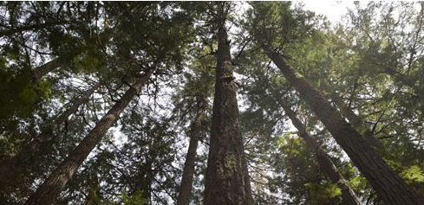
Core principles for Future Earth
Work across all scientific disciplines/knowledge; inclusive of multiple socio-geographic approaches (plus humanities & engineering)
Link global environmental change and development
Build partnerships between researchers, funders, service providers, and research users such as decision makers and practitioners
Bring on board and promoting the leadership of a new generation of Future Earth researchers

Slide 13
Science Development Connections
Contribute to defining and evaluating Sustainable Development Goals
Development of partnerships between research and practitioner communities
Translating data and observations for end-user needs and decision making

Slide 14
2025 Vision Challenges
Nexus of Sustainable water, energy, and food systems
Low carbon socio-economic systems
Safeguard the terrestrial, freshwater and marine natural assets
Build healthy, resilient and productive cities
Promote sustainable rural futures
Improve human health by understanding complex environmental interactions
Encourage sustainable consumption and production patterns
Increase social resilience to future natural threats

Slide 15
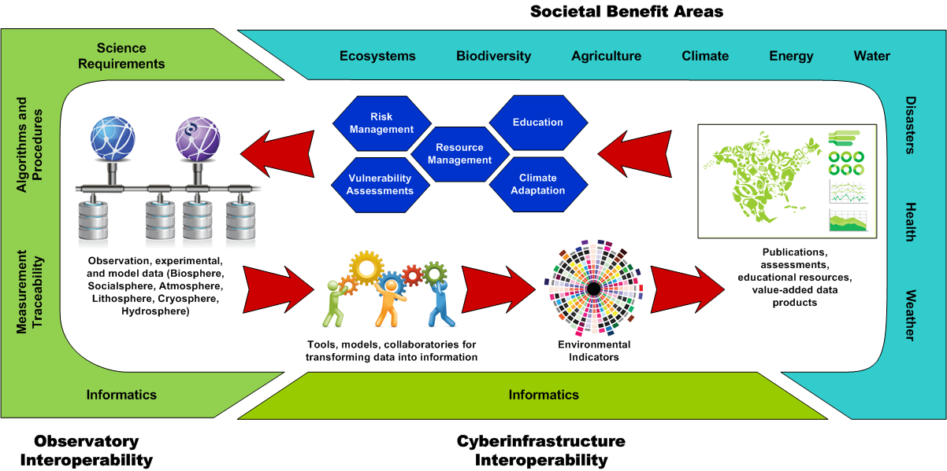
Belmont e-infrastructure WG
provided by Brian Wee
Social-ecological
system indicators

Slide 16
2014 Draft SUSTAINABLE DEVELOPMENT GOALS
GOAL 1: poverty
GOAL 2: hunger
GOAL 3: healthy lives
GOAL 4: quality education
GOAL 5: gender equality
GOAL 6: sustainable management of water
GOAL 7: sustainable and modern energy
GOAL 8: sustainable economic growth
GOAL 9: resilient infrastructure
GOAL 10: reduce inequality
GOAL 11: resilient cities
GOAL 12: sustainable consumption and production
GOAL 13: combat climate change and its impacts
GOAL 14: sustainably use the oceans
GOAL 15: sustainable use of terrestrial ecosystems,
GOAL 16: peaceful and inclusive societies
GOAL 17: global partnership

Slide 17
Research Integration
Data, observations, analysis
Example: Nexus of Sustainable
water, energy, and food systems
Addressing Sustainable Development Goals

Slide 18
Source FAO 2014
Notes:
18

Slide 19
Connecting land in the Nexus…
Future Earth FTI on Sustainability for water, food and energy through integrated water information and improved governance: : Anik Bhaduri, Richard Lawford and Claudia Pahl-Wostl
Notes:
19

Slide 20
Better Information for Sound decision Making
Use of improved information is critical for effective decision-making regarding governance within and among these sectors.
Need to develop evidence-based policies and tools for coherence, coordination, and mainstreaming at national to global levels.
Future Earth FTI on Sustainability for water, food and energy through integrated water information and improved governance: : Anik Bhaduri, Richard Lawford and Claudia Pahl-Wostl
Notes:
20

Slide 21
Linkage between Future Earth and Earth Observations
Earth observations provide an important basis for analyses directed at addressing specific problems.
Little effort directed at integrating Earth observation information with other data related to the governance and social dynamics of food, water, energy systems
Research activities to support translational efforts for science-based decision making
Enhancing the bridge between research, operations, and observations
Notes:
21

Slide 22
Key questions
How can the information available through Earth Observations be effectively used to support the needs of decision makers and promote sustainability in the W-E-F Nexus?
How can governance frameworks, decision-making processes, and the commitment to sustainability enable the effective application of this information?
Future Earth FTI on Sustainability for water, food and energy through integrated water information and improved governance: : Anik Bhaduri, Richard Lawford and Claudia Pahl-Wostl

Slide 23
Future Earth FTI on Sustainability for water, food and energy through integrated water information and improved governance: : Anik Bhaduri, Richard Lawford and Claudia Pahl-Wostl

Slide 24
Food, water, energy nexus connections to SDG’s
Ending poverty (1), hunger (2),
Ensure healthy lives (3), sustainable water management (6), access to energy (7), balanced consumption/production patterns (12), sustainable use of ocean resources (14), healthy ecosystems and biodiversity integrity (15)
Enable/promote economic growth (8), resilient infrastructure (9), sustainable cities (11), combating climate change (13), inclusive societies (16) and global partnerships (17)
Reduce inequality (10)

Slide 25
Expected outcomes
Substantive guidance on developing a program of research activities that will enable more effective use of Earth observations, observed data, and innovative governance approaches for the W-E-F Nexus.
A statement on the needs for data and information in the WEF nexus.
Procedures: new tools and best practices for the use of water and land data and modelling in decision-making.
Products: a journal special issue, a widely read journal article.
Development of university curricula m and research agendas that focus on these issues at universities associated with this project.
Future Earth FTI on Sustainability for water, food and energy through integrated water information and improved governance: : Anik Bhaduri, Richard Lawford and Claudia Pahl-Wostl
Notes:
25

Slide 26
Next steps
Given that
GEO is a partner in Belmont efforts
Future Earth is developing case studies for integrative analysis and information transfer to decision makers at multiple scales
A joint effort be developed where a set of specific analysis combing social ecological and earth system data collections for evaluation of SDG and UNFCC societal efforts

Slide 27
Questions
www.futureearth.org

Slide 29
FUTURE EARTH INITIATIVE
Climate Change
Carbon Cycle
Ocean Dynamics
Biodiversity Loss Changing Biogeochemical Cycles
Ocean Acidification
Land Degradation
Globalization
Dynamic Planet
Global
Development
Transformation to
Sustainability

Slide 30
FUTURE EARTH INITIATIVE
Dynamic Planet
Deliver water, energy and food
Decarbonise socio-economic systems
Safeguard the natural assets
Build healthy, resilient and productive cities
Promote sustainable rural futures
Encourage sustainable consumption and production patterns
Etc.
Global Development
Transformation to
Sustainability

Slide 31
FUTURE EARTH INITIATIVE
Dynamic Planet
Green Development and Low Carbon Economy Pathway
Renewable Technology Development
Improving Risk and Hazard Predictions
Integrated System Decision Making
Transformation to
Sustainability
Global
Development

