Slide 1
,
Biodiversity: EBVs versus policies
Christoph L. Häuser
Museum für Naturkunde – Leibniz Institute for Evolution and Biodiversity Science, Berlin
Ilse Geijzendorffer, Eugenie Regan, Hannu Saarenmaa, Dirk Schmeller, Florian Wetzel
& further members of the EU BON EBV task force
EU BON - The European Biodiversity Observation Network – www.eubon.eu

Slide 2
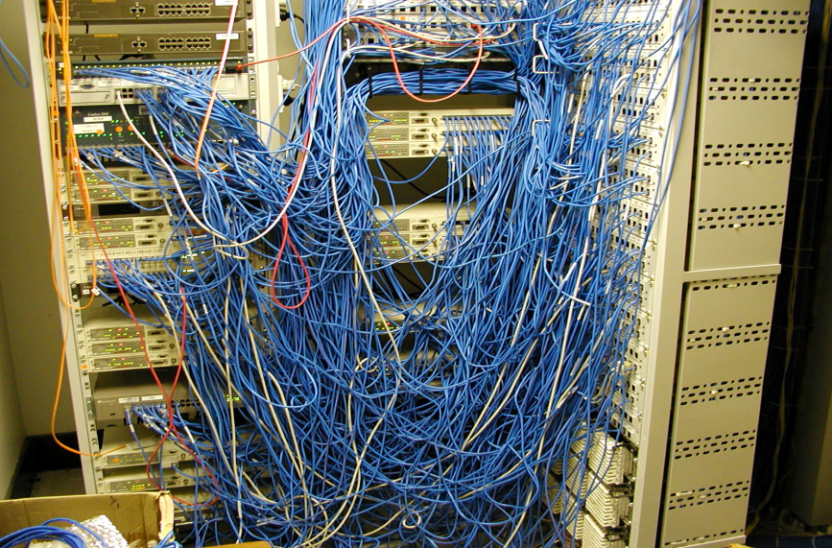


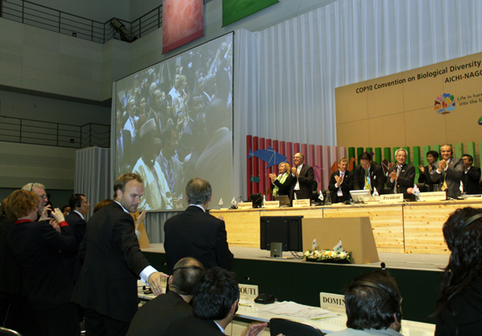
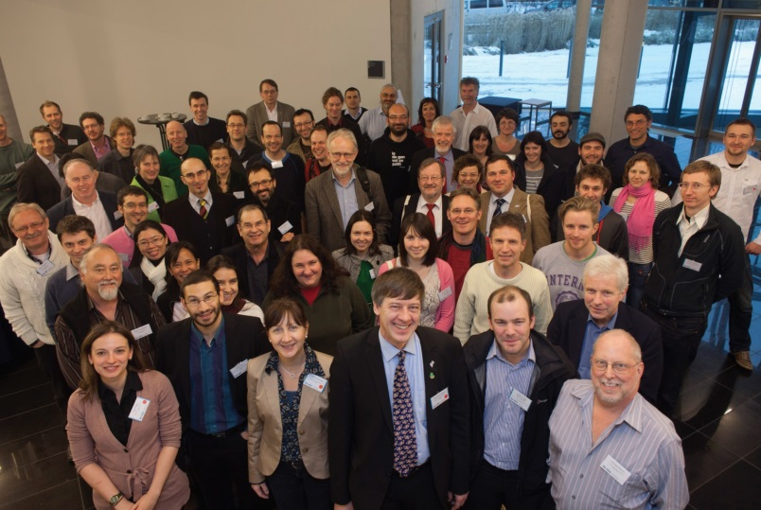
EBVs : the - direct - way from data to decisions!?

Slide 3
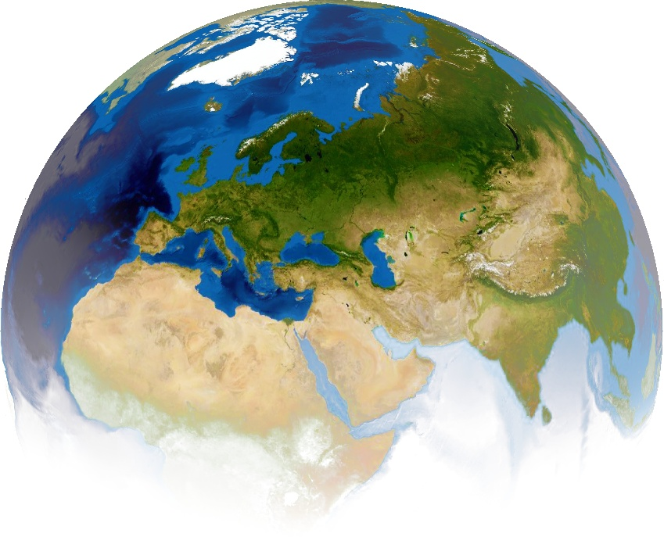
Global challenges
  The big issues:
  Biodiversity loss
  Climate change
  Water & Food scarcity
  Poverty
Our Knowledge Society
is based on science and technology, i.e., the availability of sound & reliable scientific data, analysis and interpretation

Slide 4
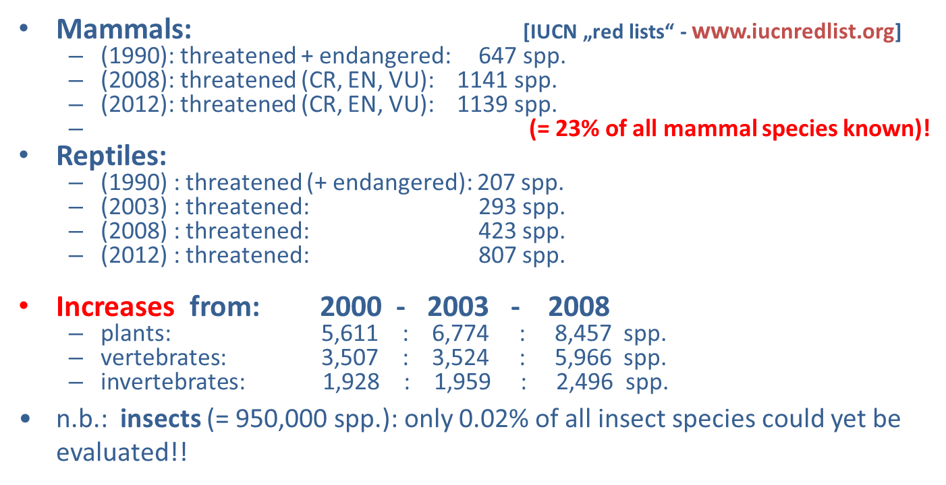
The actual threat: biodiversity loss

Slide 5
Biodiversity – challenges
ongoing biodiversity loss – continued / increased extinction rates / habitat loss
missing baseline data – lack of basic data / knowledge
fragmentation of available information – problems accessing/using existing data/knowledge
targeted information delivery – often limited impact of scientific information on policy and individual behaviour

Slide 6


EU BON - key information
EC FP7 - Cooperation Theme 6 “Environment (incl. climate change)”.
Call ENV.2012.6.2-2: Assessing global biological resources: the European contribution to the Global Earth Observation Biodiversity Observation Network (GEO BON)
Project start: 1st December, 2012
Duration: 54 months (until May 2017)
Consortium: 30 partners (18 countries)
Budget: 11,6 mio Euro (8.9 mio Euro EC contribution)

Slide 7


Main objective of EU BON
=> building a European contribution to GEO BON (GEOSS)
The main objective of EU BON is to build a substantial part of the Group on Earth Observation’s Biodiversity Observation Network (GEO BON), ...
also in light of the new Intergovernmental science-policy Platform on Biodiversity and Ecosystem Services (IPBES).

Slide 8

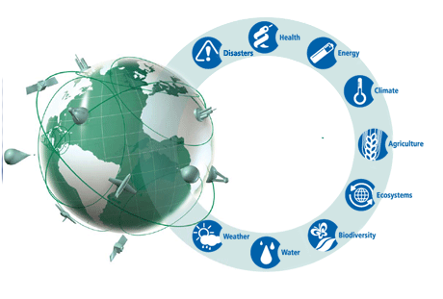

EU BON – GEOSS linkages
Expected EU BON contributions to
GEO/ GEOSS :
IN-01 Earth Observing Systems (C1)
IN-02 Earth Data Sets
IN-03 GEOSS Common Infrastructure
ID-01 Advancing GEOSS Data Sharing Principles
ID-02 Developing Institutional and Individual Capacity (C1, C2)
ID-03 Science and Technology in GEOSS
SB-01 Oceans and Society: Blue Planet (C1, C2)
EC-01 Global Ecosystem Monitoring
BI-01 Global Biodiversity Observation (GEO BON)

Slide 9
Overall goals of EU BON
Enabling greater interoperability of data layers & systems
Advancing data integration
Increasing data mobilization (from science and society)
Harmonizing and mainstreaming biodiversity recording and monitoring schemes
Improving analytical tools and services
Linking integrated information to relevant stakeholders
Strengthening European capacities and infrastructures for environmental information management
„The new, integrative EU BON approach will facilitate (political) decisions in different sectors concerned with biodiversity for human well-being at different levels, ranging from local park management to national governments, and IPBES.“

Slide 10
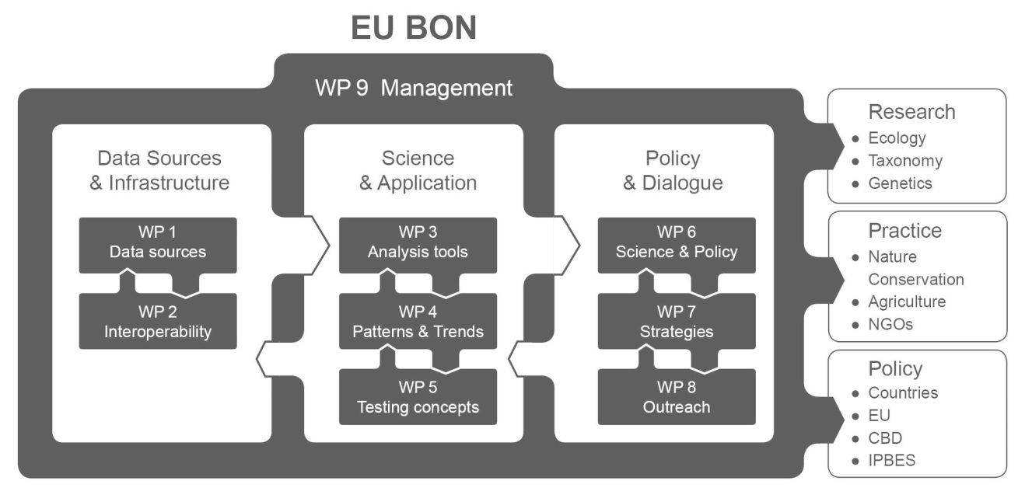
EU BON workflow / organization

Slide 11

The (biodiversity) challenge:
integration of biodiversity data
Remote sensing
Specific Challenges:
+ data standards, interoperability
+ common recording &
monitoring schemes
+ analysis, interpretation, tools [patterns and trends]
+ information dissemination
+ science policy interface(s)
Freshwater
Marine
Terrestrial
Two large realms: field („in situ“) + remote sensing data

Slide 12

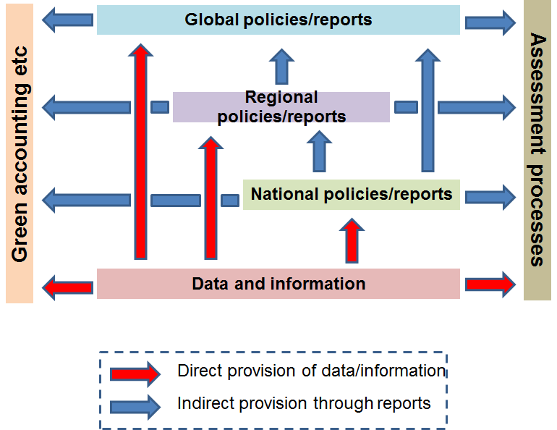



The policy challenge: more than one ….
UNEP WCMC 2014
Regan et al. 2014
EU: Bern – Convention
Birds – Directive
Water Framework Directive
Wildlife Trade Regulations
Habitats – Directive
Notes:
data goes to support policy development, policy implementation and reporting at all levels
data and information is used both directly (red arrows) and indirectly (blue arrows)
only one direction is used on arrows for simplification, but reports are used in both directions
even this is an oversimplification as national could be more than one level (eg länder then federal levels in Germany) and also regional (EU and then pan-European)

Slide 13








Many
“biodiversity-related
conventions ... “
World Heritage
IWC
UNCLOS

Slide 14
Ecosystem Accounting
UNCCD
CMS
Barcelona
Green Economy
CBD
ITPGRF
Helsinki
Bucharest
UNFCCC
CITES
IPPC
OSPAR
Regional seas
Antarctic
Ramsar
WHC
Water Conv.
MEAs
Espoo
ITTA
Florence
Alpine
Assessments
ICRW
Bern
Carpathian
Genetic resources
IPBES
MDGs/SDGs
Pan-European strategy
WOA
IPCC
FRA
GEO
EU level
RD priorities
Wildlife Trade Regulations
Habitats Directive
Birds Directive
CFP
WFD
Nitrates Directive
CAP
MSFD
Floods Directive
IAS Directive
GMO Directive
EIA Directive
ELD
Kyiv (SEA) Protocol
EU Biodiversity Strategy

Slide 15
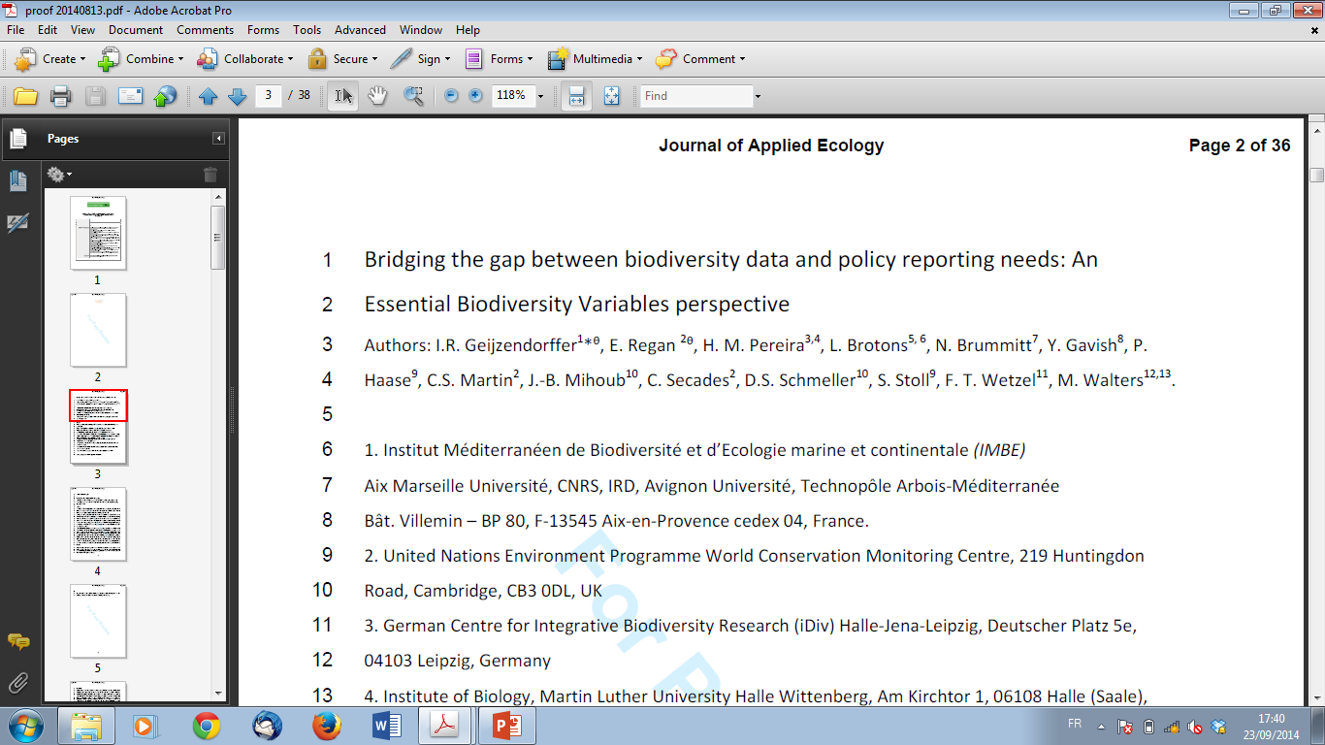
EU BON EBV case study & paper
Q: Do Essential Biodiversity Variables (EBVs) allow to estimate and bridge current information gaps ?
Journal of Applied Ecology, 2015
doi: 10.1111/1365-2664.12417
Notes:
Some of these gaps can be addressed by you and this workshop

Slide 16
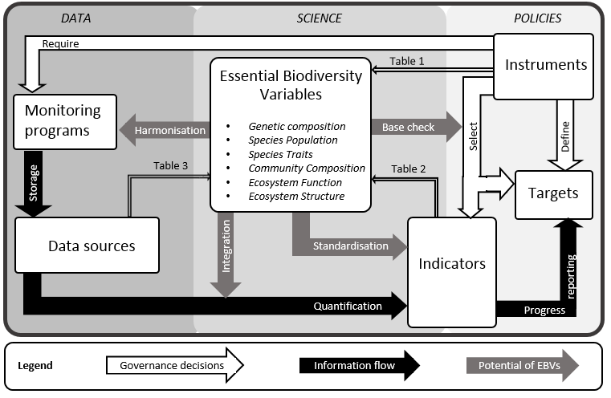
(EU BON) EBV concept

Slide 17
Study questions / goals
Attempt to match data availability & suitability towards specific EBV classes
Which information on biodiversity – changes / trends(!) - is in fact demanded by policy?
How is this demand actually met by the supply of information in official reports?
Opportunities for bridging data / information gaps by EBV approach

Slide 18
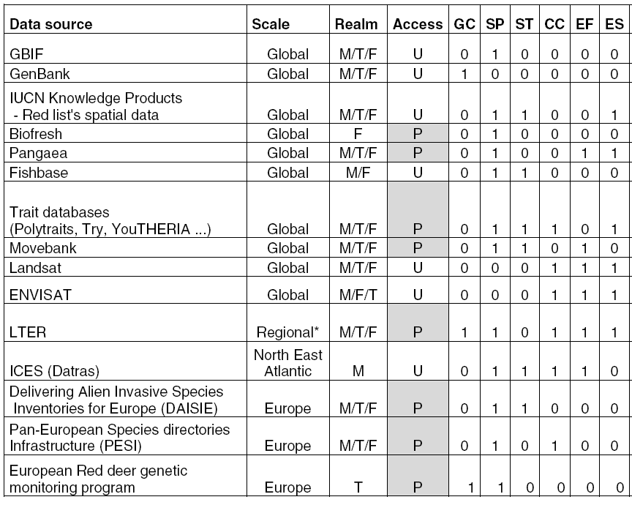
EU BON case study: available data sources and EBVs

Slide 19
Data sources and EBVs
Community
composition
Ecosystem
functioning
Ecosystem
services
Species traits
Genetic composition
Species population
Notes:
(EBV Classes Abbreviations: GC: Genetic Composition, Species populations: SP, Species traits: ST, Community composition: CC, Ecosystem function: EF, Ecosystem structure: ES).

Slide 20
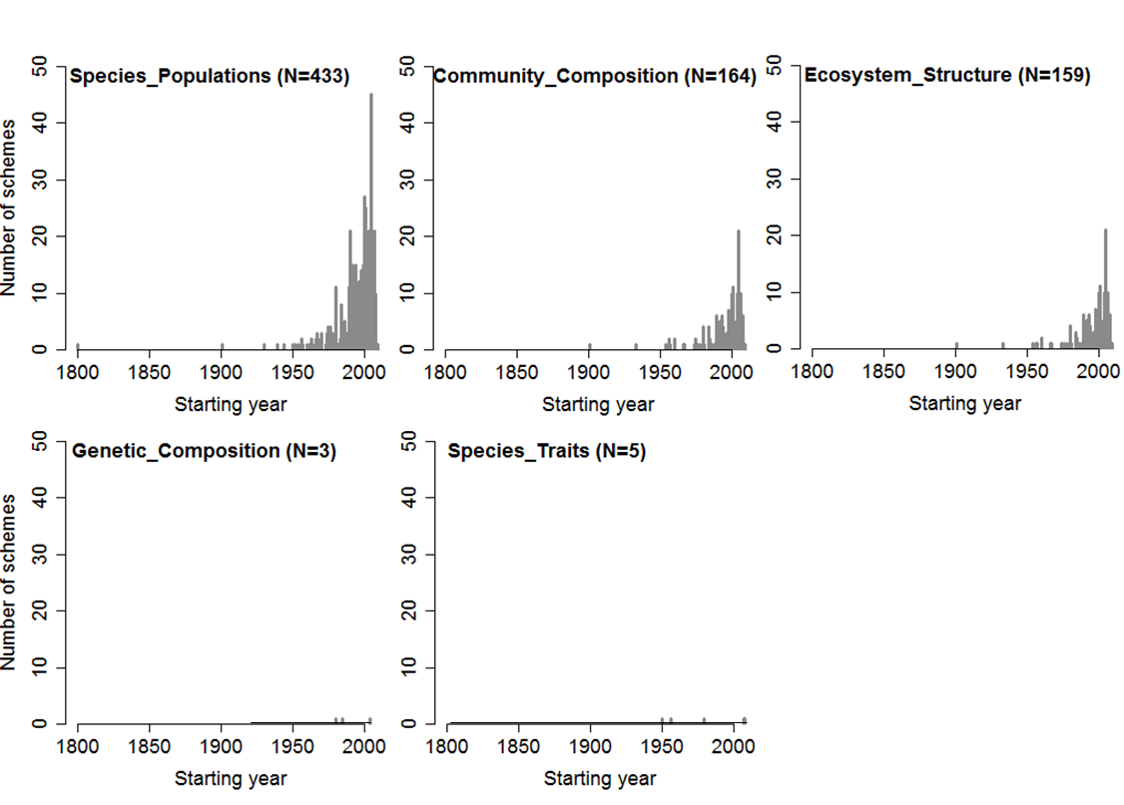

Temporal coverage
Temporal coverage
http://eumon.ckff.si/biomat/

Slide 21
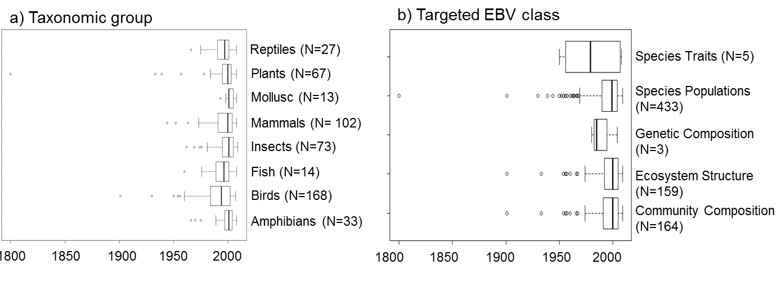
Temporal coverage
http://eumon.ckff.si/biomat/

Slide 22
Approach: biodiv. data/variables in policy instruments
Policy instruments | EBV classes
 | Genetic Composition | Species Population | Species Traits | Community Composition | Ecosystem Function | Ecosystem Structure
Convention on Biological Diversity (CBD) | 100% | 100% | 100% | 100% | 100% | 100%
Ramsar Convention on Wetlands | 50% | 100% | 100% | 100% | 100% | 100%
Convention on the Conservation of Migratory Species of Wild Animals | 75% | 100% | 67% | 50% | 100% | 100%
Habitats Directive | 0% | 67% | 0% | 0% | 25% | 65%
Birds Directive | 0% | 100% | 50% | 0% | 25% | 67%
Marine Strategy Framework Directive | 0% | 100% | 17% | 100% | 75% | 100%
European Water Framework Directive | 0% | 100% | 33% | 100% | 50% | 67%

Slide 23
Results: biodiversity variables for reporting
Policy instruments | EBV classes
 | Genetic Composition | Species Population | Species Traits | Community Composition | Ecosystem Function | Ecosystem Structure
Convention on Biological Diversity | 100% | 100% | 100% | 100% | 100% | 100%
Ramsar convention on Wetlands | 50% | 100% | 100% | 100% | 100% | 100%
Convention on the Conservation of Migratory Species of Wild Animals | 75% | 100% | 67% | 50% | 100% | 100%
Habitats Directive | 0% | 67% | 0% | 0% | 25% | 65%
Birds Directive | 0% | 100% | 50% | 0% | 25% | 67%
Marine Strategy Framework Directive | 0% | 100% | 17% | 100% | 75% | 100%
European Water Framework Directive | 0% | 100% | 33% | 100% | 50% | 67%
Notes:
Conclusions:
This is a first identification of the knowledge gap.
Based on these results, it seems that not all biodiversity trends are equally or not sufficiently covered by existing international policies

Slide 24
BIP / CBD indicator | Essential Biodiversity Variables Classes
 | Genetic Composition |  | Species Populations |  | Species Traits |  | Community Composition |  | Ecosystem Function |  | Ecosystem Structure
 | Direct | Indirect | Direct | Indirect | Direct | Indirect | Direct | Indirect | Direct | Indirect | Direct | Indirect
Ex-situ crop collections | 25% | 0% | 0% | 0% | 0% | 0% | 0% | 0% | 0% | 0% | 0% | 0%
Extent of marine habitats | 0% | 0% | 0% | 0% | 0% | 0% | 0% | 0% | 0% | 0% | 66% | 33%
Forest fragmentation | 0% | 0% | 0% | 33% | 0% | 0% | 50% | 0% | 0% | 0% | 33% | 66%
Genetic diversity of terrestrial domesticated animals | 25% | 0% | 0% | 66% | 0% | 0% | 0% | 0% | 0% | 0% | 0% | 0%
Living Planet Index | 0% | 0% | 66% | 33% | 0% | 33% | 0% | 50% | 0% | 0% | 0% | 0%
Marine Trophic Index | 0% | 0% | 0% | 100% | 0% | 17% | 50% | 50% | 0% | 25% | 0% | 66%
Red List Index | 0% | 0% | 100% | 0% | 66% | 0% | 50% | 0% | 0% | 0% | 33% | 0%
River fragmentation and flow regulation | 0% | 0% | 0% | 0% | 0% | 0% | 0% | 0% | 0% | 25% | 33% | 33%
Wild Bird Index | 0% | 0% | 66% | 33% | 33% | 0% | 0% | 50% | 0% | 0% | 0% | 0%
Wildlife Picture Index | 0% | 0% | 33% | 66% | 0% | 33% | 0% | 50% | 0% | 0% | 0% | 0%
Notes:
Thus current reporting has certain knowledge gaps, but already by making use of proxies, this gap could be reduced.
Careful with data biases.

Slide 25
Conclusions – from case study
Species/population & community composition / habitat type data / EBV classes are probably best suited for rapid implementation (both for data availability + political demand)
Information on genetic composition is not much demanded + only limited data / few proxies available
High demand for data / variables on ecosystem structure and ecosystem function, esp. for reporting; still, not too many indicators available, but some proxies

Slide 26


Additional challenges:
“DARK MATTER of biodiversity data”

Slide 27
“DARK MATTER OF BIODIVERSITY DATA”?
  Work of EuMon identified 643 monitoring schemes in Europe
  Up to 2,000 (!) monitoring programs exist
  They do not know of or care for GEOSS, GEO BON, EU BON, GBIF, …
  They do report only to their immediate scientific community, and sometimes to their local/national authorities ….
http://eumon.ckff.si/biomat/

Slide 28
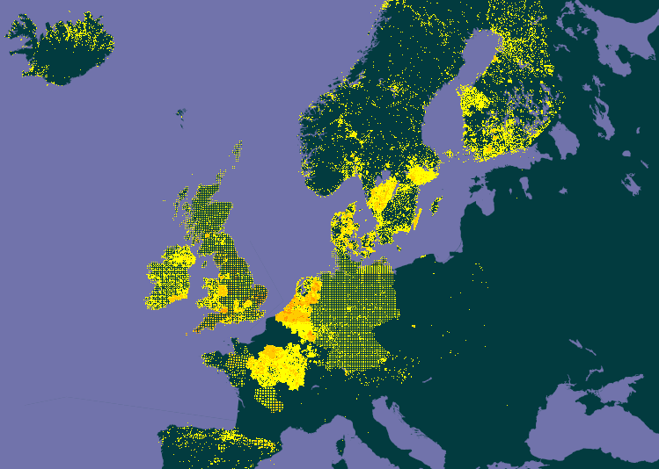

Fragmented data from GBIF,
visualising data gaps,
+ needs for
common data recording standards
Picture © Ondřej Zicha, via EoL
Achillea millefolium

Slide 29
Conclusions - general
Clear focus / priorities for individual political frameworks / instruments required (e.g., IPBES assessments …!)
Data availability / sharing remains a critical challenge / bottleneck – even in Europe / EU!
Great opportunities for EBVs to significantly advance with data standardization and open data sharing – through specific demands from international political frameworks!!

Slide 30

Many thanks to the EU BON consortium, and
thank you very much for your attention!
www.eubon.eu

